Slide 1
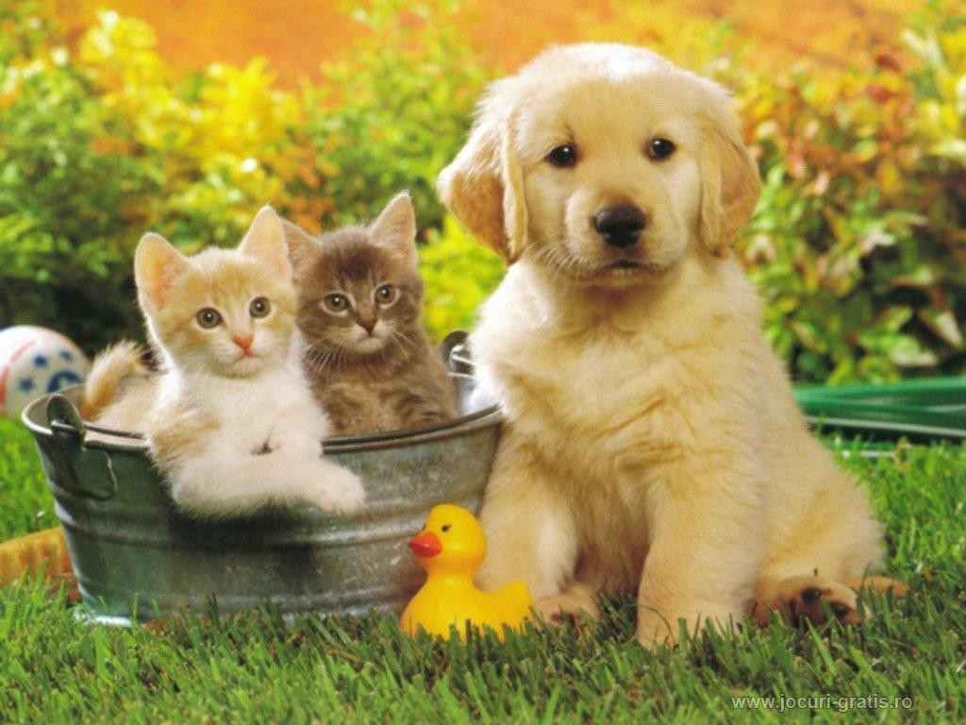
The common fungal infection in dogs & cats
م.د. فدوى عبد الرزاق جميل

Slide 2
Classification of fungi
According to pathogenesis include
1. Superficial mycosis (Malassezia spp. )
2. Cutaneous mycosis (dermatophytosis or ringworm)
3. Subcutaneous mycosis (Alterneria spp.)
4. Systemic (“deep”) mycosis include:
A- Opportunistic fungi (Aspergillus spp.)
B- dimorphic fungi

Slide 3
A. Fungal diseases of cats and dogs caused by yeasts
1. Malassezia spp. in cats and dogs
2. Cryptococcosis in cats and dogs
3. Candidiasis in cats and dogs
B. Fungal diseases of cats and dogs caused by molds
1. dermatophytes
2- Aspergillus spp.
C. Diseases of cats and dogs caused by dimorphic fungi
1. Blastomycosis
2. Coccidioidomycosis
3. Histoplasmosis
4. Paracoccidioidomycosis
5. Sporotrichosis

Slide 4
Malassezia spp.
*Malassezia is a genus of lipid-dependent yeasts that can be found as part of the normal flora on the skin and ears of many animals.
*Also known as (Pityrosporum canis)
*The most common species in dogs and cats is Malassezia pachydermatis, although there
are several others, including Malassezia furfur and Malassezia sympodialis

Slide 5
Predisposing factors
Immunosuppression
Allergic dermatitis
Hairy or pendulous ears leading to high
humidity and wax accumulation in the ear canal.

Slide 6
Diseases
Otitis externa and seborrhoeic dermatitis in dogs.
Otitis and feline chin acne.
Samples
Ear Exudate
Superficial skin scraping

Slide 7
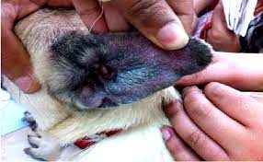
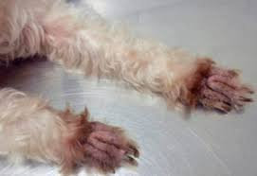
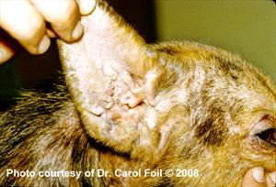
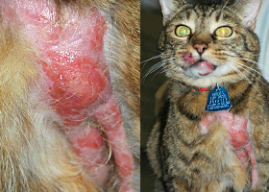
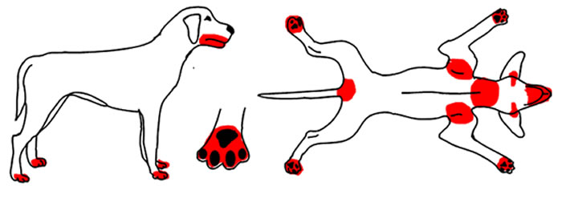

Slide 8
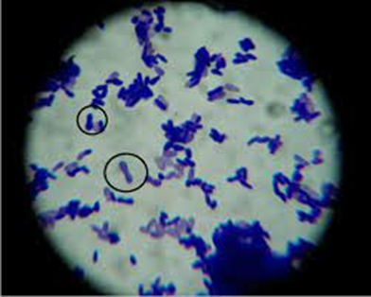
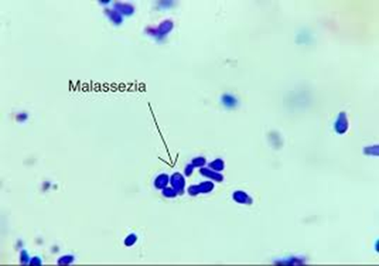
Diagnosis
1- Gram-stained or methylene-blue-stained smears
Typical bottle-shaped yeast cells or ‘Russian dolls’ or ‘peanuts’

Slide 9
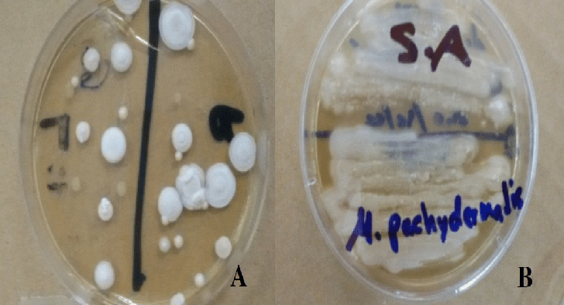
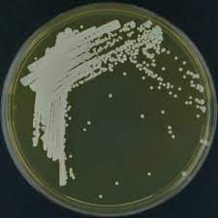
2- Growth on the culture media
Media-Sabouraud dextrose agar , Dixon’s agar
A- Culture incubated at 32–37°C for up to a week in a humid atmosphere
B- Growth can be improved by placing a film of sterile olive or coconut oil on the surface of the agar before inoculation
C- Colonies are small, smooth and often have a ‘wet-dog’ odour with white in color
d- Urease-positive

Slide 10
Special media
1- Cremophor EL agar (source of lipid)
2- Tween 60 esculin (TE) slant produce black color
3- Leeming notman agar
4- CHROM agar produce pink color

Slide 11
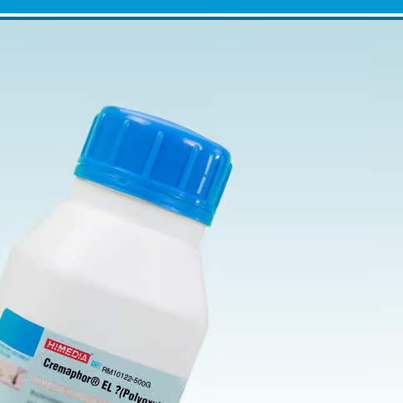
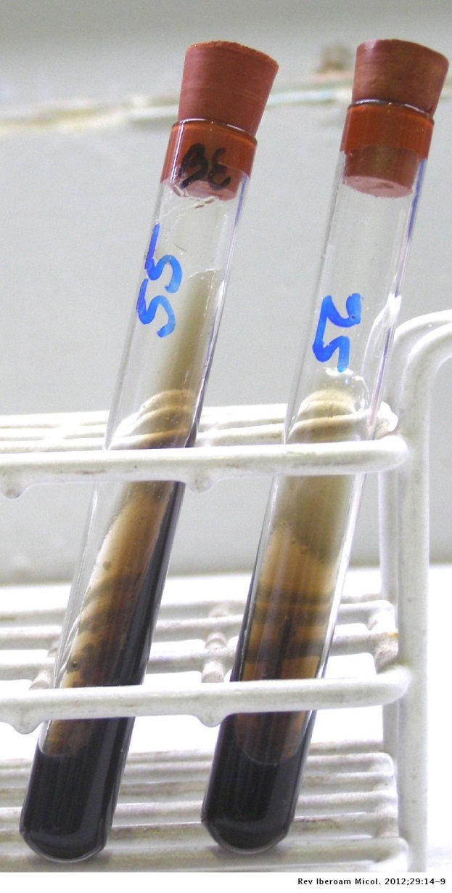
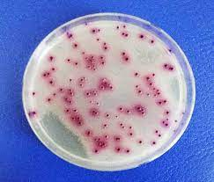
Tween 60 esculin
CHROM agar produce pink color

Slide 12
2- Cryptococcosis
Cryptococcosis is the most common systemic fungal disease
Cryptococcosis in cats and dogs is caused by Cryptococcus neoformans and Cryptococcus gattii.
The environmental reservoir of C. neoformans is usually related to bird feces, particularly pigeon droppings. However, this yeast has also been found in decaying trees, wood and plant debris, waterways and soil, all usually contaminated with bird excrement.

Slide 13
Route of infection
nasal cavity
transmission can also occur via cutaneous inoculation of fungal forms.
This disease not infectious

Slide 14
The clinical signs
1-Nasal cryptococcosis: include sneezing, snoring or snorting, dyspnea with nasal discharge.
2-Cutaneous or subcutaneous swellings and nodules :
May be seen on the face, particularly the bridge of the nose, side of the face, upper lip or nostril.
Ulcerative or proliferative lesions may develop on the tongue, gingiva or palate.
3- CNS involvement cryptococcosis
4-Ocular cryptococcosis

Slide 16
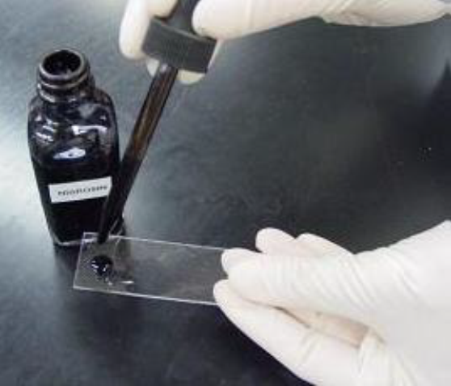
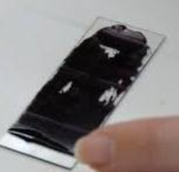
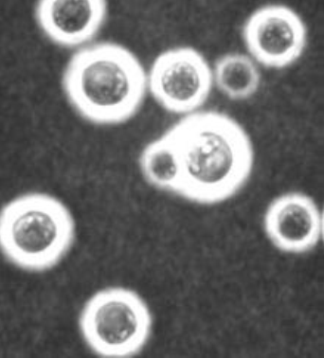
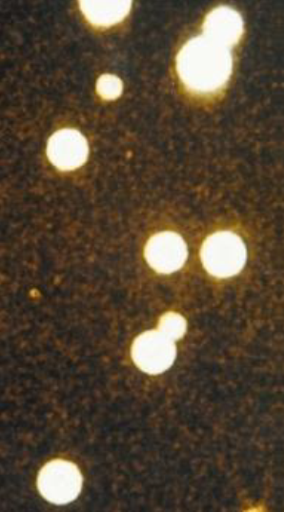
Diagnosis of cryptococcosis
1- Direct microscopic examination of India ink preparation

Slide 17
2- Isolation and identification
Definitive diagnosis is confirmed by the culture of specimens, often the cerebrospinal
fluid (CSF) or blood, and sometimes in respiratory secretions. Cryptococcus
neoformans and C. gattii grow well at 37̊C. On Sabouraud dextrose agar colonies
appear soft, creamy, opaque in 3-5 days, then colonies become mucoid and creamy

Slide 18
Cryptococcus colonies on Sabouraud's dextrose agar

Slide 19
3- Cryptococcus colonies are brown on bird seed agar
4- colonies. On canavanine glycinebromthymol blue (CGB) medium, Cryptococcus neoformans develop non-colored colonies and , while C. gattii develops blue color

Slide 20
bird seed agar
canavanine glycinebromthymol blue (CGB) medium

Slide 21
3- Candidiasis
In dogs, Candida spp are ubiquitous saprophytic yeast and widely distributed in the environment and frequently colonized the skin and mucous membranes such as oral cavity, genital and gastrointestinal tracts of dogs
Candida albicans is not a member of the normal skin flora and its presence is always the expression of a pathologic state and of its intrinsic pathogenicity.
In cats, Candida spp. are a common fungus present as a commensals on most mucous membranes including the mouth, digestive tract and vagina of cats. They also form part of the normal faecal biotome. They rarely cause primary disease, but can cause serious disease in immunocompromised .The lower urinary tract is the most common site for feline Candida spp infection.

Slide 22
Clinical signs
1- Cutaneous candidiasis (characterized by persistent alopecia, crusts, ulcers and scales
2- Candida urinary tract infections
3- Candida peritonitis
4- Oral candidiasis
5- Ocular candidiasis
6- Candida rhinitis
7- Otitis extern

Slide 23
Oral candidiasis
Thrush

Slide 24
Diagnosis
1-Macroscopically examination: The colonies appear white to creamy and non mucoid with 2-3 days at 37 C ̊ incubation.
2-Microscopically examination: by using lactophenol cotton blue stain , C. albicans produce thin walled budding yeast cells
By using Gram’s stain , G+ and spherical to oval in shape with budding but appeared much larger than bacteria

Slide 25
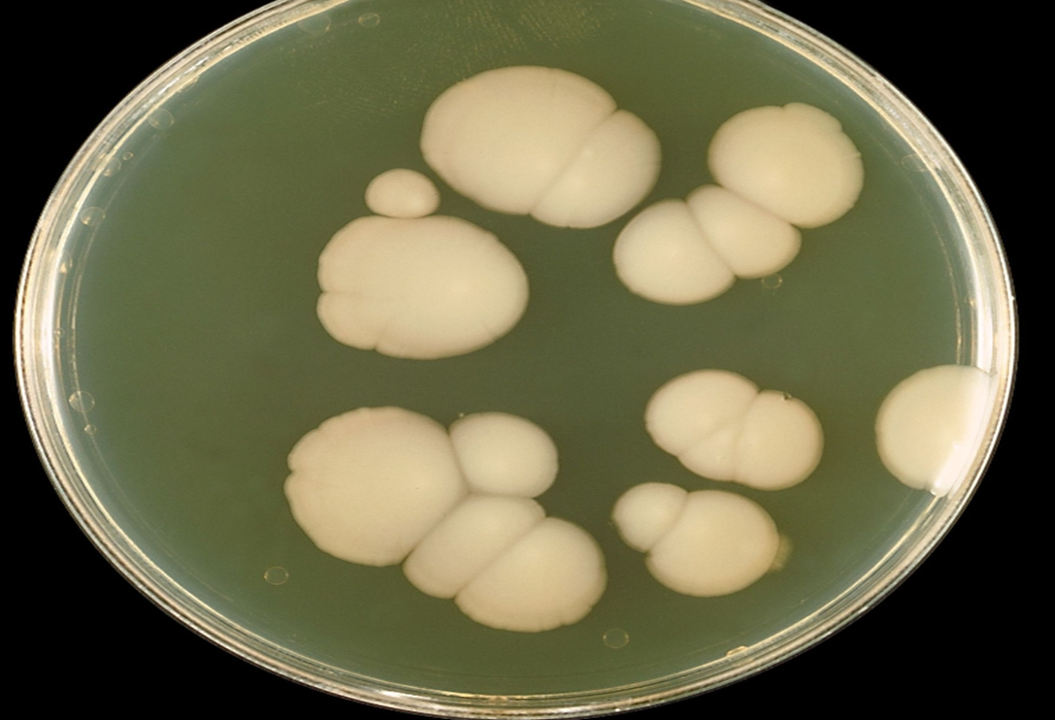
Macroscopically examination Candida albicans grow on SDA

Slide 26
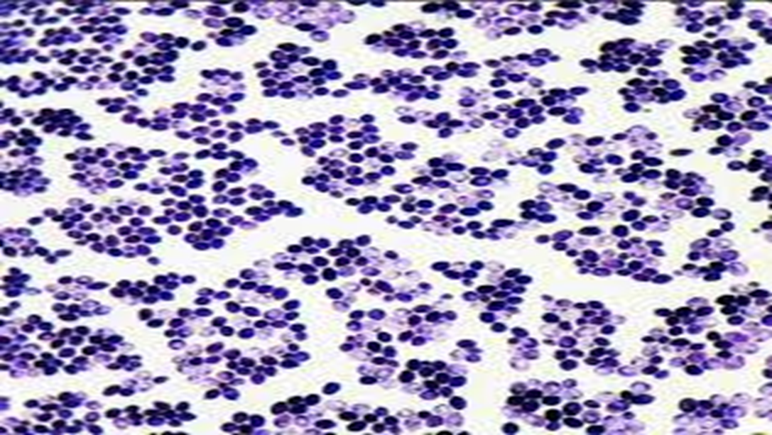
Microscopically examination by using gram stain (G+ and spherical to oval in shape)

Slide 27
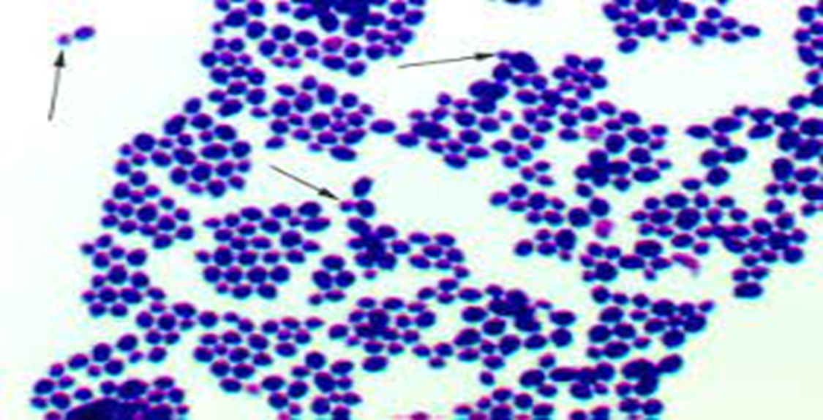
Microscopically examination by using lactophenol cotton blue (budding yeast cells)

Slide 28
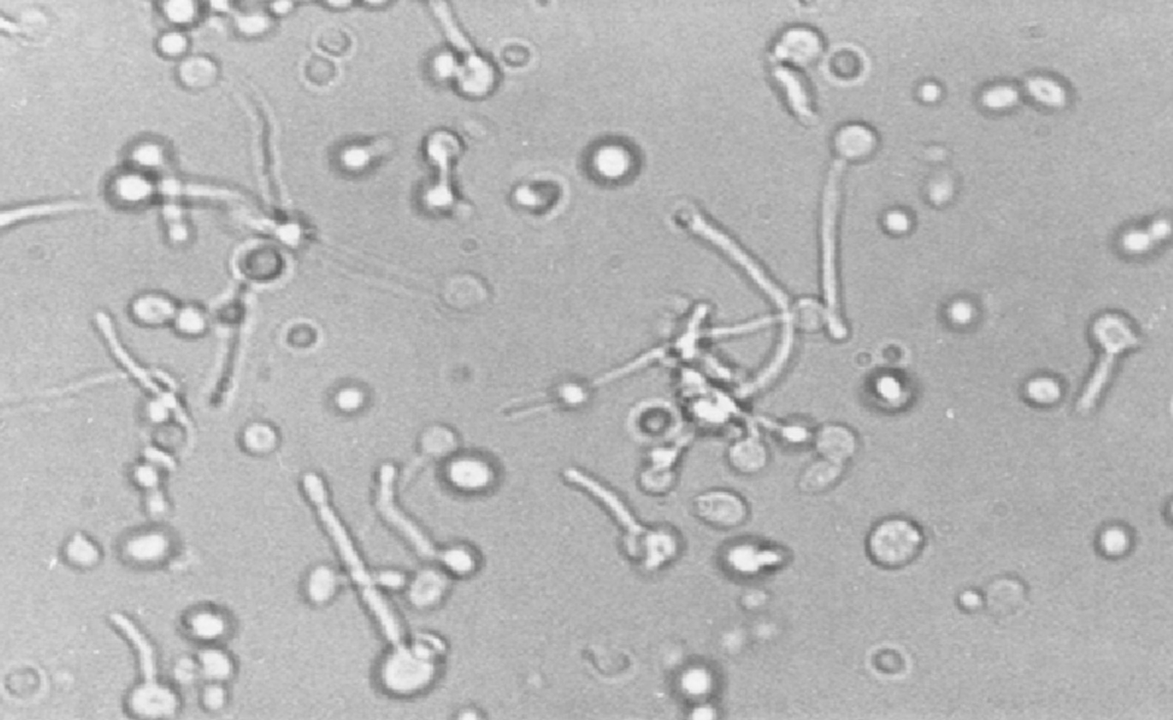
3- Germ tube

Slide 29
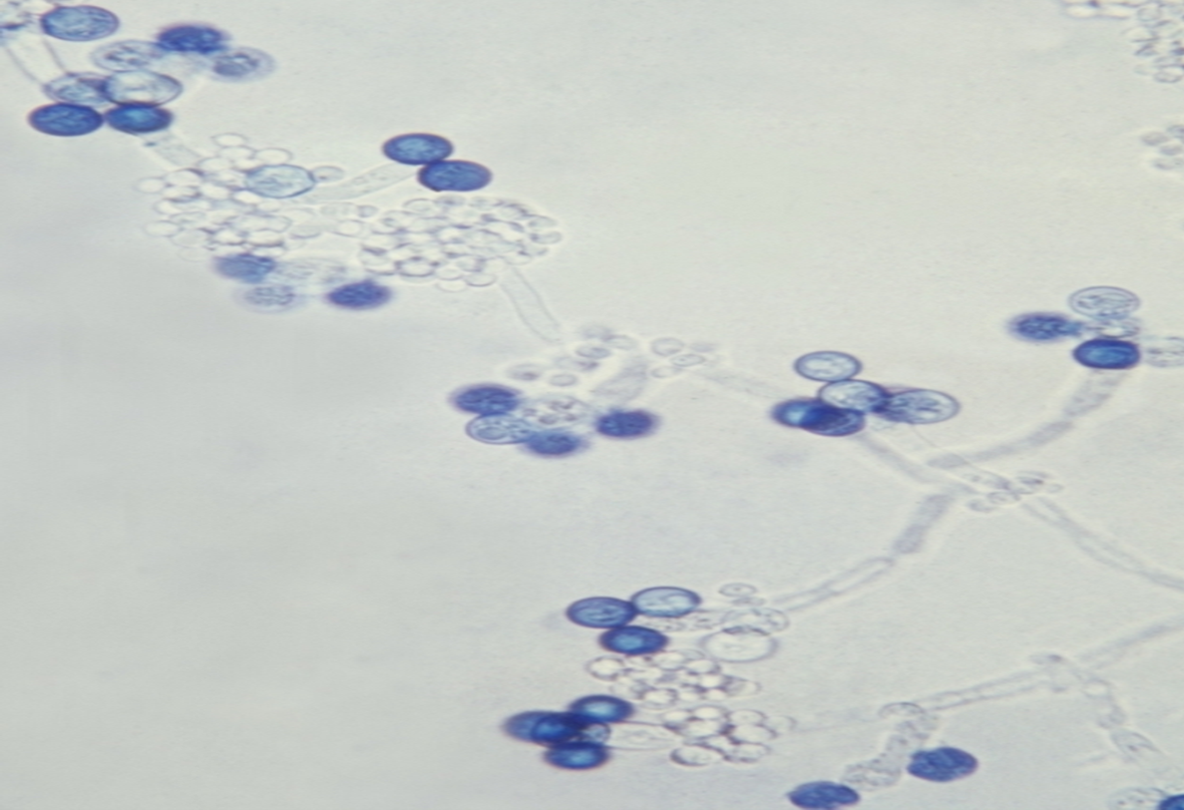
4- Chlamydospore formation

Slide 30
CHROM Agar
5- CHROM Agar characterized by special medium (rapid and differentiation medium) without autoclave
- Temperature (35- 37 C) for 48 hrs.
- C. albicans: green in color
- C. tropicalis: blue
- C. krusei : pink
- C. glaberata : purple
- C. parapsilosis : brown

Slide 31
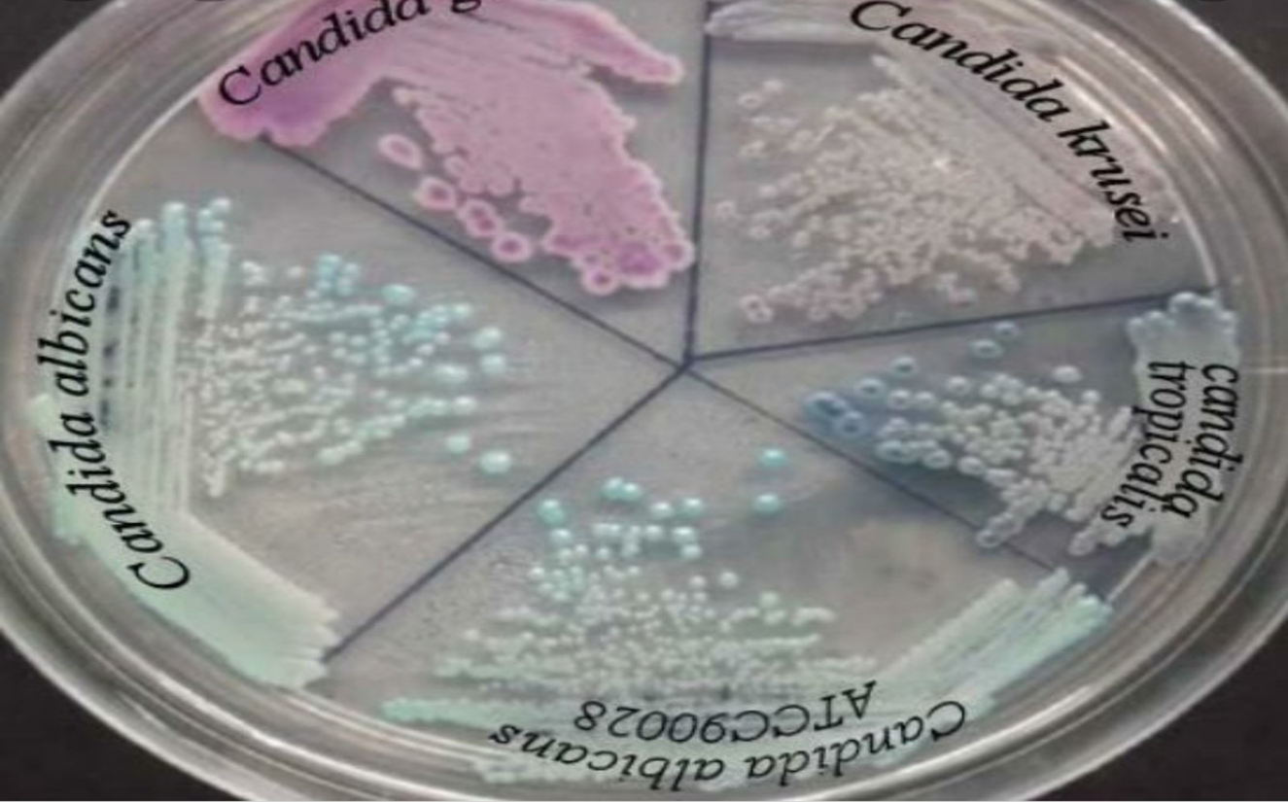

Slide 32
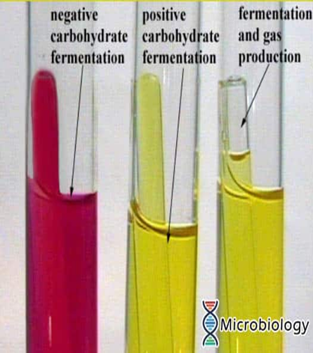
6- sugar fermentation test

Slide 33
Dermatophytosis
Dermatophytosis is worldwide the most common and important fungal skin infections of cats and dogs. • The disease is caused by several dermatophytes with Microsporum canis on the top. but other dermatophytes are also involved such as Microsporum gypseum, Trichophyton mentagrophytes, Microsporum persicolor, Trichophyton verrucosum and Trichophyton quinckeanum.

Slide 34
1.3. Transmission Transmission of dermatophytosis is dependent on many factors including: • The amount of infective material, frequency of exposure, global health of cats and dogs, and physiological stress. • Exposure to infective spores via direct animal-to-animal contact is the most common and important route of transmission and represents the highest risk factor. • Cats and dogs can also be exposed to infective spores via contact with contaminated blankets, bedding, toys, brushes, lab coats, leather gloves or even external parasites ( Newbury et al., 2010) • Cats and dogs can also be exposed to infection via airborne transmission of spores (Mancianti

Slide 35
Clinical signs of ringworm

Slide 36
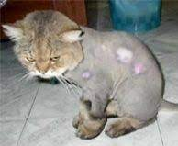
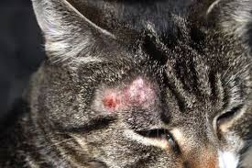
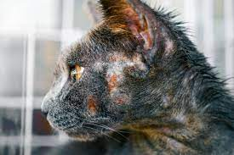
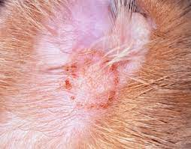
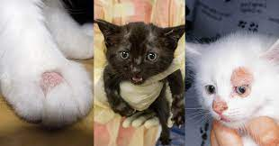
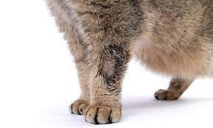

Slide 38
Diagnosis
Wood’s lamp examination • An inexpensive and simple screening tool for M canis infection. • it is not very sensitive: only about 50% of M canis strains fluoresce and other dermatophytes do not fluoresce at all.

Slide 39
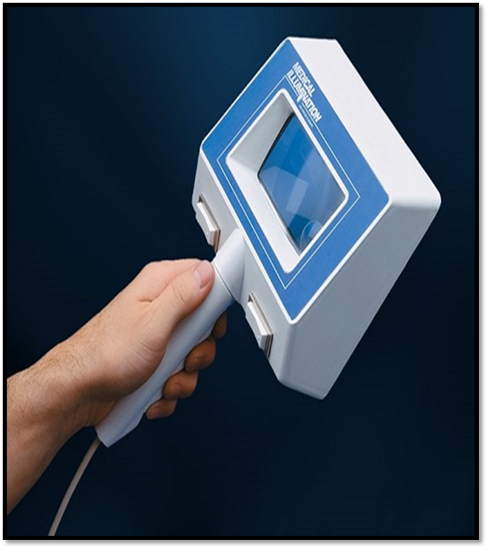

Slide 40
KOH Test
Microscope
10-20% KOH
fungal stain (lactophenol cotton blue)
glass slide
cover slides
Burner

Slide 41
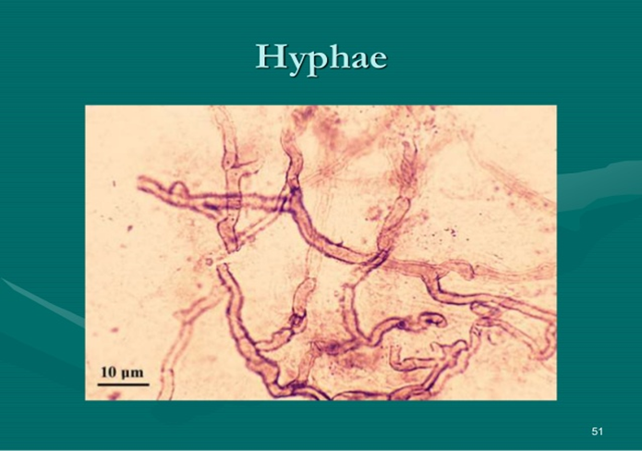
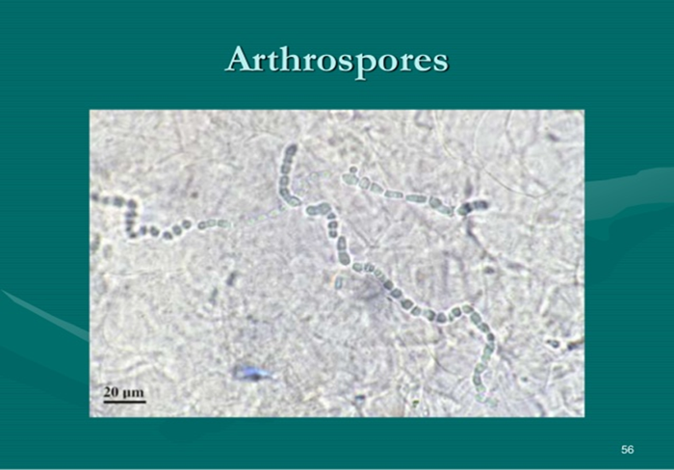
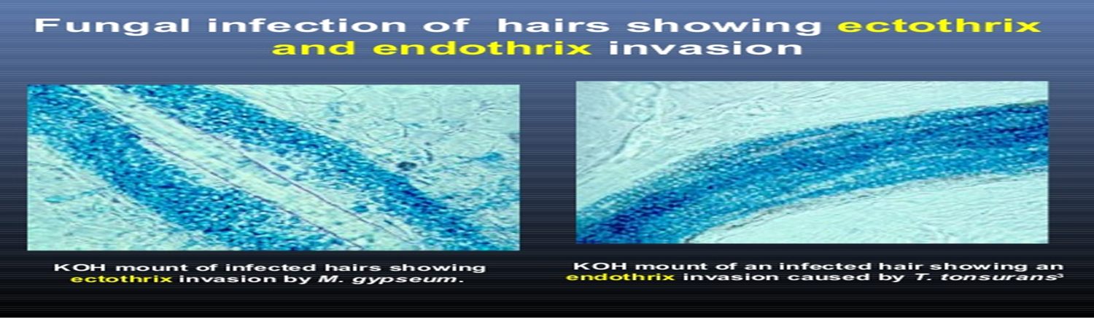

Slide 42
Culture
-Incubation period (1-3 weeks)
-Incubation temperature (25 ̊ C)
-Media
1- Sabouraud Dextrose Agar (SDA) (general)
2- Dermatophytes test medium (DTM)(specific medium)
3- Potato Dextrose Agar (PDA)
4- Mycosel Agar

Slide 43
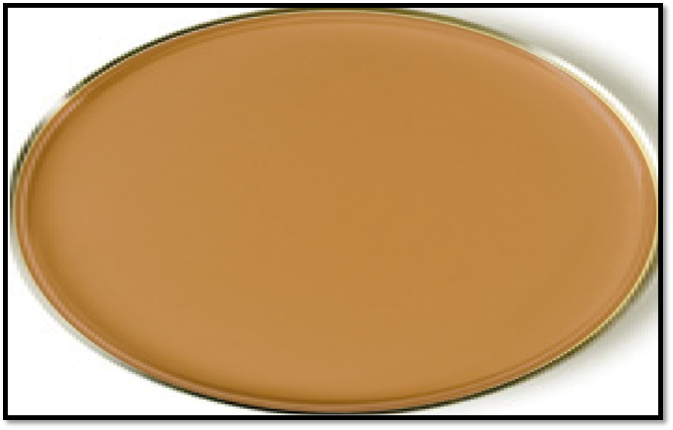

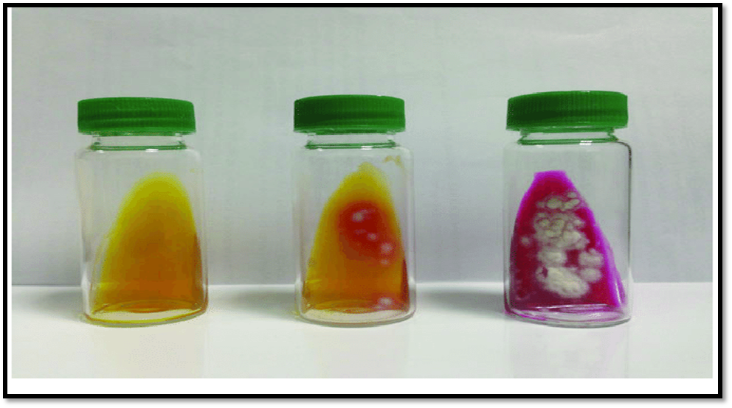
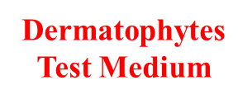

Slide 44
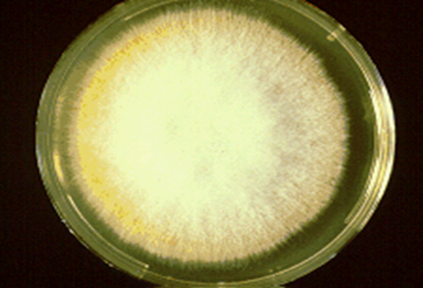
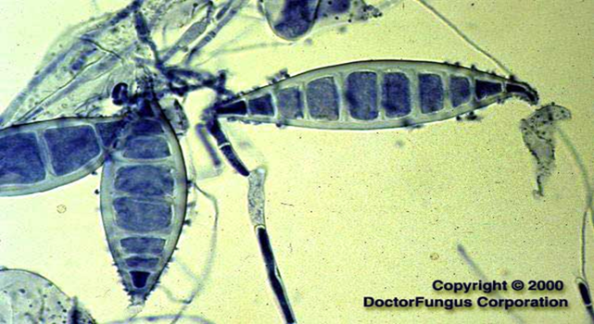
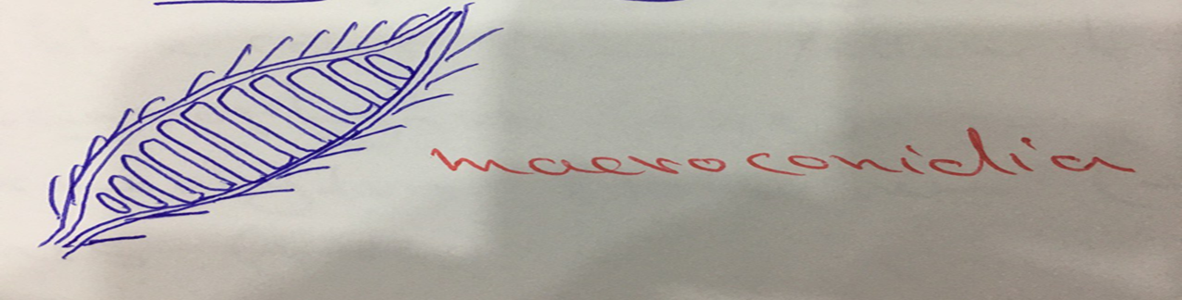
Microsporum canis

Slide 45
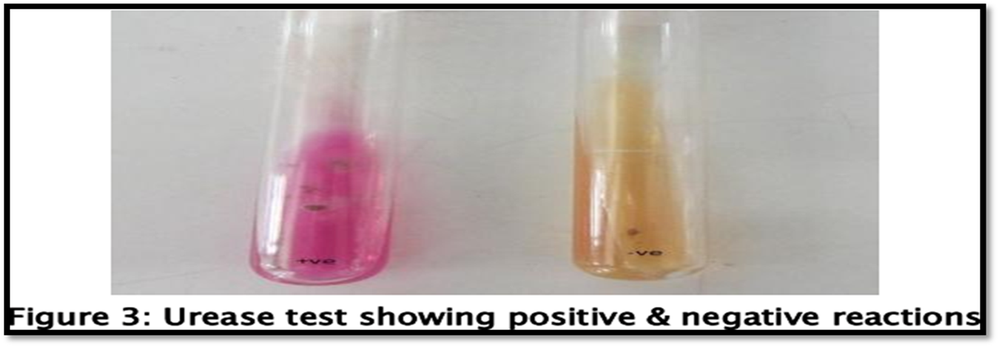
7- Urease test

Slide 46
Aspergillosis
sino-orbital aspergillosis (invasive fungal rhinosinusitis) with exophthalmia

