Slide 1
بسم الله الرحمن الرحيم
برعاية السيدعميد كلية الطب البيطري جامعة بغداد المحترم
يقيم فرع الامراض وامراض الدواجن وبالتعاون مع التعليم المستمر
ورشة عمل الموسومة
تشخيص التغيرات المرضية والوراثية في نسيج العظم
الثلاثاء 14/6/2023 عند 9 مساءا وعلى المنصة الالكترونية كوكل ميت https://meet.google.com/bni-edro-fyk
المحاضرون
ا.م.د. منى ساجت هاشم , ا.م.د. ايمان هاشم يوسف /كلية الطب البيطري/ جامعة بغداد
ا.م.د. صالحة صاحب شبر /كلية طب الاسنان / جامعة بغداد

Slide 8
Grossing/Fixation
Bone samples should be fixed for a minimum of 72 hours in 10% Neutral Buffered Formalin. Samples are then rinsed well to remove the salts from `fixation and then placed into a decalcifying agent, such as EDTA, for 7 to 14 days, depending on the sample and its size. The decalcifying agent should be fresh and changed regularly. It is crucial to use a decalcification end point test, such as x-ray, chemical testing using ammonium oxalate or weight test . It is imperative to remove all the calcium from the bone and equally important to not leave your samples in decalcification solution too long. Leaving samples in decalcifying agents too long causes excessive loss of the proteoglycans, increasing the odds of your sections folding.

Slide 9
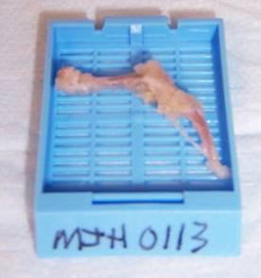

Slide 10
Decalcificatio n of Bone
Use 20% EDTA, don’t use acid decalcification methods or commercial reagents.
Making 20% EDTA EDTA disodium salt, 200 gm, distilled H2O, 950 ml, 10N NaOH, ~50ml. Combine above and stir until EDTA dissolve. Check pH and adjust to 7.4 with NaOH. Procedure to decalcification bone: Specimens can be decalcified in EDTA solution over several days up to several weeks in a refrigerator at 4°C with intermittent shaking to make a sure the decal solution is flowing around the bone. The time of decalcification depends on degree of mineralization and size of specimen.

Slide 11
1. Dissect bone and remove as much soft tissue as possible. 2. After appropriate fixation, wash tissue in distilled H2O. 3. Place tissue in EDTA with shaking or agitation at 4°C. This may take one day to several weeks depending on age of animal and tissue size. Use 20X more volume of EDTA solution to saturate tissue. 4. Change EDTA solution twice or three times a week. 5. Decalcification is complete when bone is soft and pliable. Usual 2 weeks for normal adult 4 weeks old mouse bone. Check with Histocore if unsure. 6. Rinse with distilled H2O 3X. 7. Submit to Histocore in 70% ethanol (ethanol mix with distilled H2O).

Slide 12
Processing
Bone processing programs require longer processing cycles, generally 1 hour per station in automated processors. Larger samples, such as rabbit and dog need longer programs. Tissue must be completely fixed before processing. A desired sample thickness is 3-4 mm,. If a sample is too large and "stuffed" into a cassette, the reagents will not be able to dehydrate, clear or infiltrate the tissue.

Slide 13
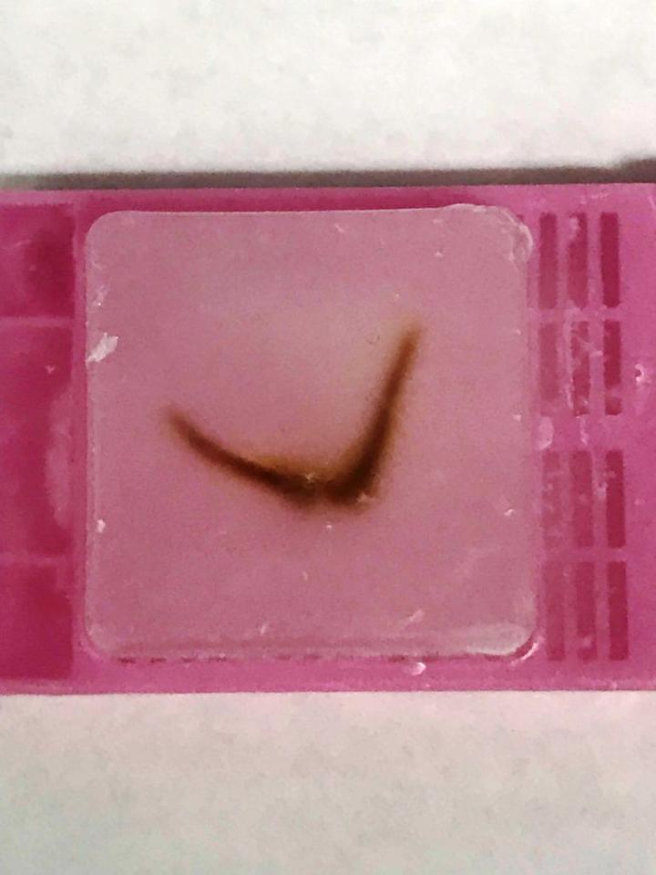

Slide 14
Microtomy
Make sure you have a heavy-duty microtome when cutting any type of bone sample. When trimming or facing into your block, be very careful! Trim slowly and change the blade when necessary. If you trim in too fast, you can cause the bone or joint to chunk out. Put your block on an ice tray with a thin layer of water and soak your block before cutting. The colder the block, the easier bone is to section. When a block is cold, the paraffin is stronger, offering more support. When sectioning, if calcium remains in your sample it may cause the sample to chunk out or the section to lift from the slide, increasing the chances of folding

Slide 15
Staining
Allow sections to completely air dry overnight at room temperature. After drying, place the slides horizontally on a slide dryer at 37° C for a minimum of 12 hours. Many times, slides are left on the slide dryer over the weekend. All of our staining is done manually, which allows us to handle our samples in the gentle manner they require. If you move too fast or jar the slides, it may cause bone and joints to fold and lift from the slide. We then run the slides through a series of xylene, 100% EtOH, 95% EtOH, and 70% EtOH each for 5 minutes to dehydrate our samples After the slides are completely dry, dip them in xylene and coverslip.

Slide 16
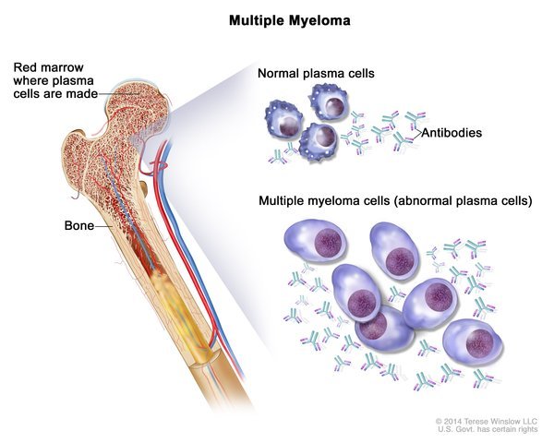

Slide 17
Multiple myeloma. Multiple myeloma cells are abnormal plasma cells (a type of white blood cell) that build up in the bone marrow and form tumors in many bones of the body. Normal plasma cells make antibodies to help the body fight infection and disease. As the number of multiple myeloma cells increases, more antibodies are made. This can cause the blood to thicken and keep the bone marrow from making enough healthy blood cells. Multiple myeloma cells also damage and weaken the bone

Slide 18
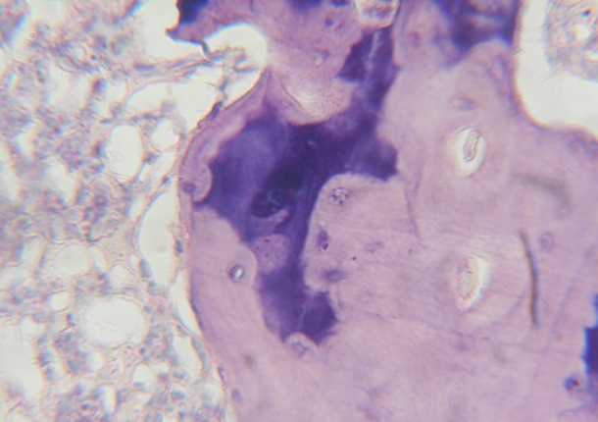

Slide 19
