Slide 1
Meat Borne Parasitic Zoonoses
By
L. Nuha Khalaf Khalil
L. Noor Abd Alhameed

Slide 2
Meat is the skeletal muscle and its associated tissues, It is derived from avian, mammalian, reptilian, amphibian, and aquatic species commonly harvested for human consumption.
Meat can be generally categorized as red or white depending on the concentration of myoglobin in muscle fiber, it is mainly composed of water, protein, and fats, minerals, vitamins, carbohydrates, and other bioactive components.
Meat’s significance is derived from its high-quality protein, containing all essential amino acids, and its highly bioavailable minerals and vitamins like Vitamin B12 and iron which play a key role in normal metabolism, preserving brain and nervous system function, and high energy levels.

Slide 3
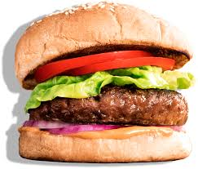
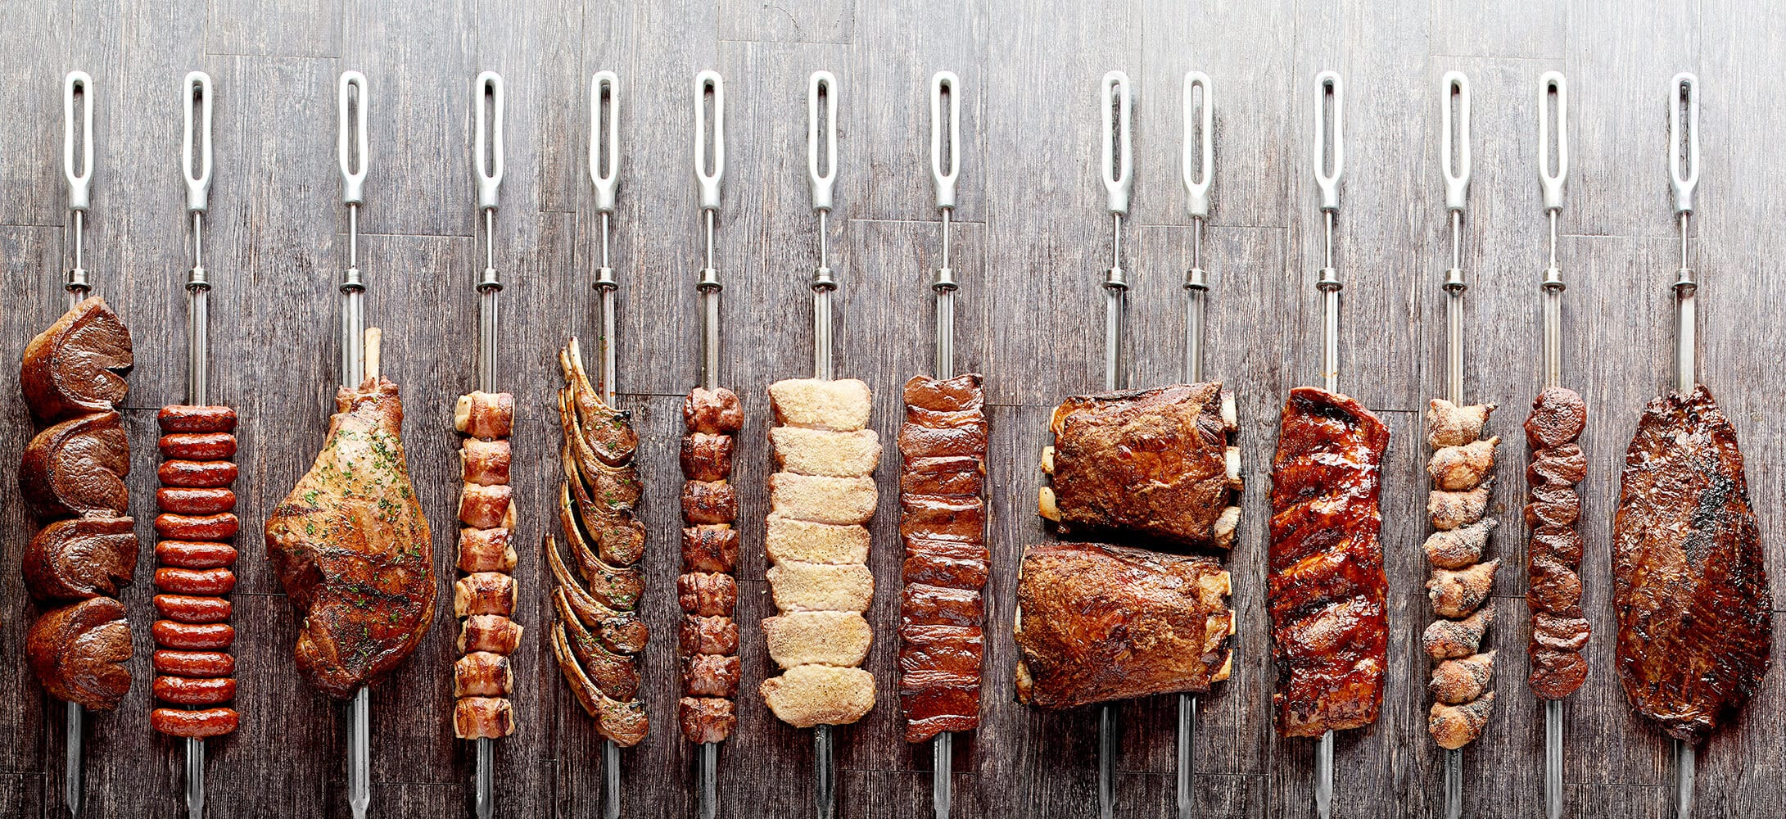

Slide 4
Meat is a perfect, high-quality protein comprise all of the nine essential amino acids (EAAs) (lysine, isoleucine, methionine, leucine, valine, tryptophan, threonine, phenylalanine, and histidine) that cannot be synthesized endogenously, the human body needs to consume to build and rebuild every cell in the body, as well as for optimal health.
Meat Borne Diseases, since ancient times, played an important role in public health; these include: Meat Borne Prionic Diseases; Viral Diseases; Bacterial Diseases; Parasitic Diseases; Fungal Diseases; Mycotoxins; Rickettsial Diseases.

Slide 5
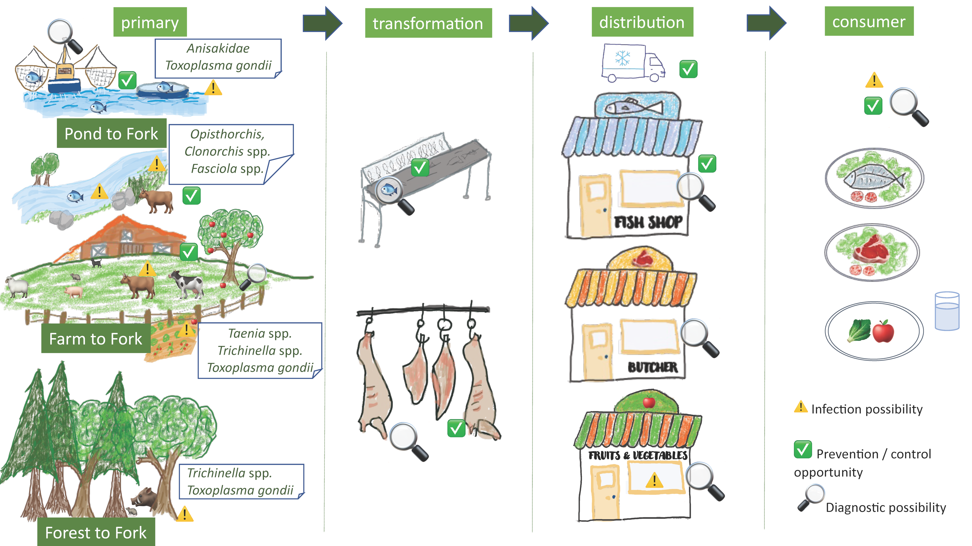
The main sources of pathogens in meat and meat products are:
the animal itself.
human handlers.
equipment’s in contact.
environmental sources.
water used in the preparation.
the methods of meat preservation and storage.

Slide 6
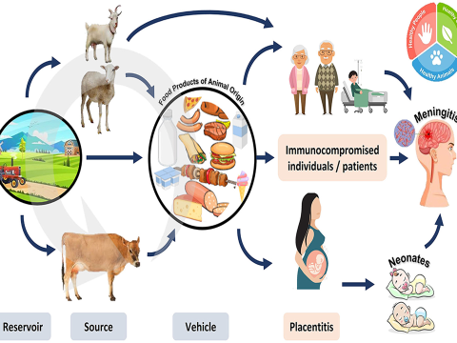

Slide 7
Parasites, maior food borne illness caused by parasites :
Illness from parasites are not as common as those caused by bacteria or viruses. But it is still important to understand this group of pathogens to prevent the illness they cause .
Parasite share common characteristics :
They cannot grow in food. They must be in the organs of another animal, called a host , to survive.
They can use many animals as hosts including cows, chickens, pigs, and fish.
They can be found in the feces of animals and people.
They contaminate both food and water , particularly water used irrigates products.

Slide 8
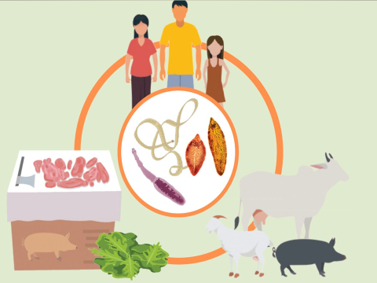
The main parasites borne by meat are :
1- Sarcocystosis
2- Toxoplasmosis
3- Ecchinococcosis
4- Taeniasis
5- Trichinellosis
6- Toxocariasis
7- Anisakiasis
8- Diphyllobothriasis
9- Opisthorchiasis
10- Heterophyiasis
11- Clinostomiasis (yellow grub disease)
12- Capillariasis

Slide 9
Sarcocystosis

Slide 10
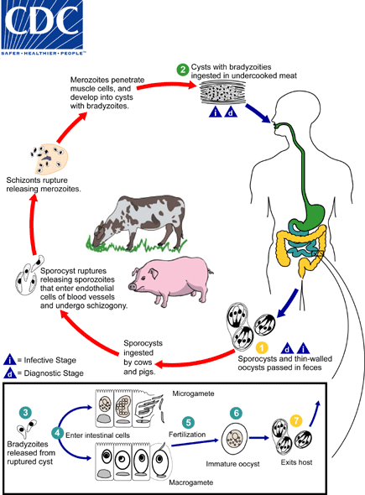
Sarcocystis hominis and S. suihominis use humans as definitive hosts and are responsible for intestinal sarcocystosis in the human host. Humans may also become dead-end hosts for non-human Sarcocystis spp. after the accidental ingestion of oocysts.

Slide 11
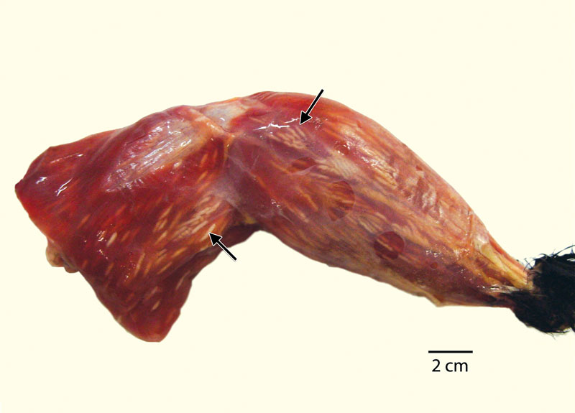

Slide 12
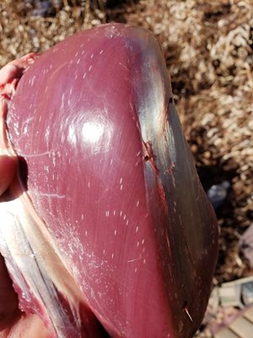
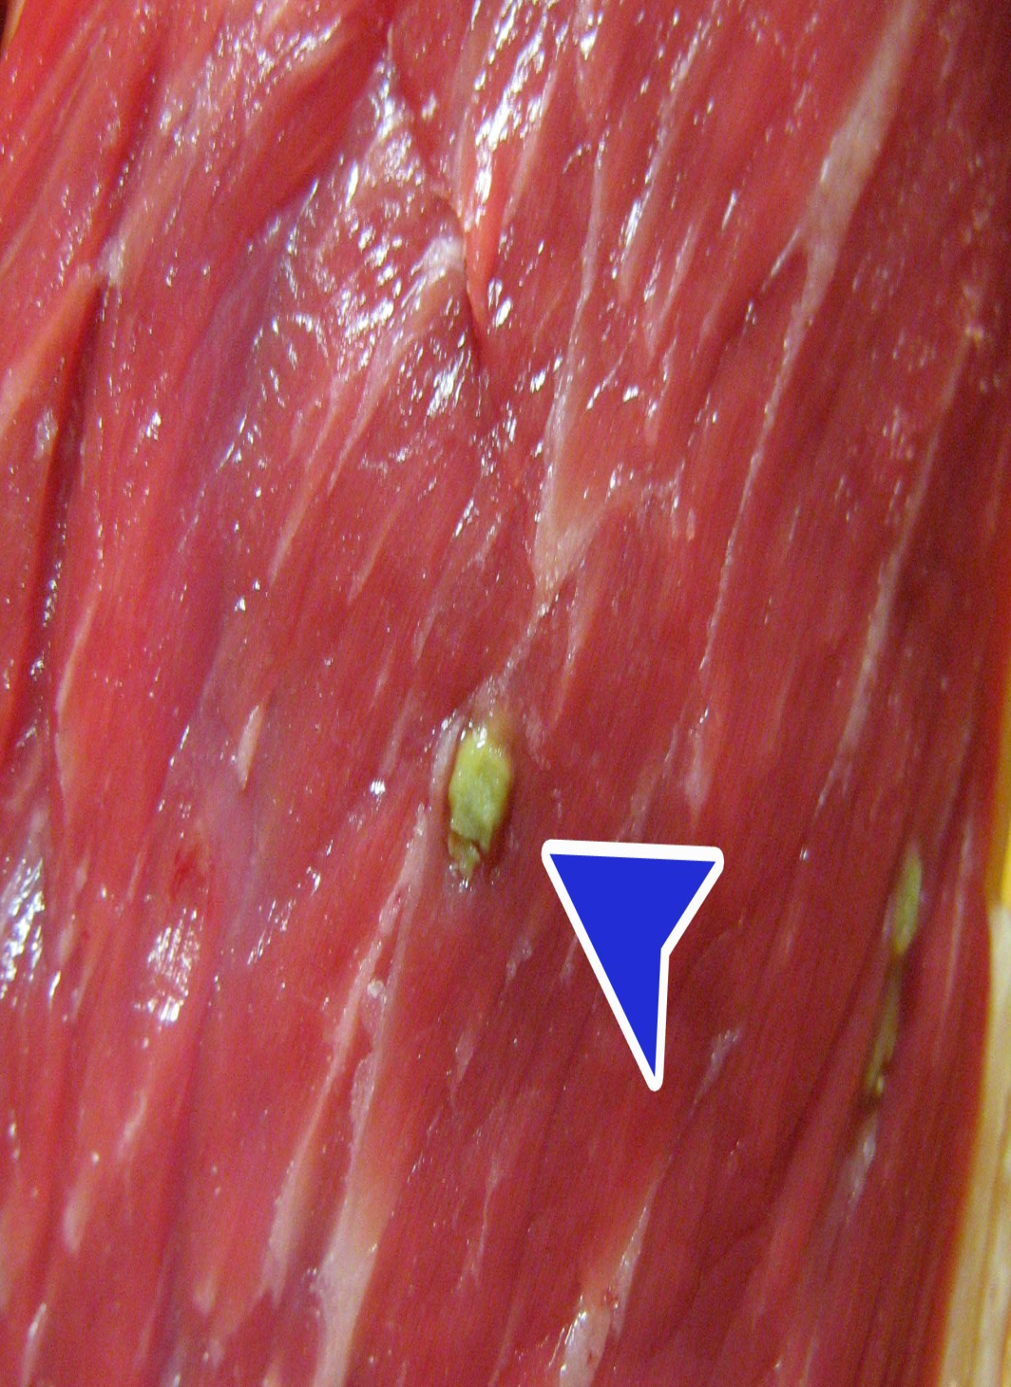
Pyogranulomatous eosinophilic myositis by Sarcocystis spp

Slide 13
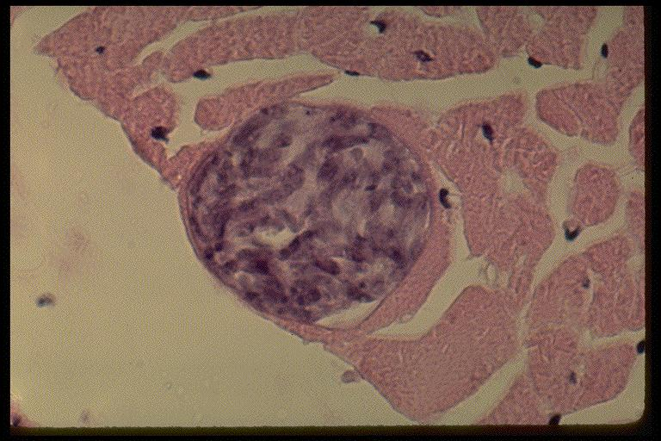
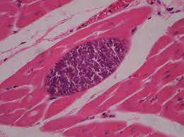
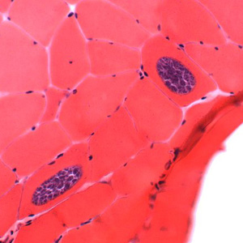

Slide 14
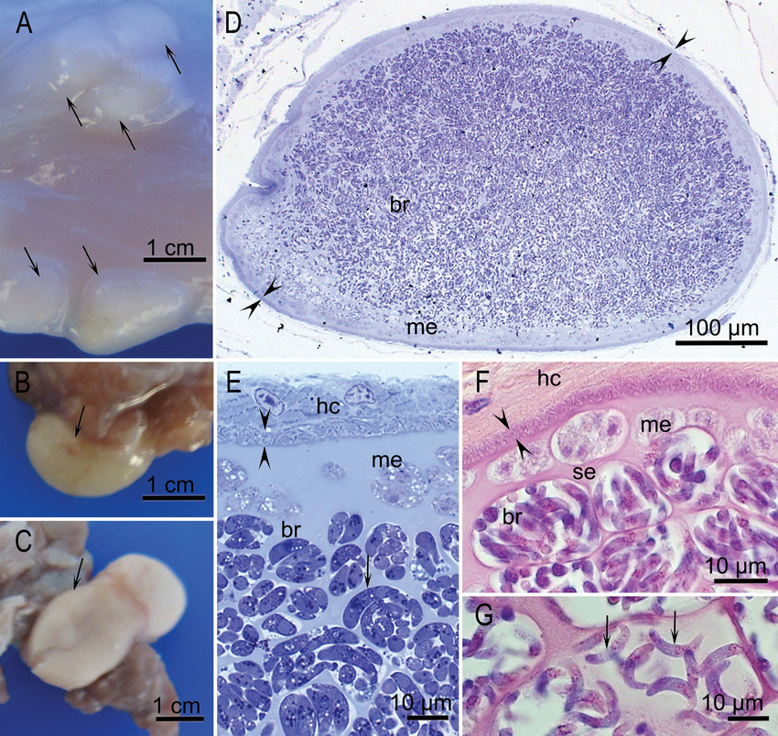

Slide 15
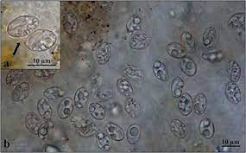
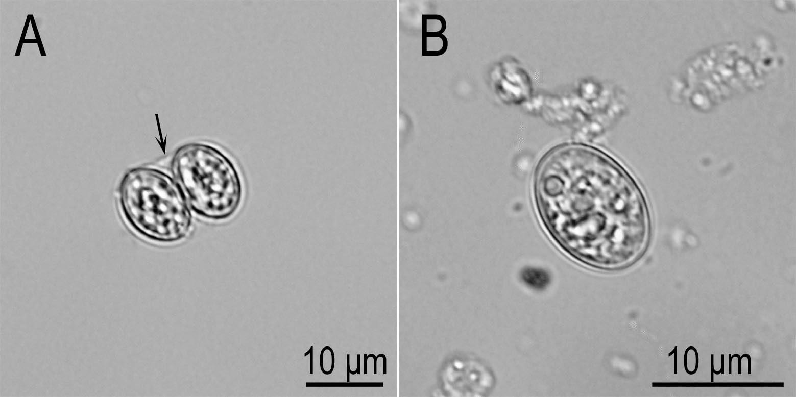

Slide 16
Ecchinococcosis

Slide 18
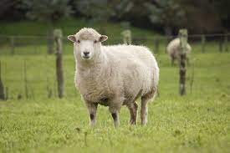
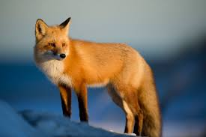
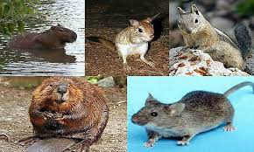
1- Echinococcus granulosus :
2- Echinococcus multilocularis :

Slide 19
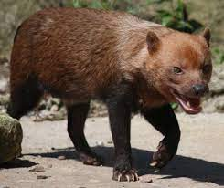
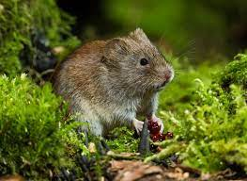
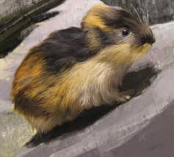
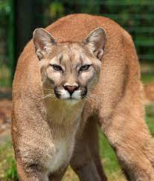
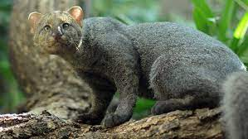
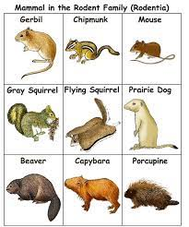
3- E. vogeli :
4- E. Oligarthrus :

Slide 21
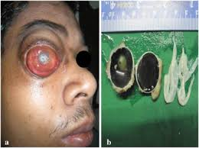
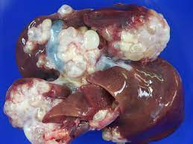
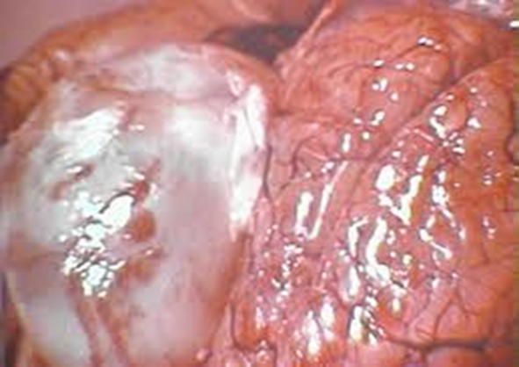
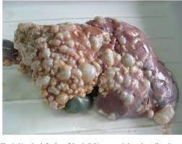

Slide 22
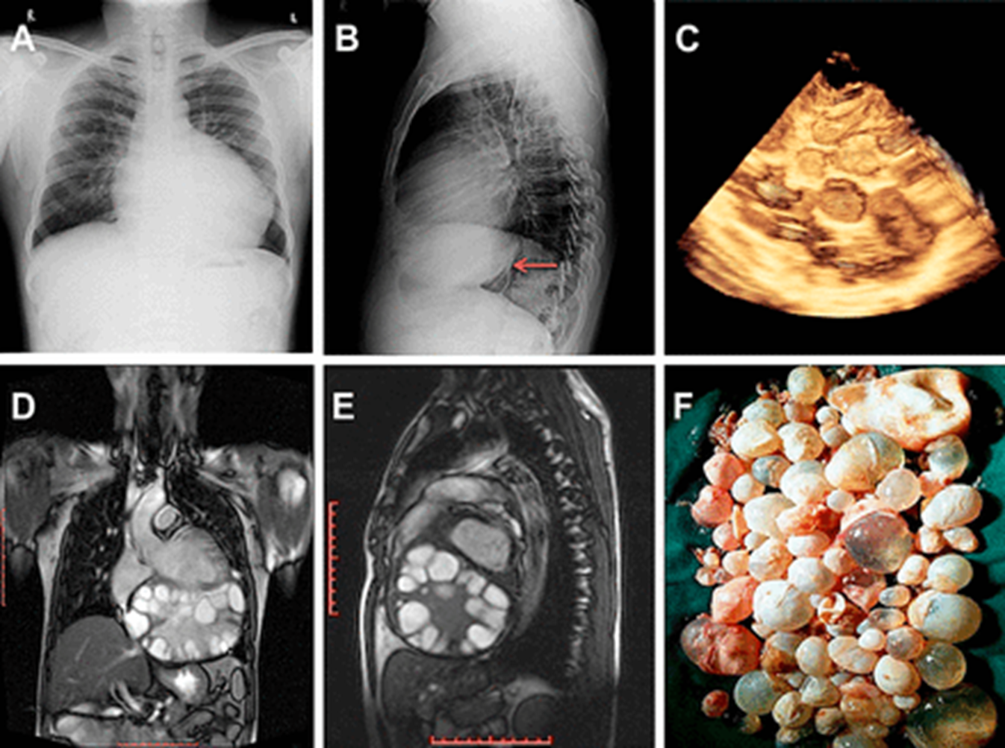

Slide 23
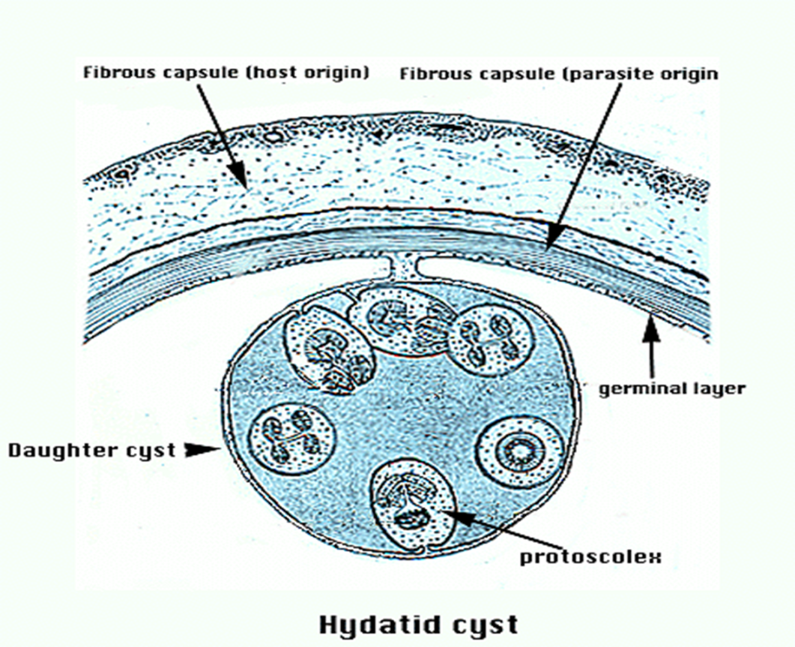
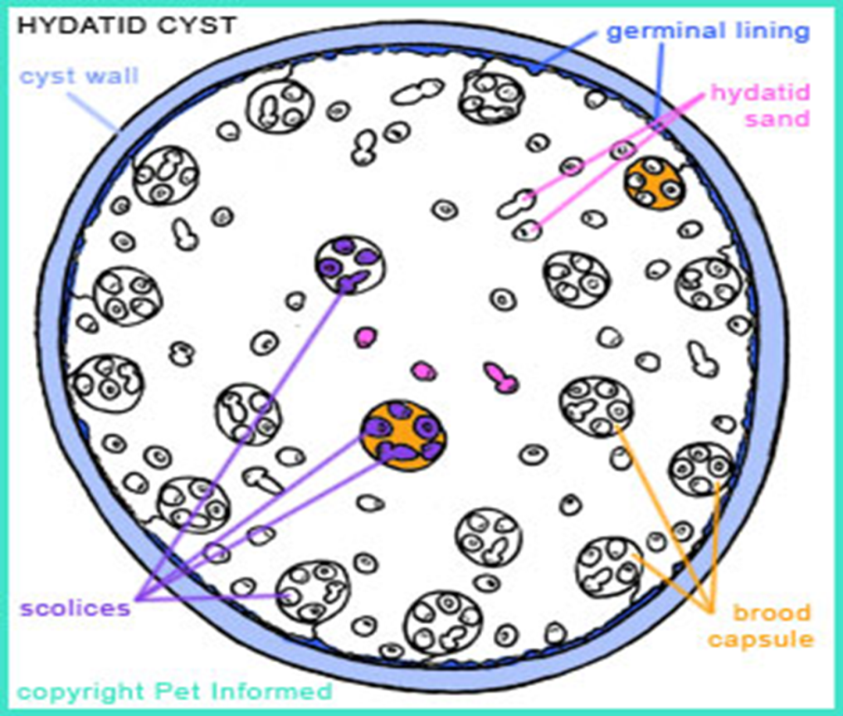
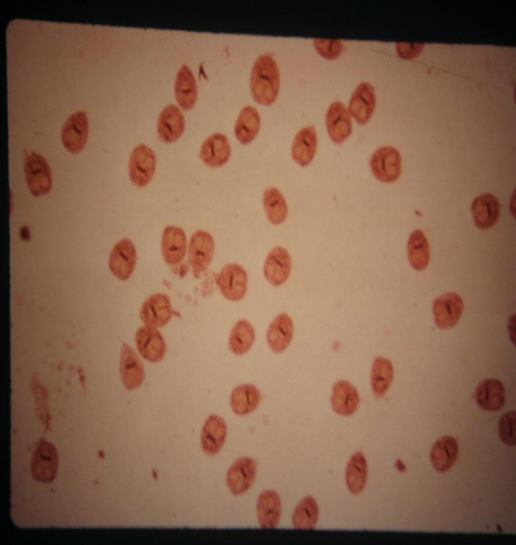
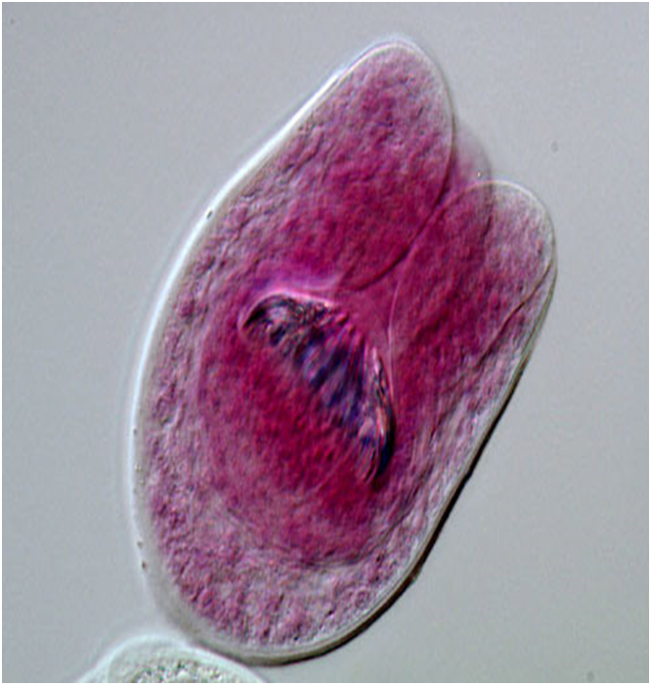

Slide 24
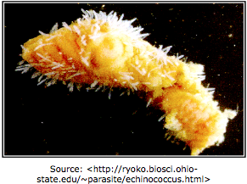
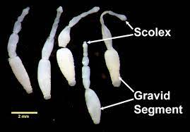

Slide 25
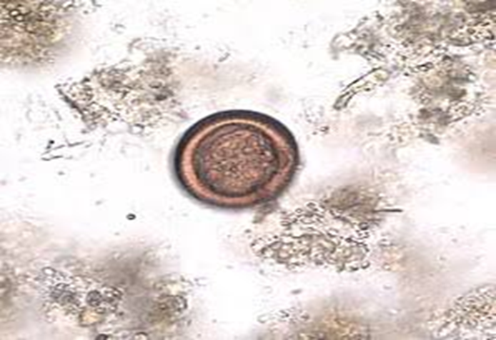
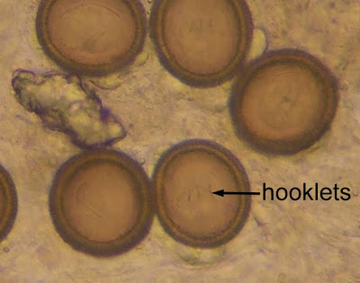

Slide 26
Trichinellosis

Slide 27
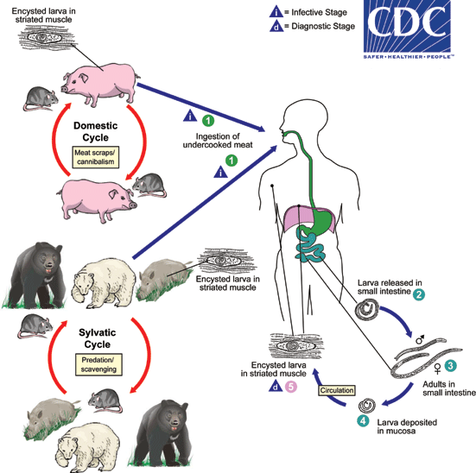

Slide 28
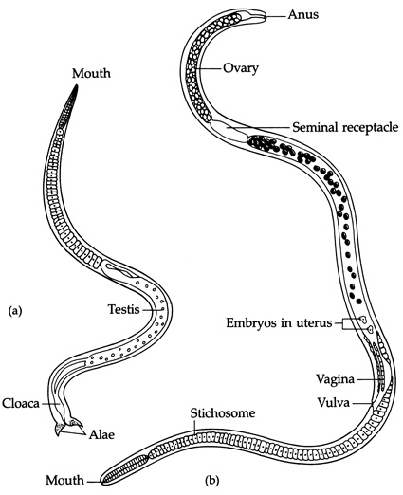
Female worms measure 2–4 mm and
males 1–1.5 mm.

Slide 29
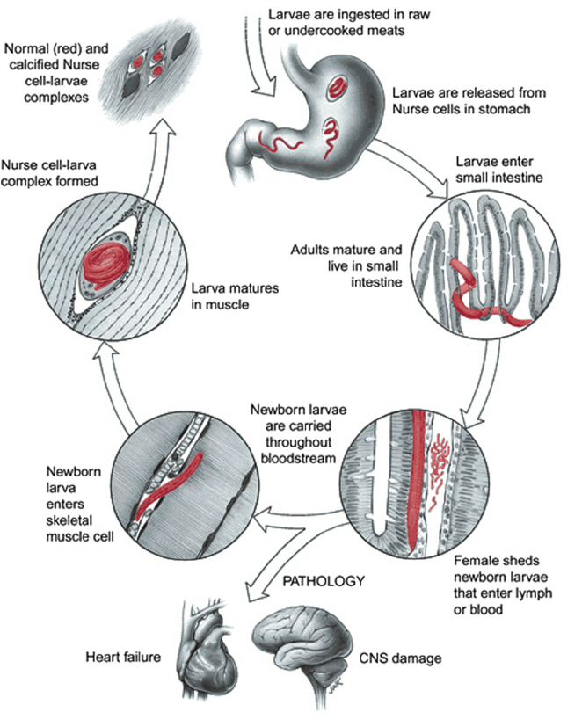

Slide 30
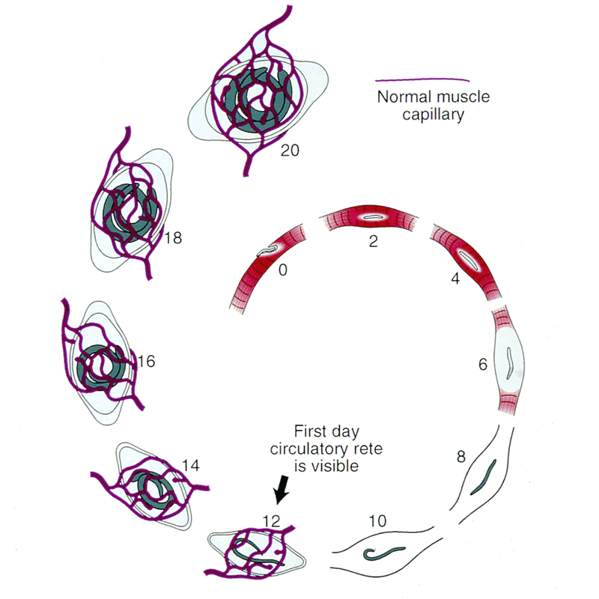
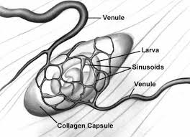

Slide 31
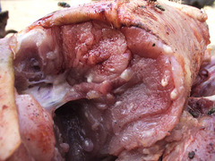
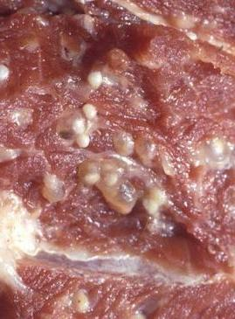
Trichinella cyst in muscles

Slide 32
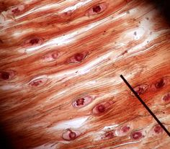
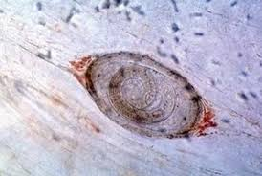
capsulated larvae in muscle biopsy

Slide 33
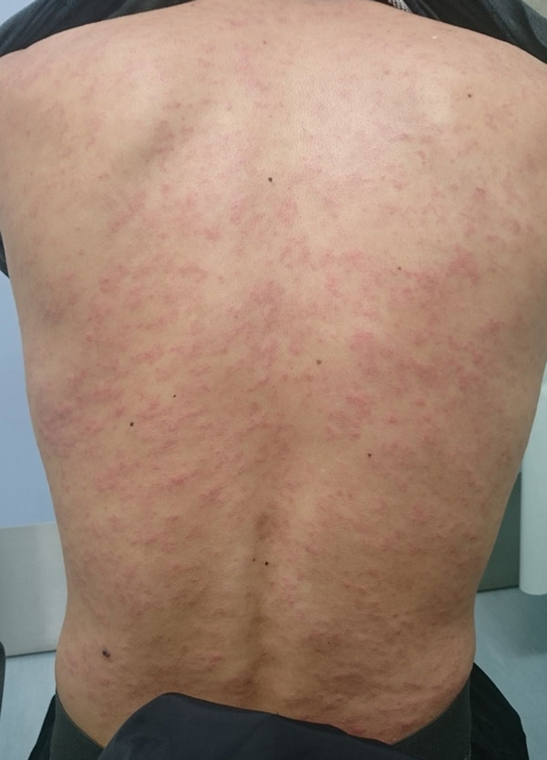
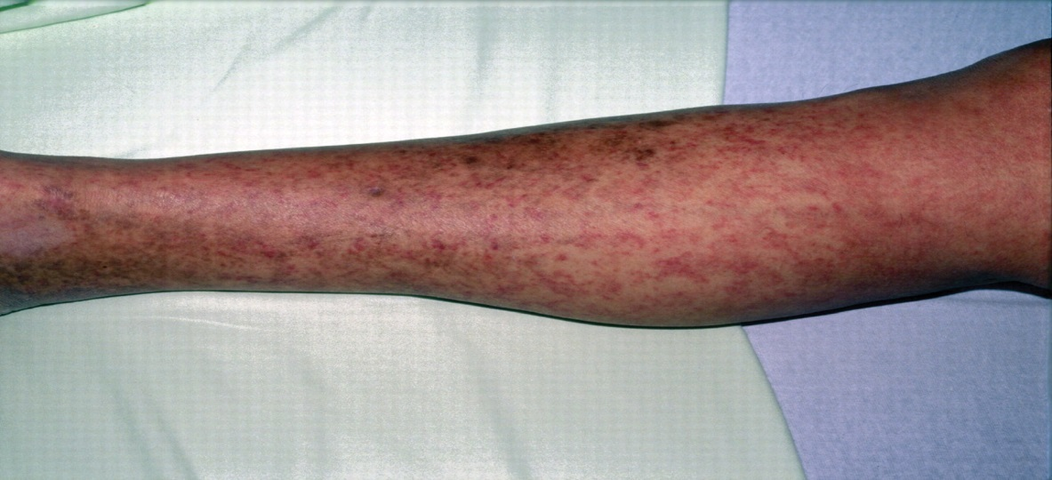

Slide 34
Taeniasis

Slide 35
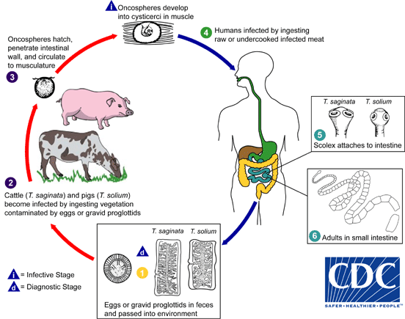

Slide 36
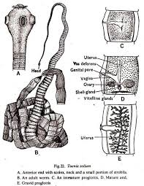

Slide 48
Anisakiasis

Slide 49
Anisakiasis
It is important to mention that L3 does not have the ability to develop to L4 in fish and humans, so parasitic reproduction in them does not take place

Slide 52
Prevention
cooking meat properly (internal temperature about 70°C or 160°F) .
freezing to around (−18°C or 0°F) should be able to destroy the protozoa .
food may be contaminated by hands, knives, utensils, cutting boards, that had contact with raw, contaminated meat or shellfish, so it is important to follow hygiene measurements: washing hands & change these utensils when preparing salad or cutting fruits.

Slide 54
Thanks For Your Attention

