Slide 1

Biometric Security on Internet of Things
Applications, Challenges,
and Future Vision
Mohammed Sadoon Hathal^{1,2}
Ali Ismail Awad²
¹Department of Computer Engineering,
College of Engineering,
University of Baghdad
Baghdad, Iraq
²Department of Computer Science,
Electrical and Space Engineering,
Luleå University of Technology
Luleå, Sweden

Slide 2

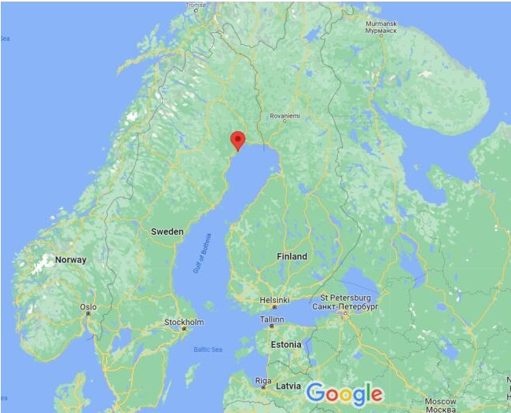

Lulea University of Technology
Luleå University of Technology is a Public Research University in Norrbotten County, Sweden.The university was originally established in 1971 under the name Luleå University College and had its first campus in the suburbs of Porsön in Luleå.
The university is famous for its groundbreaking collaborations with various industry partners, such as LKAB, Ericsson, Boliden, ABB, and Epiroc, and its high amount of externally funded research.
Luleå University of Technology is consistently ranked among the world's top universities, especially in Mining Science, Materials Science, Engineering, Computer Science, Robotics, and Space Science.
University rankings
Global – Overall
760 US News
801-900 Shanghai
618 GTU Rank
201-250 QS WUR

Slide 3
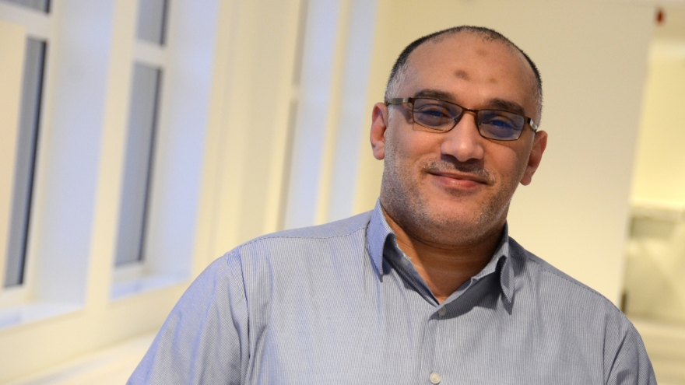
Ali Ismail Awad (SMIEEE, Ph.D.) is currently an Associate Professor with the College of Information Technology (CIT), United Arab Emirates University (UAEU), Al Ain, United Arab Emirates. He is also asociate Professor (Docent) with the Department of Computer Science, Electrical and Space Engineering, Luleå University of Technology, Luleå, Sweden, where he also served as a coordinator of the Master Program in Information Security from 2017 to 2020. He is an Associate Professor with the Electrical Engineering Department, Faculty of Engineering, Al-Azhar University at Qena, Egypt. He is also a Visiting Researcher at the University of Plymouth, United Kingdom.
His research interests include Cybersecurity, network security, Internet of Things security, and image analysis with biometrics and medical imaging applications. He has edited or co-edited eight books and authored or co-authored several journal articles and conference papers in these areas. In 2021, He was listed in the top 2% of influential scientists worldwide. He is an Editorial Board member of the Future Generation Computer Systems Journal, Computers & Seuman Systems Journal, Health Information Science and Systems Journal, and formerly IET Image Processing Journal. Dr. Awad is an IEEE senior member

Slide 4
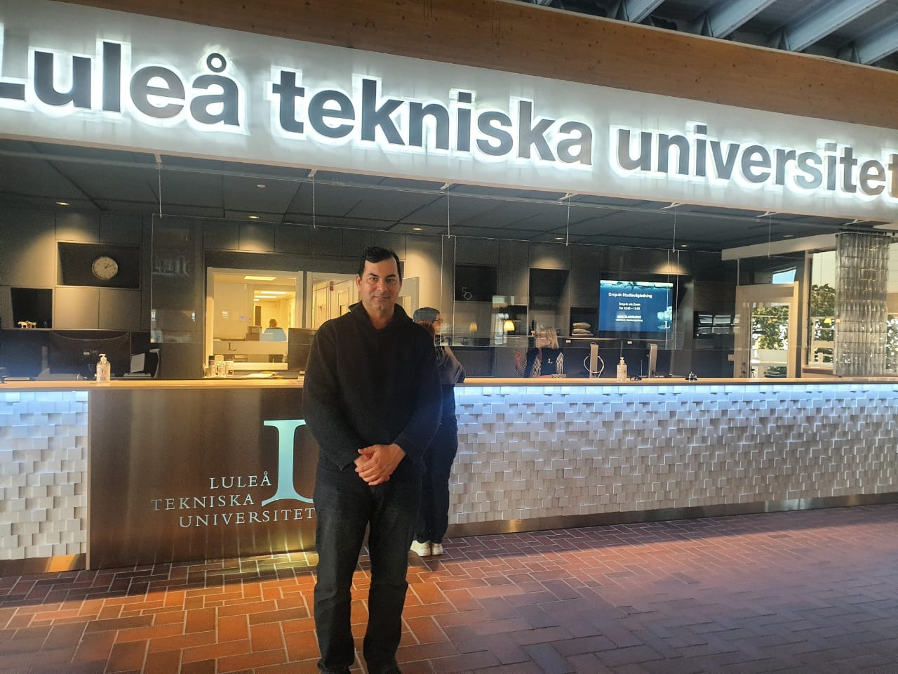

Slide 5
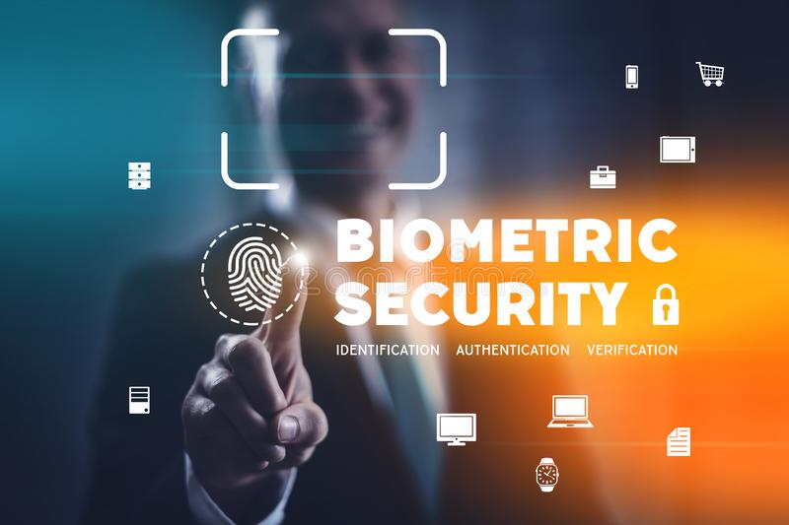
Content
01
Introduction
02
Related Work
03
Biometric System Models
04
Biometric Security Challenges
05
Open Issues

Slide 6
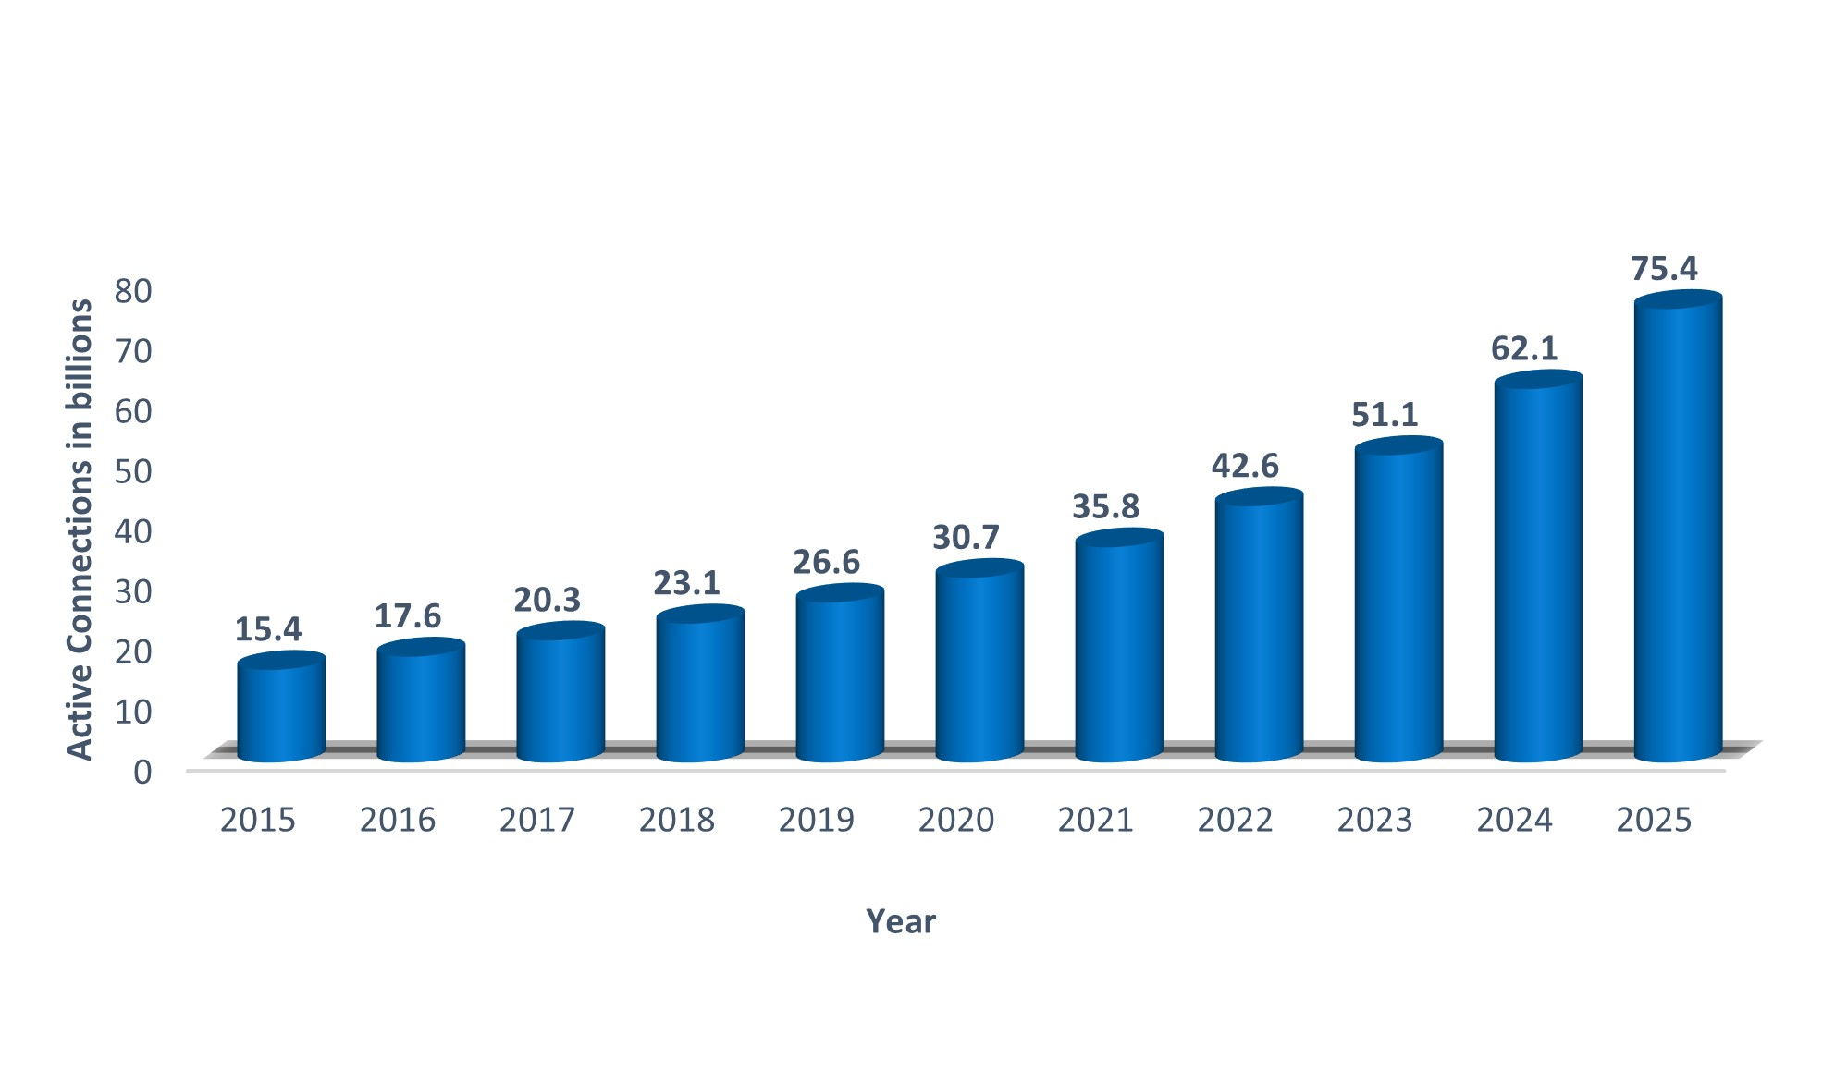
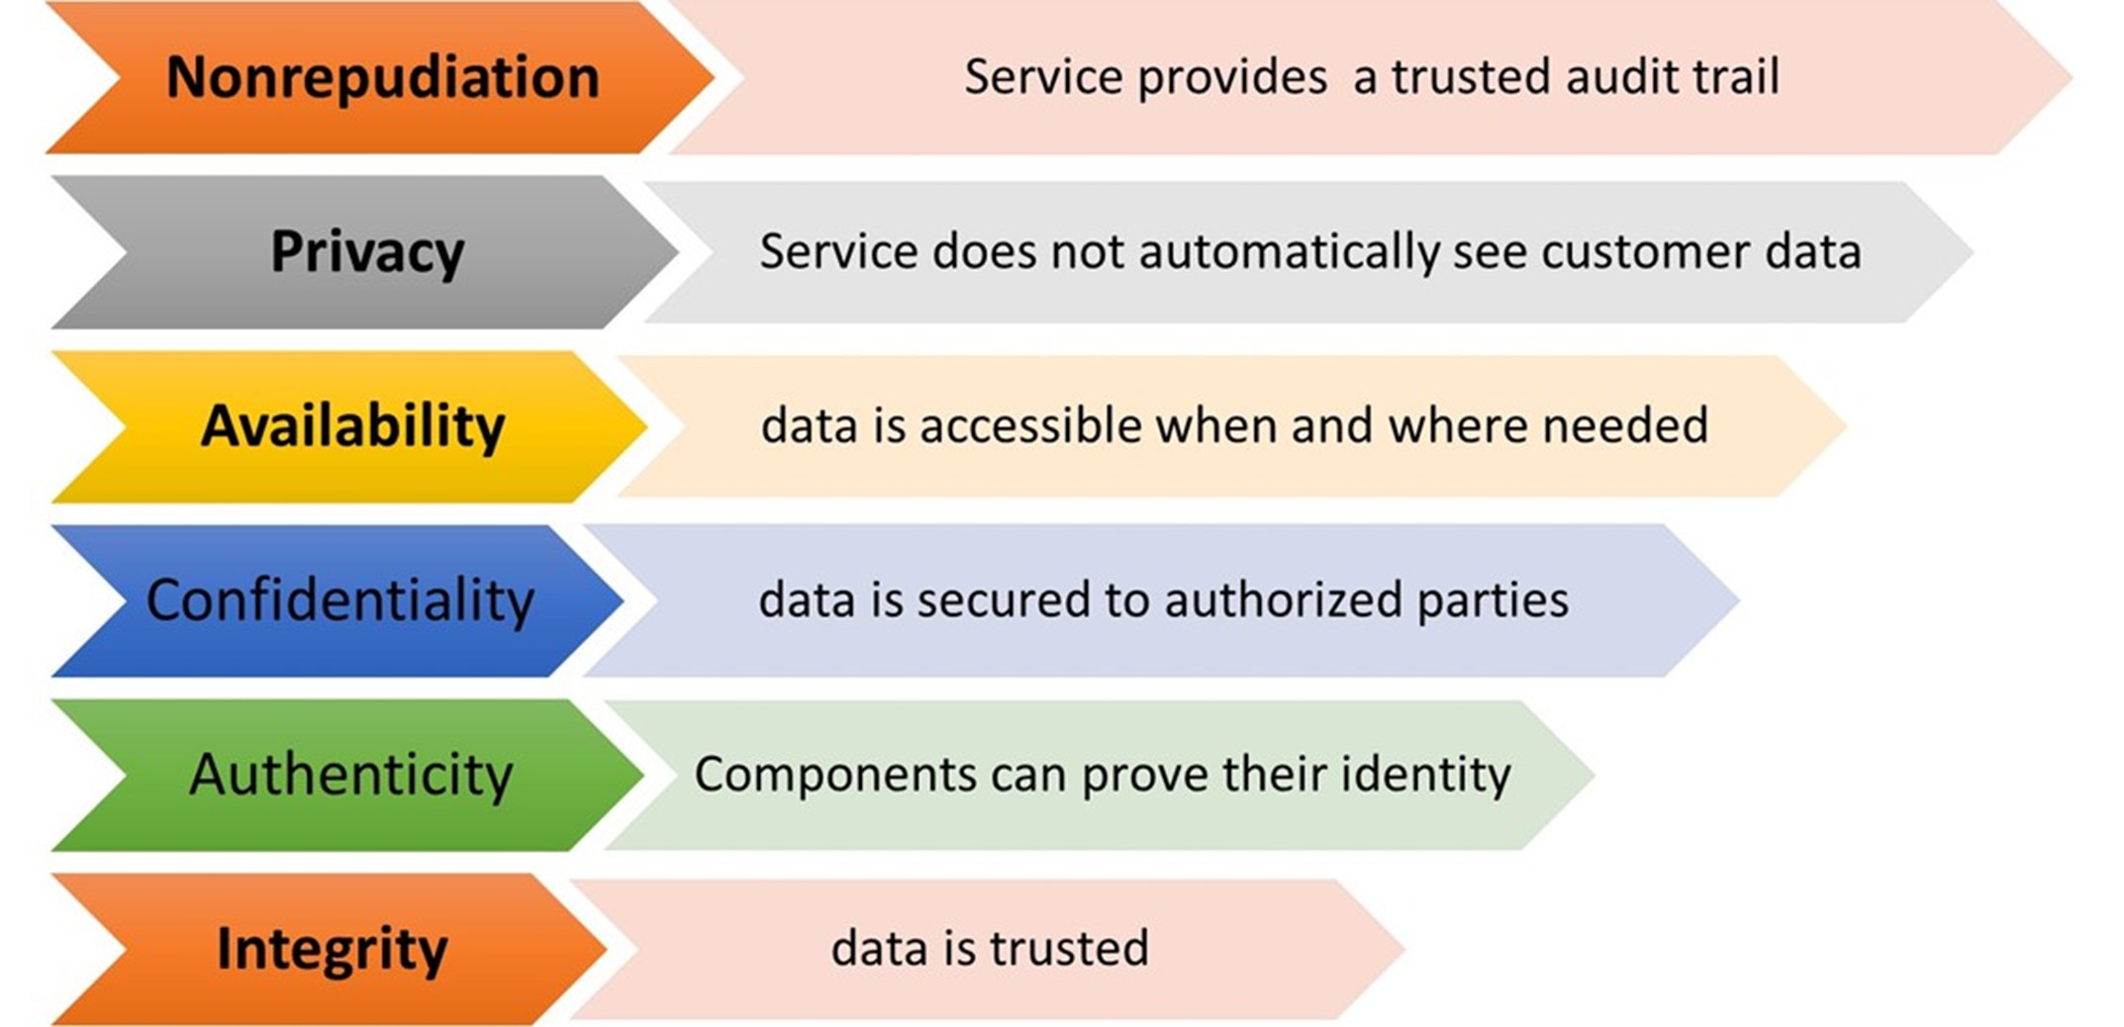
Introduction
The Internet of Things (IoT) is a recent technology in the world. As technology advances, it has become a need for communities, health care, institutions, and even homes to be connected to the internet.
-From 2022 to 2025, the expansion of connection between machines is anticipated to expand from 42.6 billion to 75.4 billion,Figure besides shows the IoT connected devices worldwide, due to an increase in the use of IoT applications in all situations throughout the world.
IoT core security
requiremnts

Slide 7
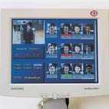
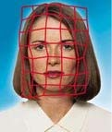
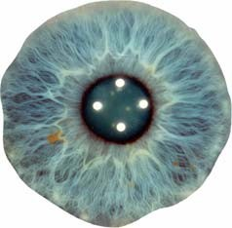
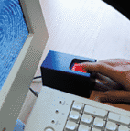

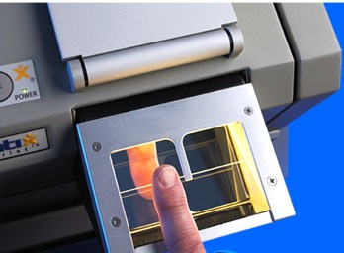
What are Biometrics?
The term "biometrics" is derived from the Greek words bio (life) and metric (to measure).
For our use, biometrics refers to technologies for measuring and analyzing a person's physiological or behavioral characteristics. These characteristics are unique to individuals hence can be used to verify or identify a person.

Slide 8
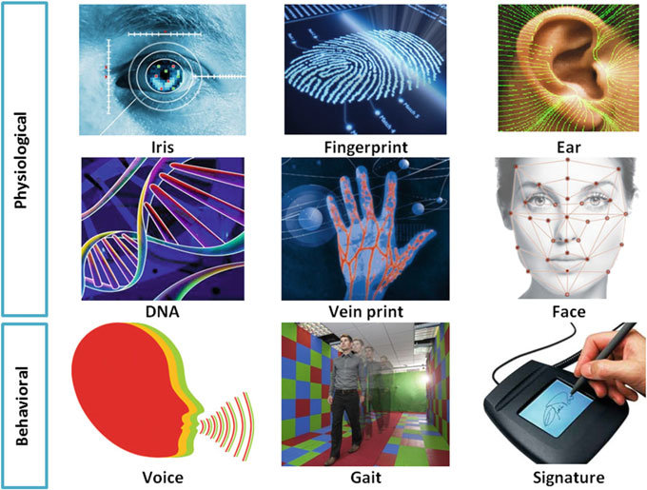
Classification of BIOMETRICS
Physical are related to the shape of the boday
Behavioral are related to the bahavior of a person
Cognitive biometrics is based ubon brain response to stimuli
Notes:
The main component’s detail consists of 3 units, which are WiFi Microcontroller, Infrared MLX90614 Temp Sensor, and Display unit

Slide 9
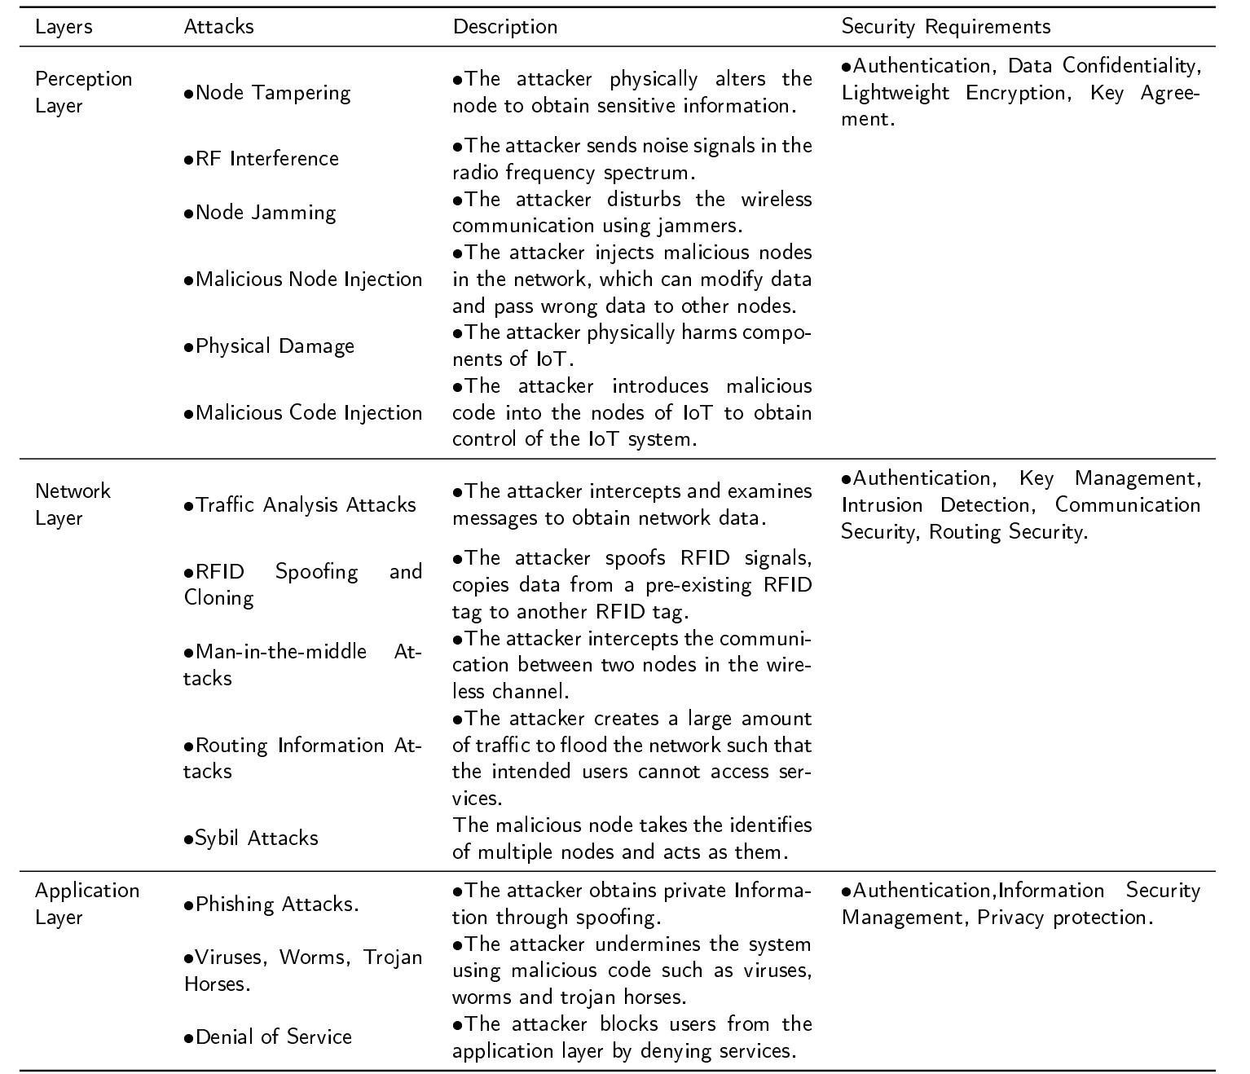
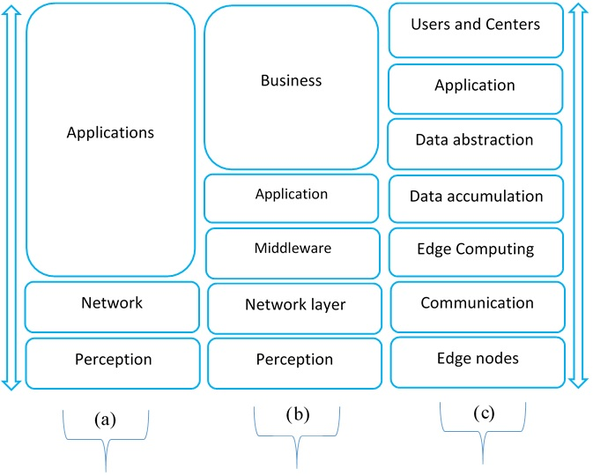
IoT Architecture
Attack on difeerent layer
3- Level 5- Level CISCO Model

Slide 10
Contribution
The contributions of this article are highlighted in the following items:
• The security issues of biometric IoT layered architecture, as well as security challenges for IoT applications are discussed and classified
• We categorize and study IoT-related biometric authentication systems based on distinct biometric qualities and the number of biometric traits utilized in biometric systems vulnerabilities or possible IoT attacks.
• The challenges posed by the implementation of biometric systems on the Internet of Things are reviewed,and possible solutions are examined and highlighted.
• This study offers several insights into future research areas in biometrics for IoT security

Slide 11
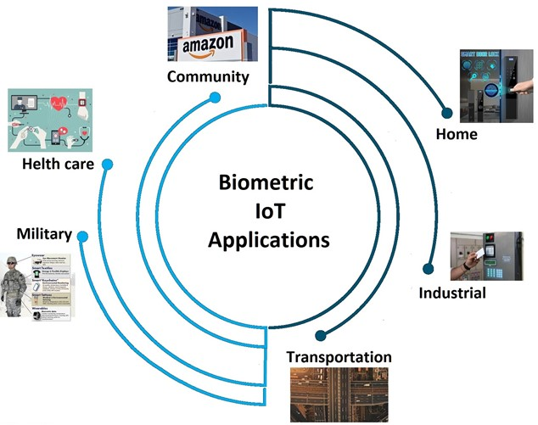
Applicatons of Biometrics
in IoT

Slide 12
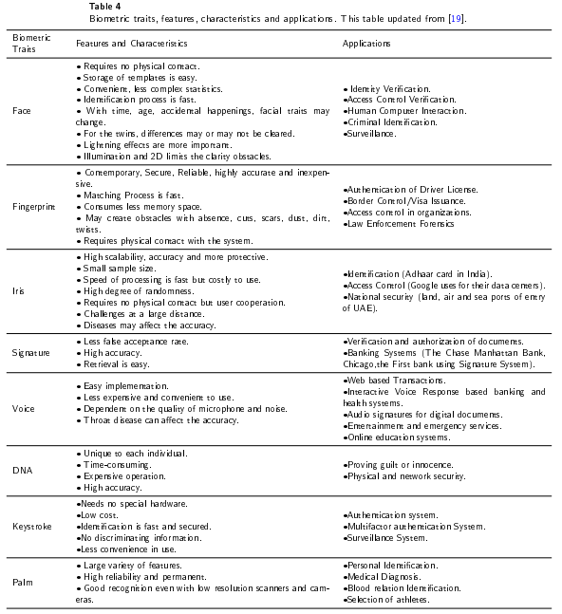
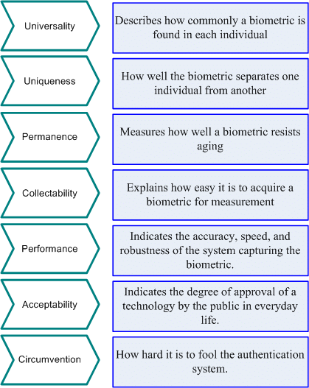
Features of Biometrics

Slide 13
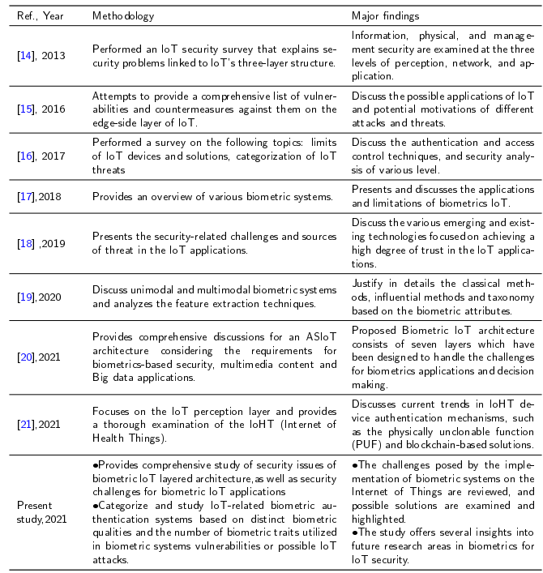
Content
Content
Summary of related published work of the biometric IoT security, focusing on the methodology and major findings

Slide 14
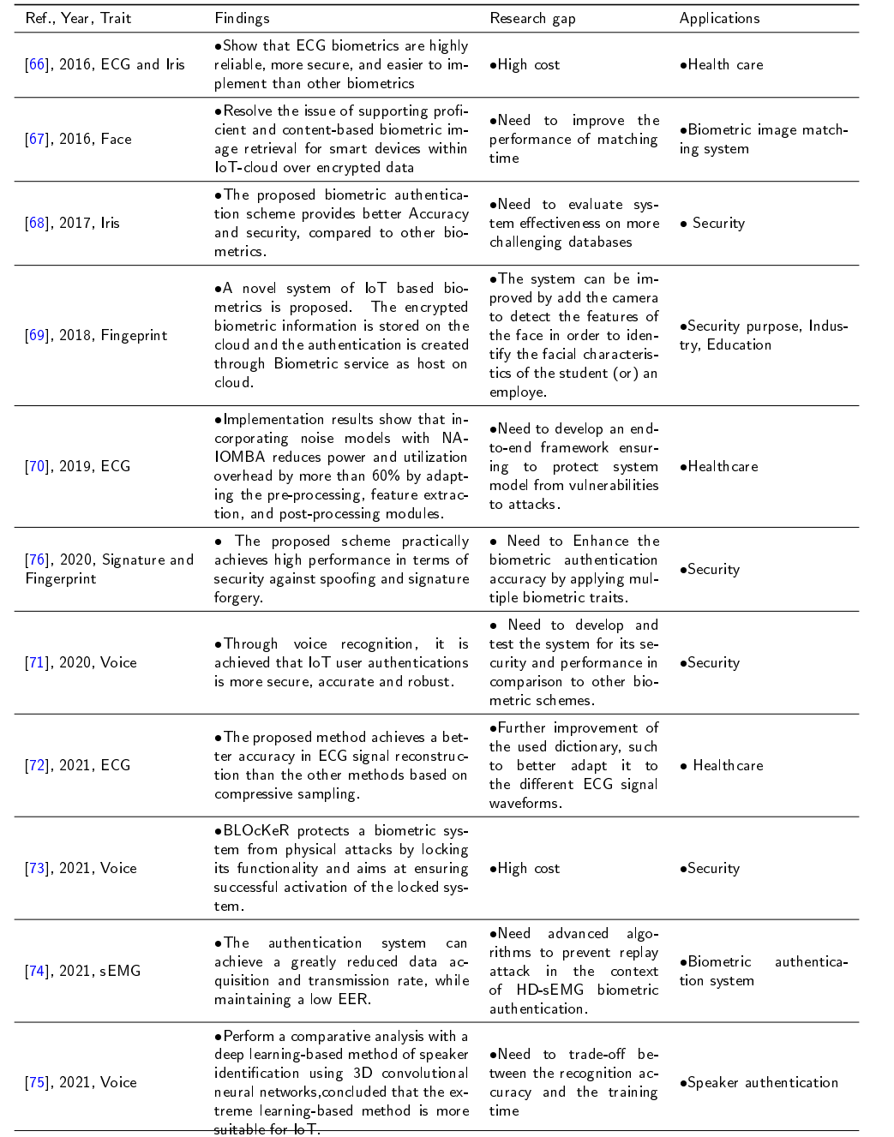
Summary of research achievements by applying biometric in IoT focusing on the methodology, findings, research gap and applications

Slide 15
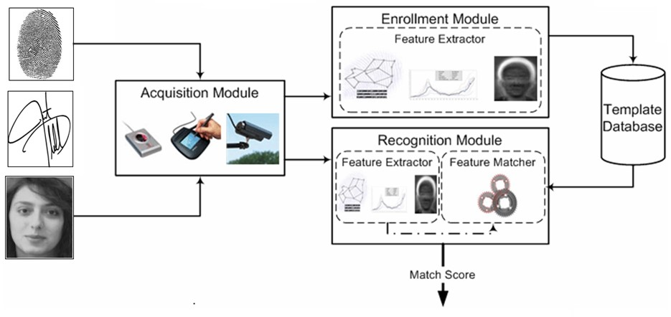
Biometric System
Biometric systems can operate in two modes; a unimodal and multimodal modes:
-A unimodal biometric recognition system leverages data from only one biometric feature (e.g., fingerprint or face).
-A multimodal biometric recognition system leverages uses two of more biometrics identifies to achieve higher
recognition accuracy
Content
Content
Content
Biometric System Diagram

Slide 16
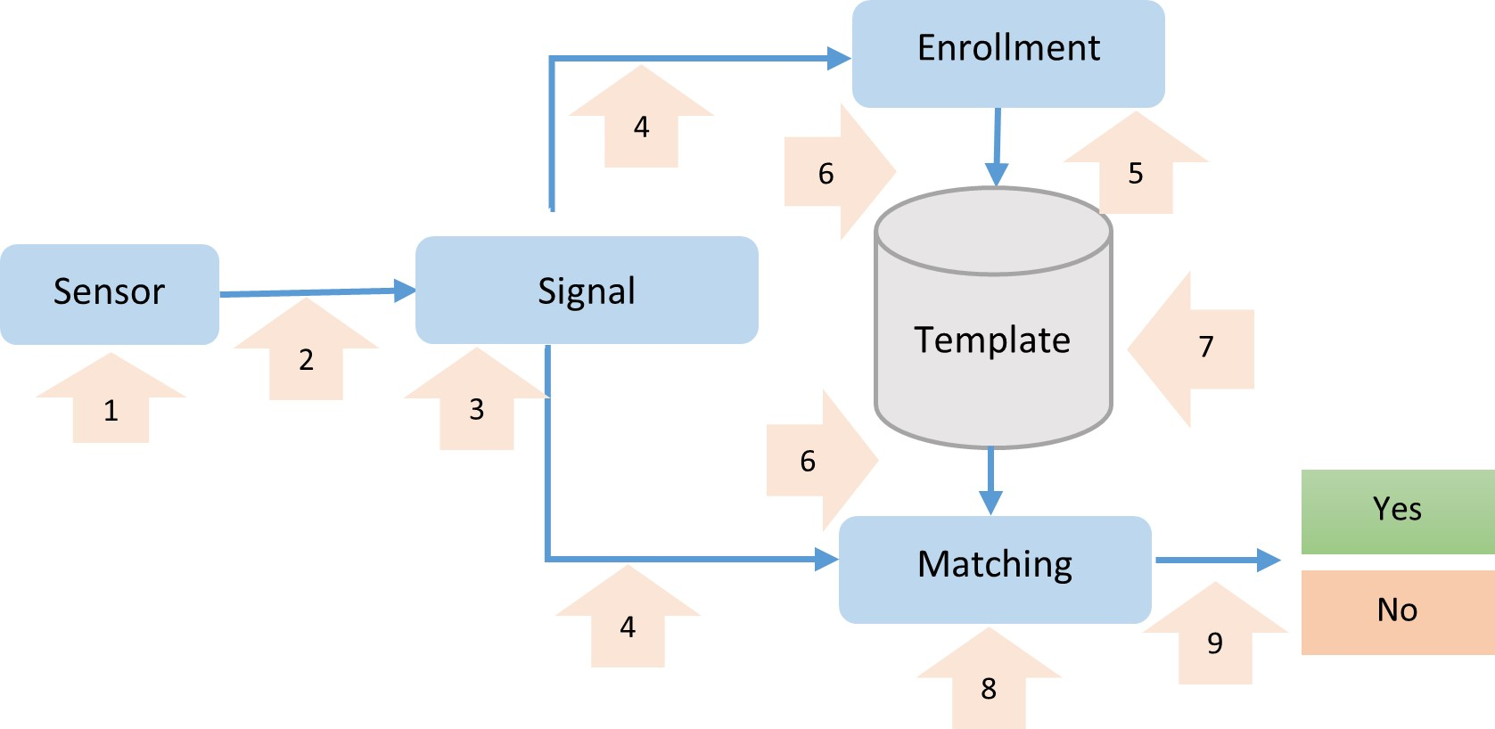
Current Challenges of Applying Biometrics in IoT Security
-Biometric System Vulnerabilities for IoT Security
Content
Content
Content
There are a variety of attacks that target biometric authentication systems, as illustrated :
-At point (1), spoof another person’s biometric data. Use of special lenses to create an iris image or a photograph of a face are two examples of it.
-Create a spoof signal between the sensor and the signal processor at point (2).
.-Alter the signal processing to change one or both future enrollment and matching procedures at point (3).

Slide 17
Current Challenges of Applying Biometrics in IoT Security
Biometric System Vulnerabilities for IoT Security
Content
Content
Content
-At point (4), fake the digital signal processing result with a precomputed signal to enroll another individual or sniff the digital signal processing for later use during biometric matching.
-At point (5), change the enrollment procedure to either create a new template or leak the existing one.
-At point (6), change how the templates are stored in the database or see how they are retrieved from the database.

Slide 18
Current Challenges of Applying Biometrics in IoT Security
Biometric System Vulnerabilities for IoT Security
Content
Content
Content
-The content of the templates database can be changed or stolen at point (7).
-At point (8), change the matching processing to get a new result or change it to steal a template.
-Change the decision value yes/no at point (9).

Slide 19
Current Challenges of Applying Biometrics
in IoT Security
• Biometric Characteristics for IoT Authentication
Each biometric attribute has its unique set of characteristics, resulting in a wide range of authentication results, adopting multi-modal biometrics improves authentication accuracy and security.
• Biometric Data Uncertainty
Many uncertainties exist in biometric data, including intraclass variability and interclass similarities.Because of skin elasticity, skin moisture content, finger movement, contact pressure, sensor noise, and imaging methodology.
• Inadequate Resources of IoT Devices
Many IoT devices have low processing capabilities. Biometric identification in an IoT scenario, which requires complicated computations including data processing, matching,and decision making
Content
Content
Content

Slide 20
Open Issues
Content
Content
Content
• Protecting biometric template data:
Biometric systems allow authentication between users and IoT devices,
According to the current research findings, privacy-preserving techniques such as cancelable biometrics and homomorphic encryption.
• Decreasing the effect of biometric uncertainty
approaches such as discriminative feature representation and deep/machine learning can be used to offset the detrimental impact of biometric uncertainty and achieve sufficient matching performance.

Slide 21
Open Issues
Content
Content
Content
• Design of a lightweight algorithms
To make biometric systems more energy efficient,lightweight and green procedures have been proposed for IoT devices
• Biometrics in combination with other technologies:
Biometrics in combination with other technologies (such as machine learning, blockchain,and edge computing) can improve IoT security

Slide 22
Content
Content
Content
Thank You

Slide 23
Published Papers
1.Artificial Intelligence (AI) Touchless Thermometer using Internet of Things (IoT) Communication.( IEEE Conference Oxford /UK 2022)
2.Ultra-wideband Featuring Enhanced Delay and Sum Algorithm and Oriented for Detecting Early-Stage Breast Cancer.(PIER Journal) 2021
3.Plain, Edge, and Texture Detection Based on Orthogonal Moment
IEEE Acess Journal)2022

