Slide 1
Detection of Mycotoxin

Slide 2
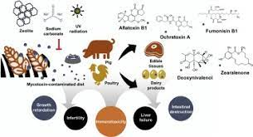

Slide 3
introduction
A toxin can be defined as a substance that is synthesized by plants animal or micro-organisms which is harmful to another organism
The term mycotoxin is a combination of Greek word (mykes) means fungus and Latin word (toxicum) meaning poison

Slide 4
Mycotoxins
are toxic secondary fungal metabolism product by certain types of filamentous fungi such as:
Aspergillus fusarium and Penicillium spp
Mycotoxigenic fungi and their produced mycotoxins are considered to be an important issue in food and feed safety due to their toxic effects like carcinogenicity immunosuppression neurotoxicity nephrotoxicity and hepatoxicity on human and animals

Slide 5
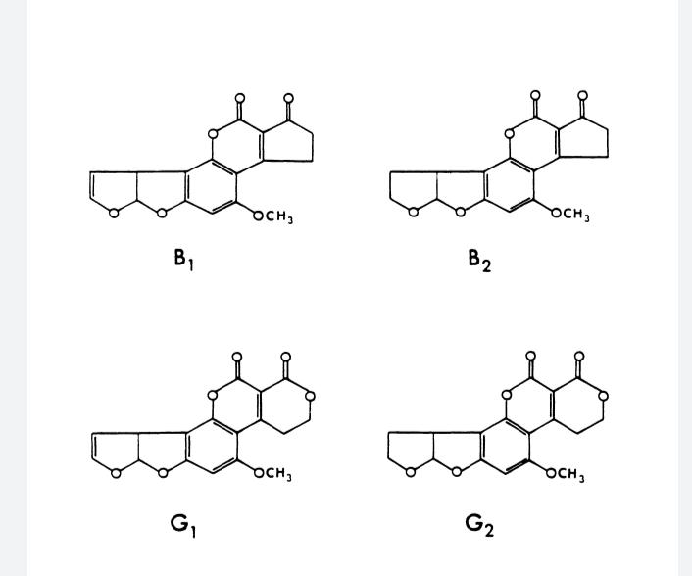

Slide 6
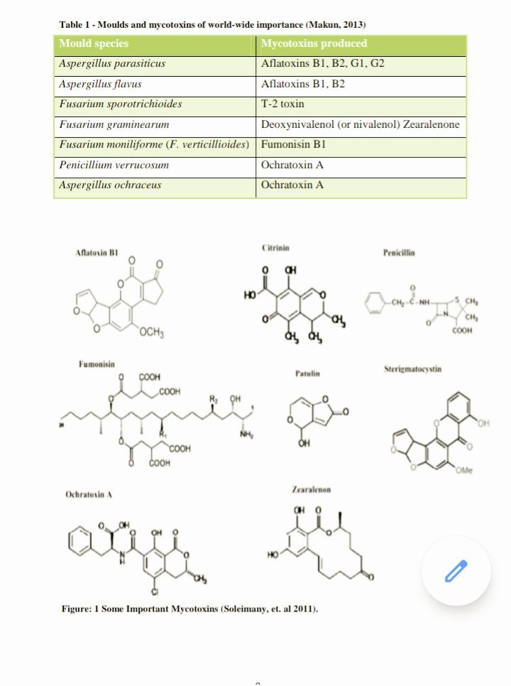
This table shows moulds and mycotoxins of world wide

Slide 7
Because most of the people and animals under threat by mycotoxins that’s way fast simple to preform and interpret and inexpensive yet sensitive methodologies for the detection of mycotoxins are the main issue in food control laboratories over the world

Slide 8
Mycotoxin in food
The toxic and carcinogenic potential of mycotoxins propose an
urgent need to develop detection methods that are rapid and
Highly specific because mycotoxins have diverse chemical structures
Those moulds and mycotoxin which are considered to be of world
Wide importance its capacity to have a significant impact upon
Human health and animal productivity in variety of countries

Slide 9
Analytical method
Biochemical methods
1- High performance liquid chromatography
(HPLC)
2- HPLC –mass spectrometry (LC-MS)
3- Gas chromatography
4- Thin layer chromatography
5- Near infrared spectroscopy

Slide 10
Immunological method
The principle of the Immunological test is the reaction of specificity of the antibodies which is assessed by determining the degree of interaction due to low molecular weight and the need of using the laboratory animals for experiment for the test

Slide 11
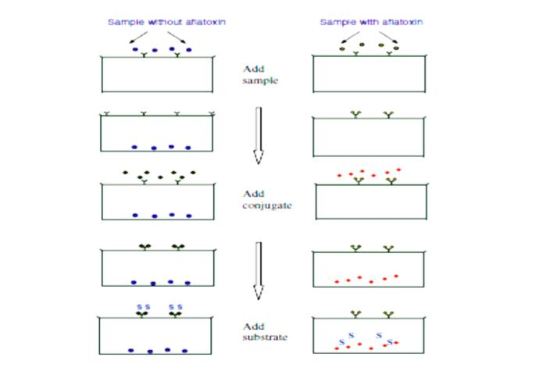
Membrane based immunoassay

Slide 12
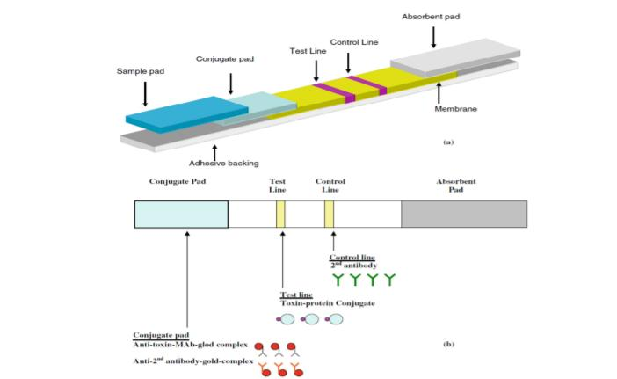
Schematic illustration

Slide 13
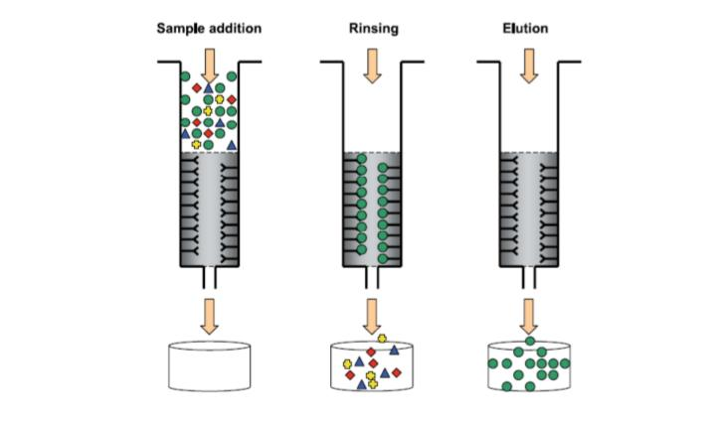
Fluorometric assay

Slide 14
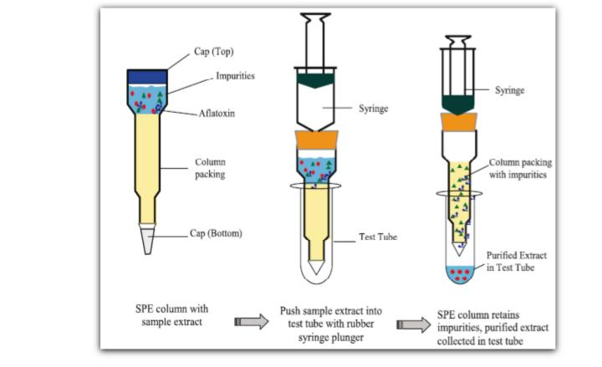
One step soild phase extraction column

Slide 15
Nucleic acid based techniques
The first step we start with is understand the biosynthetic pathway for the aflatoxin that in target we are trying to detected and the encoding genes that envelope in progress then we can design primer that based on the genes of the mycotoxin biosynthetic.

Slide 16
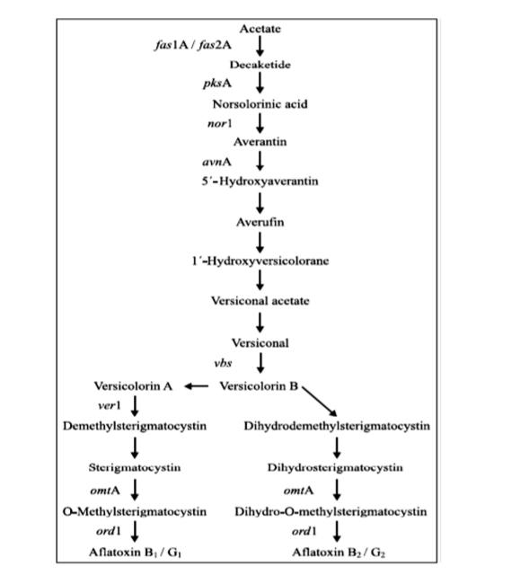
Biosynthetic pathway of aflatoxins B1,B2

Slide 17
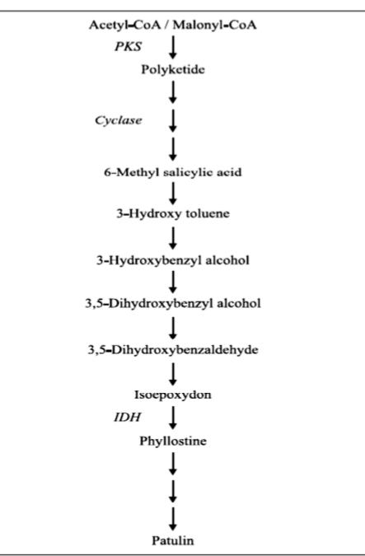
Biosynthetic pathway of Patulin

Slide 18
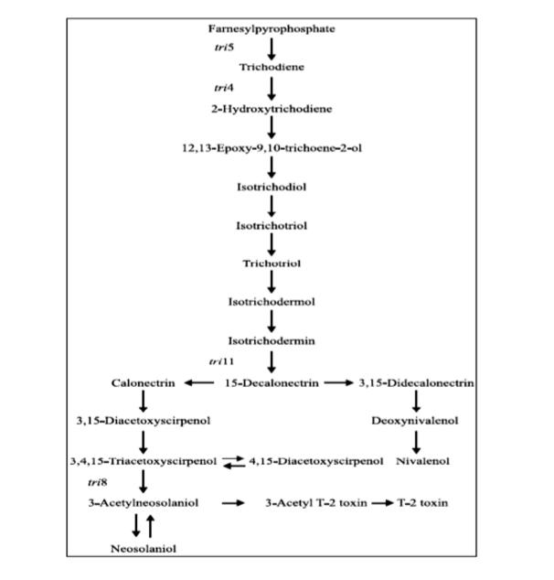
Biosynthetic pathway of trichothecenes

Slide 19
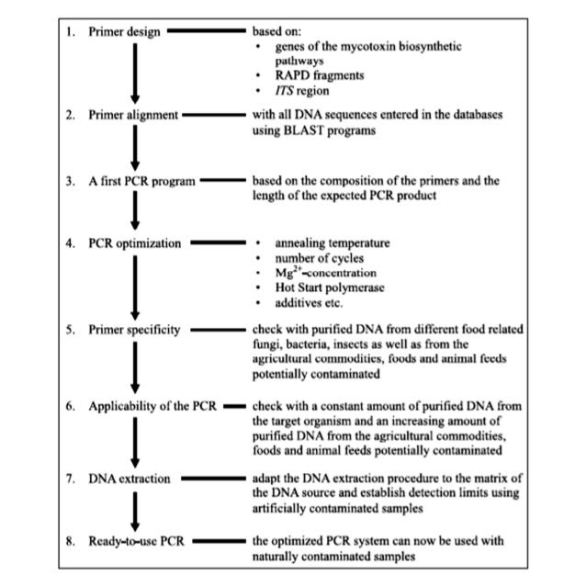
Speecific PCR assay to detect mycotoxigenic fungi

Slide 20
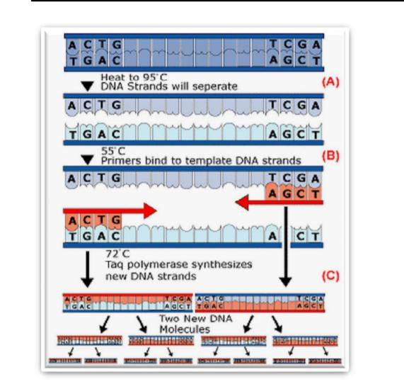
PCR

Slide 21
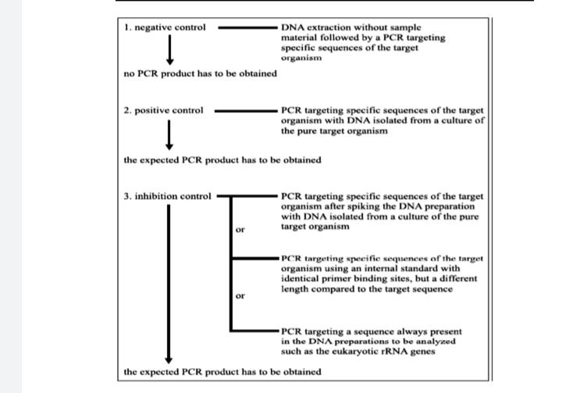
Control reaction which have to be included into a PCR assay

Slide 22
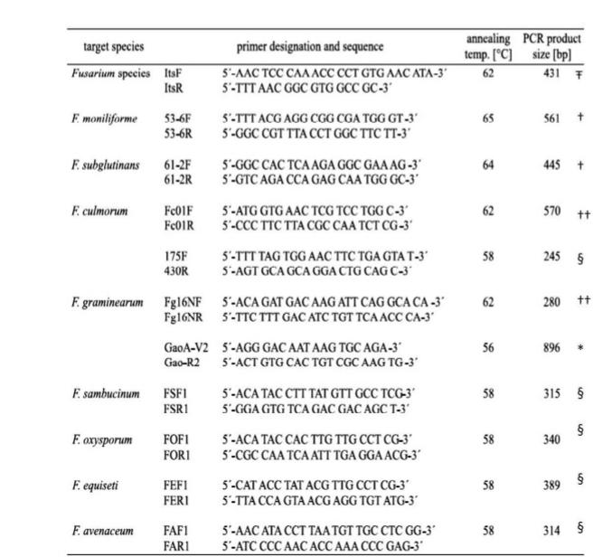
Genes and species –specific primer systems for the detection of mycotoxigenic fungi

Slide 23
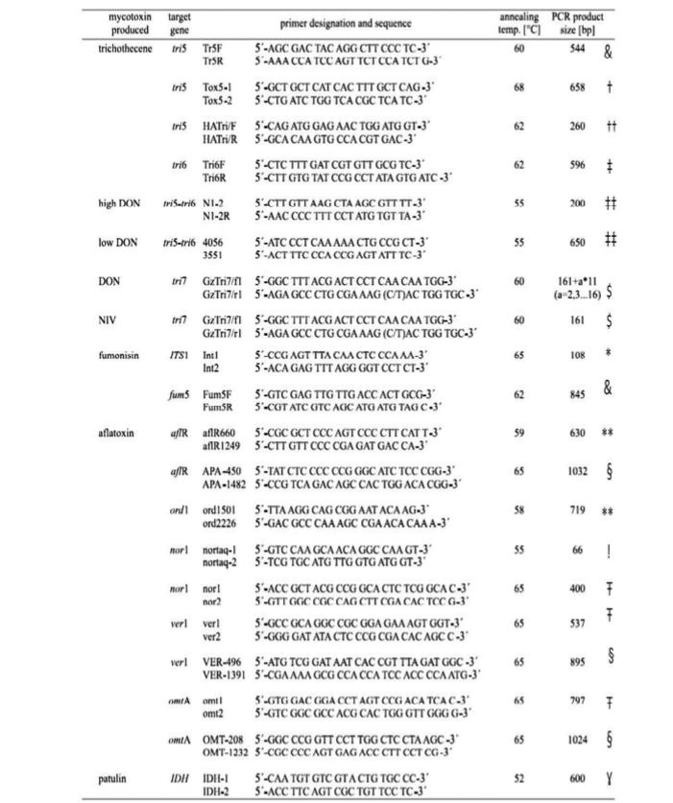

Slide 24
thank you

