Slide 1






Solutions to the Problems of Iraqi Environment Using Statistical Methods
ICSA2023 - 039

Slide 2
Lamyaa Mohammed Ali Hameed
University of Baghdad, College of administration and economics,
Department of statistics, Iraq
E-mail: lamiaa.mohammed@coadec.uobaghdad.edu.iq

Slide 3
Abstract
This research reviews most the tools, and statistical methods that were used in the field of the environment that pertain to the Iraqi reality and contributed to improving the environmental reality and solving its problems for all environmental aspects in a way that serves strategic environmental planning to protect the environment of Iraq and make it more livable in a way that helps decision-makers to provide the appropriate action for the environment more prosperous and advanced.
Keywords: Statistical methods, Iraqi environment, pollution, marsh environment, Factor Analysis

Slide 4
Introduction
The environment in ancient times was free of problems because of the dependence of primitive man on hunting and picking fruits and eating them without cooking and wearing leaves of trees and wearing wood and living in caves that the sun enters widely, and after the emergence of agriculture led to more settlements and then began to agricultural tools to appear such as the plow tied to the bull and the wheel, and then the arts of architecture developed led to the emergence of villages that include home dwellings consisting of a stone wall with a roof of Straw, fireplace and stove In the Iron Age, a huge production of steel tools and tools of war appeared, hence we note that the effects of the human race on the environment have gradually increased since the Stone Age when man tried to generate fire, causing bad effects on the environment and the accompanying Iron Age of minor accumulations of polluting materials to the environment, and with the progress of humanity, human waste became polluting water sources and rivers, and with the production of minerals, air pollution increased, and after the increase in population growth and its concentration within cities. This created cavities for pollution and the associated transmission of diseases and infections from untreated human waste. Air pollution arose directly from burning wood, and after the emergence of several diseases, the official recognition of environmental pollution began, and with the increase in population growth and the emergence of the industrial revolution, air pollution increased and became a problem in some industrial cities, the result of which was the construction of a sewage network, and since then with the establishment of large numbers of factories and the consumption of large quantities of coal and others caused unprecedented pollution, all of this led to an attempt to control pollution.

Slide 5
Natural and human sources of pollution in Iraq

Slide 6
1) The increase in pollutants on the environment resulting from industrial activities, the development of means of transportation and open burning operations directly contributed to the exacerbation of the problem of climate change, desertification and environmental deterioration in Iraq, which it led to environmental, social and economic consequences, whether in the health sector, biodiversity, and agricultural sector or water resources to affect the environment.
2) The weakness of environmental awareness in Iraq and the weakness of procedures that reduce pollutants of all kinds, including commercial, industrial, medical and agricultural, has led to the deterioration of the environmental and service reality.
3) The increase in population and urban expansion and the accompanying pressure on public utilities and overburdening them beyond their capacity, followed by pressure on the environment in the form of discharge of semi-treated or untreated sewage, the accumulation of garbage and solid waste led to an increase in burdens on the environment and led to pollution of rivers and pollution of the environment and soil, which cause of increasing environmental problems.
4) The deterioration of the environmental system in Iraq, including water, air, and soil, was due to wars, conflicts, and the use of internationally prohibited weapons, which left a clear health and environmental impact that directly contributed to the pollution of the Iraqi environment, causing a number of diseases.
5) The use of internationally prohibited weapons has left serious environmental effects and the accumulation of various toxic wastes that threaten environmental security, as well as its impact on the Iraqi people and the emergence of several unspeakable diseases.

Slide 7
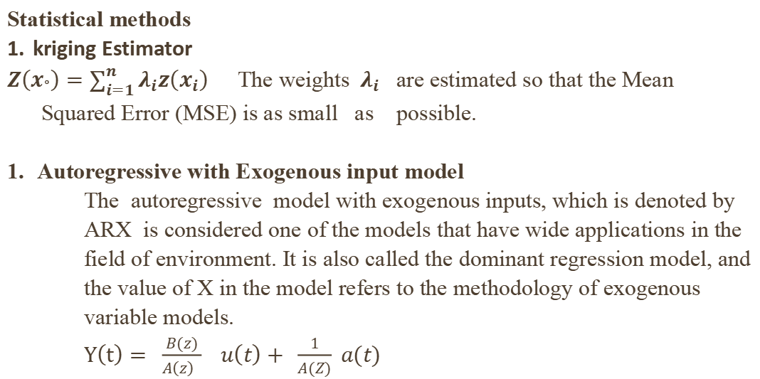
Statistical methods
kriging Estimator
$Z\left(x_{°}\right)=\sum_{i=1}^{n}{λ_{i}z\left(x_{i}\right)}$The weights $λ_{i}$ are estimated so that the Mean Squared Error (MSE) is as small as possible.
Autoregressive with Exogenous input model
The autoregressive model with exogenous inputs, which is denoted by ARX is considered one of the models that have wide applications in the field of environment. It is also called the dominant regression model, and the value of X in the model refers to the methodology of exogenous variable models.
$Y\left(t\right)= \frac{B(z)}{A\left(z\right) } u\left(t\right)+ \frac{1}{A(Z)} a(t)$

Slide 9
5. Neural Networks
It consists of Supervised Learning and Unsupervised Learning
- Prediction of ANN consists of (data collection , data preparation for prediction, Network architecture determination)
6. Factor Analysis
A Method to take a mass of observation and shrink it to a smaller data group that is more controllable and more comprehensible. It is a way to find hidden patterns, show how those patterns overlap and show what features are realized in several patterns. It is also used to sort a set of variables used for parallel items in the set. It can be present a very suitable instrument for difficult sets of data involving psychological revisions, socioeconomic position and other involved ideas.

Slide 10
7. Spatial statistical analysis : is one of the essential statistical techniques in the playing field of study of geographical variables to obtain the finest scheme of representation and explanation of spatial statistical variables. Amongst the statistical approaches used in this arena are the calculation of the correlation coefficient, analysis of elementary compounds and cluster analysis. Multivariate statistical procedures allow for the division and classification of broad aggregates of data from environmental observing programs to decrease data dimensions and abstract information that will be restricted to estimate the quality and organization of surface water.
8. Multivariate analysis
Principal Component Analysis (PCA) This kind of analysis be able to recognize the greatest significant parameters that distinguish all datasets and generating factors. The factors that take >1 variance are included only because every component must clarify the difference other than any single component .

Slide 11
Literature review

Slide 12
Conclusions | The statistical methods | Region | The Objectives | The author | Year
The best methods, especially when the data is staggered and normally distributed | spatial statistics using Kriging Estimator | Mosul | The total estimate of lead dust present in the city of Mosul | Esmaeel and Mosa^{[12]} | 2007

Slide 13
l
It was found that the Jackknife method ( JM) is the best at estimating the parameters of the outlier value. | The Gumbel distribution of the maximum values. Comparison of six methods for estimating its parameters and the adoption of the statistical measure Mean square error MSE for comparison | Baghdad | identify the dust storm phenomenon and to study the probabilistic distribution that it represents, which is the distribution of the Kemble outlier. In addition, the adoption of simulation in reaching the best estimates for the location | Abdulhussain and Al-Sarraf^{[2]} | 2011

Slide 14
ARFIMA (p, d, q ) 2015
Correlation coefficient, analysis of principal components and cluster analysis
Multi-level model (partial pooling model) - The partial pooling model - Full Maximum likelihood FML - partial pooling models (fixed and random )

Slide 15
Person correlation coefficient. | Shatt Al-Arab | A study of the effect of time (days, months, seasons and years) on the salinity change in Shatt Al-Arab water | Al-Muhyi^{[3]} | 2016
non- seasonal model of Box and Jerkins | Baghdad | Calculating the quantities of future solid wastes in Baghdad Governorate; through time series model as a statistical tool, and to find out the best forecasting model that can be used to process existing data. | Mohammed and Al.doori^{[23]} | 2016
(ARMAX)‎ model | Baghdad | Prediction of (30) values of the daily maximum temperature depending on the daily wind speed.in Baghdad | AL-mohana and Fakhri^{[6]} | 2016

Slide 16
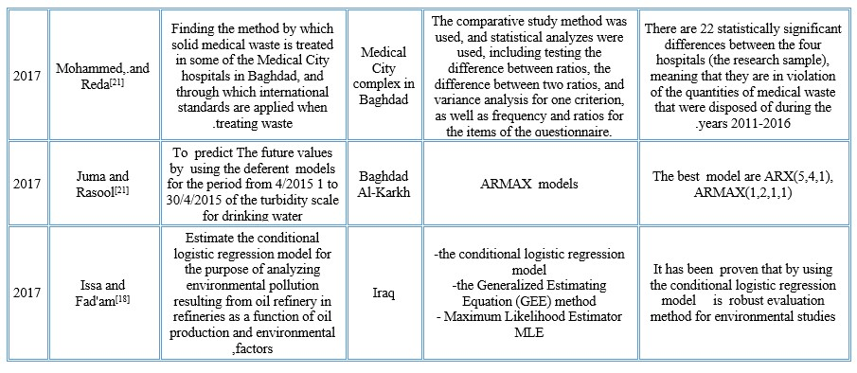

Slide 17
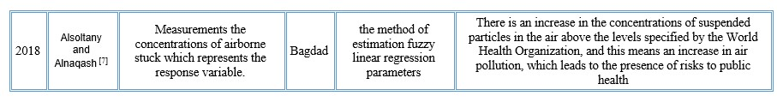

Slide 18
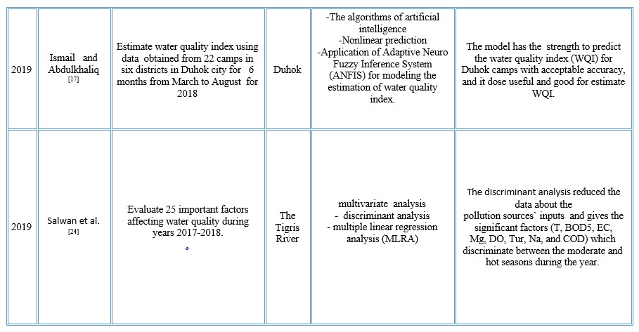

Slide 19
2020
Evaluate quality of the Tigris River by applying the water quality index method and GIS software

Slide 20
1- The time series of the variables is stationary. 2- The appropriate model for the NO₂ data is ARIMA (1.0.0). | Use of the Box & Jenkins method, Auto Regressive Integrated Moving Average (ARIMA). | Baghdad | Forecasting of air pollution with NO2 gas in Baghdad using the time series for the period 2015-2017 at a weekly rate of 157 observations. | Jabbar and Mohammed^{[19]} | 2021
A variable (the urban style) was chosen to predict the environmental quality of life in the city of Shatrah | adopting the method of factor analysis and prediction models | Shatrah, southern Iraq | Analysis of the urban environment of the city of Shatrah, southern Iraq | Al-Sahlani and Al-Yaseri^{[4]} | 2021

Slide 21
1- There is a strong correlation between the values of the dryness coefficient and the amounts of precipitation, temperatures and relative humidity recorded at the Amarah station. 2- The highest value of the drought coefficient calculated | Simple linear regression Correlation coefficients | Iraq | Studying the factors that cause an increase in environmental drought in Iraq for the period 1990-2020In the city of Amarah- Maysan, southern Iraq, | Hamdan and Hameed ^{[14]} | 2022

Slide 22
The ANN gives a valid accuracy and data fitting in clean and non-heterogeneous formations compared with higher heterogeneity that contain more than one type of lithology. | Artificial Neural Network (ANN) | Nasiriya Field | Prediction of Well Logs Data and Estimation of Petrophysical Parameters of Formation, Nasiriya Field^{[22]} | Mohammed and Dhaidan | 2023

Slide 23
5. Conclusions
1- The statistical models performance an important implement for observing environmental systems.
2- Through all the reference reviews, it can be noted that the statistical tools that were used to find solutions to the problems of the Iraqi environment were 70% of them around the Factor Analysis, which includes the Principal Components Analysis (PCA)
3- The years 2015, 2016, 2017, 2020 was the years that dealt the most with Iraqi environmental research, which used statistical methods as a tool to solve its problems.
4- Baghdad was the most environmentally researched city.
5 - There are no studies in the research literature dealing with floods or sea level.

Slide 24
THANK YOU

