Slide 1

السيرة العلمية
الاسم :- رشا هاشم مهدي
اللقب العلمي :- مدرس دكتور
مكان العمل :- جامعة النهرين/ كلية الهندسة/ قسم هندسة الليزر والالكترونيات البصرية
التحصيل العلمي:-
شهادة البكالوريوس/ جامعة النهرين/ كلية الهندسة/ قسم هندسة الليزر والالكترونيات البصرية/ 2010
شهادة الماجستير/ جامعة النهرين/ كلية الهندسة/ قسم هندسة الليزر والالكترونيات البصرية/ 2014
شهادة الدكتوراه/ جامعة بغداد/ معهد الليزر للدراسات العليا/ فرع التطبيقات الهندسية والصناعية/ قسم الهندسة الالكترونية والاتصالات/ 2019
الشهادات:-
CCNA - Cisco Certified Network Associate
TOT - Training of Trainers
SPM - Short Project Management
PMP - Project Management Professional
الاهتمامات العلمية:-
Optical Communication
Laser and Medical Applications
Plasmonic Technique
Nano-Technology

Slide 2
Biomedical Application of Nanoantenna
Dr. Rasha Hashim Mahdi
Oct. 2021

Slide 3
Outline
Introduction
Fabrication
Biomedical Design

Slide 4
Nanoparticles (NPs)
Introduction
Nanoparticles are particles between 1 and 100 nanometers in size. In nanotechnology, a particle is defined as a small object that behaves as a whole unit with respect to its transport and properties.

Slide 5
Optical Nano-Antenna
Metallic optical nano-antennas (also called optical antennas) have optical properties, as high enhancement and subwavelength confinement of the electrical field.
Optical nano-antenna enhance the interaction between light and matter, and hence hold great promise for applications

Slide 6
Plasmonic Nano-Antenna
As light interact with a metal nano-particle (NP), its conduction electrons driven by the incident electric field in collective oscillations named localized surface plasmon resonances (LSPRs).
LSPRs have an efficient transfer of EM energy from the near to the far-field of metal NPs and vice versa, so it can consider plasmonic nano-structures as nano-antennas, because they operate as same as radio antennas but at higher frequencies.

Slide 7
Localize Surface Plasmon Resonances (LSPRs)
collective oscillations known as localized surface plasmon resonance

Slide 8
Nanoantennas
Since LSPRs enable an efficient transfer of EM energy from the near to the far nanoantennas
Gold and Silver
good metallic properties and low absorption.

Slide 9
Fabrication
A.Thermal Evaporation
B.Colloidal lithography
C.E-Beam lithography
D.Nanoimprint lithography

Slide 10
Applications
Nano medicine
Fluorescence
Spectroscopy
Raman
spectroscopy
Solar cell

Slide 11
Nanomedicine (Detect)
Near-infrared fluorescence tomographic images of normal and subcutaneous tumor-bearing mice after injection of a gold NP probe

Slide 12
Mechanism of Treatment the Tumor
Specifically designed metal NPs into tumor cells
Excitation causes a temperature increase
Resonance Frequency
High intensity field
Plasmonic Structure
Nano-Antenna
Metal+Dielectric
Tumor

Slide 13
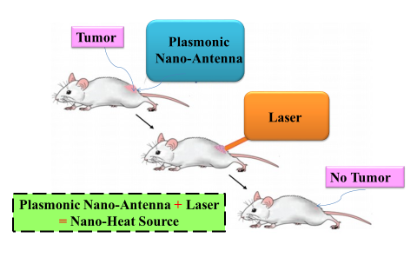
Nanomedicine (remedy)

Slide 14
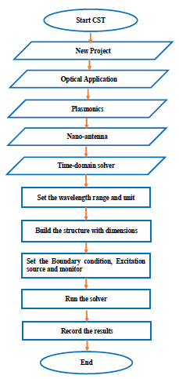
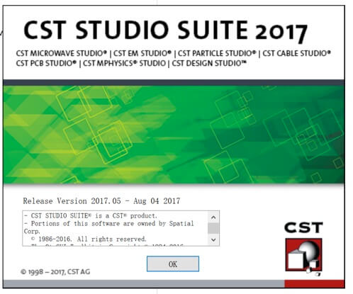
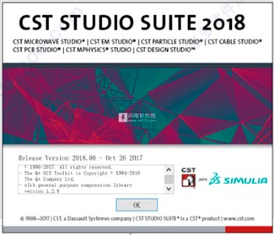
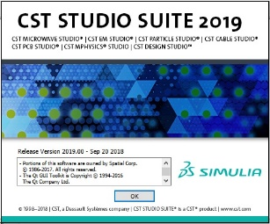
Steps of the work

Slide 15
Steps of the Design
Single design
532 nm
1064 nm
Array
532 nm
1064 nm

Slide 16
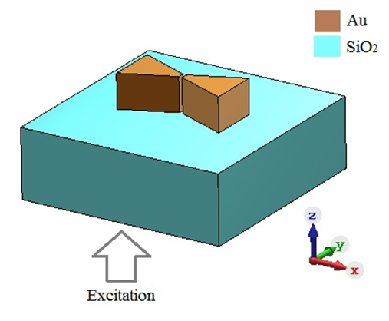
  Design of Plasmonic Bow-Tie Optical Nano-Antenna

Slide 17
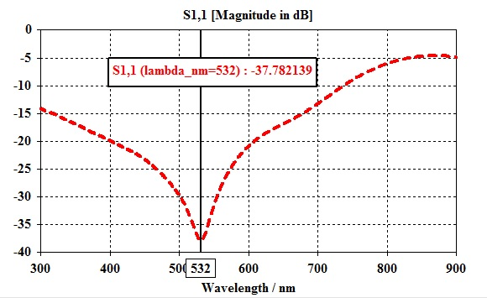
Performance of Plasmonic Bow-Tie Optical Nano-Antenna
Fig. The reflectivity of the plasmonic bow-tie optical nano-antenna at the resonance wavelength 532 nm.

Slide 18
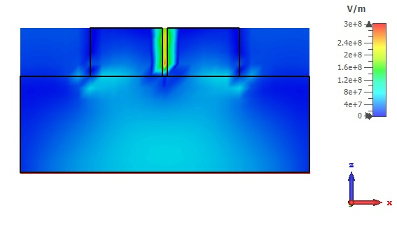
Performance of Plasmonic Bow-Tie Optical Nano-Antenna
Fig. The field distribution in the gap of plasmonic bow-tie optical nano-antenna.

Slide 19
Design of Array Plasmonic Bow-Tie Optical Nano-Antenna
2×2
3×3
4×4

Slide 20
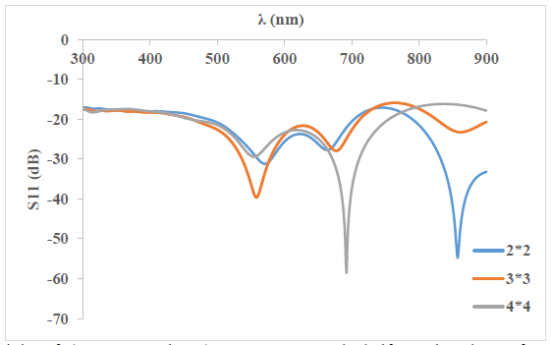
NAs array (2×2, 3×3 and 4×4) as a function
of the wavelength for 532 nm.

Slide 21
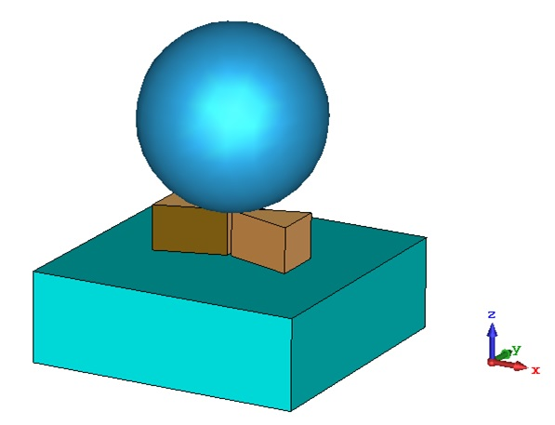
Tissue Proposed
The tissue model consists of tissue in the spherical shapes centered in the front of plasmonic bow-tie optical nano-antenna and surrounding by air.
The tissue with diameter D = 50 nm, 100 nm and 200 nm.
Fig. 3D structure of tissue with plasmonic bow-tie optical nano-antenna.

Slide 22
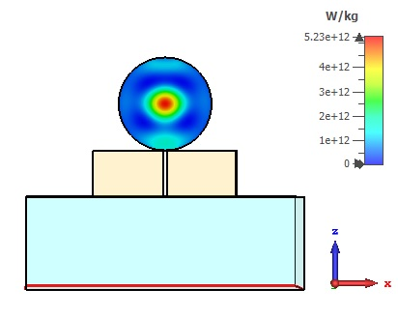
The tissue with diameter of 100 nm has a specific absorption rate about 5.23 e12 W/Kg
Fig. Side view of point SAR distribution in the tissue of D 100 nm.

Slide 23
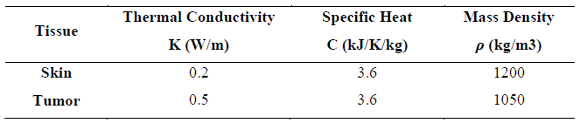
Design of Proposed Tumor

Slide 24
SAR Calculations

Slide 25
SAR Calculations
Specific absorption rate as a function of the distance from the tissue at single unit for 532 nm.

Slide 26
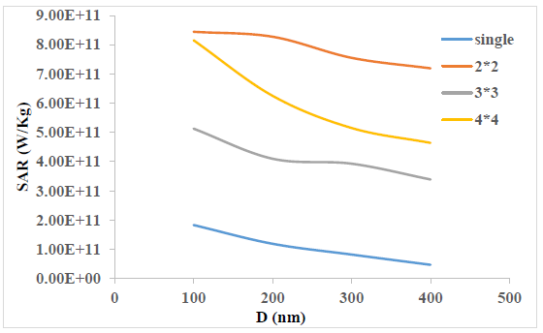
The SAR calculations for (2×2, 3×3 and 4×4) an array nano-antennas at 532 nm
Specific absorption rate as a function of the distance from the tissue at ANs for 532 nm.

Slide 27
SAR Calculation
SAR is a measure of electromagnetic power density and subsequent absorption of electromagnetic radiation and conversion to heat by human tissue.
SAR = σ|E|²/2ρ (1)
Where:-
σ =conductivity of the tissue-simulating material (Siemens/m)
E = total Root Mean Square (RMS) field strength (Volts/m)
ρ = mass density of tissue-simulating material (kg/m3)
the point specific absorption rate is recommended in this designed. Because the used plasmonic bow-tie optical nano-antenna and tissue in the nano-range, so the mass and the volume could be neglected.

Slide 28
Temperature Calculation
The relationship between the point SAR and temperature can be established by using the equation of heat (2)
dQ = ρ V C dT (2)
Where:-
Q=the thermal energy (Joule)
V = the volume (m3)
C = the specific heat (J /K. kg)
T= the temperature in Kelvin (K)
Dividing both sides in (2) by (ρ V dt ), and rearranging terms, we can write the following relationship:
(dQ/dt)/ ρ V= C. dT/dt (3)
The left side term of (3), represents the value of the SAR, so it can be used to determine the thermal distribution in tissues for a period of (Δt). It can be written as:
ΔT= (SAR*Δt)/ C (4)

Slide 29
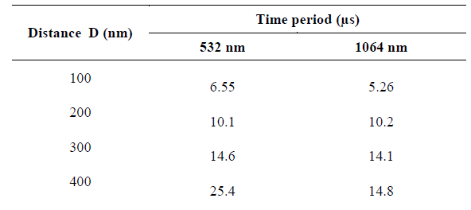
Time period Calculation
Time period estimation in tumor tissue at single nanoantenna

Slide 30
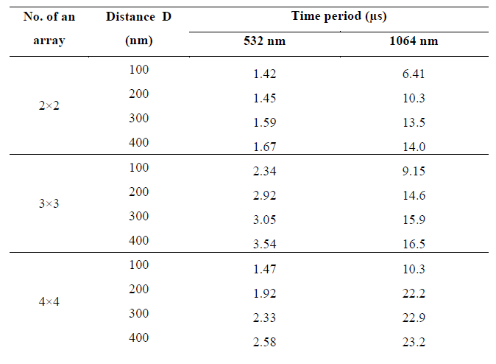
Time period in proposed tumor for an array nanoantenna

Slide 31
The good enhanced field of the plasmonic optical optical nano-antenna is the mean reason to use it in the treatment of diseased tissue.
The optical nano-antenna size is compatible to the corona virus thus it could be used to face COVID19.
The point source of the optical nano-antenna represents the suitable choice to confine the absorbed power in the tissue without affecting the surrounding tissue.
From the extracted results regarding the point SAR is 6.94 e12 W/Kg and the calculated temperature is 64 Cº in the tissue.
We can conclude that the designed plasmonic bow-tie optical nano-antenna is an encourage choice in the treatment of the tissue.

Slide 32
Thanks
for your attention
Dr. Rasha Hashim Mahdi
rashahmahdi@eng.nahrainuniv.edu.iq

