Slide 1
Using Water As Source Of Renewable Energy
Omar Hussein Alwan

Slide 2
Introduction
Present day water and energy systems are interdependent. Water is used in all phases of energy production and electricity generation. Energy is required to extract, convey, and deliver water of appropriate quality for diverse human uses, and then again to treat wastewaters prior to their return to the environment.
• We use many different sources to meet our energy needs. All sources have advantages and disadvantages. Some are cheap; others are expensive. Some contribute to global warming; others are pollution-free. Some are limited in their supplies; others are abundant. Some are always available; others are only available some of the time.

Slide 3
What is renewable energies?
Renewable energy sources include biomass, geothermal energy, hydropower, solar energy, and wind energy. They are called renewable because they are replenished in a short time. Day after day, the sun shines, the wind blows, the rivers flow, and plants grow.
We can harness this renewable energy to do work for us.
We use renewable energy sources mainly to make electricity. Here our project focus is on hydroelectric power or energy from water.

Slide 4
What is hydroelectric power?
Hydroelectric power is electricity that is supplied by generating energy from falling or streaming water. Hydroelectric power is a socalled renewable energy source. This means that the source, which provides the energy, can be renewed. This is because, unlike nonrenewable energy sources such as crude oil, we will not run out of water fully. It can be renewed after we have used it for energy generation.

Slide 5
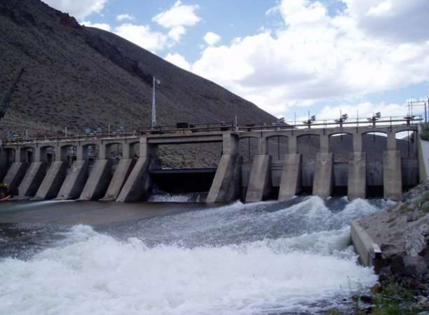
Hydropower plant

Slide 6
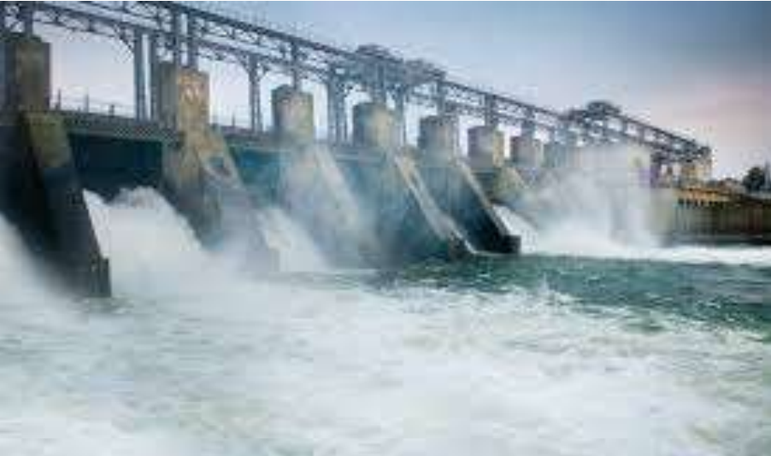
Hydropower generation process

Slide 7
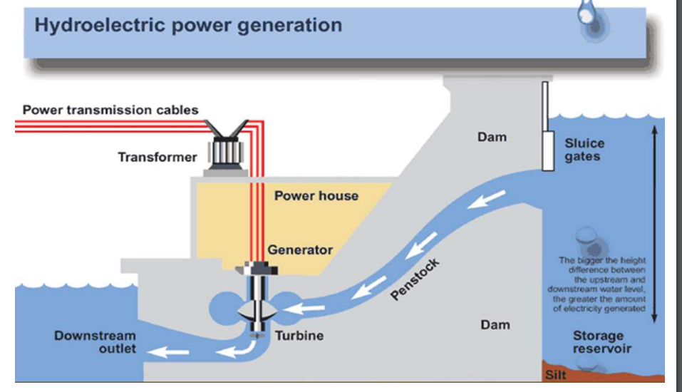
Hydroelectric dam in cross section

Slide 8
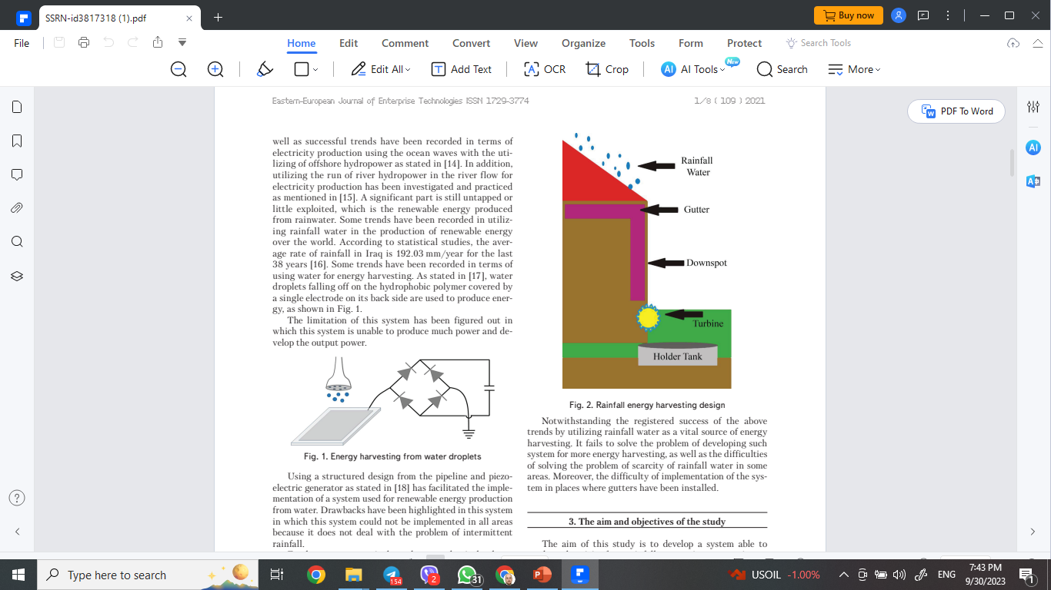
Rainfall energy Harvesting

Slide 9
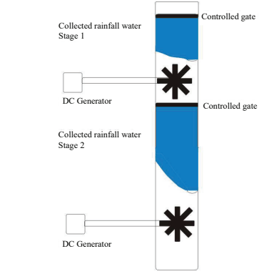
Multi Stage roof gutter for energy harvesting

Slide 10
Conclusion
The portable roof gutter design shows the handiness of installation in any premises since the structure is applicable with any design. The system is portable, which means it can be assembled and disassembled easily. As the cleaning process is considered a challenge for gutters, this system helps the cleaning process of gutters from the stuck dirt.

Slide 11
Thank you

