Slide 1

Defects capturing in dissimilar friction stir welding of aluminum alloys using Abaqus Environment.
Submitted by-
Kareem N.Salloomi

Slide 2
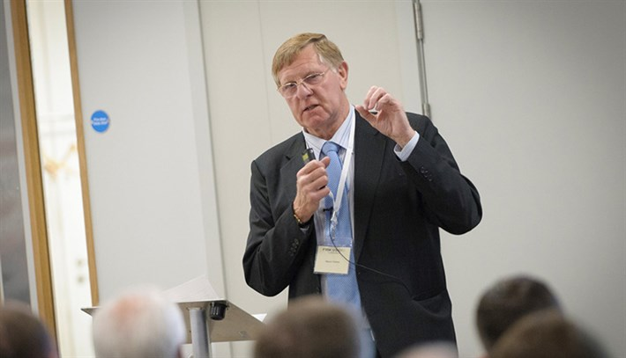
HISTORY-
Friction stir welding was invented by The Welding Institute (TWI) in December 1991. TWI filed successfully for patents in Europe, the U.S., Japan, and Australia. TWI then established TWI Group-Sponsored Project 5651,"Development of the New Friction Stir Technique for Welding Aluminum," in 1992 to further study this technique.
Inventor of friction stir welding Wayne Thomas

Slide 3
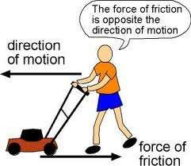
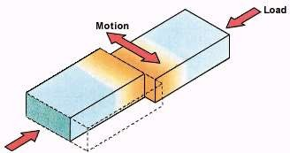
What is Friction?
FRICTION is the force resisting the relative motion of solid surfaces, fluid layers, and material elements sliding against each other
when surfaces in contact move relative to each other, the friction between the two surfaces
converts kinetic and heat energy

Slide 4
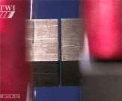
FRICTION WELDING
The process that use machines which are designed to convert mechanical
energy into heat at the joint to be welded.
This process accomplishes welding by bringing atoms of the materials being joined to equilibrium spacing principally through plastic deformation due to the application of pressure at temperatures below the melting point of the base materials, without the addition of filler that melts.
This process rely on friction to cause heating and bring atoms or molecules together by microscopic plastic deformation to produce a weld

Slide 5
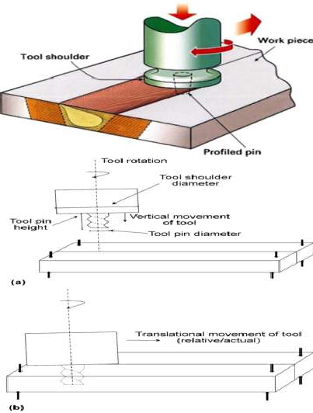
Friction Stir Welding (FSW)
A cylindrical tool with a pin like attachment is rotated and slowly inserted into the rigidly clamped joint to be welded.
The frictional and deformational effects due to the rotating tool surface in contact with the work piece cause plasticization of the metals to be joined.
Thus it may be called as deformation
Process used to join metals.
http://products.asminternational.org/hbk/content/V06A/D03/graphics/inline/i00

Slide 6
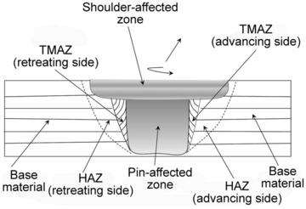
Zones affected
The tool rotation direction has similar to the tool translation direction, is known as the advancing side of the weld
The tool rotation is opposite to the tool translation direction, is known as the retreating side of the weld
Zone in contact with shoulder is shoulder effected zone and zone in contact with pin is pin- affected zone
http://products.asminternational.org/hbk/content/V06A/D03/graphics/inli ne/i0082748.jpg

Slide 7
Thermal aspects
L
The welding cycle is split in four stages during which the heat flow and thermal profile will be varied.
  Dwell: the material is preheated by a stationary, rotating tool to achieve a sufficient temperature ahead of the tool to allow the traverse. This period may also include the plunge of the tool into the work piece.
  Transient heating: when the tool begins to move there will be a transient period where the heat production and temperature around the tool will alter in a complex manner until an essentially steady-state is reached.
  Pseudo steady-state: although fluctuations in heat generation will occur the thermal field around the tool remains effectively constant, at least on the macroscopic scale.
  Post steady-state: near the end of the weld heat may "reflect" from the end of the plate leading to
Additional heating around the tool.
Heat is generated primarily from two sources
  Frictional
  Plastic deformation
Frictional component is an outcome of rotational movement of tool shoulder and pin surface and is also the primary heat source.
The frictional heat produced softens the metal which causes plastic deformation.
During pseudo-steady steady state welding both frictional and plastic deformation
Contribute to over all heat generation.

Slide 8
Heat generation
The heat generation is assumed to occur predominantly under the shoulder, due to its greater surface area, and to be equal to power required to overcome the contact forces between the tool and work piece.
The contact condition under the shoulder can be described by sliding friction, using a friction coefficient μ and interfacial pressure P, based on the interfacial shear strength at an appropriate temperature and strain rate.
The mathematical equation for total heat generated by the tool shoulder is Q_{total} have been developed from
Q1 = Heat generated at the tool shoulder,
Q2 = Heat generated at the tool pin,
Q3 = Heat generated at the tool pin tip

Slide 9
Material flow
With respect to all the thermal aspects in FSW, Plastic flow plays an important role in
heat generation.
Experiments on Material flow in FSW are categorised as
  Marker studies: A small quantity of dissolvable materials are placed in grooved along the welding path and thus the FSW tool passing displaces the markers from which the material is reconstructed
  Dissimilar welding: Materials those are differently etched are welded together, with the material flow is reconstructed by post welding etching. And also the microstructural changes after the FSW are used to understand the material movement.
The basic material flow characteristics from the above kind of experiments are
  Near the shoulder the atoms from retreating side are diffused or dragged towards the
centre weld line and deposited on advanced side
  Atoms from the line intersecting pin diffuses and deposit behind the tool through the retreating side for not more than 1 pin diameter, exception with welds of lower thickness for which the shoulder has its domination.
  Flow pattern similar to shoulder area is visible at pin bottom but at very low scale(area).
  Tool run out can vary material flow in addition to causing periodic variation in welding

Slide 10
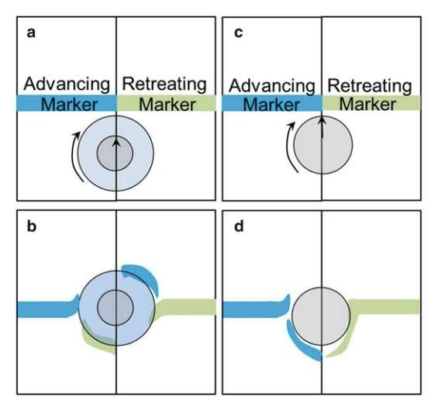
Material Flow
A schematic view of the material transport in the shoulder/work piece interface region
(a, b) and the pin/work piece interface region (c, d)
Image courtesy P.S. De, N. Kumar, J.Q. Su, and R.S. Mishra, Fundamentals of Friction Stir Welding

Slide 11
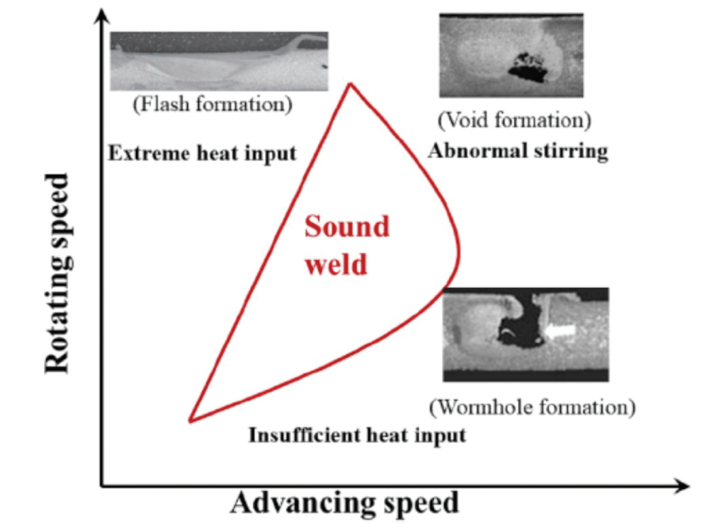
Defects
Defects mainly occur due to flow related or geometric.
There are various types pf defects which includes
  wormhole or voids: It is the tunnel of inadequately consolidated and forged material running in the longitudinal direction which is formed due to excessive heat input due to high rotational speed low transverse feed
  Lack of penetration:
  Lack of fusion:
  Surface lack of fill: due to insufficient forge pressure
  Root-flow defect :
  Nugget collapse: A unique defect which is caused high welding speed and
excessive metal flow to stir zone and excessive hot weld.
  Surface galling: sticking of material at the tip of the pin causes surface galling which is tearing of metal on top surface of weld.
  Ribbon flashing: excessive expulsion of material on the surface of welding
  Scalloping: defect in which the series of small voids located in the
advancing side interleaving the stir zone along the weld

Slide 12
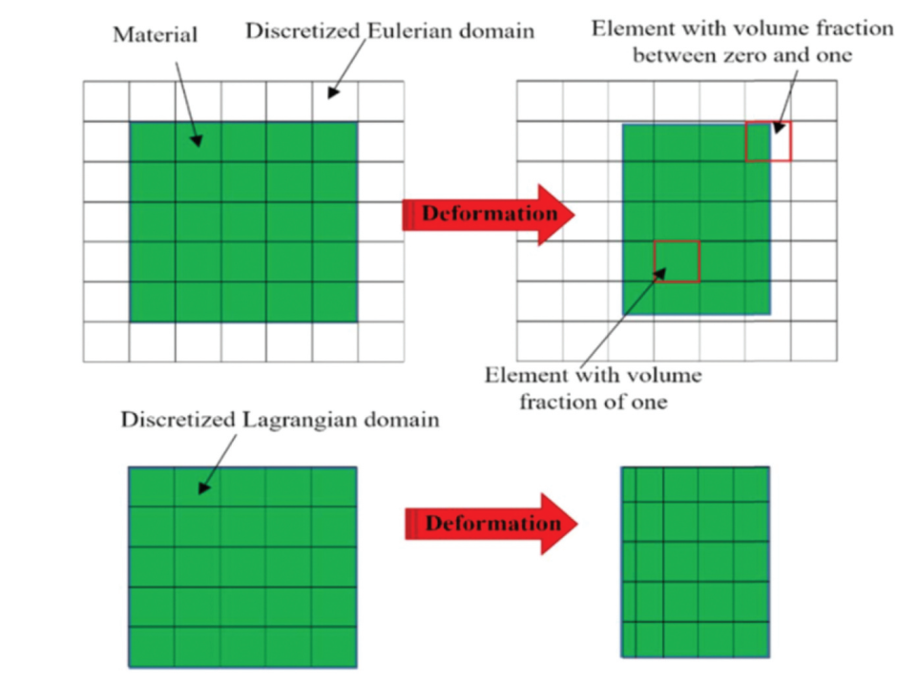
Coupled Eulerian-Lagrangian Finite Element Model

Slide 13
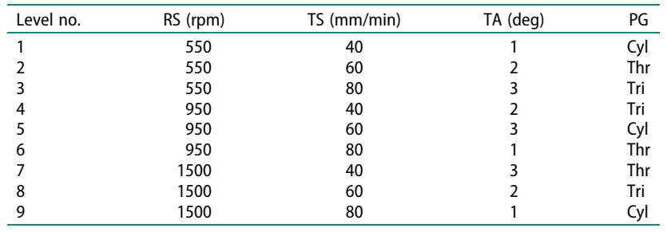
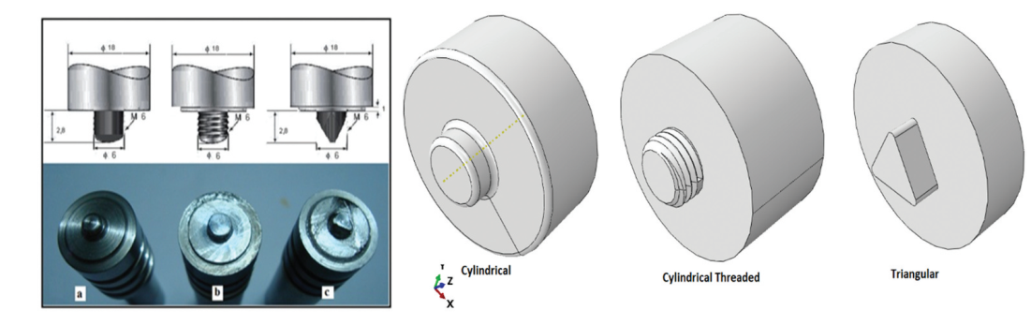
Parameters used in FSW CEL Simulation

Slide 14
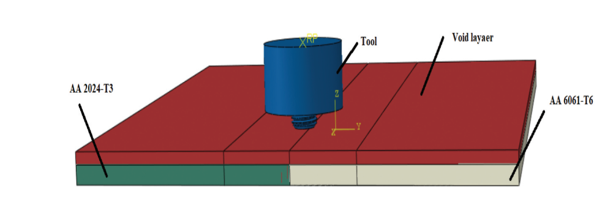
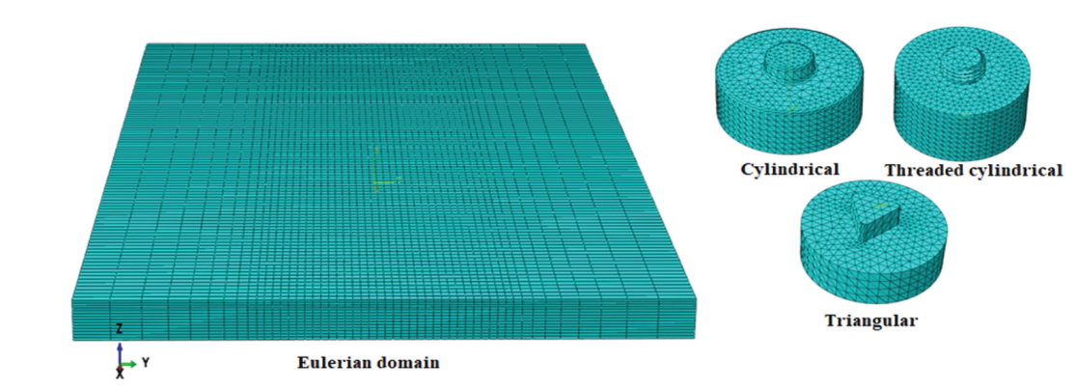
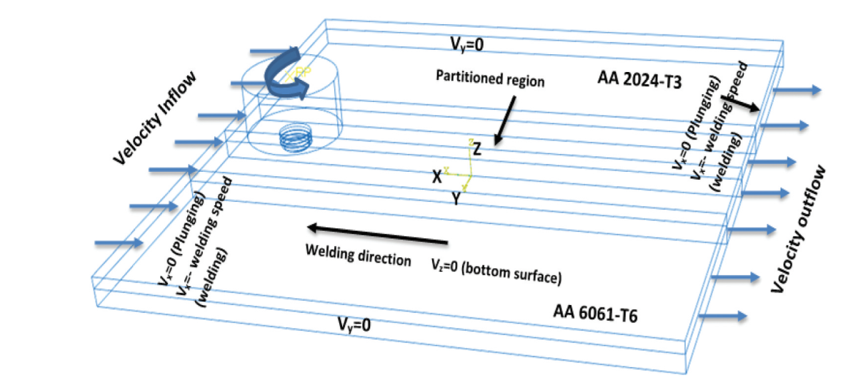

CAD+ Finite Element Model + Boundary Conditions

Slide 15
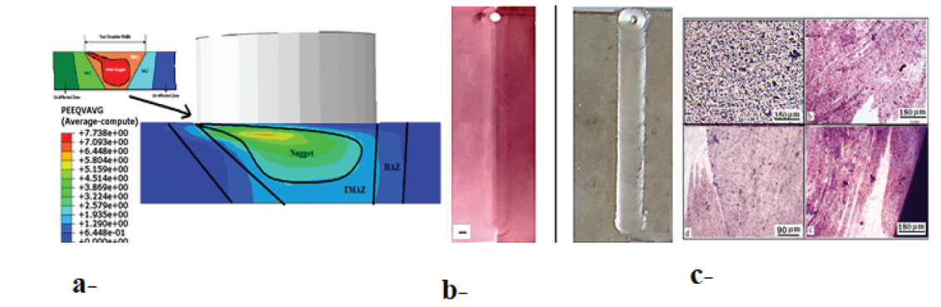
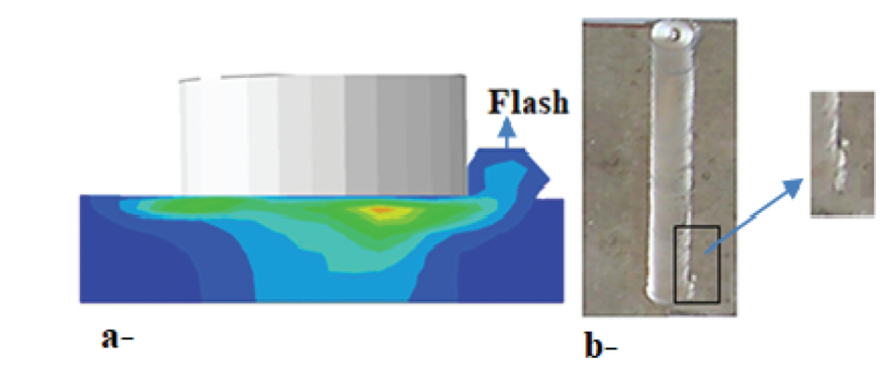
DEFECTS Capturing
Level 1 Void Capturing

Slide 16
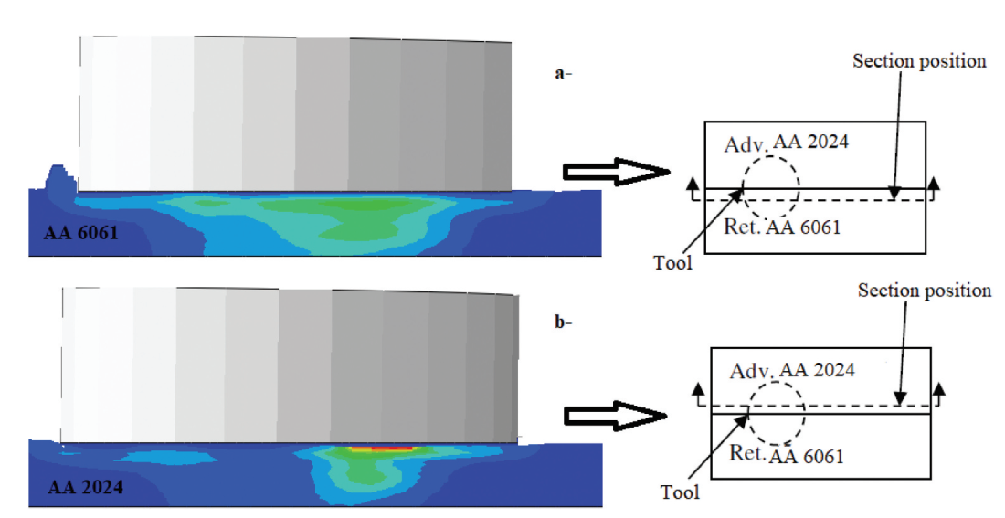

Slide 17
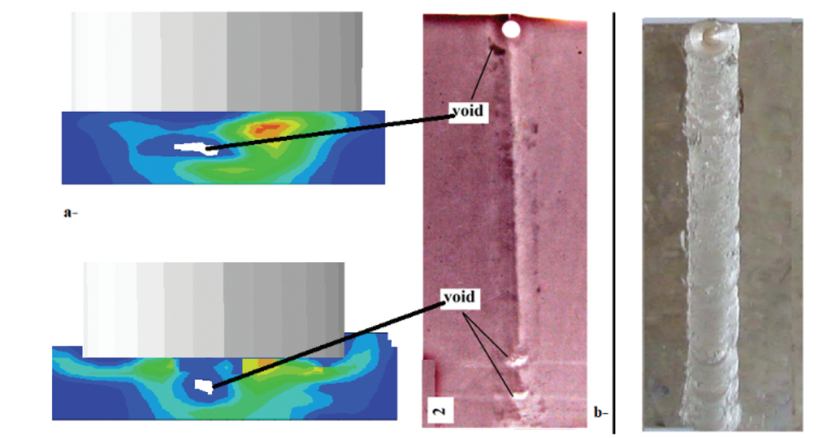
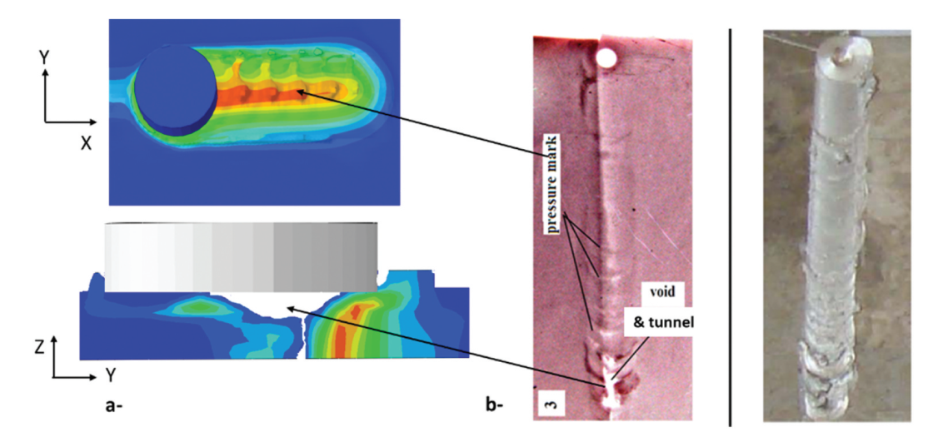
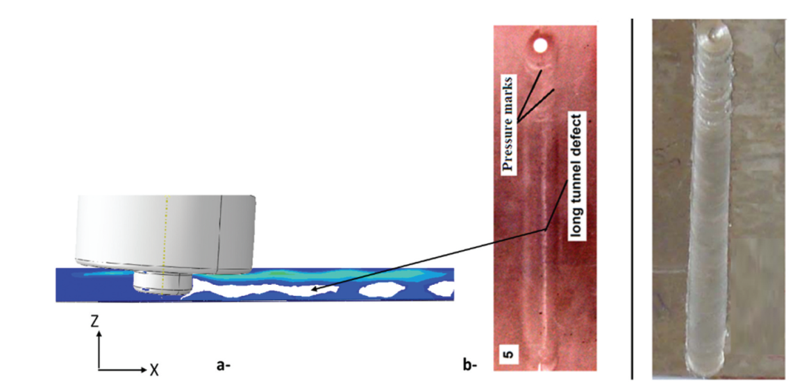
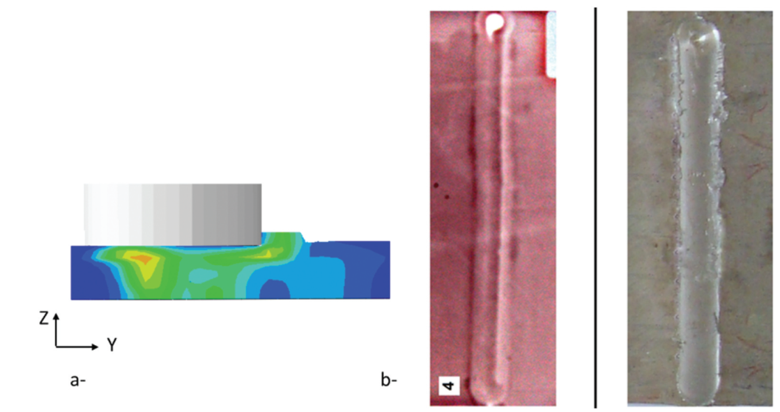
Level 2 Void Capturing
Level 3 Void Capturing
Level 4 Void Capturing
Level 5 Void Capturing

Slide 18
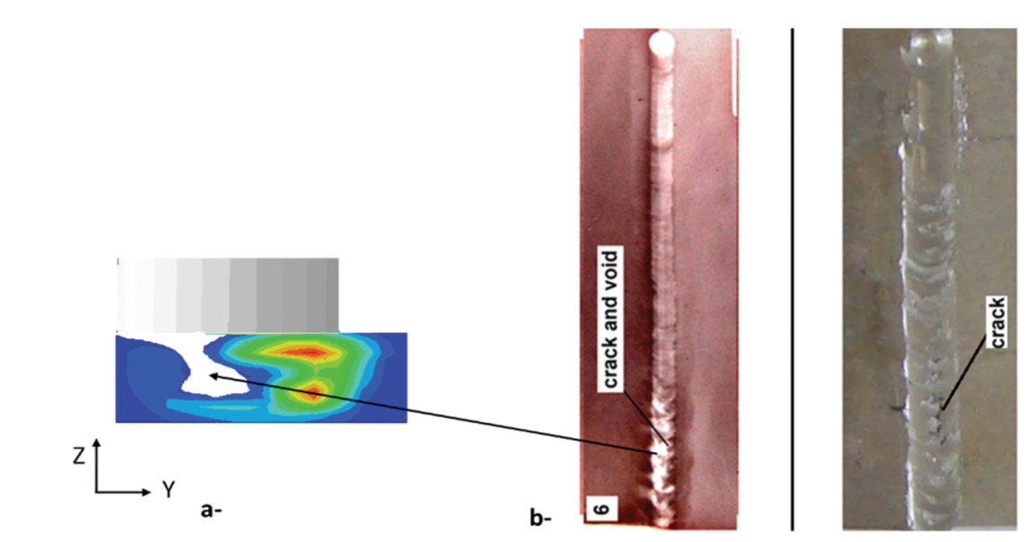
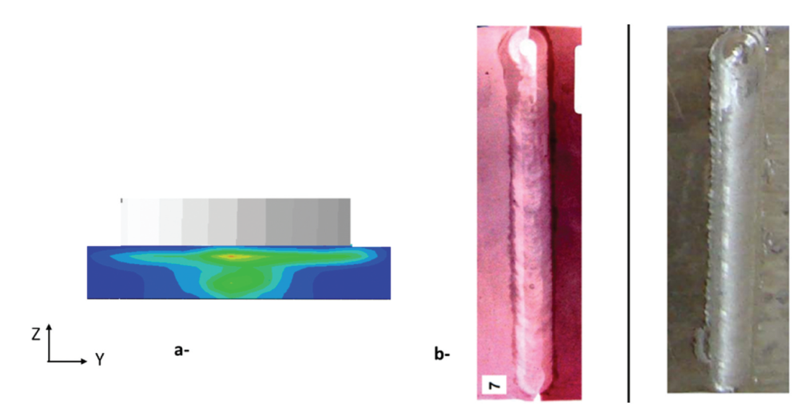
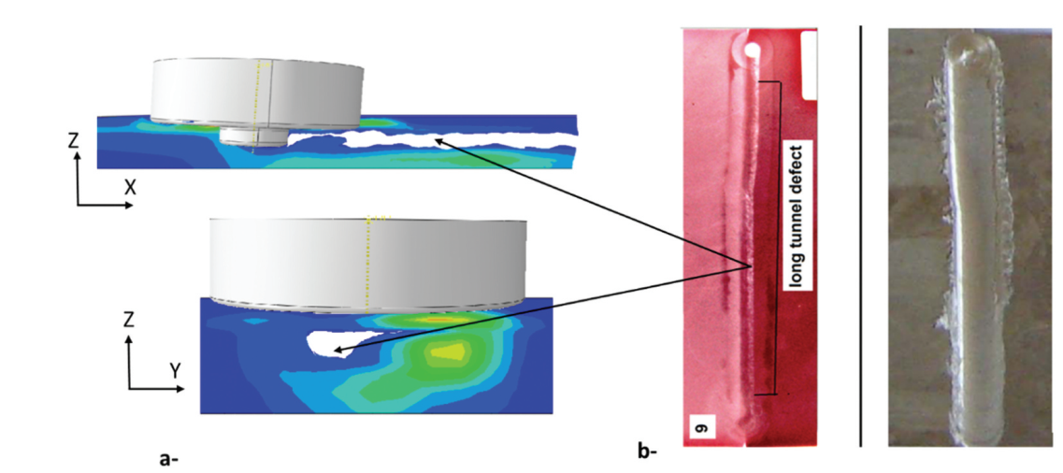
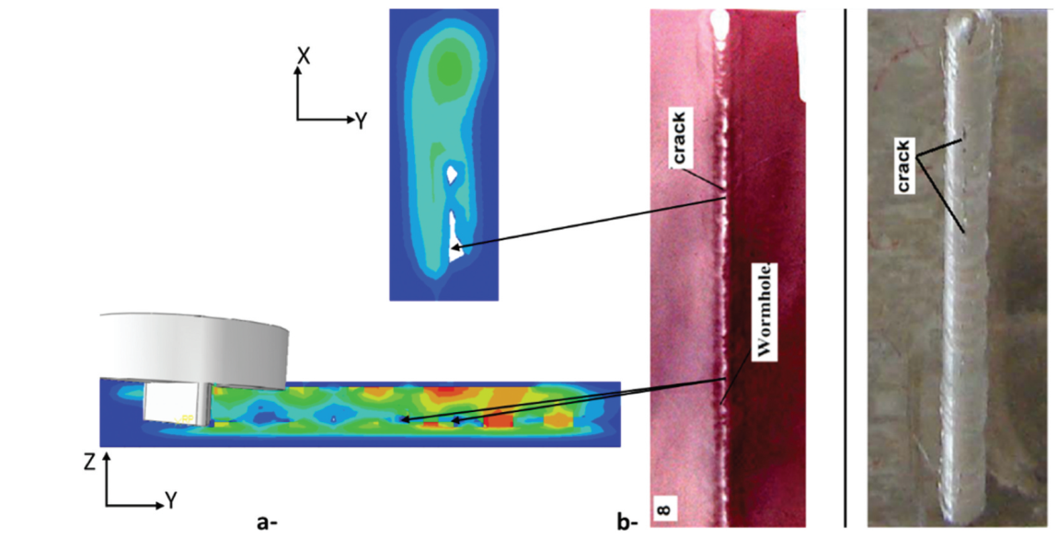
Level 6 Void Capturing
Level 7 Void Capturing
Level 8 Void Capturing
Level 9 Void Capturing

Slide 19
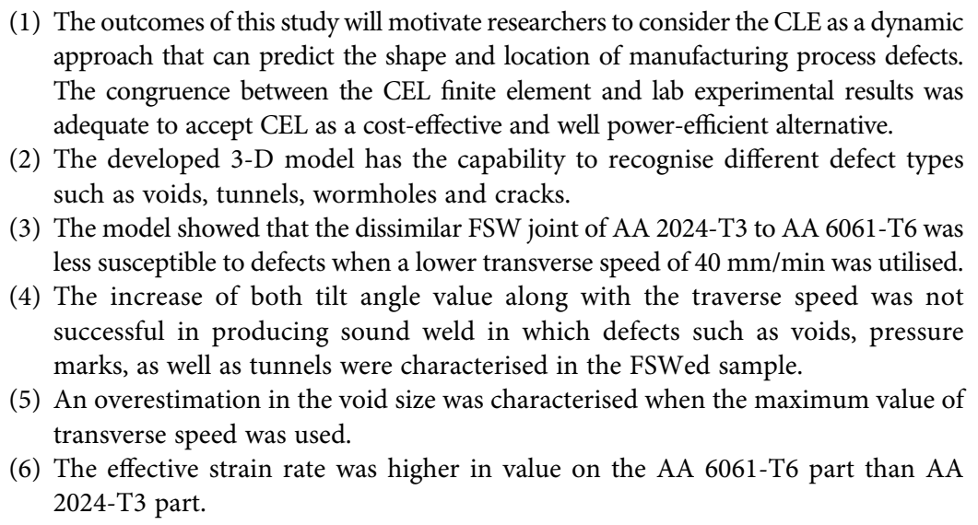
Conclusion

Slide 20
REFERENCES
IMAGE COURTESY: HTTP://SEMINARLINKS.BLOGSPOT.FI/2014/04/FRICTION-STIR-WELDING-FSW- SEMINAR.HTML
IMAGE COURTESY : HTTP://GIPHY.COM/SEARCH/WELDING?SORT=RECENT
IMAGE COURTESY : HTTP://WWW.PICGIFS.COM/JOB-GRAPHICS/WELDER/
HTTPS://WWW.YOUTUBE.COM/WATCH?V=ANBQH8XBGXQ
HTTP://EN.WIKIPEDIA.ORG/WIKI/FRICTION_STIR_WELDING
HTTP://EN.WIKIPEDIA.ORG/WIKI/FRICTION_WELDING
P.S. DE, N. KUMAR, J.Q. SU, AND R.S. MISHRA, FUNDAMENTALS OF FRICTION STIR WELDING,
R.S. MISHRA, Z.Y. MA / MATERIALS SCIENCE AND ENGINEERING R 50 (2005) 1–78
ASM HANDBOOK ONLINE VOLUME 6A
Salloomi KN, Shammari A, and Ahmed SH. Evaluation of FSW process parameters of dissimilar
aluminium alloys. Innovative Systems Design and Engineering. 2017;7(January 2016):55–69.
.
Kareem N. Salloomi (2022): Defect monitoring in dissimilar friction stir welding of aluminum alloys using Coupled Eulerian-Lagrangian (CEL) finite element model, Advances in Materials and Processing Technologies, DOI: 10.1080/2374068X.2022.2106669

