Slide 1
LASER and Applications
Assistant Teacher. Ali. M. khudair,

Slide 2
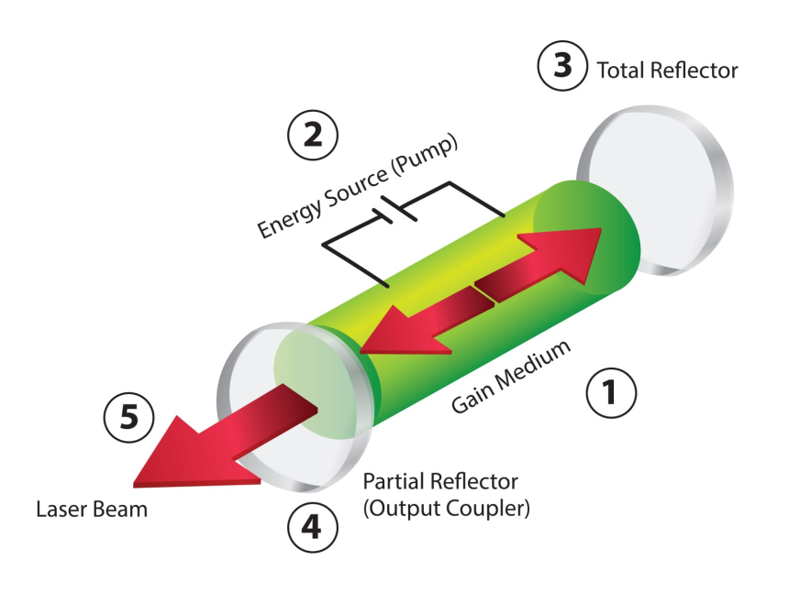

LASER
A laser is a device that emits light through a process of optical amplification based on the stimulated emission of electromagnetic radiation.
LASER: light amplification by stimulated emission of radiation

Slide 3
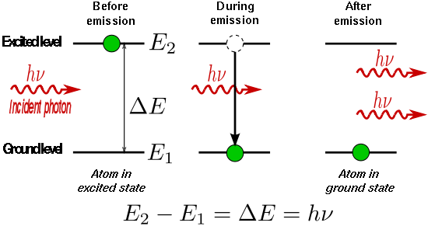
Principle of Emission of Radiations

Slide 4
Difference between
Spontaneous and Stimulated Emission
Spontaneous emission: Electron drops from an excited state to a lower state (no outside mechanism) - emitting a photon.
Stimulated emission (lasers): Stimulated emission is the process by which an atomic electron (or an excited molecular state) interacting with an electromagnetic wave of a certain frequency may drop to a lower energy level, transferring its energy to that field. A new photon created in this manner has the same phase, frequency, polarization, and direction of travel as the photons of the incident wave.
This is in contrast to spontaneous emission which occurs without regard to the ambient electromagnetic field.

Slide 5
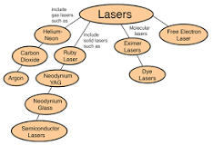
Types of LASER
Lasers are classified into 4 types based on the type of laser medium used:
  Solid-state laser
  Gas laser
  Liquid laser
  Semiconductor laser

Slide 6
Applications of LASER
Thousands of highly varied applications in every section of modern society,
  including consumer electronics, information technology, science, medicine, industry, law enforcement, entertainment, and the military.
The first use of lasers in the daily lives of the general population was the supermarket barcode scanner
The compact disc player was the first laser-equipped device
Communications: Lasers are used for free-space optical communication,
  including laser communication in space

Slide 7
Applications of LASER
Industry: cutting, welding, material heat treatment, marking parts, non-contact measurement of parts.
Military: marking targets, guiding munitions, missile defense, electro-optical counter measures (EOCM), lidar, blinding troops.
Law enforcement: LIDAR traffic enforcement. Lasers are used for latent fingerprint detection in the forensic identification field[64][65]
Research: spectroscopy, laser ablation, laser annealing, laser scattering, laser interferometry, lidar, laser capture microdissection, fluorescence microscopy, metrology.
Commercial products: laser printers, barcode scanners, thermometers, laser pointers, holograms, bubblegrams.
Entertainment: optical discs, laser lighting displays

Slide 8

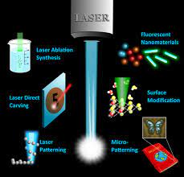

Slide 9
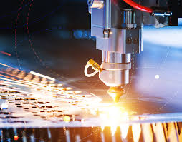

Slide 10
References
Gould, R. Gordon (1959). "The LASER, Light Amplification by Stimulated Emission of Radiation". In Franken, P.A.; Sands R.H. (Eds.). The Ann Arbor Conference on Optical Pumping, the University of Michigan, 15 June through 18 June 1959. p. 128. OCLC 02460155.
"laser". Reference.com. Retrieved May 15, 2008.
"Four Lasers Over Paranal". www.eso.org. European Southern Observatory. Retrieved 9 May 2016.
Conceptual physics, Paul Hewitt, 2002
"Schawlow and Townes invent the laser". Lucent Technologies. 1998. Archived from the original on October 17, 2006. Retrieved October 24, 2006.
Chu, Steven; Townes, Charles (2003). "Arthur Schawlow". In Edward P. Lazear (ed.),. Biographical Memoirs. vol. 83. National Academy of Sciences. p. 202. ISBN 0-309-08699-X.
"lase". Dictionary.reference.com. Retrieved December 10, 2011.

