Slide 1
Various Implemented Applications of Mechatronics
Assist. Prof. Dr. Yarub Alazzawi
Al-Khwarizmi College of Engineering/ Mechatronics Engineering Dep.
https://scholar.google.com/citations?user=NhwcogoAAAAJ&hl=en

Slide 2
Outline:
Proj-1: Self-Capacitance based Wireless Power Transfer for Wearable Electronics
Proj-2: A compact and energy-efficient ultrasound receiver using PTAT reference circuit
Proj-3: Multi-access In-vivo Biotelemetry using Sonomicrometry and M-scan Ultrasound
Imaging
Proj-4: Feasibility of Self-powering and Energy Harvesting using Cardiac Valvular
Perturbations
Proj-5: Design of CMOS telemetry circuits for in-vivo wireless sonomicrometry
Proj-6: Self-powered system-on-chip for substrate computing and ultrasonic
communications
Proj-7: Feasibility of non-contact ultrasound generation using implanted metallic surfaces
as electromagnetic acoustic transducers
Proj-8: Detection of Ventricular Catheter Occlusion by Monitoring the Intracranial Pressure
(ICP) using PVDF Piezoelectric Sensor
Proj-9: Ultrasound Harmonic Bio-sensing Using Floating-Gate PMOS Transistor
Proj-10: Bomb-sniffing locusts
Proj-11: Electronic tooth for wireless diabetes detection through saliva
Proj-12: AuNP Core-Shell Nanostructure for quantum-based biosensing
Proj-13: Contactless ultrasound communication and energy delivery for implantable devices
Proj-14: Smart mouthguard for pilot’s spin shrink estimation

Slide 3

Proj-1:Self-Capacitance based Wireless Power Transfer for Wearable Electronics:
Theory and Implementation
Yarub alazzawi et.al, IEEE TBIOCAS 2019.
Yarub Alazzawi
PhD Thesis Defense
Advisor: Prof. Shantanu Chakrabartty
Adaptive Integrated Microsystems Laboratory (http://aimlab.seas.wustl.edu/)

Slide 4
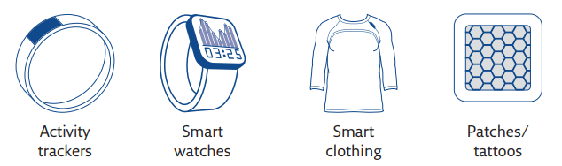

Motivation: Wearables
Remote monitoring of wearable electronic devices
Internet
Hearing aid
Heart rate,
Respiratory rate
Gateway
Insulin pump
Smartwatch,
Fitbit
Activity tracker
Smart shoes
Wearable biomedical sensor
Andrea Aliverti,
Breathe 2017

Slide 5
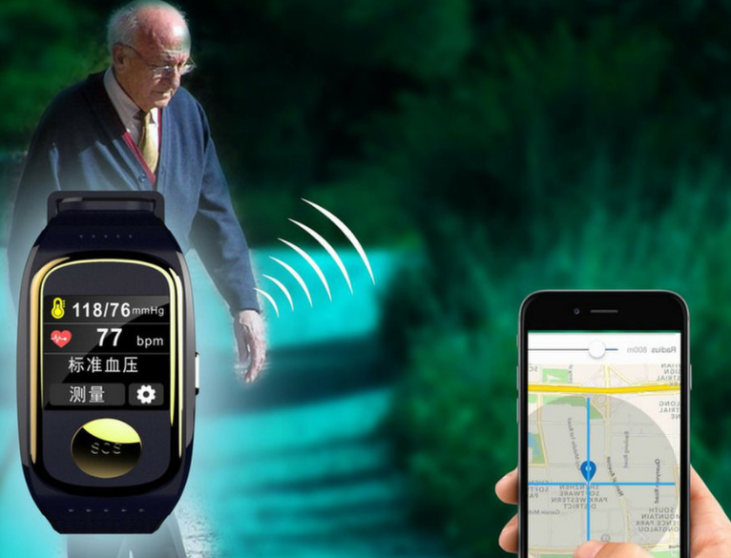
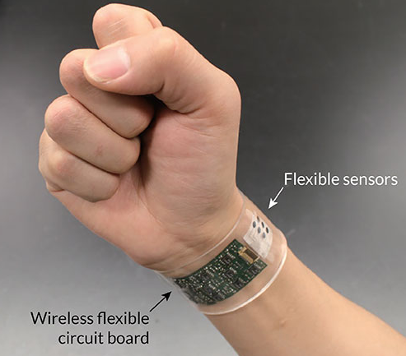
Motivation & Background
Wireless human health monitoring
Tracking health wearable electronics
https://classifieds.justlanded.com/2018
Meghan Rosen,
Science News 2016
All these wearable and implantable electronics require energy source to be functional.

Slide 6
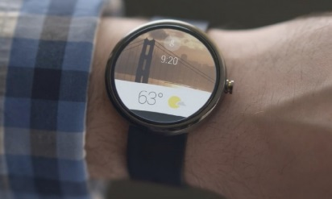
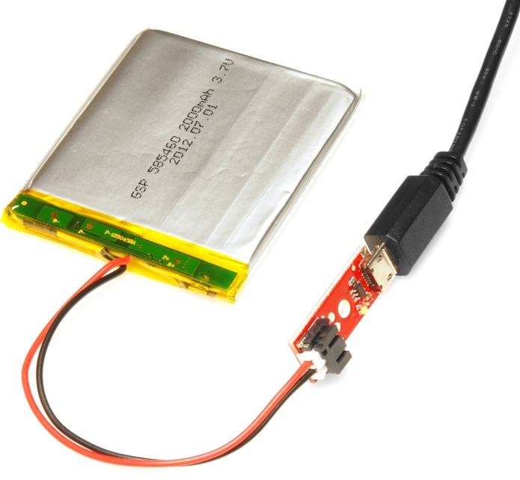
Challenge: Powering
Battery: Requires periodic charging
ROBIN WYLIE
arstechnica.com 2015
Energy capacity is limited by volume of the battery.
determines the size and weight of the wearable.

Slide 7
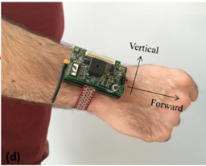
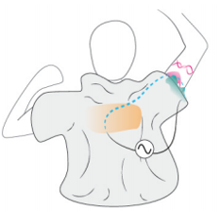
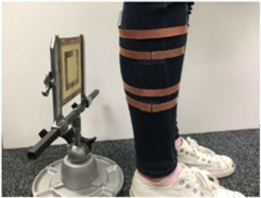
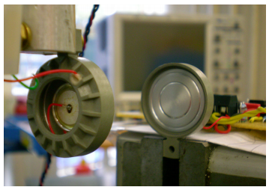



Solution: Wireless Power Transfer (WPT)
Wireless Power Transfer
modalities
Radio Frequency (RF)
Capacitive coupling
Induction
(Ind)
Ultrasound
(US)
Salar Chamanian, et al., Sensors and Actuators 2016
Wang, Edward J., et al. International Symposium on Wearable Computers. ACM, 2018.
Liu, Daerhan, et al., IEEE
TOPE (2018).
Roes, M. G. L., et al, Electronics Society. IEEE, 2011.
$$10\%$$
$$70\%$$
$$20\%$$
Some of these are remotely delivered, others are locally.

Slide 8
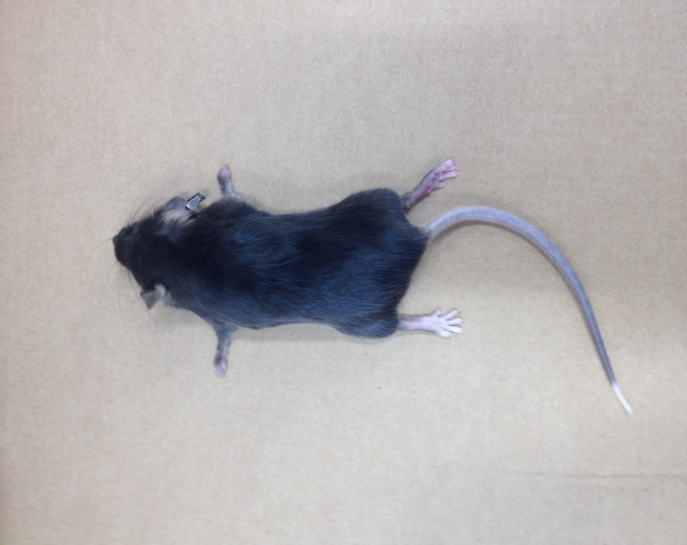




























Self Capacitance-based WPT
Yarub alazzawi et.al, IEEE TBIOCAS 2019.
Energy
Harvester
(Receiver)
$$C_{b4}$$
$$C_{s}=2πεr_{h}$$
$$C_{b3}$$
$$r_{h}$$
$$C_{b5}$$
Mouse
cadaver
$$R_{L}$$
arm
$$r_{a}$$
$$h_{to}$$
Energy
harvester
$$R_{L}$$
$$h_{a}$$
$$r_{to}$$
Floating
electrode
$$C_{p}$$
$$C_{s}$$
$$h_{l}$$
torso
$$C_{c}$$
leg
Power
source
$$C_{b2}$$
$$r_{l}$$
$$C_{b6}$$
External ground
tail
$$C_{c}$$
$$r_{t}$$
$$h_{t}$$
Power
source
$$R_{s}$$
$$C_{c}$$
$$P_{s}$$
$$C_{p}$$
External ground
$$C_{b}$$
$$R_{L}$$
$$C_{b1}$$
$$C_{s}$$

Slide 9
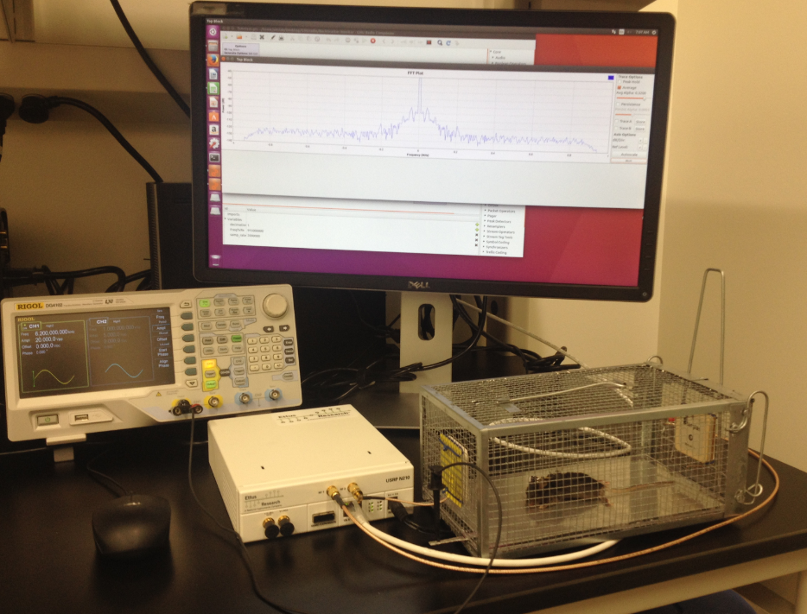
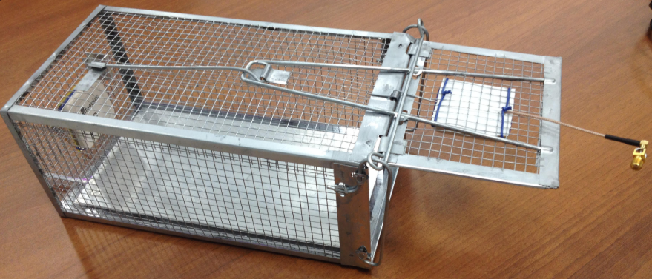


Experimental setup
Yarub alazzawi et.al, IEEE TBIOCAS 2019.
Power
Source
Data
Monitoring
Antenna-1
Antenna-2
Capacitive coupling setup
Mouse Cadaver
$$T_{X}$$
$$R_{X}$$
Power
Source
Plexiglas
Aluminum
RF
Transceiver
Plexiglas
Diagnostic Cage

Slide 10
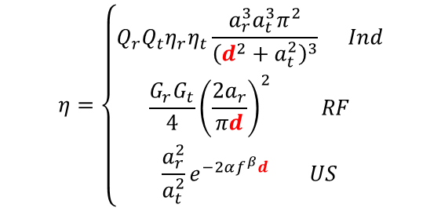

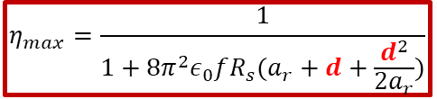
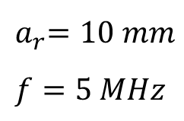

PTE comparison
SC maximum efficiency degrades more gracefully with respect to $(d)$
$$η=\left\{\begin{aligned}Q_{r}Q_{t}η_{r}η_{t}\frac{a_{r}^{3}a_{t}^{3}π^{2}}{{\left(d^{2}+a_{t}^{2}\right)}^{3}} Ind \\ \frac{G_{r}G_{t}}{4}{\left(\frac{2a_{r}}{πd}\right)}^{2} RF \\ \frac{a_{r}^{2}}{a_{t}^{2}}e^{−2αf^{β}d} US\end{aligned}\right.$$
Self-capacitance (SC)
$$η_{max}=\frac{1}{1+8π^{2}ε_{0}fR_{s}(a_{r}+d+\frac{d^{2}}{2a_{r}})}$$
1
${ a}_{r}=10 mm$
$f=5 MHz$
$$d$$
$$R_{L}≈\frac{1}{8π^{2}ε_{0}fa_{r}}$$
SC-based WPT demonstrates a superior PTE compared to the other WPT techniques

Slide 11

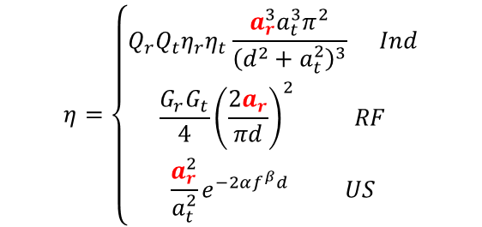








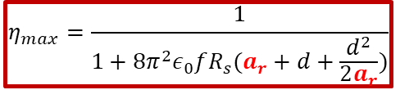
PTE comparison
Maximum Efficiency for SC close to 100% even with millimeter size harvester form-factor ${(a}_{r})$
$$η=\left\{\begin{aligned}Q_{r}Q_{t}η_{r}η_{t}\frac{a_{r}^{3}a_{t}^{3}π^{2}}{{\left(d^{2}+a_{t}^{2}\right)}^{3}} Ind \\ \frac{G_{r}G_{t}}{4}{\left(\frac{2a_{r}}{πd}\right)}^{2} RF \\ \frac{a_{r}^{2}}{a_{t}^{2}}e^{−2αf^{β}d} US\end{aligned}\right.$$
$${10}^{2}$$
$${10}^{0}$$
efficiency (%)
$${10}^{−2}$$
$${10}^{−4}$$
Self-capacitance (SC)
$$η_{max}=\frac{1}{1+8π^{2}ε_{0}fR_{s}(a_{r}+d+\frac{d^{2}}{2a_{r}})}$$
$${10}^{−6}$$
$d=0.1 m$
$f=5 MHz$
$$a_{r}$$
SC-based WPT demonstrates a superior PTE compared to the other WPT techniques,
SC-based WPT does not require any frequency adjustment when the transducer size or alignment changes.
$$R_{L}=\frac{1}{8π^{2}ε_{0}fa_{r}}$$

Slide 12





SC-WPB for multiple wearable devices
smart home
Yarub alazzawi et.al, IEEE IOT 2020,
Wearable
device
Induction
Ultrasound
Self capacitance
Tx coil
Tx piezo
Different modalities of wireless power broadcasting (WPB)
Power
Source

Slide 13
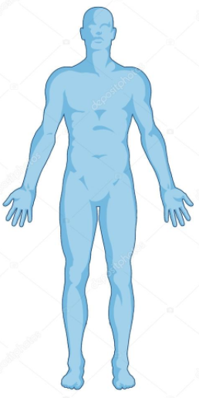





































Equivalent circuit model for SC-WPB
$$C_{Cn}$$
$$I_{n}$$
Body
n
$$C_{bn4}$$
$$R_{Ln}$$
$$C_{bn5}$$
$$C_{bn3}$$
$$r_{h}$$
arm
Fringe fields
$$r_{a}$$
$$r_{to}$$
$$h_{to}$$
$$R_{Ln}$$
$$C_{bn2}$$
$$h_{a}$$
torso
Power
source
$$C_{sn}$$
$$C_{C3}$$
$$I_{3}$$
Body
3
$$I_{n}$$
$$C_{Cn}$$
leg
$$h_{l}$$
External
ground
$$r_{l}$$
$$I=\sum_{1}^{n}{I_{n}}$$
External ground
$$C_{bn1}$$
$$C_{bn6}$$
$$C_{C2}$$
$$I_{2}$$
Body
2
$$R_{s}$$
$$I$$
$$C_{C1}$$
$$I_{1}$$
$$C_{C2}$$
$$I_{2}$$
$$C_{C3}$$
$$I_{3}$$
$$C_{Cn}$$
$$I_{n}$$
Displacement
current
$$V_{s}$$
$$I$$
$$C_{C1}$$
$$I_{1}$$
Body
1
$$C_{b1}$$
$$R_{L1}$$
$$V_{o1}$$
$$R_{L3}$$
$$V_{o2}$$
$$R_{L3}$$
$$V_{o3}$$
$$R_{Ln}$$
$$V_{on}$$
$$C_{b2}$$
$$C_{b3}$$
$$C_{bn}$$
Power
Source
$$C_{s1}$$
$$C_{s2}$$
$$C_{s3}$$
$$C_{sn}$$
$$V_{s}$$
Multiple objects (e.g. human bodies) complicate equivalent circuit model

Slide 14

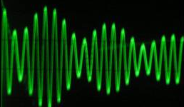
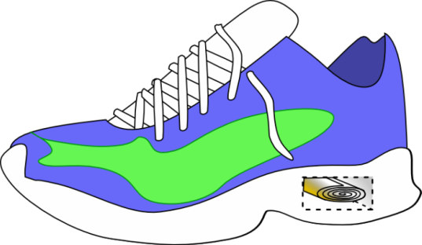
Ongoing work: SC-WPT for energy harvesters
Battery-less electronics
Electric charge propagation
Shoe power source
Wireless Charging from shoe power generator for self-powering

Slide 15
Proj-2: A compact and energy-efficient ultrasound receiver using PTAT reference circuit
Yarub alazzawi et.al,
ELSEVIER Microelectronics 2019.
Conventional
sensing system
Use reference as sensor frontend.
Preamplification and rectification units are removed.

Slide 16
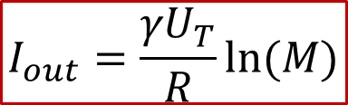
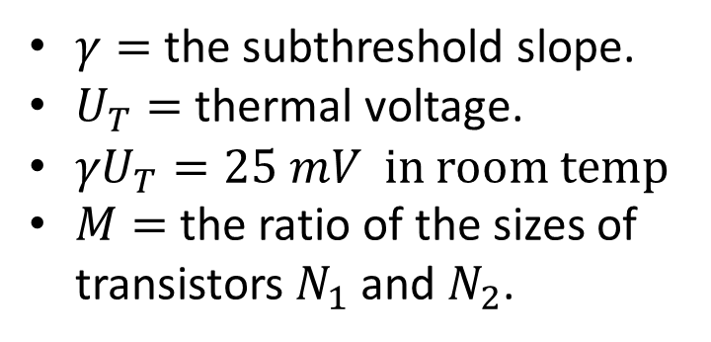
PTAT: Reference Circuit
PTAT: Proportional To Absolute Temperature
Yarub alazzawi et.al,
ELSEVIER Microelectronics 2019.
$$I_{out}=\frac{{γU}_{T}}{R}ln⁡(M)$$
$γ=$the subthreshold slope.
$U_{T}=$ thermal voltage.
${γU}_{T}=25 mV$ in room temp
$M=$ the ratio of the sizes of transistors $N_{1}$ and $N_{2}$.
PTAT resistance (R) can be used as an input port.

Slide 17



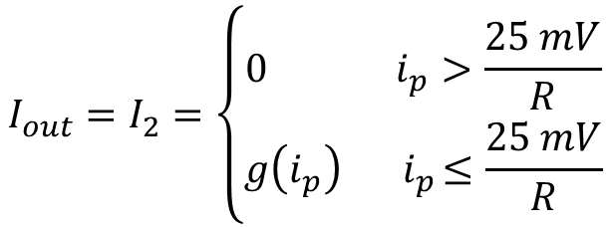
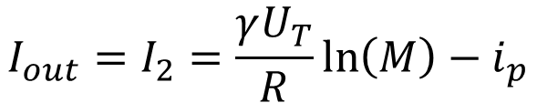
PTAT Current Sensing/Rectification
Yarub alazzawi et.al,
ELSEVIER Microelectronics 2019.
sub-threshold biasing:
$$I_{out}=I_{2}=\frac{γU_{T}}{R}\ln\left(M\right)−i_{p}$$
Rectifier equation:
$$I_{out}=I_{2}=\left\{\begin{aligned}0 { i}_{p}>\frac{25 mV}{R} \\ g\left(i_{p}\right){ i}_{p}≤\frac{25 mV}{R}\end{aligned}\right.$$
$$i_{p}$$

Slide 18
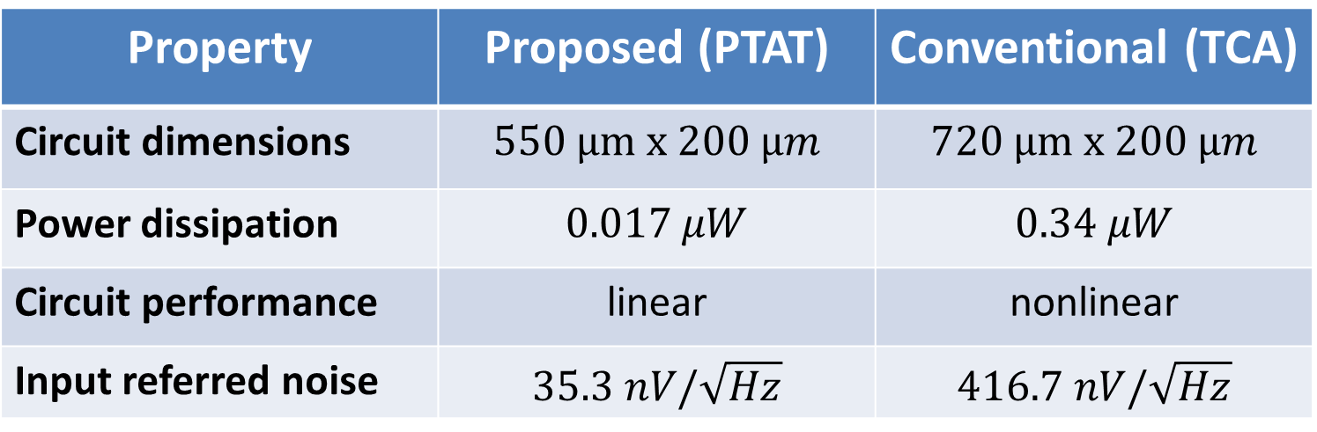
Comparison with a conventional frontend
Yarub alazzawi et.al,
ELSEVIER Microelectronics 2019.
Property | Proposed (PTAT) | Conventional (TCA)
Circuit dimensions | $$550 μm x 200 μm$$ | $$720 μm x 200 μm$$
Power dissipation | $$0.017 μW$$ | $$0.34 μW$$
Circuit performance | linear | nonlinear
Input referred noise | $$35.3 nV/\sqrt{Hz}$$ | $$416.7 nV/\sqrt{Hz}$$
For the same sensitivity, TCA is more noisy and consumes more power, in addition to its nonlinearity and bigger size.

Slide 19
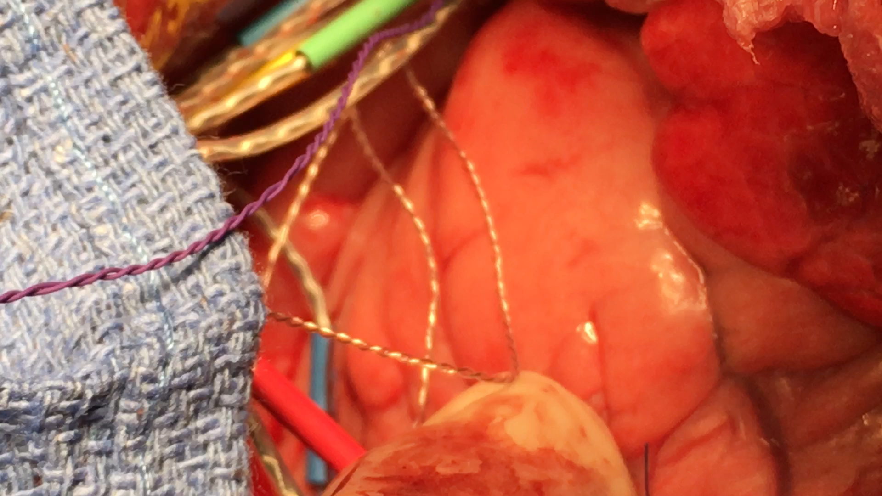
Proj-3: Multi-access In-vivo Biotelemetry using Sonomicrometry and M-scan Ultrasound Imaging
Yarub alazzawi et.al, IEEE TBME 2017.

Slide 20
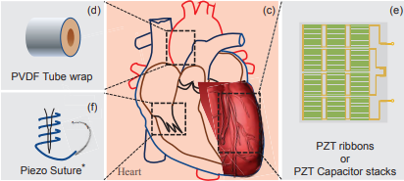
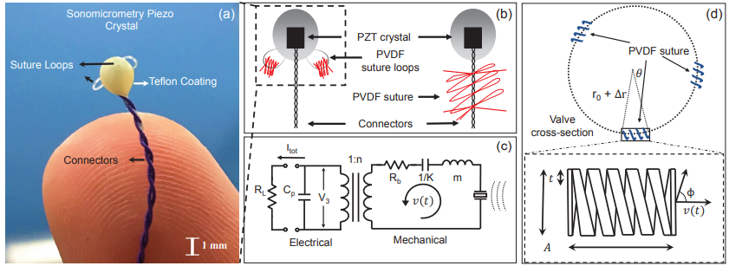
Proj-4: Feasibility of Self-powering and Energy Harvesting using
Cardiac Valvular Perturbations
Yarub alazzawi et.al, IEEE TBioCAS 2018.

Slide 21
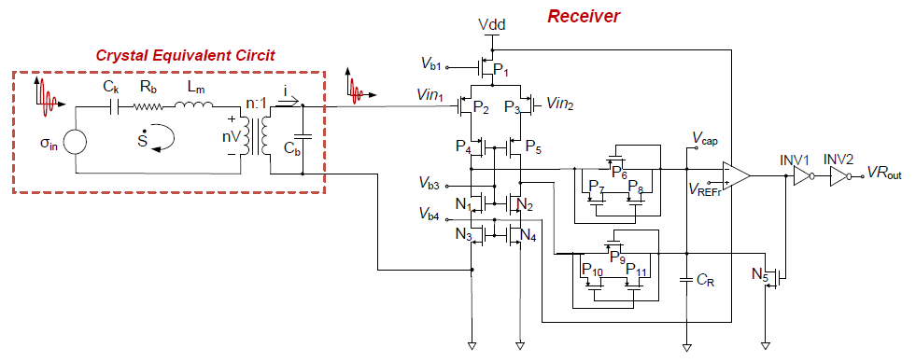
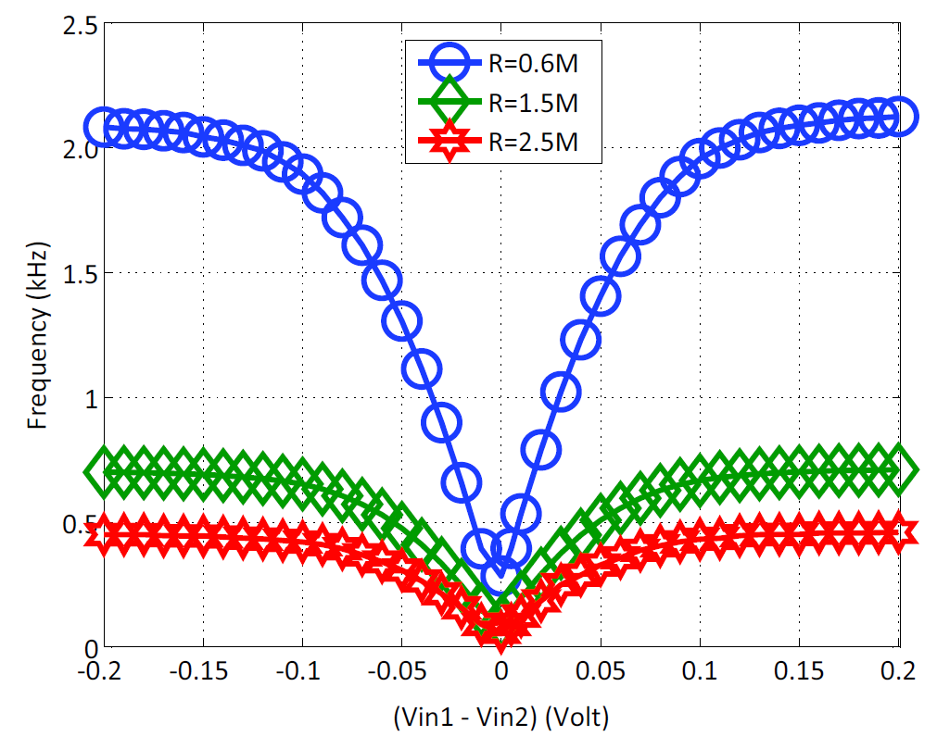
Proj-5: Design of CMOS telemetry circuits for in-vivo wireless sonomicrometry
The receiver is also designed using a pulse modulator which is configured to measure the energy of the ultrasonic pings received by the crystal.
Yarub alazzawi et.al, IEEE ISCAS 2016.
The frequency of the generated pulses is proportional to the received energy and could be used to detect a received pulse.
Measured pulse-rates for different values of the input voltages and different values of the reference resistor (R).

Slide 22
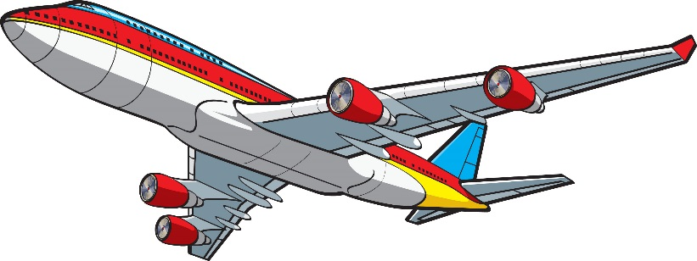
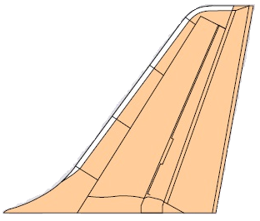
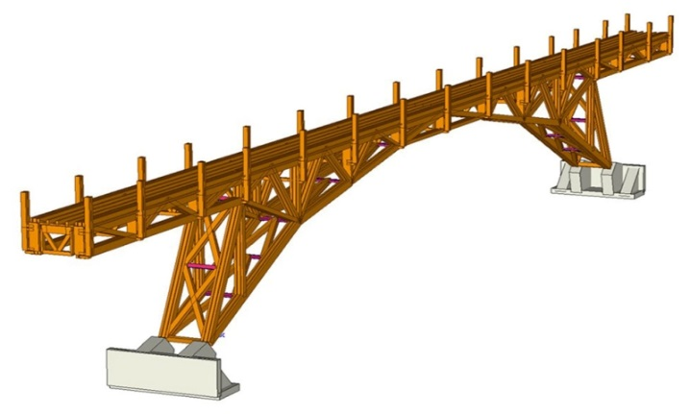

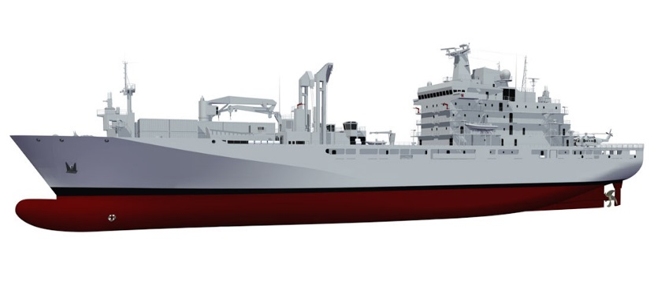
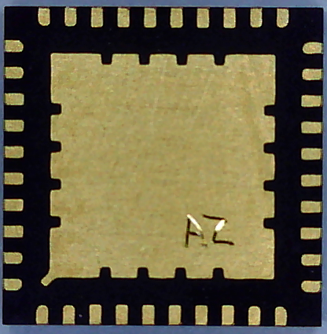
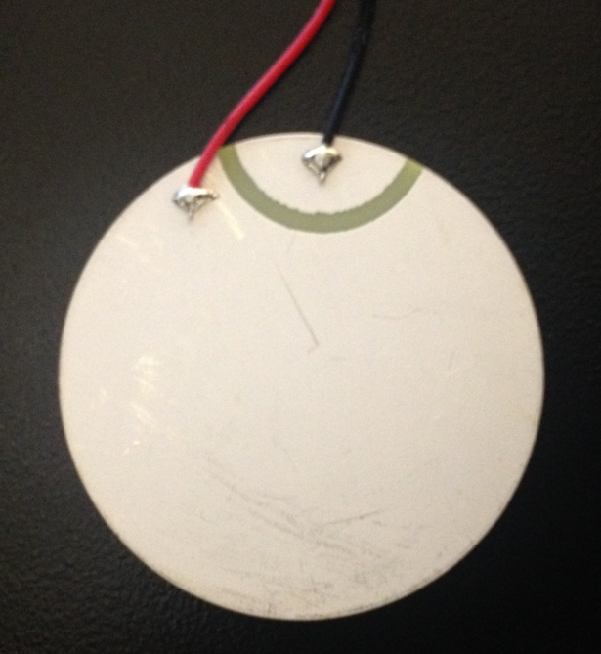
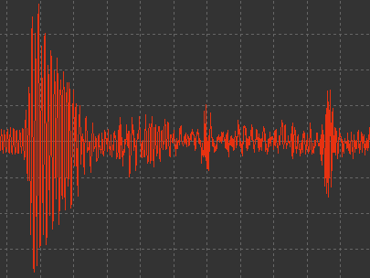
Proj-6: Self-powered system-on-chip for substrate
computing and ultrasonic communications
Yarub alazzawi et.al, IEEE MWCAS 2017.
smart structures
Smart Substrate Plate SSP
Structure health monitoring
SSP
Self-contained energy harvester
US Substrate Pulse Link
Central computer
Wireless sensor
Bi-direction communication
Sensor node
Low-power embedded hardware
Wireless signal
Microchip
Piezo

Slide 23
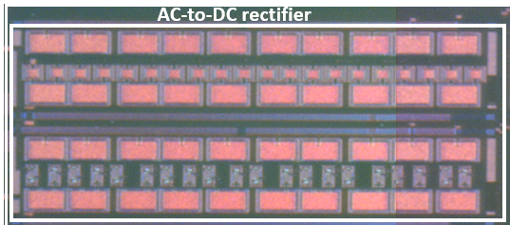
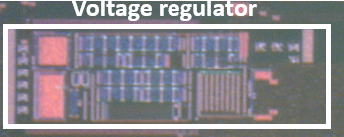
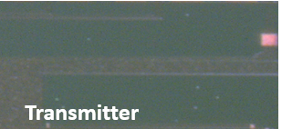
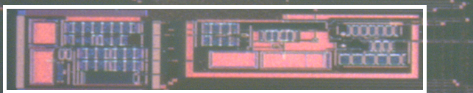
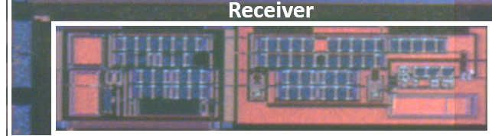
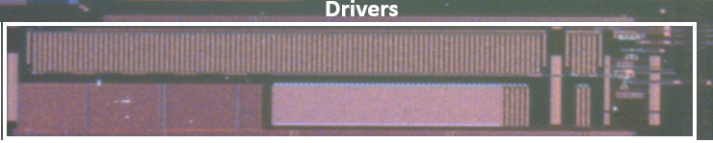


Transceiver circuit implementation
PZT
Voltage
Multiplier
Voltage
Regulator
$${1000}_{μm}$$
$${475}_{μm}$$
PZT
Receiver
Transmitter
PZT

Slide 24
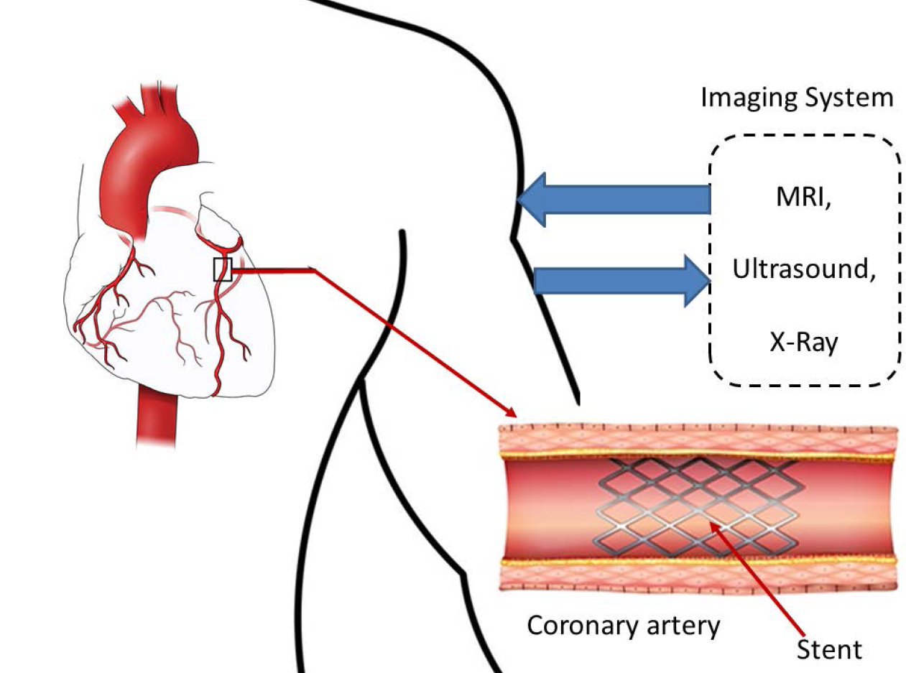
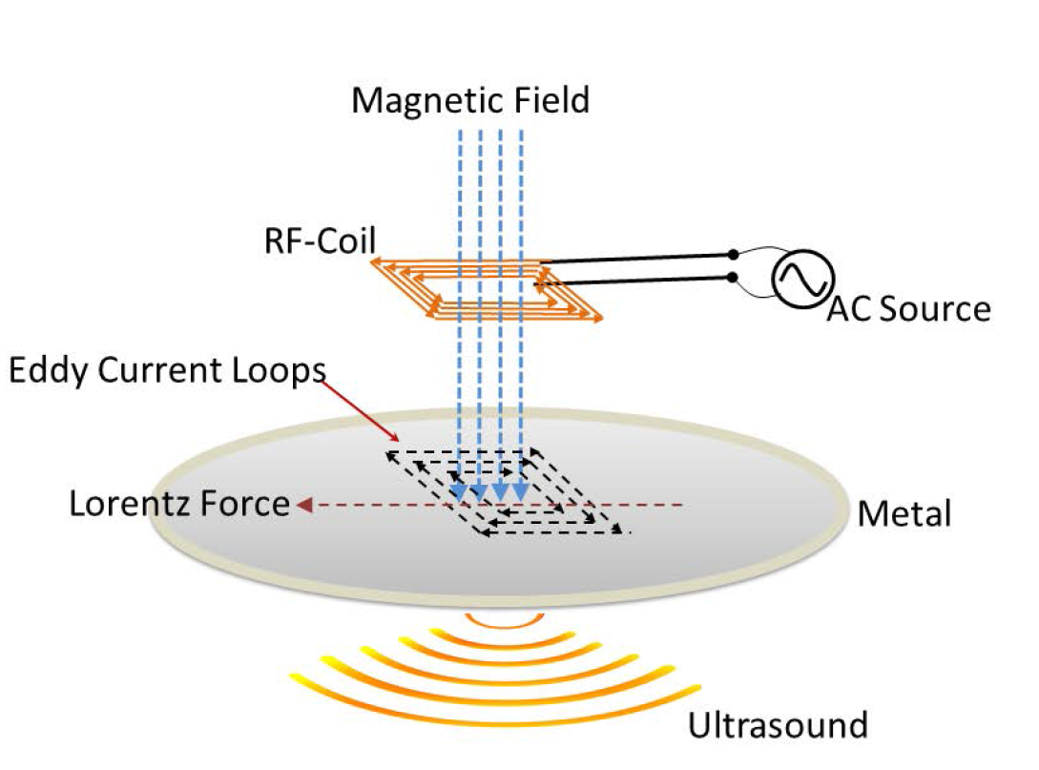
Proj-7: Feasibility of non-contact ultrasound generation using implanted metallic surfaces as electromagnetic acoustic transducers
Yarub alazzawi et.al, IEEE BioCAS 2015.
we investigate the feasibility of using an in-vivo metallic implant like a stent for the generation of acoustic waves which can then be used for imaging areas inside or near the surface of the implant.

Slide 25
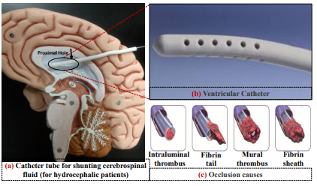
Proj-8: Detection of Ventricular Catheter Occlusion by Monitoring the Intracranial Pressure (ICP) using PVDF Piezoelectric Sensor
there is no published work or data about detecting the occlusion or the amount of it, and the discomfort of the patient is usually the sign doctors rely on to do the cleaning process

Slide 26
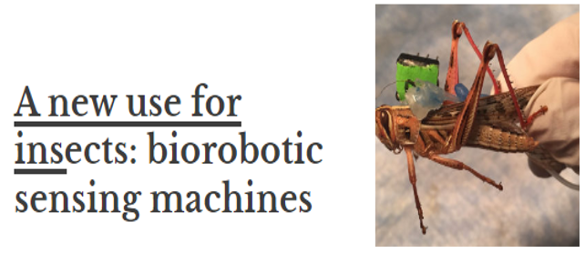
Proj-10: Bomb-sniffing locusts
The signals in the bugs’ brains reflected those differences in vapor concentration

Slide 27



Proj-11: Electronic tooth for wireless diabetes detection through saliva
Power
Source
Data
monitoring
Rx
Human
Head
Phantom
Setup
RF
Transceiver
Gel
phantom
Tx
An electronic tooth can be used to detect the amount of glucose inside the saliva

Slide 28
Proj-14: Au-Silica-AuNP Core-Shell Nanostructure
AuNP
Silica-coated AuNP
Au
SiO₂
Au
500 nm
500 nm
AuNP
Silica-coated AuNP
Au-Silica-AuNP Core-Shell
Quantum dots can be used to design implanted sensors for various applications

Slide 29
Publications
Journals
Yarub Alazzawi, Kenji Aono, Erica L. Scheller , and Shantanu Chakrabartty. "Exploiting Self-capacitances for Wireless Power Transfer ." IEEE Transactions on Biomedical Engineering , 2019
Yarub Alazzawi, Oindrila Chatterjee, and Shantanu Chakrabartty. "A Compact and Energy-efﬁcient Ultrasound Receiver using PTAT Reference Circuit ." ELSEVIER Transactions on Microelectronics, 2019.
Yarub Alazzawi, Kenji Aono, Erica L. Scheller , and Shantanu Chakrabartty. "Self-Capacitance based Wireless Power Broadcasting for Internet of Medical Things (IoMT) ." IEEE Transactions on Internet of Things, 2020, under review.
Kondapalli, Sri Harsha, Yarub Alazzawi, and Shantanu Chakrabartty. "Multiaccess in vivo biotelemetry using sonomicrometry and M-scan ultrasound imaging." IEEE Transactions on Biomedical Engineering 65.1 (2018): 149-158.
Kondapalli, Sri Harsha, Yarub Alazzawi, and Shantanu Chakrabartty. "Feasibility of Self-powering and Energy Harvesting using Cardiac Valvular Perturbations." IEEE transactions on biomedical circuits and systems (2018).

Slide 30
Publications
Conference proceedings
Yarub Alazzawi, Chunqui Qian, and Shantanu Chakrabartty. "Feasibility of non-contact ultrasound generation using implanted metallic surfaces as electromagnetic acoustic transducers." Biomedical Circuits and Systems Conference (BioCAS), 2015 IEEE. IEEE, 2015.
Yarub Alazzawi, and Shantanu Chakrabartty. "Design of CMOS telemetry circuits for in-vivo wireless sonomicrometry." Circuits and Systems (ISCAS), 2016 IEEE International Symposium on. IEEE, 2016.
Yarub Alazzawi, and Shantanu Chakrabartty. "Self-powered system-on-chip for substrate computing and ultrasonic communications." 2017 IEEE 60th International Midwest Symposium on Circuits and Systems (MWSCAS). IEEE, 2017.
Patents
Chakrabartty, Shantanu, Yarub Alazzawi, Srikanth Signamaneni, Keng-Ku Liu, and Mingquan Yuan. "Systems and methods for detecting embedded target elements using signal interference." U.S. Patent Application 16/023,761, filed January 3, 2019.
Chakrabartty, Shantanu, Yarub Alazzawi, Kenji Aono, and Erica L. Scheller “Methods and apparatus for wireless power delivery and remote sensing using self-capacitances” U.S. Patent Application 62/804,470.

Slide 31


Thank you

Slide 32
Questions ?

