Slide 1
Global Warming | اسم النشاط
27/03/2023 | موعد بدء وانتهاء النشاط
حلقة نقاشية | نوع النشاط
التعريف بظاهرة الاحتباس الحراري, أسبابها, اثارها السلبية واهم الحلول للسيطرة عليها. | وصف النشاط
م.م. اسامة فوزي سعيد osamafs@kecbu.uobaghdad.edu.iq | حساب مسؤول النشاط ووسائل الاتصال

Slide 2
Presented by:
Osama F. Saeed

Slide 3
Outline
Objectives
What is global warming?
Who is responsible?
Effects of global warming
How do we overcome global warming ?
Conclusions

Slide 4
Keywords
Greenhouse gases: A gas that traps the sun's heat in the earth's atmosphere (CO2, H2O, CH4 and NOx).
Fossil fuels: Fuels made of organic matter such (coal, natural gas and oil).

Slide 5
Objectives
To understand what Global warming is.
To learn the causes of Global warming.
To learn the effects of Global warming.
How do we overcome this problem?

Slide 6

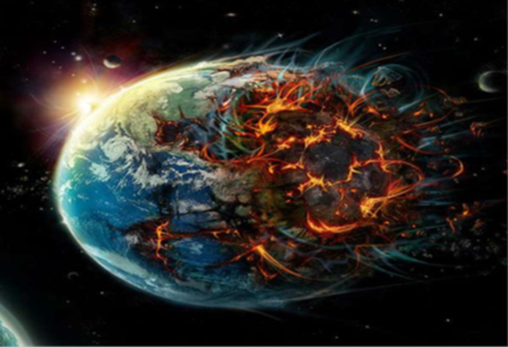
What is global warming?

Slide 7
Global warming is the rise of average temperature of earth’s atmosphere and the oceans.
Between 1906 and 2006, the Earth’s average surface temperature increased between 0.6 to 0.9 degrees Celsius.

Slide 8
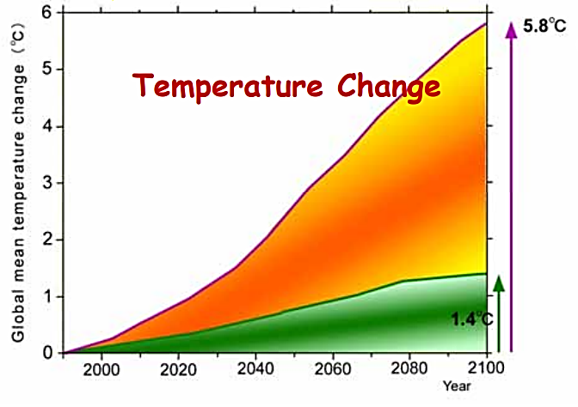

Slide 9
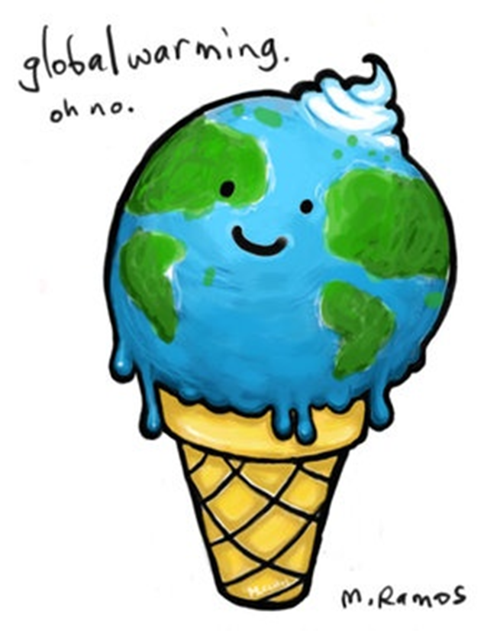
Who is responsible?

Slide 10
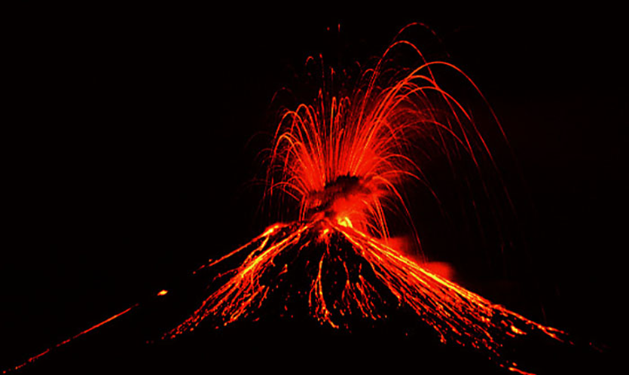
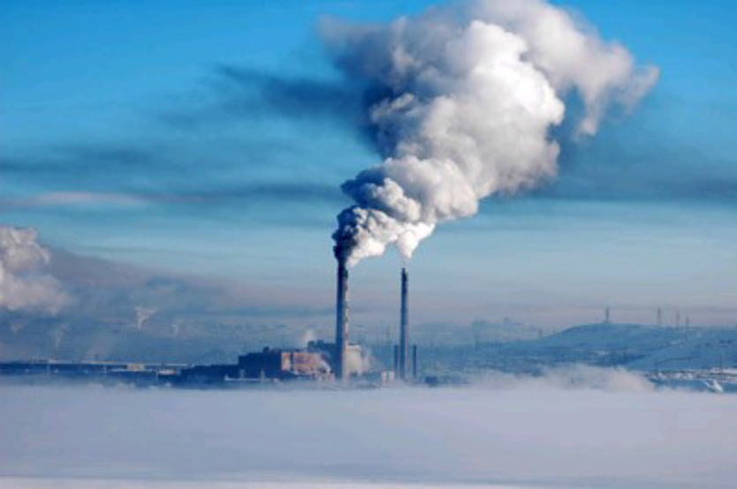
Global warming is caused by:
Natural causes that are created by nature (release of methane gas from volcanoes)
Human causes

Slide 11
Human causes
Burning fossil fuels give off CO2. When you dig up the fossil fuels you dig up the CH4 as well letting it escape into the atmosphere.
Carbon dioxide (CO2) exhaust from cars, airplanes and power plants.
Deforestation.

Slide 12
According to Intergovernmental Panel on Climate Change (IPCC),
carbon dioxide and methane levels have increased by 35% and 148% since the industrial revolution of.

Slide 13
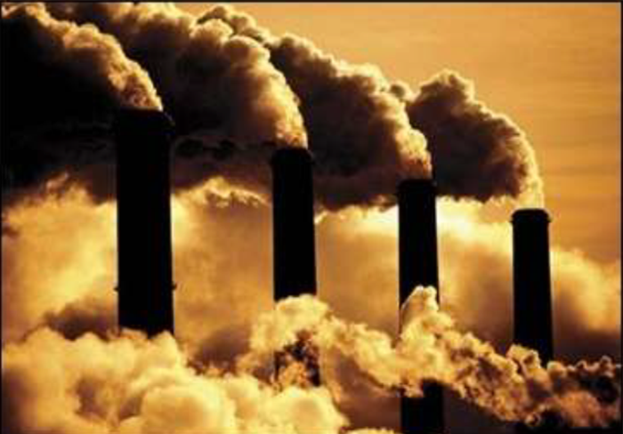
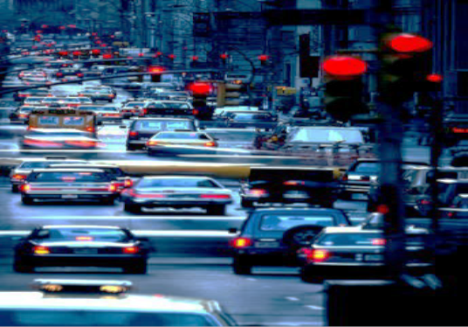
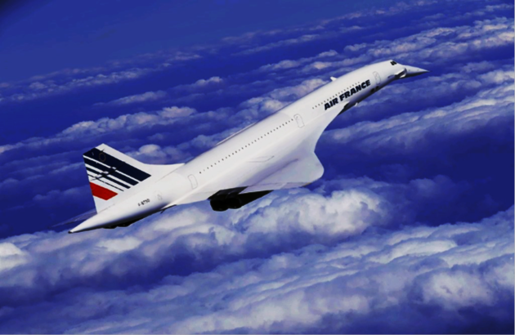
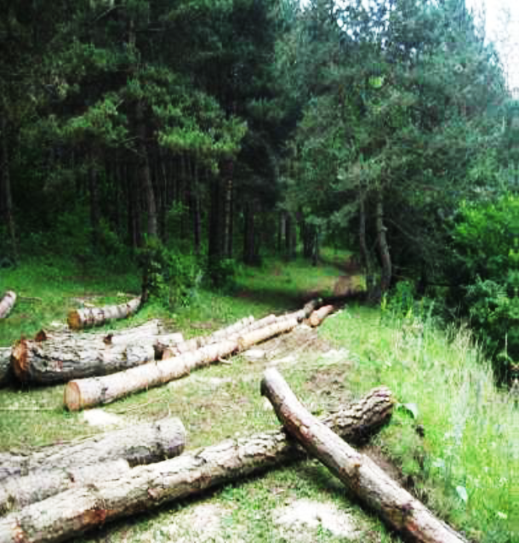

Slide 15


China
America is the #1 global warming polluter in the world.

Slide 18
Effects of global warming
Rise in sea levels worldwide.
Ocean heat content has increased, and snow cover and ice extent have decreased.
More killer storms.
Increased probability and intensity of droughts.
Effects of global warming already being felt on plants and animals worldwide.

Slide 19
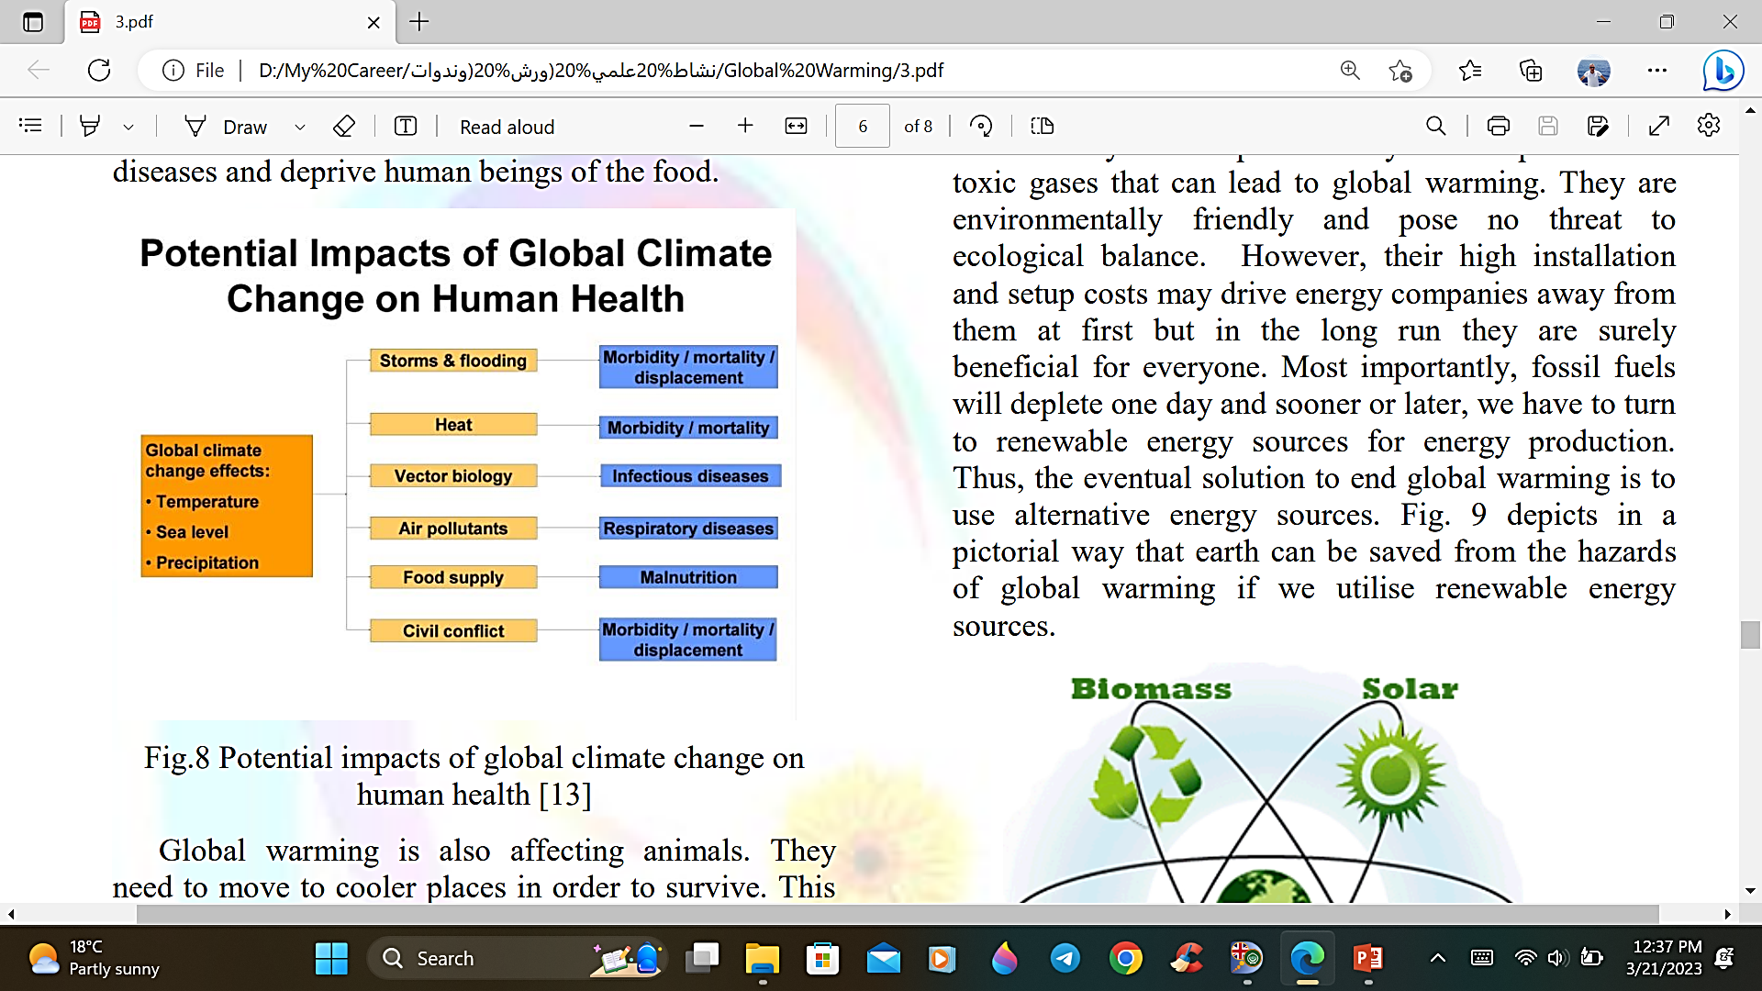

Slide 21

How do we overcome global warming ?

Slide 22
There are two paths to control Global warming;
International and governmental efforts.
Personal and individual efforts.

Slide 23
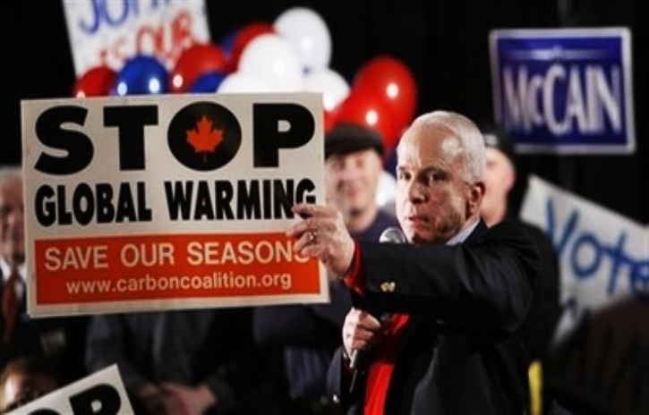
Kyoto Protocol
An international treaty designed to limit global greenhouse gas emissions (1997).
The United States and Australia have not ratified the Kyoto Protocol.

Slide 24
Personal Efforts
Hybrid and electric operated vehicles should be used.
Stop deforestation and more numbers of trees should be planted .
Use of alternative energy sources, they include wind, solar, biomass, geothermal and hydropower (do not produce any sort of pollution or toxic gases that can lead to global warming).

Slide 25
Conclusions
Global warming is a big hazard and is not only causing trouble to the human beings but also to animals and plants.
Earth can be saved from the hazards of global warming if we utilize renewable energy sources.

Slide 26
If global warming continues unrestrained and nothing effective is done to limit this evil, it will cause significant climate changes, a rise in sea levels, extreme weather events and other ruthless natural, environmental and social impacts

Slide 27
Finally, the earth is too old to stand up through this phenomena. Therefore, if we don't find a way to overcome this problem, imagine how would the future generation survive with a climate that is hotter than it already is now?

Slide 28
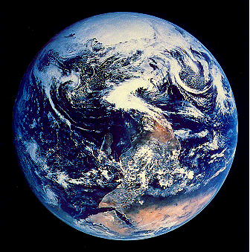
We only have one beautiful planet
Earth.

