Slide 1
آلية تقديم ترقية علمية باقل الاخطاء

Slide 2
Tips to avoid predatory and hijacked journals
Asst.Prof. Dr. Israa Al-Baldawi
Al Khwarizmi College of engineering
Department of Biochemical Engineering

Slide 3
JOURNAL SELECTION
Elsevier Journal Finder
https://journalfinder.elsevier.com/
Key in title and abstract
Beyond Elsevier Journals
https://www.journalguide.com/
Key in title and abstract

Slide 4
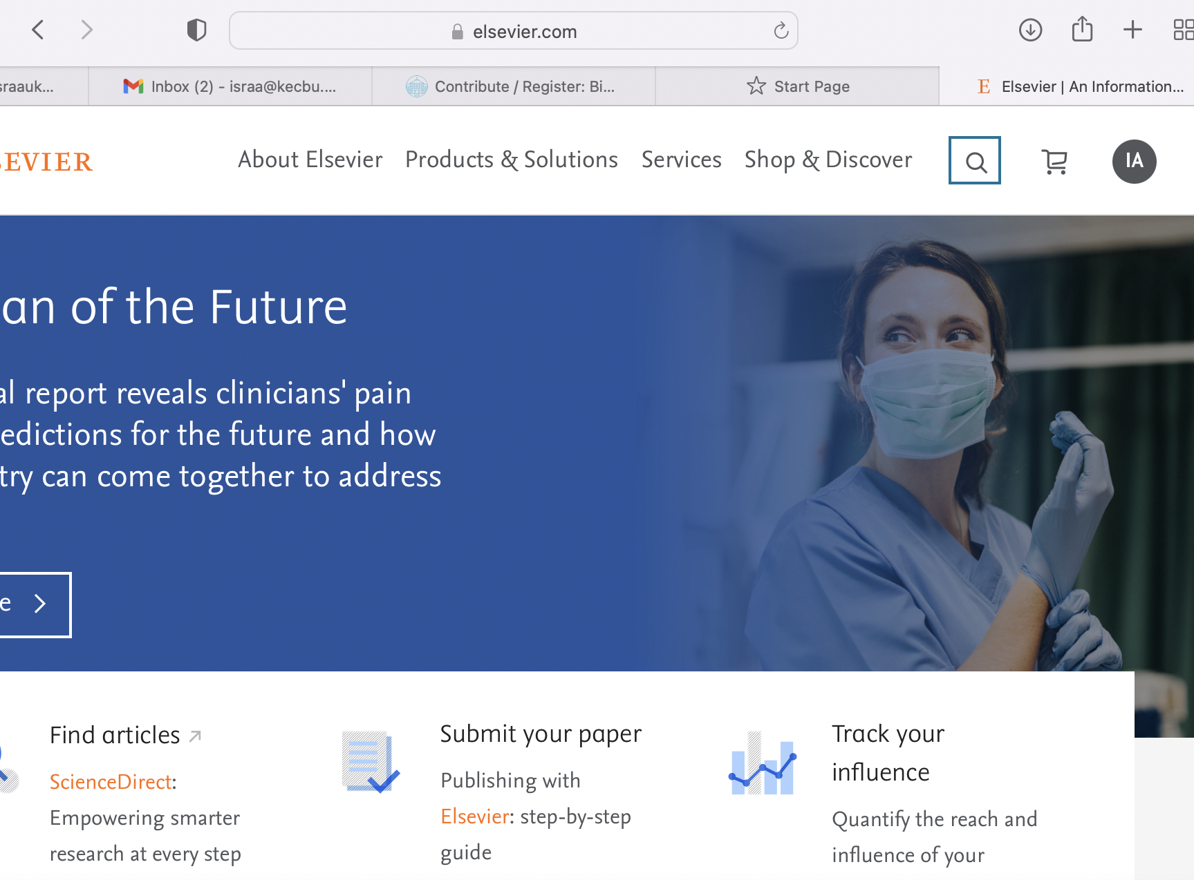
Select Journal
اختيار المجلة

Slide 5
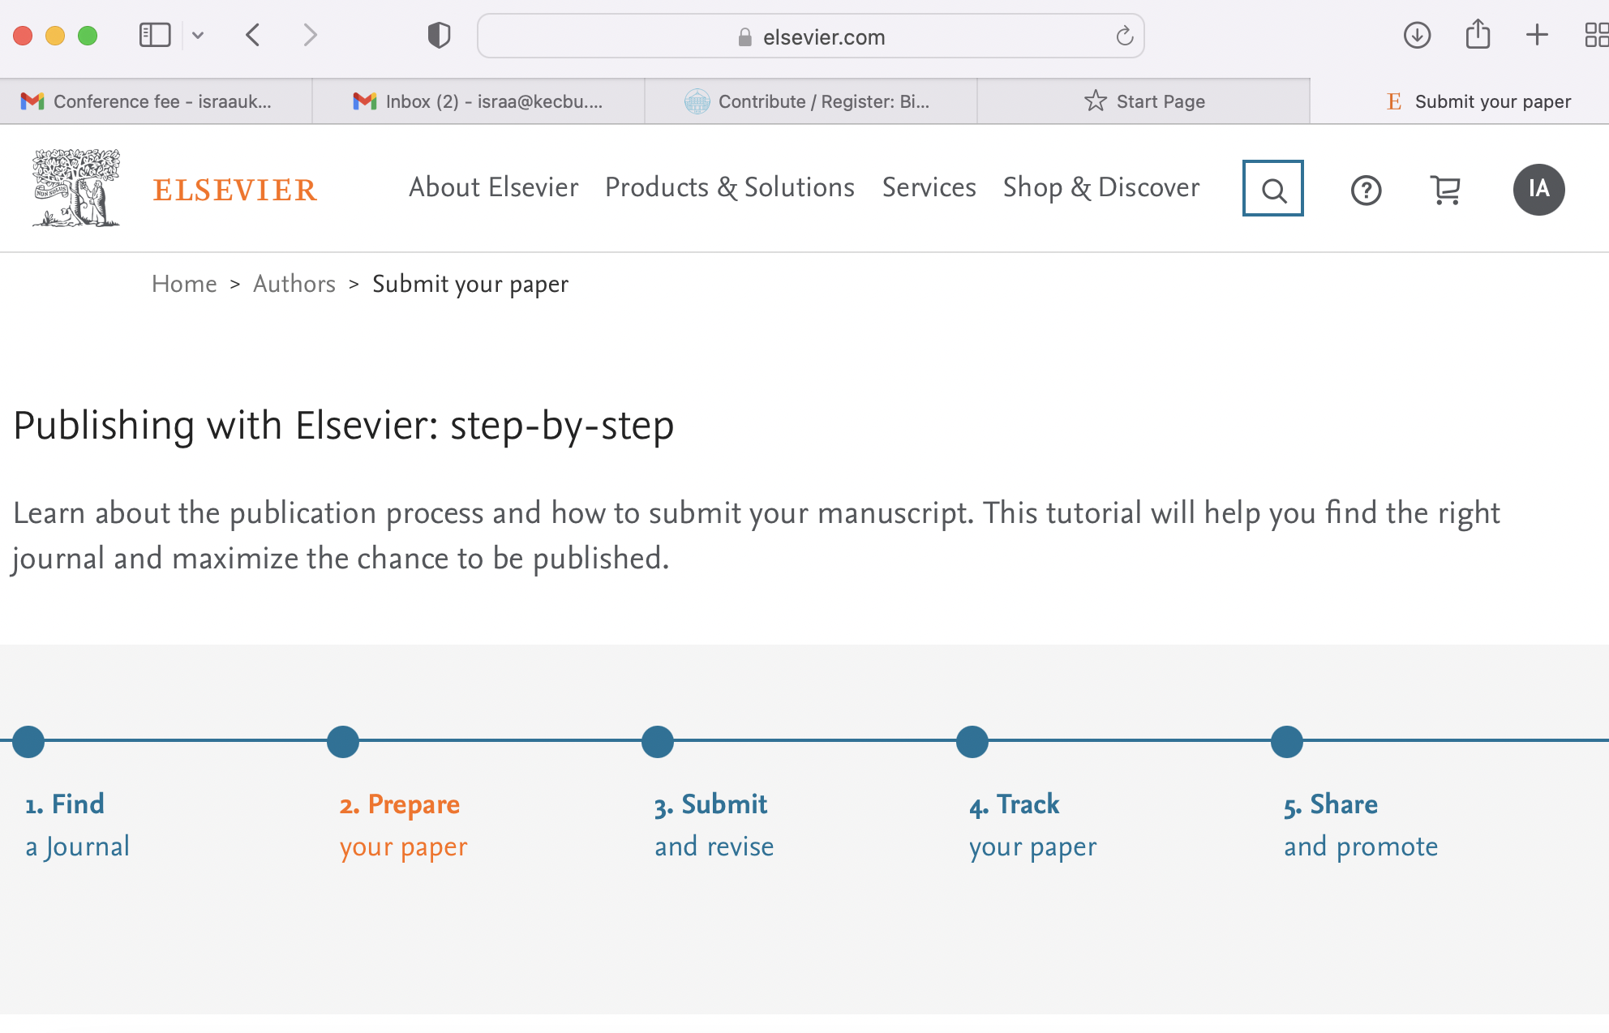

Slide 6
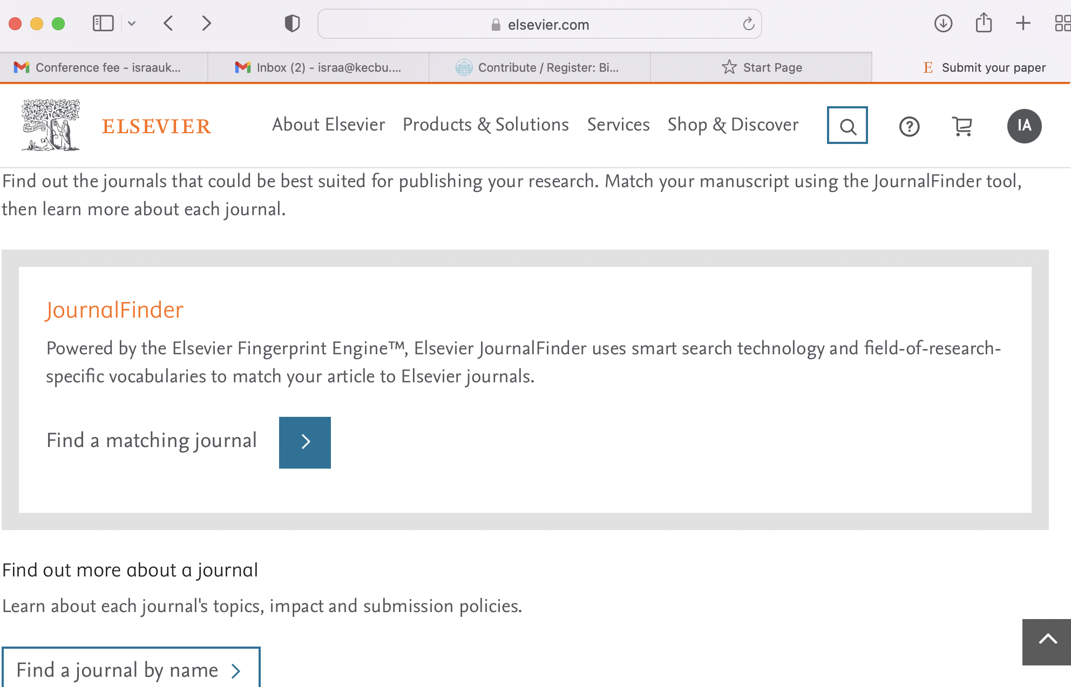

Slide 7
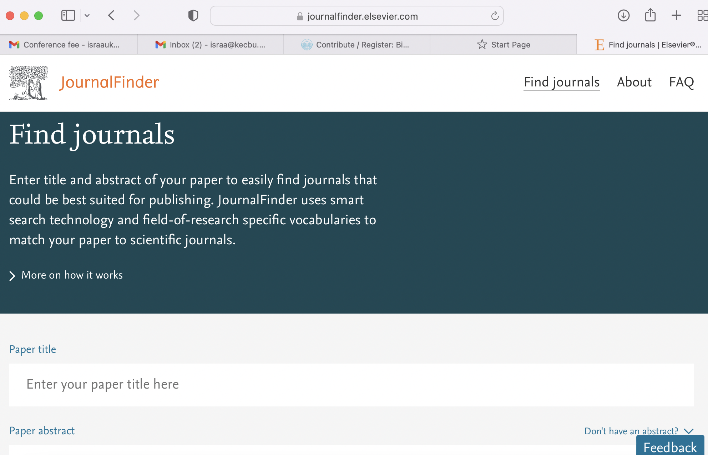

Slide 8
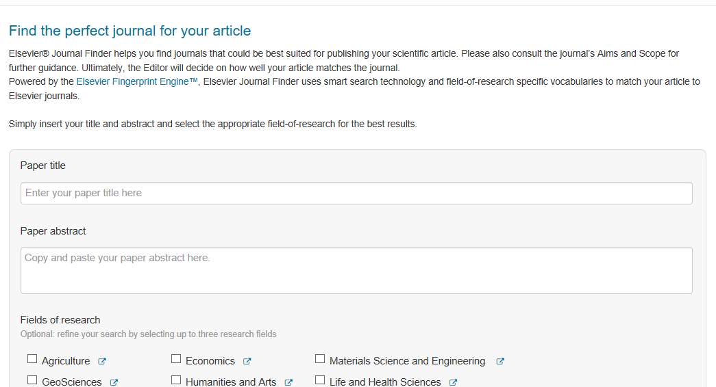

Slide 9
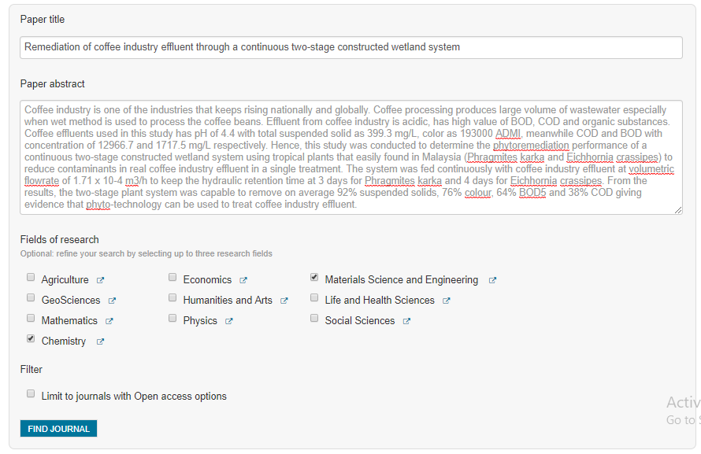

Slide 10
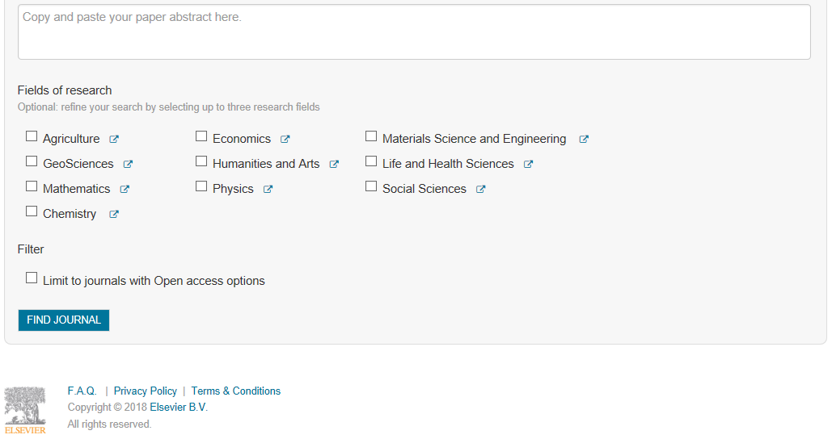

Slide 11
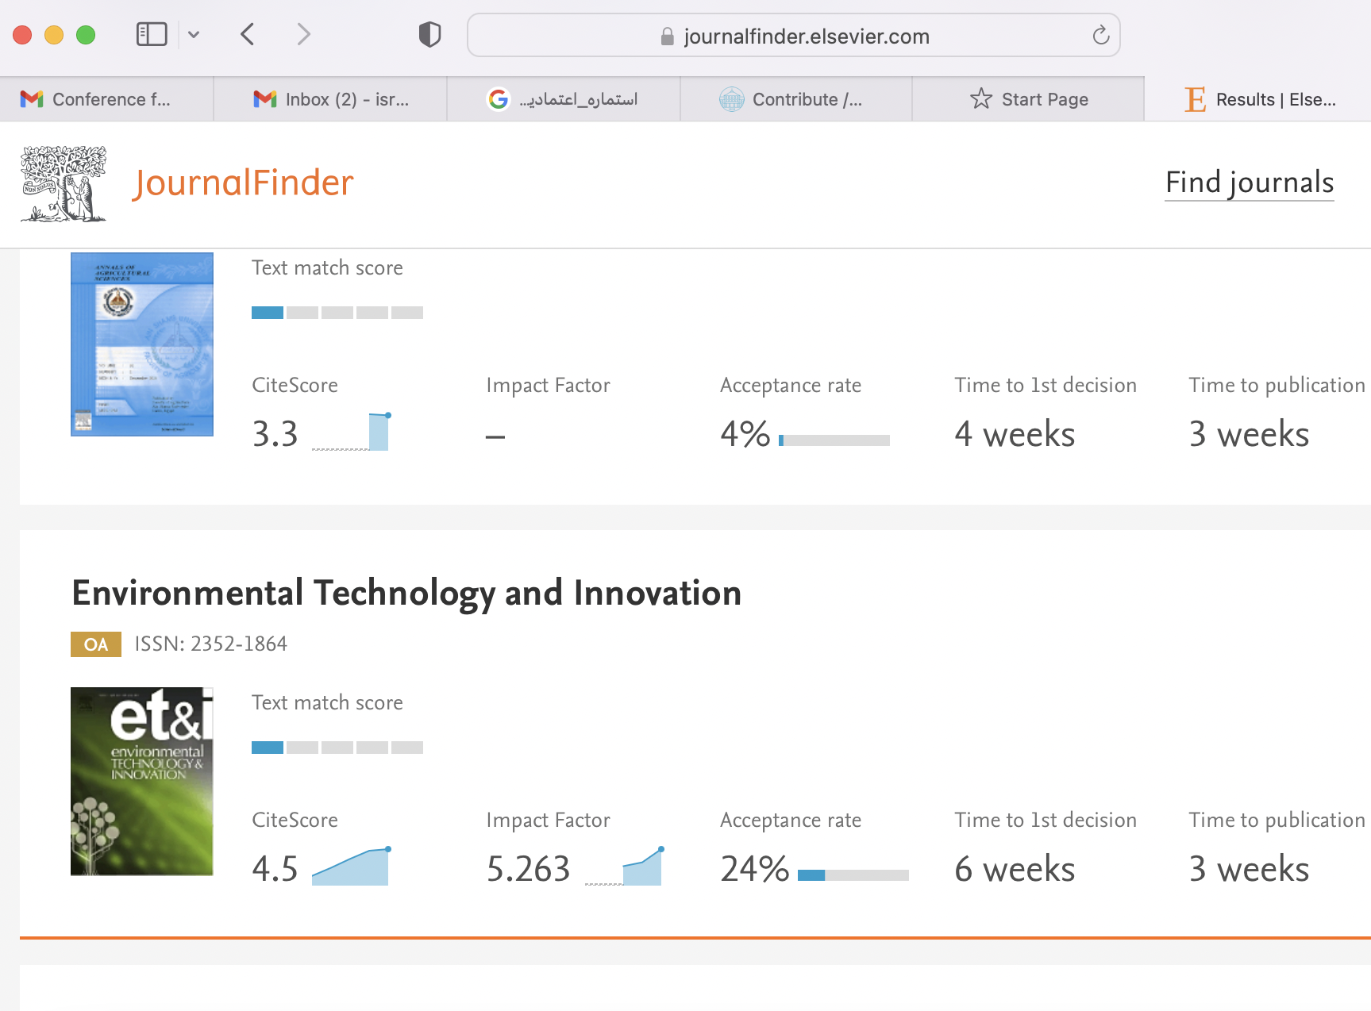

Slide 12
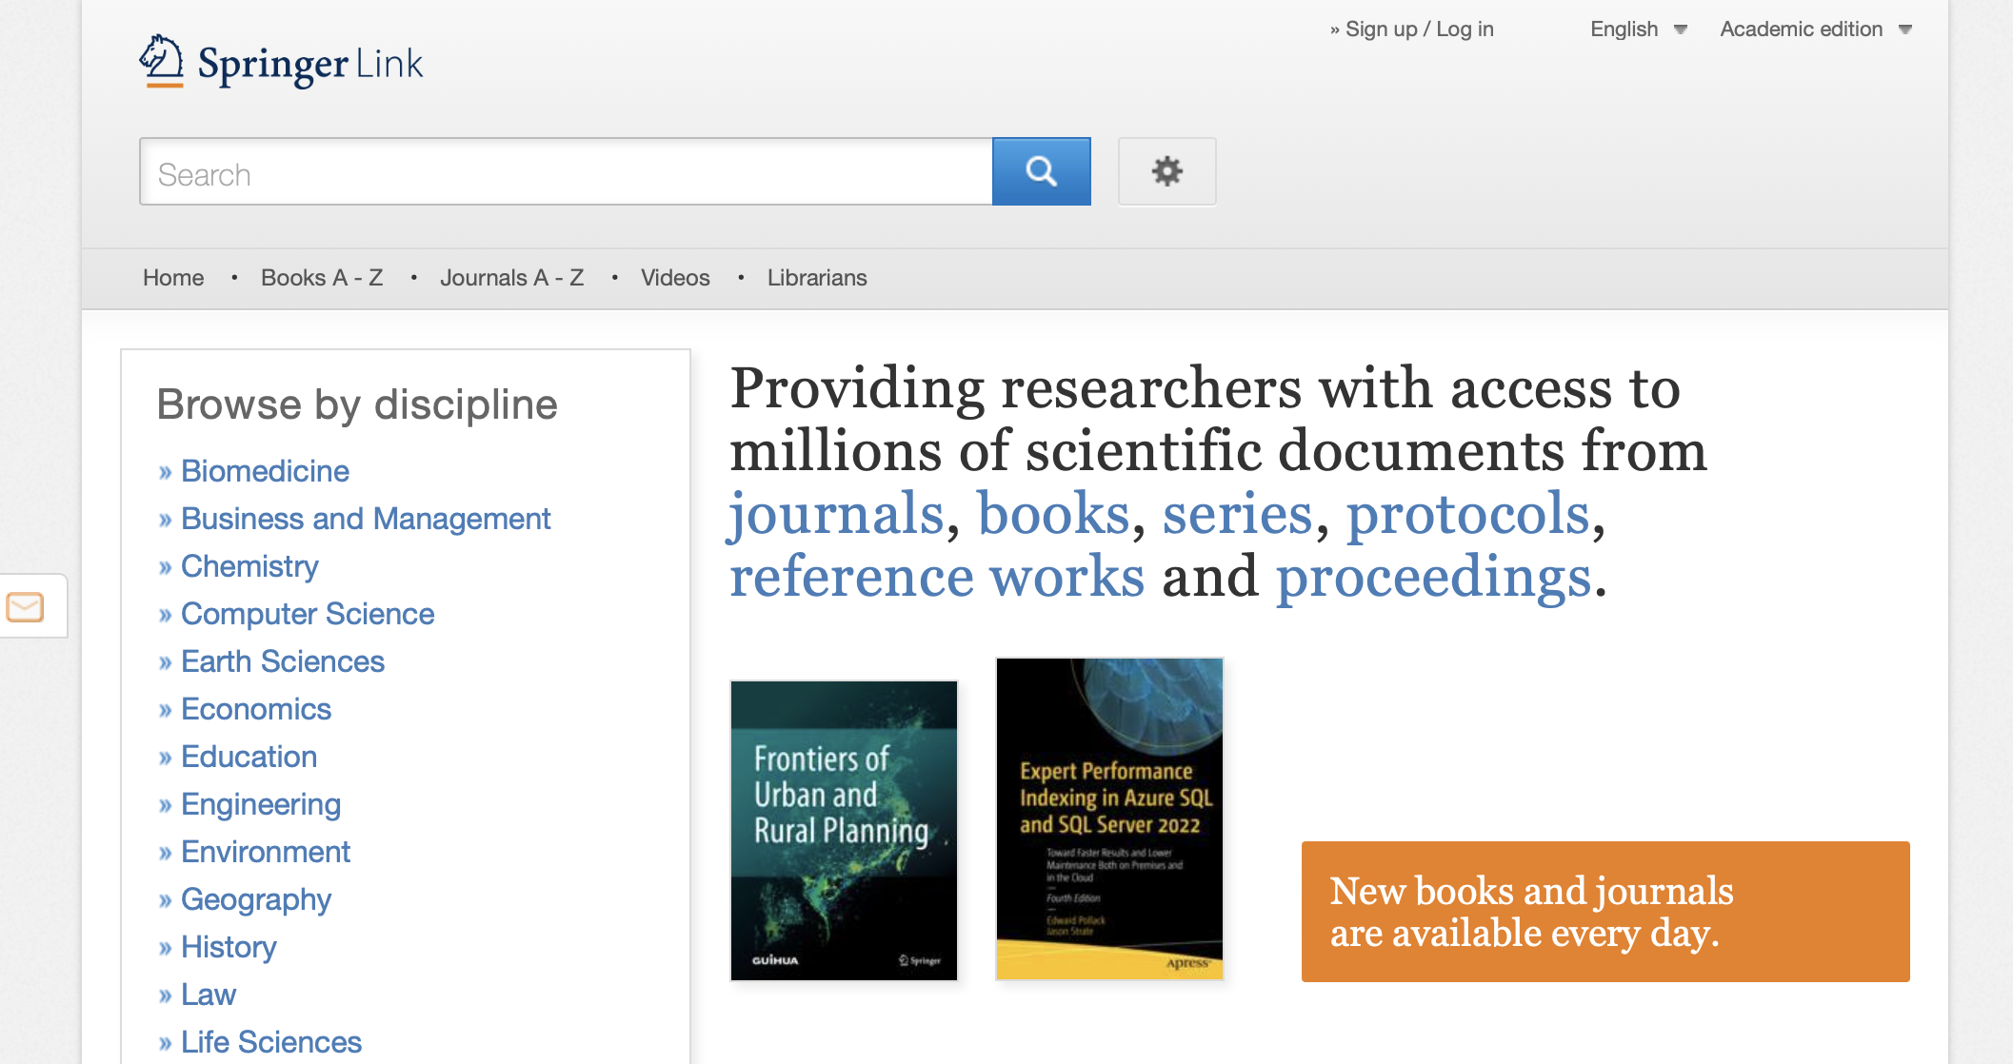

Slide 13
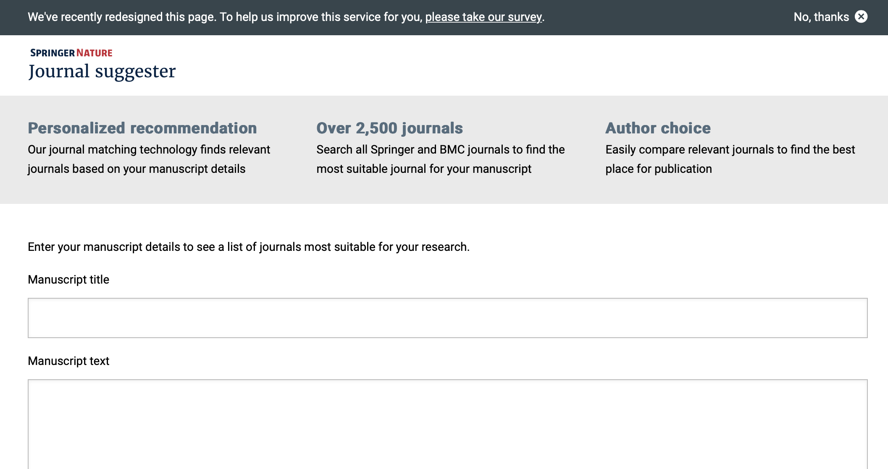

Slide 14
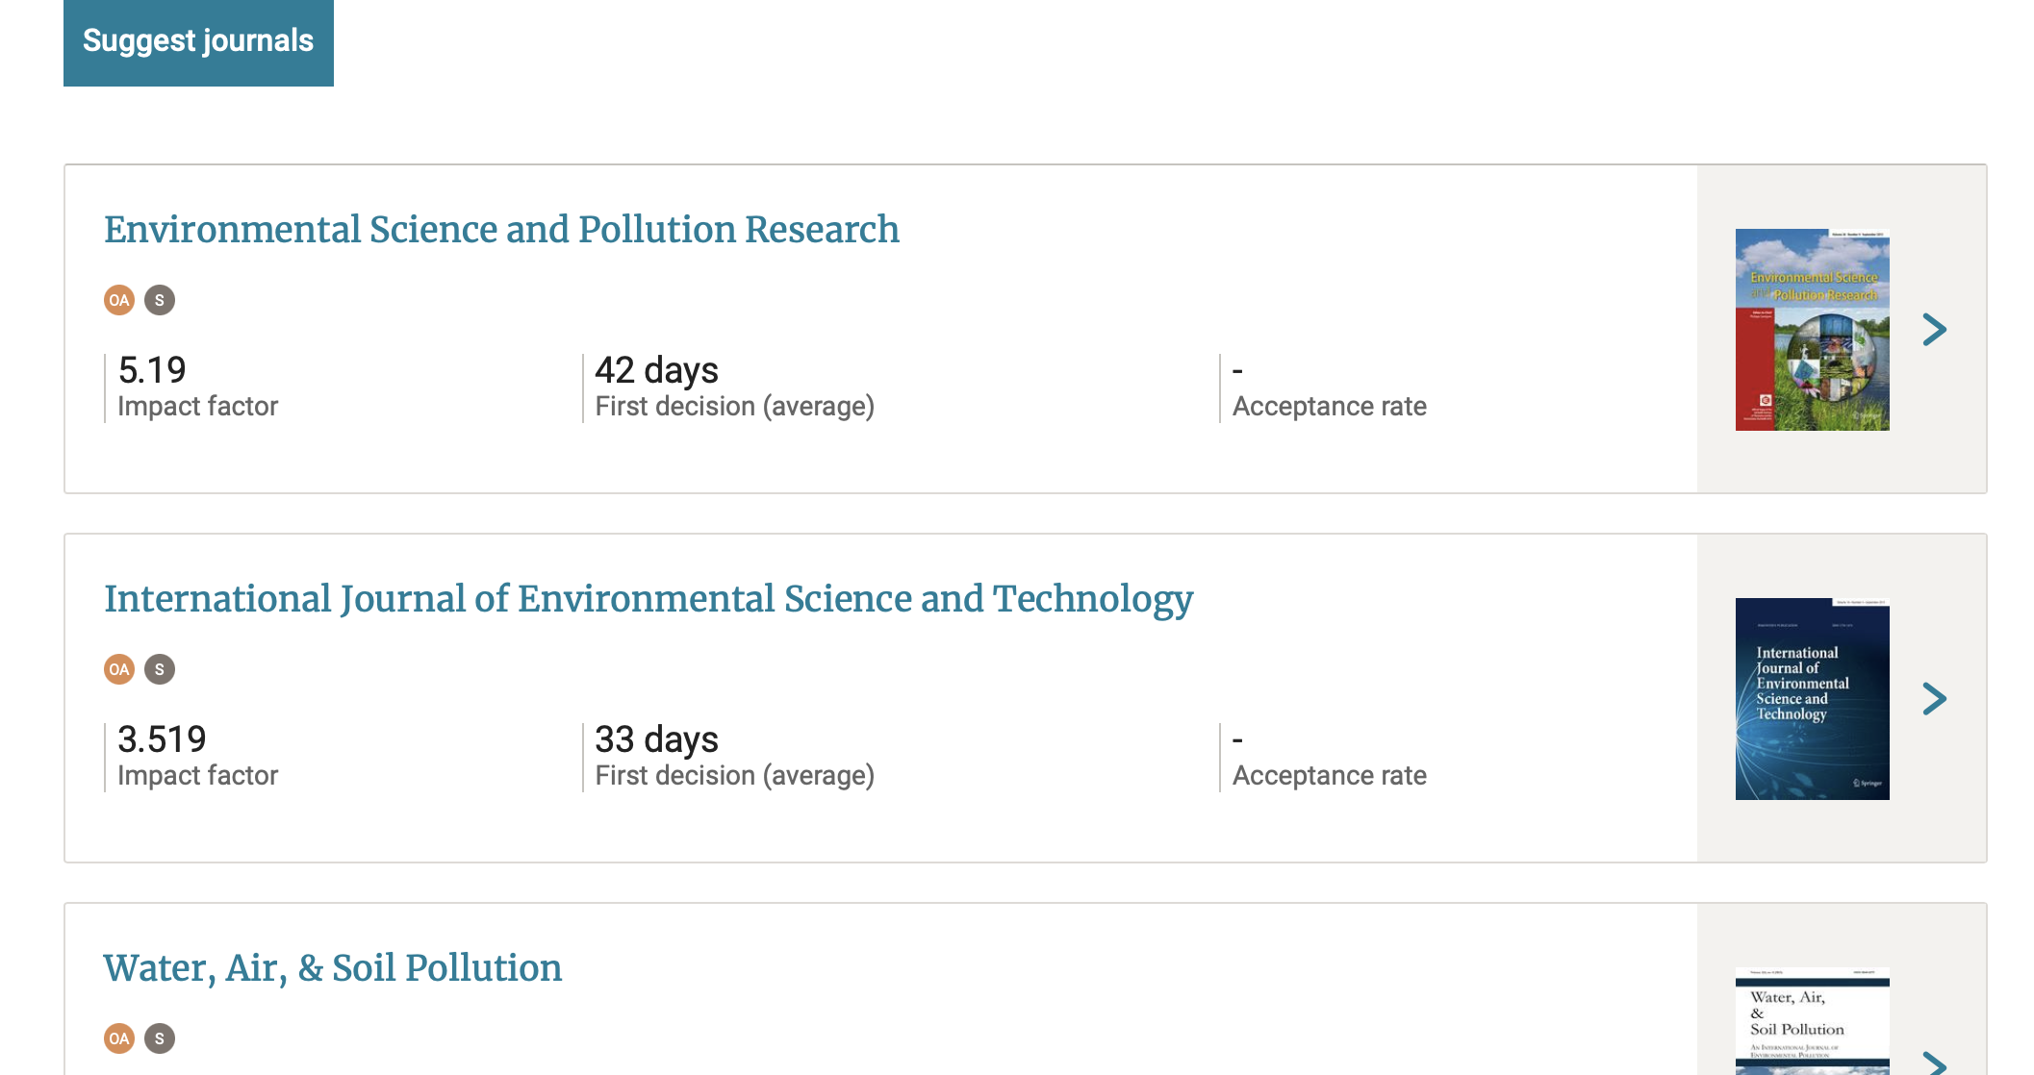

Slide 15
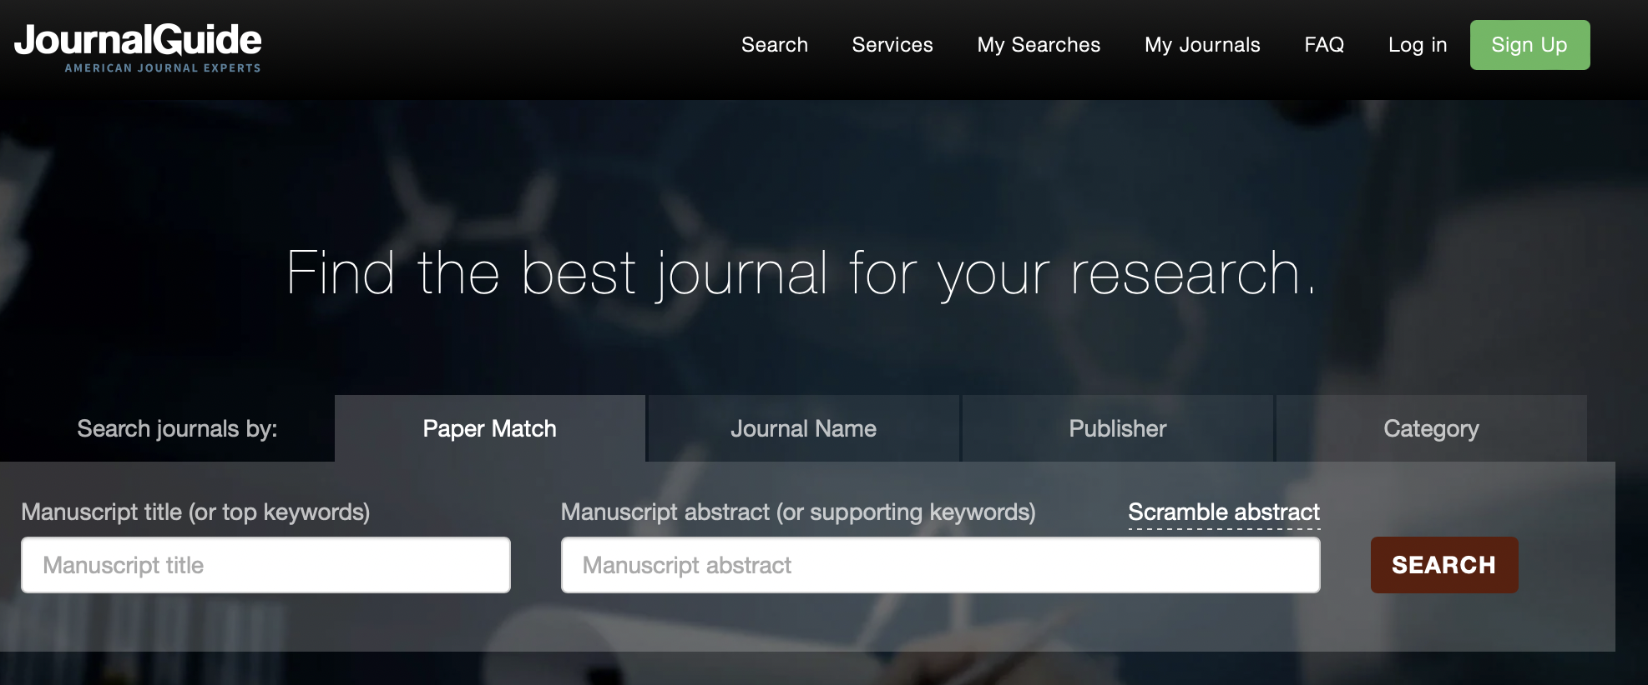
BEYOND ELSEVIER JOURNALS
Not limited to Elsevier journals (https://www.journalguide.com).

Slide 16
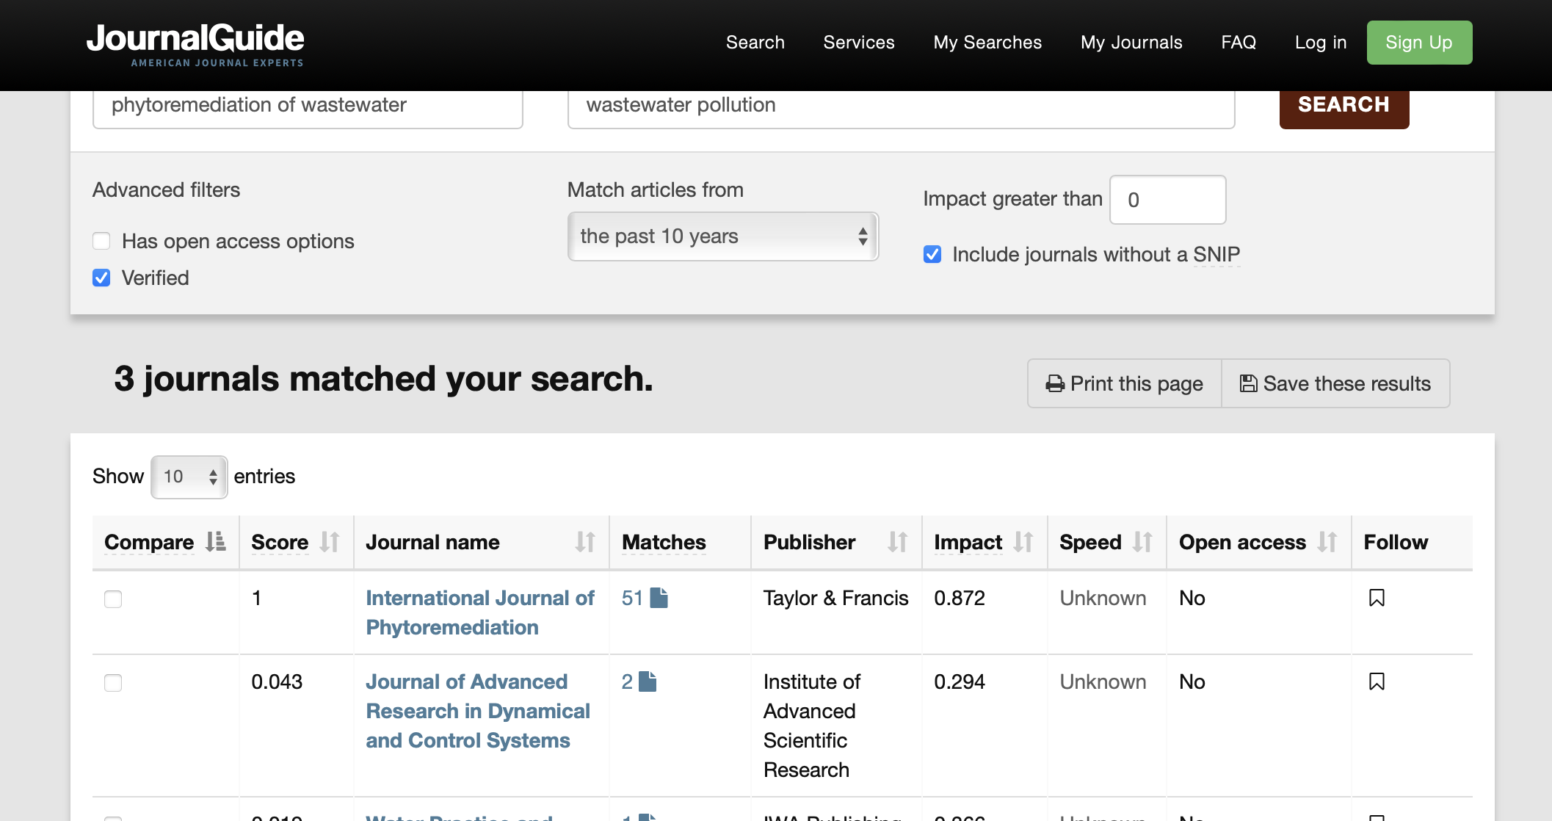

Slide 17
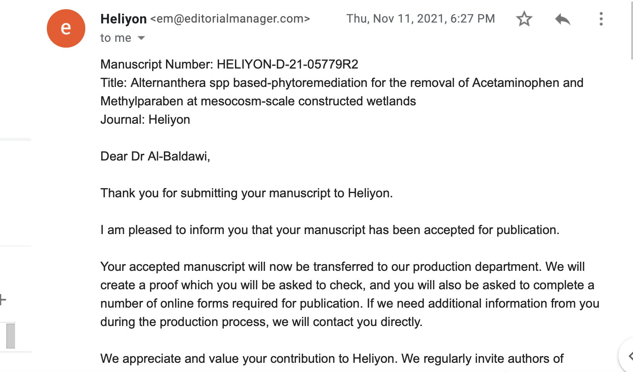

Slide 18
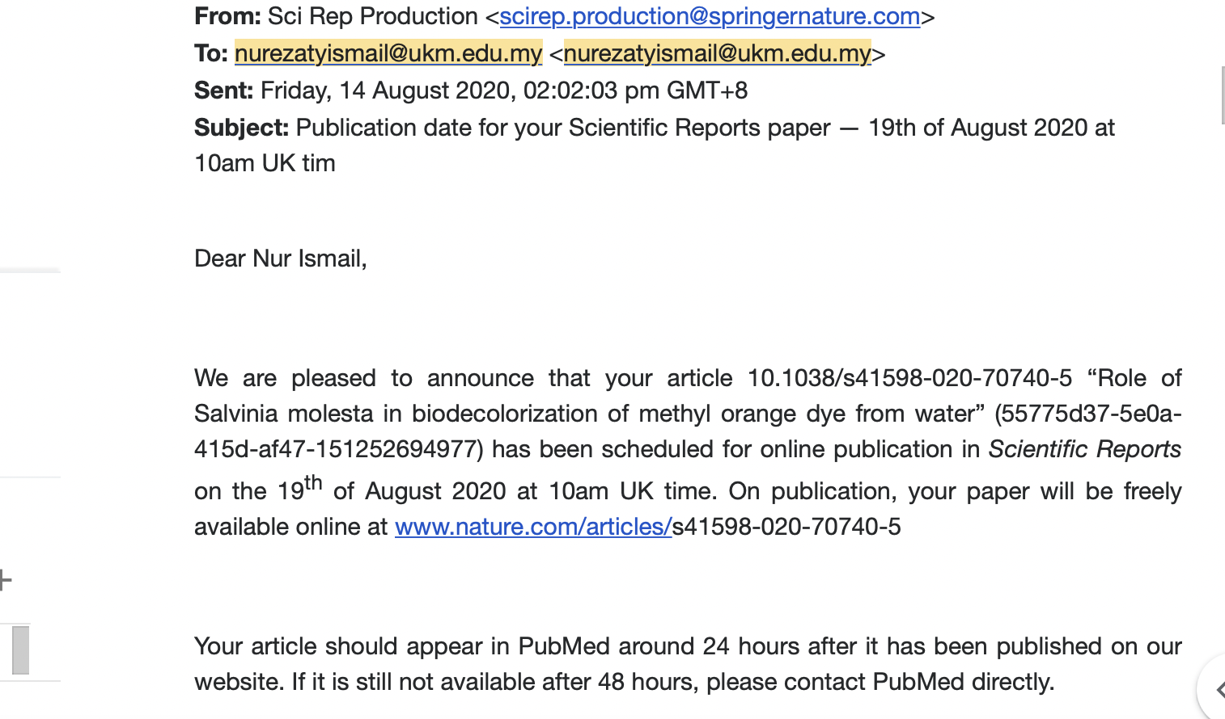

Slide 19
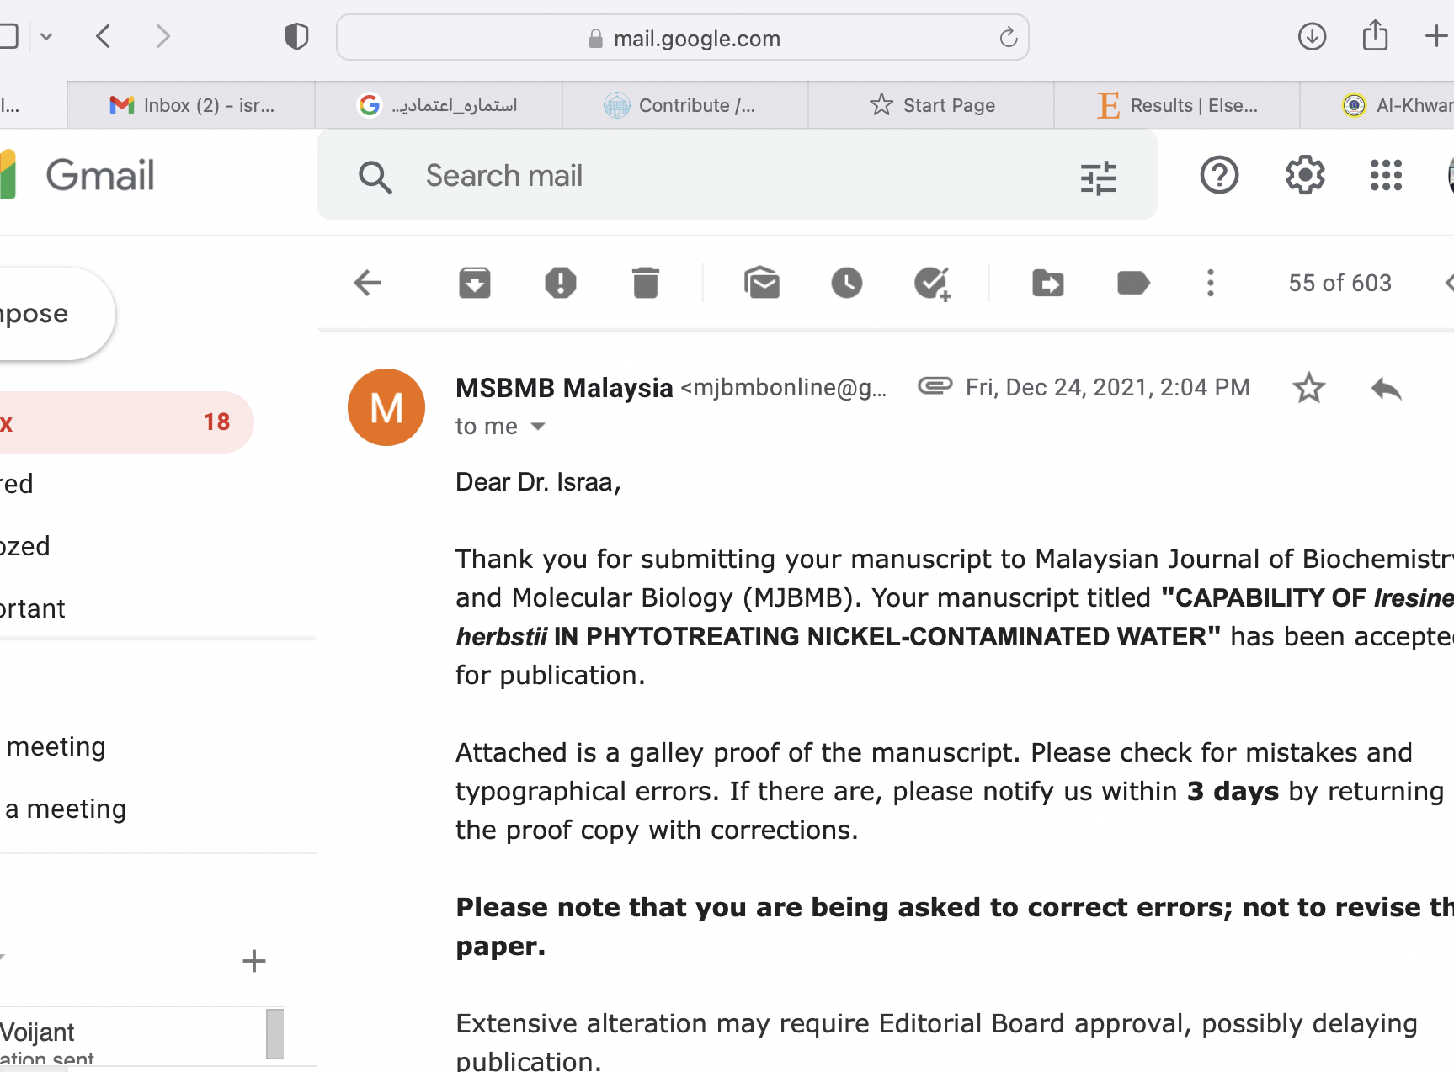
Acceptance letter

Slide 20
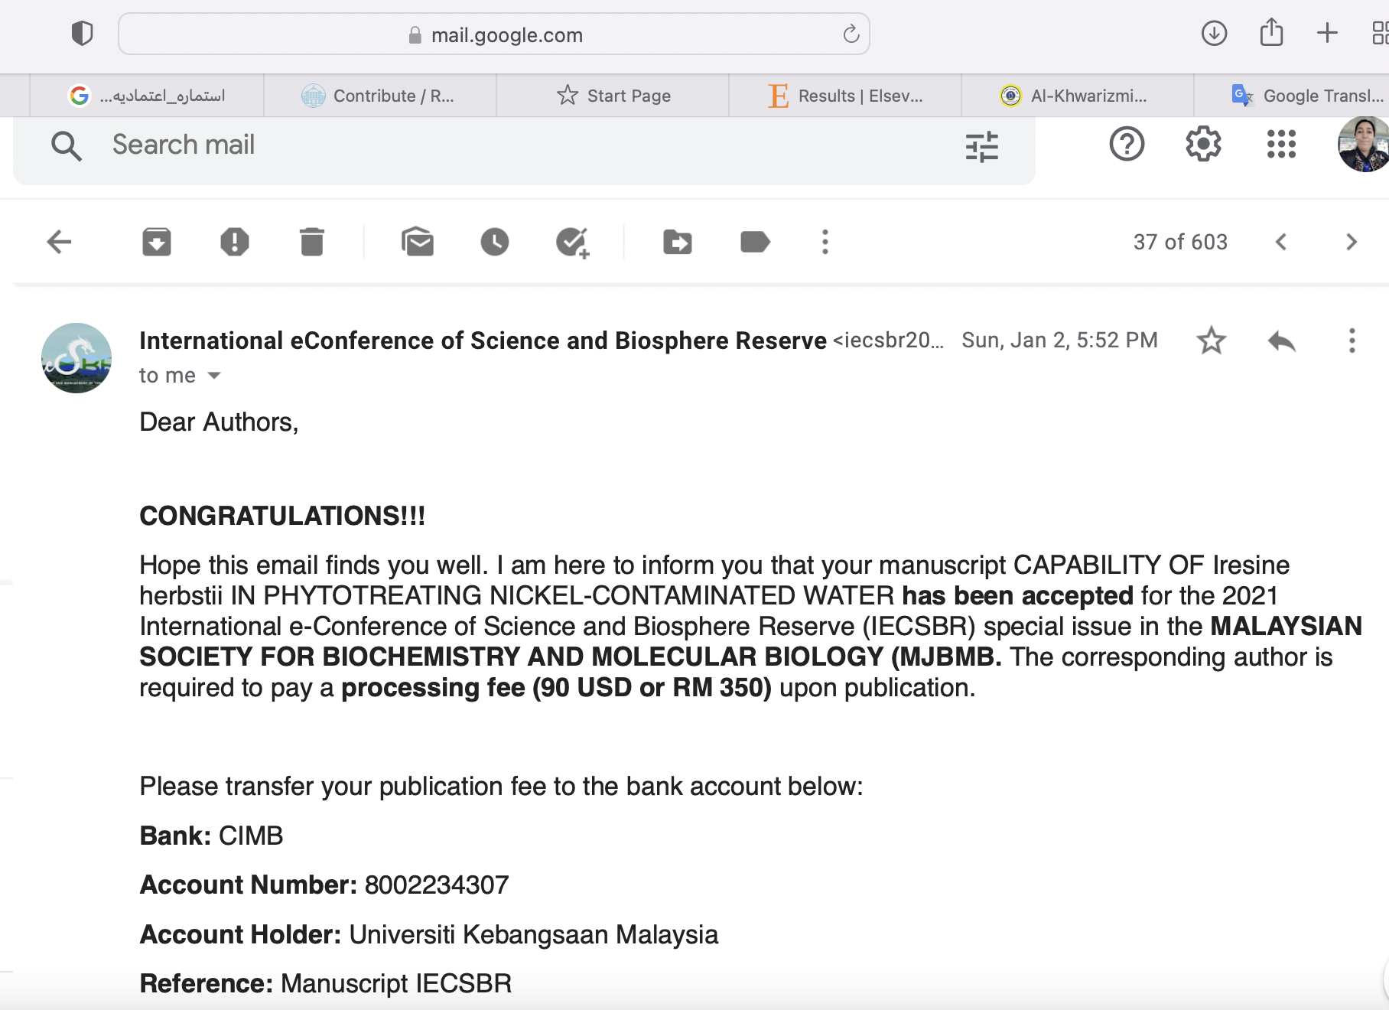

Slide 21
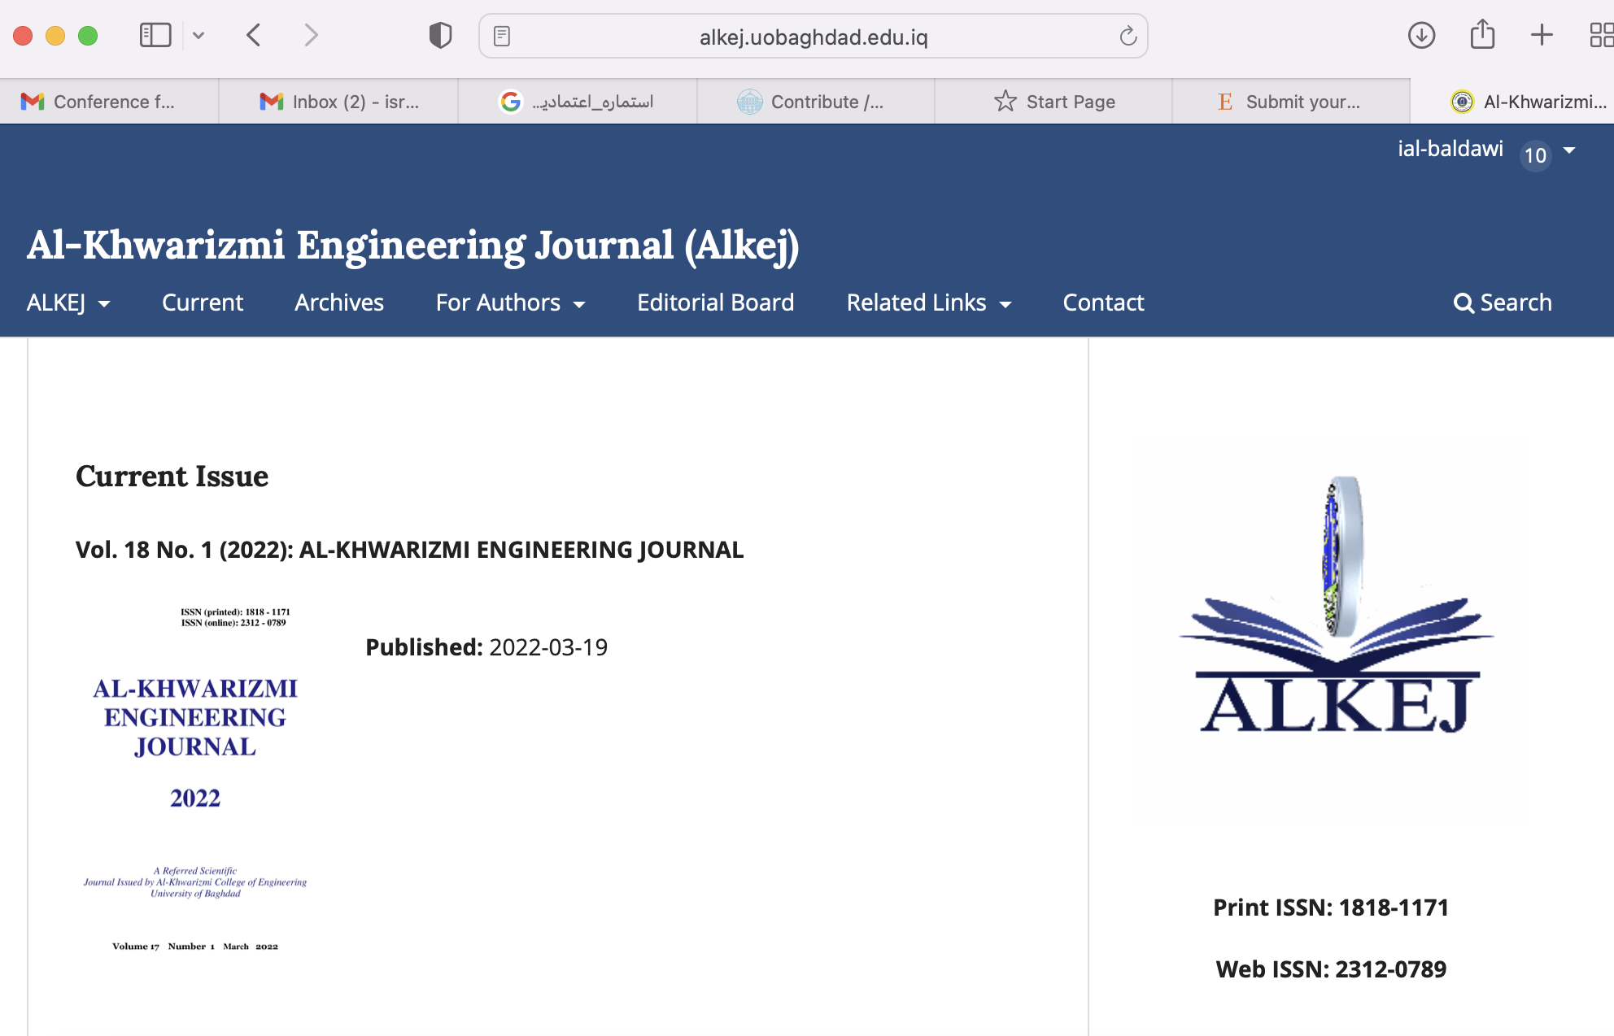
Local Journal
مجلة الخوارزمي

Slide 22
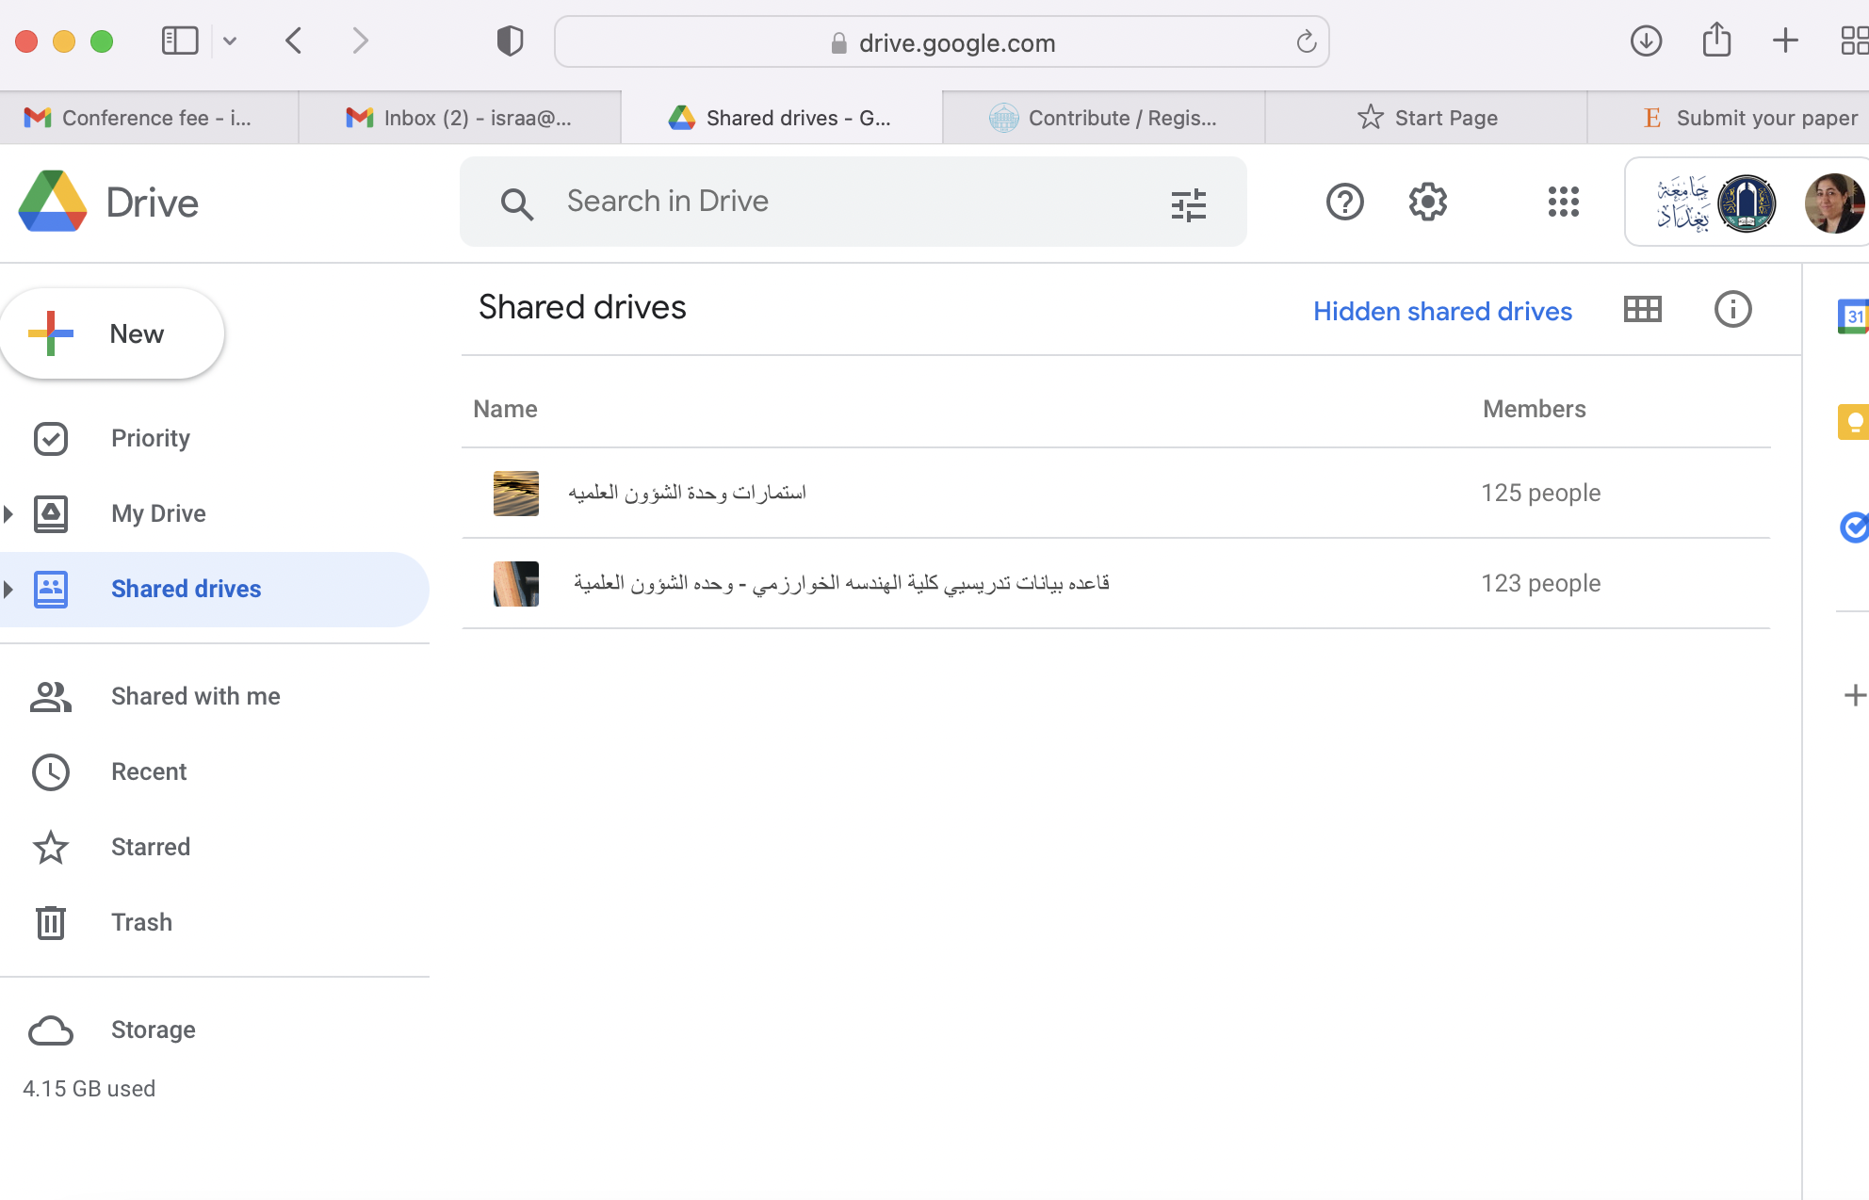
Share Drive
وحدة الشؤون العلمية

Slide 23
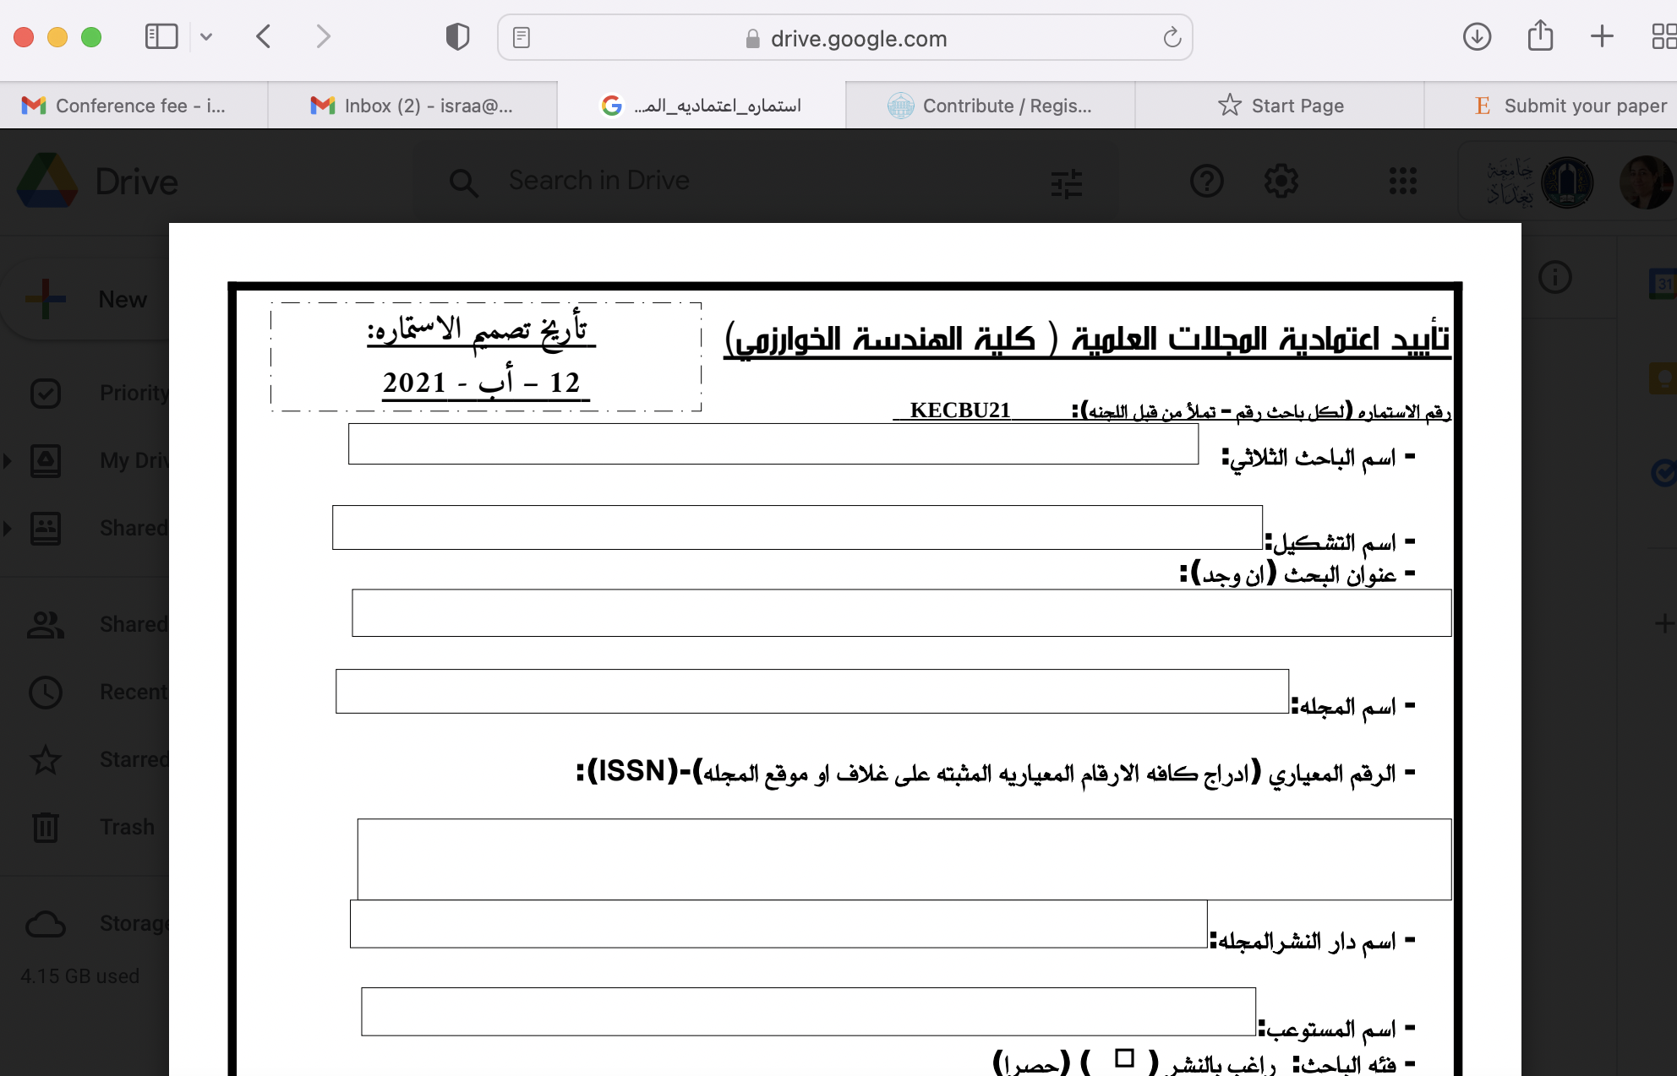
Share Drive
استمارة الاعتمادية

Slide 24
Predatory VS hijacked journals
Predatory journals are completely fake titles, has questionable مشكوك فيها peer review and publishes papers by receiving money.
Meanwhile, A hijacked journal uses a fake website that mimics يقلد the look of a reputable حسن السمعة journal

Slide 25
Predatory and hijacked journals
Term invented by Jeffrey Beall in 2010
The academic world today includes hijacked journals and predatory publishers that operate based on a ‘pay and publish’ model and function for financial reasons only.
Refers to practice of charging fees to authors to publish their articles without the standard editorial and peer review services provided by legitimate المجلات العلمية الشرعية scholarly journals, though often with the pretense التظاهر that there is.
This can apply to journals as well as conferences

Slide 26
Predatory Publishing
Predatory publishers have taken advantage of the Open Access movement, as it is a practice to charge authors publishing fees (APCs)
Article acceptance to publication turnaround time are very quick
Notification of publishing fees given only after papers are accepted
Improper use of ISSN numbers, fake Impact Factor scores

Slide 27
Hijacked journals
Have titles very close to those of highly respected legitimate journals, with only little modifications.
Send spam e-mails.
Show off about the high quality of the journal, which can include false claims about journal metrics and where it is indexed.
Make false claims about where the journal is indexed (e.g. SCOPUS, PUBMED).
Are not linked to or run by a credible scholarly مصداقية, academic or technical society or association, though some pretend to be.

Slide 28
6 Ways to explore Predatory and Hijacked Journal
Always check the website thoroughly.
Check if the journal is a member of DOAJ, COPE, OASPA or STM.
Check the journal's contact information.
Research the editorial board.
Take a look at their peer review process and publication timelines.
Read through past issues of the journal.

Slide 29
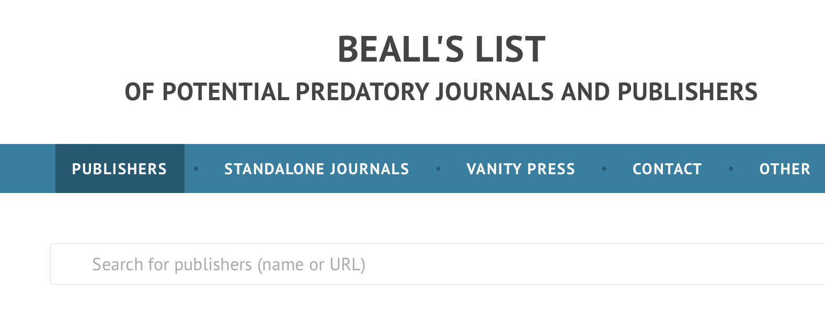
Online check website
https://beallslist.net

Slide 30
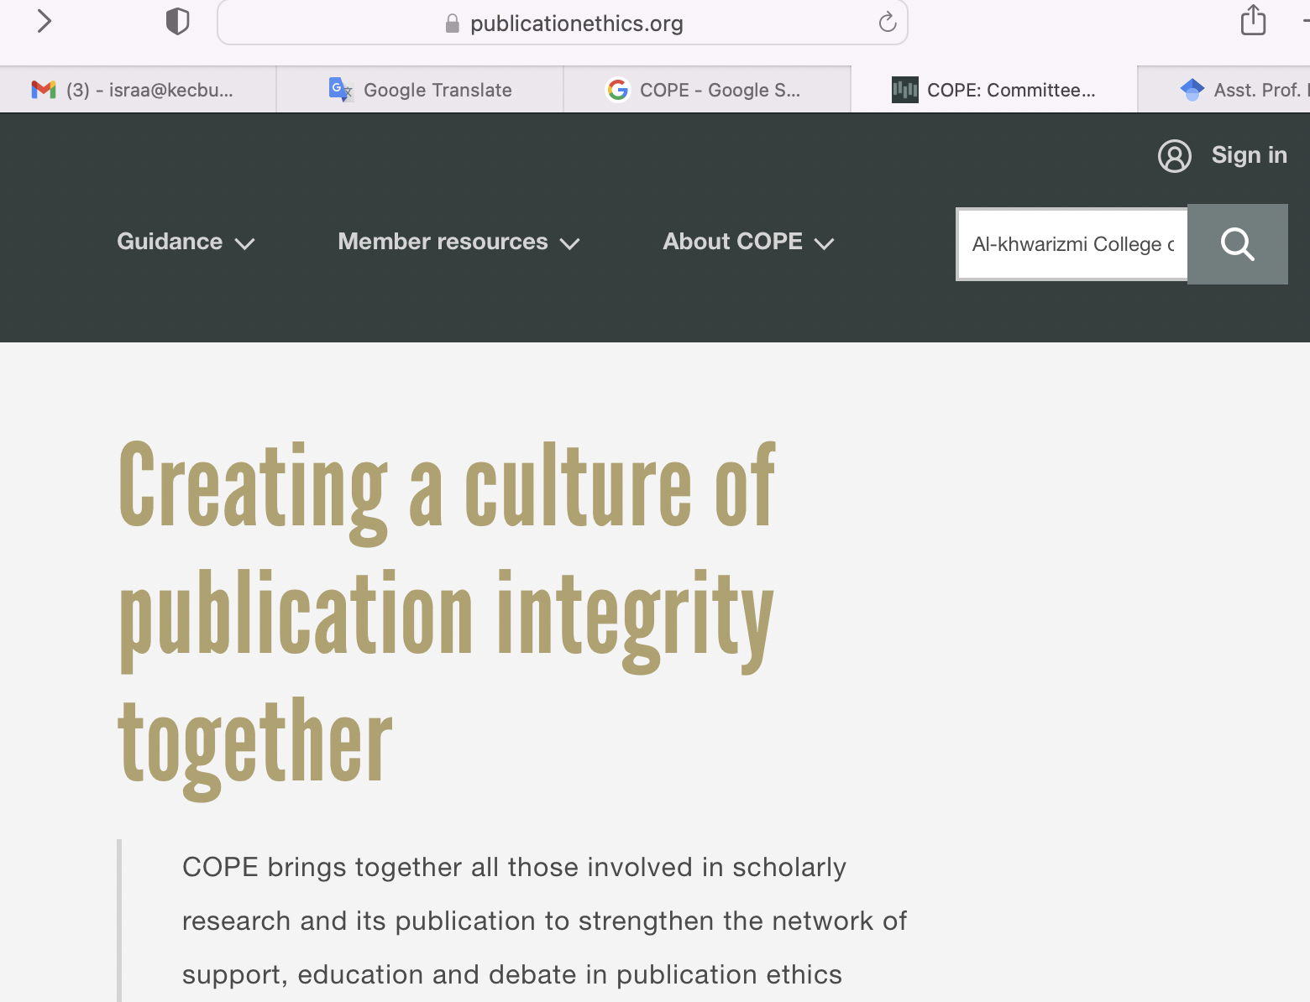
https://publicationethics.org

Slide 31
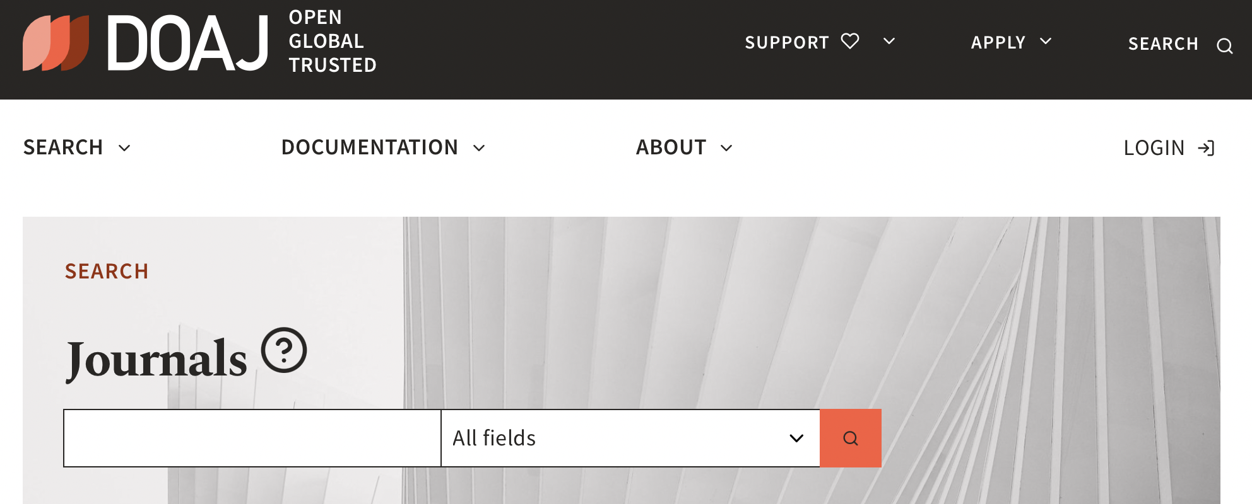
Check the journal title in the DOAJ
Check the journal title against a whitelist of reputable حسن السمعة publications. Is the title listed in the DOAJ?
https://doaj.org/search/journals?ref=homepage-box&source=%7B%22query%22%3A%7B%22query_string%22%3A%7B%22query%22%3A%22Journal%20of%20Mechanical%20Engineering%20Research%20and%20Developments%22%2C%22default_operator%22%3A%22AND%22%7D%7D%2C%22track_total_hits%22%3Atrue%7D

Slide 32
https://oaspa.org/2021-a-year-of-growth-where-oaspa-welcomed-a-diverse-set-of-new-members/

Slide 33
Publish your manuscript
THINK !
Are you submitting research to a trusted journal?
Is it the right journal for you?
CHECK ✓
Use the website of Beall’s list
DOAJ
SUBMIT ➤
Only if you can answer YES

Slide 35
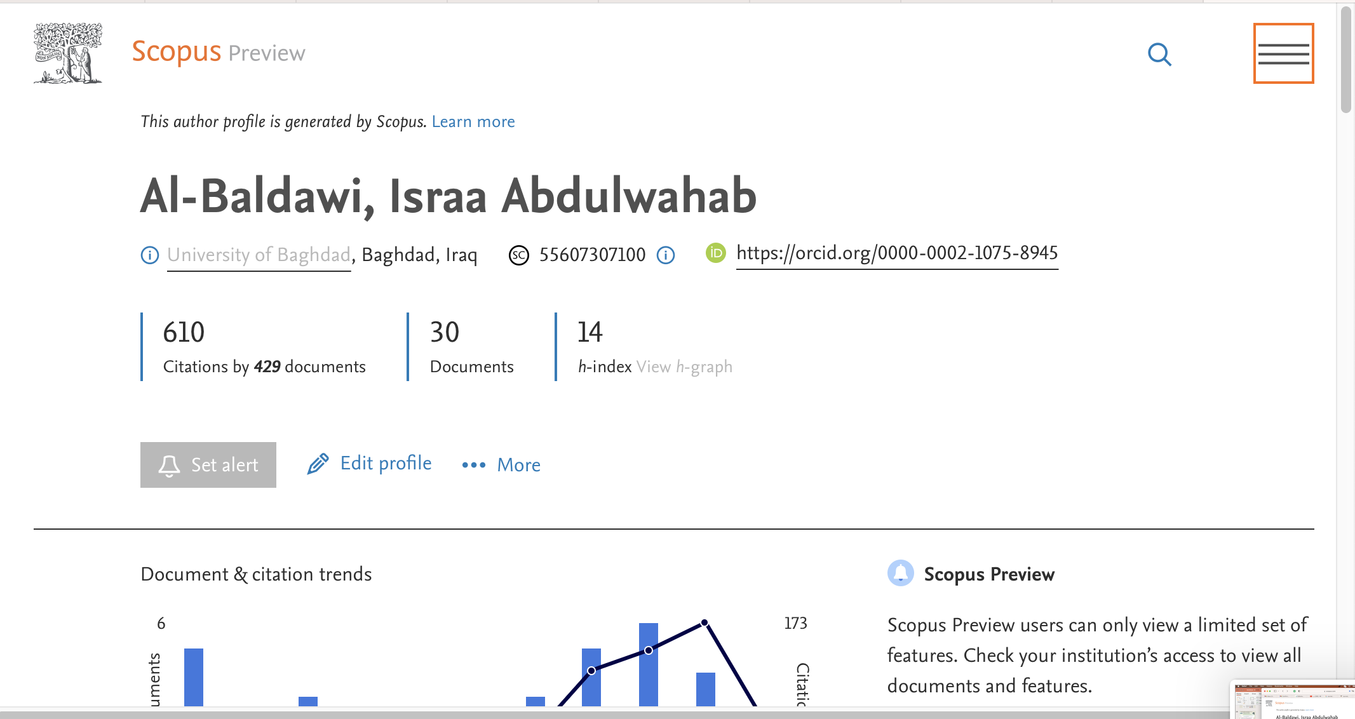

Slide 36
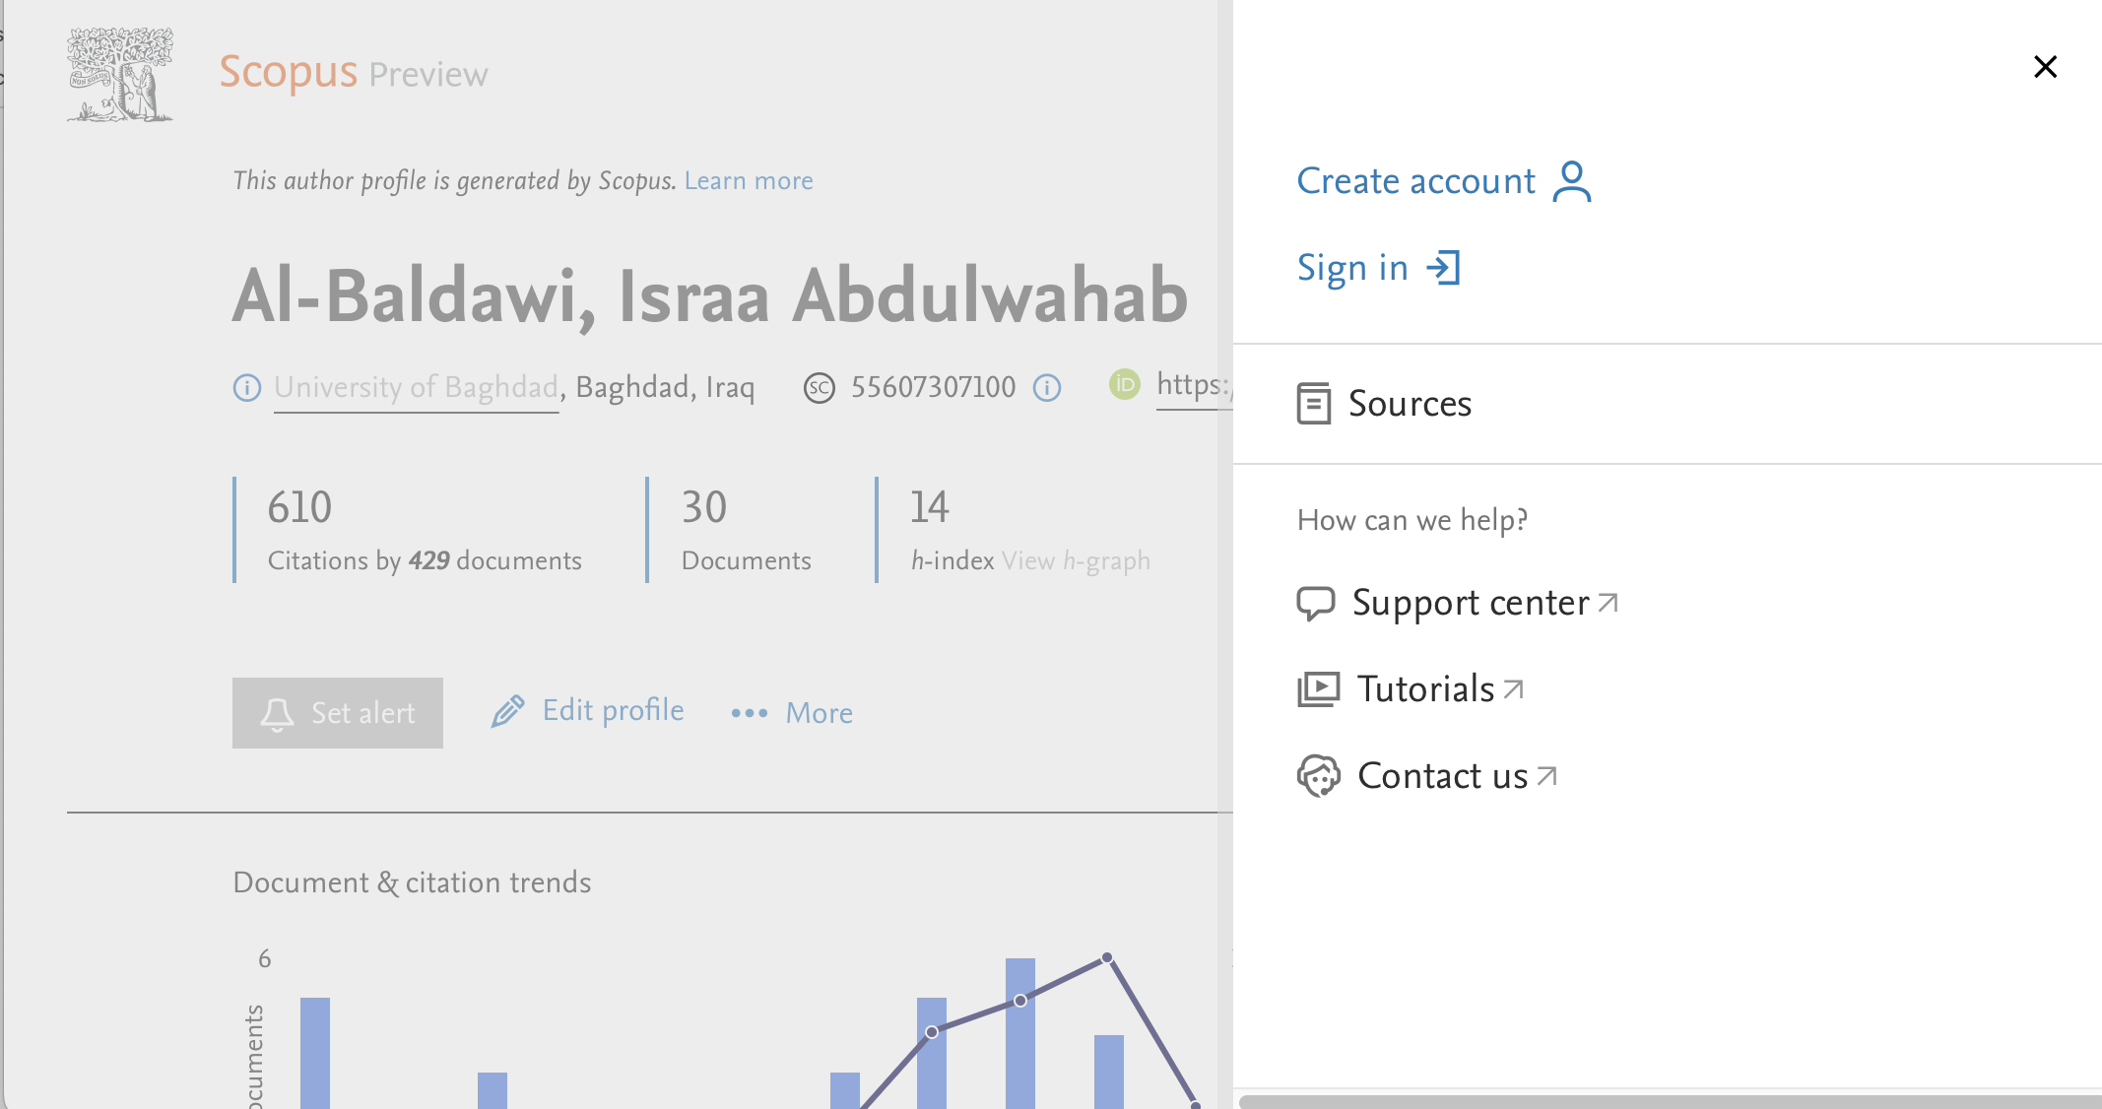

Slide 37
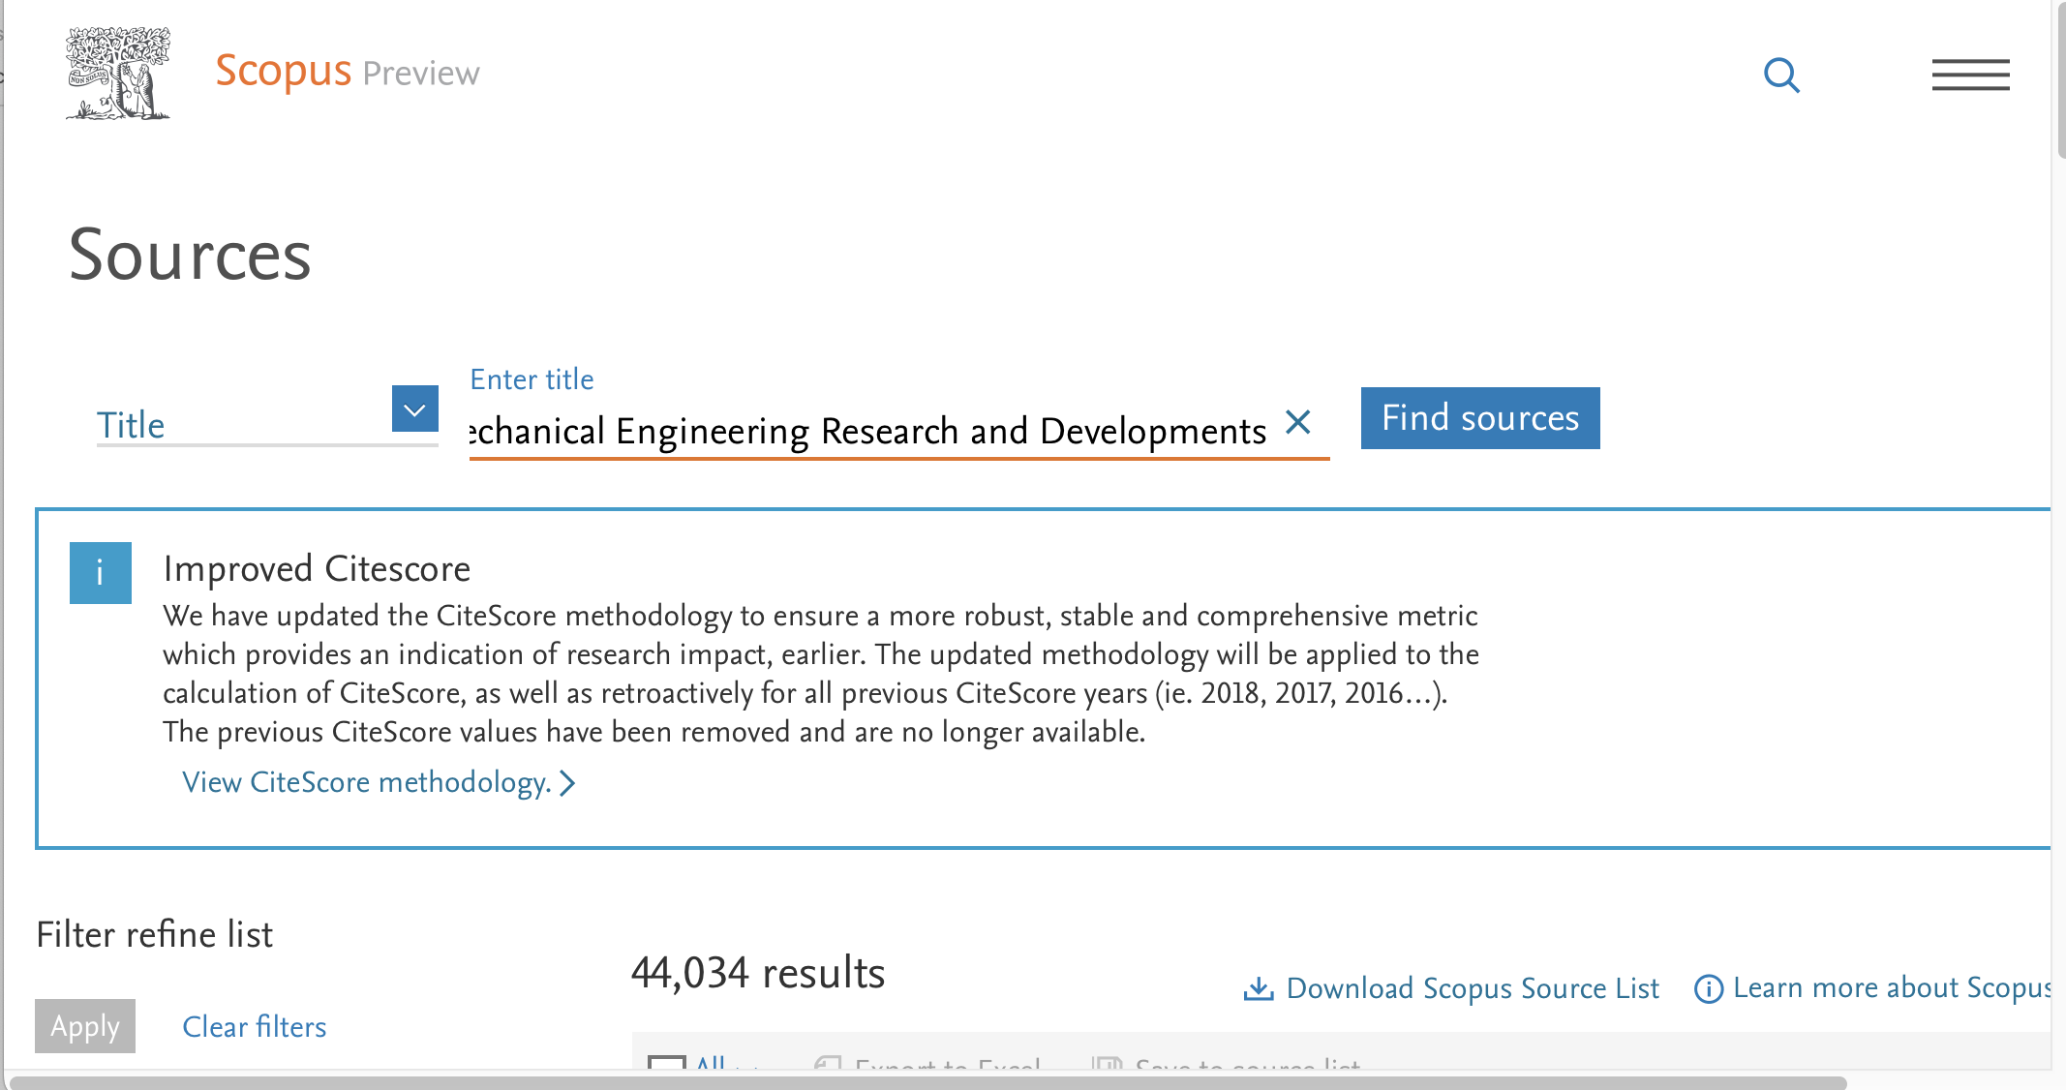

Slide 38
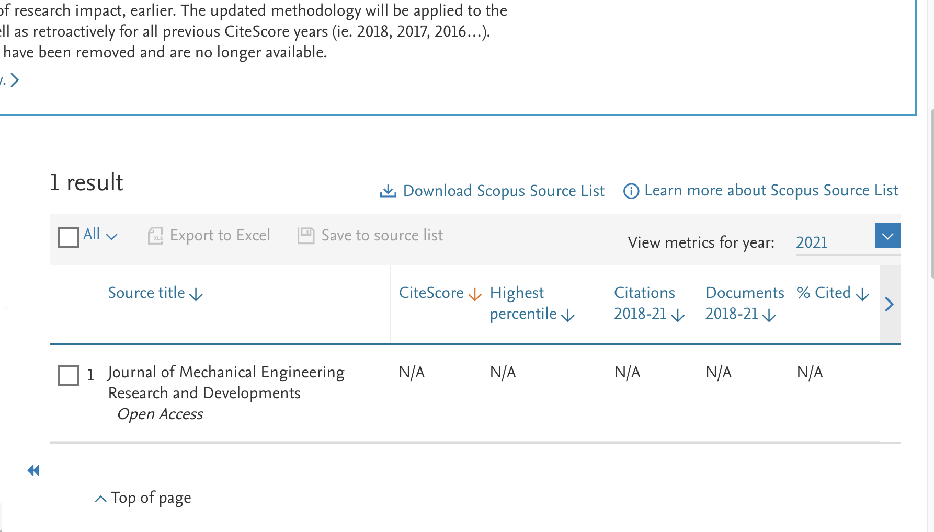

Slide 39
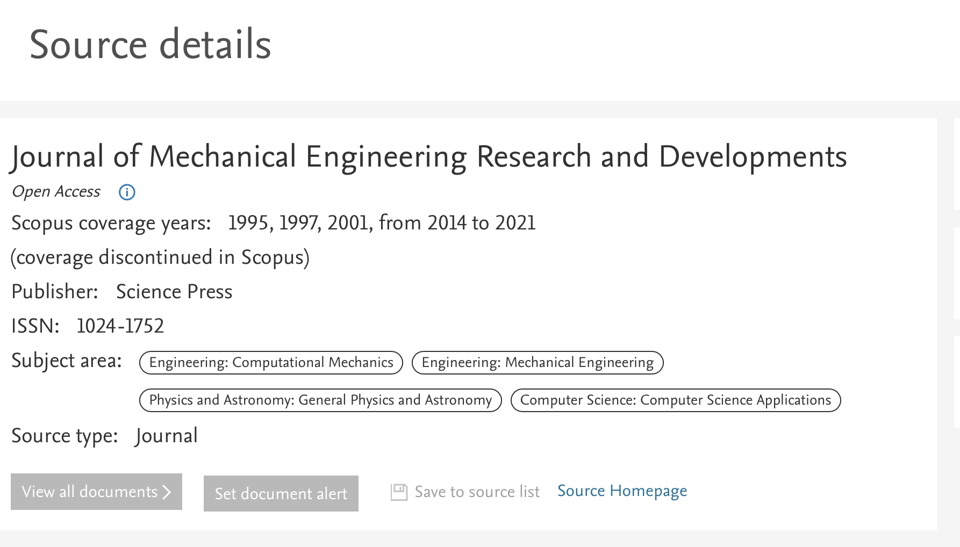

Slide 40
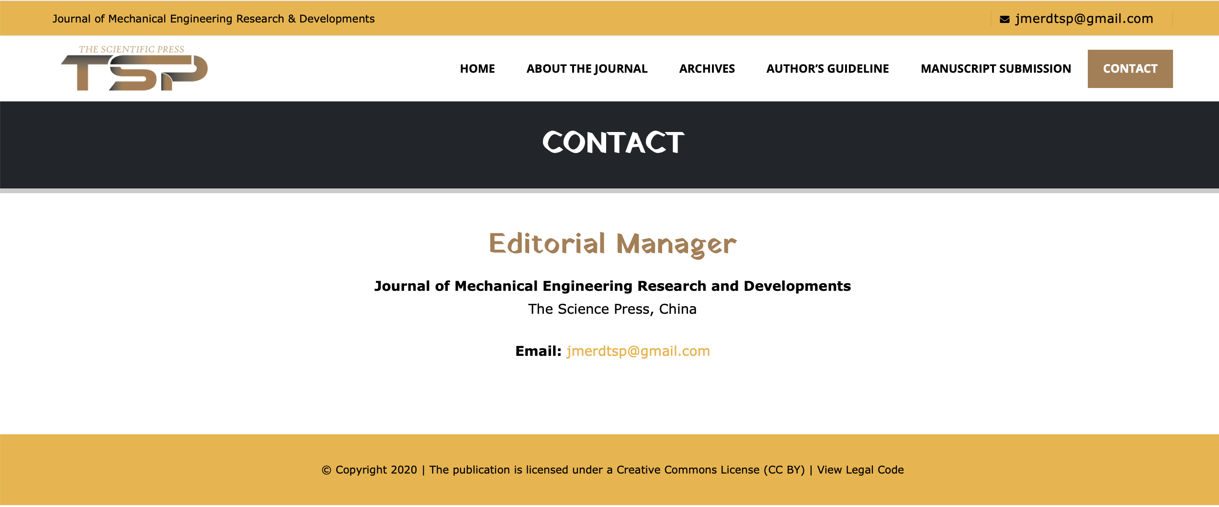

Slide 42
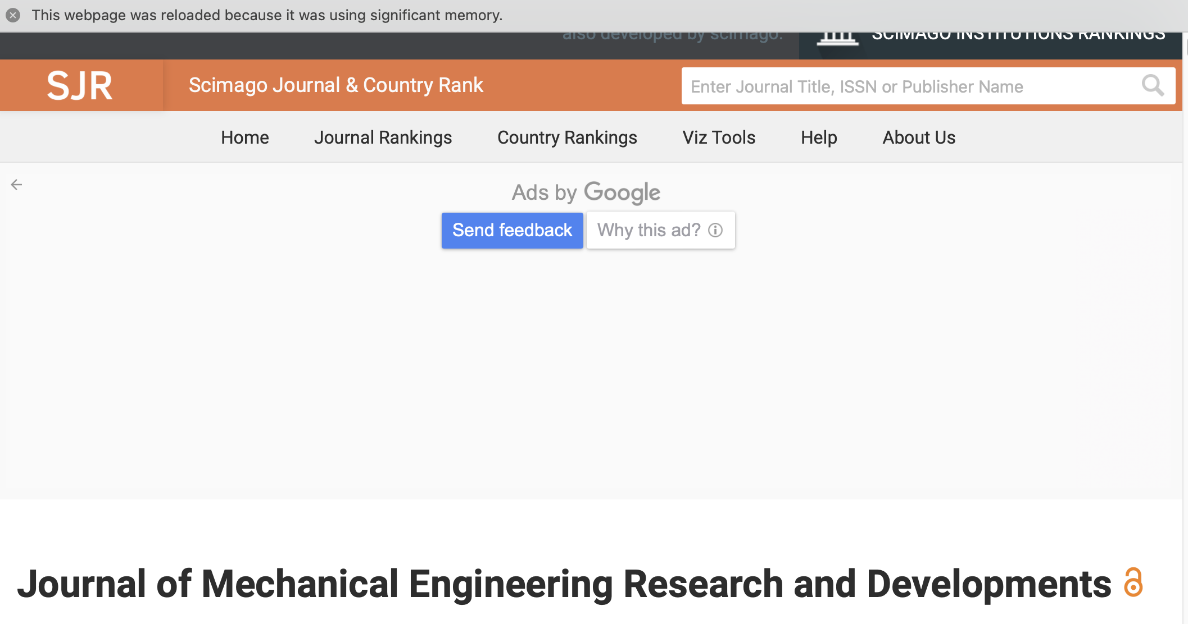

Slide 43
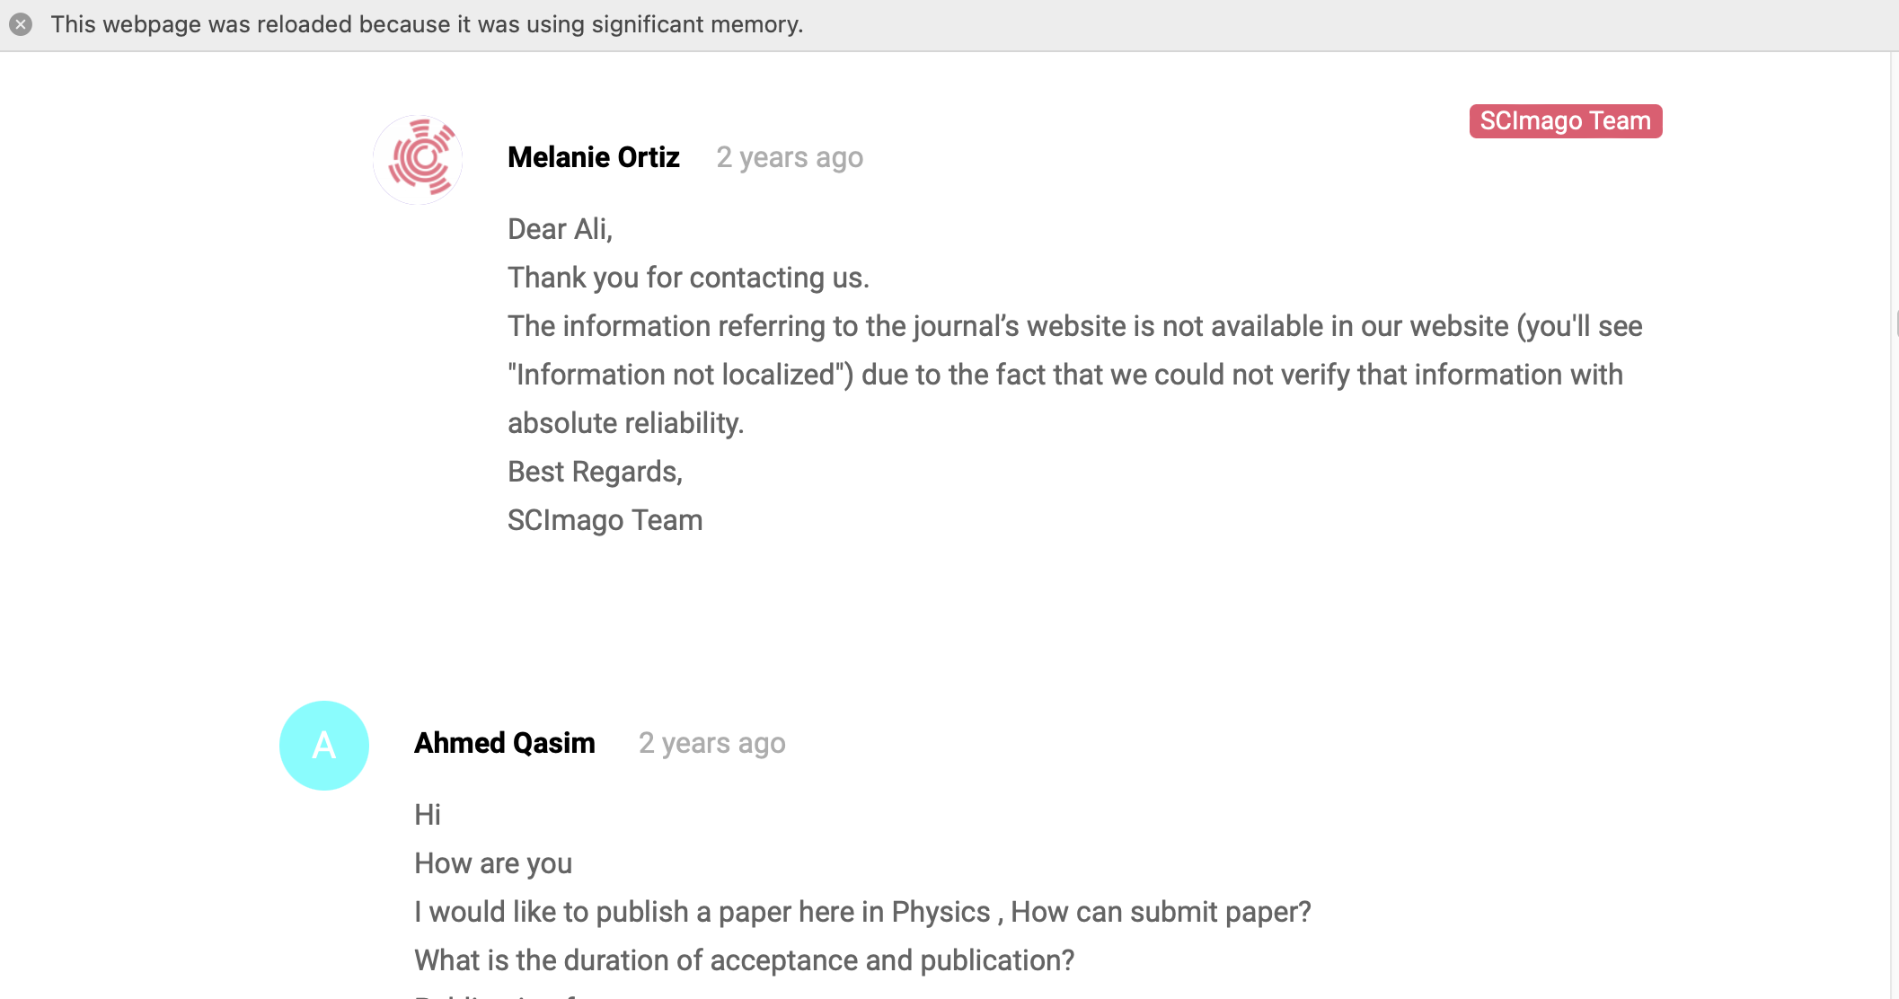

Slide 44
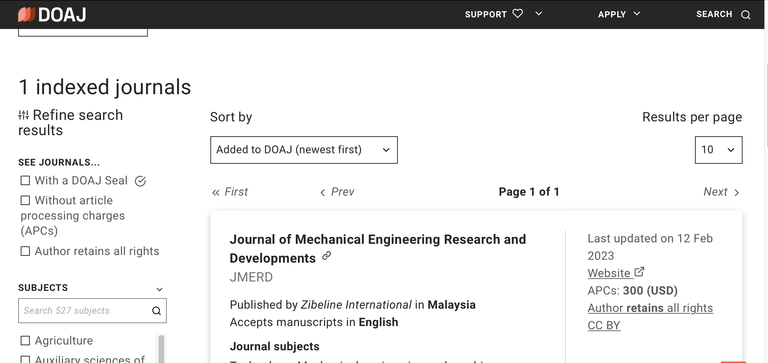

Slide 45
Thank you for your attention
israa@kecbu.uobaghdad.edu.iq
israaukm@gmail.com

