Slide 1
Bio Polymer
Filler
م. زينب يعقوب
م. هــدى عـادل
ا.م.د. شذى كاظم
م.د. روى غسـان

Slide 2
The introduction :-
Polymer filler fillers are one of the most important fillers that help create the required filler. O help
Polymers improve various loaners of the desired filler, such as length, shape and size
And the components that make up the filler, as well as the use of polymers to control the formation of fillers, and that through .
The term filler is attributed to the scientist William FellerThere are more than 140 types of cosmetic filler injections in the UK and the European market, while in the US there are only six types authorized for use. In 2012, the Artiste was launched in the U.S. market and is a regulator and auxiliary device for subcutaneous filler injection. Studies have shown that the device can reduce patient discomfort and side effects by controlling the flow rate of filler injections that the doctor uses to fill lips and frown lines.
Control the different layers that form the filler. Thus, the padding of the total (english) was ensured:
A coin of a filling of soft tissues under the skin to help fill (filler injectable).
Wrinkles on the faceand restore a more smooth appearance. Most of these wrinkle fillings are now in
Eventually it was absorbed from the body's pulp. Some people need more than one hamna to protect you.
Homogeneous effect on wrinkles.The effect will last for six months or more. The success of the results depends on
Skin health, skill of MMMDM health shepherds, type of filling used

Slide 3
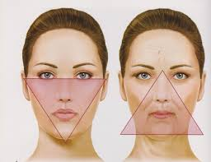
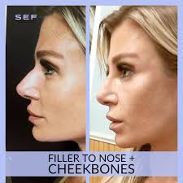
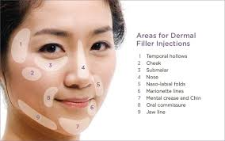
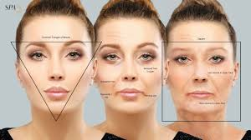
Injectable filler is the process of injecting a filling of soft tissue under the skin to help fill in wrinkles on the face and restore a smoother appearance. Most of these wrinkle fillings are temporary because they are eventually absorbed by the body.
Some people may need no more than one injection to achieve a homogeneous effect on wrinkles. The effect lasts for six months or more. The success of injection results depends on the health of the skin, the skill of the health care provider, and the type of implant used. In the United States, cosmetic implant injections are approved as medical devices and supplies by the U.S. Food and Drug Administration and these injections can be prescribed and injected by health care providers.
While in Europe and the UK, cosmetic implants are classified as medical devices and supplies that can be prescribed and dispensed without the need for a prescription and can be injected by anyone licensed to do so by the relevant medical authorities. And they require the mark «European conformity», which regulates compliance with production standardsBut does not require any evidence of medical competence.

Slide 4
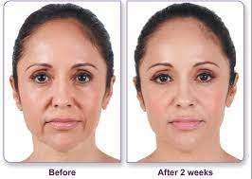
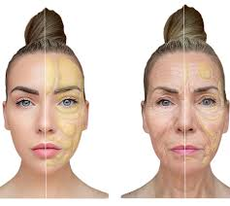
The advantages that are supplied by polymers
Polymers are one of the most important advantages offered by fillers. Allows using them protects you from the required performance of the filler, and that through improves the quality, performance and design of the filler. In addition, the polymer helped improve the thermal performance of the filler, and they are bored of the excess heat produced by the filler and improve the thermal performance of the filler

Slide 5
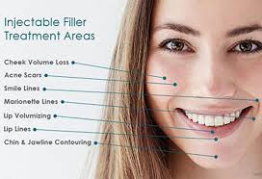
How it works
For dermal cosmetic filling, also known as "injections" or "soft tissue fillers", as their name suggests: they fill empty areas and cavities under the skin. Some fillers are natural and some are manufactured, but they all improve the appearance of the skin and hide the signs of aging in the following ways:
Filling wrinkles, fine lines and deep wrinkles
Improve other imperfections such as scars
Filling delicate lips or wrinkles
Stacked cheeks
Drawing the jawline and other areas of the face

Slide 6
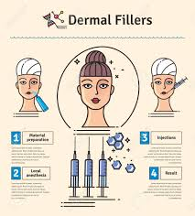
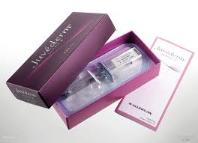
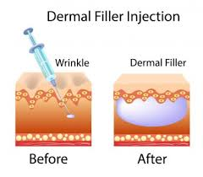
Materials used
Materials used in the manufacture of cosmetic fillers are extracted from sugar molecules or consist of hyaluronic acids, collagen, which are extracted from pigs, cows or carcasses, or can be generated in the laboratory, and biopolymers can also be used in the manufacture of cosmetic fillers, including calcium hydroxylapatite, polycaprolactone, polymethyl methacrylate, and polylactic acid.

Slide 7
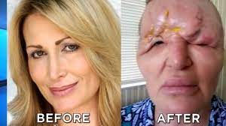
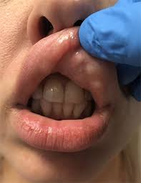
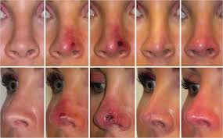
Risk
Risks of using cosmetic filler injections incorrectly include bruising, redness, pain or itching at the injection site. Less commonly, there may be infections or allergic reactions, and may cause scars and lumps that may require surgical intervention. A study published in the Journal of the American Society of Dermatology in March 2015 showed that the incidence of filler complications and side effects was less than 1% of those studied.

Slide 8
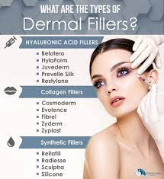
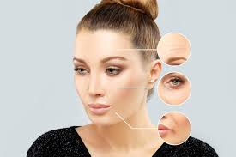
Types of fillers
1- Hyaluronic acid :-
This substance is the most common in filler injection sessions for several reasons, most notably that this substance is completely safe for the body as it is consumed by the body naturally, without any side effects such as those resulting from permanent fillers. It can be repeated easily as soon as its size decreases significantly, and repeated injections do not cause any side effects or damage, as well as they do not cause allergies with reasonable costs, and their results often last from 6 months to a year.
2- Calcium hydroxylabtate :-
This material is also one of the most commonly used types of fillers, as it is a completely safe natural material that naturally exists within the human bone tissue, and can be manufactured commercially as well. This substance does not cause any side effects or complications, and gives the injected area a normal full appearance and its results last until about 12 months, and then dissolves in the body over time naturally.

Slide 9
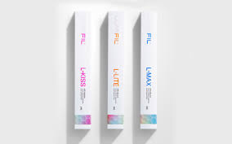
3- Autologous fats :-
It is a fat that is extracted from the body of the condition for which filler needles will be injected, so it is called "body fat". This technique depends on the doctor suctioning a quantity of fat from the patient's body from a specific agreed place, mostly from the lower abdomen and then treating it to re-inject it again into certain areas of the face or body. Many prefer to use this method because it is completely safe, because the substance used in the injection is extracted from the same body as the patient, but it is disadvantaged by the lack of continuity of results due toBecause it requires miniliposuction before the filler injection process.
4- Animal collagen :-
It is considered one of the first materials used in fillers, and it is extracted from animals, specifically from cow skins, and is considered one of the common types due to its cheap cost, and is used with deep wrinkles. It is considered one of the safe substances authorized by the US Drug Authority, but before using it is preferable to make sure that the person who will be injected, does not suffer from any allergy to animal ingredients

Slide 10
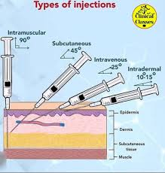
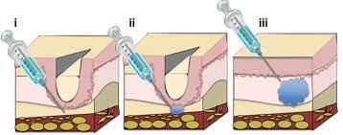
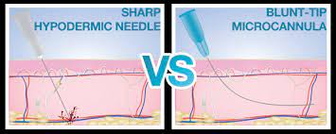
Uses of filler needles
Uses of filler needles There are many uses of cosmetic and therapeutic filler injections that have contributed to the spread of this technique on a large scale, especially with the wonderful results and ease of procedure as a safe alternative to complex and expensive plastic surgeries at the same time, and the most prominent uses of filler needles for the face and body are the following :-
Treatment of wrinkles such as smile line .
Cases of sagging cheeks.
Contour of the face, cheeks and jaw.
Accentuate the chin .
Treatment of wrinkles in the neck area.
Treatment of wrinkles and cracks of the hands.
Filler bikini area to restore freshness and tighten the area.
Body filler used in buttocks and buttocks contours .

Slide 11
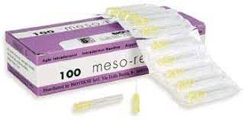
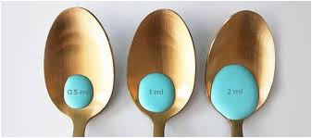
Conclusions
The use of polymers in fillers included improved quality, performance and design the inside of the filler, so that they control the layers that form the desired filler.
Also, the influence of polymers included improved thermal performance of fillers and boredom excess heat produced by fillers, and consequently, the evil use of polymers in the filler that it can protect you the required performance of the filler using polymers, through the control of the layers that form the filler required.
In general, determining the material of filler injection is ultimately due to the opinion of the treating doctor, who chooses it according to his previous experience, the condition of the skin and the problem it suffers from. Cosmetic doctors always prefer to use hyaluronic acid filler and calcium hydroxylabite filler because they are the safest and their results are more than wonderful.

