Slide 1


A work shop submitted by
Prof. Dr. Ali H. Abbar
University of Baghdad, Al-Khwarizmi College of Engineering, Department of Biochemical Engineering
Electrochemical technologies
in wastewater treatment

Slide 2

فَأَمَّا الزَّبَدُ فَيَذْهَبُ جُفَاء وَأَمَّا مَا يَنفَعُ النَّاسَ فَيَمْكُثُ فِي الأَرْضِ كَذَلِكَ يَضْرِبُ اللّهُ الأَمْثَالَ
صدق الله العظيم
سورة الرعد(17)

Slide 3
introduction
Fresh water is one of the world’s scarcest resources. Only 2.5% of the earth’s water is fresh water, of which 70% is frozen in icecaps and only 1% of the earth’s fresh water available for human consumption.
Each year around US$150 billion is spent worldwide on wastewater treatment. Water treatment, management, and recycling are also of critical importance for industrial processes, power generation, the chemical industry, and the pharmaceutical industry.
Efficient management of the industrial water cycle can influence production performance, operating costs and the environment.

Slide 4
introduction
A wide variety of products (over 100,000) are manufactured in the chemical and pharmaceutical manufacturing industries.
As a consequence, waste streams generated in these industries can be heavily laden with contaminants, toxins, nutrients, and organic content, presenting unique challenges in terms of treatment especially as regulations become more stringent.
On the other hand, industrial-manufacturing processes in the pharmaceutical industry produce wastewater that is generally characterized as high strength organic effluent—waste streams that can be challenging to manage with conventional wastewater treatment.

Slide 5
Traditional wastewater treatment

Slide 6
Electrochemical Technologies for Water Treatment
Over the last two decades, electrochemical technologies have been studied in the field of wastewater treatment in the world.
These technologies have many advantages as compact model, saving area, highly removal efficient of non-biodegradable compounds, reduction of secondary by-products, and can be integrated with environmentally friendly methods.
Types of wastewater have been studied such as: petroleum refining, tanning, pharmaceuticals , textile, carwash and dairy
Electrochemical technologies used for water treatment:
Electrodeposition
Electrocoagulation
Electroflotation Combined process
Electrooxidation (New challenge)
Electrokinetics

Slide 7
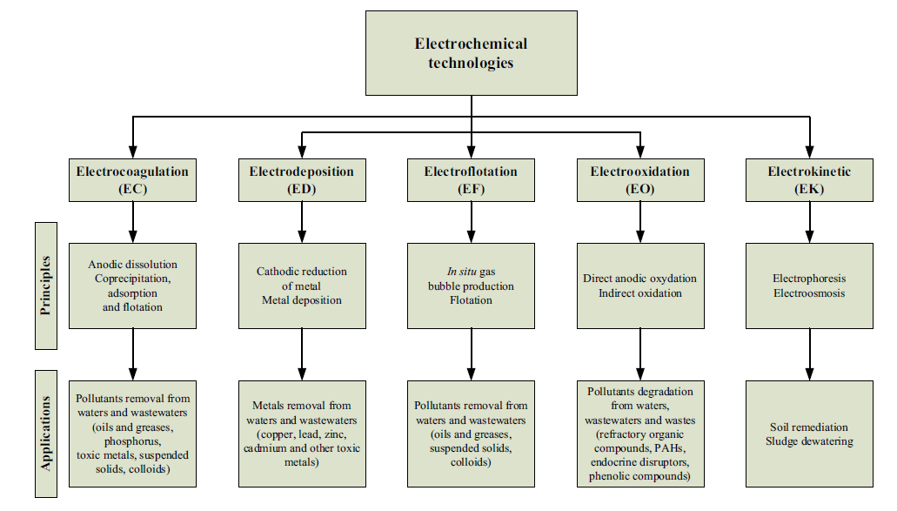
Fig. (1). Electrochemical technologies for environnemental applications

Slide 8
ELECTRODEPOSITION
Metals such as Ni, Co, Cr, Ag, Au, Fe, Cu, Zn, and V are widely used as base catalysts for multiple applications and electroplating industry
The production of such wastes is a major environmental concern due to their toxicity potential for emissions to the environment
Electrodeposition (ED) process refers to electrochemical process for metal removal or recovery.
This technology is widely used either to remove toxic metals (Pb, Cd, Cu, Ni, Zn, Cr and others) from industrial effluents or to recover precious metals (Ag, Pt, Au, etc.)from solutions.

Slide 9
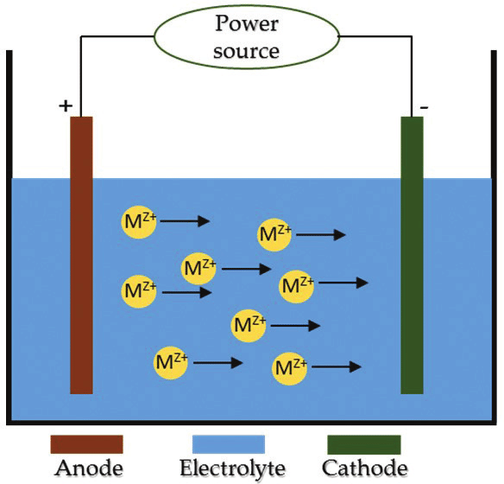
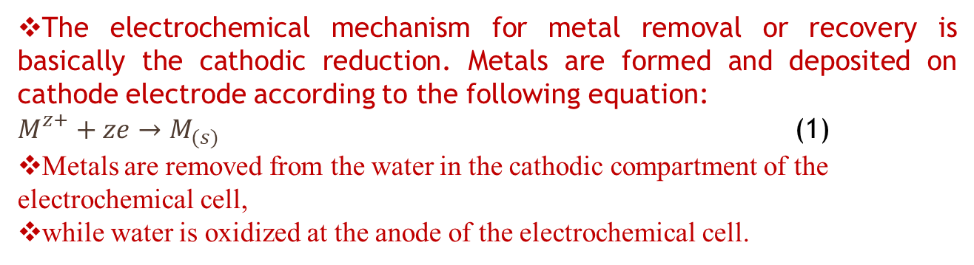
Figure(1) Electrochemical cell.
The electrochemical mechanism for metal removal or recovery is basically the cathodic reduction. Metals are formed and deposited on cathode electrode according to the following equation:
$M_{}^{z+}+ze→M_{(s)}$ (1)
Metals are removed from the water in the cathodic compartment of the electrochemical cell,
while water is oxidized at the anode of the electrochemical cell.

Slide 10
Several metals mentioned in Table 1 can be recovered effectively by ED from aqueous solution, depending on the Electrochemical Motive Force (EMF).
the ranking of the potential on the electrochemical series determine the relative oxidation (positive potential) and reduction power of species.
Thus, for effluent contains several metals (for instance Cd, Co, Cu, Ni, Pb and Zn). Accordingly, the EMF series follow the order of metals deposition as: Cu > Pb >Co > Ni > Cd > Zn.
Table (1)

Slide 11
ELECTRODEPOSITION
However, other parameters, such as the pollutant concentration, and the affinity existing between the pollutant and cathode electrode can considerably influence cathodic deposition of metal .
It is the reason for which a preliminary voltametric study is required to choose suitable electrode material for metal deposition.
The development of the electrochemical process is highly affected by the current efficiency (CE) as well as the space-time yield (STY) of the reactor—defined as the mass of product produced by the reactor volume per unit time.

Slide 12
ELECTROchemical cell design
Different types of electrochemical reactors have been implemented for metal recovery, including plate and frame cells, tank cells, rotating cells, fluidized beds, and packed beds. Because of the high oxidation potential in the electrochemical reactor caused by water oxidation, anode materials for metal recovery are typically made of dimensionally stable anodes (DSA).
Figure(2) Tank cell.

Slide 13
ELECTRODEPOSITION
Figure(3) Filter press reactor.
Figure(4) Rotating cylinder electrode

Slide 14
ELECTRODEPOSITION
Figure(5) Pump cell.

Slide 15
Figure(6) Fixed bed reactor
Figure(7) Fluidized bed reactor.

Slide 16
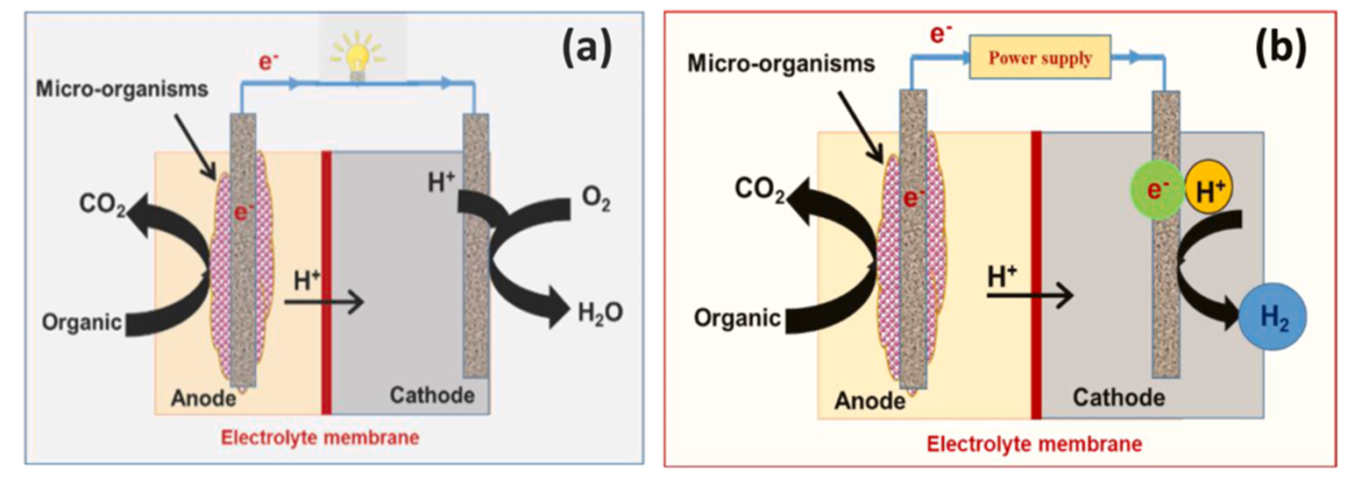
Bioelectrochemical systems (BESs)
A BES is called a microbial fuel cell (MFC) if electrical power is harvested and is called a microbial electrolysis cell (MEC) if electrical energy is supplied to drive an otherwise nonspontaneous reaction. The schematics of microbial fuel and electrolysis cells, as typical examples of BESs are shown in Fig. 8.
Fig. 8. Schematic diagram of bioelectrochemical cells, (a) microbial fuel cell MFC, (b) microbial electrolysis cell MEC.

Slide 17
Advantages of Electrodeposition
Electrodeposition (ED) could offer an alternative solution to remove effectively metals from solution by minimizing the amount of metallic sludge residues produced. The treatment is carried out without addition of chemicals, so that the treated effluent or solution can often be recycled .
Contrary to chemical precipitation, the application of ED allows maintaining a final pH similar to the initial value recorded before treatment.
Another particularity of ED process results from its capability of selectively recovering metals.
The corresponding anodic reaction can be advantageously exploited to destroy other organics.

Slide 18
Drawbacks of Electrodeposition
The application of ED process faces several technological constraints that must be overcome to make this process more effective:
The interference occurring owing to the hydrogen evolution or oxygen reduction on cathode electrode has to be prevented or minimized by choosing suitable electrode.
The surface of cathode electrode is modified during electrolysis and needs additional process control.
Sometimes a supporting electrolyte must be added in solution owing to low ion concentration, resulting in the increase in the treatment cost.
when the initial concentration in effluent is low, the process becomes mass transport limited. Consequently, mass transport enhancement has to be achieved to make the process efficient
Potentiostatic control is usually used to maximize current efficiencies and minimize parasitic reactions. However, potentiostatic control is difficult to achieve in full scale application

Slide 19
Our contribution

Slide 20
Our contribution

Slide 23
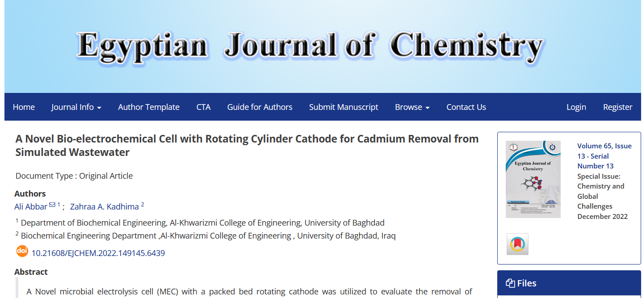
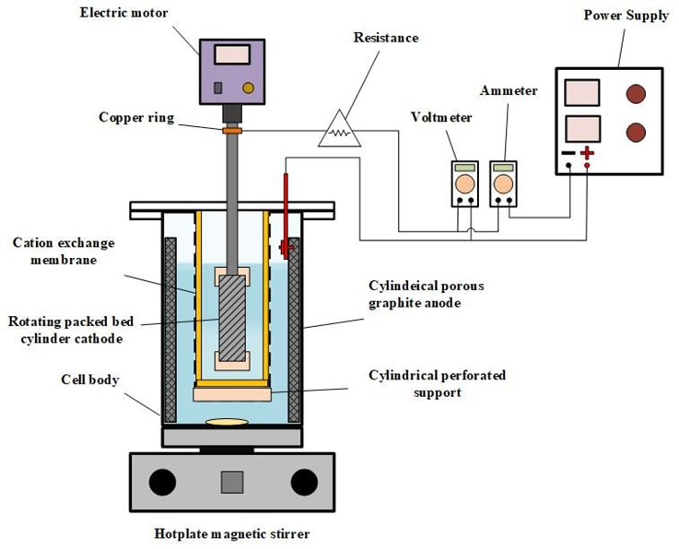


Slide 24
ELECTROCOAGULATION
Electrocoagulation (EC) has been used for the treatment of wastewater for the removal of suspended solids, the removal or destruction of microorganisms, algae, iron, silicates, and humus.
EC applications include the treatment of wastewater from textile, petroleum and oils shale wastewater, municipal sewage, oily wastewater, refractory oily wastewater, restaurant wastewater, wastewaters loaded with phenol, etc.
Likewise, it has been used to remove color causing-compounds and suspended clay from effluents. EC process has also been proposed for removal of toxic metals , for phosphate removal from laundry effluent, for nitrate removal , and for fluoride removal.

Slide 25
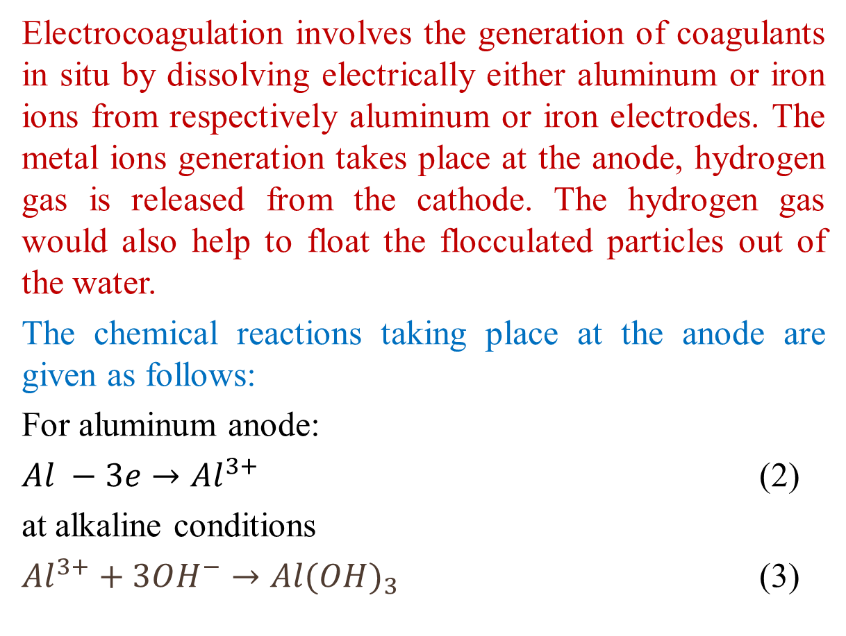
ELECTROCOAGULATION
Electrocoagulation involves the generation of coagulants in situ by dissolving electrically either aluminum or iron ions from respectively aluminum or iron electrodes. The metal ions generation takes place at the anode, hydrogen gas is released from the cathode. The hydrogen gas would also help to float the flocculated particles out of the water.
The chemical reactions taking place at the anode are given as follows:
For aluminum anode:
$Al −3e→Al_{}^{3+}$ (2)
at alkaline conditions
$Al_{}^{3+}+3OH^{−}→Al{(OH)}_{3}$ (3)

Slide 26
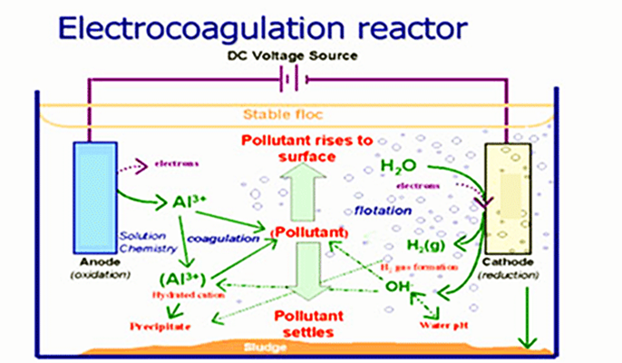
ELECTROCOAGULATION
Figure(9)

Slide 27
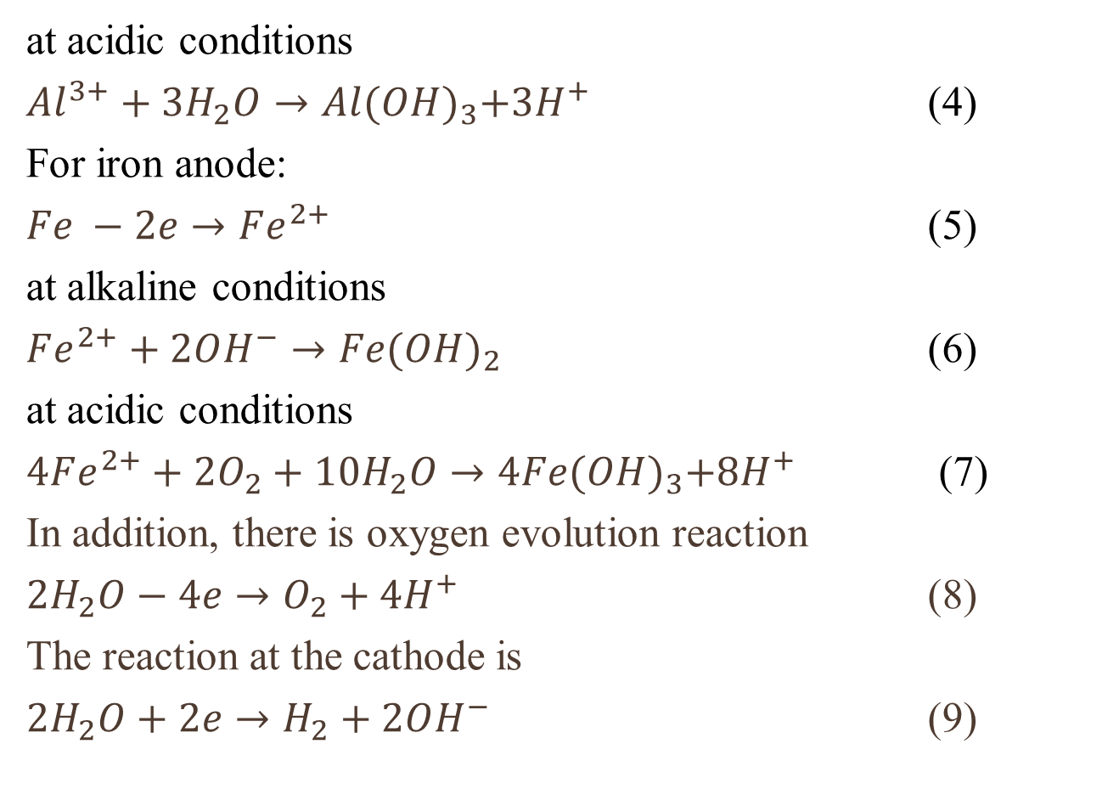
ELECTROCOAGULATION
at acidic conditions
$Al_{}^{3+}+3H_{2}O→Al{(OH)}_{3}+3H^{+}$ (4)
For iron anode:
$Fe −2e→Fe_{}^{2+}$ (5)
at alkaline conditions
$Fe_{}^{2+}+2OH^{−}→Fe{(OH)}_{2}$ (6)
at acidic conditions
$4Fe_{}^{2+}+2O_{2}+10H_{2}O→4Fe{(OH)}_{3}+8H^{+}$ (7)
In addition, there is oxygen evolution reaction
$2H_{2}O−4e→O_{2}+4H^{+}$ (8)
The reaction at the cathode is
$2H_{2}O+2e→H_{2}+2OH^{−}$ (9)

Slide 28
ELECTROCOAGULATION
This process sometimes is called electrofloculation. It is schematically shown in Fig. 10. The electrodes can be arranged in a mono-polar or bi-polar mode. The materials can be aluminum or iron in plate form or packed form of scraps such as steel turnings, millings, etc.
(a) Horizontal flow (b) Vertical flow
Fig. 10. Electrocoagulation units.

Slide 29
Factors affecting electrocoagulation
Current density or charge loading
The current efficiency depends on the current density as well as the types of the anions. The quality of the treated water depends on the amount of ions produced (mg) or charge loading, the product of current and time (Ah).
Presence of NaCl
The addition of NaCl would also lead to the decrease in power consumption because of the increase in conductivity. Moreover, the electrochemically generated chlorine was found to be effective in water disinfections
pH effect
The effects of pH of water or wastewater on electrocoagulation are reflected by the current efficiency as well as the solubility of metal hydroxides.
It is generally found that the aluminum current efficiencies are higher at either acidic or alkaline condition than at neutral. The pollutants removal efficiencies were found to be the best near neutral pH using aluminum electrode
Temperature
Although electrocoagulation has been around for over 100 years, the effect of temperature on this technology was not very much investigated. The current efficiency of aluminum increases initially with temperature until a maximum at 60 ◦C. Further increase in temperature results in a decrease in CE.

Slide 30
Advantages of Electrocoogulation
The interest of using EC for water or wastewater treatment can be summarized in four main points.
Firstly, EC allows in situ production of a coagulating agent, contributing to cost reduction related to chemical transportation in large scale application. Likewise, this approach enables to get rid of the constraints linked to the storage of chemical products.
Secondly, during EC, the resulting effluent is not enriched with anions and salts content does not increase compared to chemical coagulation. This contributes to production of metallic sludge which is more compact using EC compared to those generated by chemical coagulation or precipitation.
Thirdly, EC treatment has a practical advantage of producing effluent having pH close to the neutral value, often required for effluent discharge in the receiving water. In comparison, the effluent from the FeCl3 process or fromAl2(SO4)3 process needs to be neutralized (by (Ca(OH)2 or (NaOH)) before discharge, since these chemicals are highly acidic solutions.
Another interesting characteristic of EC results from its capability of setting smallest colloidal particles in motion owing to the electric field induced by the potential difference, resulting in an increase in probability of aggregating dispersed or colloïds particles.

Slide 31
Drawbacks of electrocoagulation
Despite the effectiveness of EC process in removing pollutants
(organic, inorganic and bacteria) and its practical advantages
(compared to chemical coagulation), it has some drawbacks such as
high energy consumption
sometimes the difficulty to successfully dewater the metallic sludge.
In fact, while the effluent is not sufficiently conducive, the energy consumption increases resulting in the increase of treatment cost. Likewise, the metallic sludge is sometimes comprised of thin particles, which are difficult to effectively dewater. The resulting low solid content of the sludge induces high transportation and final disposal cost of sludge.

Slide 32
Our contribution

Slide 33
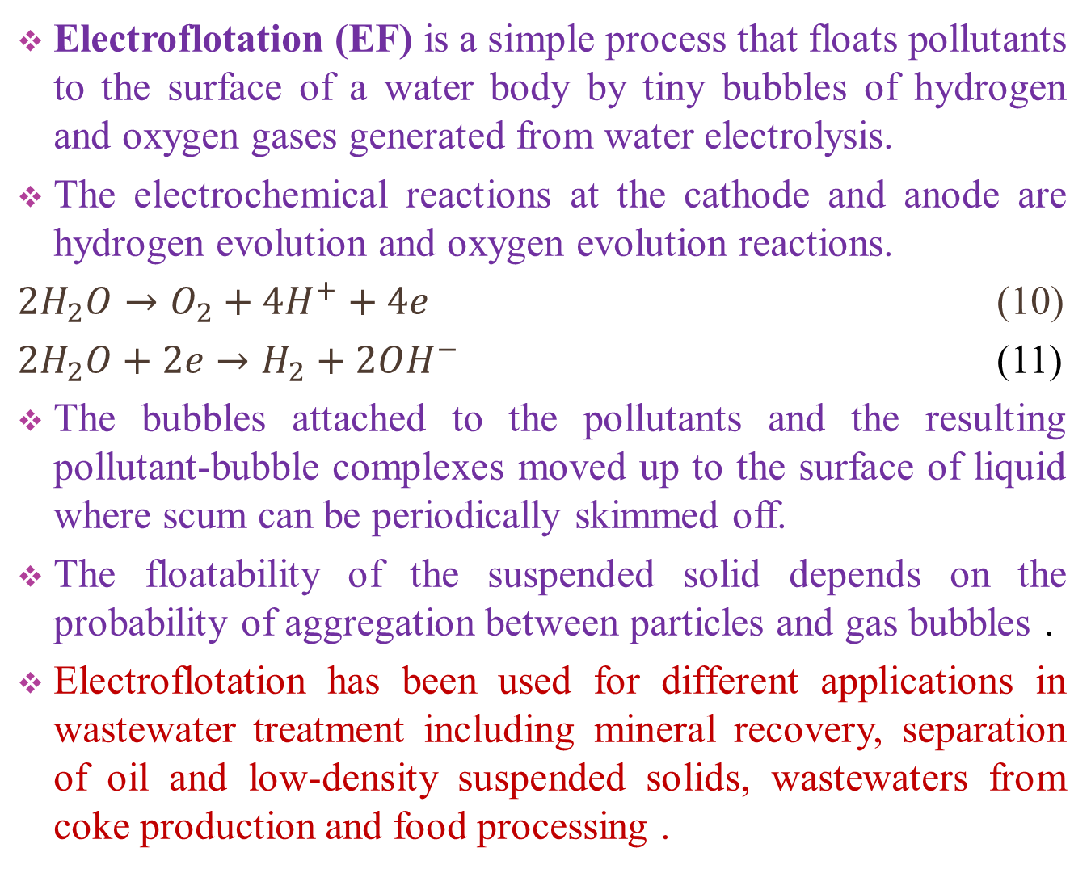
ELECTROFLOTATION
Electroflotation (EF) is a simple process that floats pollutants to the surface of a water body by tiny bubbles of hydrogen and oxygen gases generated from water electrolysis.
The electrochemical reactions at the cathode and anode are hydrogen evolution and oxygen evolution reactions.
$2H_{2}O→O_{2}+4H^{+}+4e$ (10)
$2H_{2}O+2e→H_{2}+2OH^{−}$ (11)
The bubbles attached to the pollutants and the resulting pollutant-bubble complexes moved up to the surface of liquid where scum can be periodically skimmed off.
The floatability of the suspended solid depends on the probability of aggregation between particles and gas bubbles .
Electroflotation has been used for different applications in wastewater treatment including mineral recovery, separation of oil and low-density suspended solids, wastewaters from coke production and food processing .

Slide 34
ELECTROFLOTATION
Typical EF systems consist of two electrodes, a power supply, and a sludge-handling unit.
Electrodes are typically placed at the bottom of the cell and they can be placed vertically or horizontally.
Graphite (Gr) and lead dioxide (PbO2) are among the most common insoluble anodes used in electroflotation, followed by dimensionally stables anode (DSA) electrodes, such as Ti/IrO2,Ti/RuO2, TiO2-RuO2, Ti/Pt(fig.11)
Figure(11)

Slide 35
Factors affecting electroflotation
pH effect
The size variation of the bubbles depends on water pH as well as the electrode material
The hydrogen bubbles are smallest at neutral pH. For oxygen bubbles, their sizes increase with pH.
Using buffer solution, optimal is at pH between 3 and 4. Decrease or increase pH from 3 to 4 results in the increase of hydrogen bubbles.
Current density
The gas bubbles depends also on the current density incresase with increasing current.
Surface condition
The polished mirror surface of the stainless steel plate gives the finest bubbles. Besides size of bubble, the bubble flux, defined as the number of gas bubbles available per second per unit cross-section area of the flotation cell.

Slide 36
Factors affecting electroflotation
Therefore, the bubbles generated at both electrodes can be dispersed into wastewater rapidly and attach onto the flocs effectively, ensuring high flotation efficiency. Another arrangement of the electrodes is shown in Fig. 12. It has the advantage of the uniform property of the surface of an electrode. It is also very much efficient
Figure(12)
Figure(13)

Slide 37
Advantages of Electroflotation
The effectiveness of EF process results from its capacity to produce uniform and tiny bubbles. It is well-known that the solid/liquid separation efficiency by flotation or EF depends greatly on bubble sizes.
Generally, smaller the size of gas bubbles, more effective the process is for removing suspended and colloidal particles from solution. the average size of hydrogen bubbles generated during EF varied from 15 to 30 μm, whereas the size of oxygen produced ranged from 45 to 60 μm for an imposed current density of 10 to 40 mA/cm2.
In comparison, the bubble sizes of conventional dissolved air flotation (DAF) varied from 50 to180 μm, which values are three to four times higher than those recorded by EF. Besides, EF process requires simple and compact equipment.

Slide 38
Drawbacks of Electroflotation
EF has some drawbacks such as the change in electrode surface.
The corrosion of anode electrode occurs while the effluent contains fatty acids.
In fact, cleaning is periodically required. The inversion of polarity (anode becomes cathode and cathode becomes anode) is periodically required, while the anodic electrode is not necessarily a good cathode electrode and reciprocally.
On the other hand, EF reactors are usually comprised of two horizontal electrodes installed at the bottom of the cell with an interelectrode gap varying from 10-50 mm. It has been reported that such electrode arrangement cannot ensure quick dispersion of the oxygen bubbles generated at the bottom anode into wastewater flow, affecting flotation efficiency due to the bubbles that agglomerate.

Slide 39
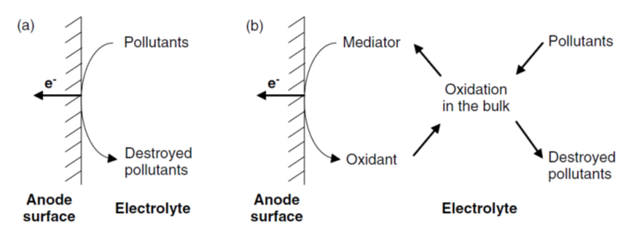
ELECTROOXIDATION
Electrochemical oxidation is considered to be a very powerful tool for breaking up most even the most resistant organic compounds.
The interest of using electrochemical oxidation is based on its capability of reacting on the pollutants by using both direct and indirect effect of electrical current. Direct anodic oxidation, where the organics can be destroyed at the electrode surface, and indirect oxidation where a mediator is electrochemically generated to carry out the oxidation.
Figure (14) Diagram of (a) direct pollutant oxidation (b) indirect pollutant oxidation

Slide 40
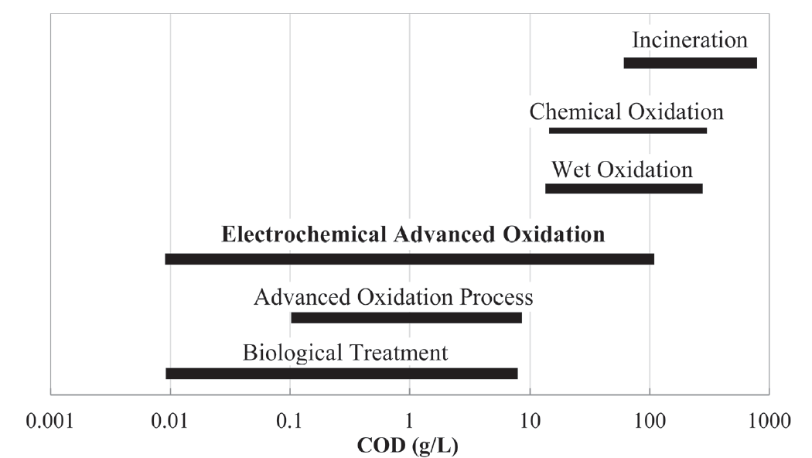
Figure(14) suitability of water treatment technology based on influent COD concentration

Slide 41
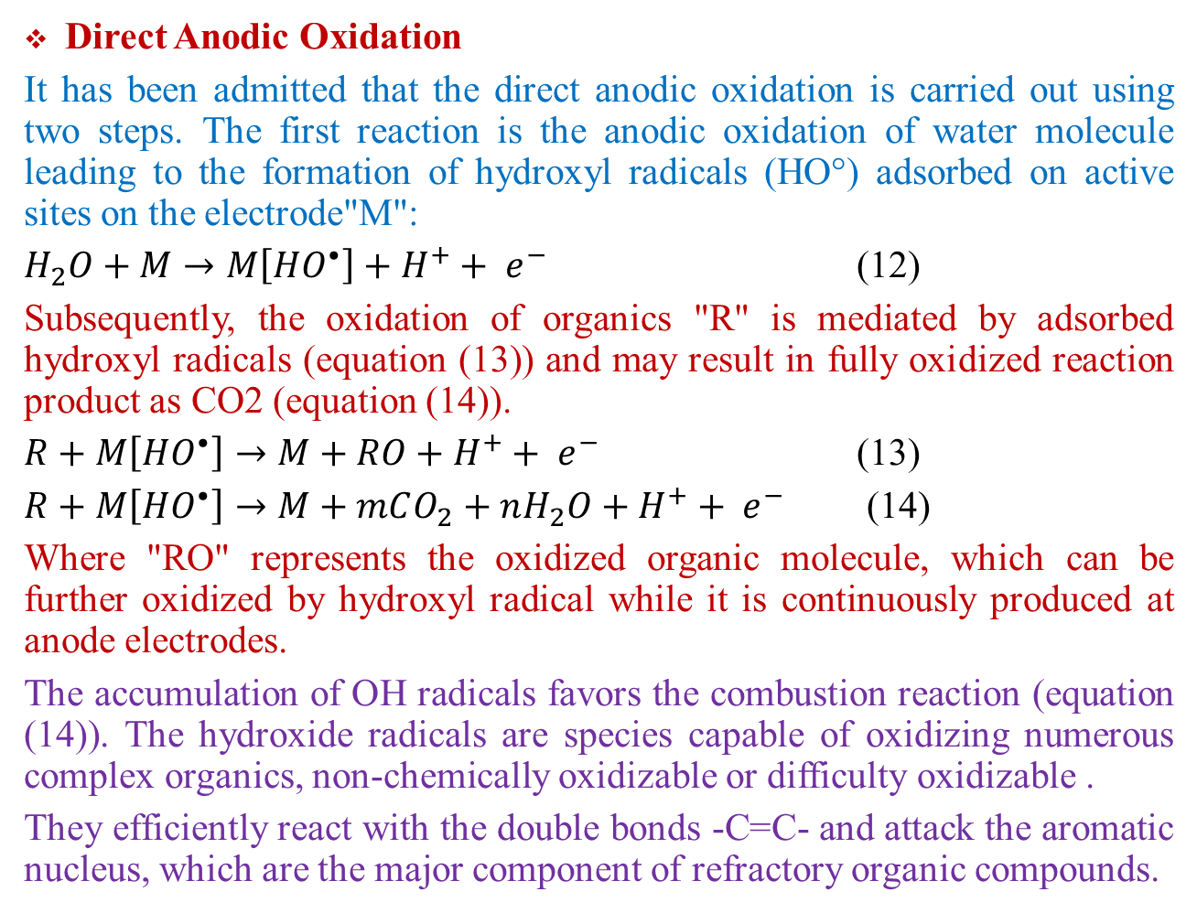
ELECTROOXIDATION
Direct Anodic Oxidation
It has been admitted that the direct anodic oxidation is carried out using two steps. The first reaction is the anodic oxidation of water molecule leading to the formation of hydroxyl radicals (HO°) adsorbed on active sites on the electrode"M":
$H_{2}O+M→M\left[HO^{•}\right]+H^{+}+ e^{− }$ (12)
Subsequently, the oxidation of organics "R" is mediated by adsorbed hydroxyl radicals (equation (13)) and may result in fully oxidized reaction product as CO2 (equation (14)).
$R+M\left[HO^{•}\right]→M+RO+H^{+}+ e^{− }$ (13)
$R+M\left[HO^{•}\right]→M+mCO_{2}+nH_{2}O+H^{+}+ e^{− }$ (14)
Where "RO" represents the oxidized organic molecule, which can be further oxidized by hydroxyl radical while it is continuously produced at anode electrodes.
The accumulation of OH radicals favors the combustion reaction (equation (14)). The hydroxide radicals are species capable of oxidizing numerous complex organics, non-chemically oxidizable or difficulty oxidizable .
They efficiently react with the double bonds -C=C- and attack the aromatic nucleus, which are the major component of refractory organic compounds.

Slide 42
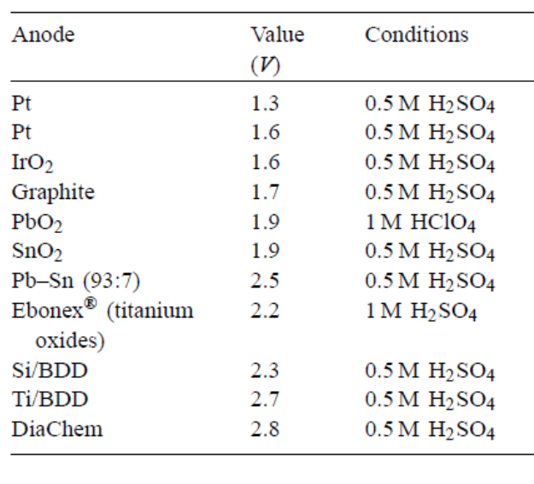
ELECTROOXIDATION
Table 6 Potential of oxygen evolution of different anodes, V vs. NHE

Slide 43
Indirect electro-oxidation via in situ generated chemical oxidants
Electrogeneration of active chlorine
The indirect effect of electrolysis is also interesting to destroy recalcitrant organics. For instance, in the presence of chloride ions, these ions can be respectively oxidized at the anode electrodes and formed in hypochlorous acid (HClO) solutions (see equations (16)). HClO is powerful oxidants capable of oxidising and modifying the structure of organic molecules and leading to more oxidized and less toxic compounds.
(16)
The choice of the anode material utilized is important for in situ
generation of active chlorine, and DSA-type anodes coated with alayer of RuO2 or IrO2 are particularly effective.
Active chlorine production is suitable for the treatment of some types of wastewaters, such as olive oil, textile, and tannery Effluents.

Slide 44
Electro-Fenton method
Indirect electro-oxidation methods based on the cathodic electrogeneration of hydrogen peroxide are being developed for the treatment of certain wastewaters, such as acidic wastewaters containing toxic and refractory organic pollutants.
The direct remediation of wastewaters using this approach is limited by the low oxidation potential of H2O2.
The electro-Fenton process is a more effective method of wastewater treatment, which is based on using H2O2 in acidic effluents with Fe2+ ion as catalyst (Fenton’s reagent) to give homogenous •OH as strong oxidant of organics according to the reaction:
(17)

Slide 45
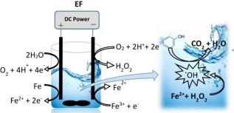
Electro-fenton methods have become very attractive owing to much higher degradation rates of organic pollutants than traditional Fenton method approaches due to the continuous regeneration of Fe2+ at the cathode via
This electrochemical approach thus avoids Fe3+ accumulation in the medium, thereby eliminating the production of iron sludge.
The electrofenton process has been successfully used to treat nonbiodegradable or refractory organic compounds such as: phenolic compounds, dyes, pesticides and herbicides, leachate.
BDD electrodes are particularly effective for the electrofenton process.

Slide 46
Drawbacks of Electrofenton
The main limitation of the Fenton approaches is the requirement of low pH conditions. Fe3+ precipitation from solution at pH ≥3.5 can led to the termination of this reaction.
The electrofenton system also requires a low solution pH, typically within the pH range less than 3.5 and consequently it is impractical if large amounts of chemicals are needed to acidify the water prior to treatment.
Therefore, the inherent drawback of needing a low pH limits wide application of the Fenton approaches, although they are useful when the solutions are initially quite acidic.

Slide 47
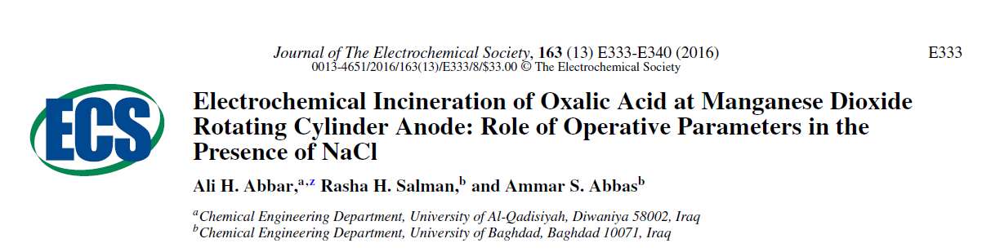
Our contribution

Slide 49
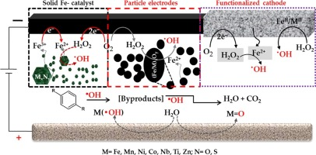
Combined processes
Electro-coagulation coupled electro-flotation process
Combined electrocoagulation–electrooxidation
Electrocoagulation/electrooxidation–electroflotation (ECEO–EF)
Hybrid electrocoagulation/ electrodialysis process
Electrocoagulation—photocatalytic process
Combined photoelectrocatalytic/electro-Fenton process

Slide 50
Our contribution

Slide 52
ELECTROKINETIC
Electrokinetic (EK) process is an emerging technology developed to remove inorganic and organic contaminants from wet solid matrix (including soils and sludge) with low hydraulic permeability.
This process involves the application of direct-current electric field across contaminated wet matrix through electrodes fixed firmly in the subsurface.
In fact, the EK process takes place when an electrical potential gradient is a much more effective force in driving fluid flow through particles of waste than a hydraulic force .
EK technique has been widely applied to remove metals and organic pollutants from soils or sludge
Extractability of contaminants depends primarily on the mobility of contaminants within the wet solid matrix (soil or sludge), which is a function of the chemical state of the contaminants, surface characteristic of matrix particles

Slide 53
ELECTROKINETIC
Fig. (13). Scheme of the different mechanisms involve in the electrokinetic process

Slide 54

Thank you

