Slide 1
corrosion protection and control using nanomaterials | اسم النشاط
23/03/2023 | موعد بدء وانتهاء النشاط
ورشة عمل | نوع النشاط
يتم التطرق الى التوجهات الحديثه في الحمايه من التاكل في المنشاءات الصناعيه باستخدام المواد النانويه | وصف النشاط
ا.د. علي حسين عبار ali.abbar@kecbu.uobaghdad.edu.iq | حساب مسؤول النشاط ووسائل الاتصال

Slide 2
Corrosion protection by electrodepostion as Nanomaterial coatings
الحمايه من التاكل بالترسيب الكهربائي بصيغة طبقة حمايه نانويه
Prof. Dr. Ali H. Abbar
Department of Biochemical Engineering, Al-Khwarizmi College of Engineering, University of Baghdad, Baghdad, Iraq

Slide 3
INTRODUCTION
In spite of much advancement in the science and technology of Corrosion prevention and control, the phenomenon of corrosion (usually of metals and alloys) continues to pose a major concern to many industries around the world. The direct and indirect cost of corrosion is huge (estimated to be US$2.2 trillion).
In general, corrosion can be prevented by suitable modifications in: material (e.g. selection of corrosion resistant materials), environment (e.g. addition of inhibitors) and material surfaces (e.g. coatings). Metals can be protected cathodically (e.g. cathodic protection) as well as anodically (e.g. passivation). In practice, effective corrosion control is achieved by combining two or more of these methods. Usually, highly corrosion resistant materials are associated with a high cost factor.
The use of cheaper metallic materials along with proper corrosion control strategies is therefore economic for many applications.

Slide 4
Nanomaterials in corrosion prevention
Among the different corrosion prevention strategies, coatings (both passive and active) are benefited appreciably by nanomaterials.
A nanocoating can be defined as having either the thickness of the coating in nanoscale or the second phase particles that are dispersed into the matrix in the nanosize range or coatings having nanosized grains/phases.
When conferring corrosion control by nanomaterials, there are two main considerations:
1)The first aspect is the understanding of corrosion behaviors of nanostructured materials; whether or not a nanostructured material possesses better corrosion resistance when compared with the micro structured counterpart.
2)The second aspect is how nanosized materials can be effectively employed in corrosion prevention strategies (e.g. in an automobile or aerospace coating) ,an area where nanotechnology corrosion control benefits are considerable.

Slide 5
Properties of Nanomaterials
Materials with morphological features on the nanoscale (usually smaller than 100 nm) in at least one dimension are referred to as nanomaterials.
The overall property of a nanostructured material depends essentially on parameters such as the size and distribution of the constituent phases (particle, grain, phase, etc.), nature of grain boundaries and interaction between the phases.
Due to the small size of the building blocks, high surface to volume ratio and the very high relative number of atoms in the grain/phase boundaries, these materials are expected to have improved and diversified properties when compared with their micro-structured counterparts.

Slide 6
Table 1 Nano materials

Slide 7
Fabrication of nanostructured materials
There are various strategies available (both vacuum and non-vacuum based) for the fabrication of nanostructured materials, These are plasma, arching, chemical vapor deposition, electrodeposition, sol-gel synthesis, mechanical attrition and the use of natural nanosystems. Among which simple and economic solution-based (non-vacuum) approaches such as electrodeposition and sol–gel techniques are particularly interesting.
Electrodeposition is perhaps the cheapest strategy for making nanocrystalline metals, alloys and metal matrix composites, both in bulk form and as coatings.
Likewise, many investigations have been performed on silica, zirconia, titania and their composite sol–gel thin films for application in corrosion protection.

Slide 8
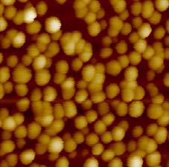
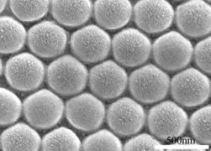
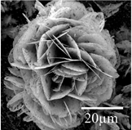
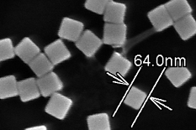
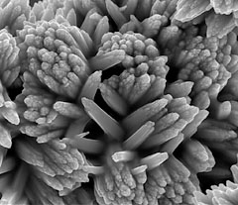
Examples of Nanomaterials
Nanomaterials (gold, carbon, metals, meta oxides and alloys) with variety of morphologies (shapes)
Au nanoparticle
FePt nanosphere
SnO2 nanoflower
Silver nanocubes
Titanium nanoflower

Slide 9
Electrodeposition
The versatile technique for nanomaterials
The electrodeposition technique involves deposition of a metal or alloy coating over a conducting surface by means of electrolysis from a well-formulated electrolyte known as a bath, which can be an aqueous solution of a simple salt or a complex salt type. The discharge of a metal depends on its position in the electrochemical series and the chemistry of the solution from which deposition is done.
Electrodeposition of a pure metal, or codeposition of an alloy from an electrolyte, takes place on the surface of the target, which is the cathode of the electrochemical system of the coating process. This process happens by applying an external current (direct or pulsed) to the electrodeposition system. By this method, 2D and 3D nanostructures of metals, alloys and nanocomposites have been deposited successfully. 1D nanostructure crystallites can also be prepared using the electrodeposition method by utilizing the interference of one ion with the deposition of the other.

Slide 10
Among the diverse processes available, the electrochemical method is a well-accepted technique for the synthesis of a wide range of nanostructured materials, e.g. metal nanoparticles, nanowires, nanofilms, bulk NC metals, laminated composites, multilayered coatings and nanoparticle-reinforced composite coatings.
Electrodeposition techniques can yield porosity-free finished products that do not require subsequent consolidation processing . Further, the process requires low initial capital investment and provides high production rates with few shape and size limitations.
Electrodeposition is an important technique for the fabrication of nanostructured materials, offering control over the structure, composition and properties, and thus facilitates the preparation of novel materials with enhanced properties that cannot be obtained by other techniques.

Slide 11
FIGURE 1 (A) Schematic of electrodeposition and electrical double layer (EDL). (B) Modes of electrodeposition. (C) Voltage-time transient curves of electrodeposition and schematic illustrating the nucleation and growth of films by varying deposition overpotentials. (D) Comparison of bulk to atomic-level electrodeposition. (E) Possible electrodeposited products.

Slide 12
Table 2 Summarized reduction potentials of transition metals.

Slide 13
Schematic illustrating the dimension-controlled electrodeposits
Figure 2 Schematic illustrating the dimension-controlled electrodeposits
Figure 3 Schematic of 3D conformal coatings via electrodeposition

Slide 14
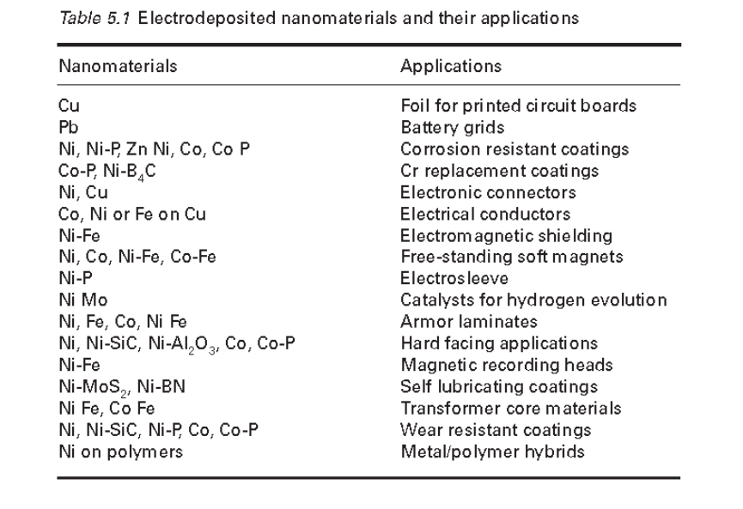
Table 3. Electrodeposited nanomaterial and their applications

Slide 15
Figure 4 Electrodeposition of metals. Periodic table of metals that can be electrodeposited from an aqueous solution.

Slide 16
Figure 5 Electrodeposition of metals. Schematics of pulsed electrodeposition of Ni nanoparticles (NPs) and SEM images with Ni NPs on n-Si with various numbers of pulsed deposition cycles..

Slide 17
Corrosion resistance of electrodeposited nanomaterials
the corrosion behavior of NC nickel (32 nm grain size) in 2N H2SO4 in de-aerated media and found that the corrosion potential of NC nickel was shifted about 200 mV further to the positive than that of polycrystalline nickel.

Slide 18
            corrosion behavior of NC zinc produced by pulse current electrodeposition with electrogalvanized steel in 0.5 N NaOH electrolyte. The estimated corrosion rate of NC zinc (90 μA/cm2 ) was found to be about 60% lower than that of electrogalvanized steel.
Corrosion behaviors of two types of NC Cu–Ni alloys were compared with cast Monel-400 alloy in 3% NaCl solution and it was found that corrosion current density ( i corr ) of NC alloys was superior to Monel-400 Both optical and SEM examination of the corroded surface revealed a well-defined pitting type of attack for Monel-400, unlike the homogeneous corrosion of NC alloys
incorporation of 20 nm SiC particles during Ni deposition improves the corrosion resistance, as revealed from impedance and cathodic polarization measurements, due to the modification of the surface morphology and crystallinity of the nickel matrix the corrosion resistance of Cu–TiO2 nanocomposite coatings was higher than that of electrodeposited copper
A Ni–Cr nanocomposite with an average Cr concentration of 11 wt% deposited onto nickel plate by electrodeposition of Ni and Cr nanoparticles from a nickel sulfate bath showed superior hot corrosion resistance under molten Na2SO4 –K2SO4 –NaCl in air at 700°C.

Slide 19
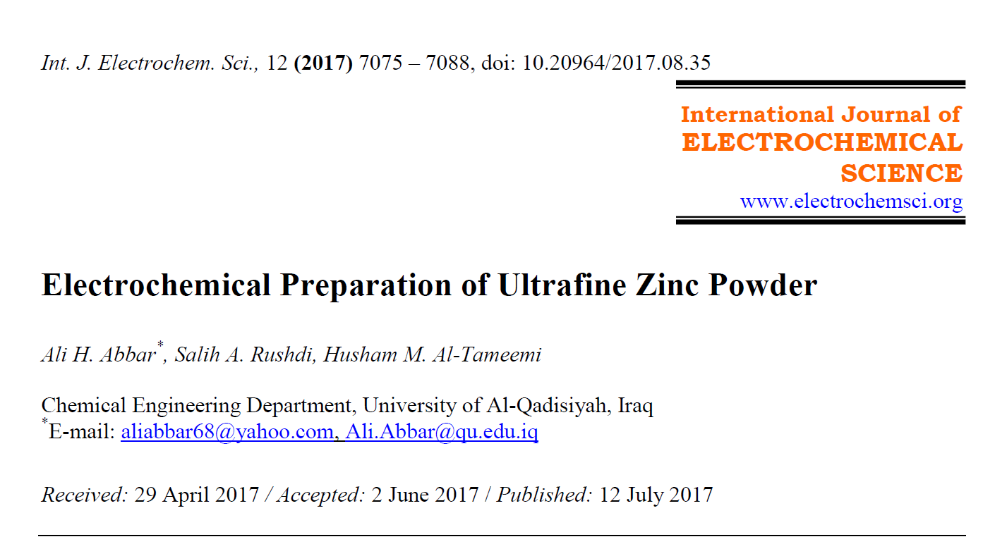
Our contributions

Slide 20
Conclusion
Electrodeposition is a versatile technique for the production of nanostructured materials with lower capital investment, higher production rates and few shape and size limitations.
Electrodeposited nanomaterials such as nanostructured metals, alloys and metal matrix composites have proven successful in providing superior corrosion resistance of substrate materials compared with the corresponding microstructured materials.

Slide 21

Thank
you

