Slide 1

MAGNETIC TECHNOLOGY AND MAGNETIC WATER APPLICATIONS
Assoc. Prof. Dr. Sami D. Salman
Biochemical Engineering Department
Al-Khwarizmi College of Engineering
University of Baghdad

Slide 2
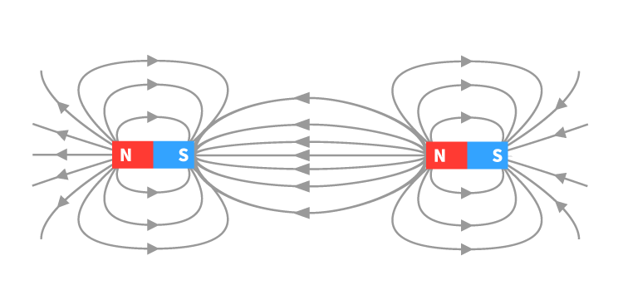
WHAT IS THE MAGNETIC FIELD
The magnetic filed is a magnetic force created in the apace around the body of magnetic. The magnetic field is the area around a magnet in which the effect of magnetism is felt. We use the magnetic field as a tool to describe how the magnetic force is distributed in the space around and within something magnetic in nature.
magnetic field lines plot for a bar magnet

Slide 3
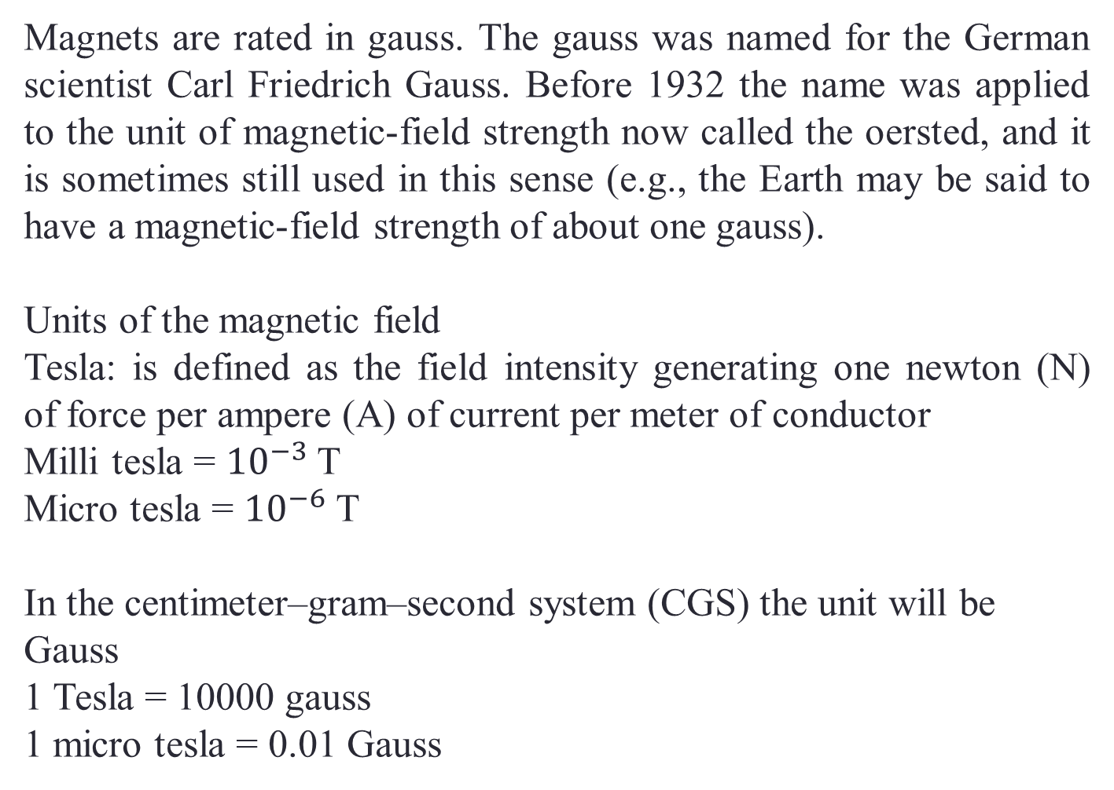
Magnets are rated in gauss. The gauss was named for the German scientist Carl Friedrich Gauss. Before 1932 the name was applied to the unit of magnetic-field strength now called the oersted, and it is sometimes still used in this sense (e.g., the Earth may be said to have a magnetic-field strength of about one gauss).
Units of the magnetic field
Tesla: is defined as the field intensity generating one newton (N) of force per ampere (A) of current per meter of conductor
Milli tesla = ${10}^{−3}$ T
Micro tesla = ${10}^{−6}$ T
In the centimeter–gram–second system (CGS) the unit will be
Gauss
1 Tesla = 10000 gauss
1 micro tesla = 0.01 Gauss

Slide 4
WHAT MAGNETIC TECHNOLOGY DO
Water can be magnetized when subjected to Magnetic field , and some important properties of magnetized water have become useful in industries associated with its surface tension, pH, viscosity, electrical conductivity, and scale formation inhibition. Magnetic treatment does not change the chemistry of the water, but It alters the structure and property of liquid water resulting in improvement of filtration properties and increase dissolving properties of water.
Magnetohydrodynamic (MHD) (magnetofluid dynamics or hydromagnetic) is the study of the dynamics of electrically conducting fluids. Examples of such fluids include, liquid metals, and salt water or electrolytes.

Slide 5
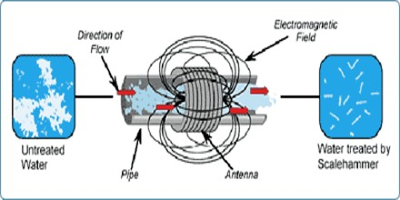

Slide 6
MAGNETO HYDRODYNAMICS PRINCIPLE
Lorentz force is exerted on water ions
The redirection of the particles increases the frequency of collisions between ions of opposite sides
Combining to form a mineral precipitate or insoluble compound Magneto hydrodynamics
A water molecule consists of one oxygen and two hydrogen atoms
They form clusters with other water molecules
Clusters come in many sizes depends on water molecules involved
Restructures the water molecules into very small water molecule clusters,

Slide 7
Each made up of six symmetrically organized molecules.
Cluster is recognized by the cell as "bio-friendly"
Magnetic treated water is biologically active
Helps in accumulation of proteins instead of fat in animals
Improve metabolism of animals
Magnetic water aluminates harm full chemical and gases
Cleaning of sheds with magnetic water reduces germs & bacteria

Slide 9
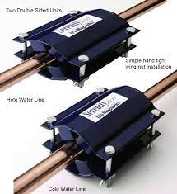
Magnetic Devices
Two magnetic rods symmetrically oriented along the axis of feed pipe
Pole pieces at the end of each permanent magnet focused the magnetic field

Slide 10
Magnetic Devices
Magnetic induction in the range of 3.5–136 mTesla
Water flow direction should be from North magnetic pole to South magnetic pole
The magnets should be installed on the pipe between the main valve and the irrigation pipe.
The mounting plate serves to increase the magnetic field present inside the pipe

Slide 11
What is a magnetic water treatment device
Typically, these devices are permanent magnets or electromagnets that attach to waterlines entering homes and businesses to “purify” or “condition” water supplies. Manufacturers adopt a variety of commercial names for their products from the complex—”patented directional controlled magnet,” “Perm-core,” and “Magnetizer”—to the simple— ”metal bar” or “plug-in treatment device.” Typically, the devices purportedly use electromagnetic fields to change the molecular makeup of various water constituents like calcium and iron to other more “inert” forms. The claimed result is a reduction or elimination of water contaminants. One manufacturer describes the magnetic treatment processes this way, “Water and minerals are subjected to violent intra-molecular vibrations and shock at the same time magnetic energy is being added, the mineral’s crystallization is upset and cohesion broken.” Sales representatives often persuade potential customers that they can rely on magnetic treatment devices to provide lifetime, energy-free home water treatment.

Slide 12
Features of Magnetic Devices
No Running Cost
No Maintenance
No Operational Cost
Simple Installation
No Raw Material Used
Product Life 15 years
No Space Constraint
No Replacement of Parts
100% Chemical free technology with no side effects
No Electricity Required

Slide 13
Types
Temporary magnets
Permanent magnets
Interior installed magnet
Exterior installed magnet

Slide 14
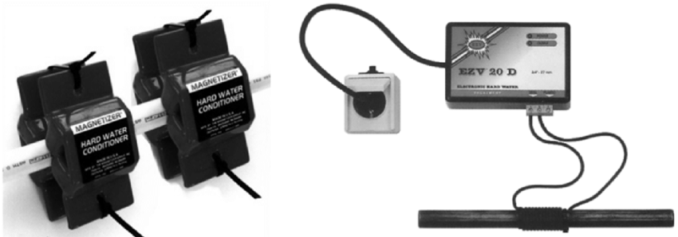
Temporary magnets

Slide 15
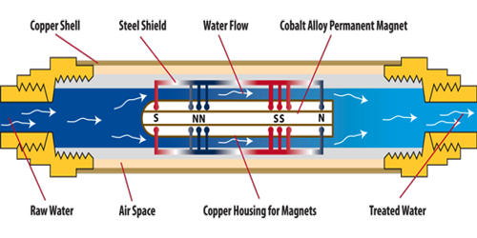
Interior installed magnet

Slide 16
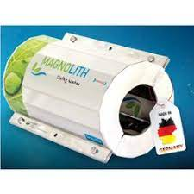
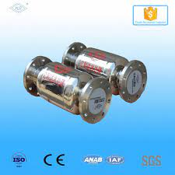
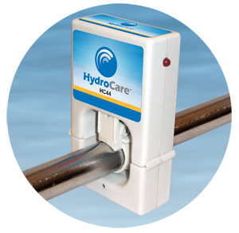
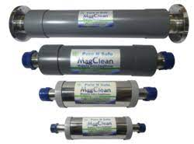
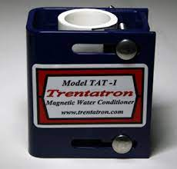
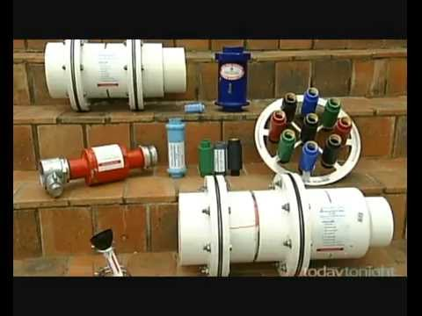

Slide 17
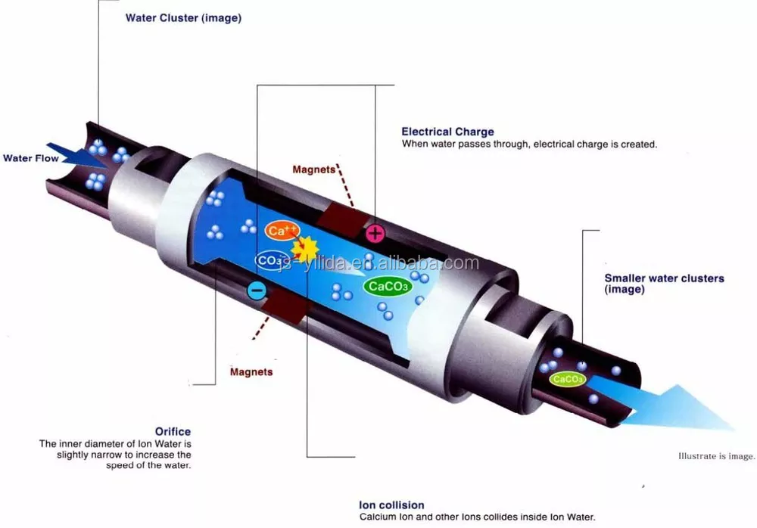
Exterior installed magnet

Slide 18
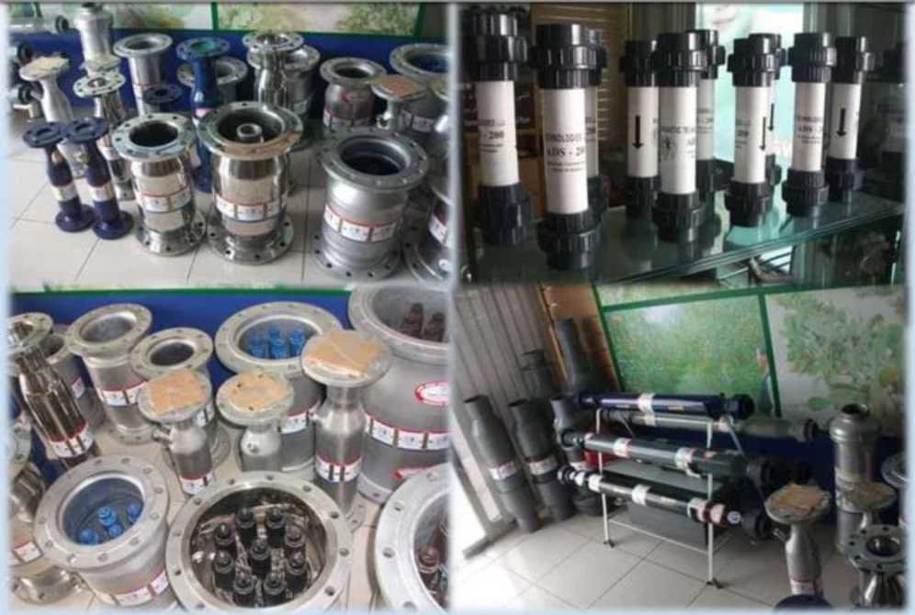
Magnetic Devices Range

Slide 19
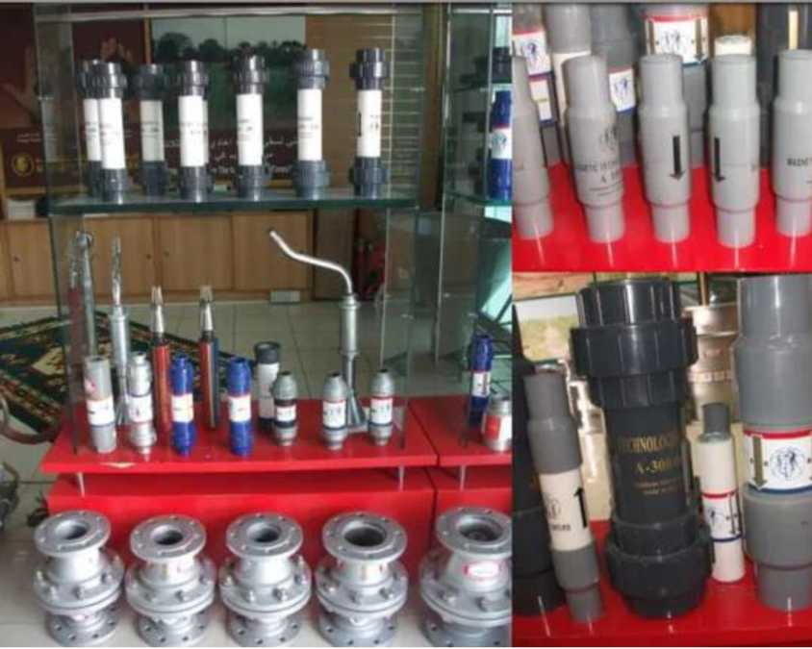
Magnetic Devices Range

Slide 20
Working principle
Making use of great energy that generates from neodymium, iron, boron, rare earth and permanent magnetic material, with optimal design, and form a crest vertical center field. When water or fluid flow through the vertical magnetic field, it will produce an electromotive force, the lattice refinement, the original water fouling crystal particle size from about 3.39 microns to about 0.22 microns, flow rate will be faster, the electromotive force generated is greater, the effect is more ideal, to achieve the purpose of anti-scaling and scale removal.
Meanwhile, water flow is treated by magnetic field, lead to the electrical conductivity and osmotic pressure changed and microbial cell ruptured, and cells stop breeding, which achieves effect of sterilization and algae removal.
Since the water treated by magnetic field, it will produce tiny electron flow, which change Fe2O3· NH2O into stable Fe3O4 and generates black magnetic iron oxide which deposited onto the tube wall surface to form a film barrier layer, the oxygen in the water separated from the pipe wall, in this case, it will realize the purpose of rust removal and prevention.

Slide 21
Working Principle Summery
Water passes through the magnetic field, all super- molecules vibrate
This will intensify the internal vibration of these super-molecules to the breaking point.
These super-molecules fracture and release their encaged particles (Ca,Mg).
Precipitates come out of solution as a sludge and can be easily removed from the system.

Slide 22
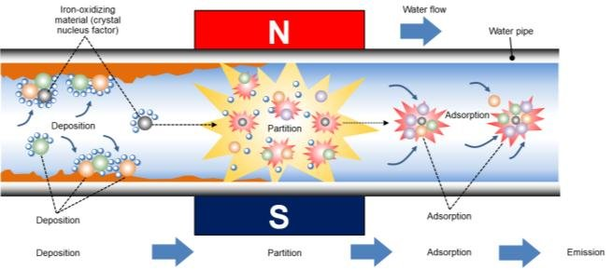

Slide 23
PRODUCT CHARACTERISTICS
Clear and to prevent pipe scale and rust build
Environmental pollution does not use chemicals
Not energy, long lifespan for effective running.
No expert management of low maintenance costs
Small, simple and quick installation
Process to achieve zero emissions, save a lot of water
Improve the system heat transfer efficiency, energy saving (15%-30%)
Descaling process can produce hydrogen peroxide and reduce bacteria content in water

Slide 24
ENGINEERING APPLICATION
Central Air Conditioning System
Industrial cooling water system
Landscape, swimming pool system
Eliminate scaling by magnetic field
Heat exchange system, heating system
Production and domestic hot water supply system
Impact of magnetic water diary
Magnetic Water Treatment in the Agriculture Industry

Slide 25
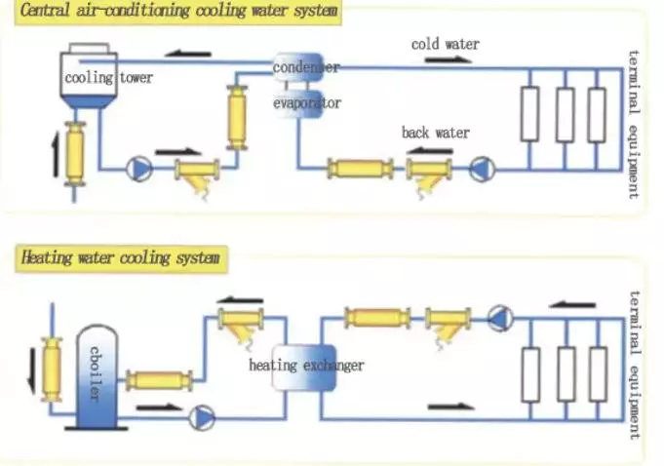

Slide 26
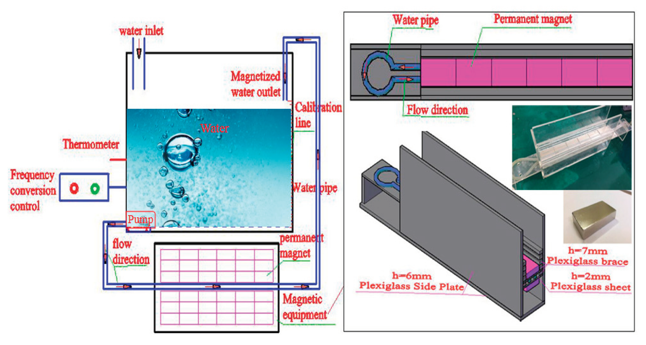

Slide 27
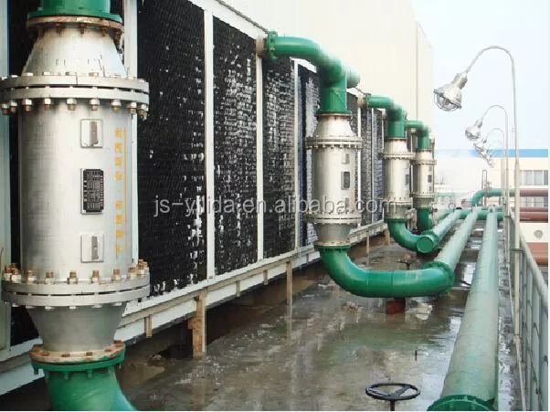

Slide 28
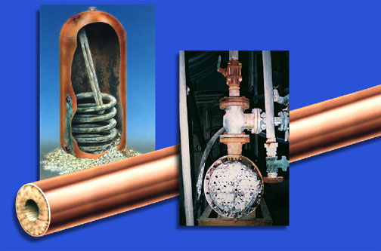
Scale – What Is It ?
Minerals such as Magnesium & Calcium when heated up will adhere to the pipes and plumbing system

Slide 29
What Causes Scale?
Changes in of temperature
cooling
Changes of temperature
heating
Causes scale built-up on the pipes and appliances

Slide 30
Problems Caused By Scale
Loss of heat efficiency
Reduced flow rates
Failure of equipment
Expensive maintenance
Causes corrosion

Slide 31
Where Do We Find Scale At Our Home?
Washing
Machines
Water
Heaters
Dishwashers
Reduces The Life
Of Appliances
Ice Makers
Water Pipes
Boilers

Slide 32
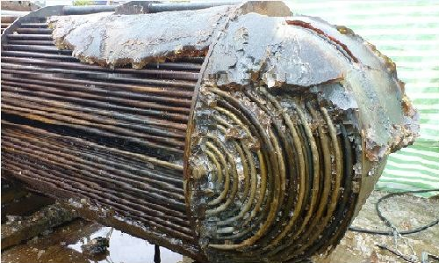
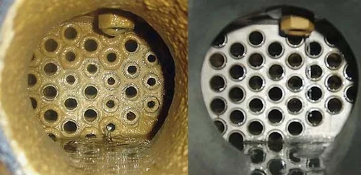

Slide 33
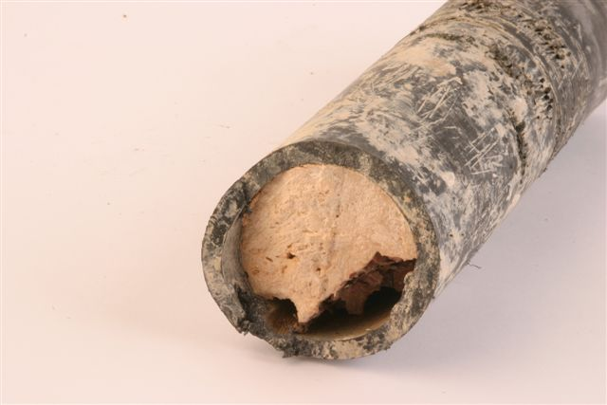
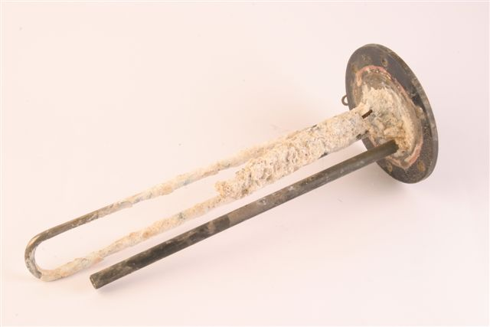
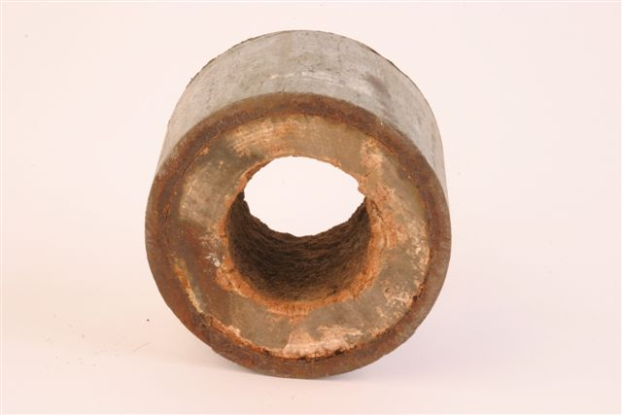
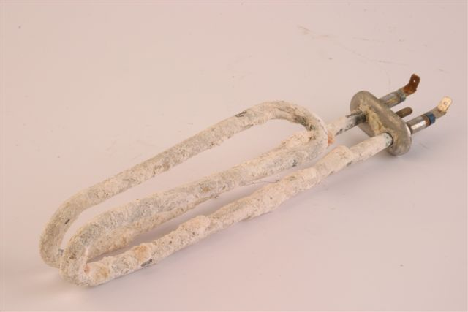

Slide 34
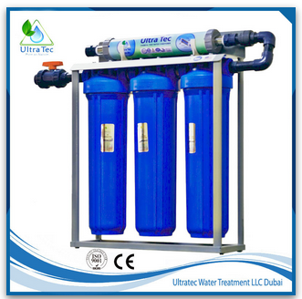
Magnetic treatment has shown significant removal of scale from the pipe walls. Remarkable removal of scale achieved in higher magnetic field strength by 30%. Higher magnetic strength had higher removal of scale compared to lower strength. Magnetized samples formed a larger crystal that led to water softening.

Slide 35
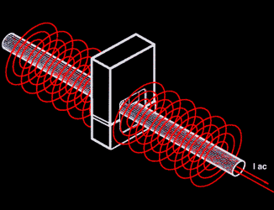
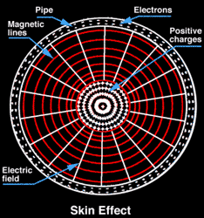
How Does Hydrocar Works?
Patented electronic technology induces electric fields through the entire plumbing system. These fields produce nuclei which adhere to the minerals in the water. Even when the water is heated up, the minerals will not clog the pipes, and will remain suspended and will wash away with the water flow. It will also dissolve existing buildup.

Slide 36
One Compact Unit For Whole House Solutions
How Does It Work?
Induces signal LONGITUDINALLY through the entire system
Both up and down stream
Treats static water

Slide 37
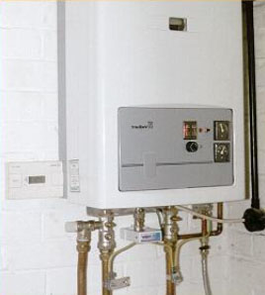
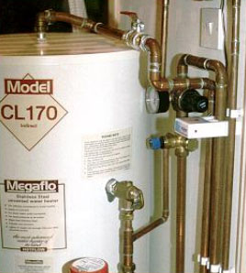
Easy To Install
The compact unit is easily installed on all types of pipes in residential homes. simply click on, plug in, and switch it on

Slide 38
Prevent Scale Build Up & Breaks Up Existing Scale
Model – HC44
(pipe size 1”)
(House up to 3 Baths )
Model – HS40
(pipe size 2”)
(Larger Capacity )
Maximum Power:
1.2 Watts

Slide 39
The Superior Solution
  Prevents & removes existing limescale
  Environmentally friendly, no chemicals or salts
  No maintenance-no salt bags, no filters
  No more clogged pipes, boilers and hot water heaters
  Increased water pressure
  Protects washing machines & dishwashers, faucets and shower heads
  Protects 24 hours a day / 7 days a week
  Provides whole house protection
  Works in all types of water flow
  Works on all kinds of pipes
  Does not require plumbing & is very easy to install
  Unique worldwide patented technology

Slide 40
Magnetic Water Treatment in the Food Industry
Milk
Increase milk production by 10% to 15%
Increase fat content of milk by 0.13 - 0.15%
Magnetically treated water can also help in process of milking.
Magnetically treated water reduces firmness of the utters and making milking process easier
Magnetically treated water drastically decreases the amount of bacteria in milk
Meat
Improve taste of meat
Increase average weight gain in calves up to 35%
Increase average weight gain in lamb up to 12%
Increase in quantity of meat
Improve quality of meat

Slide 41
Resistance against diseases
Prevent diseases in animals caused by contaminated water and fodder
Animal that drink magnetically treated water also show signs of significant disease resistance
Gives protection against skin diseases
Skin glow and shines.
Decrease disease and death rates by approx. 2 times

Slide 42
Commercial Benefits
The installment of special magnetic system will double the storage time (shelf life) of milk in containers.
Breeding
Improve fertility
Increase the reproductive performance of animals by making them more active.
Other benefits
Showering with Magnetic water improve Health conditions and mood of animal

Slide 43
Magnetic Water Treatment in the Agriculture Industry
In agriculture, a high concentration of salt accumulation in the soil can decrease the value of farmlands and productivity meaning less healthy or less abundant crops for farmers. Because of this, there is a need to reduce salinity in soil and “improve the leaching of salts below the root zones of salt-sensitive crops,” such as potatoes, tomatoes, and citrus fruits. Especially when irrigating crops with groundwater, you run the risk of distributing water containing high levels of saline. When salt dissolves in water, sodium and chloride ions separate and displace other beneficial mineral nutrients like potassium and phosphorus. The damage can appear as plant discoloration, delayed or diminished growth, and nutrien

Slide 44
Increased root growth due to better absorption of dissolved minerals and nutrients, improving yield and profitability
Better, faster growing grass, plants, fruits and vegetables with less water used
The soil remains moist longer, thus requiring less irrigation water
Increased fertilizer efficiency, reducing chemical use, as the fertilizer is absorbed by the plant and is not wasted
Descaling irrigation lines, eliminating maintenance down-time resulting in lower costs
Good & proven use for desalination systems to keep the membranes brine free and corrosion/scale free, as well as inhibiting algae
Lowering SAR (sodium adsorption ration) in desalinated water by 90%
Substantially lowering operational costs while enhancing yields

Slide 45
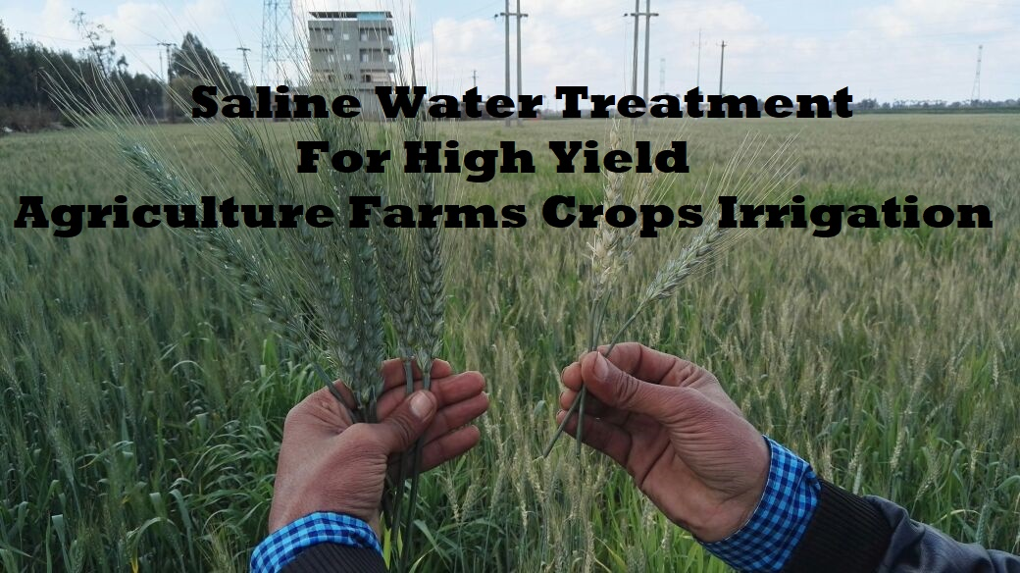

Slide 47
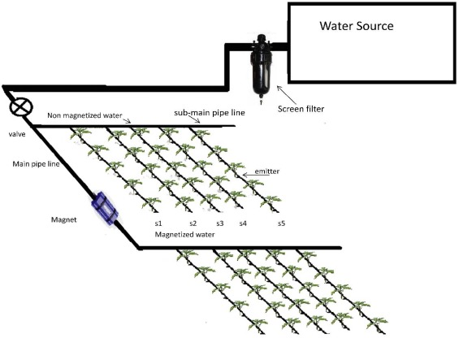

Slide 48
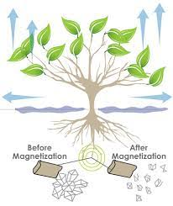

Slide 49
Installation Images

Slide 56
Benefits
Devices are eco friendly
Low installation cost
No energy requirements
Prevents water from forming normal chemical reactions
Reduces hydrogen sulfide smells and iron buildups
Gives hard water properties of soft water
Stops buildup of scale and rust
No Water Treatment Cost.
Durable and Long Lasting.
Zero Maintenance Cost
Degassing of water
Reduce electrical bills

Slide 57
Advantages
Yields 10%-30%
Water absorption in soil
Bio-availability of water and nutrients to plants
Increase oxygen concentration
Improve soil pH
Increase flow of water
Increase weight and size of product
Extent shelf life of produce
Increase seed germination
Reduce water use up to 30%
increase the levels of CO2 and H+ in soil

Slide 58
Reduce total dissolved solids (TDS)
Reduce fertilizer and pesticide needs
Advanced ripening of fruits in all cases
Affect soil nutrient availability
Activate plant enzymes
Reduce disease in livestock
Reduce disease in aquaculture industry
Increase the no of hydrogen bond
Enrich soil permeability

Slide 59
Case studies

Slide 60
Case study -1

Slide 61
Materials and methods
Grains were selected and planted in twenty pots
Half of the pots were irrigated once a week interval with tap water
Other ten pots were irrigated with the tap water after magnetization
Plant height, fresh and oven dry weight of twenty wheat plants were determined

Slide 62
Results
Growth criteria
Photosynthetic pigment contents
Indole and phenol contents
Wheat yield and its components

Slide 66
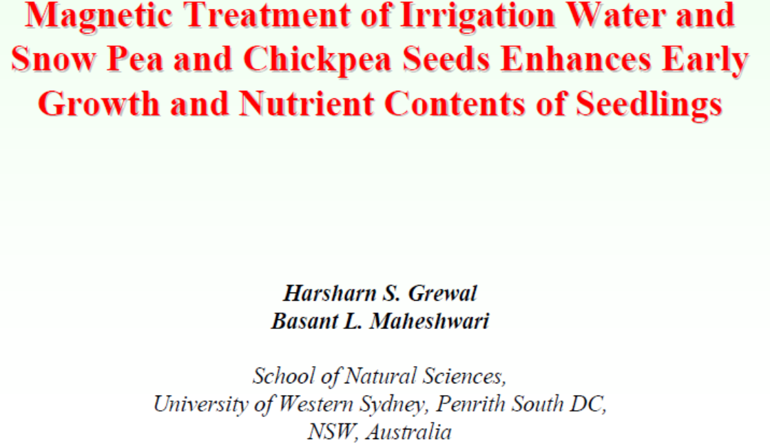
Case study -2

Slide 67
Materials and methods
The treatments included
(i) Magnetic treatment of irrigation water
(ii) Magnetic treatment of seeds (MTS)
(iii) Magnetic treatment of irrigation water and seeds
(iv) No magnetic treatment of irrigation water or seeds as
control treatment

Slide 68
Results
MTW (Magnetically-treated water)
Emergence rate index
snow pea- 42%
chickpea- 51%
Shoot dry weight
snowpea- 25%
chickpea- 20%
MTS (Magnetic treatment of seeds)
Emergence rate index
snow pea- 33%
chickpea- 37%
Shoot dry weight
snow pea- 11%
chickpea- 4%

Slide 73


