Slide 1
Application of Simulink in Process Control | اسم النشاط
08/03/2023 | موعد بدء وانتهاء النشاط
ورشة عمل | نوع النشاط
استخدام Simulink الموجود ضمن برنامج الماتلاب في محاكاة منظومة السيطرة لغرض ايجاد القيم المثلى لمتغيرات جهاز السيطرة وفص استقرارية نظام السيطرة بطريقة رسم بود | وصف النشاط
ا.م.د. خالد وليد حميد kwhameed@kecbu.uobaghdad.edu.iq | حساب مسؤول النشاط ووسائل الاتصال

Slide 2
ورشة عمل بعنوان
SIMULINK for Process Control
Asst. Prof Dr. Khalid W. Hameed
Al-Khwarizmi College of Eng.
University of Baghdad

Slide 3
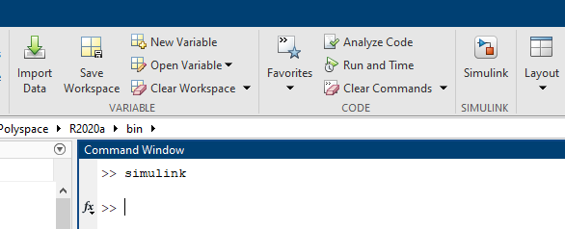
SIMULINK is a part of MATLAB that can be used to simulate the dynamic systems. To facilitate model definition, SIMULINK adds a new class of windows called block diagram windows. In these windows, models are created and edited primarily by mouse-driven commands. Part of mastering SIMULINK is to become familiar with manipulating model components within these windows.
How to entre to the Simulink?:
1. Start Matlab and then the Simulink environment by typing simulink to the matlab promoter, or click
Type Simulink & Enter OR click this Icon

Slide 4
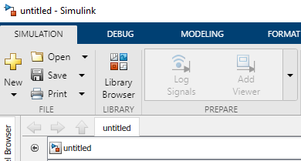
2. From the new window, click the blank model
3. Open the Library Browser

Slide 5
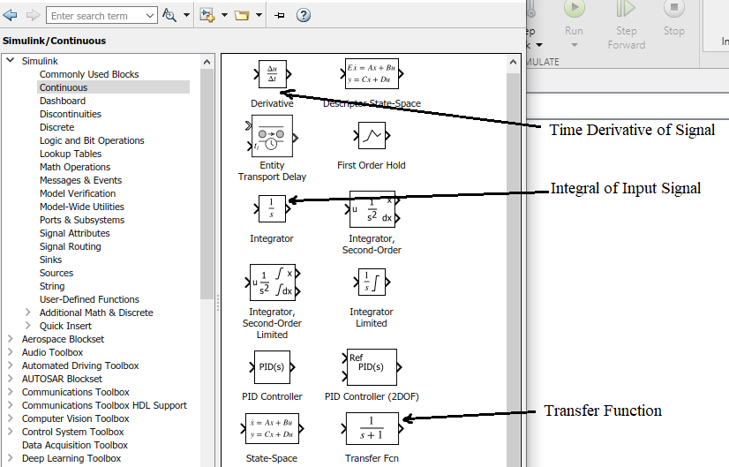
4. You can construct your block diagram by drag-and-dropping the appropriate blocks from the main Simulink windows. Some of the most commonly used blocks: From the “Continuous” blocks (click on the “Continuous” button) you can use the typical blocks to construct dynamic systems (e.g. transfer function, time delay, etc.).

Slide 6
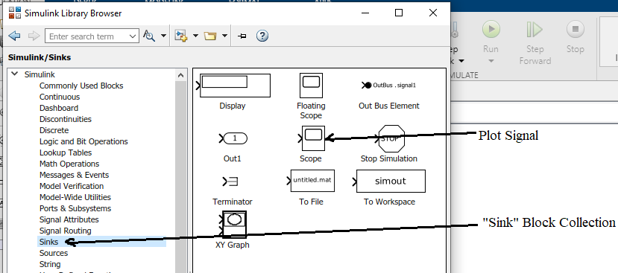
5. From the “Sink” we often use the “Scope” block to plot the results.

Slide 7
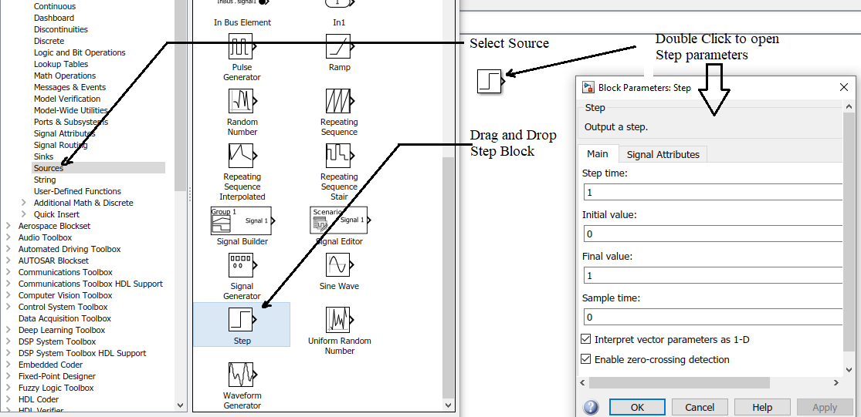
6. From the “Sources” the “Step” function is used to simulate step changes in the input:

Slide 8
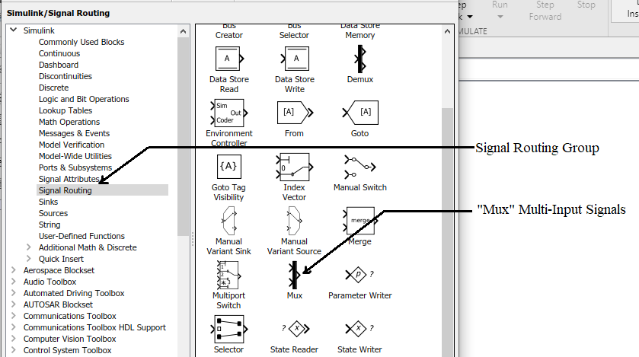
7. From the “Signal Routing” blocks the “Mux” block is often used to concatenate signals into a “bus” e.g. for plotting multiple signals in “Scope”.

Slide 9
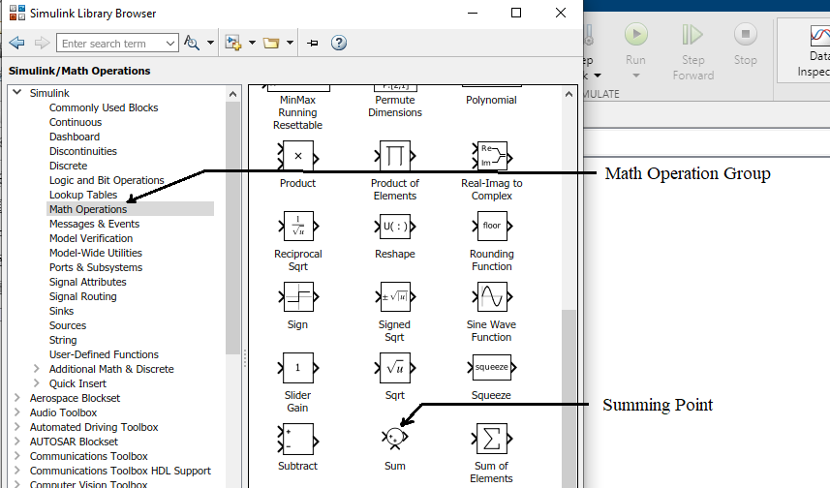
8. The “Math Operations” set of blocks provides the usual mathematical operations:

Slide 10
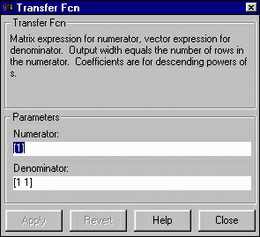
9. Modifying Blocks: A block can be modified by double-clicking on it. For example, if you double-click on the "Transfer Fcn" block in the simple model, you will see the following dialog box.
This dialog box contains fields for the numerator and the denominator of the block's transfer function. By entering a vector containing the coefficients of the desired numerator or denominator polynomial, the desired transfer function can be entered. For example, to change the denominator to s²+2s+4, enter the following into the denominator field: [1 2 4]

Slide 11
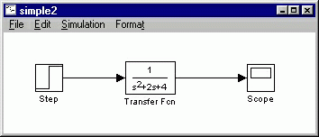
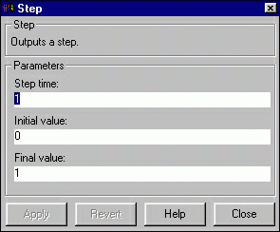
and hit the close button, the model window will change to the following
which reflects the change in the denominator of the transfer function.
The "step" block can also be double-clicked, bringing up the following dialog box.
The default parameters in this dialog box generate a step function occurring at time=1 sec, from an initial level of zero to a level of 1. (in other words, a unit step at t=1). Each of these parameters can be changed. Close this dialog before continuing.

Slide 12
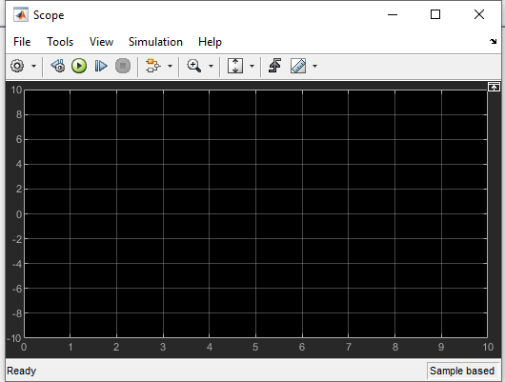
The most complicated of these three blocks is the "Scope" block. Double clicking on this brings up a blank oscilloscope screen.
When a simulation is performed, the signal which feeds into the scope will be displayed in this window. Detailed operation of the scope will not be covered in this tutorial. The only function we will use is the autoscale button, which appears as a pair of binoculars in the upper portion of the window.

Slide 13
Ex.1: Typical open-loop dynamic responses of second order systems
Step 1. Start the Simulink environment by typing “simulink” to the matlab prompter or click
Step 2. From the new window, click the blank model and Open the Library Browser
Step 3. Drag and drop the blocks below from the Simulink windows into the model window
Step 4. Double click the blocks to set up different second order transfer functions.
- Right click to copy any block in the area of simulink
- Define one over damped, one critically damped and one under damped system.

Slide 14
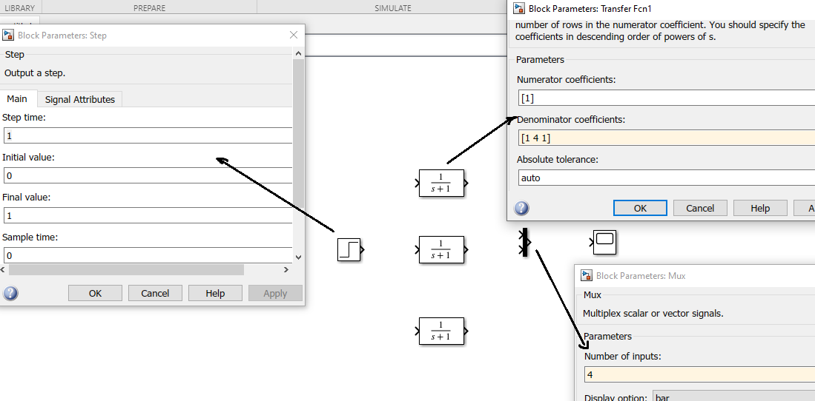
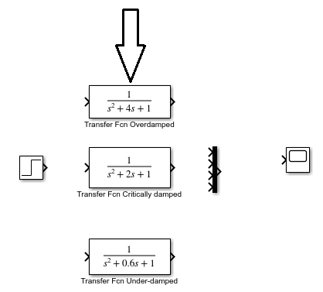

Slide 15
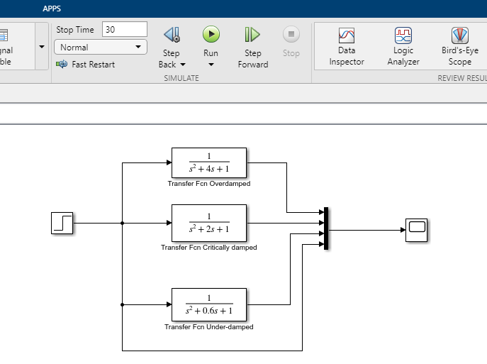
Step 5. Connect the blocks together as shown below and Set the simulation time to 30 sec

Slide 16
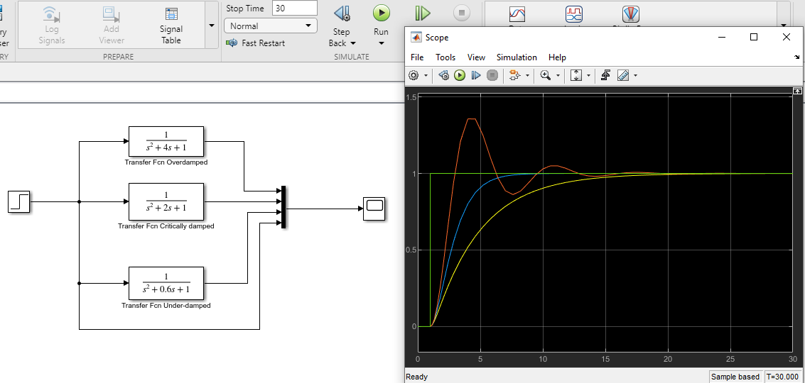
Step 6. Simulate the process by pressing the “Run” button and then show the results
by double clicking on the “Scope” block:

Slide 17
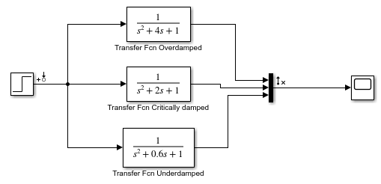
Now, Plot the Bode diagram for the three systems above
1) Delete the output of the Step signal, and make the (Mux) 3 input
The final block diagram will be as shown in the figure below

Slide 18
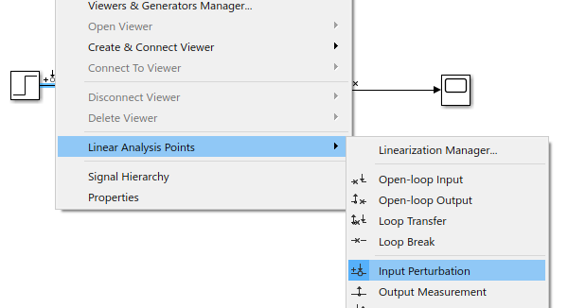
- Right click for input systems and select Linear Analysis Points > Input Perturbation as shown below

Slide 19
Then right the output system and select Linear Analysis Points > Open-Loop Output as shown below
Then right the output system and select Linear Analysis Points > Open-Loop Output as shown below

Slide 20
Now Select Apps group, and click Model Linearizer as shown below:

Slide 21
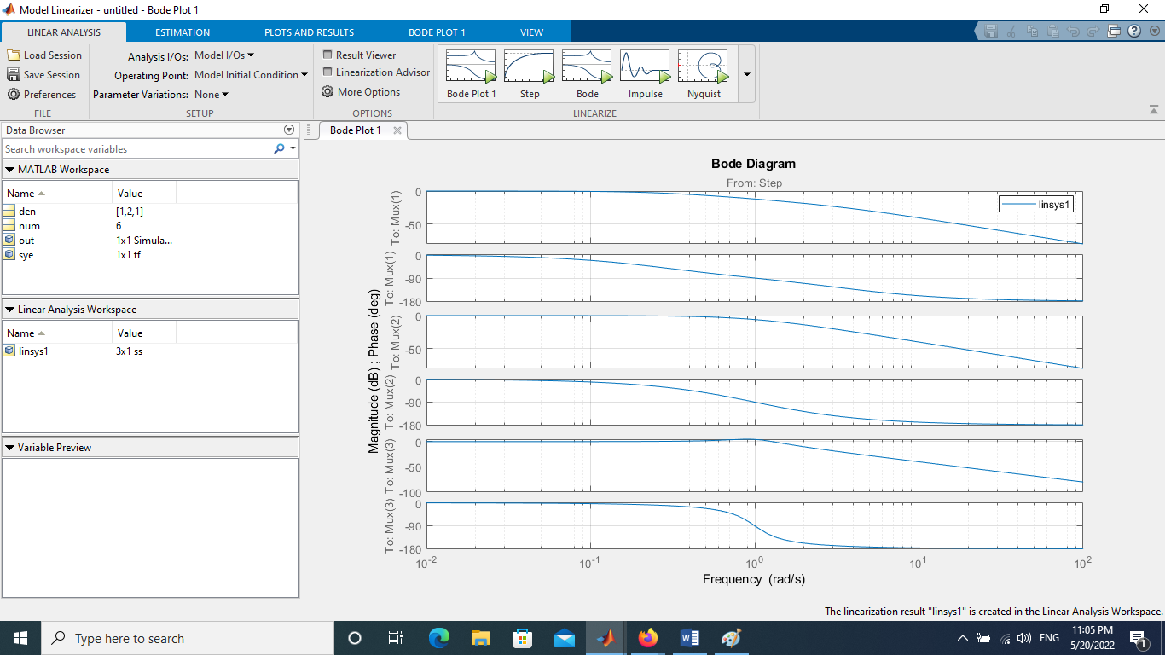
From new windows, select Bode
The Bode plot will show as follows:
From this figure above, the three systems are stable

Slide 22
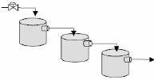
Ex.2: PID controller tuning using “practical” Ziegler-Nichols” technique. Consider the following third order process
Tune a PID controller using a practical method and the Ziegler-Nichols tuning rules. It is based on the similar idea as the ZN method described in the lecture, with the difference that the ultimate gain and ultimate period are determined experimentally, not analytically.

Slide 23
Step1. Download the Simulink block diagram, Create the block diagram as follows:
Double click the PID controller and select (Ideal) instead of (Parallel)
Step2. Set the controller to a P-only controller (by setting I =1/τ_{i} = 0 and D = τ_{D} = 0).
Step3. Start to give values to P until the closed loop system is at the verge of instability (sustained oscillations are obtained)

Slide 24
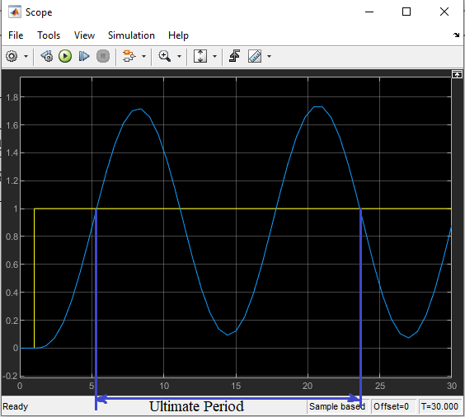
Step 4. Determine from the figure the ultimate period (Pu). Use the zoom buttons in the figure window and obtain the ultimate period (the time interval for one entire oscillation).

Slide 25
Step 5. With the ultimate gain and period determined at step 3 and 4 compute the parameters of a PID controller using the ZN tuning rules.
K_{u} = final value of P
τ_{u} = ultimate period
For PID Controller:
K_{C} = 0.6 K_{u}
τ_{i} = 0.5 τ_{u}
τ_{d} = 0.125 τ_{u}
Step 6: Set the controller parameters to P = K_{C} = 10 , I = 1/τ_{i} = 1 and D = τ_{D} = 10).

Slide 26
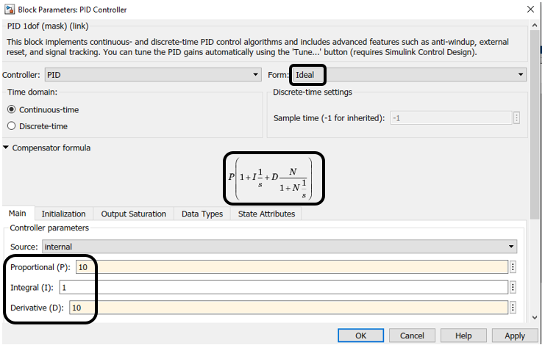

Slide 27
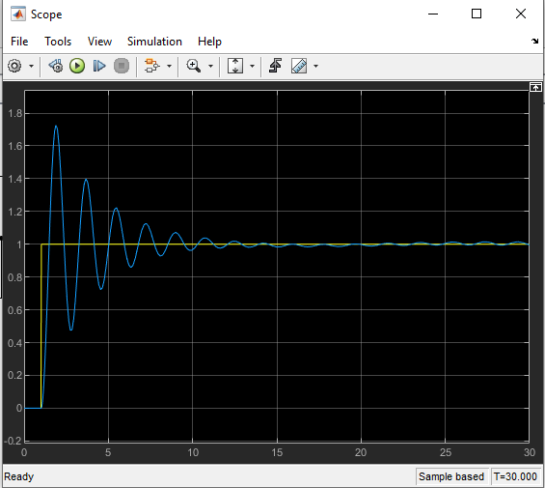
Click RUN to see the response as shown in the figure below
- It is clear that from the response, the system is critically stable but required adjustment the parameters of the controller so as to give better response. It can be done that by trial and error, but an alternative method, double click the PID controller and click the Tune button, the PID Tuner windows will appear as shown below:

Slide 28
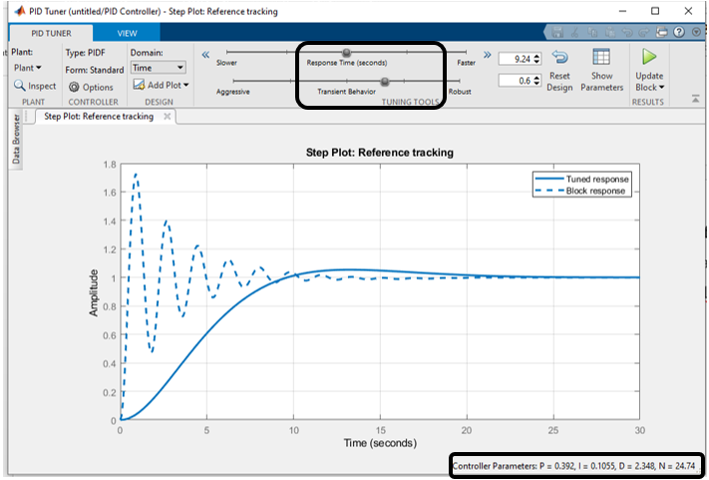
The suggested of parameters of controller are listed below of the figure, but in can be changed them from the Nobs of Tuning Tools located in the upper of the figure above to obtain better response. After adjusted the Nobs of the Tuning Tools, the response will be as shown in the figure below.

Slide 29
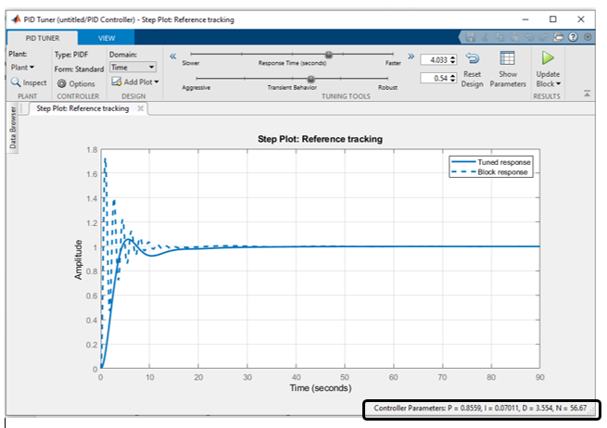
The parameters of the controller will be as in the figure above

Slide 30
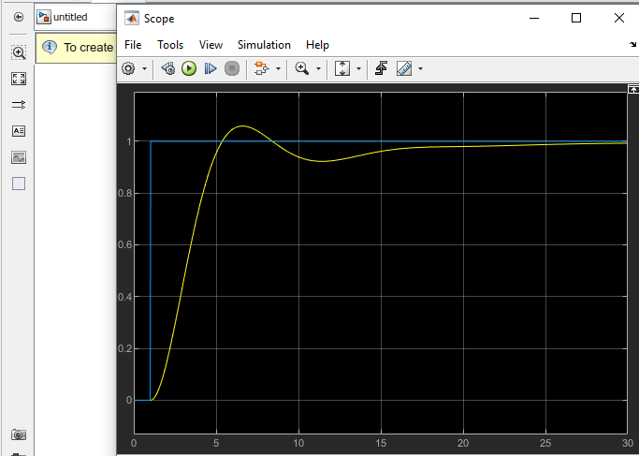
These parameters are substituted in the PID icon or click the Update Block , then click RUN to see the response throughout the Scope as shown below.

Slide 31
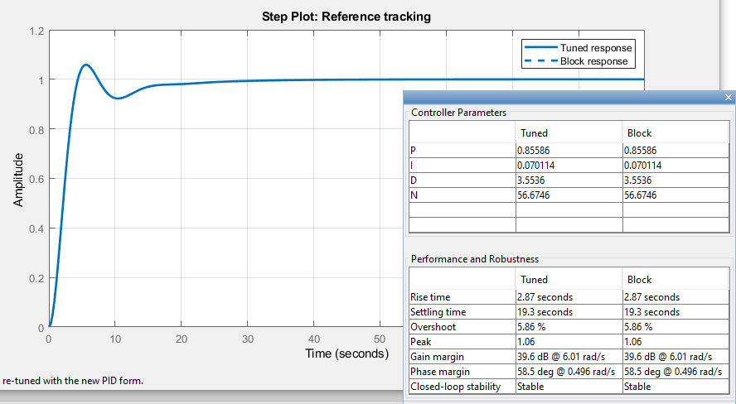
Step 7. To see the parameters of the response, click the Show Parameters icon
Step 8. Compare the values of the ultimate gain and frequency and the tuning parameters obtained with the “practical” approach with those obtained using the analytical Method (direct substitution) in the lecture.

Slide 32
Thank you for Attention

