Slide 1
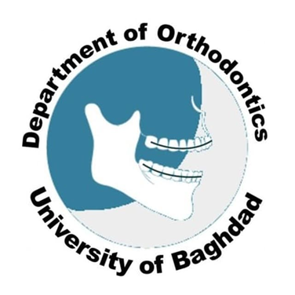
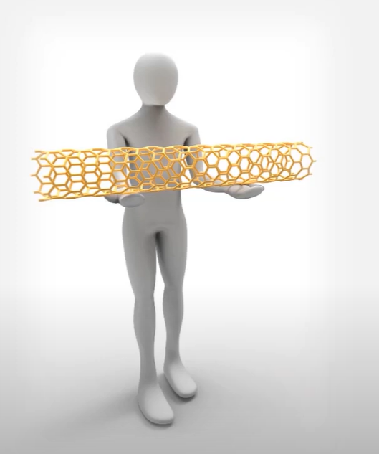
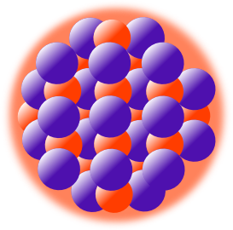
Nanotechnology in Orthodontics
Prepared by
Shahba AbdulGhafoor Mohammed
Ph.D. Student

Slide 2

Introduction
Nanomaterials
History
Definitions
sources.
Invention of scanning probe microscopy
Types
Terminology
nanostructures
classifications
Terminology
nanostructures
Nanoparticles in Nanodentistry:
Nanomaterials Application in Orthodontics

Slide 3
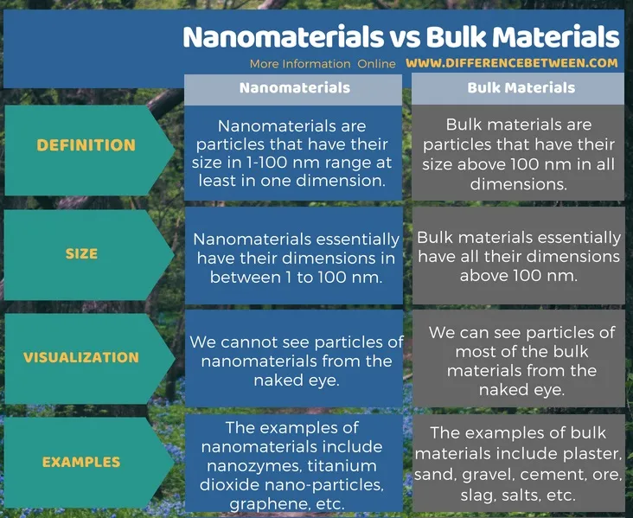
Introduction
Nanomaterials

Slide 4

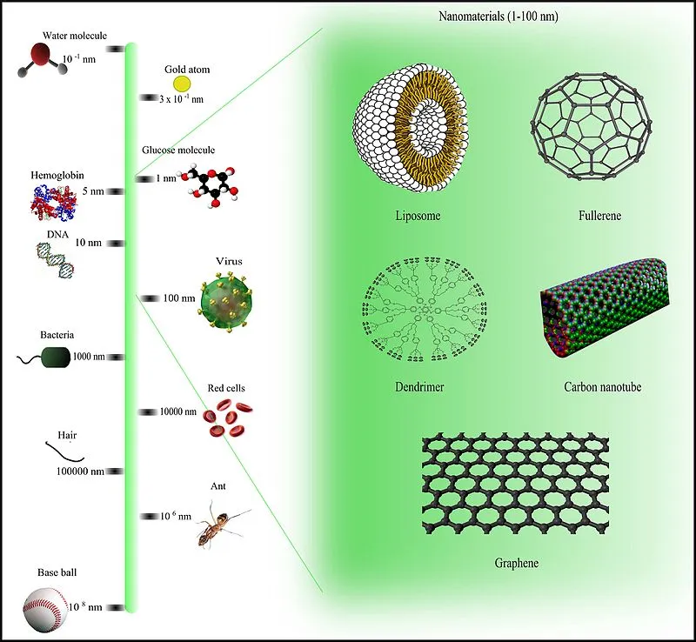
Nanomaterials
Nanomaterials have several advantages over bulk materials such as the huge surface-to-volume ratio, very high porosity and completely different physiochemical properties.
Two principal factors cause the properties of nanomaterials to differ significantly from other materials: increased relative surface area, and quantum effects. These factors can change or enhance properties such as reactivity, strength and electrical characteristics.

Slide 5
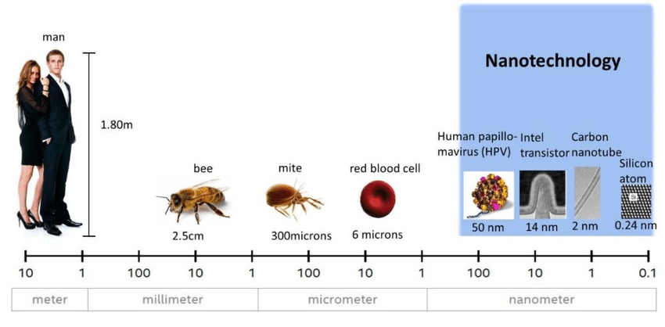
Introduction
Nanomaterials
A nanometre is one billionth of a metre (0.000 000 001 m).
So, it may not come as a surprise that nanoparticles of material show different properties compared to larger particles of the same material.
The surface area to volume ratio for a material or substance made of nanoparticles has a significant effect on the properties of the material. Firstly, materials made up of nanoparticles have a relative larger surface area when compared to the same volume of material made up of bigger particles.

Slide 6
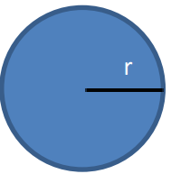
Introduction
Nanomaterials
For example, let us consider a sphere of radius r The surface area of the sphere will be 4πr ² The volume of the sphere = 4/3πr ³ Therefore the surface area to the volume ratio will be 4πr ² /(4/3πr ³ ) = 3/r

Slide 7
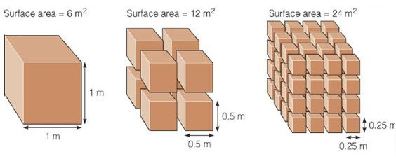
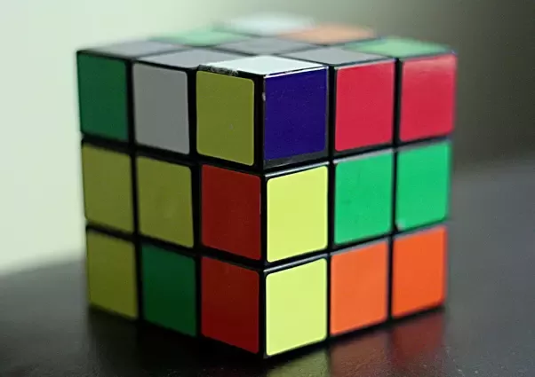
Introduction
Nanomaterials
It means that the surface area to volume ratio increases as the radius of the sphere decreases and vice versa. It also means that when a given volume of material is made up of smaller particles, the surface area of the material increases. Therefore, as particle size decreases, a greater proportion of the particles are found at the surface of the material. For example, a particle of size 3 nm has 50% of its particles on the surface; at 10 nm, 20% of its particles are on the surface; and at 30 nm, 5% of its particles are on the surface. Therefore, materials made of nanoparticles have a much greater surface area per unit volume ratio compared with the materials made up of bigger particles.

Slide 8
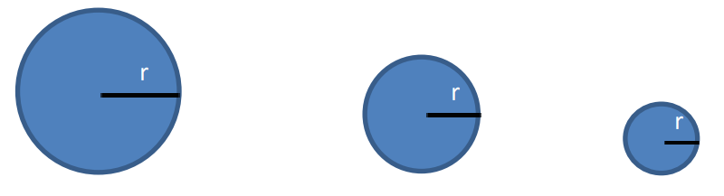
Introduction
Nanomaterials
This leads to nanoparticles being more chemically reactive. As chemical reactions occur between particles that are on the surface, a given mass of nanomaterial will be much more reactive than the same mass of material made up of large particles. This means that materials that are inert in their bulk form are reactive when produced in their nanoparticle form. A good way to get the idea across is to make use of some model spheres. Ask the students to try and compare the relative volumes and surface area.

Slide 9
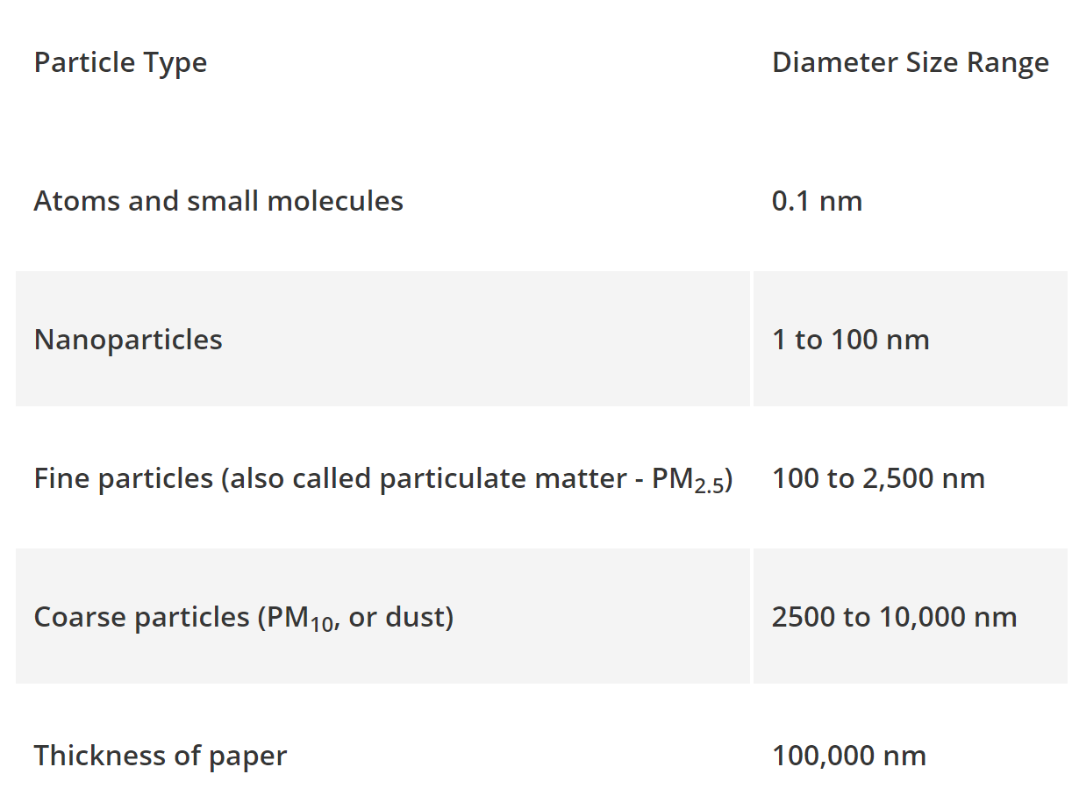
Introduction
Nanomaterials
The table below shows the size of nanoparticles compared to other structures:

Slide 10
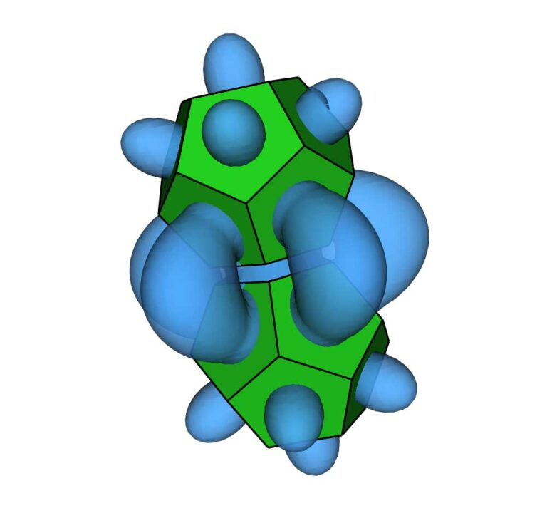
Introduction
Nanomaterials
Entropic bonding is a way of explaining how nanoparticles interact to form crystal structures. It’s analogous to the chemical bonds formed by atoms. But unlike atoms, there aren’t electron interactions holding these nanoparticles together. Instead, the attraction arises because of entropy.
Nanoparticles in the shape of a dodecahedron. This new way of understanding how entropy creates attractive forces between nanoparticles could accelerate the development of nanomaterials with designed properties. ,
(Glotzer,2022)

Slide 11
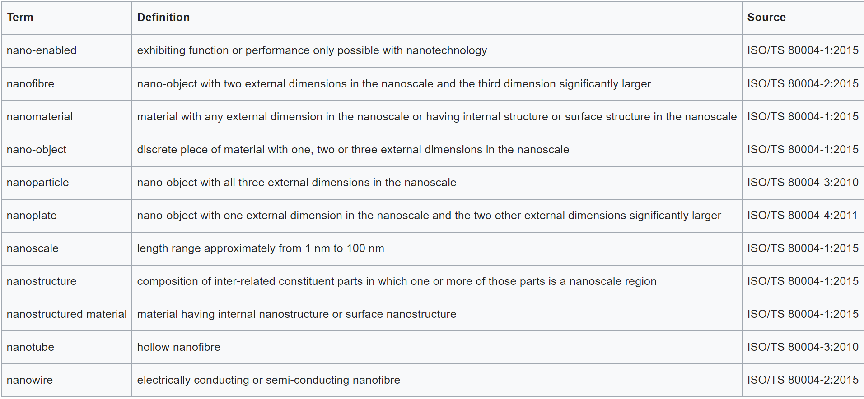
Introduction
Nanomaterials
Key terms and definitions for nanotechnologies

Slide 12
Introduction
Nanomaterials
a) Surface Area: Nanoparticles have large surface area than bulk materials. For example, nano ZnO particles have superior UV blocking properties compared to its bulk. That is why it is used in the preparation of sunscreen lotions.
b) Melting Points: Nanoparticles have significantly lower melting points compared to bulk forms. Ex: Gold nanoparticles melt at much lower temperatures (300 o C) than gold slab (1064 o C).
c) Colour: Nanoparticles have different colour compared to bulk forms. Eg: Nanoparticles of yellow gold and greysilicon are red in colour.

Slide 13

Introduction

Slide 14
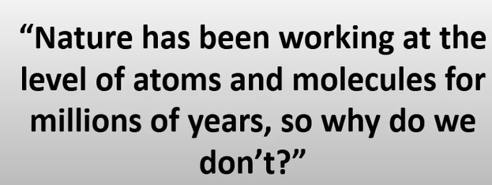

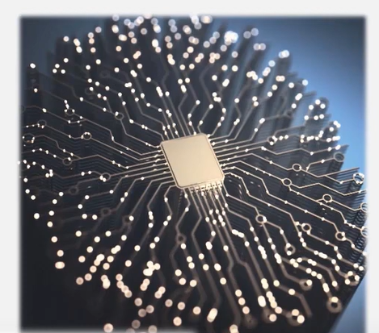
Introduction
Feynman
A central processing unit (CPU), also called a central processor, main processor or just processor, is the electronic circuitry that executes instructions comprising a computer program.

Slide 15
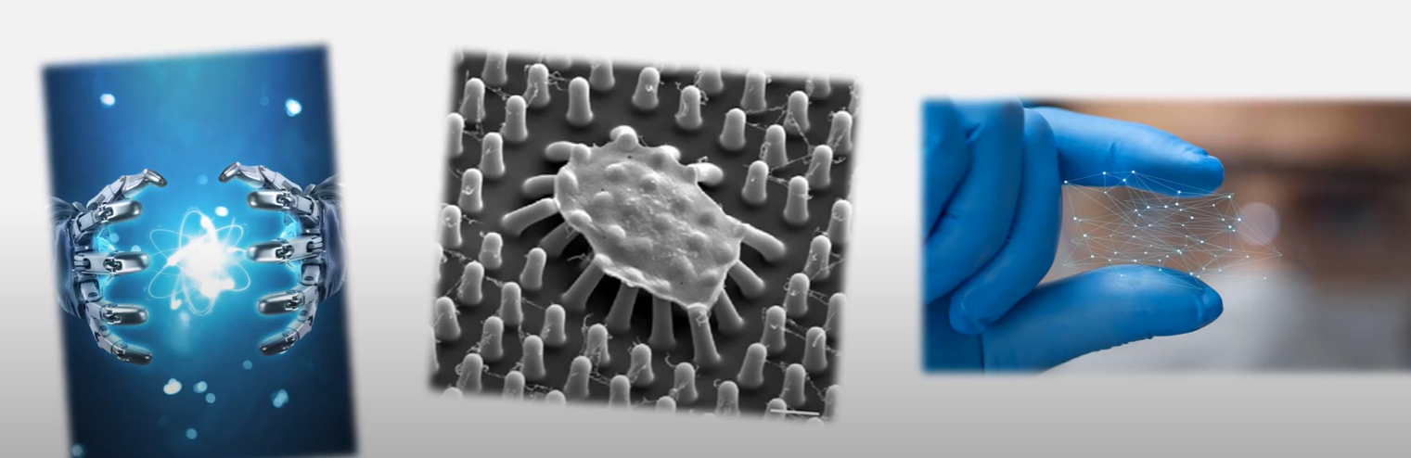
Introduction

Slide 16
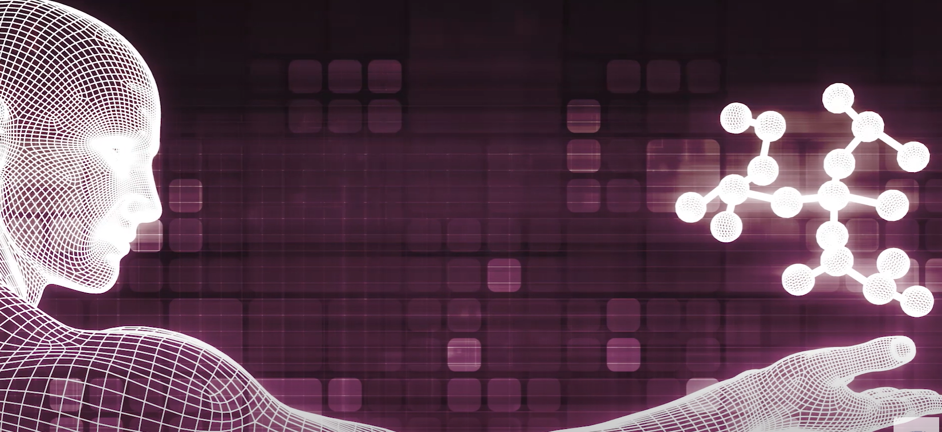
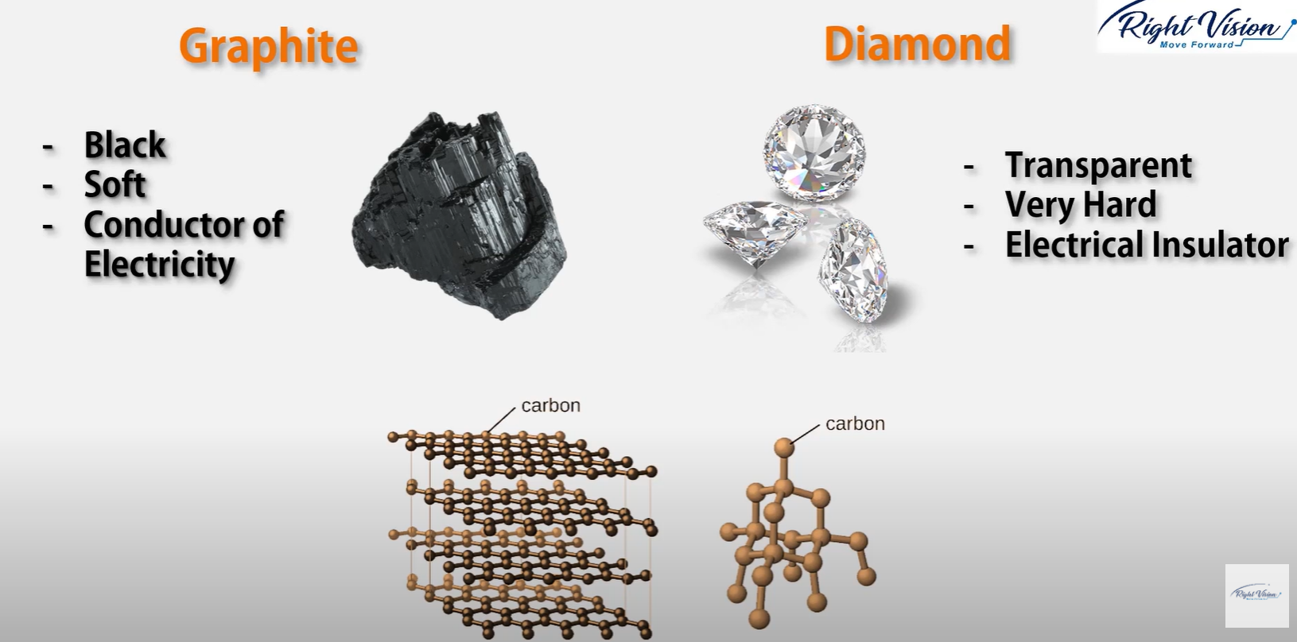
Introduction

Slide 17
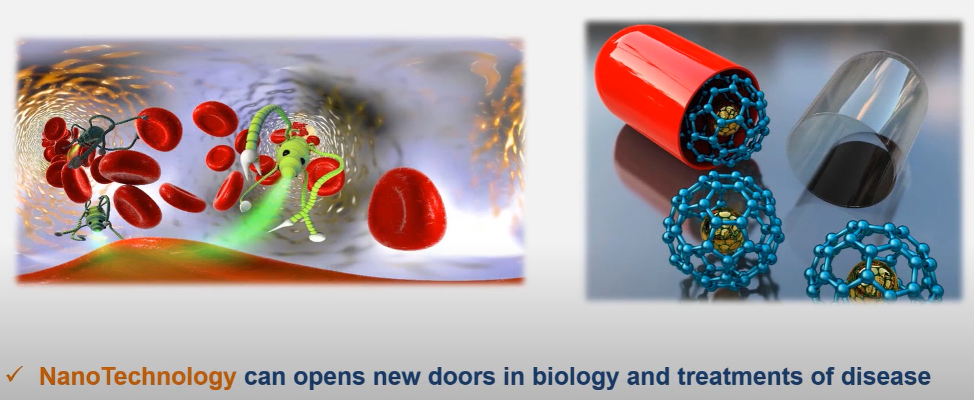
Introduction

Slide 18
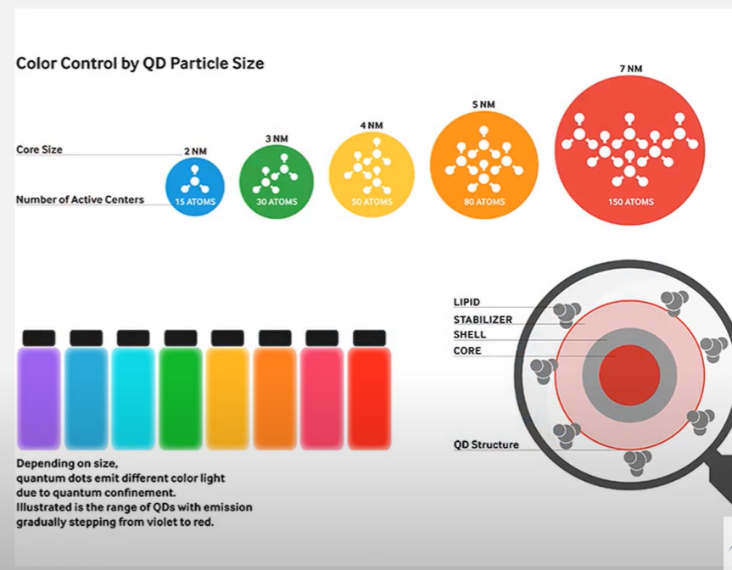
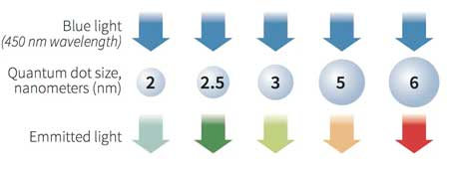
Introduction
QUANTUM DOTS
Quantum dots are nanoscale man-made crystals that have the ability to convert a spectrum of light into different colors. Each dot emits a different color depending on its size. (Image: RNGS Reuters/Nanosys)

Slide 19
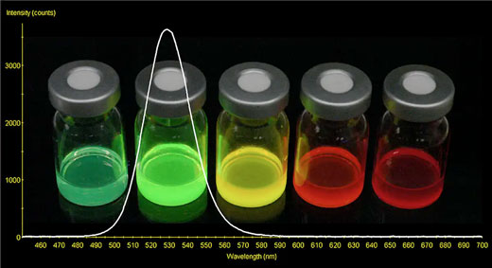
Introduction
Vials of quantum dots producing vivid colors. For instance, a cadmium-based quantum dot showing pure, highly specific green color response. (Image: NASA)

Slide 20
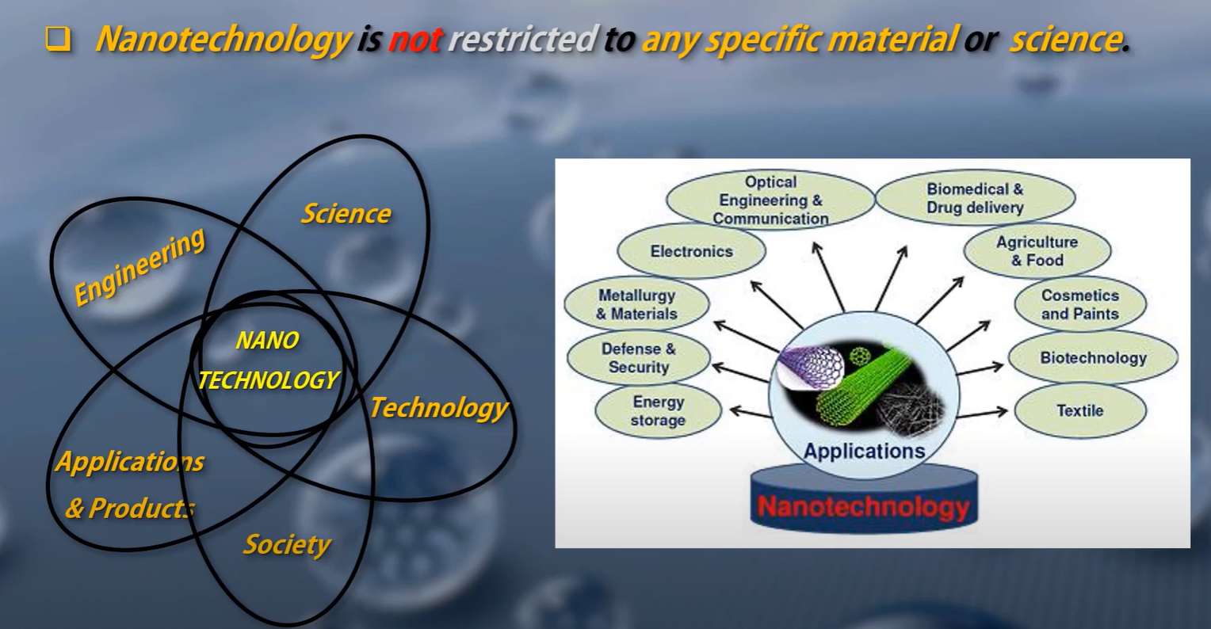
Introduction

Slide 21
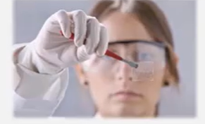
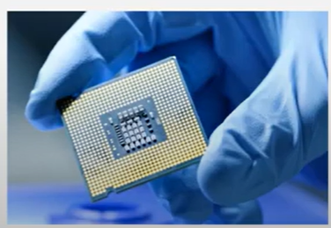
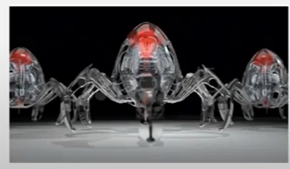
Introduction
Nanotechnology
Benefit
Applications
Perspectives
Nanotechnology is enbling technology
All the stuff we are using could have NT in them
reality
hype

Slide 22

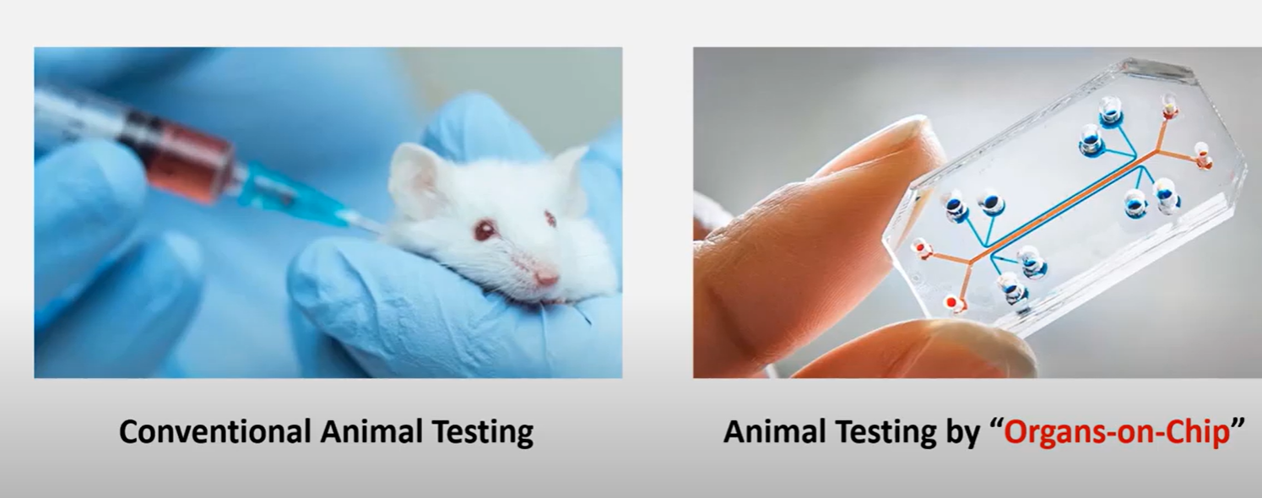
An organ-on-a-chip is a micro-scale system used for mimicking the human body environment. The goal for organ-on-a-chip is to develop human tissue models for disease modeling and drug testing. They use microfluidics, along with cells, to imitate the physiological and mechanical conditions experienced in the body.

Slide 23
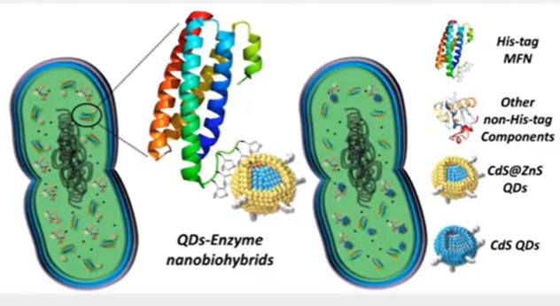


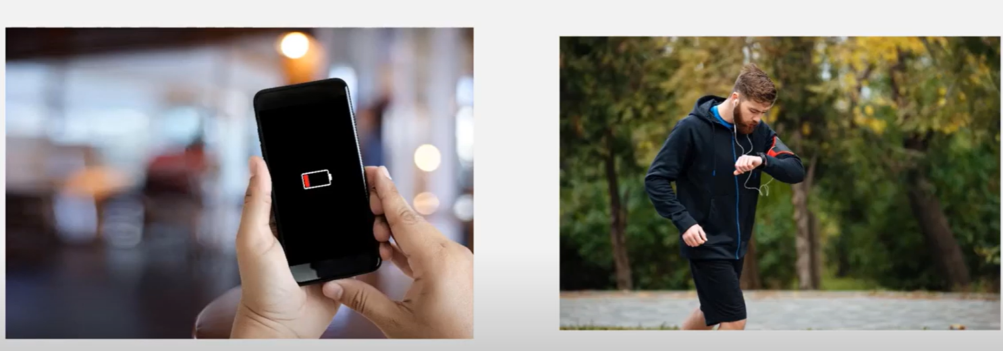

Slide 24
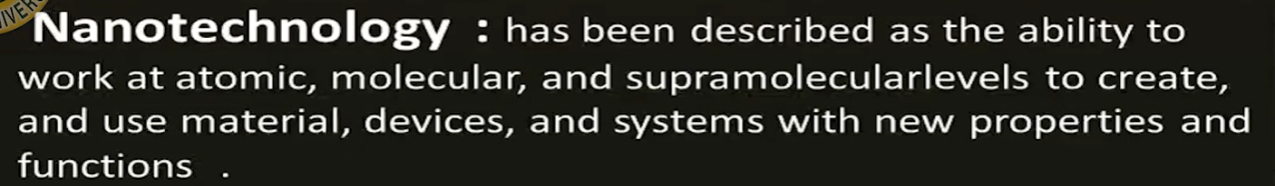
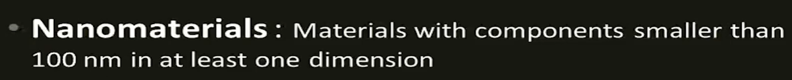
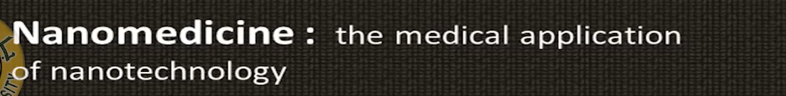
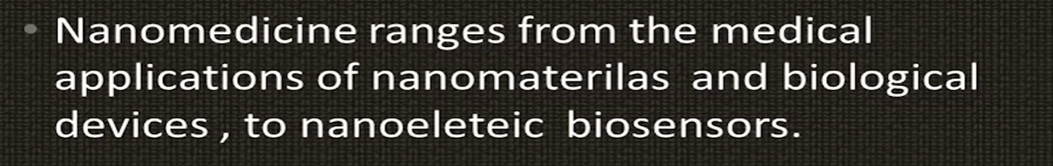
Definitions

Slide 25
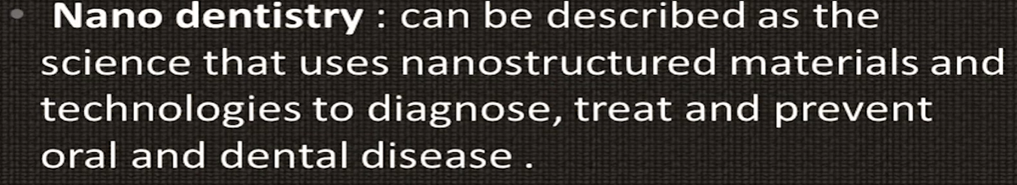

Definitions

Slide 26
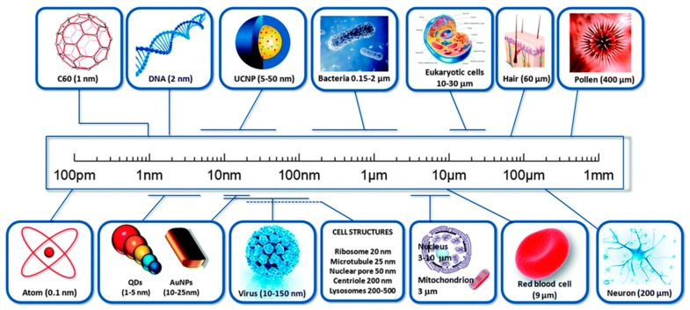
Definitions

Slide 27

History
The earliest evidence of nanotechnology and its application is traced back to 600 BC at Keeladi, India.
Mesopotamia بلاد مابين النهرينfor creating a glittering effect on the surface of pots اواني.
Middle Ages and Renaissanceعصر النهضة often retains a distinct gold- or copper-colored metallic glitter.
The technique originated in the Muslim world. As Muslims were not allowed to use gold in artistic representations, they sought a way to create a similar effect without using real gold. The solution they found was using luster.

Slide 28
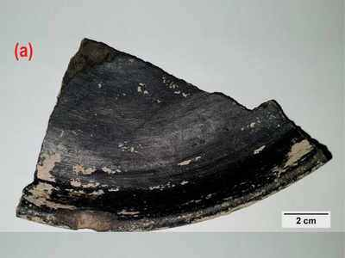
History
Five years ago, in a nondescript village some 450km from Chennai, were found the remains of a city that went back to the 3rd-6th century BCE. Now, in broken pieces of pottery from the excavation site, Keeladi, scientists have stumbled upon the world's first known use of nanotechnology, over 2,600 years ago. The findings have been documented in a paper published in ‘Nature’ this month.

Slide 29

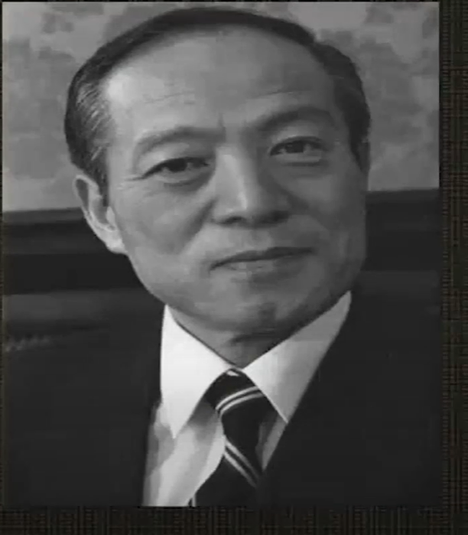

History
Richard Feynman
Norio Taniguchi
K. Eric Drexler

Slide 30
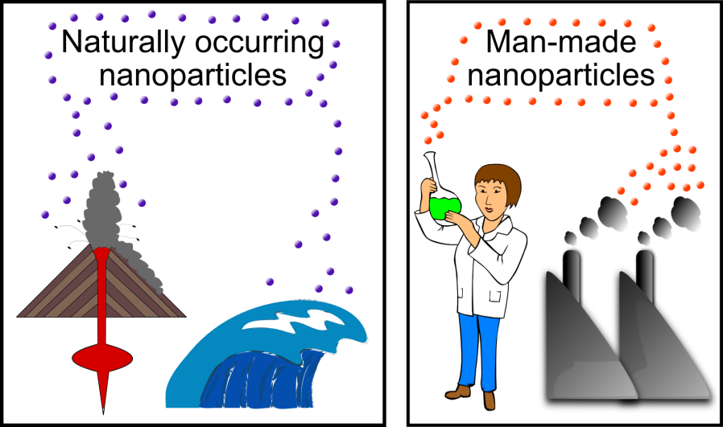
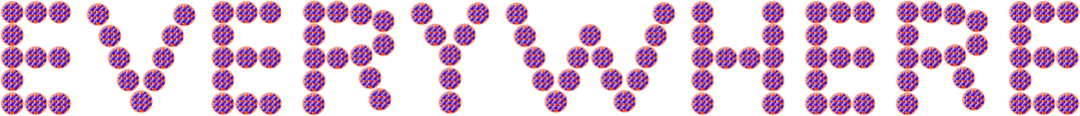

source.
Lohse,2017

Slide 31
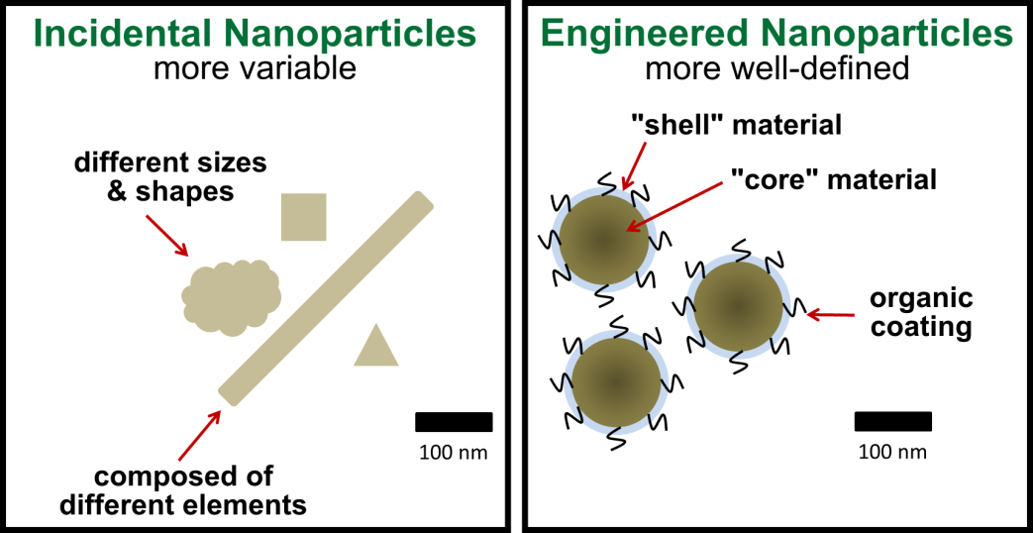
source.
Lohse,2017
There are two types of synthetic nanoparticles: “incidental” (byproducts of other human activities) and engineered (made to order).

Slide 32
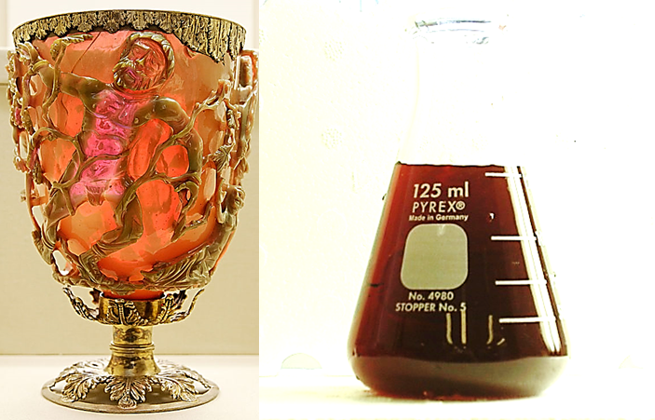
source.
Lohse,2017
The Lycurgus cup
Roman colloidal gold. (L) The Lycurgus cup. Gold and silver nanoparticles in the glass make for some fantastic and very unique color effects. (R) A solution of gold nanoparticles in water. Some people still drink this as a health tonic. I wouldn’t recommend it.

Slide 33
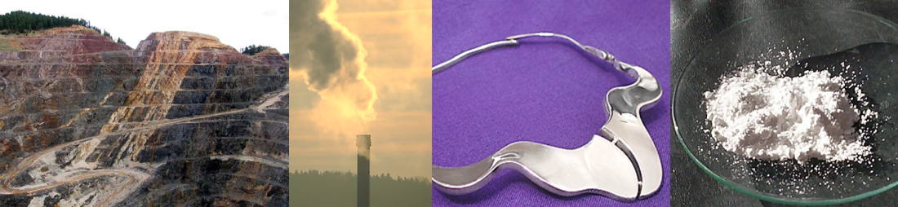
source.
Where can we find nanoparticles in our everyday world? (L-R) Industrial processes like large-scale mining and fossil fuel burning can release nanoparticles, your best silverware and jewelry can give off small quantities of silver or copper nanoparticless, powdered titanium dioxide, like you might find in sunscreen.
Lohse,2017

Slide 34


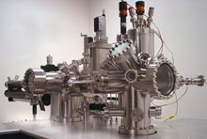
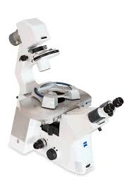
Invention of scanning probe microscopy
Gerd Binnig (left) and Heinrich Rohrer (right) won the 1986 Nobel Prize in Physics for their 1981 invention of the scanning tunneling microscope.

Slide 35
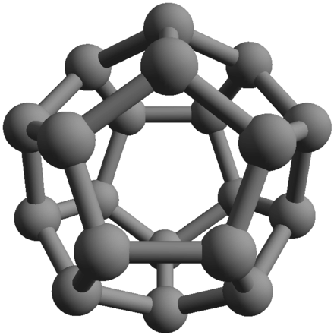
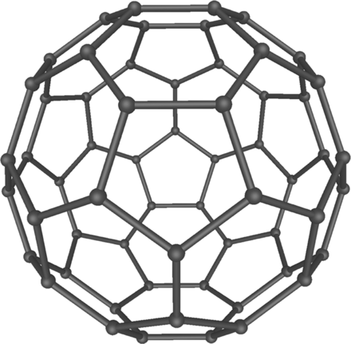
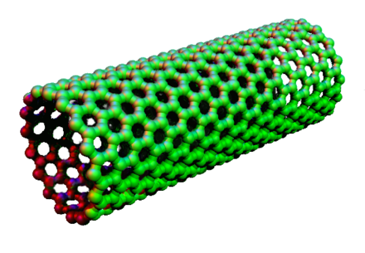
Invention of scanning probe microscopy
Model of the C₂₀ fullerene.
Model of the C₆₀ fullerene (buckminsterfullerene).
Model of a carbon nanotube

Slide 36
Types
Nanomaterial's can be categorized into four types such as:
(1) inorganic-based nanomaterials;
(2) carbon-based nanomaterials;
(3) organic-based nanomaterials; and
(4) composite-based nanomaterials.

Slide 37
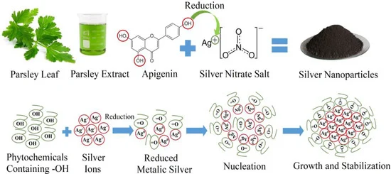
Types
Generally, inorganic-based nanomaterials include different metal and metal oxide nanomaterials. Examples of metal-based inorganic nanomaterials are
silver (Ag), gold (Au), aluminum (Al), cadmium (Cd), copper (Cu), iron (Fe), zinc (Zn), and lead (Pb) nanomaterials,

Slide 38
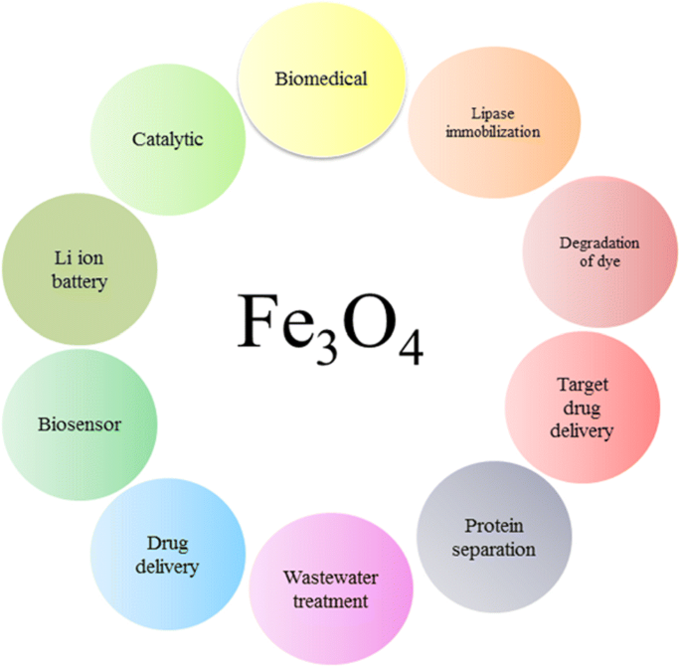
Types
whereas examples of metal oxide-based inorganic nanomaterials are zinc oxide (ZnO), copper oxide (CuO), magnesium aluminum oxide (MgAl₂O₄), titanium dioxide (TiO₂), cerium oxide (CeO₂), iron oxide (Fe₂O₃), silica (SiO₂), and iron oxide (Fe₃O₄), etc.

Slide 39
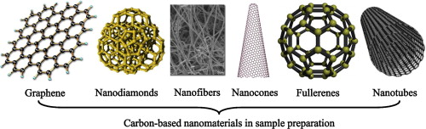
Types
Carbon-based nanomaterials include graphene, fullerene, single-walled carbon nanotube, multiwalled carbon nanotube, carbon fiber, an activated carbon, and carbon black.

Slide 40

Types
The organic-based nanomaterials are formed from organic materials excluding carbon materials, for instance, dendrimers, cyclodextrin, liposome, and micelle.
Organic nanoparticles (a) Dendrimers (b) Liposomes and Micelles (c) Ferritin.

Slide 41

Types
The composite nanomaterials are any combination of metal-based, metal oxide-based, carbon-based, and/or organic-based nanomaterials, and these nanomaterials have complicated structures like a metal-organic framework.

Slide 42

Terminology
The term “nano” comes from ancient Greek and means “dwarf”
When used as a prefix for something other than a unit of measure (as for example in words like "nanoscience"), nano refers to nanotechnology, or means "on a scale of nanometres".

Slide 43


gold crystals that are 1/10,000th the diameter of a human hair.

Slide 44

nanostructures

Slide 45

classifications
Other classifications divide nanoparticles according to whether they are carbon-based, ceramic, semiconducting, or polymeric

Slide 46



Slide 47



Slide 48


Slide 49
disadvantages
Instability of the nanomaterials.
Poor corrosion resistance.
High solubility.
When the nanomaterials with the high surface area come in direct contact with oxygen exothermic combustion takes place leading to an explosion.
Impurity
Nanomaterials are considered to be biologically harmful. These have high toxicity which can lead to irritations.
Carcinogenic
Difficult to synthesize
No safe disposal available
Hard to recycle

Slide 50

Nanodentistry-
Nano dentistry refers to the use of nanotechnology for diagnosing, treating and preventing oral and dental diseases. This is done to preserve and improve oral/dental health using nanostructured materials.
Notes:
Nano dentistry facilitates faster and to the point, accurate diagnosis. It provides enhanced properties to the dental materials, which facilitates excellent handling properties and makes the material more durable. It provides superior hardness and increased flexural strength.

Slide 51

Nanodentistry
A wide range of studies and reviews have been conducted to study Nanodentistry and its various aspects.
An article by Aeran et al, aimed to study about Nanodentistry and its applications..(Aeranet al., 2015)
The clinical applications, benefits and hazards of Nanotechnology in dentistry were analysed in detail too. (Shashirekha, Jena and Mohapatra, 2017)
A review done by Sasalwaad et al, stated that Nanodentistry is the next big thing but is small. (Shilpa S. Sasalawad , Sathyajith N. Naik , K. K. Shashibhushan , P. Poornima, Shivayogi M. Hugar , N. M. Roshan, 2014)
The recent advances in Nanodentistry were also reviewed. (Izadiet al., 2020)
As per a study done by Rao et al, it was stated that Nanodentistry created a new ‘buzz’ in dentistry. (Raoet al., 2013)
There are many challenges that can be encountered while employing nanotechnology in fields such as dental, medical and engineering, biological and ethical challenges as well as feasibility. The biological challenges may include the risk of toxicity and incompatibility caused due to the materials. Public acceptance is a huge ethical challenge.(Bumb, Bhaskar and Punia, 2013)) This also portrays a significant potential for misuse.

Slide 52

Nanotechnology for dental applications
Barot etal,2020

Slide 53

Potential Harm:
Toxicity
Hypersensitivity
Particles can be inhaled or ingested by the patient. These have the ability to cross cell membranes and reach the liver and bring about severe damage.
(AlKahtani, 2018)

Slide 54



Slide 55
Nanomaterials Application in Orthodontics
Nanotechnology is used, in brackets, archives, elastomeric ligatures, orthodontic adhesives. Improving the microbicidal properties, reducing friction
and increasing the strength of the material are some of the advantages. However, a significant problem is the potential cytotoxicity of nanomaterials, therefore further research is needed

Slide 56
Nanomaterials Application in Orthodontics
The prolonged process of wearing orthodontic braces dental plaque and eventually results in a greater risk of caries.
The demineralization process that starts the caries is called a white spot lesion (WSL), meaning, that decalcification of enamel surfaces adjacent to the orthodontic appliances is directly associated with orthodontic treatment
Research shows that more plaque can accumulate around composites compared to other restorative materials, which results in an increased percentage of secondary caries . Moreover, resin composites do not have bacteriostatic properties.

Slide 57

Nanomaterials Application in Orthodontics

Slide 58

Tahmasbi etal,2019

Slide 59

Nanomaterials Application in Orthodontics

Slide 60

Nano-Coatings in Orthodontic Archwires
Minimizing the frictional forces between the orthodontic wire and brackets has the potential to increase the desired tooth movement and thus shorten treatment time. In recent years, nanoparticles have been used as a component of dry lubricants.
examples are Inorganic fullerene-like tungsten sulfide nanoparticles (IF-WS2) that are used as self-lubricating coatings for orthodontic stainless steel

Slide 61
Coated Orthodontic Archwires
Today, nanotechnology aims to reduce frictional forces, allowing the system to work more easily:
it was suggested that the best solution is the coating of orthodontic archwires with a film incorporating
nanoparticles. The best materials for achieving the goal of friction reduction are considered to be MoS2
(molybdenum disulfide) and W2 (tungsten disulfide)
Stainless steel archwires, 0.19 0.25, coated with MoS2 (molybdenum disulfide) and W2
(tungsten disulfide).
Notes:
The inorganic fullerene-like tungsten disulfide (IF-WS2) nanoparticles have been exploited
for this purpose; it was shown that under certain reducing and sulfidizing conditions, at elevated
temperatures, tungsten oxide (WO3) nanoparticles could form nestedWS2 fullerene-like nanostructures,
creating layers that resemble an onion or a nanotube. The layers were weakly connected through
van der Waals forces only, and it is known that WS2 and MoS2 particles with layered structures
(platelets) provide good lubricity [48]. The positive chemical and physical characteristics of fullerene
have led engineers to develop modern inorganic fullerene-like nanoparticles, to apply these properties
to new materials, even in dentistry. The attention focused in particular on chalcogenides (binary salts
of S, Se or Te) of the transition metals, in particular, on the disulfides MoS2 and W2: they have
a layer structure, similar to graphite, which is characterized by the overlapping molecular planes.
These nanoparticles were firstly described by Tenne in 1992. The van der Waals forces between the
layers are relatively weak, and this determines the characteristics: these nanoparticles are allowed to
roll rather than slide when they are interposed between a metal and solid lubricant [11,22]. Among the
main features, there is the ability to maintain an intimate contact with metal surfaces, to dissipate less
energy under a force load due to elastic deformations of the nanoparticles, and to develop a lower
temperature with increasing friction. The nanoparticles also develop poor reactivity owing to the
bonds that characterize them, which prevent any oxidation phenomena [11].
Regarding the toxicity of these materials, some studies have demonstrated no toxic eects in rats
and after dermal application [46]. Further research is necessary to demonstrate there are no toxic eects
in humans for the entire length of an orthodontic treatment.

Slide 62

Delivering Nanoparticles from an Elastomeric Ligature Elastomeric ligatures can serve as a support scaffold to deliver nanoparticles that can be anti-cariogenic or anti-inflammatory. They may also carry embedded antibiotic drug molecules.

Slide 63

Delivering Nanoparticles from an Elastomeric Ligature
The most recent studies seem to evaluate the potentiality of the association of ligatures with
silver nanoparticles, a material that appears to have the ability to counter dental biofilm and decrease
the enamel demineralization caused by the accumulation of bacterial plaque, without affecting the
mechanical characteristics of the material itself and therefore the effectiveness of orthodontic therapy.
Gómora etal,2017

Slide 64

Delivering Nanoparticles from an Elastomeric Ligature
Nanotechnology in dentistry applied to materials is innovative for the concept of leading to better
anticariogenic characteristics; the silver particles have been incorporated into different materials and
can be obtained with minimally invasive methods from elements such as flowers and mushrooms.
Gómora etal,2017

Slide 65
Delivering Nanoparticles from an Elastomeric Ligature
It is known that silver has a superior antibacterial property compared with other metals; it has a strong
cytotoxic effect on a wide range of microorganisms: the mechanism is not very clear; it probably acts
by denaturing the enzymes of the respiratory cycle and DNA synthesis. Furthermore, silver is not
very toxic and has good compatibility with human cells. Today, however, other studies are needed to
determine their actual biocompatibility
Gómora etal,2017

Slide 66

Delivering Nanoparticles from an Elastomeric Ligature
Research has shown that fluoride release is characterized by an initial burst of fluoride in the first few days followed by a logarithmic fall. The whole process is effective against common enamel demineralization around the orthodontic bracket during treatment
Gómora etal,2017

Slide 67



Slide 68



Slide 69
Shape Memory Polymers (SMP) in Orthodontics
Future directions of research on shape—nanocomposite polymers with memory for the production of aesthetic orthodontic wires may have interesting potential in the research of orthodontic biomaterials.

Slide 70

Control of Oral Biofilms during Orthodontic Treatment
Mechanisms of NP mediated antimicrobial and antibiofilm activities against oral bacteria. Panel A shows the inhibition of glucosyl transferase by NPs leading to the reduced exopolysaccharide production and biofilm formation and loosening of biofilm through penetration. Panel B shows NPs mediated biochemical changes occurring at cellular level either in the planktonic cells or within the individual cells of the dental biofilm (e.g. ROS generation, DNA binding, enzyme inhibition, depleted levels of intracellular ATP). Panel C shows the changes taking place at the membranes of individual cells such as disruption of cell membrane, inhibition of cytochrome oxidase involved in the bacterial respiration .
( Khan et al., 2015).

Slide 71

Nanomaterials Application in Orthodontics

Slide 72

Orthodontic Power Chains
In a study conducted in Taiwan by Cheng et al., the authors tried to improve the physical
properties of power chains by performing a surface treatment called nanoimprinting. The treatment
consists of creating nanostructures on the surface of the chains called nanopillars. The results seem
encouraging, as this treatment converts the material from hydrophilic to hydrophobic and alleviates
the shortcomings of these orthodontic auxiliaries
Anodic aluminum oxide (AAO)

Slide 73

Orthodontic Bands
Band cements with antimicrobial characteristics (antibacterial release materials such as silver nanoparticles)
Moreira etal,2015

Slide 74

Orthodontic Miniscrews
The TiO2 nanotube arrays were loaded with RhBMP-2 (recombinant human bone morphogenetic
protein-2) and ibuprofen and were compared with a control group of standard miniscrews. The effects of the drugs were evaluated in vivo: the study looked at how drug-modified miniscrews had a positive eect on tissue health.
These modified miniscrews can convey other drugs, such as antibiotic agents, aspirin and
Vitamin C, to decrease inflammation at the insertion site and patient discomfort. This modification
to the materials has also proved important in ensuring greater surface roughness of the aids and
improving wettability compared to conventional products.

Slide 75
Bracket Materials
Nitrogen doped titanium dioxide (TiO2) brackets: Orthodontic brackets have been coated with nitrogen doped titanium dioxide. The activation of Nitrogen doped Titanium dioxide leads to the formation of OH. Free radicals, superoxide ions (O2), peroxyl radicals (HO2) and hydrogen peroxide (H2O2). These chemicals, through a series of oxidation reactions, react with biological molecules such as lipids, proteins, enzymes and nucleic acids, damage biological cell structures, but also exert antimicrobial activity
Batra etal,2016

Slide 76


Slide 77

aligners
Nano-sized gold particles can be used on orthodontic appliances e.g., aligners, to increase its antibacterial activity, by preventing biofilm formation as can be seen in . Both the gingiva and teeth are covered by aligners for almost the entire day, which is a risk factor for plaque accumulation. Gold particles also show positive biocompatibility both in vitro and in vivo.
Zakrzewski etal,2021

Slide 78
Fluoroapatite, fluorohydroxyapatite or hydroxyapatite NPs:
Resin modified GIC has been improved by incorporating nano-sized fluoroapatite (NFA) or fluorohydroxyapatite (NFHA) particles at 25% concentration; however, this was at the cost of significant reduction in shear bond strength. The fluoride release nearly tripled after 70 days . Nano-hydroxyapatite (Nano-HA) has also been added to orthodontic banding cement to prevent microleakage.
Enan etal,2021

Slide 79

Nanoparticles in orthodontic adhesives
There are two distinct types of dental nanocomposites currently available: nanofills and nanohybrids Nanofills contain nanometer-sized particles (1-100 nm) throughout the resin matrix, with no other large primary particles included. Nanohybrids consist of larger particles (400-5000 nm) with added nanometer-sized particles. The use of nanoparticles addresses the aforementioned difficulty by combining high mechanical strength with long-term polish retention in one material.
Yan Liu etal,2018

Slide 80


Nanoparticles in orthodontic adhesives
It was shown that modifying conventional GIC with nanohydroxy and fluoroapatite and N-vinylpyrrolidone containing polyacids improved its mechanical properties. When tested, it proved to have greater CS and higher diametral tensile strength (DTS) and biaxial flexural strength (BFS) than the control group consisting of conventional GIC .
Chieruzzi etal,2018

Slide 81

Conclusions Nano-modification of conventional GICs and RMGICs can be achieved by the incorporation of nano-sized fillers to RMGICs, reducing the size of the glass particles and introducing nano-sized bioceramics to the glass powder.

Slide 82
BioMEMS/NEMS for orthodontic tooth movement and maxillary expansion
Microelectromechanical systems (MEMS) devices
Evidence suggests that orthodontic tooth movement can be enhanced by supplementing the mechanical forces with electricity
An enzymatic microbattery, when placed on the gingiva near the alveolar bone, might be a possible electrical power source for accelerating orthodontic tooth movement.

Slide 83
Nanorobot delivery for oral anesthesia
In 2000, Robert A Freitas Jr. suggested that dental nanorobots can be utilized to induce oral anesthesia. These nanorobots can be controlled by an onboard nanocomputer that executes preprogrammed instructions and can be delivered as colloidal suspension containing millions of active analgesic micrometer-sized nanorobot particles on the patient’s gingiva.

Slide 84
composite adhesive
Silver nanoparticles: Silver NPs have been added to composite adhesive containing silica nanofillers. Addition of silver NPs significantly reduced the adhesion of cariogenic

Slide 85


Slide 86


Conclusions
Nowadays, nanotechnology plays an important role in the dental field since it has
the potential to bring significant innovations and benefits. The recent positive results are
a stimulus for future research, especially regarding orthodontics. The range of research
including orthodontic bonding materials, covering of brackets and wires, as well as their
antimicrobial characteristics has a huge potential

Slide 87
How to disperse nanopowder and nanoparticles?
Disperse nanoparticles:
1. If used in the aqueous phase, may use ultrasonic treatment to disperse;
2. If used in oil phase, may use high shear mixing instrument to disperse.
3. If directly used as dry powder form, may use ball mill treatment to disperse.
How to disperse nano-materials and mix with other powder? There is no specific method of the world. It is still a research topic. In general, if one nanomaterial will be mixed with other powder (for example: your ceramic powder), the first step is to put the nanomaterial into water or ethanol in the high-speed mixing instrument, add 1% dodecyl benzene sulfonate (detergent main ingredients), Instantly after mixing, then put the dispersed nanomaterial into the other powder (your ceramic powder) and continue to mix by still using high-speed mixing instrument, stirring rate the higher the better, time the longer the better as well, and then heating the mixed liquid material to be evaporated completely.

Slide 88
How to disperse nanopowder and nanoparticles?
The Methods of Nanoparticle Dispersions:
Rule: The smaller the particle size, the greater the surface area, the better the particle activity. That is, the nanoparticles can fully reveal the nano-properties..
Safety: Nanoparticles present possible dangers, both medically and environmentally. Most of these are due to the high surface to volume ratio, which can make the particles very reactive or catalytic. They are also able to pass through cell membranes in organisms, and their interactions with biological systems are relatively unknown.

Slide 89

How to disperse nanopowder and nanoparticles?
Synthesis of Nanomaterials by High Energy Ball Milling

Slide 90

How to disperse nanopowder and nanoparticles?
Nanoparticles in an appropriate solvent (alcohol for example) is sprayed onto a substrate using differential pressure via a jet/nozzle of an atomizer.

Slide 91
Conclusions
Today, nanotechnology has an important and more consistent role in the dental field since it
has the potential to bring significant innovations and benefits. The recent positive results must be a
stimulus for future research, in particular, regarding the field of orthodontics. We have explained how
nanomaterials have introduced many advantages in this field, especially regarding their mechanical and
antibacterial properties. The coordinated and safe management of orthodontic treatment is fundamental;
the limitations of dental materials and technical procedures often refer to this goal, but science and
nanotechnology have helped to partially solve some limitations, improving patient management in the

Slide 92


Slide 93


