Slide 1
Assisstant professor Dr.Hiader Mohammed Ali
Malposed canine

Slide 2
Ectopic canine teeth develop displaced from their normal position. Any permanent tooth can be ectopic, and the cause may be both genetic and environmental. Orthodontic treatment is justified because ectopic canine teeth can migrate in the jaw bone and may damage the adjacent teeth roots and bone.

Slide 3
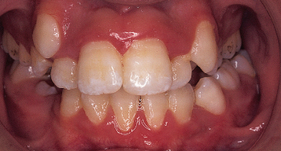
An ectopic tooth is defined as a tooth that is following an abnormal eruption path whereas an impacted tooth is a tooth that is unable to erupt without assistance and is usually associated with an ectopic path of eruption.

Slide 4
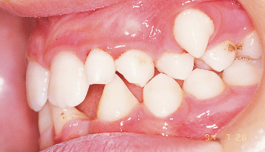
On average, the permanent maxillary canines erupt into the oral cavity between the ages of 10–12 years (Haavikko 1970), but with a normal deviation of several years (Hurme 1949; Hägg and Taranger 1986).

Slide 5
Ectopic teeth are similar to impacted teeth. The difference is that ectopic teeth erupt somewhere they shouldn't (referred to as an 'abnormal eruption path'), whereas impacted teeth may be on course to erupt in the right spot, but are simply not able to. A tooth can be both ectopic and impacted.

Slide 6
Ectopic buccally erupted maxillary canines are one of the most frequently encountered conditions in orthodontic practice. The prevalence of permanent maxillary canine impaction or ectopic eruption in the general population is approximately 1–2%. Palatally displaced canines (PDC) occur twice as frequently as buccally.

Slide 9
Clinical cases

Slide 10
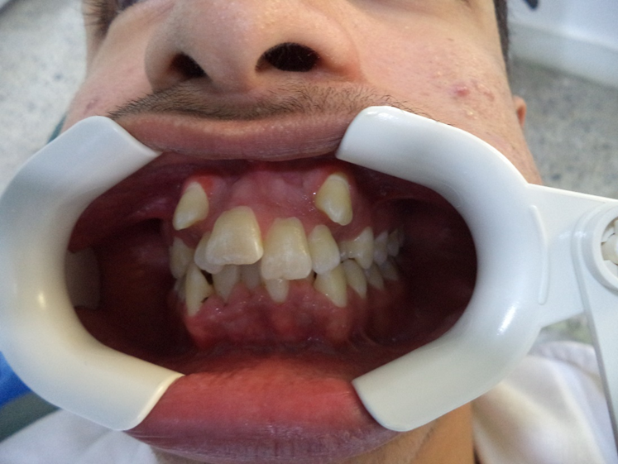
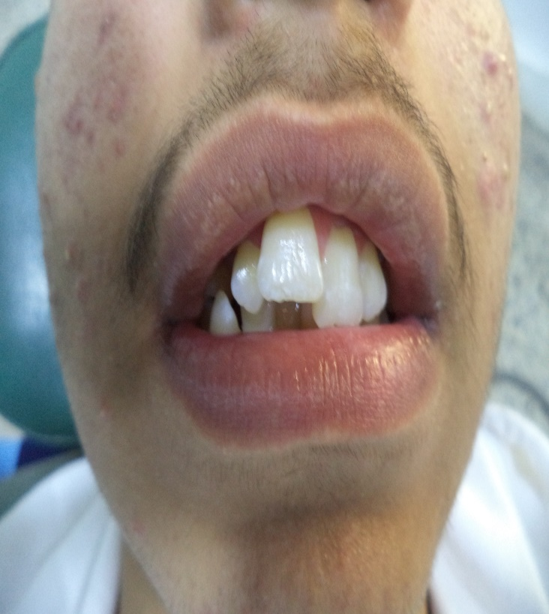
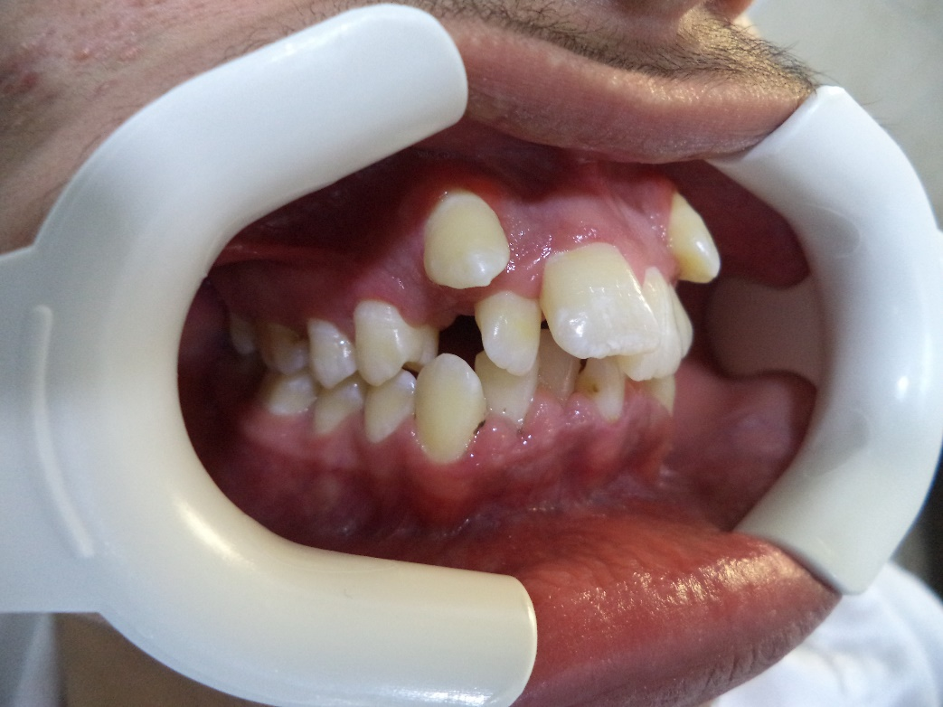
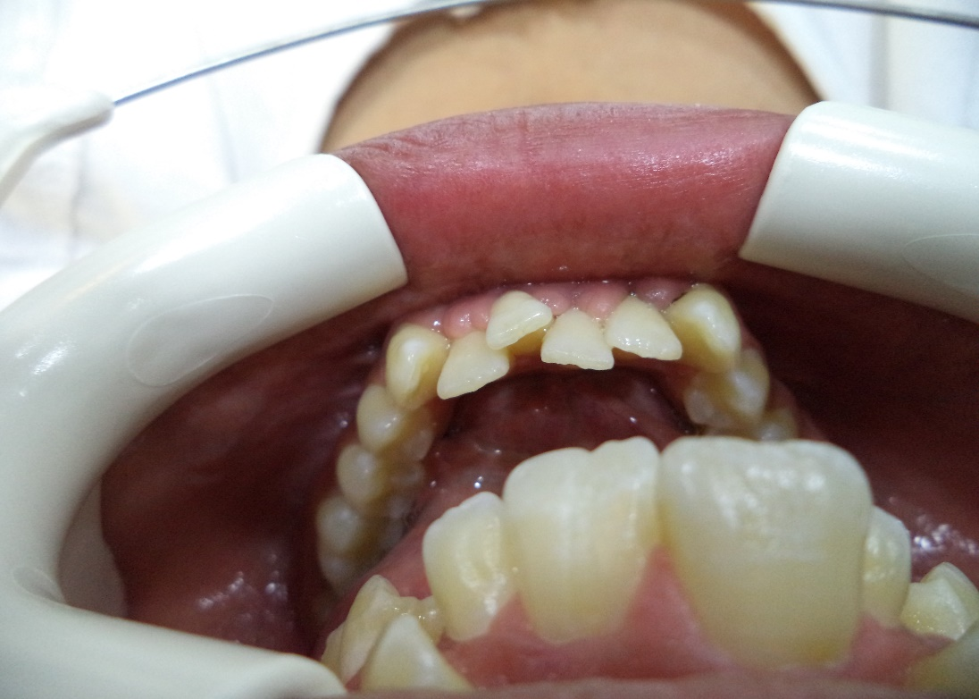
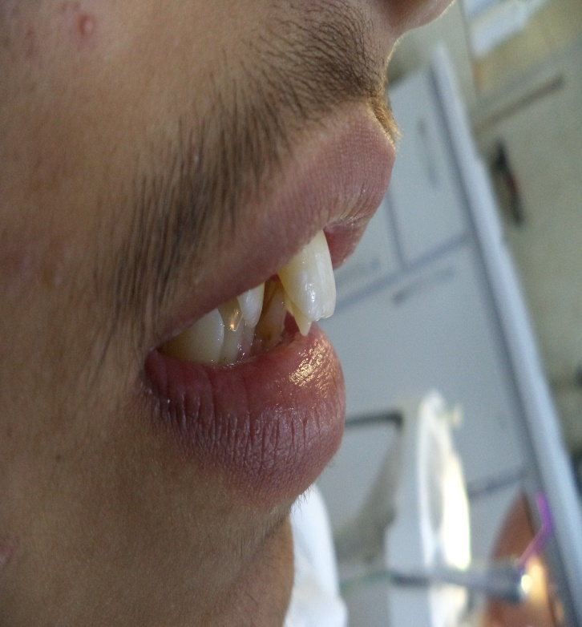

Slide 11
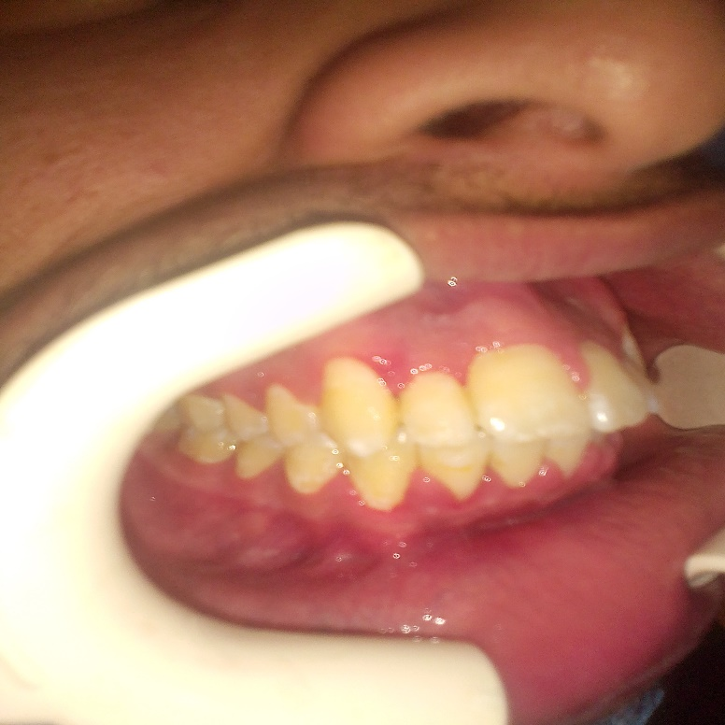
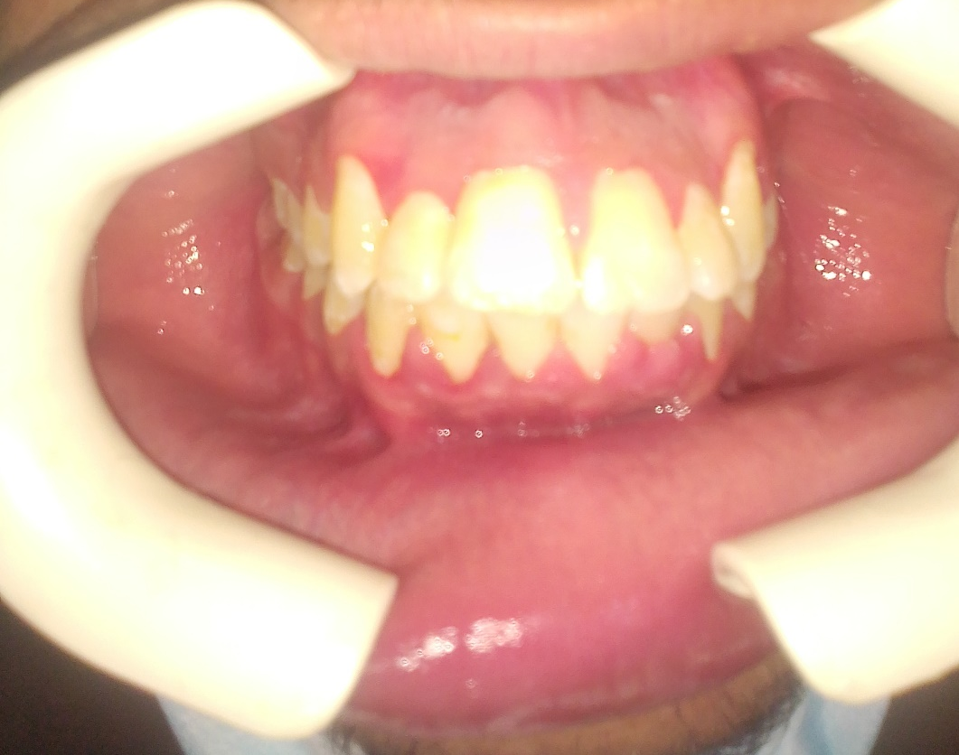
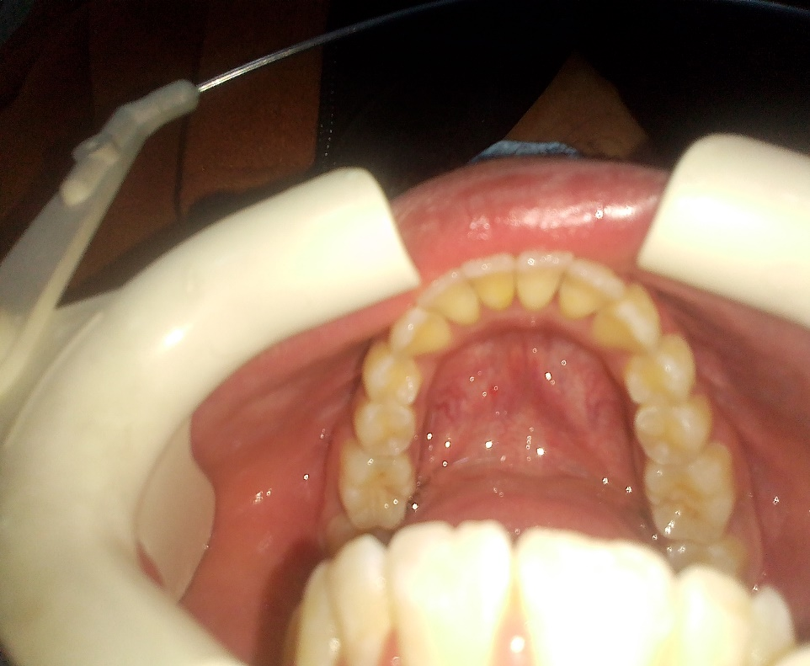
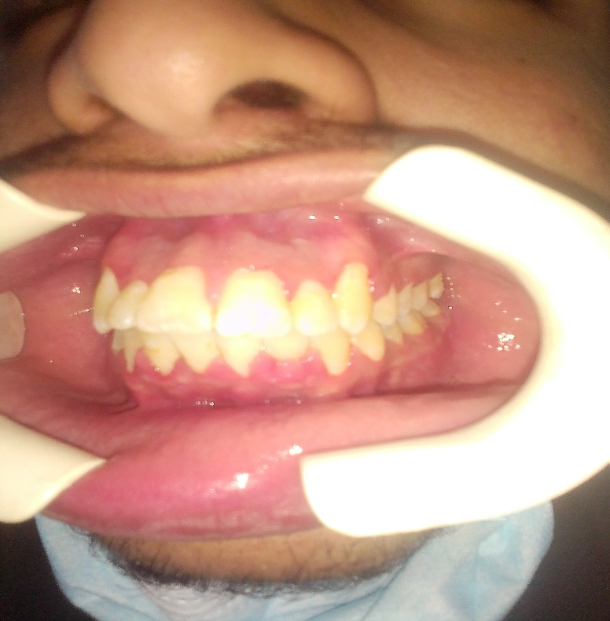

Slide 12
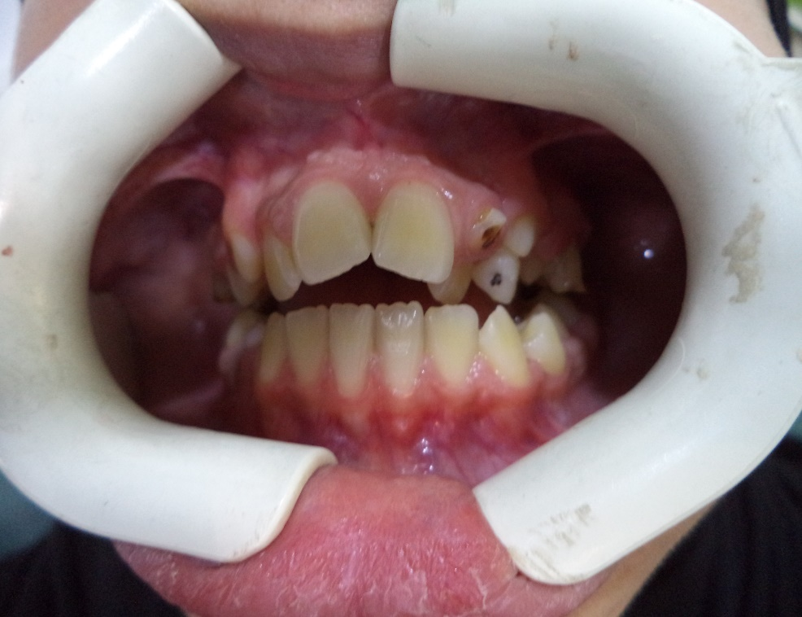
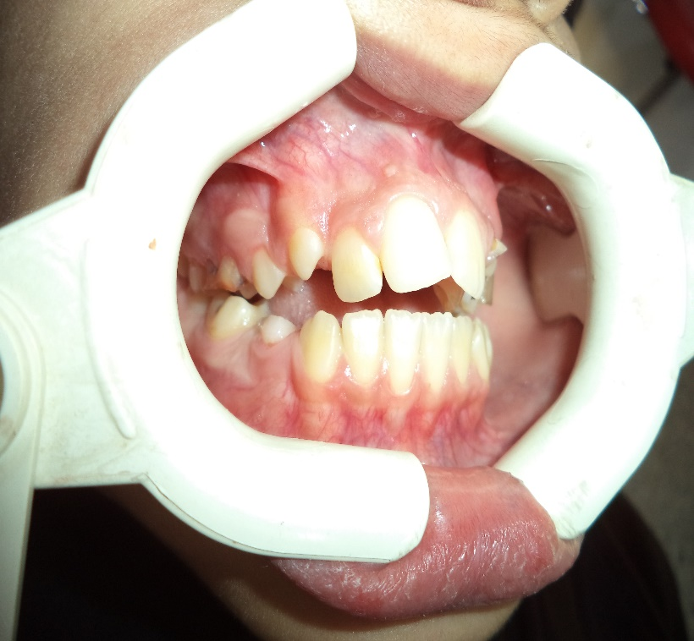
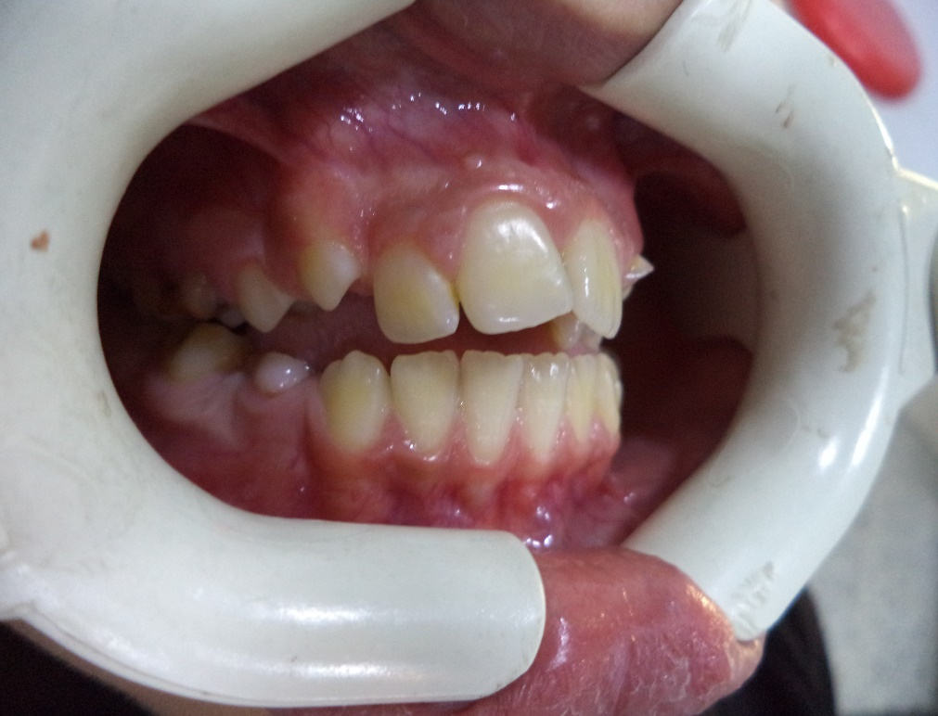
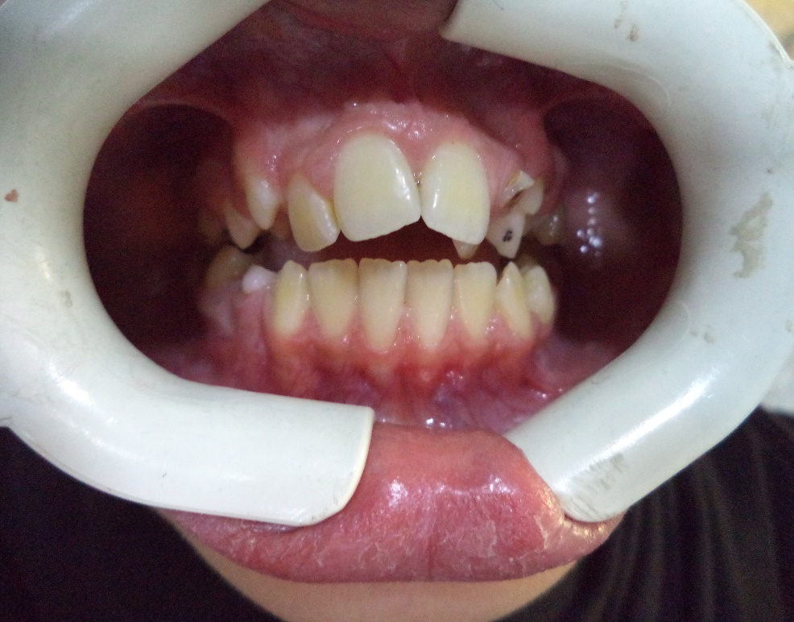
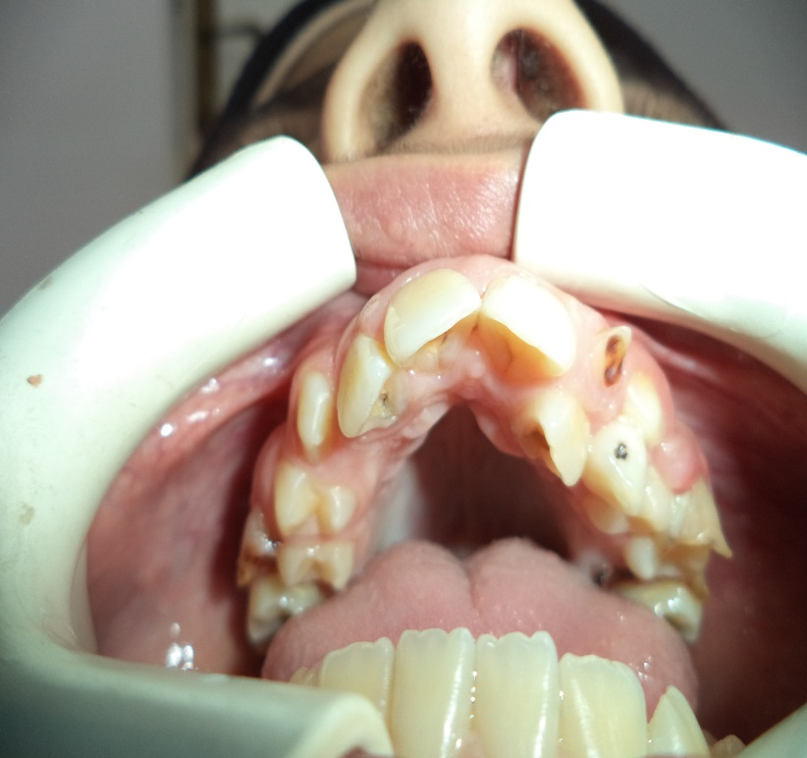

Slide 14
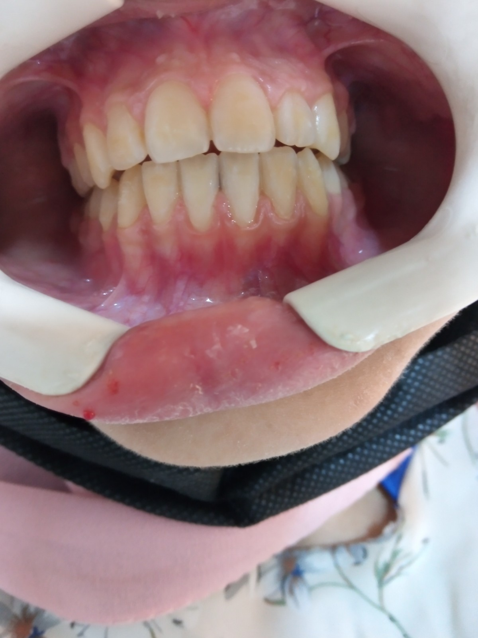
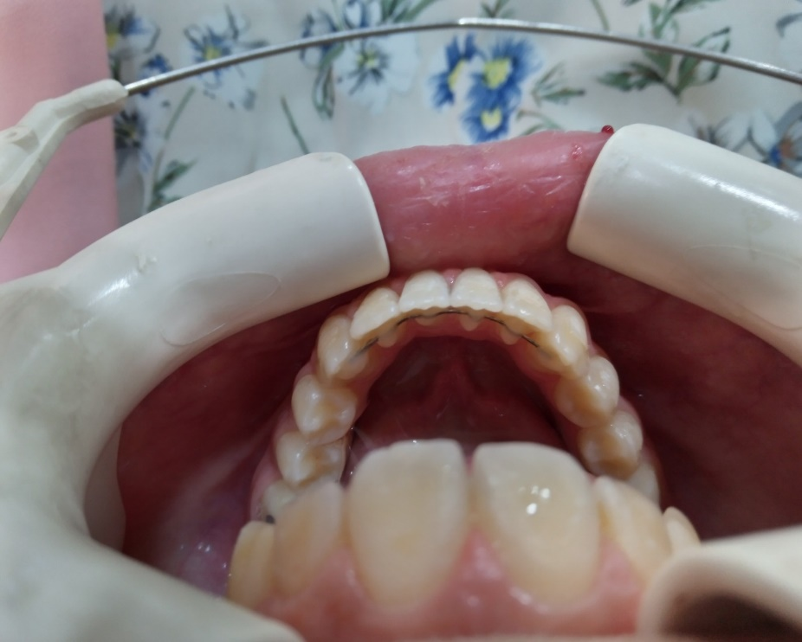
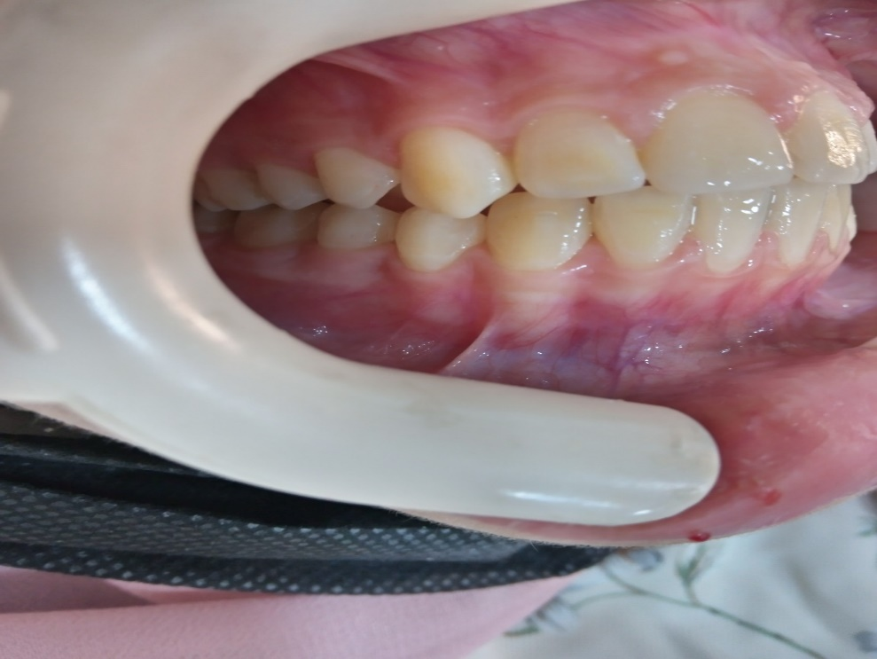

Slide 15
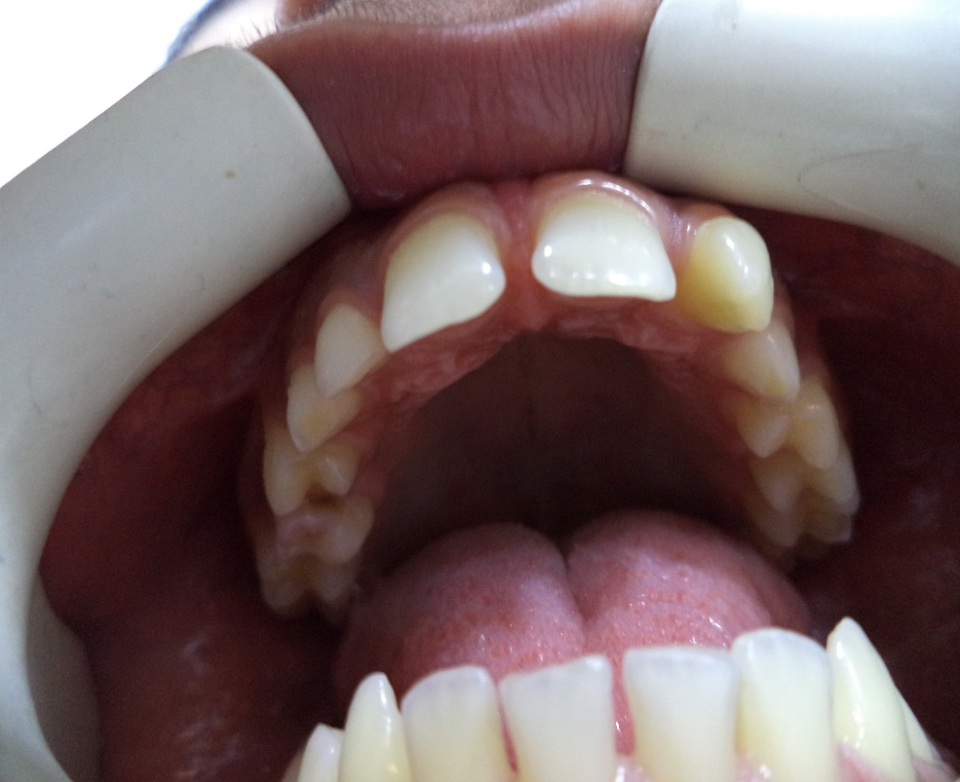
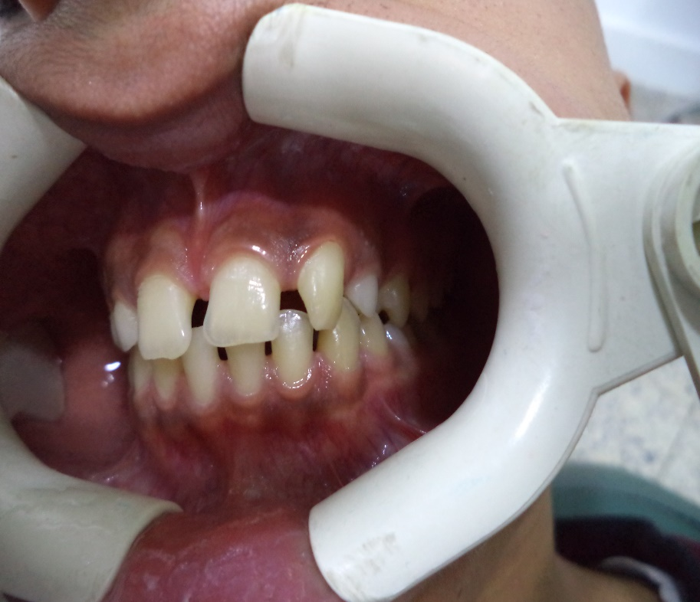
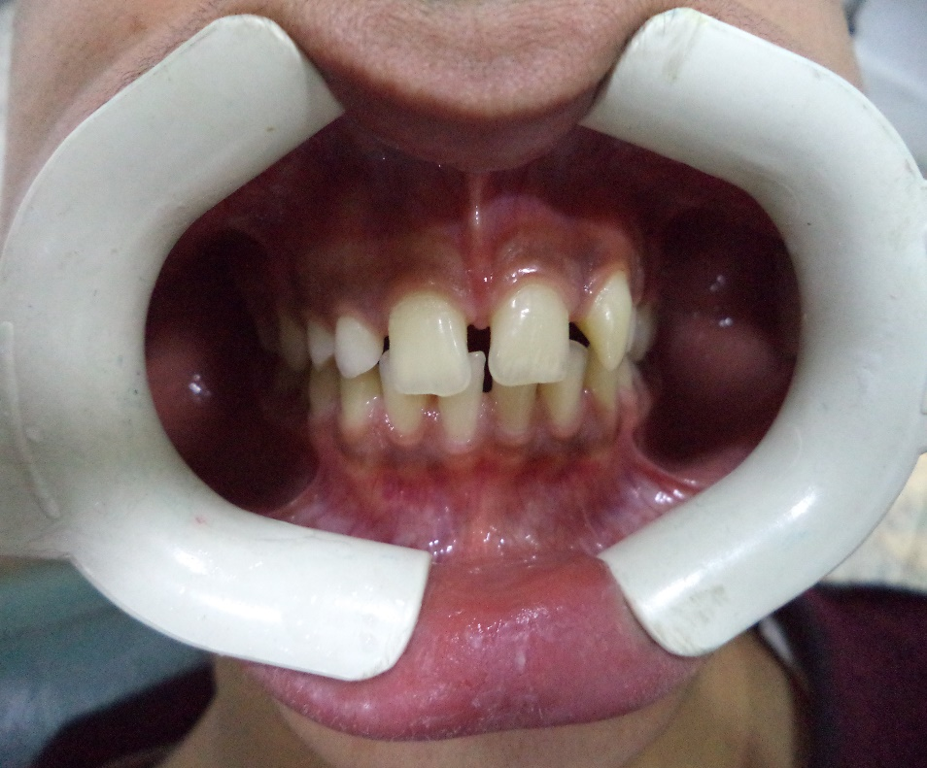
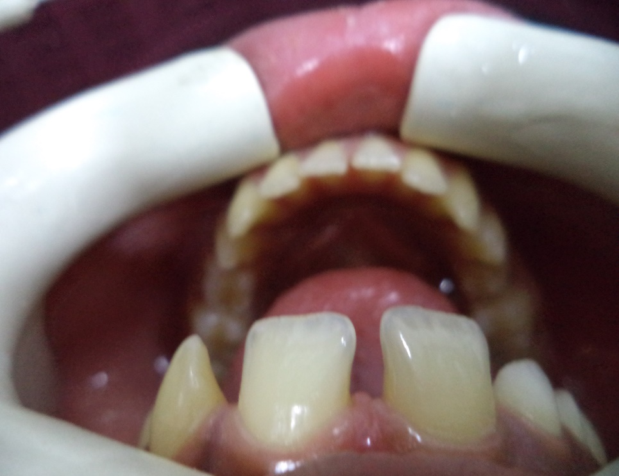
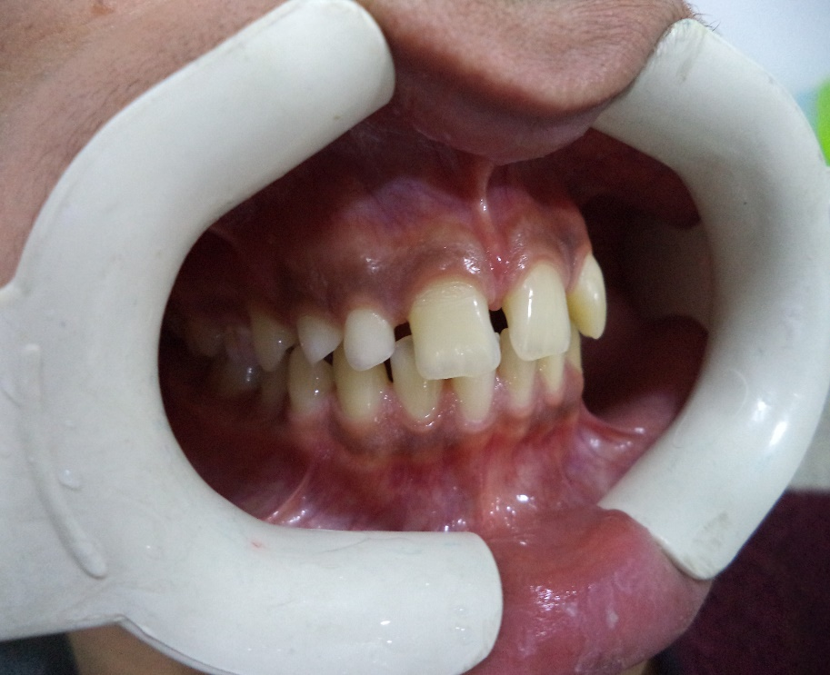

Slide 16
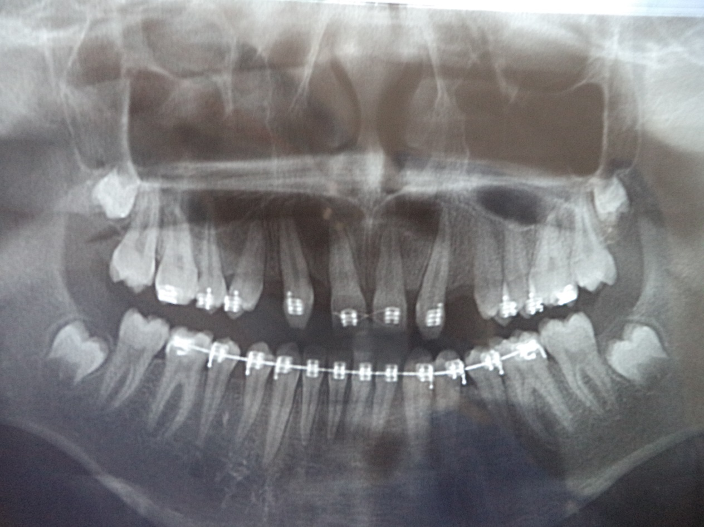

Slide 17
