Slide 1
Assessment of third molar space, level, and Angulation in OPG
Lecturer:
Noor Falah AL-Khawaja
B.D.S, Msc.

Slide 2
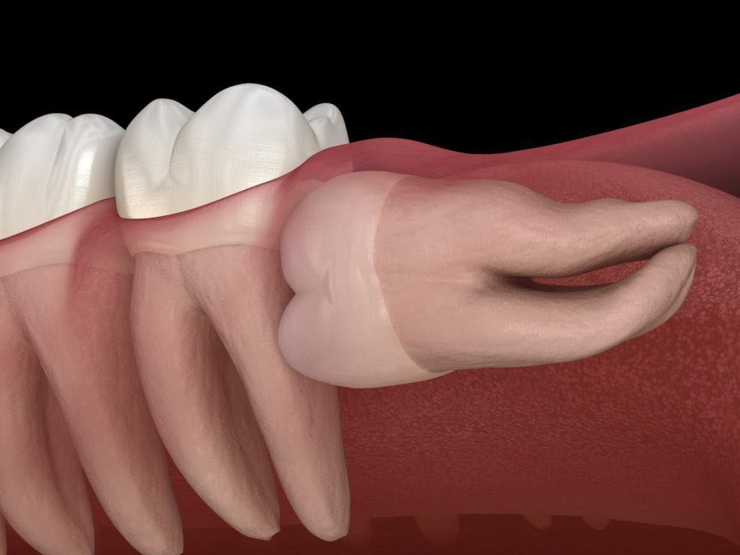
Introduction : The relationship between third molars and dental crowding has not yet been clariﬁed in the literature.

Slide 3
To Fully evaluate its effect. We Must Assess two things :-
.Because Anterior crowding is a multifactorial problem. All Other causes that could be causing it must be assessed
.The Width, Angulation and Eruption level of the wisdom teeth must be carefully evaluated

Slide 4
Studies Relating Third Molar to Lower Anterior Crowding
1. Bergstrom and Jensen study
They have found that in both maxilla and mandible there was a greater degree of crowding on the side where the third molar was present.
2- Lindqvist and Thailander
They noted that the space change on the extraction side was improve in relation to the control side in 70 percent of cases.
(Sumitra andTandur, 2005)

Slide 5
Schwarze Study
He found a signiﬁcant forward movement of the ﬁrst molars associated with increased lower arch crowding in the
non-extraction group.
Selmer-Olsen's study
He suggested that in people with unilateral congenital absence of a third molar there was less crowding.
(Sumitra andTandur, 2005)

Slide 6
Studies Denying Third Molar relation on Lower Anterior Crowding

Slide 7
1- Ades Study
He studied four groups. One with missing third molars. The second were impacted. The third were erupted and functional. The fourth extracted at least 10 years before the post retention records.
No signiﬁcant differences were found in mandibular growth or Lower labial segment between any of the subgroups.
(Sumitra andTandur, 2005)

Slide 8
2- Harradine study
he evaluated the lower anterior crowding relapse in the patient undergoing orthodontic treatment and the difference was not statistically signiﬁcant.
(Gopalasamy et.al., 2020)
3- Little RM
In his study he observed that 90% of the extraction cases undergoing orthodontic treatment still ended up with lower anterior crowding
(Gopalasamy et.al., 2020)

Slide 9
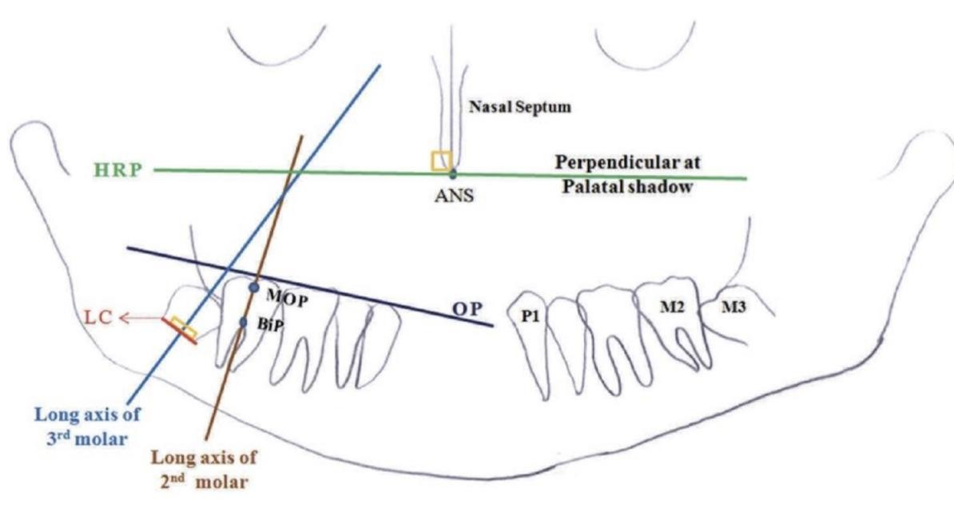
The landmarks used in the assessment are:
Long axis of the second molar: It was drawn extending from the mid-occlusal point and midpoint of root bifurcation of the second molar
(Sood et.al., 2018)
ANS, anterior nasal spine; BiP, bifurcation point; HRP, horizontal reference plane; LC, line at cervical level of molar bud; MOP, mid-occlusal point; OP, occlusal plane.

Slide 10
Long axes of the third molar buds: It was traced as the perpendicular bisector of a line connecting outlines of the most mesial and distal cervical areas.

Slide 11
OP: It is the line joining the tips of most superior cusps of the first premolar and tip of most superior mesial cusps of the second molar. A perpendicular line touching the most distal point of the second molar crown was also drawn from OP.

Slide 12
HRP: Nasal septum and ANS were marked, and line joining them was traced and bisected. A perpendicular line to this midline bisector extending bilaterally through palatal shadow was drawn, termed as horizontal reference plane.

Slide 13
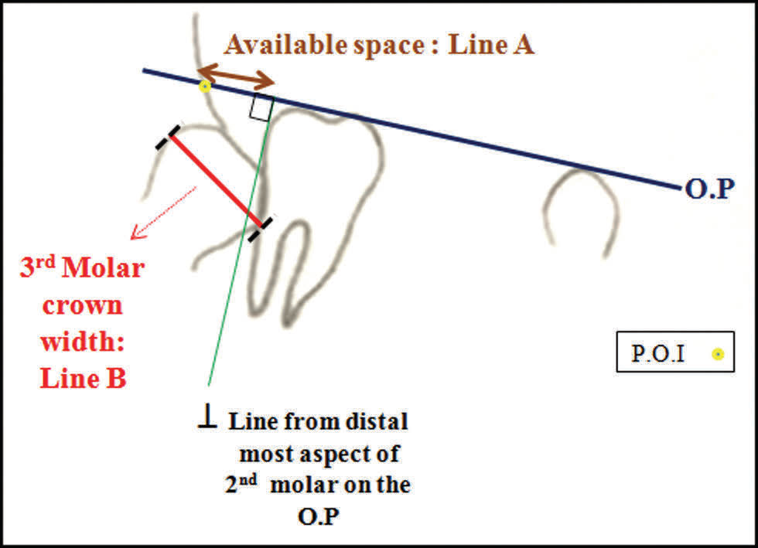
Linear Measurements Used in the Assessment
1) Eruption Space (Ganss, 1993; Sood et.al., 2018)
● Available space: It was measured as distance between intersection of OP with anterior border of ramus and intersection of line perpendicular to the OP from distal most aspect of second molar. (Line A)
● Third molar crown mesiodistal width: It is the length of the line connecting most mesial and distal outlines of the third molar crown. (Line B)
● Ganss ratio: The ratio of line A to B, that is, available space/third molar crown mesiodistal width

Slide 14
the Ganss ratio used to evaluate space If the ratio values are > 1, 70% of teeth would gradually enter into the arch. Lower values indicated probability of impaction.

Slide 15
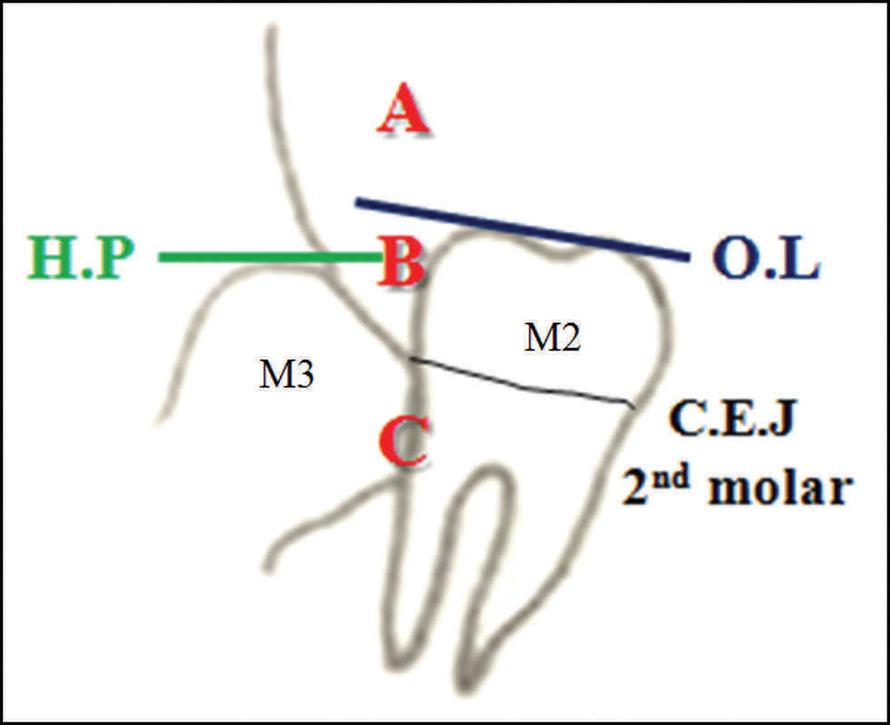
2. Eruption Depth :- was calculated as depth of the third molar in relation to the neighbouring second molar
Level A (fully erupted) group: Same level as or above the OP of the adjacent second molar.
Level B (partially erupted) group: Below the OP but above the cementoenamel junction (CEJ) of the second molar.
Level C (unerupted) group: Beneath the CEJ of the second molar.

Slide 16
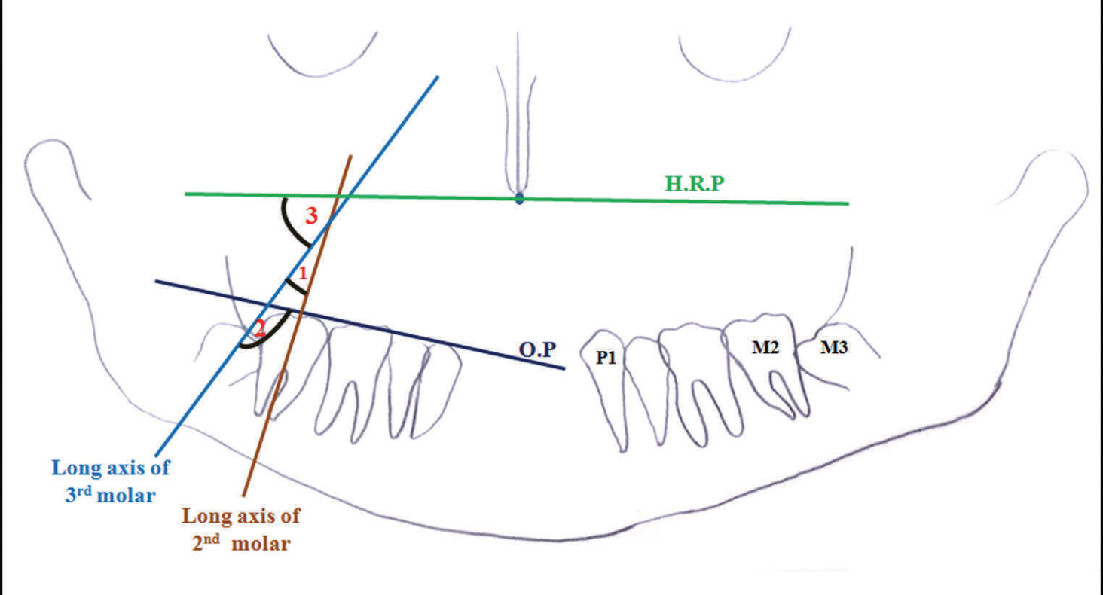
Angle measurements (Cherian and Ravi, 2016; Sood et.al., 2018).
● Third molar angulation with second molar: It is the angle formed by the long axis of the mandibular third molar and long axis of the mandibular second molar.
● Third molar angulation with OP: It is the angle formed between OP and the long axis of the third molar.
Third molar angulation with HRP: It is the angle formed between the HRP and long axis of the mandibular third molar

Slide 17
The development of space for the third molar is affected various factors, including:
backward slope of anterior border of ramus in relation to the alveolar border.
resorption of bone from anterior border of ramus.
forward movement of dentition.
growth in length of the mandible.
sagittal direction of mandibular growth.
sagittal direction of eruption of dentition.
Hattab and Alhaija, 1999

Slide 18
The role of the third molar still is a debatable issue despite multiple attempts to resolve its role in late anterior crowding. Further detailed studies are also required to assess correlation between lower anterior crowding and third molar eruption depth, angulation and space in different skeletal malocclusions, and also in different facial morphologies, including large sample size.

Slide 19
Thank you for listening

