Slide 1
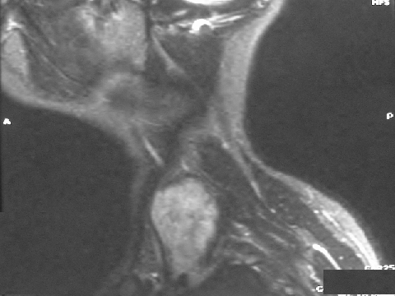
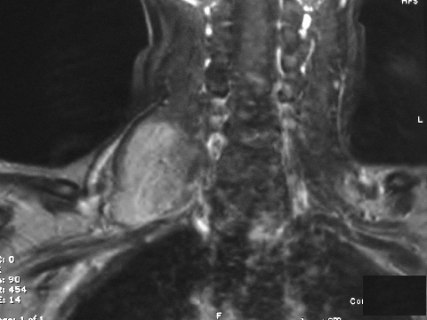
Ancient Schwannoma
Done by: Fatima Jaleel Ismael

Slide 2
Clinical features
Patient :42 years old female
with neck tumor mass since 3 years
Painless
Enlarged in size and cause pressure on the airway

Slide 3
Clinical Examinations and investigations
On physical examination there is normal color of the overlying skin
No lymphadenopathy
The Mass is compressable on palpation
MRI Report suggest schwanomma or neurofibroma.
Excisional biopsy was done and tumor submitted for histopathological examination.

Slide 4
Gross sample
Sample consisted of one large soft tissue piece measuring (5*4*3) cm, with three lymph nodes.
Grayish white in color, well defined mass with smooth glistening surface.

Slide 5
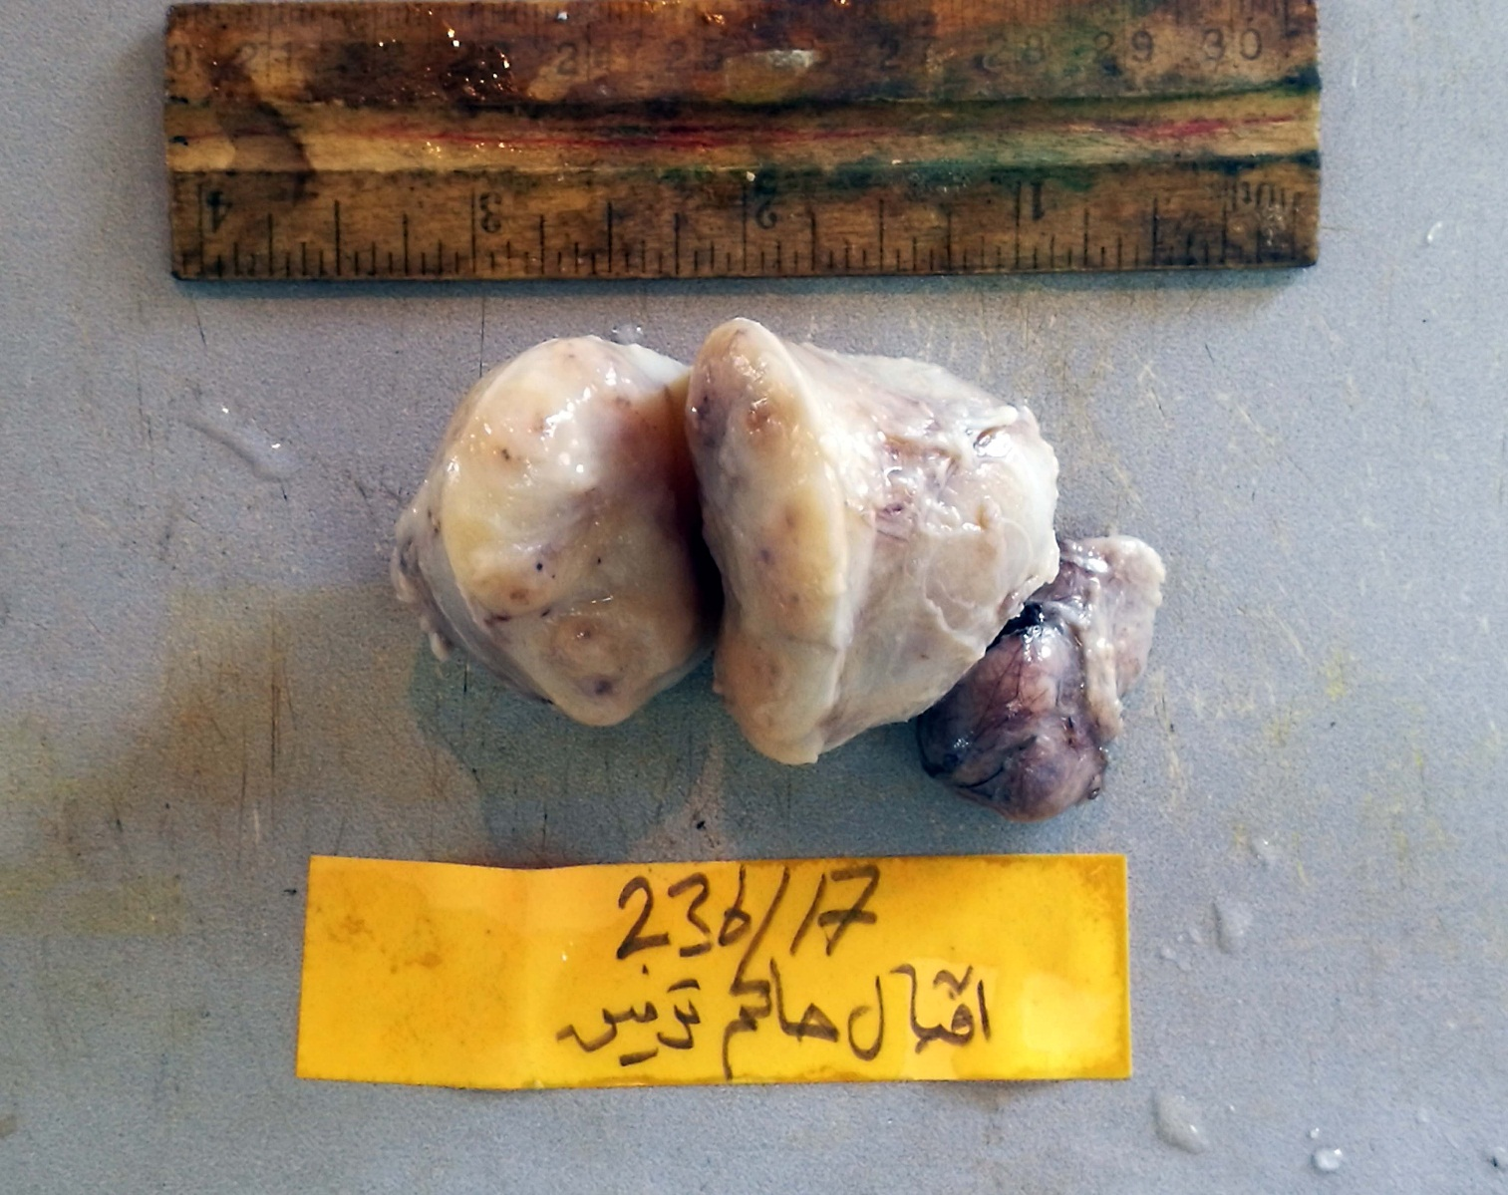
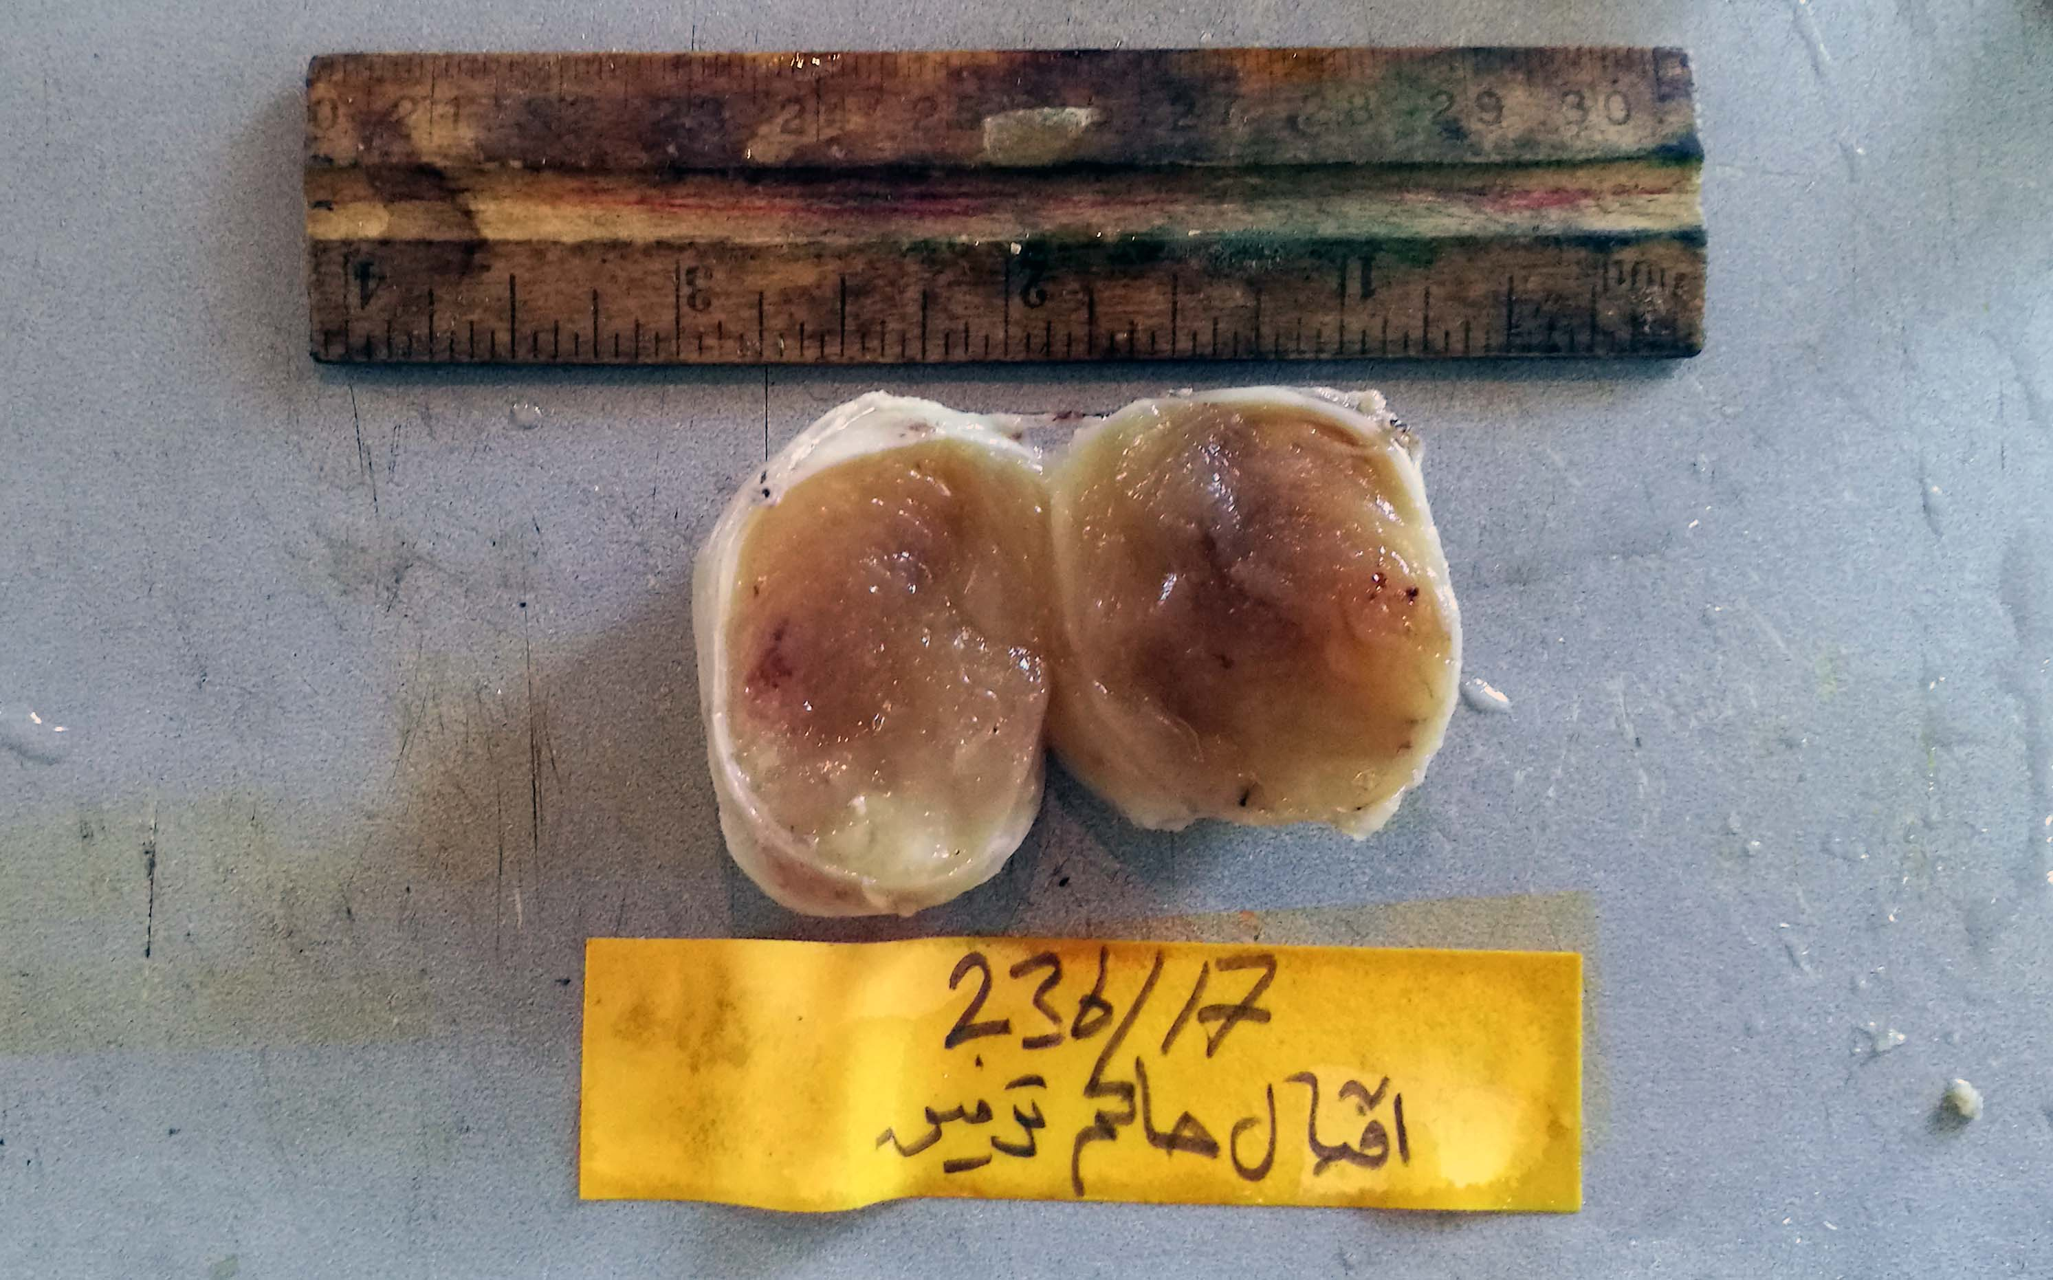

Slide 6
Histopathological report
Sections showed an encapsulated tumor mass composed of spindle cell proliferation in a dense collagenous stroma with focal vascular background, with thrombosed and thickened blood vessels.
spindle cells is palisading with verocay body formation was seen.
Focal degenerative atypia was seen.
Focal Cystic degeneration.
The histopathological picture is C/W an ancient Schwannoma

Slide 7
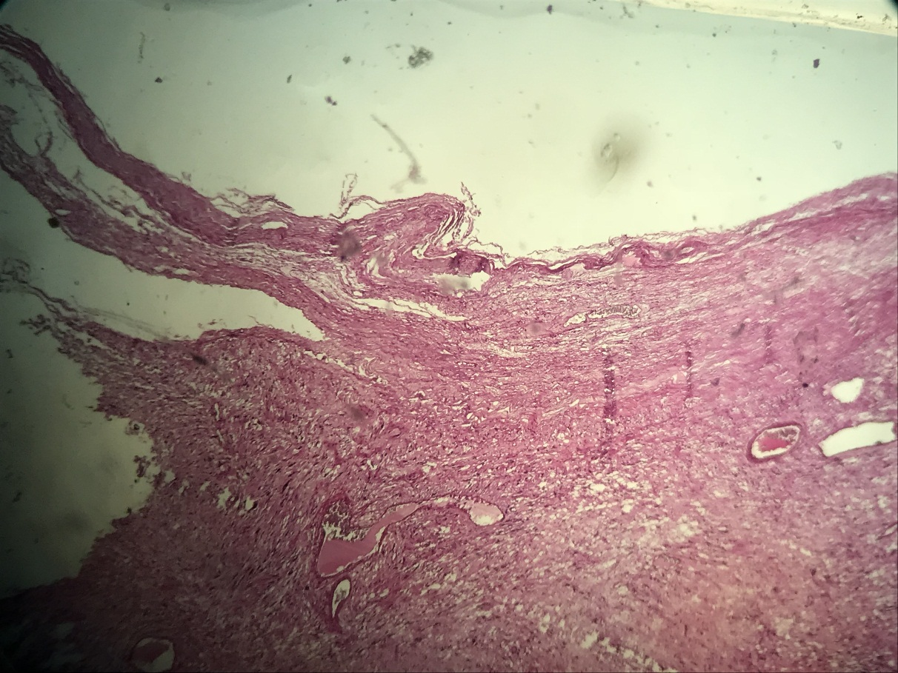
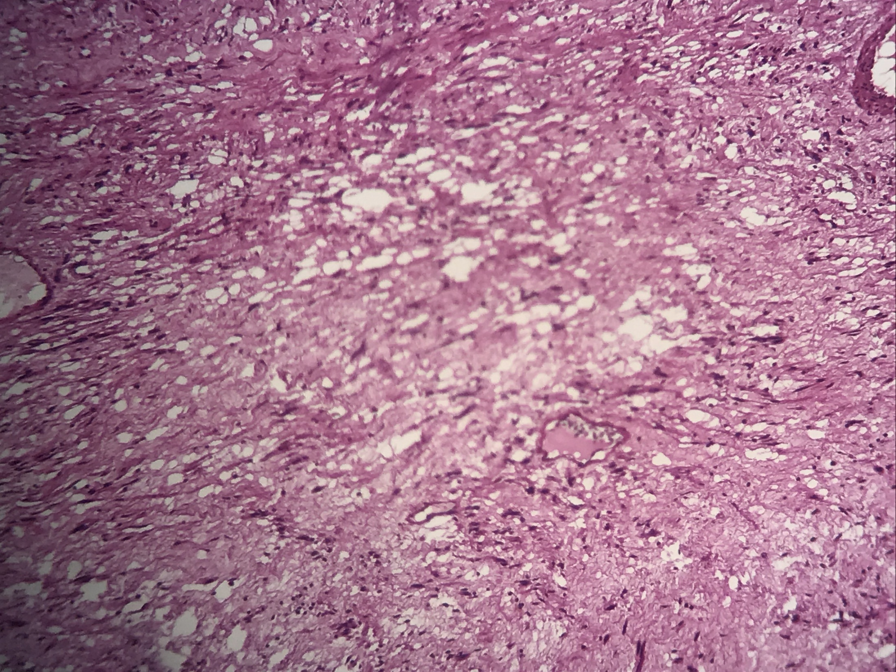
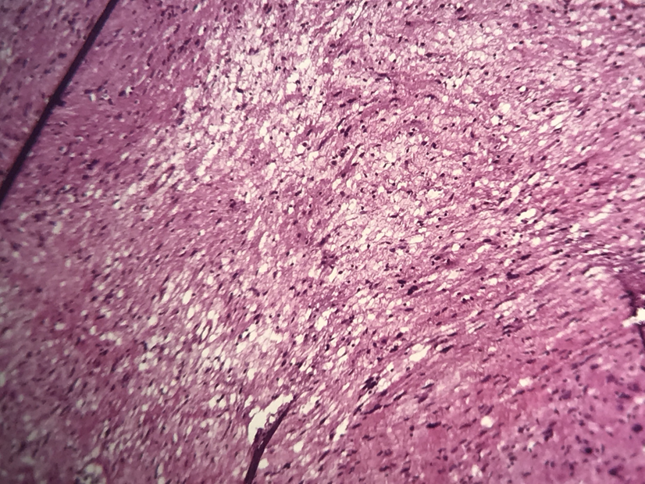

Slide 8
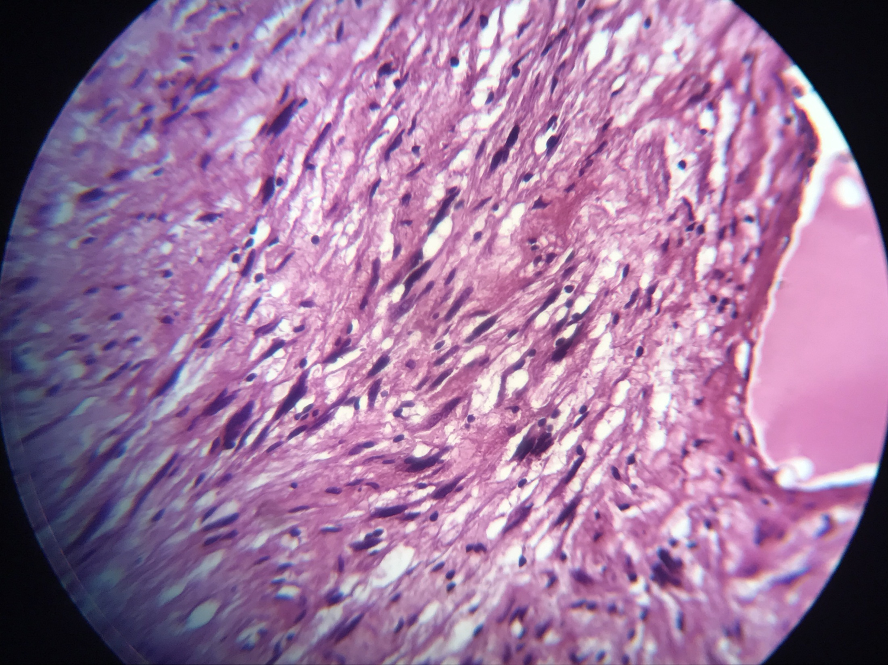
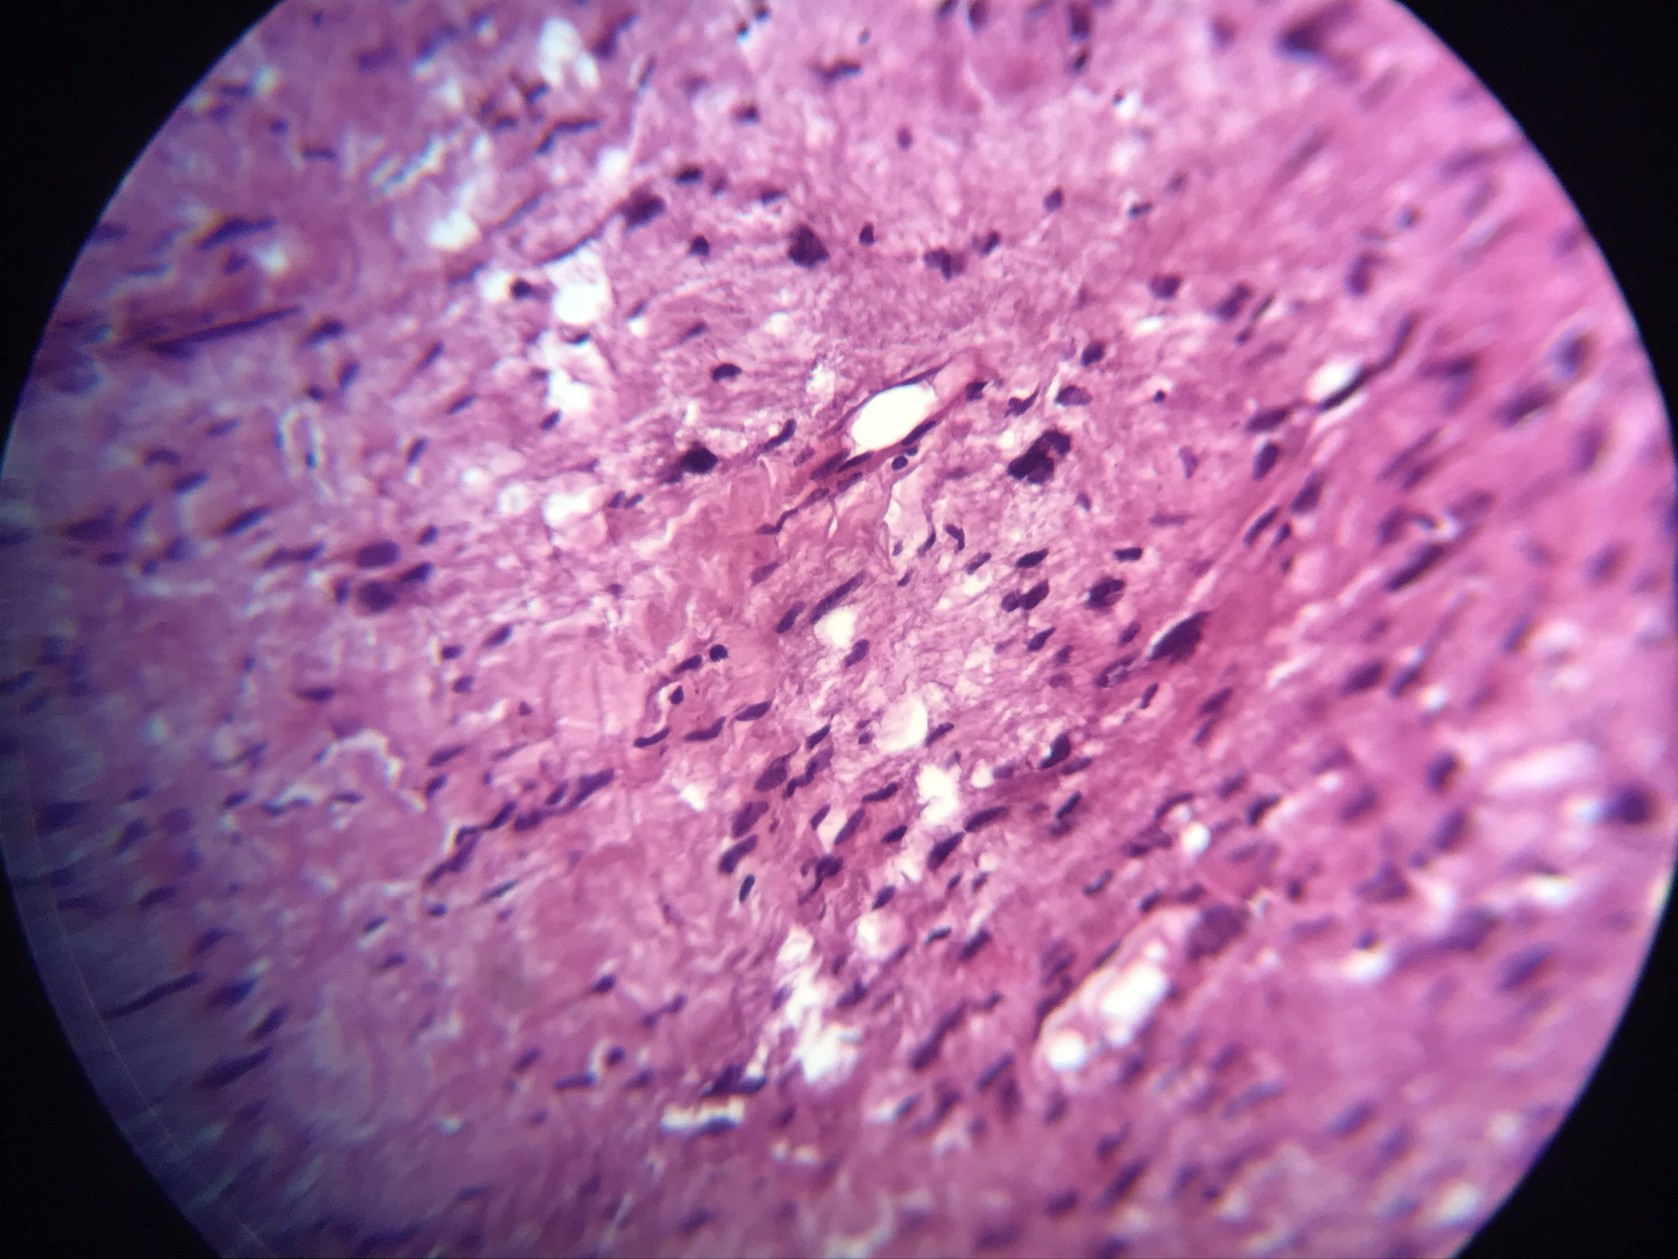

Slide 9
Schwannoma
Clinical Features.
Schwannomas are relatively common benign tumors that most often occur in patients between the ages of 20 and 50 years, without a sex predilection.
Schwannomas most often involve the spinal nerve roots and the cervical, sympathetic, vagus, peroneal, and ulnar nerves.
The overwhelming majority of schwannomas are sporadic in nature, with less than 5% of cases arising in association with NF2 or a recently defined syndrome known as schwannomatosis.
NF2 is caused by mutations in the NF2 gene, located on chromosome 22, with subsequent loss of expression of merlin protein.
The majority of schwannomas are solitary, with multiple plexiform schwannomas arising in NF2 or schwannomatosis.
Schwannomas may present either with neurologic features related to the involved nerve or as asymptomatic soft-tissue tumors

Slide 10
Pathologic Features
Schwannomas are encapsulated tumors, with the notable exception of tumors occurring in the sinuses, for unknown reasons.
They are composed of cellular Antoni A zones, often containing foci of nuclear palisading around cell processes (Verocay bodies),
These Verocay bodies consist of reduplicated basement membrane and cytoplasmic processes.
admixed with less cellular, partially myxoid Antoni B zones closely resembling neurofibroma Thickwalled, hyalinized blood vessels are present in nearly all typical schwannomas.
The constituent Schwann cells have eosinophilic, fibrillar-appearing cytoplasm and elongated wavy nuclei.
The relative percentage of Antoni A and B zones varies greatly from case to case

Slide 11
Histopathological varients
Schwannomas may occasionally undergo extensive cystic change, resembling a thrombosed blood vessel, with only a thin peripheral rim of neoplastic cells.
Rarely, schwannomas may consist entirely of epithelioid cells (epithelioid Schwannoma
plexiform schwannoma, which is characterized grossly and microscopically by a multinodular, plexiform growth pattern. Such tumors occasionally are associated with NF2 or schwannomatosis.
Degenerative changes can be seen in some older tumors (ancient schwannomas). These changes consist of hemorrhage, hemosiderin deposits, inflammation, fibrosis, and nuclear atypia. However, these tumors are still benign, and the pathologist must be careful not to mistake these alterations for evidence of a sarcoma

Slide 12
Histopathological varients
Cellular Schwannoma
  Composed of predominantly or exclusively Antoni A areas without Verocay bodies
  Often deep (mediastinum and retroperitoneum)
Neuroblastoma-like schwannoma
was first described by Goldblum et al., demonstrating the presence of rosette-like structures formed by a radial arrangement of small, round, neoplastic Schwann cells around collagenous cores

Slide 14
Ancient schwannoma
term was first introduced by Ackerman and Taylor 2 in 1951. In their series of 48 thorax schwannomas,
the authors noted 10 cases showing distinctive findings such as increased cellularity, areas of hyalinization, and nuclear pleomorphism. Especially on frozen section evaluation,
the presence of cellularity and atypia may lead the pathologist to describe the lesion as sarcoma.
Dah reported 6 cases out of a total 11 cases that have been misdiagnosed as sarcomas.
Absence of mitotic activity is the only key feature to differentiate benign ancient schwannomas from malignant schwannomas.
The presence of a capsule, evidence of prior hemorrhage, and areas representing degenerative changes also may suggest a benign lesion

Slide 15
Ancient schwannoma of the neck
is a rare benign neoplasm derived from neural crest cells and is usually solitary., only a few ancient schwannomas have been reported in different locations in the neck region.
A significant percentage of ancient schwannomas are located in deep locations such as the retroperitoneum.
Ancient schwannomas of the neck are frequently misdiagnosed, and preoperative investigations are therefore often fruitless

Slide 17
immunohistochemistry
Schwannomas of all types are uniformly and intensely S-100 protein positive and express glial fibrillary acidic protein in a majority of cases.
The pericapsular region of a schwannoma may contain EMA- and CD34- positive cells;
rarely EMA-positive perineural cells may also extend into the substance of the tumor, alongside hyalinized blood vessels.

Slide 18
Differential diagnosis
Solitary lesion
Peripheral nerve sheath tumors:
1_RAUMATIC NEUROMA (AMPUTATION NEUROMA)
painful lesions that histologically appear as nerve trunks embedded in dense collagenous scarring.
2_PALISADED ENCAPSULATED NEUROMA (SOLITARY CIRCUMSCRIBED NEUROMA)
Oral examples of PEN are seen most frequently on the hard palate, although any oral or pharyngeal mucosal surface may be affected
The cellular fascicles are typically four to six cells thick and are arranged in parallel
streams in some areas, and nuclear palisading is seldom pronounced
3_NEUROFIBROMA
oral or pharyngeal neurofibroma is usually diagnosed in teenagers and young adults, although persons of all ages are susceptible.
Many lesions feel like a bag of worms on palpation

Slide 19
Multiple lesion

Slide 20
TREATMENT AND PROGNOSIS
The solitary neurilemoma is treated by surgical excision, and the lesion should not recur. Malignant transformation does not occur or is extremely rare.
Vestibular schwannomas in patients with NF2 are difficult to manage.
Surgical removal is indicated for large symptomatic tumors, but this almost always results in total deafness and risks facial nerve damage.
Stereotactic radiosurgery may be considered for older adult or frail patients, as well as for individuals who decline traditional surgery.

Slide 21


