Slide 1
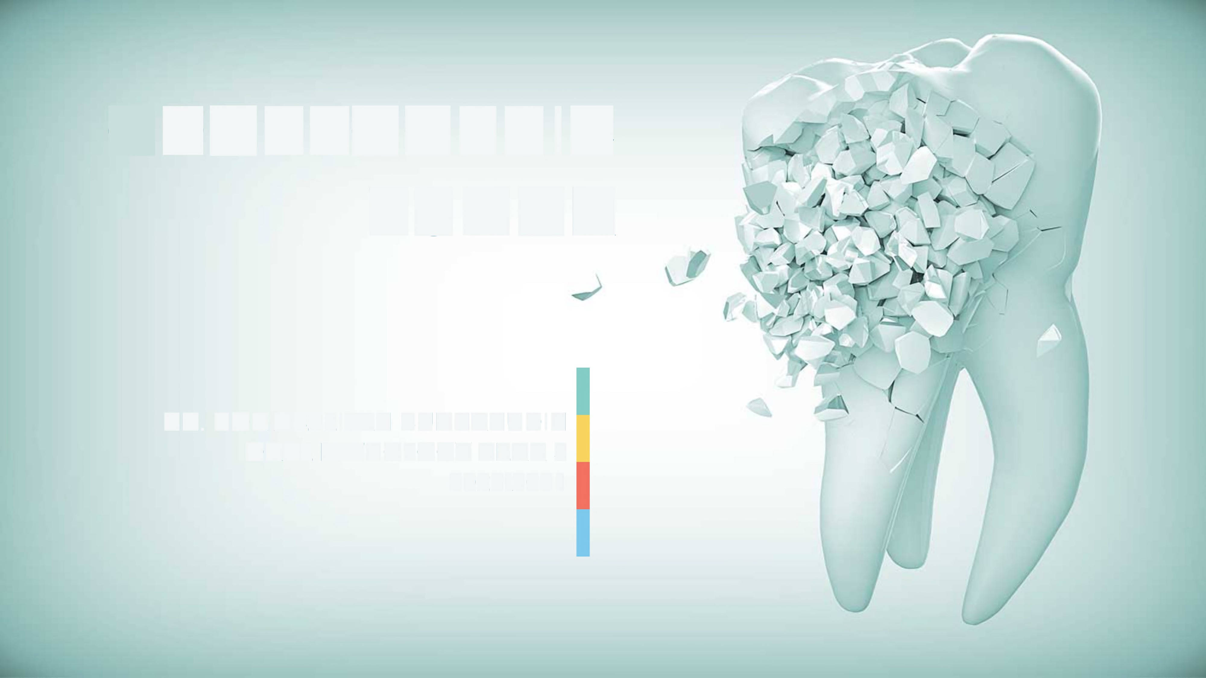
ODONTOGENIC
TUMORS
(Radiographic View)
Ass. Lect. Farah Abdul Salam

Slide 2
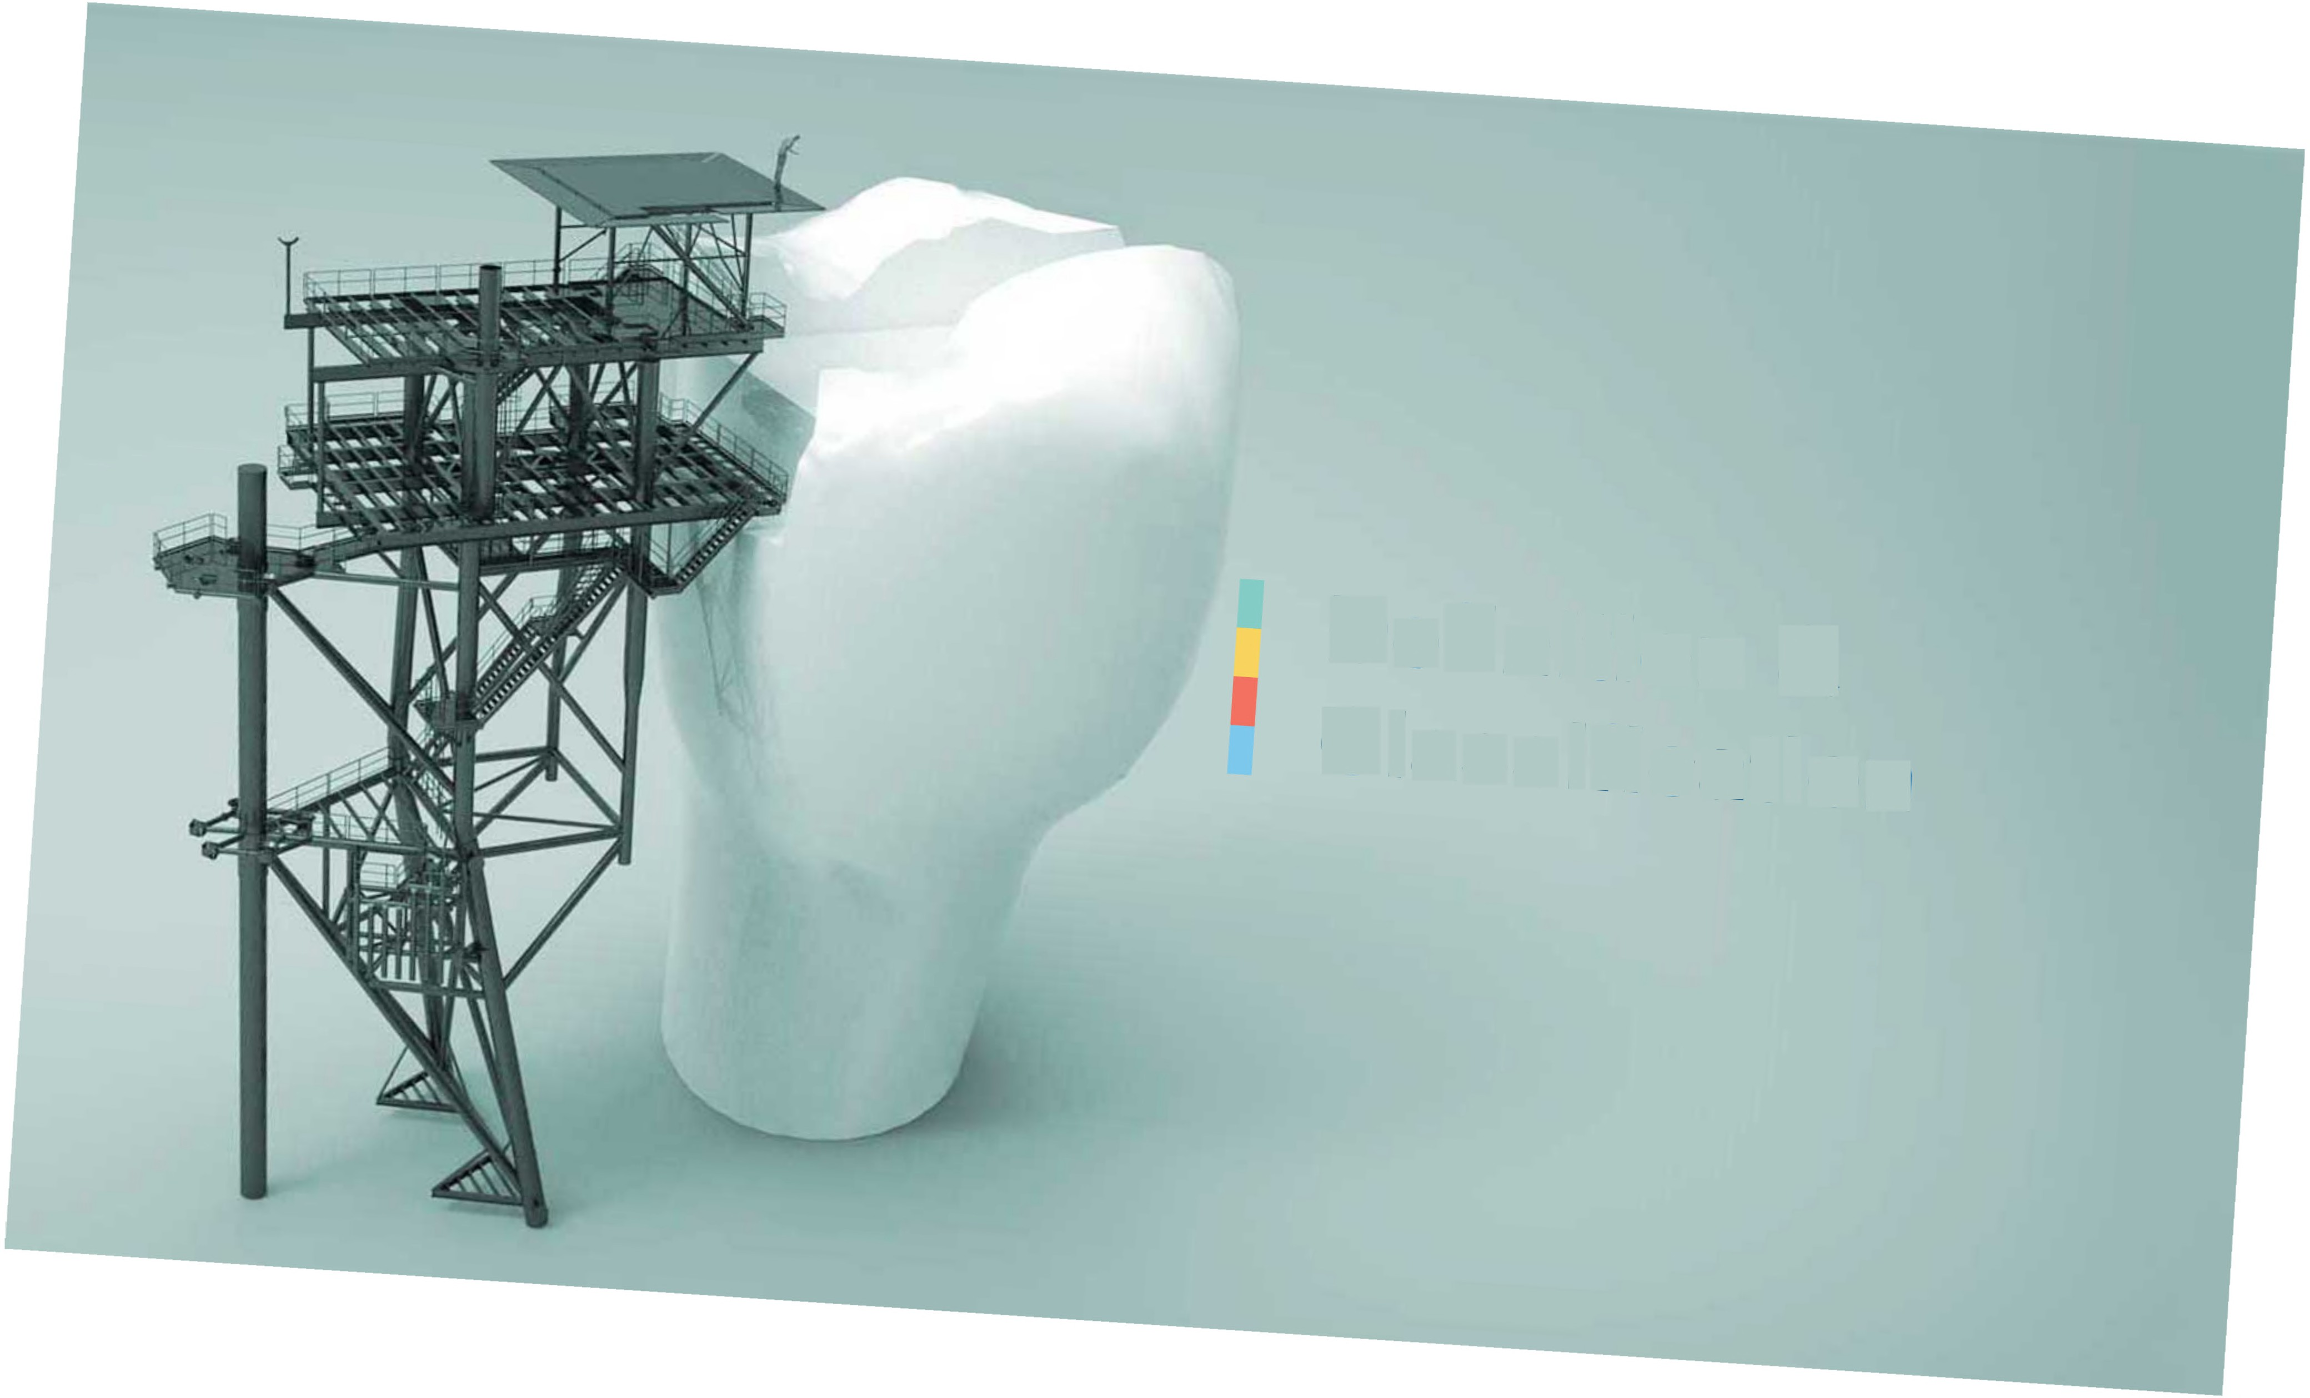

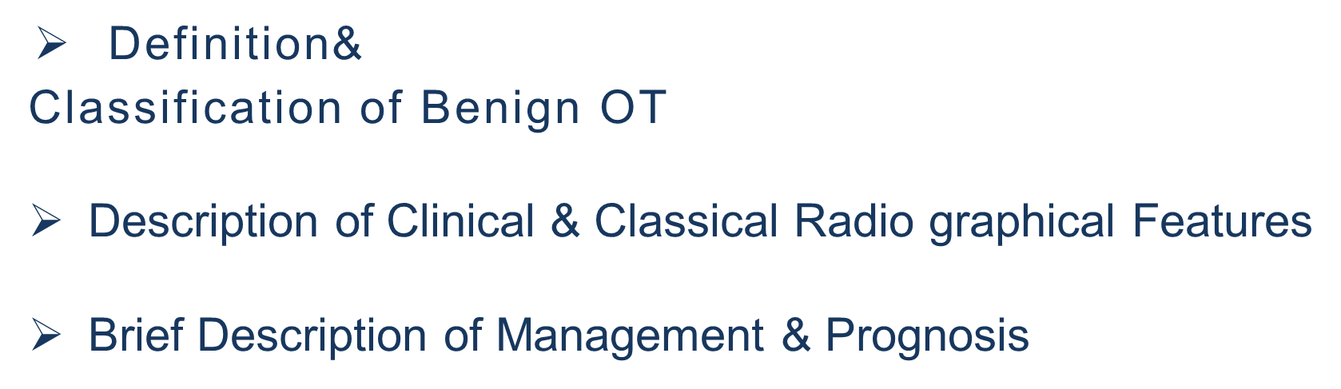

Slide 3
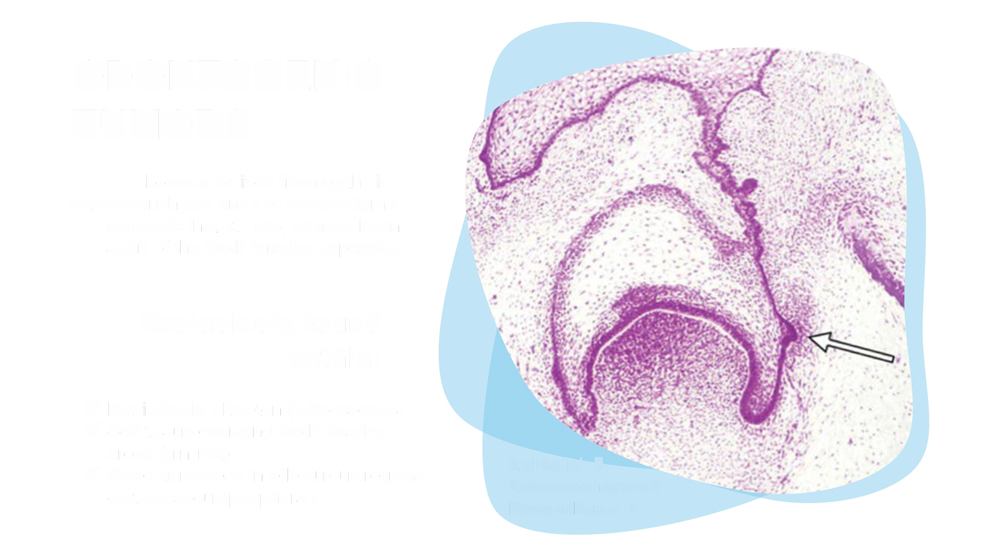
ODONTOGENIC
TUMORS
Lesions derived from epithelial,
ectomesenchyme and / or mesenchymal
elements that still are, or have been
apart of the tooth forming apparatus
Exclusively found
within:
-
✓ Maxillofacial skeleton (intraosseous(
✓ Soft tissue overlying tooth-bearing
areas (gingiva(
✓ Alveolar mucosa in edentulous regions
extraosseous/peripheral
Epithelial: ?
Ectomesencyme:? Mesenchymal:?

Slide 4
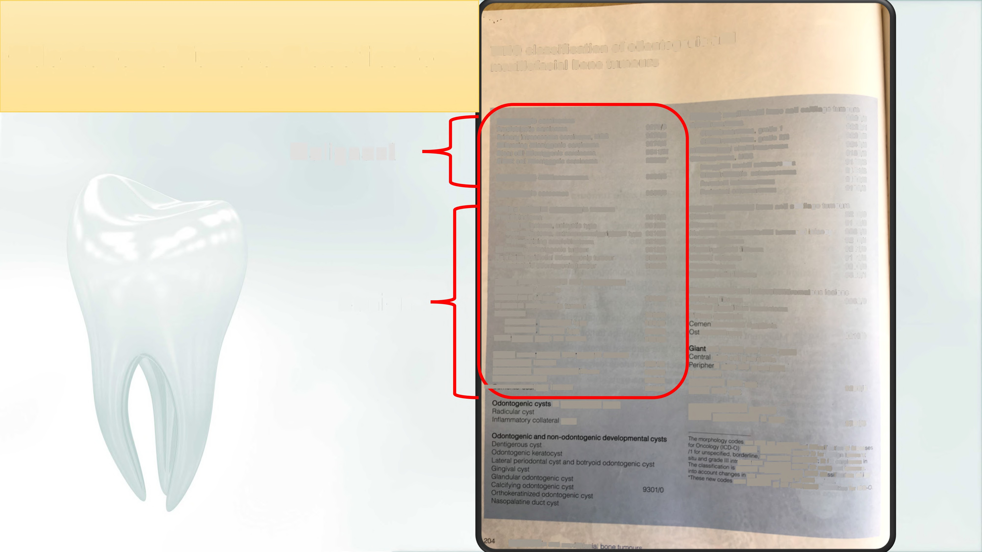
Odontogenic
Tumors
Classification
WHO classification of odontogenic an
maxillofacial bone tumours
Malignant max
illofacial bone and cartilage tumours
Odontogenic carcinomas
Ameloblastic carcinoma
Primary intraosseous carcinoma, NOS Sclerosing odontogenic carcinoma Clear cell odontogenic carcinoma Ghost cell odontogenic carcinoma
Chondrosarcoma
Chonadrosarcoma, grade 1
Chondrosarcoma, grade 2/3
Mesenchymal chondrosarcoma
Osteosarcoma, NOS
Low-grade central osteosarcoma
Chondroblastic osteosarcoma
Parosteal osteosarcoma
Periosteal osteosarcoma
9220/3
9270/3
9270/3
9270/3
9341/3
9302/3°
9222/
''
Malignant
9220/3
9240/3
9180/3
9187/3
9181/3
9192/3
9193/3
Odontogeniccarcinosarcoma
8980/3
Odontogenic sarcomas
9330/3
Benign epithelial odontogenic tumours
Ameloblastoma
Ameloblastoma, unicystic type
Ameloblastoma, extraosseous/peripheral type
Metastasizing ameloblastoma
Squamou s odontogenic tumour
Calcifying epithelial odontogenic tumour
Adenoma toid odontogenic tumour
Benign maxillofacial bone and cartilage tumours
9310/0
9310/0
9310/0
9310/3
9312/0
9340/0
9300/0
Chondroma
Osteoma
9220/0
9180/0
Melanotic neuroectodermal tumour of infancy 9363/0
Chonroblastoma
Chondromyxoid fibroma Osteoid osteoma Osteoblastoma Desmoplastic fibroma
9230/
9241/0
9191/0
9200/0
8823/1
Benign mixed epithelial and mesenchymal
odontogenic tumours
Ameloblastic fibroma
Primordial odontogenic tumour
Odontoma
Odontoma, compound type
Odontoma, complex type
Dentinogenic ghost cell tumour
Fibro-osseous and osteochondroratous lesions
Benign
9330/0
Ossifying fibroma
Familial gigantiform cementoma
Fibrous dyspla sia
to-osseous dysplasia
eochondroma
9262/0
9280/0
9281/0
9282/0
9302/0
9210/0
Benign mesenchymal odontogenic tumours
Odontogenic fibroma
Odontogenic myxoma/myxof ibroma
Cementoblastoma
Cemento-ossifying fibroma
cell lesions and bone cysts
giant cell granuloma
al giant cell granuloma
Cherubism
Aneurysmal bone cyst
Simple bone cyst
9321/0
9320/0
9273/0
9274/0
9260/0
of inflammatory origin
Haematolymphoidtumours
cysts
Solitary plasmacytomaof bone
_{qr6j.} ~~_{"aw~ca,sstcaton"ot 0sea}
or uncen~' "e
9731/3
are fromthe intra .
0 tor benign tumours
7zaim+ow.oo»
@pitheta
behaviour; /2 tor carcinoma
·i.%, 7,.7
our una....""o" uswo etas it«cation, tang
were appro" g ot these lesions
by the [ACM+O Committee tor CD
Odontogenic and maxillofaci l

Slide 5

WHO
2017
CLASSIFICATION
I
Benign
Odontogenic Tumors
I
Epithelial
Mixed Epithelial &Mesenchymal
Ameloblastic Fibroma
Odontoma
Primordial Odontogenic
Tumor
Dentinogenic Ghost Cell
Tumor (DGCT)
Mesenchymal only
Odontogenic fibroma Odontogenic myxoma/myxofibroma
Cementoblastoma
•
Ameloblastoma
•
•
•
•
•
•
•
•
Unicystic type
Extraosseous/peripheral Metastasizing ameloblastoma
•
•
•
Cementa-ossifying
fibroma
•
Squamous Odontogenic
Tumor (SOT)
Calcifying Epithelial
Odontogenic
Tumor(CEOT)
Adenomatoid Odontogenic
Tumor(AOT)
•
•

Slide 6

Benign Epithelial Odontogenic Tumor
I
AMELOBLASTOMA

Slide 7
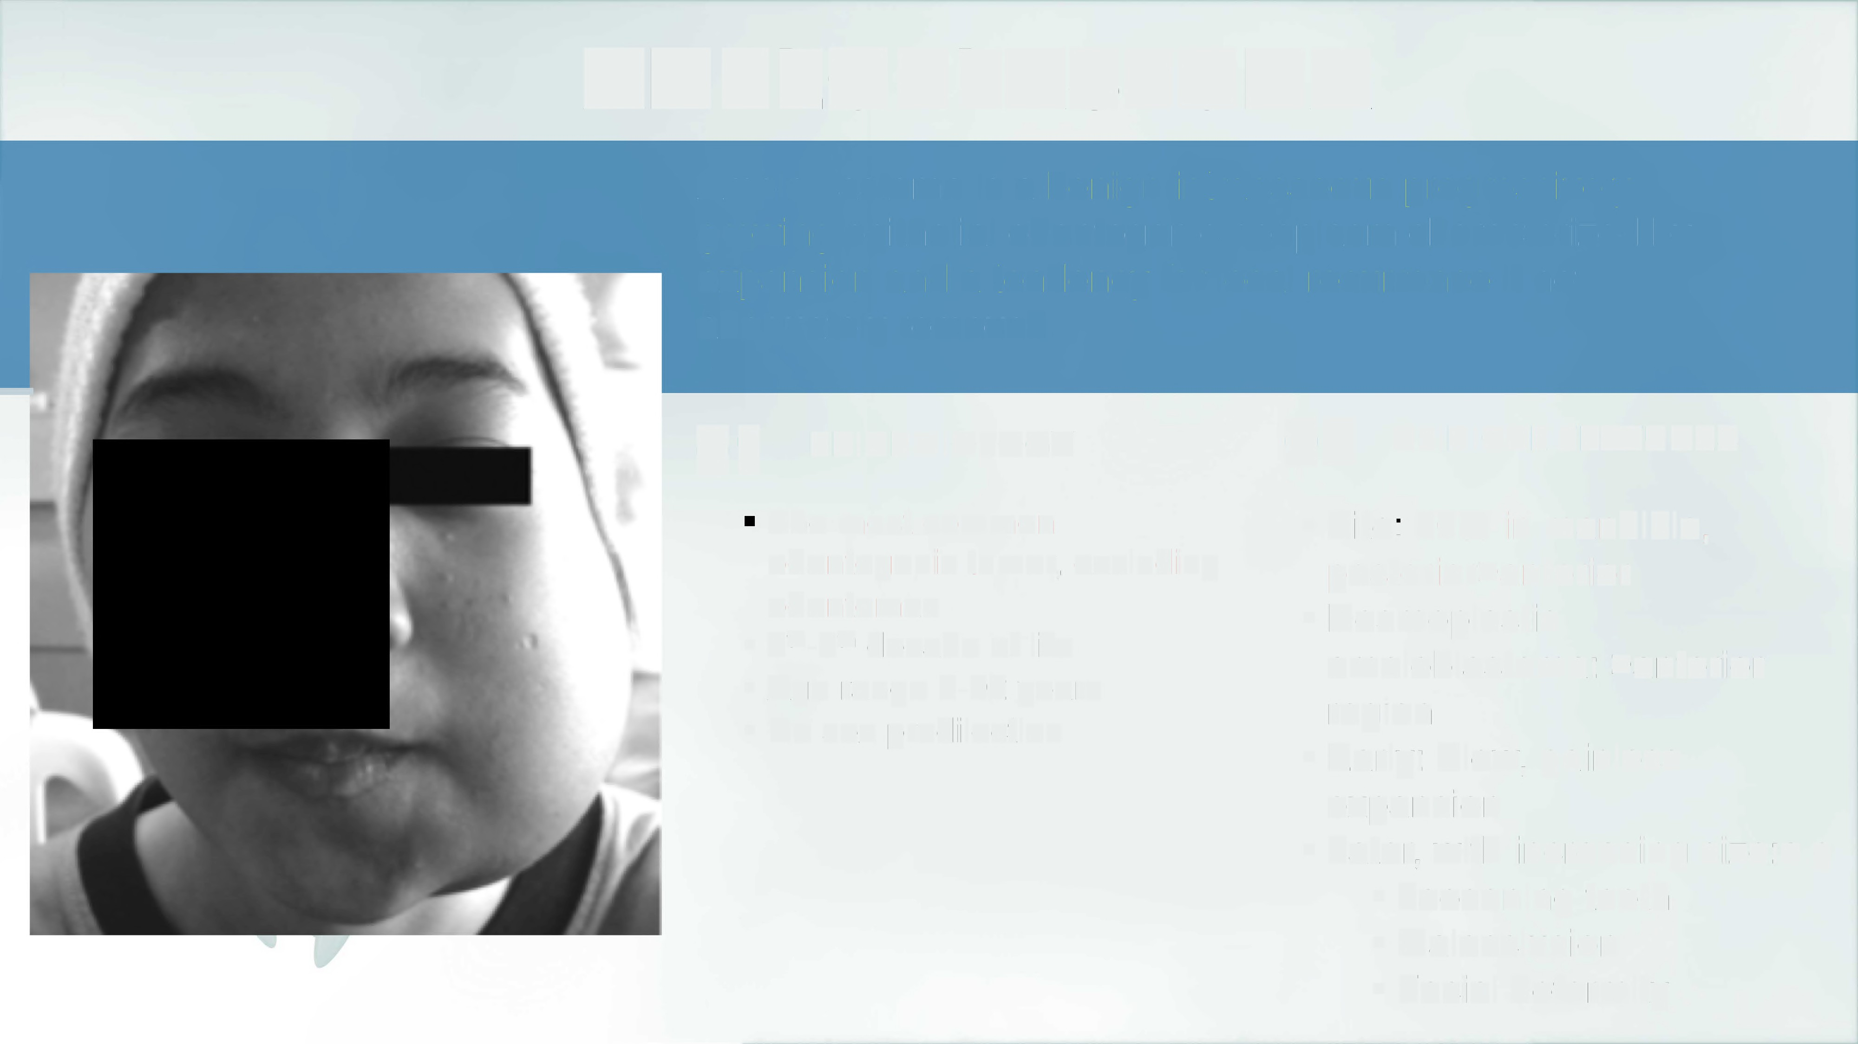
AMELOBLASTOMA
Ameloblastoma is a benign intraosseous progressively growing epithelial odontogenic neoplasm characterized by
expansion and a tendency
adequately removed.
for
local recurrence if not
-
01
02
EPIDEMIOLOGY
CLINICAL FEATURES
The most common
odontogenic tumor, excluding
odontomas
4th-5th decade of life
Age range 8-92 years
No sex predilection
•
Site: 80% in mandible,
posterior>anterior
•
•
•
•
Early: Slow, painless
expansion
•
Later, with increasing size:e.g
•
•
•
Loosening teeth
Malocclusion
Facial deformity

Slide 8

Ameloblastoma
Ameloblastoma
Conventional, Classic intraosseous, solid/multicystic ameloblastoma
Desmoplastic Ameloblastoma
Squamoid or elongated tumour island within dense fibrous stroma
Un icystic Ameloblastoma
•
•
•
Luminal
lntraluminal
Mural
Variants/Subtypes
Metastasizing Ameloblastoma
Ameloblastoma that metastasizes despite its benign histological appearance
Extra osseous/Peripheral
• Occur in soft tissue (gingiva(
Or in Alveolar Mucosa…

Slide 9
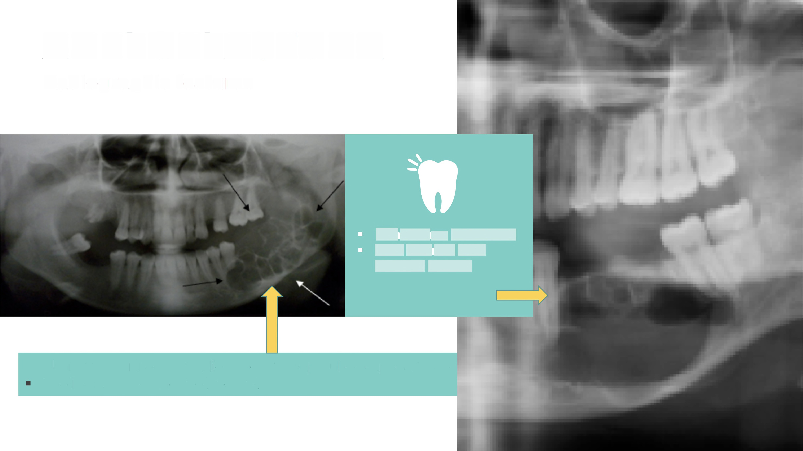
AMELOBLASTOMA
Radiographic
features
Sometimes Unilocular well defined smooth border
•
Usually a multilocular radiolucency
Tooth displaced and root resorption
(soap-bubble appearance)

Slide 10
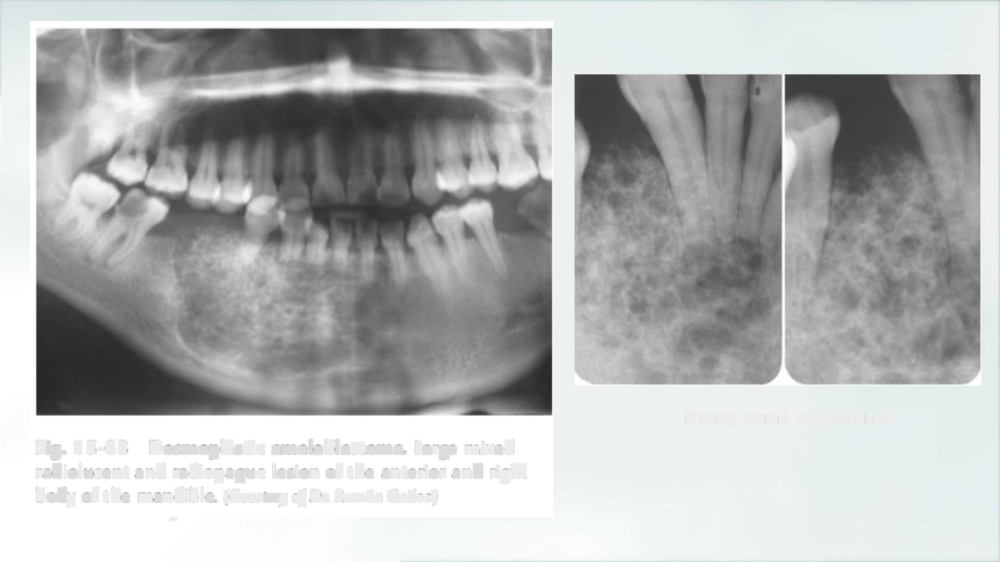
Honey-comb appearance
Fig. 15-63
radiolucent body of the
Desmoplastic ameloblastoma. Large mixed
and radiopaque lesion of the anterior and right
mandible. (Courtesy of Dr. Rom~n Carlos.)
r

Slide 11
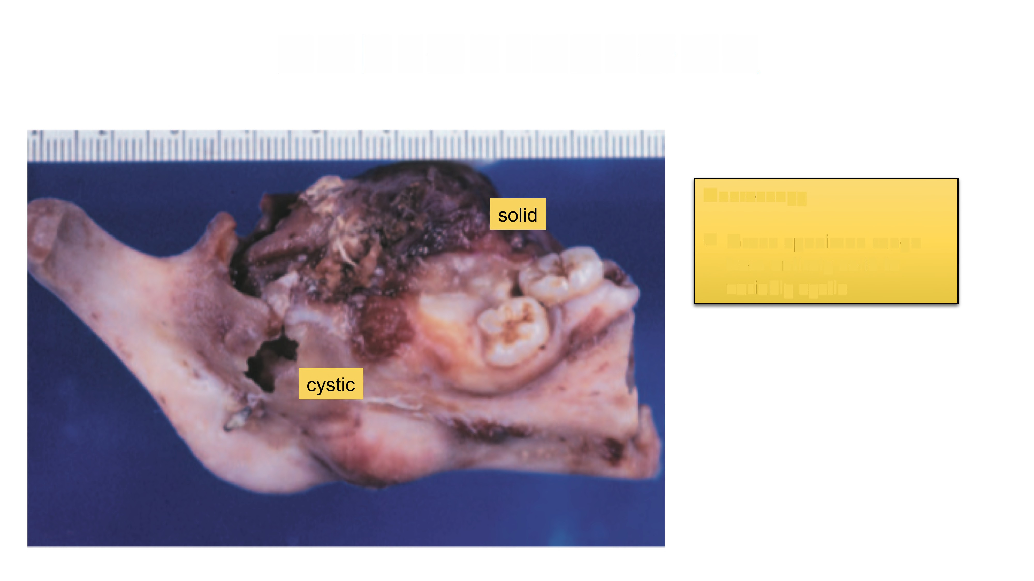
AMELOBLASTOMA
Macroscopy
✓ Gross specimen
range
from entirely solid to
variably cystic

Slide 12
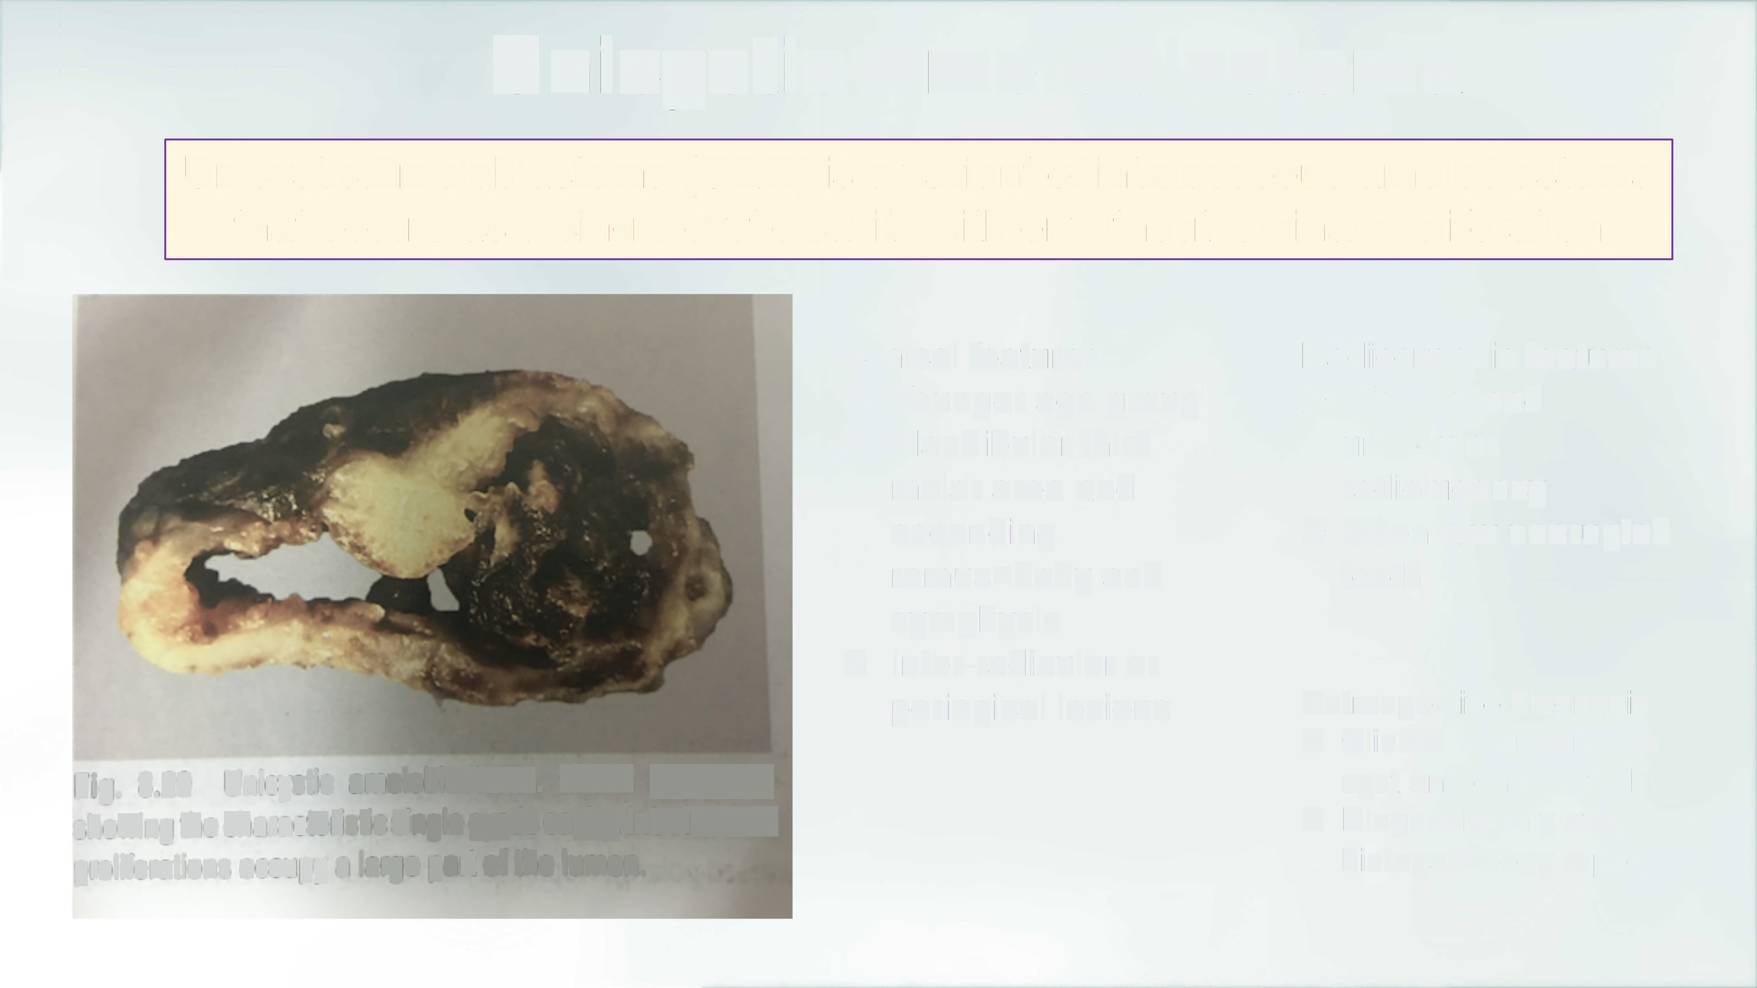
Unicystic Ameloblastoma
Unicystic Ameloblastoma
(UAM) is a variant of intraosseous ameloblastoma
that
occurs
as
a
single
cystic
cavity with or without
luminal proliferation
Clinical features
Radiographic features
►
► Well-defined
unilocular
radiolucency
►
Younger age group
Mandibular third
molar area and
ascending
ramus>body and
symphysis
lnter-radicular or
periapical lesions
► Often a/w unerupted
tooth
►
Retrospective diagnosis
> Clinical diagnosis of a
cyst and enucleated
> Diagnosis only after
histopathology report
Fig. 8.20
Unicystic ameloblastoma.
Gross specimen
showing the characteristic single cystic cavity. Intraluminal
proliferations occupy a large part of the lumen.

Slide 13
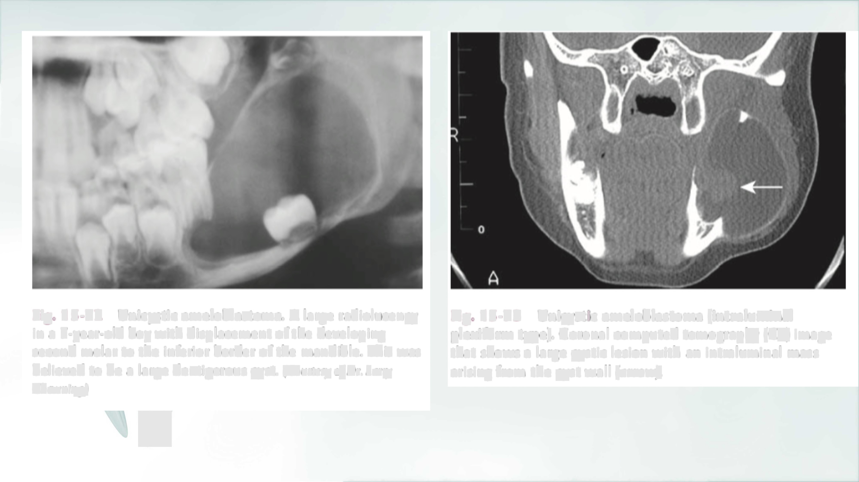
Fig. 15-72 Unicystic ameloblastoma. A large radiolucency
in a 7-year-old boy with displacement of the developing second molar to the inferior border of the mandible. This was
believed to be a large dentigerous cyst. (Courtesy of Dr. Larry
Chewning.)
Fig. 15.-73 Unicystic ameloblastoma (intraluminal
plexiform type). Coronal computed tomography (CT) image
that shows a large
cystic lesion with an intraluminal mass
arising from the cyst wall (arrow).
y

Slide 14
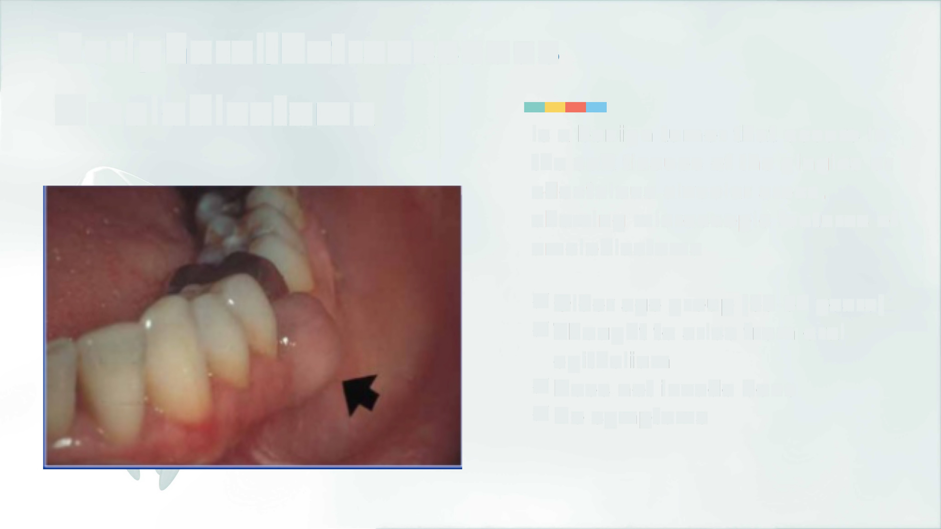
Peripheral/Extraosseous
Ameloblastoma
Is a benign tumor that occurs in
the soft tissues of the gingiva or
edentulous alveolar areas,
showing microscopic features of
ameloblastoma
✓ Older age group
✓ Thought to arise
epithelium
✓ Does not invade
✓ No symptoms
from oral
bone

Slide 15
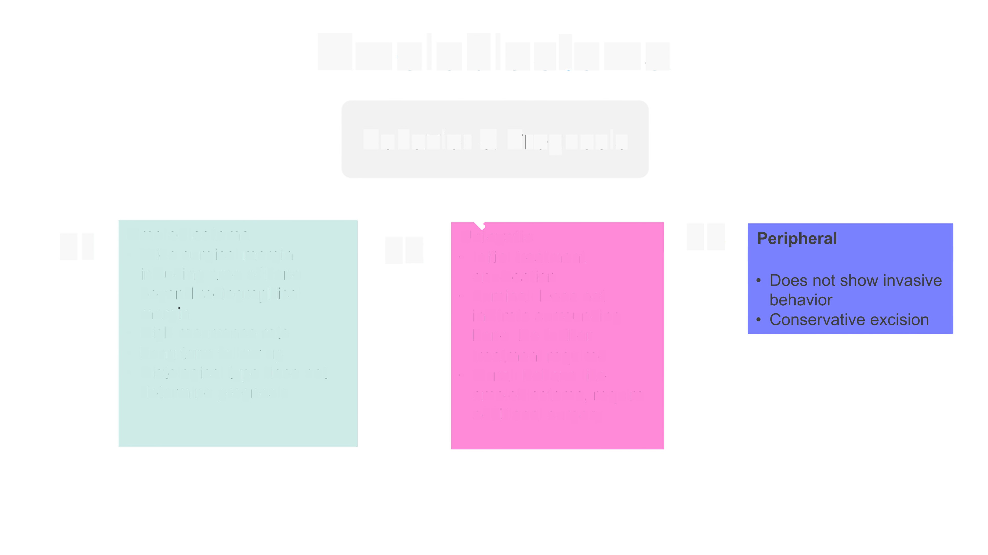
Ameloblastoma
Management & Prognosis
01
Ameloblastoma
Unicystic
03
02
•
Wide surgical margin
including area of bone beyond radiographical margin
High recurrence rate
Long term follow up Histological type does determine prognosis
•
Initial treatment
enucleation Luminal: Does not infiltrate surrounding bone. No further treatment required Mural: behave like ameloblastoma, require additional surgery
•
•
•
•
not
•

Slide 16
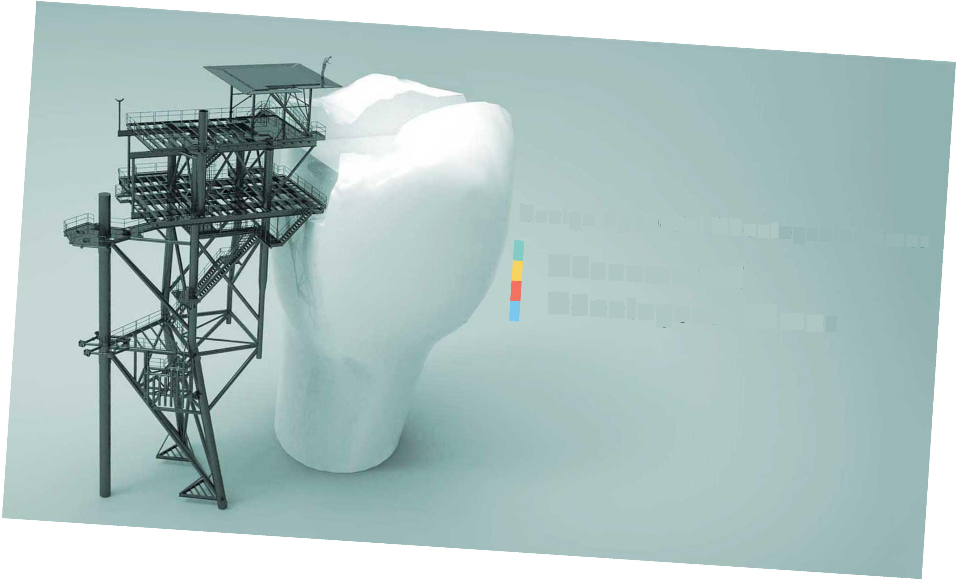
Benign Epithelial Odontogenic Tumor
Adenomatoid
Odontogenic Tumor

Slide 17

Adenomatoid
Odontogenic Tumor (AOT(
0
Is a benign epithelial tumor
duct-like structures
that shows
✓
v
✓
✓
AOTs account for <5% of odontogenic
tumors
2/3 are diagnosed in teenagers
95% intraosseous, some reported extraosseous
Site:
✓ Maxilla (anterior)>mandible
✓ a/w unerupted teeth in pericoronal region
✓ follicular/extrafollicular type
✓ 60% of cases a/w unerupted canine (maxilla(

Slide 18
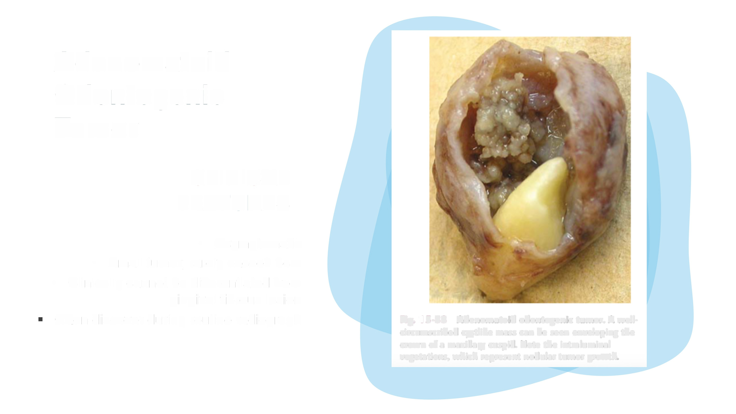
Adenomatoid
Odontogenic
Tumor
CLINICAL
FEATURES
•
Asymptomatic
•
Small
tumor, rarely exceed 3cm
•
Clinically cannot be differentiated from
gingival fibrous lesion
Often discover during routine radiograph
Fig. 15-88 Adenomatoid odontogenic tumor. A well•
circumscribed cystlike mass can be seen enveloping the crown of a maxillary cuspid. Note the intraluminal vegetations, which represent nodular tumor growth.

Slide 19
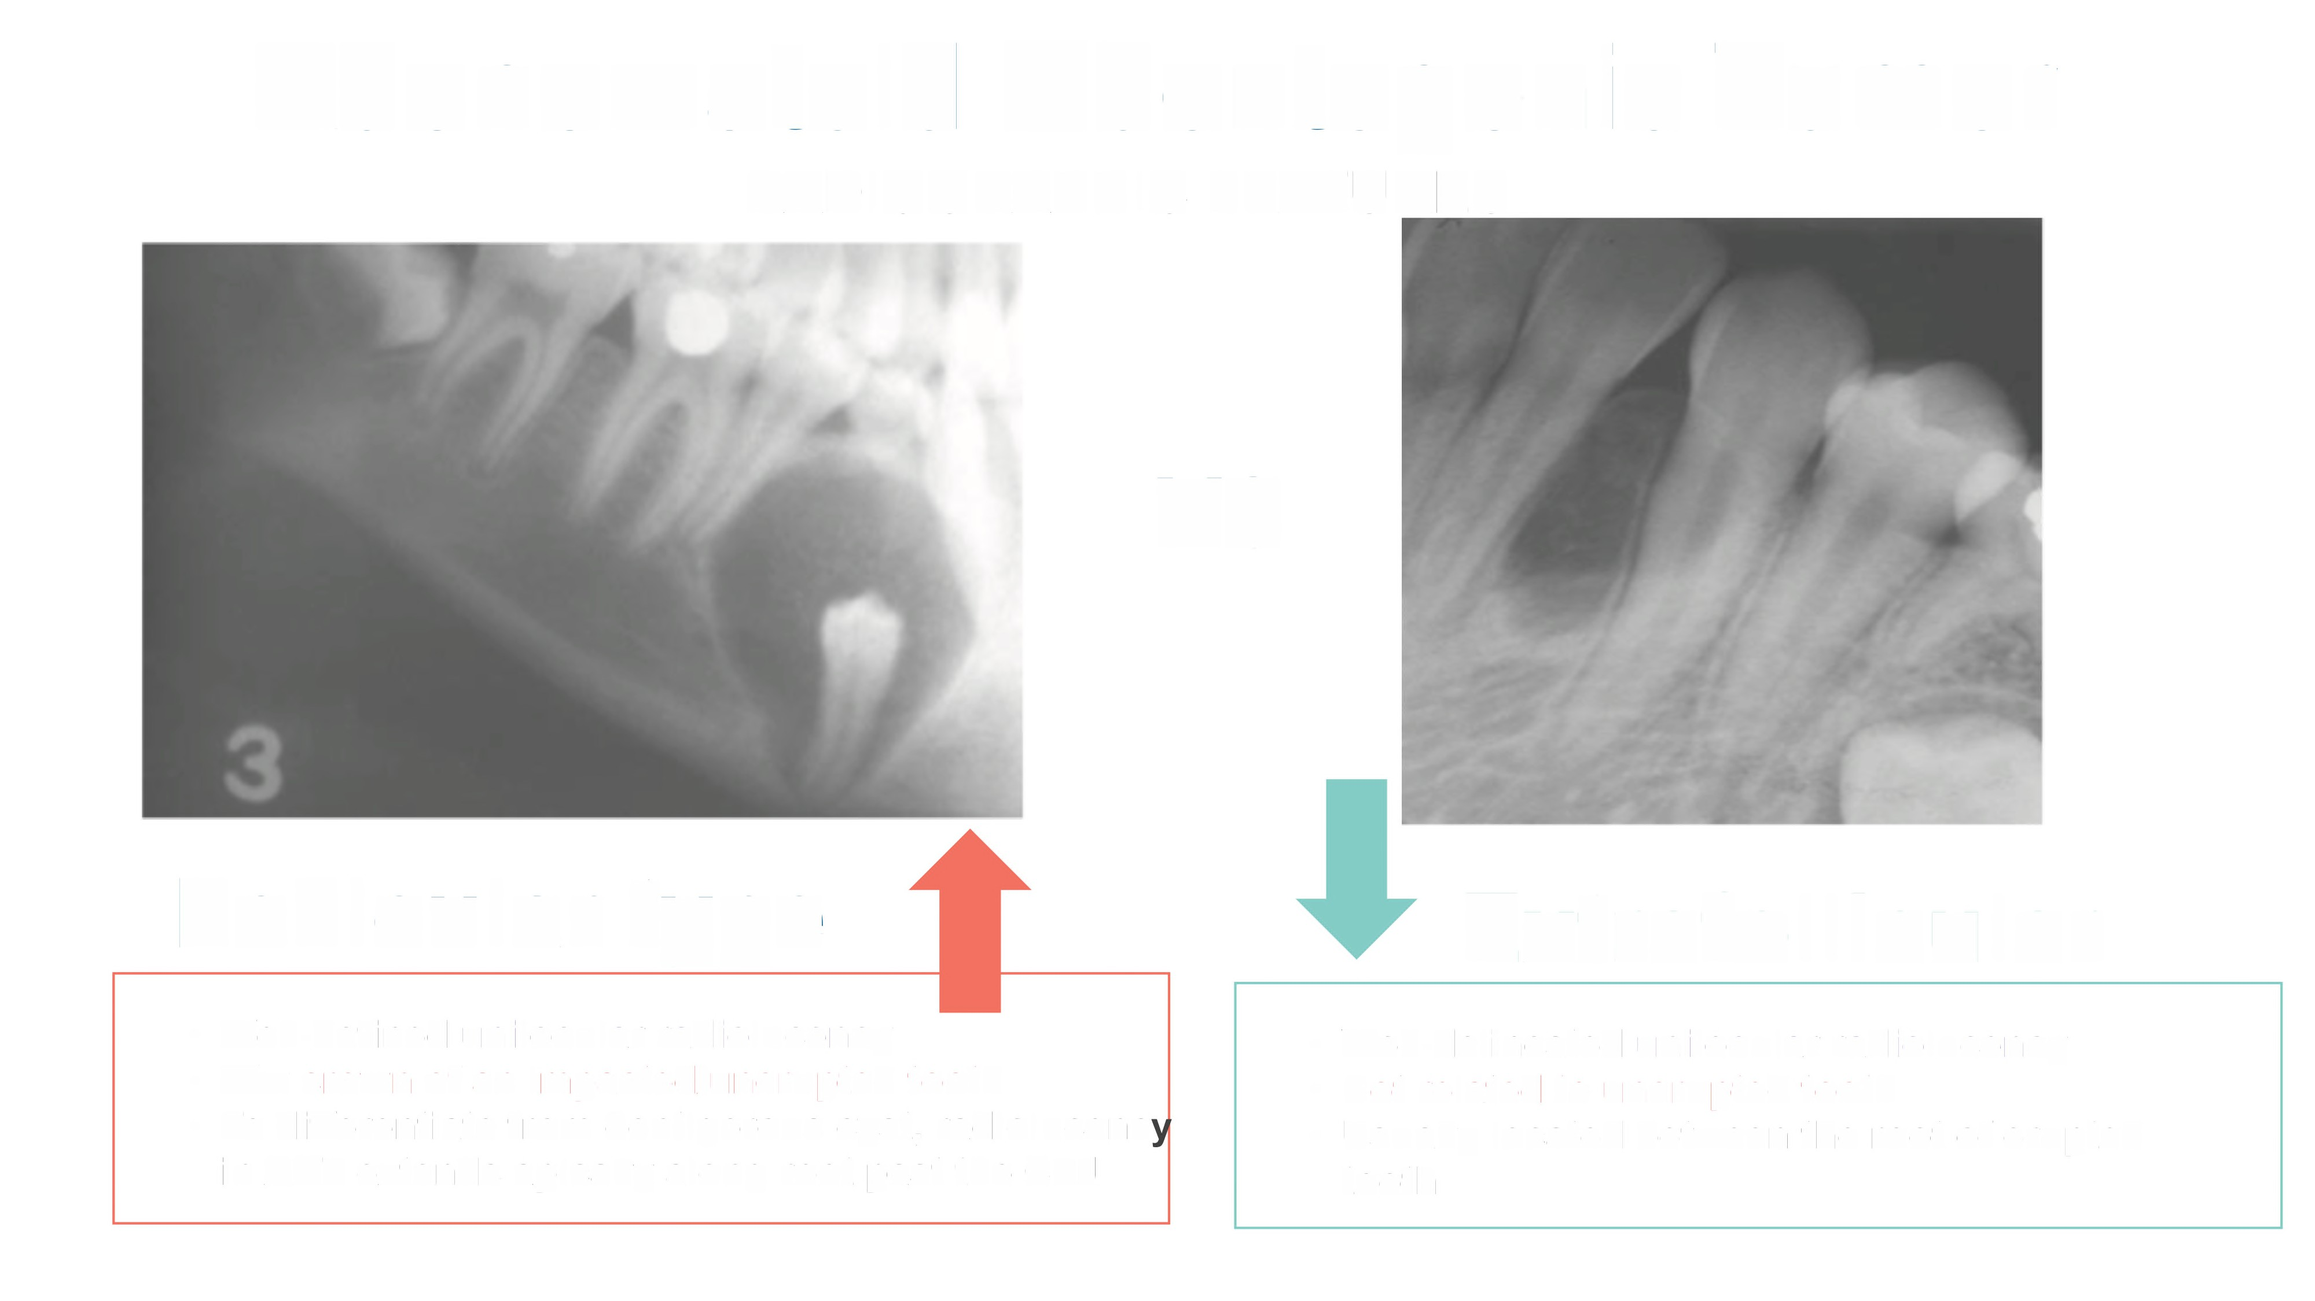
Adenomatoid
Odontogenic
Tumor
RADIOGRAPHIC FEATURES
vs
Follicular type
Extrafol
I icu lar
•
•
•
Well-defined unilocular radiolucency
A/w crown of an impacted/unerupted
•
•
•
Well-delineated unilocular radiolucency
Not related to unerupted tooth
Usually located between the roots of erupted teeth
tooth
To differentiate from dentigerous cyst, radiolucenc
in AOT extends apically along root passing the CEJ

Slide 20
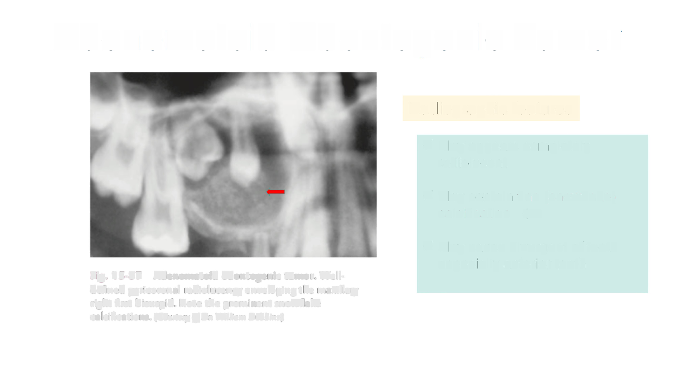
Adenomatoid
Odontogenic Tumor
Radiographic features
✓ May appears completely
radiolucent
✓ May contain fine (snowflake(
calcification
...
✓ May cause divergence of teeth
especially anterior teeth
Fig. 15-87 Adenomatoid odontogenic tumor. Well•
defined pericoronal radiolucency enveloping the maxillary
right first bicuspid. Note the prominent snowflake calcifications. (Courtesy of Dr. William Dobbins.)

Slide 21
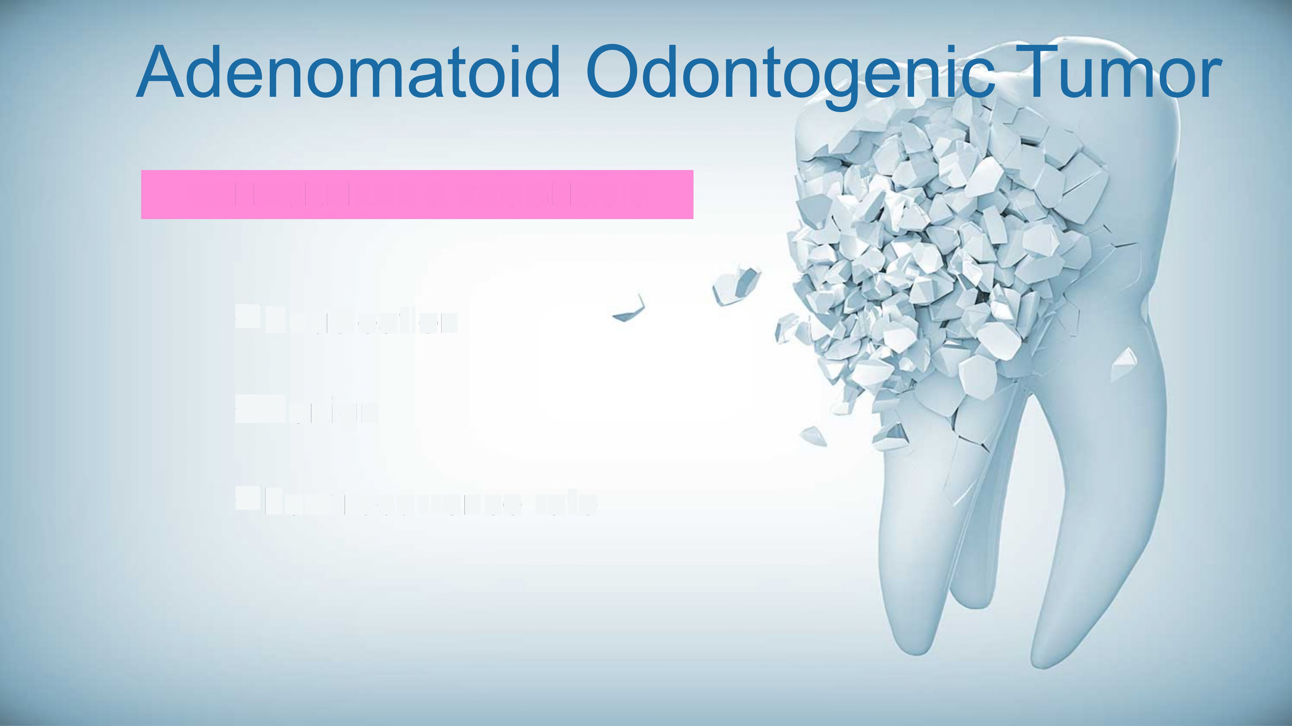
MANAGEMENT & PROGNOSIS
Enucleation
.Low recurrence rate

Slide 22

I
I
l
alcifying
Epithelial
Odontogenic Tumor
CEOT
7
%$.'
I
•
•
•
•
•
•
•
•
Pindborg tumor
lntraosseous/extraosseous
Rare
mean age 40
Site: Molar/premolar region
Asymptomatic
slow growing expansile mass
Radiograph: Mixed radiolucent/radiopaque
1

Slide 23

Calcifying
Epithelial
Odontogenic Tumor
CEOT
Management &
Prognosis
✓ Locally invasive tumor
✓ Small tumors may be enucleated
✓ Larger tumor require local resection
✓ Recurrence rate is about 15%

Slide 24
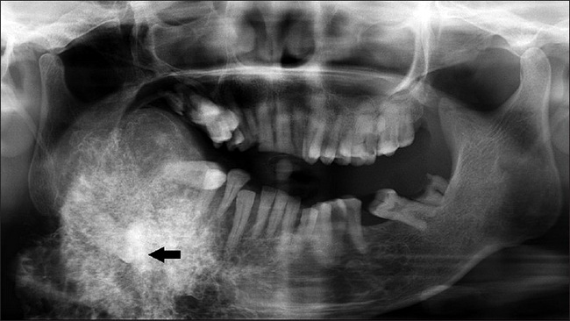

Slide 25

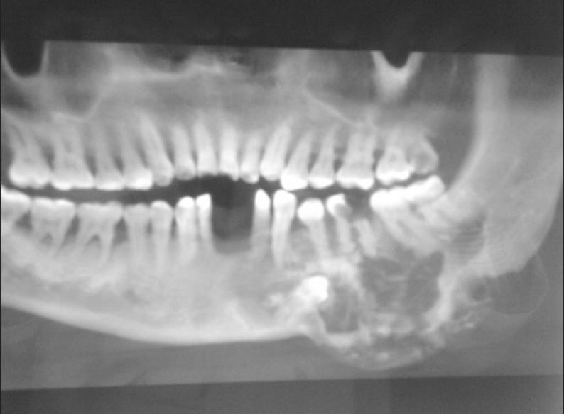
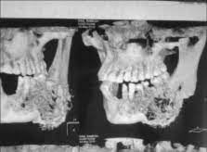
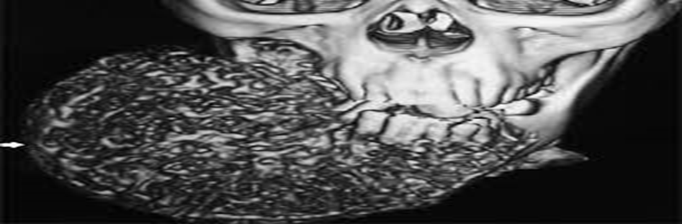

Slide 26
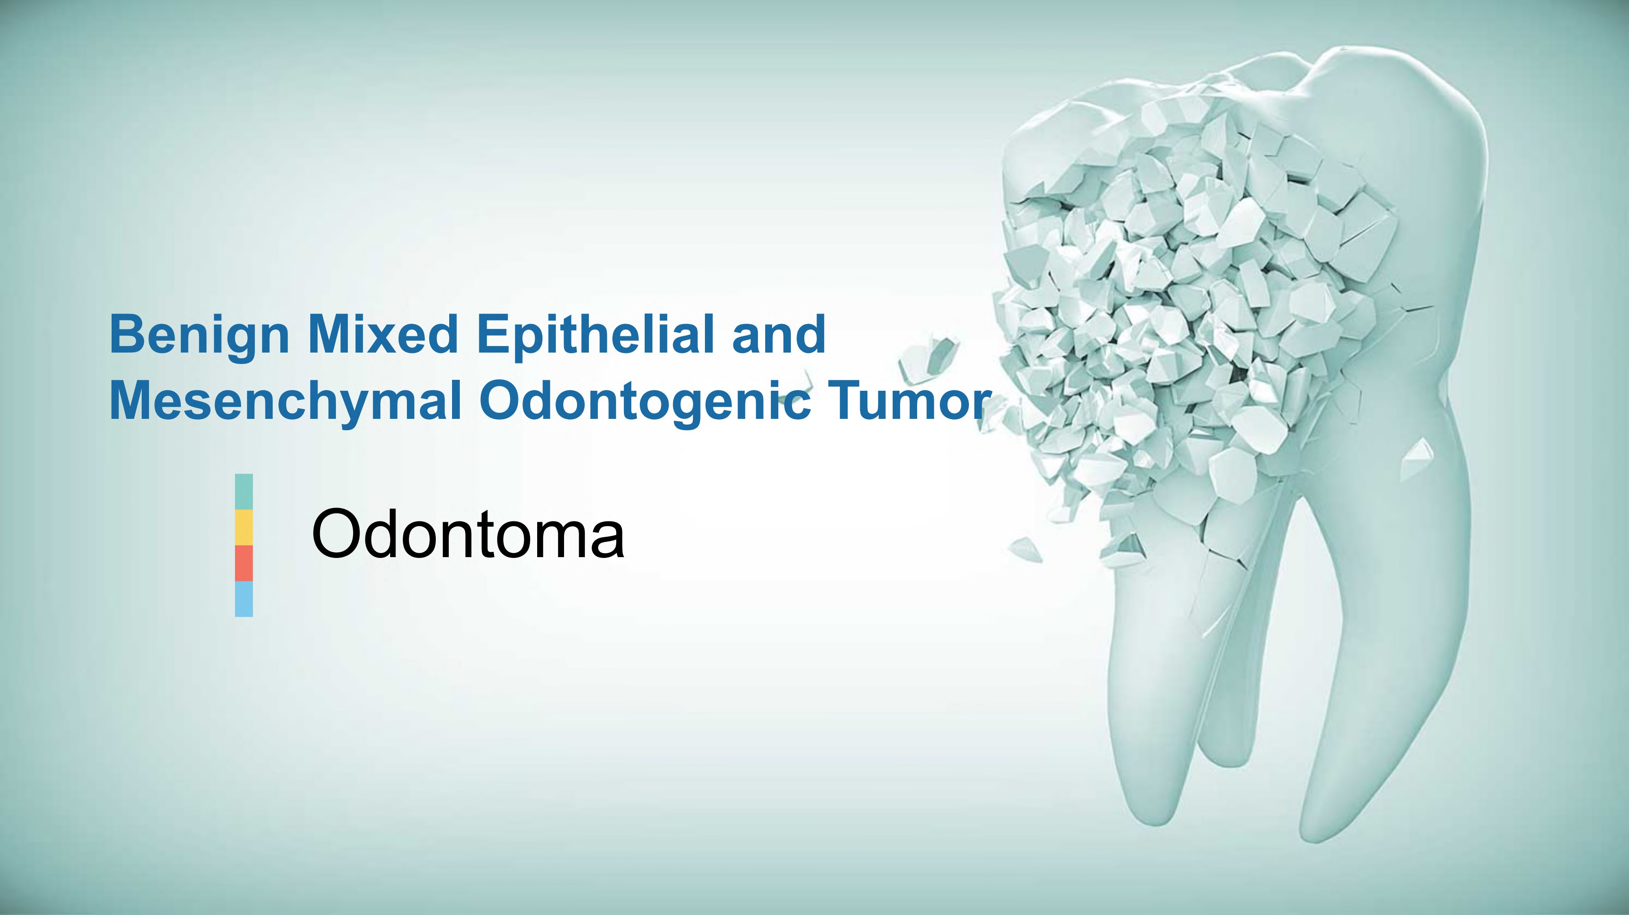

Slide 27

Odontoma
"Odontoma are mixed epithelial and mesenchymal
tumour-like malformations (hamartomas) composed
•
Most common
odontogenic tumor
Children/young adults
Painless
Frequently a/w
unerupted tooth
of
dental hard
and
soft tissues"
•
•
Compound Odontoma
V Multiple miniature tooth
V Mainly in anterior maxilla
Complex Odontoma
V Conglomeration of hard tissue
.Mainly in posterior mandible
•
Usually detected
radiograph
on
•
Can cause impaction,
diastema/ displaced adjacent teeth

Slide 28
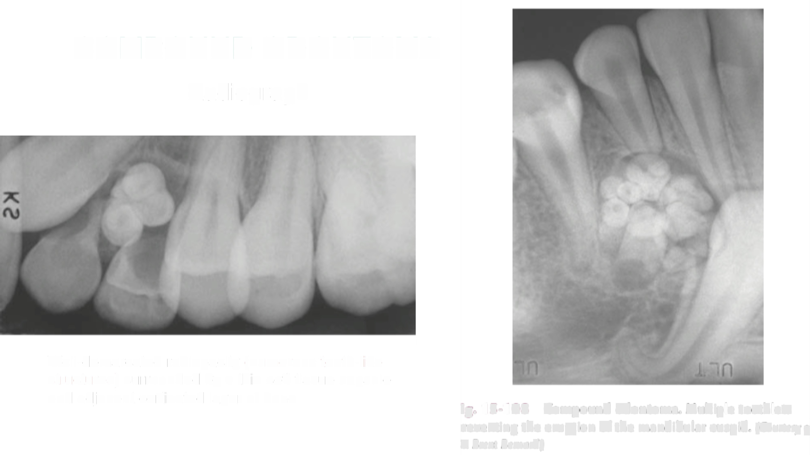
COMPOUND
ODONTOMA
Radiograph
Well-demarcated radiopacity (numerous
tooth-like
structures) surrounded by a thin soft tissue capsule
and adjacent corticated layer of bone.
ig. 15-108
Compound odontoma. Multiple toothlets
reventing the eruption of the mandibular cuspid. (Courtesy o
r. Brent Bernard.)

Slide 29
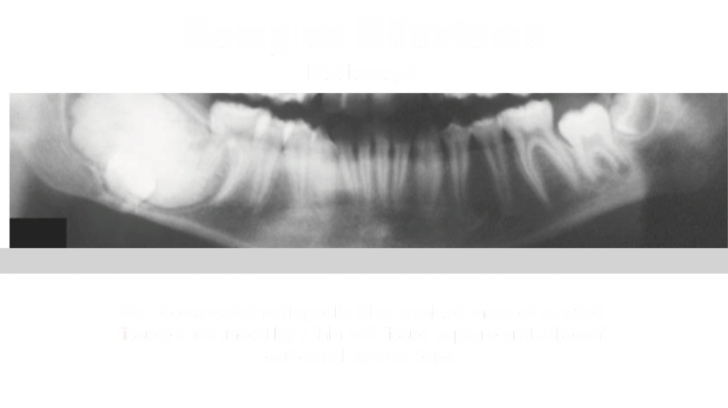
Complex
Odontoma
Radiograph
Well-demarcated radiopacity (disorganized
mass of calcified
tissue) surrounded by a thin soft tissue capsule and adjacent
corticated layer of bone.

Slide 30
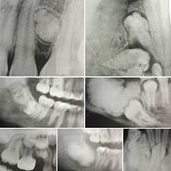
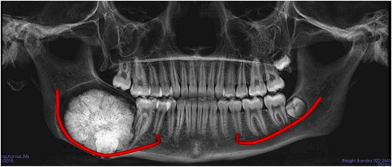
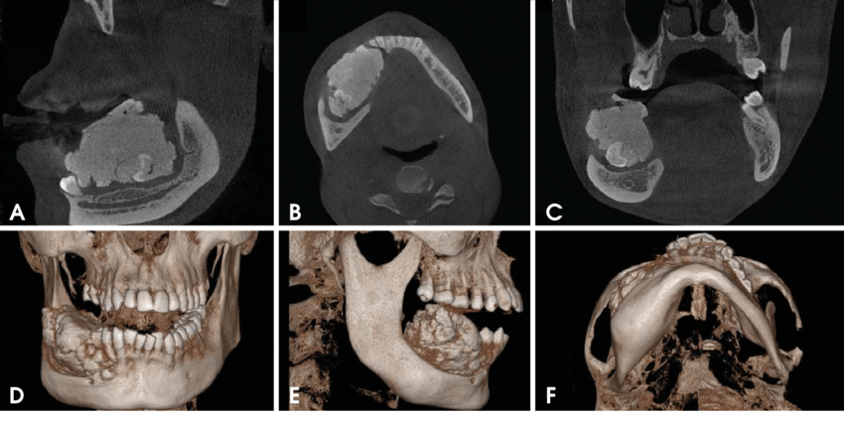

Slide 31

Odontoma
► Management:
Local
excision
► Prognosis:
Excellent
►Complex Odontoma- recurs
inadequately removed
if

Slide 32
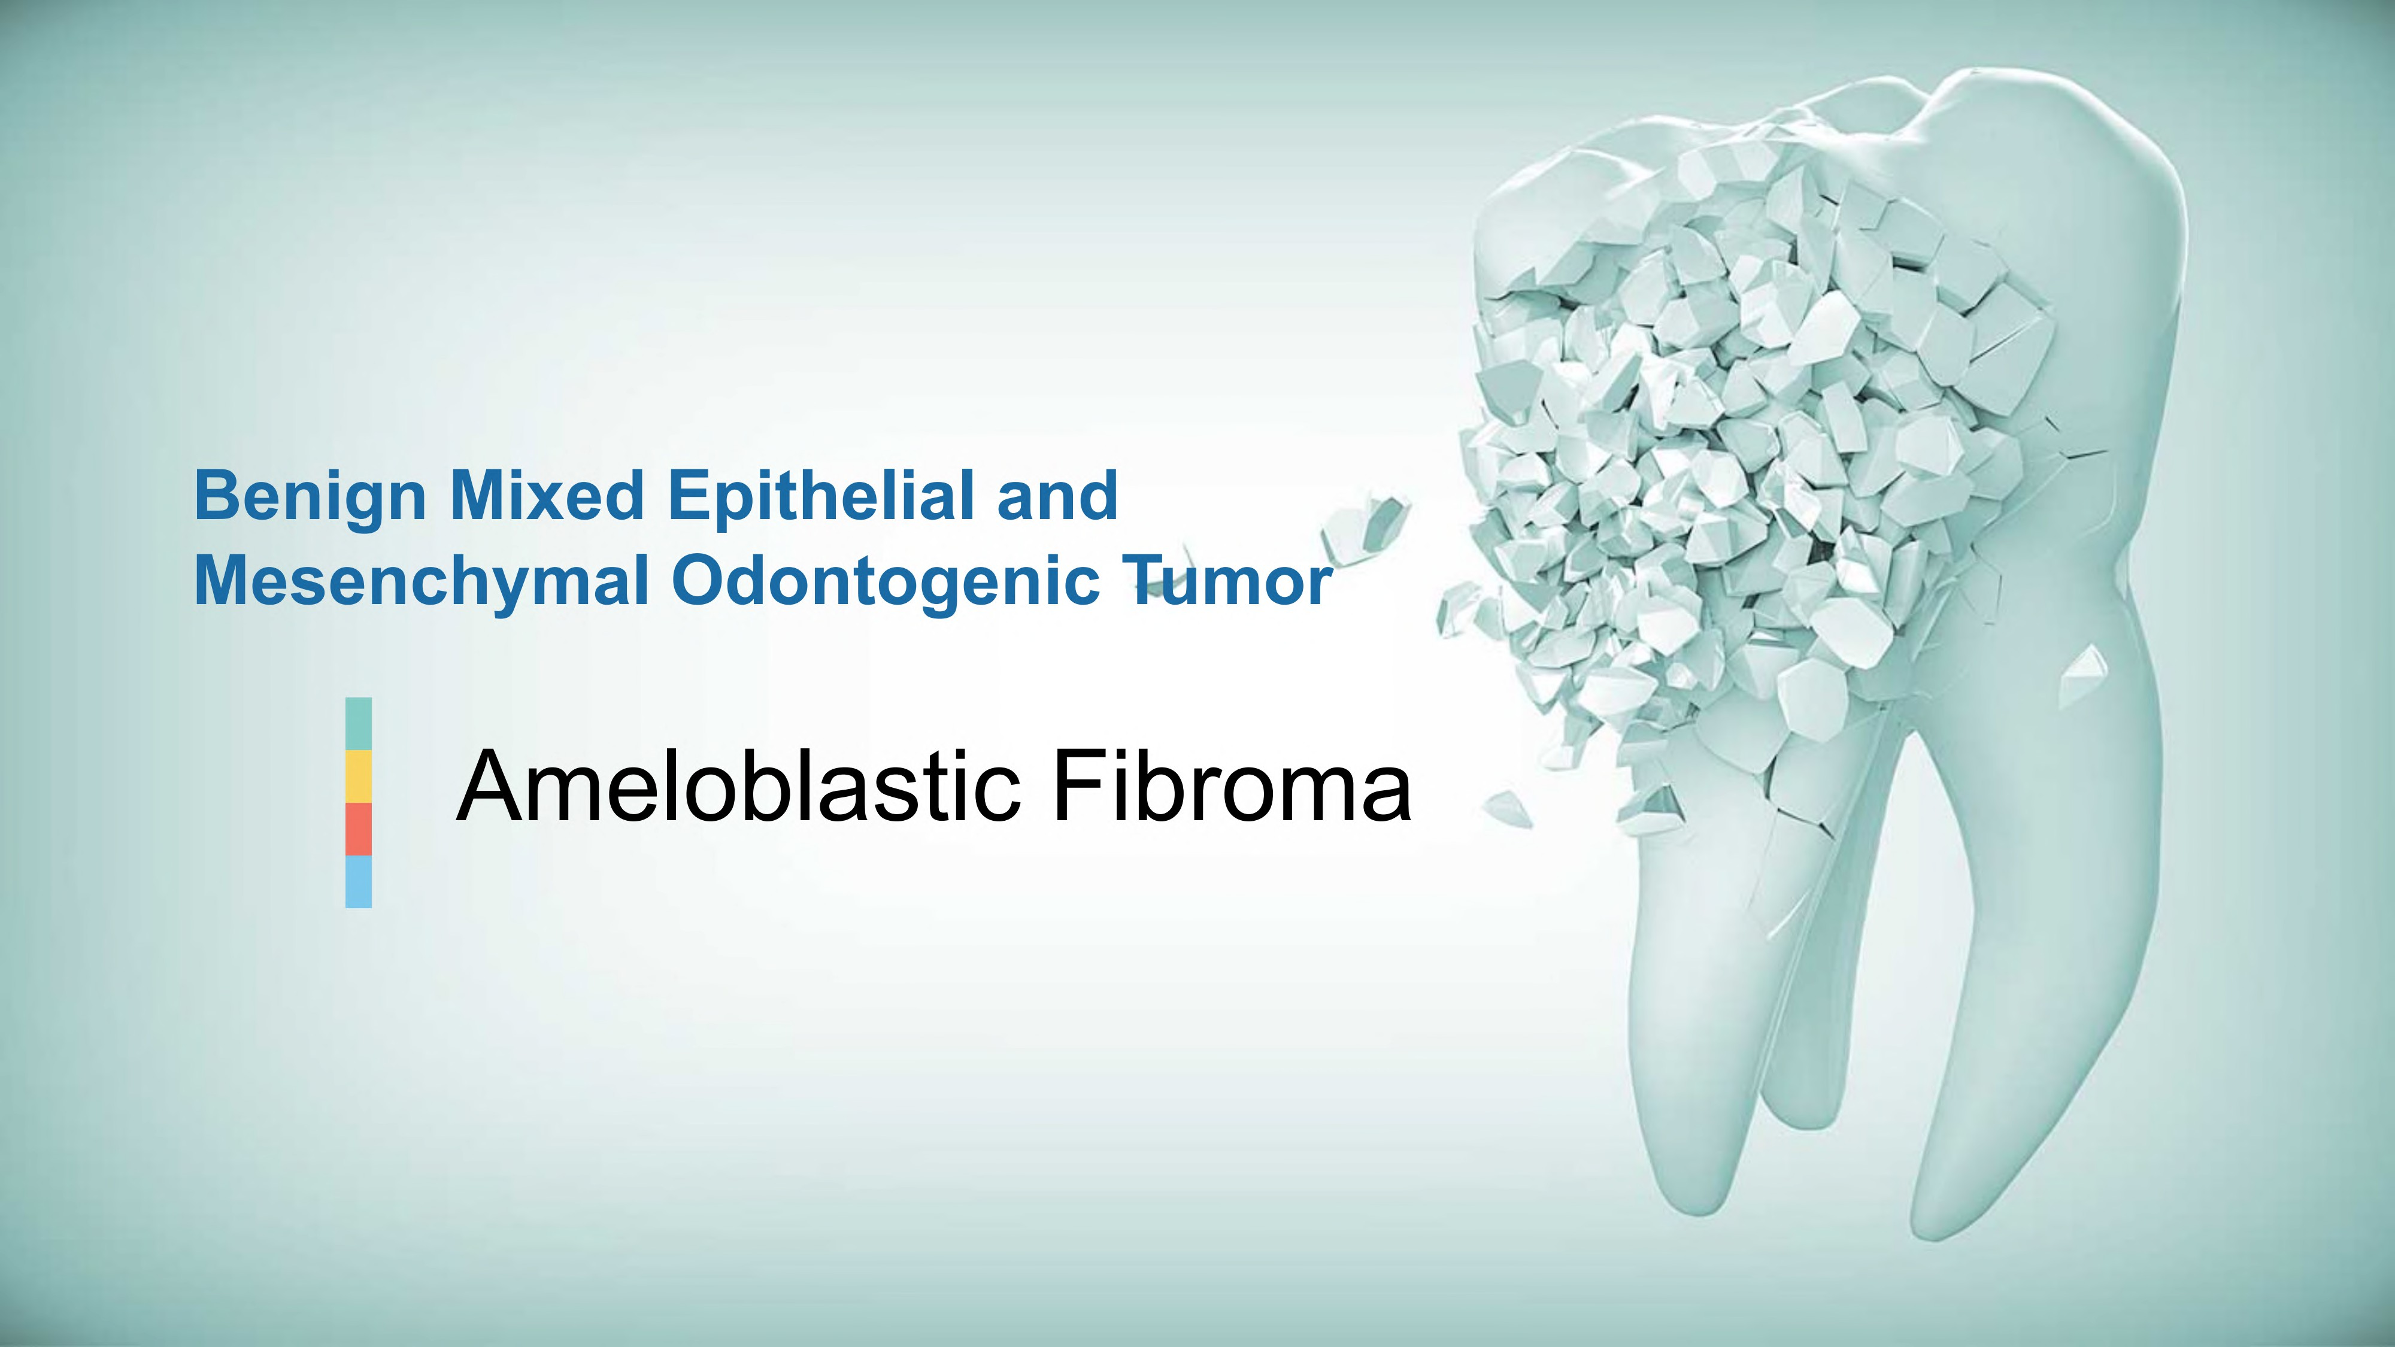

Slide 33
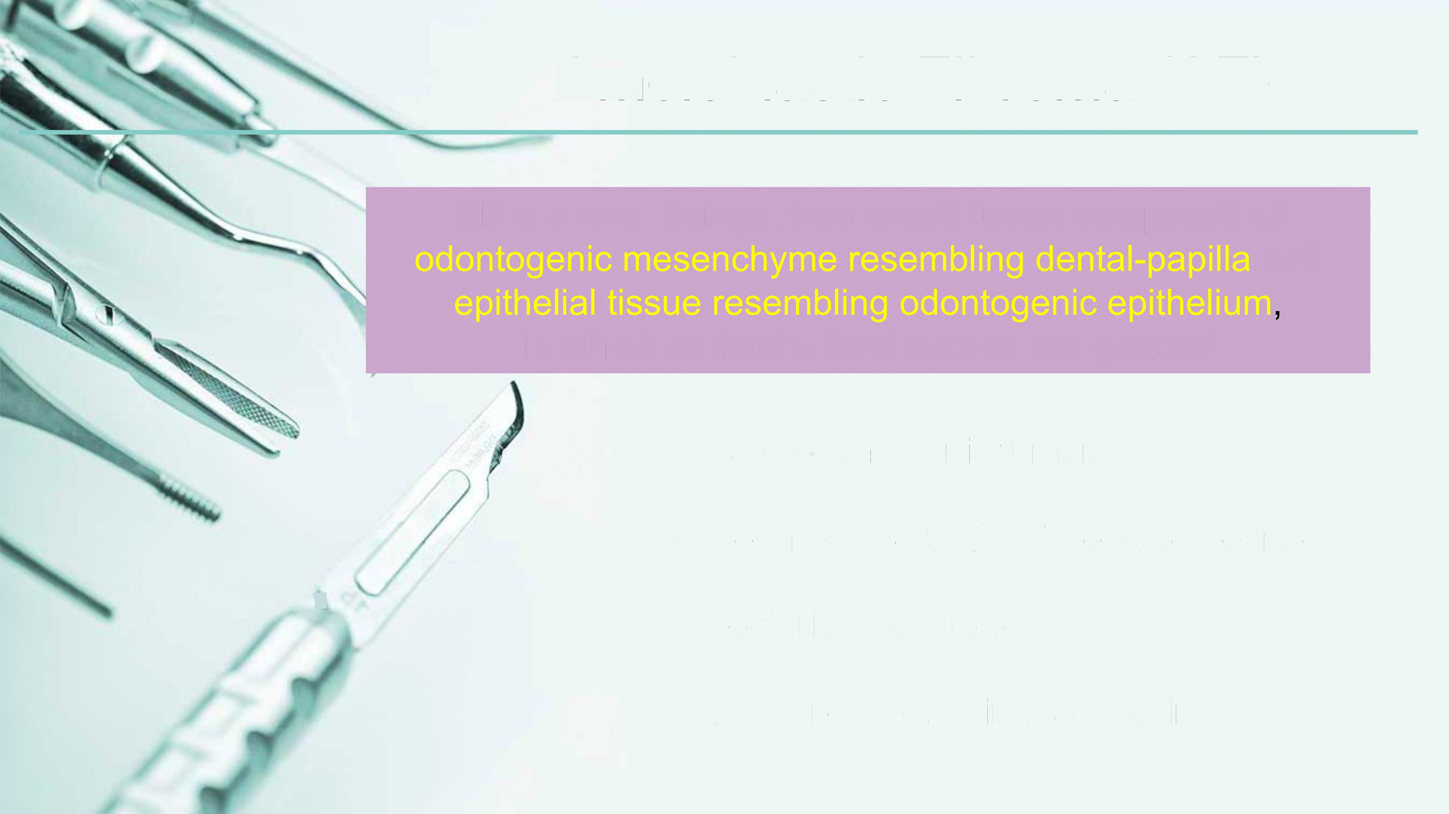
Ameloblastic
Fibroma
(AF)
AF
is a rare,
benign, true mixed tumor composed
of
and
in
which
no dental hard tissues are present
✓
Rare odontogenic tumors
✓
Mean age 15 y/o
1
Posterior mandible
✓
✓
Slow-growing, painless swelling

Slide 34

Ameloblastic
Fibroma
MANAGEMENT
& PROGNOSIS
✓ Small, asymptomatic in young children:
conservative
removal
✓ Extensive tumor: Radical treatment
✓ Sarcomatous transformation: rare

Slide 35
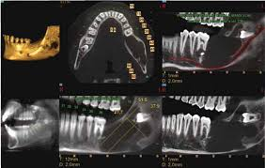

Slide 36
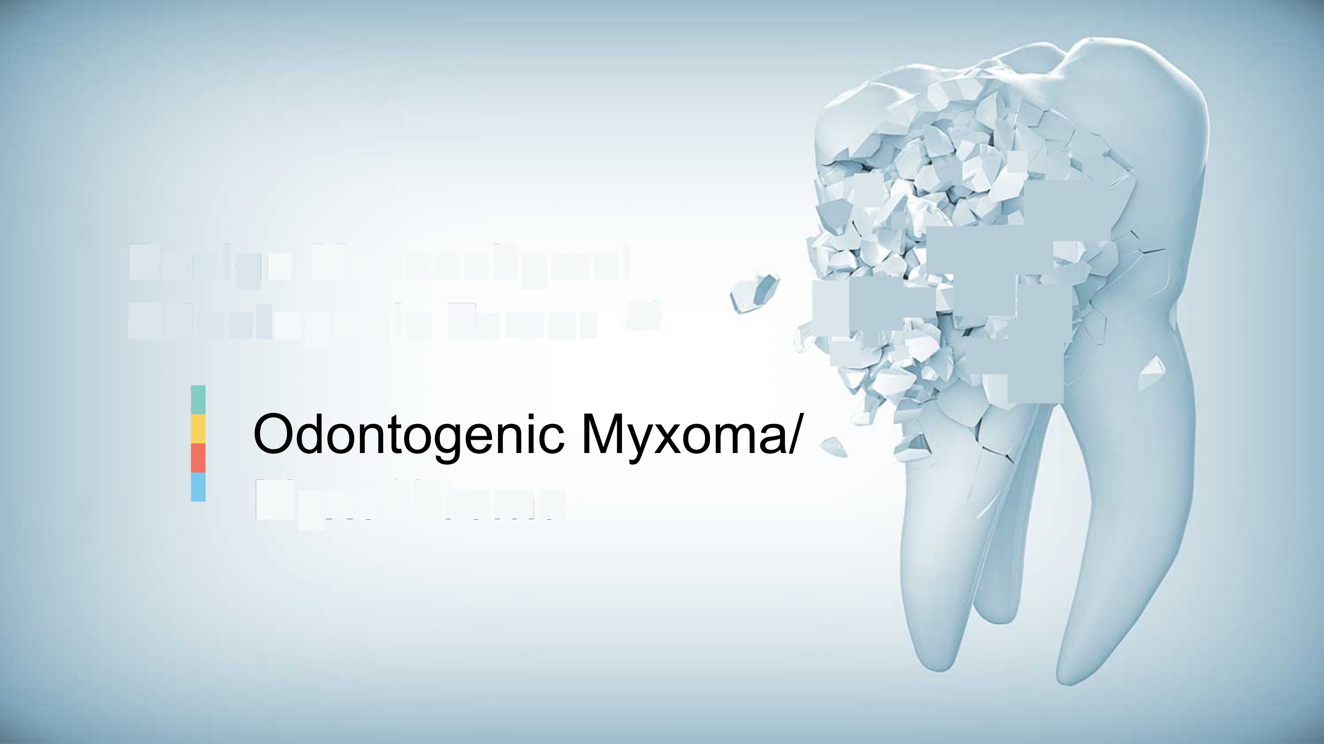
'
•
s
,
v
7_{t}
$_{S}
v,
'
4
Benign
Mesenchymal
'ti;2,
Odontogenic
Tumor
-
,- "i!r'j ,,,..
~~
Myxofibroma

Slide 37

Odontogenic
Myxoma
Is
a benign odontogenic neoplasm characterized by stellate and spindle•
shaped cells dispersed in an abundant myxoid extracellular matrix.
When
a
greater amount of collagen is evident, the term "odontogenic
myxofibroma" may
be
used
7
•
•
•
•
3rd most frequent odontogenic tumor
2nd-4th decade
Molar regions
Locally invasive-painless expansion
1

Slide 38
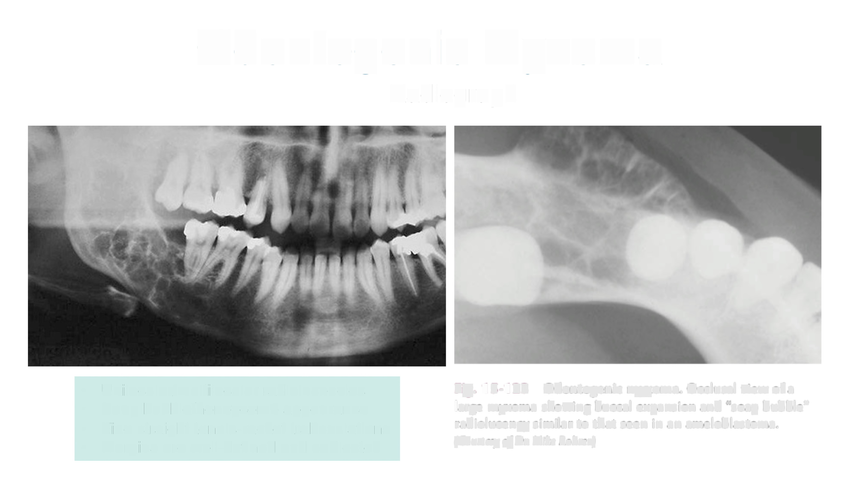
Odontogenic
Myxoma
Radiograph
•
•
•
•
Unilocular/multilocular radiolucencies
Soap bubble/honeycomb appearance
Fine straight tennis-racket trabeculations
Margins are well-defined and corticated
Fig. 15-123
large myxoma
Odontogenic myxoma.
Occlusal view of a
showing buccal expansion and "soap bubble"
radiolucency similar to that seen in an ameloblastoma.
(Courtesy of Dr. Mike Rohrer)

Slide 39

Odontogenic
Myxoma
Management & Prognosis
✓ Small tumor: curettage
✓ Larger tumor: Excision
✓ Good prognosis
✓ Recurrence if inadequately removed

Slide 40
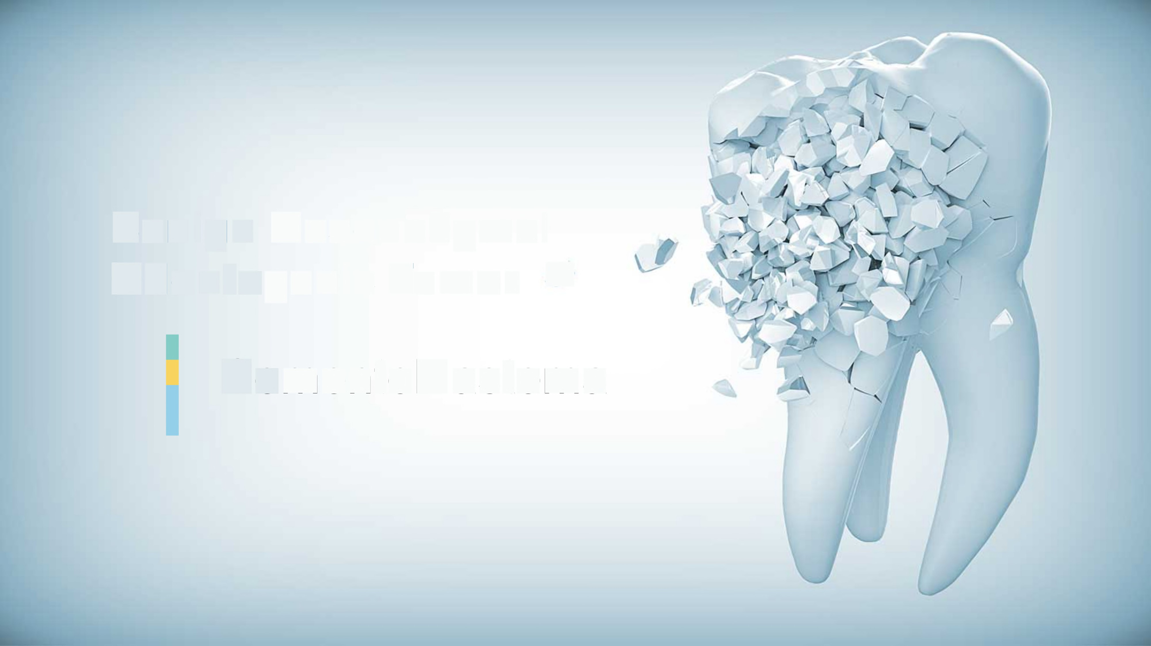
Benign
Mesenchymal
Odontogenic Tumor ->
,
Cementoblastoma

Slide 41

Cementoblastoma
''
Is a distinctive benign odontogenic tumor that
is
It
intimately associated with the roots of teeth.
is characterized by the formation of calcified
cementum-like tissue, which is deposited
directly on a tooth root.

Slide 42
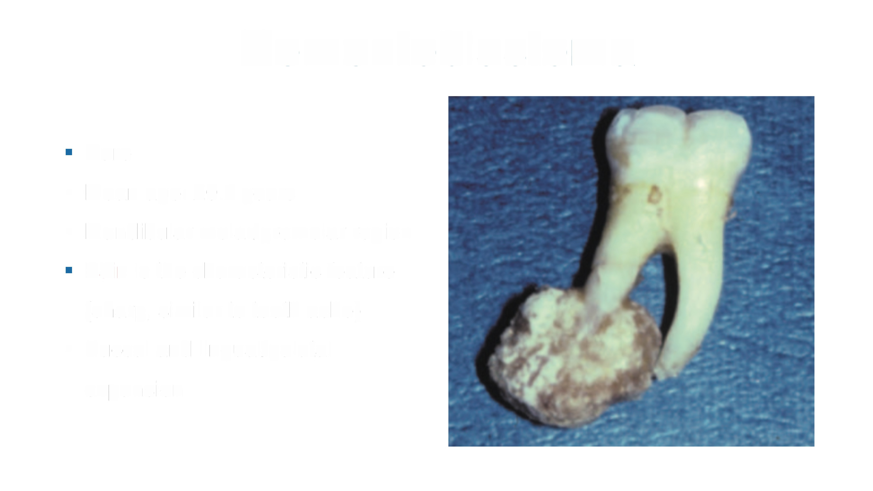
Cementoblastoma
Rare
Mean age: 20.7 years
Mandibular molar/premolar region
•
•
Pain is
(sharp, Buccal
the characteristic feature
similar to tooth ache)
and lingual/palatal
•
expans.on
i

Slide 43
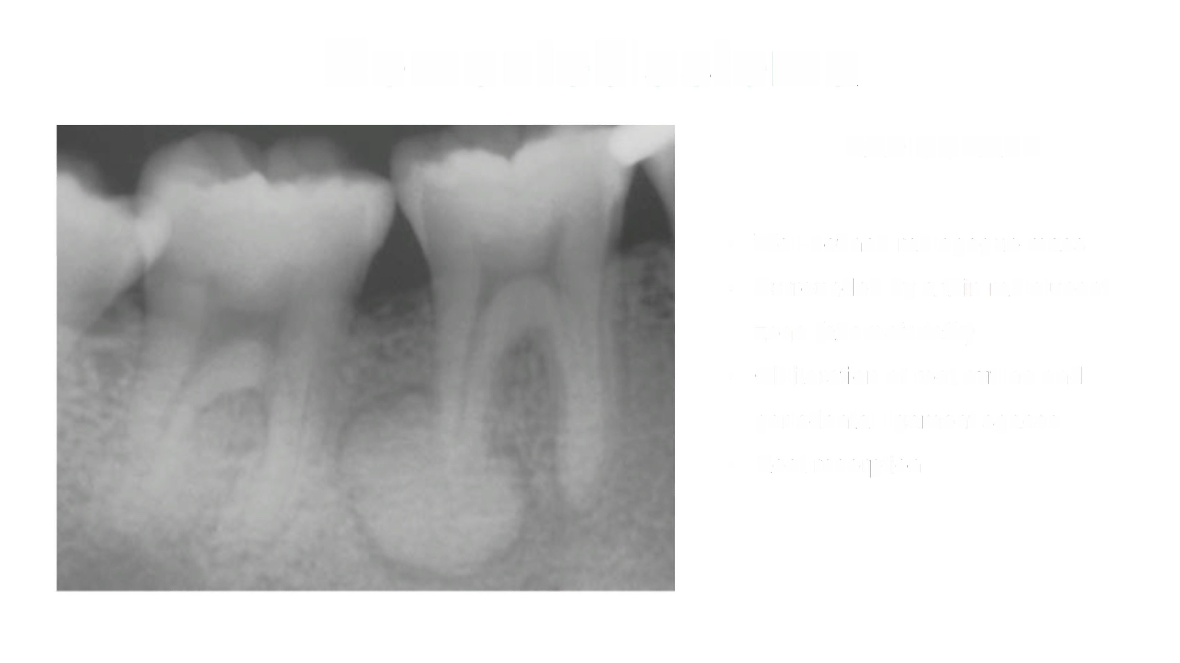
Cementoblastoma
RADIOGRAPH
•
•
Well-defined radiopaque mass
Surrounded by a thin radiolucent
zone (characteristic(
Obliteration of root outline and
periodontal ligament spaces
Root resorption
•
•

Slide 44

Cementoblastoma
Management & Prognosis
✓ Surgical removal with
tooth
✓ Recurrence in incomplete removal

Slide 45
Conclusion
Odontogenic Tumors are relatively rare & heterogenous group of mostly Benign Neoplasms , hamartomas & other odontogenic lesions that demonstrate great variability in
Etiology
Biologic behavior
Clinical Significanse
Radiographical Features
& Histological Pattern which is very essential to reach the Definite Diagnosis
& Finally determine Management & Prognosis

Slide 46
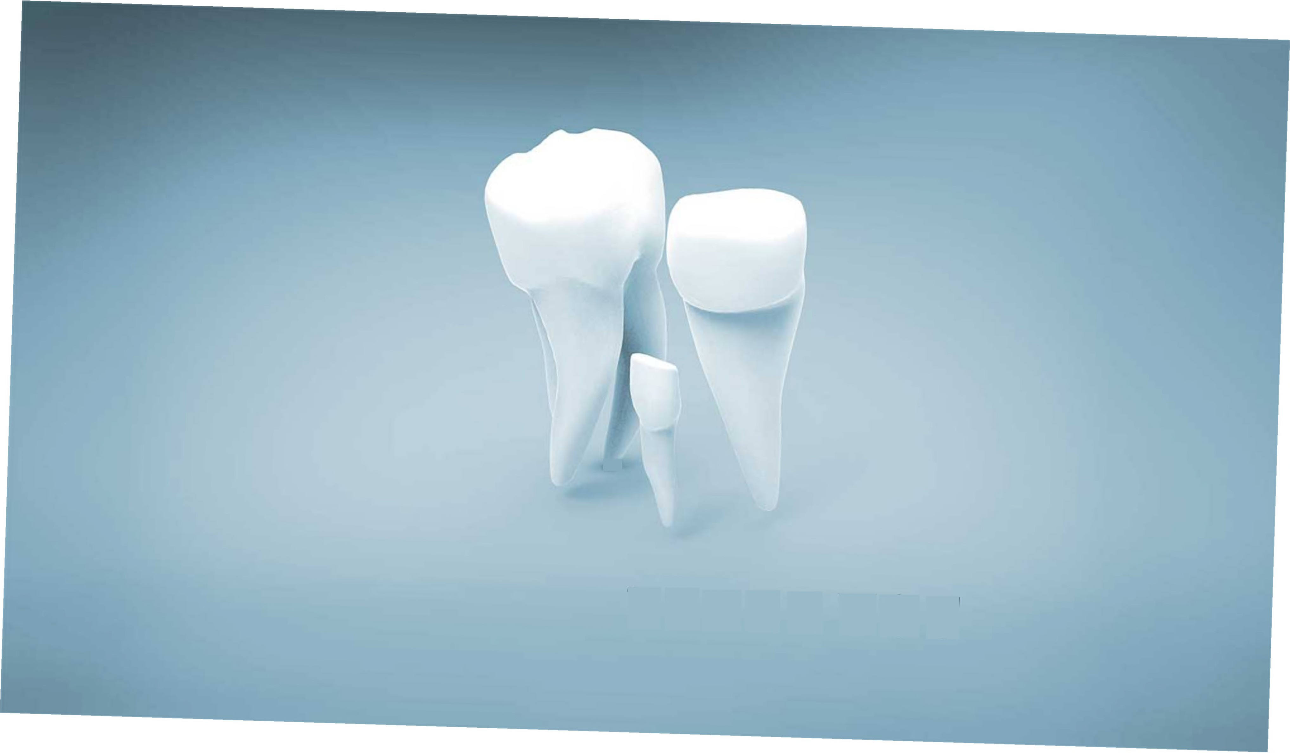
4
THANK
YOU

