Slide 1
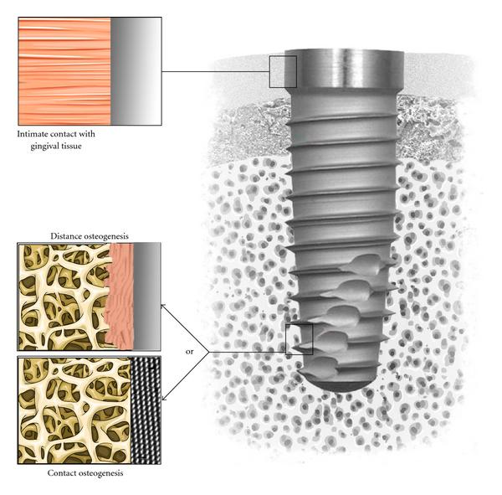
Anchorage in orthodontics

Slide 2


Slide 3
Contents
Definition of Anchorage
Sources of Anchorage
Intraoral Sources of Anchorage
Extraoral anchorage
Classification of anchorage
Muscular anchorage
Anchorage requirement depends
Classifying anchorage equipments
Temporary anchorage

Slide 4
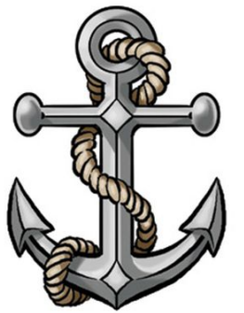
Definition of Anchorage
1. According to Graber
Anchorage is defined as "the nature and degree of resistance to displacement offered by an anatomic unit when used for the purpose of affecting toot hmovement".
2. According to White and Gardner
Anchorage is defined as "the site of delivery from which a force is exerted".
Phliarri,2011
Notes:
Whenever a force is applied, it produces an equal and
opposite reactive force. For tooth movement to occur
in the desired direction this reactive force should be
equal to or greater than the force applied. The areas
or units which provide the resistance to the reactive
force thereby preventing undesirable tooth movement
are called anchorage units.

Slide 5
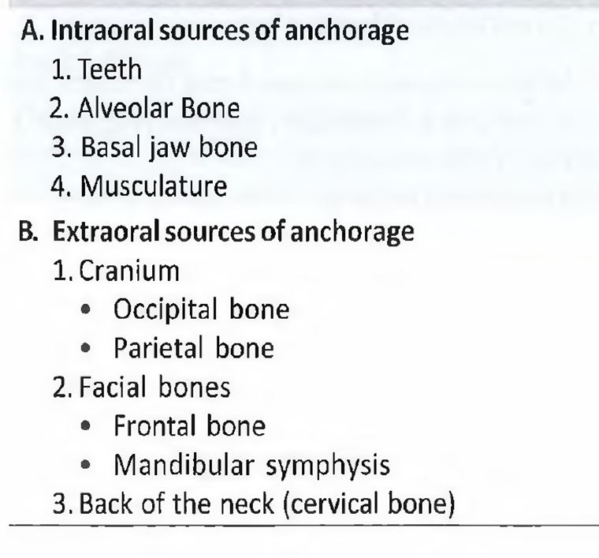

Sources of Anchorage
Anchorage can be obtained from several sources during
orthodontic treatment, which can be either intraoral or
Extra oral sources
Phliarri,2011

Slide 6
Intraoral Sources of Anchorage
Less dense trabecular bone
of the maxillary anterior region
Dense alveolar bone with horizontal arrangement
of the trabeculae in the mandibular posterior region
Singh,2007
Notes:
Alveolar Bone
Within limits the alveolar bone resists deformation.
This can be seen from the rearrangement of trabecular
pattern within the alveolar bone. Once the forces generated
exceed those that can be resisted by the alveolar
bone it permits tooth movement by bone remodeling.
Less dense alveolar bone offers less anchorage (Figs
22.1A and B). More mature bone increases anchorage.
This takes place because of two factors—one, the bone
becomes more calcified and dissolution takes time and
two, the regenerative capacity of the bone decreases.
Forces that are dissipated over a larger bone surface
area offer increased anchorage

Slide 7
Anatomic position of the teeth
Axial inclination of teeth
Number of roots
Intercuspation of teeth
Intraoral Sources of Anchorage
teeth
Size of the root
Root Form
Phliarri,2011

Slide 8
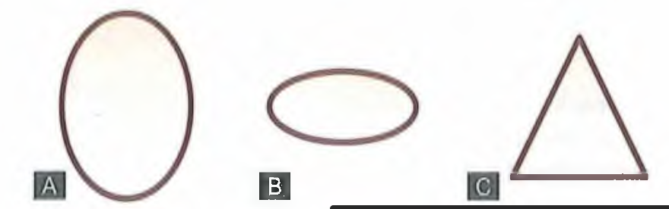
Intraoral Sources of Anchorage
Form of tooth
Different forms of roots. (A) Round root
form. (B) Flat root form. (C) Triangular root form
Phliarri,2011
Notes:
Root form The root form, to a large extent is responsible
for the degree of anchorage provided by a tooth.
The root in cross section can be either round, flat
(mesiodistally) or triangular (Fig. 22.2). The distribution
of the periodontal fibers on the root surface aid
in anchorage. The more the fibers the better the
anchorage potential. The direction of attachment of
the fibers also effects the anchorage offered by a tooth.
Round roots have only half their periodontal fibers
stressed in any given direction. Hence, offer the least
anchorage. Mesiodistally flat roots are able to resist
mesiodistal movement better as compared to labiolingual
movement, as more number of fibers are
activated on the flatter surfaces as compared to the
relatively narrower labial or lingual surfaces.
Triangular roots, like those of the canines are able to
provide greater anchorage. Their flatness adds to
resistance.
The tripod arrangement of roots (Fig. 22.3A), like
that seen on maxillary molars also aids in increasing
the anchorage. The round palatal root resists extrusion
and the two flat buccal roots resist intrusion and the
mesiodistal stresses. Under clinical situations where
the buccal tube is bonded/welded on the buccal aspect
of these teeth they show a tendency to ‘roll’ mesially,
the crown rotating mesiopalatally under a mesially
directed force (Fig. 22.3B).

Slide 9
Intraoral Sources of Anchorage
Form of toothh
Tripod arrangement of roots
Mesio-palatal rotation of the maxillary 1st molar
Singh,2007

Slide 10

Size of root
Long roots of the maxillary canines increase their
anchorage potential
Singh,2007
Notes:
Size of roots The larger or longer the roots the more
is their anchorage potential. The maxillary canines,
because of their long roots can, at times, be the most
difficult teeth to move in certain clinical circumstances
(Fig. 22.4).

Slide 11
Inclination of the teeth
Singh,2007
Notes:
Axial inclination of the tooth When the tooth is inclined
in the opposite direction to that of the force
applied, it provides greater resistance or anchorage
(Fig. 22.5).

Slide 12
Good intercuspation leads to greater anchorage
potential
Singh,2007
Notes:
Intercuspation Good intercuspation leads to greater
anchorage potential (Fig. 22.6). This is mainly because
the teeth in one jaw are prevented from moving
because of the contact with those of the opposing jaw,
this is especially true for teeth in the posterior segment
which also show the presence of attrition facets.

Slide 13
Basal Bone
Certain areas of the basal bone like the hard palate
and the lingual surface of the mandible in the anterior
region can be used to augment the anchorage. The
Nance palatal button is one such appliance that makes
use of the hard palate to provide resistance to the
mesial movement of the maxillary molars .
The Nance palatal button
Singh,2007
Notes:
Basal Bone
Certain areas of the basal bone like the hard palate
and the lingual surface of the mandible in the anterior
region can be used to augment the anchorage. The
Nance palatal button is one such appliance that makes
use of the hard palate to provide resistance to the
mesial movement of the maxillary molars (Fig. 22.7).

Slide 14
Cortical Bone
Ricketts floated the idea of using cortical bone for
anchorage. The contention being that the cortical bone
is denser with decreased blood supplies and bone
turnover. Hence, if certain teeth were torqued to come
in contact with the cortical bone they would have a
greater anchorage potential. The idea as such remains
controversial as tooth roots also show resorption in
such conditions and the risk of non-vitality of such
teeth is also more.
Profit,2017

Slide 15
Musculature
Singh,2007
Lip bumper makes use of the tonicity of the lip
musculature and enhances the anchorage potential of the
mandibular molars preventing their mesial movement
Notes:
Musculature
Under normal circumstances the perioral musculature
plays an important part in the growth and development
of the dental arches. Hypotonicity of the perioral
musculature might lead to spacing and flaring of the
anterior teeth. The hypertonicity of the very same
muscles has the reverse effect. Lip bumper is an
appliance that makes use of the tonicity of the lip
musculature and enhances the anchorage potential of
the mandibular molars preventing their mesial
movement (Fig. 22.8).

Slide 16
Classification of anchorage
CLASSIFICATION OF ANCHORAGE
A. Anchorage classified according to the manner of
force application as:
1. Simple
2. Stationary
3. Reciprocal.
B. Anchorage classified according to the jaws
involved as:
1. Intramaxillary
2. Intermaxillary.
C. Anchorage classified according to the site where
the anchorage units as:
1. Intraoral
2. Extraoral
3. Muscular.
Profit,2017

Slide 17

D. Anchorage classified according to the number ofanchorage units as:
1. Single
2. Compound
3. Reinforced.
E. White and Gardiner classified anchorage into six categories as:
1. Simple
2. Stationary
3. Reciprocal
4. Reinforced
5. Intermaxillary
6. Extraoral.
Singh,2007

Slide 18
For understanding anchorage it is convenient to
divide anchorage into—
Both
can be of three types—simple, stationary or reciprocal.
Simple anchorage can be further subdivided as—
single, compound and reinforced
into intramaxillary and intermaxillary
intraoral and
extraoral anchorage.
Extraoral anchorage can be of the following types
depending upon the location of the support units as—
cervical, occipital, cranial or facial
Notes:
For understanding anchorage it is convenient to
divide anchorage into—
intraoral and extraoral anchorage.
Further, intraoral anchorage can be subdivided
into intramaxillary and intermaxillary anchorage.
Both
can be of three types—simple, stationary or reciprocal.
Simple anchorage can be further subdivided as—
single, compound and reinforced.
Extraoral anchorage can be of the following types
depending upon the location of the support units as—
cervical, occipital, cranial or facial.

Slide 19
Intraoral anchorage
simple
stationary
reciprocal
single
compound
single
compound
simple
stationary
simple
compound
simple
compound

Slide 20
intraoral
intramaxillary
simple
stationary
intermaxillary
INTRAORAL ANCHORAGE
This type of anchorage is said to exist when and only
when all the anchorage units are present within the
oral cavity
reciprocal

Slide 21
SINGLE OR PRIMARY ANCHORAGE
Cases where the tooth to be moved is pitted against a
tooth with a greater alveolar support area is said to
display primary or single anchorage. For example, a
molar along with adjacent premolars used to align
another molar

Slide 22
COMPOUND ANCHORAGE
This type of anchorage provides for the use of more
teeth with greater anchorage potential to move a tooth
or group of teeth with lesser support. For example,
retracting incisors using loop mechanics in the fixed
orthodontic appliances

Slide 23
REINFORCED ANCHORAGE
Here the anchorage units are reinforced by the use of
more than one type of resistance units. For example, the use of headgears along with routine fixed
mechanotherapy or (extraoral anchorage and intraarch
compound anchorage) or the use of a transpalatal
arch in fixed mechanotherapy or simply
the banding of the second molar for the retraction of
the permanent canine

Slide 24
EXTRAORAL ANCHORAGE

Slide 25
MUSCULAR ANCHORAGE
The perioral musculature is not only very strong but
also resilient. The forces generated by the musculature
can sometimes be used to bring about tooth movement.
The lip bumper appliance may be used to distalize the
mandibular first molars or the transpalatal
arch when kept away from the palate, may cause the
intrusion of the teeth to which it is attached, the
maxillary first molars

Slide 26
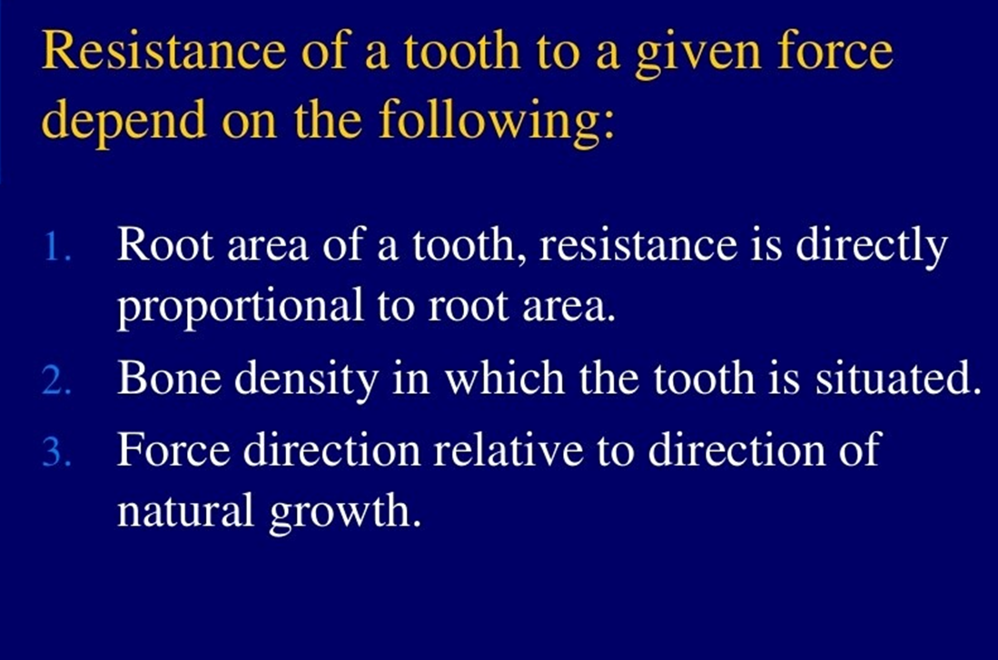
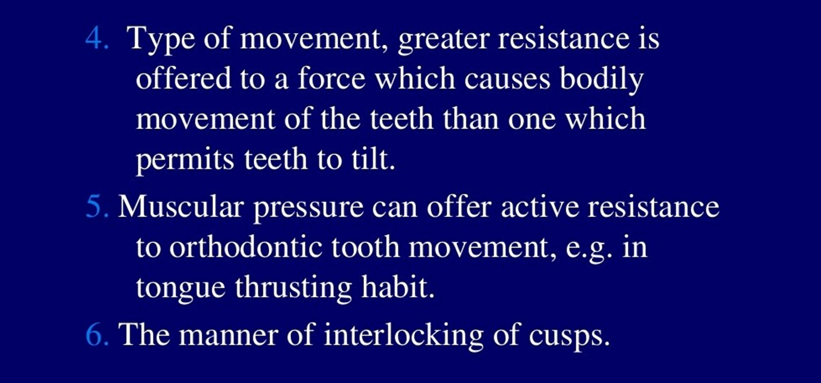
Bayouni,2014

Slide 27
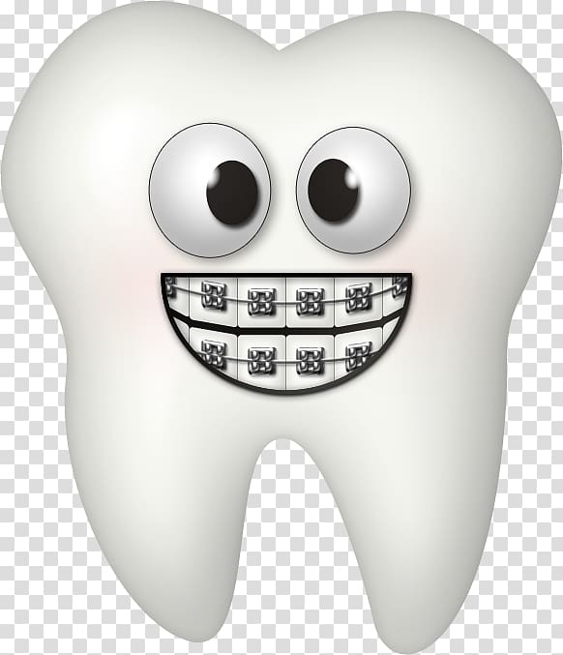
anchorage requirement depends on:
a. The number of teeth to be moved
b. The type of teeth to be moved
c. Type of tooth movement
d. Periodontal condition
e. Duration of tooth movement.
Notes:
anchorage requirement depends on:
a. The number of teeth to be moved the greater the
number of teeth being moved the greater is the
anchorage demand. Moving teeth in segments as
in retracting the canine separately rather than
retracting the complete anterior segment together
will decrease the load on the anchor teeth.
b. The type of teeth to be moved teeth with large flat roots
and/or more than one root exert more load on the
anchor teeth. Hence, it is more difficult to move a
canine as compared to an incisor or a molar as
compared to a premolar.
c. Type of tooth movement—moving teeth bodily
requires more force as compared to tipping the
same teeth.
d. Periodontal condition—teeth with decreased bone
support or periodontally compromised teeth are
easier to move as compared to healthy teeth attached
to a strong periodontium.
e. Duration of tooth movement—prolonged treatment
time places more strain on the anchor teeth. Shortterm
treatment might bring about negligible
amount of change in the anchor teeth whereas the
same teeth might not be able to withstand the same
forces adequately if the treatment becomes
prolonged.

Slide 28
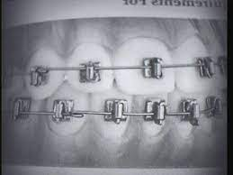

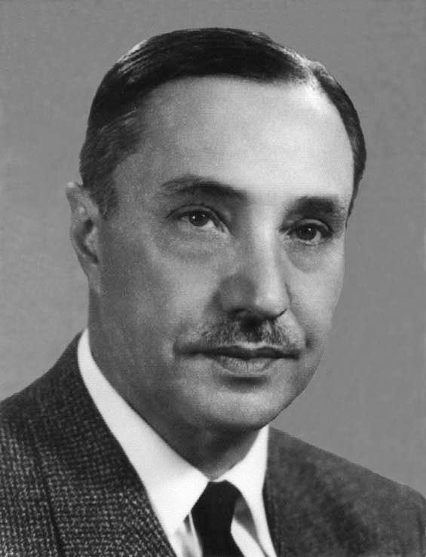
CLASSIFYING ANCHORAGE REQUIREMENTS
one-third the extraction
space is lost as anchor loss if no additional means are
used to conserve anchorage.
Based on this premise he
classified cases depending upon the space requirements
of the particular case as maximum anchorage,
moderate anchorage and minimum anchorage
Notes:
The Begg light wire appliance remains unique in the history of orthodontic innovation. Whereas many current self ligating bracket appliances suppose to be low friction or friction free, it is the Begg appliance that best exemplifies low friction, free sliding mechanics, by creating only a single point of contact between the bracket and the arch wire.
One key advantage of the appliance set up was the use of light elastic forces for the correction of anterior overbites and overjets. This mechanism sets up differential intra oral anchorage and a system of preferential tooth movement where certain teeth or blocks of teeth regulate independently. This system need Monthly visit and it is a cheaper treatment method of orthodontics.

Slide 29
CLASSIFYING ANCHORAGE REQUIREMENTS
TWEED’S CLASSIFICATION OF
ANCHORAGE PREPARATION
First degree or minimal anchorage preparation
Second degree or moderate anchorage preparation
Third degree or total anchorage
Notes:
Tweed classified anchorage preparation so as the
anchor molars would not move into the extraction
spaces and sufficient space would be available to bring
about the retraction of the anterior teeth.
First degree or minimal anchorage preparation was
reserved for cases where the facial esthetics were good
with an ANB angle equal to or less than 0 to 4°. The
total discrepancy should be less than or equal to 10
mm.
The anchorage preparation consisted of inclining
the terminal molars which are angulated such that the
direction of pull of the intermaxillary elastic force
during function will not exceed 90° when related to
the long axis of these teeth.
Second degree or moderate anchorage preparation is
usually required in cases where the ANB angle exceeds
4.5° with a Class II profile (retrognathic mandible).
Tweed recommended the banding of mandibular
second molars in all such case with the terminal molars
so angulated that their distal marginal ridge is at gum
level. With such an anchorage preparation the
direction of pull from the Class II elastics would be
greater than 90° during function. Such a pull will
further depress rather than elongate the terminal
molars.
Third degree or total anchorage preparation was
reserved for cases which had an ANB angle of more
than or equal to 5° and the total discrepancy was 14-
20 mm.
The anchorage preparation was such that all the
molars and premolars were tipped distally with the
distal marginal ridge of the second molar being located
below the gum level.
Such anchorage preparation is usually not required
nowadays.

Slide 30


Slide 31
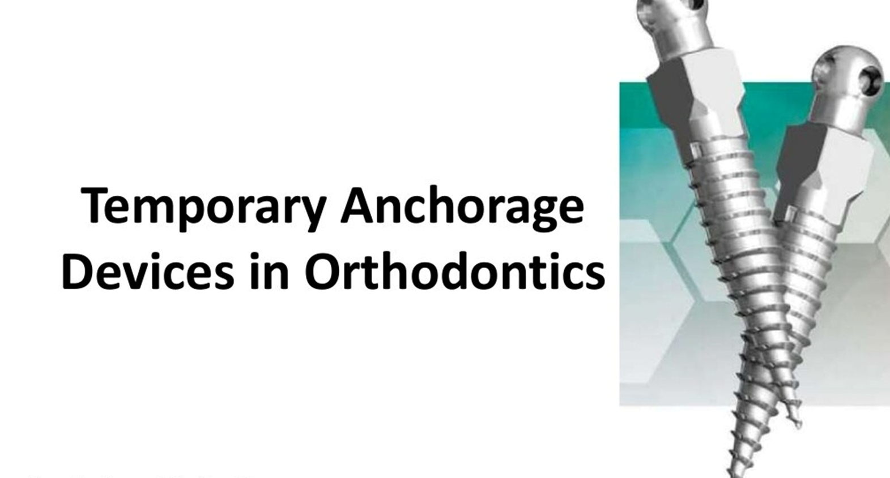
Mini‐implants are mechanically retained (like bone
fixation screws) rather than forming a clinically discernible
ankylotic union with the bone
Notes:
Orthodontic implants were first produced in the 1990s by
modification of dental implant designs, making them
shorter (e.g. 4–6 mm length) and wider (e.g. 3 mm diameter).
However, they retained the crucial requirement for
osseointegration, which is a direct structural and functional
union of bone with the implant surface causing
clinical ankylosis of the fixture. In contrast, orthodontic
miniplates and mini‐implants (miniscrews) are derived
from bone fixation technology, and primarily rely on
mechanical retention rather than osseointegration. In
effect, modification of the maxillofacial bone plate design,
adding a transmucosal neck and intraoral head, resulted
in the miniplate, whilst adaption of the fixation screw
design produced the mini‐implant. Since the start of this
millennium, a wide variety of customised orthodontic
mini‐implants have been produced and these are now used
in the vast majority of orthodontic bone anchorage applications.
Orthodontic implants are no longer in standard use
and the invasive nature of miniplates tends to limit their
use to orthopaedic traction (e.g. Class III) cases or occasionally
where the alveolar and palatal sites are too limited
for mini‐implant usage

Slide 32

Gainsforth and Higley (1945) who
proposed possibilities of orthodontic anchorage in the
basal bone by inserting Vitallium screws into a dog’s ramus for the purpose of distalising a maxillary canine.
The concept of osseointegration and use of titanium
implants for replacement of teeth was introduced by
Per Ingvar Branemark.Creekmore and Eklund (1983)
bite.Kanomi (1997) was the first to
describe that mini implant of 1.2 mm diameter and 6 mm
length can be explicitly used for orthodontic purpose.
Abso-Anchor Screw was developed in 1999 by a group of
Korean clinicians,
Aarhus Mini-Implant was created by a
Scandinavian group and an Italian group developed Spider Screw in 2003.Lately, palatal onplants, mid palatal
screws and miniplate implants are being researched and
reported.
Ahmed et al,2020
Notes:
Gainsforth and Higley (1945) who
proposed possibilities of orthodontic anchorage in the
basal bone by inserting Vitallium screws into a dog’s ramus for the purpose of distalising a maxillary canine.
The concept of osseointegration and use of titanium
implants for replacement of teeth was introduced by
Per Ingvar Branemark.Creekmore and Eklund (1983)
gave the first clinical report of TAD usage in the anterior
nasal spine for intrusion of upper incisors in a patient
with severe deep bite.Kanomi (1997) was the first to
describe that mini implant of 1.2 mm diameter and 6 mm
length can be explicitly used for orthodontic purpose.10
Abso-Anchor Screw was developed in 1999 by a group of
Korean clinicians, Aarhus Mini-Implant was created by a
Scandinavian group and an Italian group developed Spider Screw in 2003.Lately, palatal onplants, mid palatal
screws and miniplate implants are being researched and
reported.

Slide 33
Classification
Labanauskaite et al classified implants as following:
According to shape and size
a. Conical (cylindrical)
- Miniscrew implants
- Palatal implants
- Prosthodontic implants
b. Miniplate implants
c. Disk implants (onplants)
According to implant bone contact
a. Osseointegrated
b. Non-osseointegrated
According to the application
a. Orthodontic implants
b. Prosthodontic implants
Labanaaskaite etal,1989

Slide 34
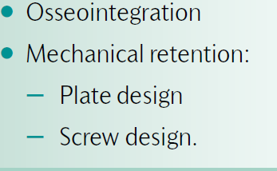
Classification of mini implants
Notes:
The use of temporary anchorage devices (TADs), also known as orthodontic
bone anchorage devices, is becoming increasingly common in
contemporary orthodontics. They first became popular in the 1990s and
were developed from the dental implants used in restorative dentistry
and maxillofacial bone plates. There are three distinct types

Slide 35

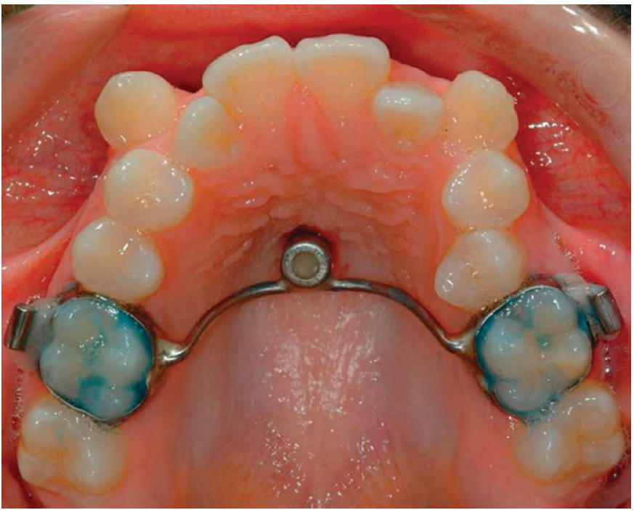
osseointegation
They have three principal disadvantages:
(1) They need to be left for 3 months after placement to allow
osseointegration.
(2) Due to their size, they are restricted to being used in edentulous
areas.
(3) Since the implant osseointegrates, it requires a complex
surgical procedure together with bone removal at the
completion of treatment and some patients may find this
unacceptable.
Osseointegrated mid-palatal implant used in conjunction
with a transpalatal arch to achieve absolute anchorage.
Profit ,2017
Notes:
Osseointegrated implants
These were modified from dental implants, making them shorter,
with a wider diameter than those used in restorative dentistry.
Osseointegrated implants can be used to provide maximum anchorage
and are useful if large or difficult tooth movements are required.
This type of implant, placed in the mid-palatal region and attached to a
palatal arch (Fig. 15.17), was compared with conventional headgear in
a randomized controlled trial. The authors concluded that mid-palatal
implants are an acceptable technique for reinforcement of anchorage.

Slide 36
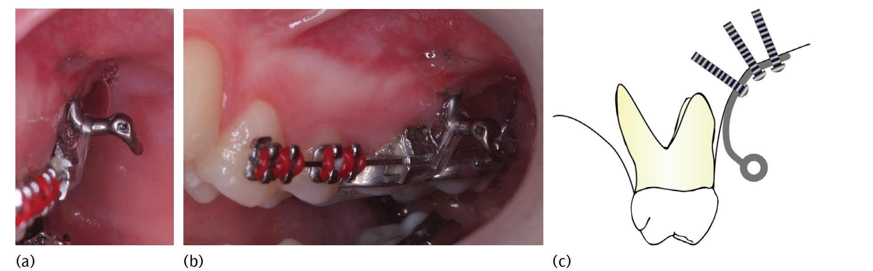
Miniplate systems
These are based on maxillofacial bone plates, with a transmucosal
portion projecting into the mouth to allow connection to the fixed
appliance. They can provide reliable anchorage, but require a surgical
procedure to both place and remove them
Profit ,2017

Slide 37
• Direct anchorage is achieved when forces are applied directly to the
TAD
• Indirect anchorage is achieved when the TAD is linked to the anchorage
teeth, and then the orthodontic forces are applied to this anchorage
unit
Notes:
Mini-screws
These were developed from the screws of maxillofacial plating
systems, but are smaller in size (typically 6–12 mm in length and
1.2–2 mm in diameter), hence the term mini-screw. No osseointegration
is required (or desired) which means that they do not provide
absolute anchorage as there is the possibility that they can move
during treatment. Their head and neck configuration has been
adapted to facilitate placement of auxiliaries to the fixed appliance
(Fig. 15.19).
Due to their ease of use—for both the patient and the orthodontist—
the mini-screw approach is now the most popular. There is a range of
different systems available with various claimed strengths and weaknesses.
Their designs and the associated treatment mechanics are
under constant review. They are usually placed under local anaesthesia
and can often be removed at the end of treatment without
requiring any anaesthetic.
Bone anchorage devices have the ability to provide anchorage in
three dimensions: anteroposteriorly, vertically, and transversely. They
can provide anchorage either directly or indirectly:

Slide 38

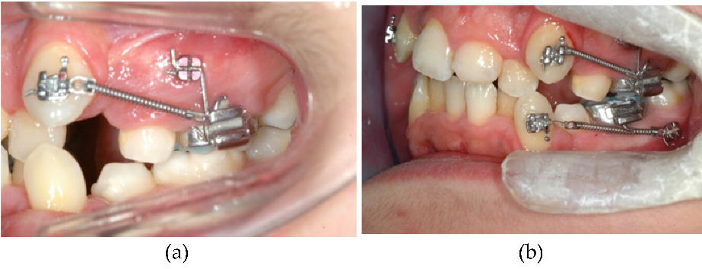
The benefit of using TADs for indirect anchorage is that conventional treatment mechanics can be utilized, however, the disadvantage is that if the TAD moves or becomes loose between visits, then some anchorage loss could have occurred before it is noticed and rectified

Slide 39
Temporary Anchorage Devices
Stability.
Short-term or primary stability is determined by
mechanical retention of the screw in bone, which depends on
bone properties, the engineering design of the screw, and placement technique.
Long-term or secondary stability is defined by the biologic union of the screw to the surrounding bone. It is determined by the implant surface, bone characteristics, and bone turnover
(especially in the context of cortical versus medullary bone) andis affected by the implant surface and themechanicalsystem used.
To obtain good secondary stability it is important to limit micromovementsthat could lead to bone resorption and formation ofa fibrous capsule. Over time, primary stability decreases whilesecondary stability increases; clinical stability is the sum of primaryand secondary stability and is the major factor in clinical success.

Slide 40
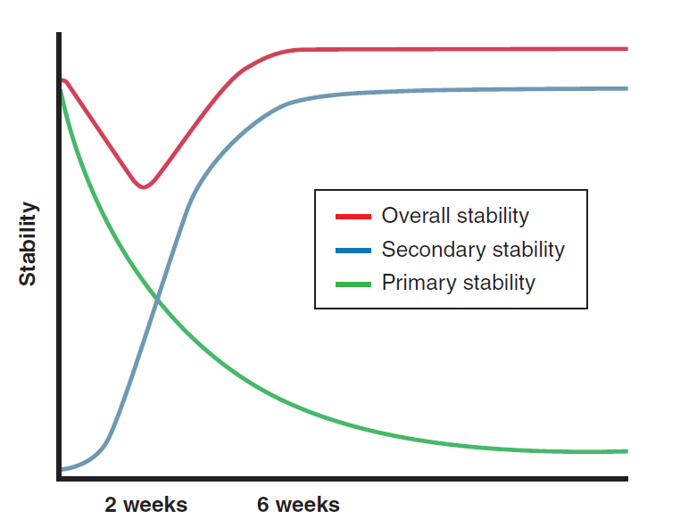
Notes:
Primary stability, which is created by mechanical retention
of a bone screw in bone, is maximal immediately after the screw has been
placed and declines rapidly as bone remodeling occurs around the screw.
Secondary stability, created by a biologic union between the screw and
bone, increases over time. Clinical stability is the sum of primary and
secondary stability. Note that clinical stability declines to a minimum at
about 2 weeks after insertion, then (if all goes well) stabilizes at a somewhat
larger value than the initial primary stability at about 6 weeks.

Slide 41
The implantable anchorage devices can also be
classified based on types of anchorage device used on
the following bases
Endosseous implants.
Surgical miniplates
Miniscrew implants (MSIs)
Ahmed etal,2020
Notes:
The implantable anchorage devices can also be
classified based on types of anchorage device used on
the following bases
2.2.1. Endosseous implants13
These are osseointegrated implants that can withstand more
mechanical force compared to the mechanically retaining
implants. The drawbacks of this type is that there is a
waiting period before loading, extensive surgical procedure
is required for placement and the removal is problematic.
These were used earlier in the palate for molar distalization.
2.2.2. Surgical miniplates-3,13
The modified or conventional surgical titanium miniplates
with intraoral extension can be used for orthodontic
anchorage. Regions with thick cortical bone such as the
zygomatic region and the buccal shelf area of the mandible
are suitable for such implants. Applications of these
implants include en masse molar distalization and intrusion
of buccal segment in open bite cases. The downside of these
implants was the need for extensive surgical procedure and
post-operative discomfort for the patient.
2.2.3. Miniscrew implants (MSIs)
These implants have mechanical retention and provide short
duration anchorage in orthodontics. The small diameter of
these screws provides high versatility for placement site.
Inter-radicular bone is the most common site for placement.
These implants are absolute anchorage units.

Slide 42
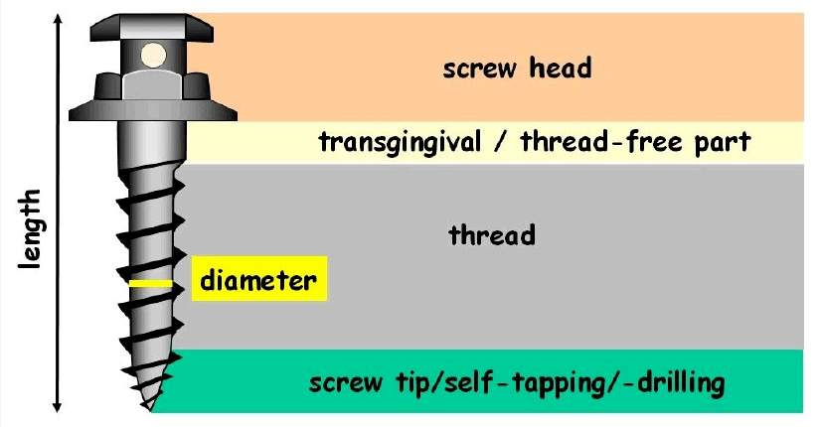
Design and parts
Notes:
Design and parts
Conventional MSI has the following parts
2.3.1. Head
It is the orally exposed portion of the screw which provides
attachment for the springs and elastics. It has a screw driver
slot or a particular design to engage the miniscrew driver
for implant placement. Numerous kinds of head design are
available for different types of anchorage and for prevention
of soft tissue irritation. Most common type is the button
like design with a sphere or double sphere-like shape or
a hexagonal shape. A 0.8mm diameter hole in the head
or neck of the screw is mostly used for direct anchorage.
Furthermore, bracket-like designs are also available that can
be used for both types of anchorage.14The driving head
can only be used on the miniscrew given by that specific
manufacturer. The head of the screw encompasses a hole
and a collar for various attachments.6Figure 1 shows the
parts of a miniscrew.15
2.3.2. Neck
Screw neck or the trans-mucosal part passes through the
mucosa and connects the screw with head. Variable lengths
of neck are available for different mucosal thickness. The
surface of the neck should be smooth and well-polished
to diminish plaque accumulation around the neck. The
junction of TAD with the mucosa is crucial as most of the
implant failure due to peri-implantitis usually begins from
this site.
2.3.3. Screw
This part gets embedded in the cortical or medullary bone to
provide retention. The thread of the screw around shank or
main body of the TAD has the cutting edge that facilitates
insertion. The depth of the cutting edge and its angle
determines the stresses generated during insertion and the
amount of insertion torque required for insertion.
Thread design can be conical as in miniscrews or
parallel tapering only at the end as in Orthodontic Mini
Implant.4Figure 2 shows different types of miniscrews. The
length of TAD is defined as the length of the threaded
body. It can range from 5-12mm for various clinical
procedure according to anatomical considerations.16 Costa
et al evaluated the intraoral hard and soft tissue depths and
established that miniscrew implants of 4-6mm length are
safe in most regions, but subject to variations according to
the bone depth of individual patients.17Total screw length id
determined by the screw, neck and head length. The major
diameter of TAD is the maximum diameter determined by
the outer diameter of the threads and can range from 1.2
-2 mm. Diameters greater than 2mm should not be used
in the inter-radicular region and those less than 1.2mm
are weak and prone to breakage.18 The minor diameter
refers to the inner core diameter, which usually ranges
from 0.2 to 1.6mm. The pitch of the screw is the distance
between the two threads. High pitch denotes threads placed
far apart and vice versa. A screw with a larger pitch gets
inserted at a faster rate. Figure 3 shows the design features
of a miniscrew. Table 1 shows the currently available
orthodontic miniscrew systems.

Slide 43
Design features of a miniscrew

Slide 44
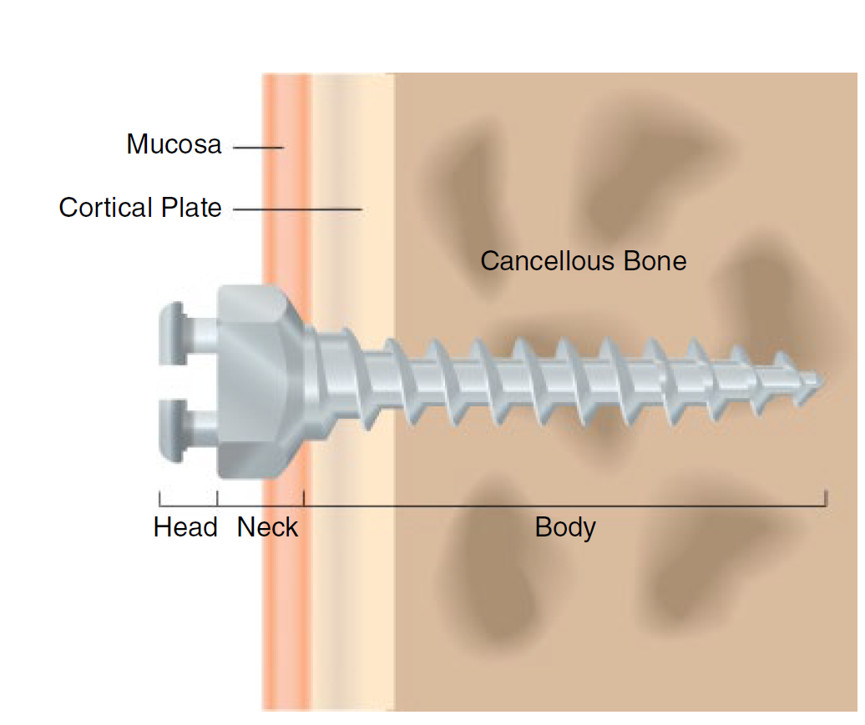
Galli,2012
The three principal sections of a mini-implant: the
head superficial to the tissues, the neck traversing the mucosa,
and the threaded body within the cortical and cancellous bone
Notes:
Principal
Design Features
Most mini‐implants have three constituent parts: the head,
neck and body (Figure 1.1), and are fabricated from a titanium
alloy such as surgical grade 5 (Ti‐6Al‐4V). Grade 5 machined
(smooth) titanium alloy is a good choice for mini‐implants
because it supports rapid cell proliferation and has good
cytocompatibility (which is better than stainless steel) and
cell adhesion [4,5]. The head is the platform which connects
to orthodontic appliances or elastic traction. The neck
is the part that traverses the mucosa. The body is the endosseous
section with threads around a core and a tapered tip.
Mini‐implants were initially available only in self‐tapping
(non‐drilling) forms whereby a full‐depth pilot hole had to
be drilled before mini‐implant insertion. However, many
self‐drilling screws are now available. These have a tapered
body shape with sharp tips and threads, and are inserted in
a corkscrew‐like manner. Full‐depth predrilling is avoided,
although shallow perforation of the cortex is still advantageous
where the cortex is thick or dense, for example the
posterior mandible and palate.

Slide 45
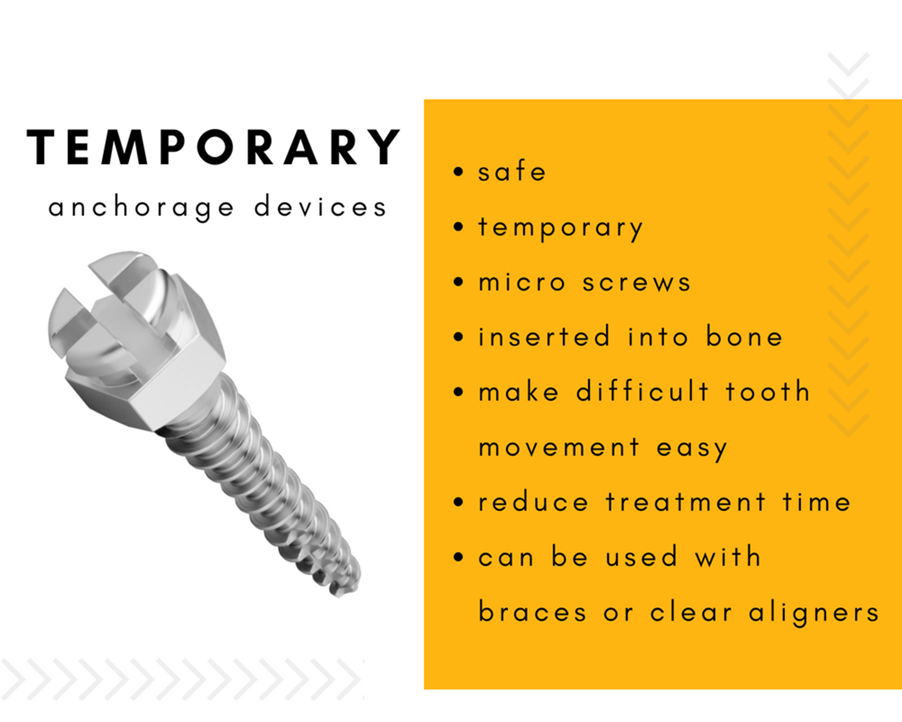
Notes:
2.4. Properties14
2.4.1. Biocompatibility
Medical type IV or type V titanium alloy (Ti6Al4V) which
is an alloy of titanium, aluminium and vanadium is the
material of choice for the production of majority of the
implants except for Orthodontic Mini Implants, which is
made from stainless steel. The medical grade titanium offers
biocompatibility and strength which is higher as compared
with commercially pure (CP) titanium.
2.4.2. Osseointegration
TADs are designed to be mechanically retained in the bone.
For easier removal of TADs, extensive osseointegration is
detrimental. For this reason, these devices are made with
smooth surfaces in order to reduce the bone ingrowth and
to promote soft tissue attachment and without any special
surface treatment regimen.

Slide 46
Indications for use of TADs
1. Absolute anchorage
2. For patients not compliant with the use of headgear
3. In case of missing first molars
4. For difficult tooth movements such as anterior
/posterior intrusion, en masse distalization of
upper/lower arches, molar up righting and molar
distalization.
5. In adult orthodontics for complex tooth movements.
6. TADs can also be used for the attachment of
orthopaedic forces
7. Correction of midline asymmetry and cant of
occlusion.
Notes:
Indications for use of TADs
1. Absolute anchorage in maximum retraction
requirements.
2. For patients not compliant with the use of headgear,
TADs are viable option for anchorage.
3. In case of missing first molars, TADs can provide
anchorage as well as help manage the space
judiciously.
4. For difficult tooth movements such as anterior
/posterior intrusion, en masse distalization of
upper/lower arches, molar up righting and molar
distalization.
5. In adult orthodontics for complex tooth movements.
6. TADs can also be used for the attachment of
orthopaedic forces to jaws when there is a lack of
anchorage units.
7. Correction of midline asymmetry and cant of
occlusion.

Slide 47
Clinical Procedure
Screw selection-self drilling and self tapping
Mizrahi etal,2007
Notes:
Clinical Procedure
2.5.1. Case selection, informed consent and records
Patient’s medical history and assessment of oral cavity for
absence of gingival inflammation and periodontal disease
are to be done initially. Informed consent should always
be obtained from the patient or the parent. Apart from
the usual orthodontic records, intraoral radiographs of the
proposed miniscrew site have to be taken to assess the bone
morphology and roots of adjacent teeth.22 In case further
assessment of bone quality is required; cone beam computed
tomography (CBCT) may be taken for bone density values.
It has been suggested that D4 and D5 bones types are not
suitable for implants.23
2.5.2. Sites of Insertion
In the maxilla, TADs can be placed in the incisive fossa,
canine fossa, infra-zygomatic ridge, pre-maxillary region or
mid-palatal region. While in the mandible, TADs can be
placed in symphysis, canine fossa, anterior external oblique
ridge, retro-molar area or sub-maxillary fossa.17
Studies have shown that the safest site for placement of
TADs in the maxilla was in the anterior and apical portion
and the tuberosity region was most unsuited for implant
placement due to reduced bone thickness in this region. In
the mandible, safest insertion site was between the first and
second molars and between first and second premolars.24 In
the palate, the strongest bone support for implant insertion
was found 6 to 9mm posterior to the incisive foramen and 3
to 6 mm paramedian.25
Placement of TADs in the extra-alveolar bone will
diminish tooth root contact and allows the force vector
closer to the centre of resistance of the tooth. But such
implants will lay in mobile alveolar mucosa which can be
overcome by using trans-mucosal attachments.17
2.5.3. Direction of Insertion
The miniscrew implants are inserted obliquely in an apical
direction in the maxilla and parallel to the roots in the
mandible.26 In the maxilla, insertion angulation is 30◦
to 40◦ to the long axes of the teeth while it is 10◦ to
20◦ in the mandible.27In the region of maxillary sinus, a
more perpendicular direction of insertion of mini implant
is suggested to minimize the chances of perforation of
maxillary sinus. 28
2.5.4. Technique for Placement
The miniscrew implants can be self-drilling or self-tapping.
An adjustable acrylic template or surgical guide can be
used before implant placement. Recently, clinicians have
used 3D CBCT, and customized surgical guide fabricated
using stereolithographic techniques. This method helps
for placement of self-drilling miniscrews with precision
adjacent to dental roots and maxillary sinuses.29,30
In self-tapping screws, predrilling is done under a small
amount of local anaesthesia, preferably by an oral surgeon.
At the site of placement, soft tissue is removed using a soft
tissue punch and the pilot hole is drilled using a drill bit
and a drill rotating at a speed not exceeding 1000rpm. The
pilot hole should be maximum 2 to 3mm deep and should
be 0.3mm smaller than the screw diameter. The implant is
then inserted using an appropriate screw driver.
The self-drilling screws have specially formed tips and
cutting flutes that can be inserted into the bone without
predrilling, thereby decreasing the likelihood of damage to
the tooth root, tooth germ or nerves, thermal necrosis of
the bones and the fracture of the drill bit.4 However, selfdrilling
screw requires pilot hole drilling if the thickness of
bone cortex is more than 2mm which may cause the bending
of the fine tip of the screw.14 Figure 6 shows self-drilling
and self-tapping screws.
2.5.5. Loading and anchorage consideration
Unlike dental implants immediate loading of orthodontic
miniscrews can be done using light forces.28 It is advisable
to provide at least 2 mm clearance between the implant and
the adjacent tooth root as the implant might move during
orthodontic loading in some patients.31
2.5.6. Implant removal
The miniscrew can be removed using the same screw driver
with or without local anaesthesia. Normally, the wound after
implant removal does not require any special treatment and
heals uneventfully. In case the screw cannot be retrieved
during the removal appointment, it is advisable to wait for 3
to 4 days. The micro fractures or bone remodelling caused
due to the initial attempt will loosen the screw. In case of
implant fracture during removal, a small surgical procedure
may be required for removal.1
Implant Driving Method
There are two methods of placement of mini-implants.:
Self-tapping method: In this method, the miniscrew is driven into the tunnel of bone formed by drilling, making it tap during implant driving. This method is used when we use small diameter miniscrews.
Self-drilling method: Here, the miniscrew is driven directly into bone without drilling. This method can be used when we want to use larger diameter (more than 1.5 mm) miniscrews.

Slide 48
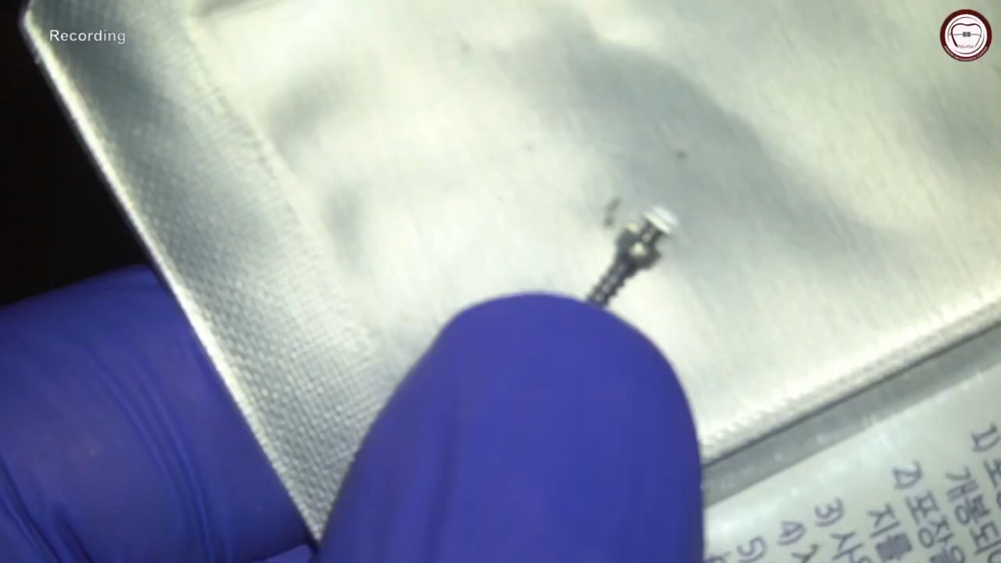

Slide 49
Risk Factors
It can be classified as:
General risk factors .
include tobacco smoking, age, risk of
infective endocarditis, diabetes and medications like
bisphosphonates, immune-modulators, anti-epileptics
and anticoagulants.
Local risk factors .
it includes gingivitis and
periodontitis, reduced mouth opening, bone quality and
radiotherapy.
Hoste etal,2008
Notes:
Risk Factors
It can be classified as:
1. 1. General risk factors – good general health
is essential for uneventful healing and prevention
of inflammation around the implant. General risk
factors include tobacco smoking, age,32,33 risk of
infective endocarditis, diabetes and medications like
bisphosphonates, immune-modulators, anti-epileptics
and anticoagulants.
2. 2. Local risk factors – it includes gingivitis and
periodontitis, reduced mouth opening, bone quality and
radiotherapy.

Slide 50
Complications
1. Complications during insertion.
2. Complications under orthodontic loading .
3. Soft tissue complications .
4. Complications during removal
Notes:
Complications34
1. Complications during insertion – Inter-radicular
miniscrew placement can cause trauma to root of
the tooth and periodontal ligament. Slippage of
the miniscrew under the mucosal tissue along the
periosteum may occur due to failure to completely
engage the cortical bone. Nerve injury during
miniscrew insertion is higher in the maxillary palatal
slope, the mandibular buccal dentoalveolus and
the retromolar area. Air subcutaneous emphysema
may result during miniscrew placement through the
loose alveolar tissue in the retromolar, mandibular
posterior buccal and zygomatic region. Perforation
of the nasal sinus and maxillary sinuses may
occur during insertion in the maxillary incisal,
maxillary posterior dentoalveolar and zygomatic
region. Miniscrew stability may be disturbed due to
increased torsional stresses during placement causing
implant bending or fracture or micro fractures in the
peri-implant bone.
2. Complications under orthodontic loading – Stationary
anchorage failure may occur due to low bone density
and inadequate cortical bone thickness. Miniscrew
migration within the bone is potential as absolute
anchorage under orthodontic loading is not always
achievable.
3. Soft tissue complications include aphthous ulceration,
soft tissue overgrowth on miniscrew head and
auxiliary, soft tissue inflammation, infection and periimplantitis.
4. Complications during removal comprise miniscrew
fracture and partial osseointegration.

Slide 51
Limitations of TADs
Orthodontic implants are contraindicated in case of systemic
bone diseases and in medically compromising conditions.
Patients younger than 12 years of age who have not yet
completed the skeletal growth are inappropriate for TAD
placement.
Miniscrews should not be placed adjacent to
bone remodelling areas such as healing socket or near a
deciduous tooth.
Thin cortical bone less than 0.5mm is a
limitation for miniscrew placement.
Clinician’s skill is a keyfactor for implant usage.
Ethical issues due to the invasive nature of the procedure are a restraint.
Notes:
Limitations of TADs
Orthodontic implants are contraindicated in case of systemic
bone diseases and in medically compromising conditions.
Patients younger than 12 years of age who have not yet
completed the skeletal growth are inappropriate for TAD
placement. Miniscrews should not be placed adjacent to
bone remodelling areas such as healing socket or near a
deciduous tooth. Thin cortical bone less than 0.5mm is a
limitation for miniscrew placement. Clinician’s skill is a key
factor for implant usage. Ethical issues due to the invasive
nature of the procedure are a restraint.

Slide 52
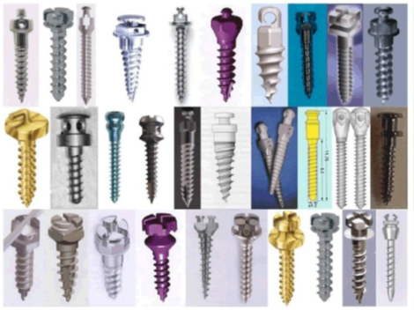
Different shapes
Notes:
Bone screw types for use as orthodontic temporary anchorage
devices (TADs). Note the differences in the shape of the head and
collar, the shape (form) of the screw and the screw threads, and the pitch
(separation) of the screw threads. Each of these screws requires a special
driver that fits the base of the head, and the method for attaching a wire
or spring to the screw is different in each case. The optimum characteristics
Implant shape
This determines the bone–implant contact area available for stress transfer and initial stability. The design must limit surgical trauma and allow good primary stability. It is difficult to identify the “perfect” implant shape. The most commonly used is cylindrical or cylindrical-conical, with a smooth or threaded surface. Studies have shown that the degree of surface roughness is related to the degree of osseointegration. Most implants used for orthodontic anchorage are similar to conventional designs. Specially designed implants are discussed below.
of a bone screw for orthodontic applications depends primarily on
where it is to be placed and the amount of force it will have to withstand,
and secondarily on its difficulty or ease of use.

Slide 53
Temporary Anchorage Devices
The key characteristics of any orthodontic temporary anchorage device (TAD) are
(1) its short- and long-term stability, the major indicator of success or failure, and
(2) its ease of use, which includes both its placement and the
features of the attachment that extends into the oral cavity. Th

Slide 54
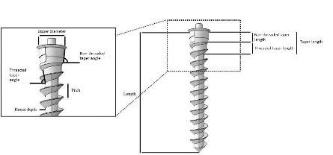
Factors in stability-related success that have been shown to be important are:
• The pitch of the screw threads
• The length of the screw
Ahmed etal,2020
Notes:
Factors in stability-related success that have been shown to be
important are:
• The pitch of the screw threads (i.e., how close the threads are to
one another). A tight pitch means the threads are close, a loose
pitch means they are farther apart. The denser the bone, the
closer the threads should be. It has become apparent that most
of a screw’s resistance to being dislodged comes from contact
with cortical bone and relatively little from medullary bone.
Because the layer of cortical bone is thin in the dental alveolus,
a tighter pitch of the threads near the head of the screw gives
greater contact with the cortical bone, higher pull-out strength,
and better primary stability.28
• The length of the screw. If the amount of contact with cortical
bone is the major factor in stability, and the amount of contact
with medullary bone makes little difference, it seems apparent
that short screws should perform as well as longer ones. But
the amount of soft tissue overlying the bone is an important
consideration; screws extending into the base of the zygomatic
process need to be longer to reach some cortical bone. A long
screw that passes all the way through the alveolus to reach
cortical bone on the other side (called a bicortical screw) does
provide greater stability,29 but for most applications this is not
worth the greater invasiveness.

Slide 55
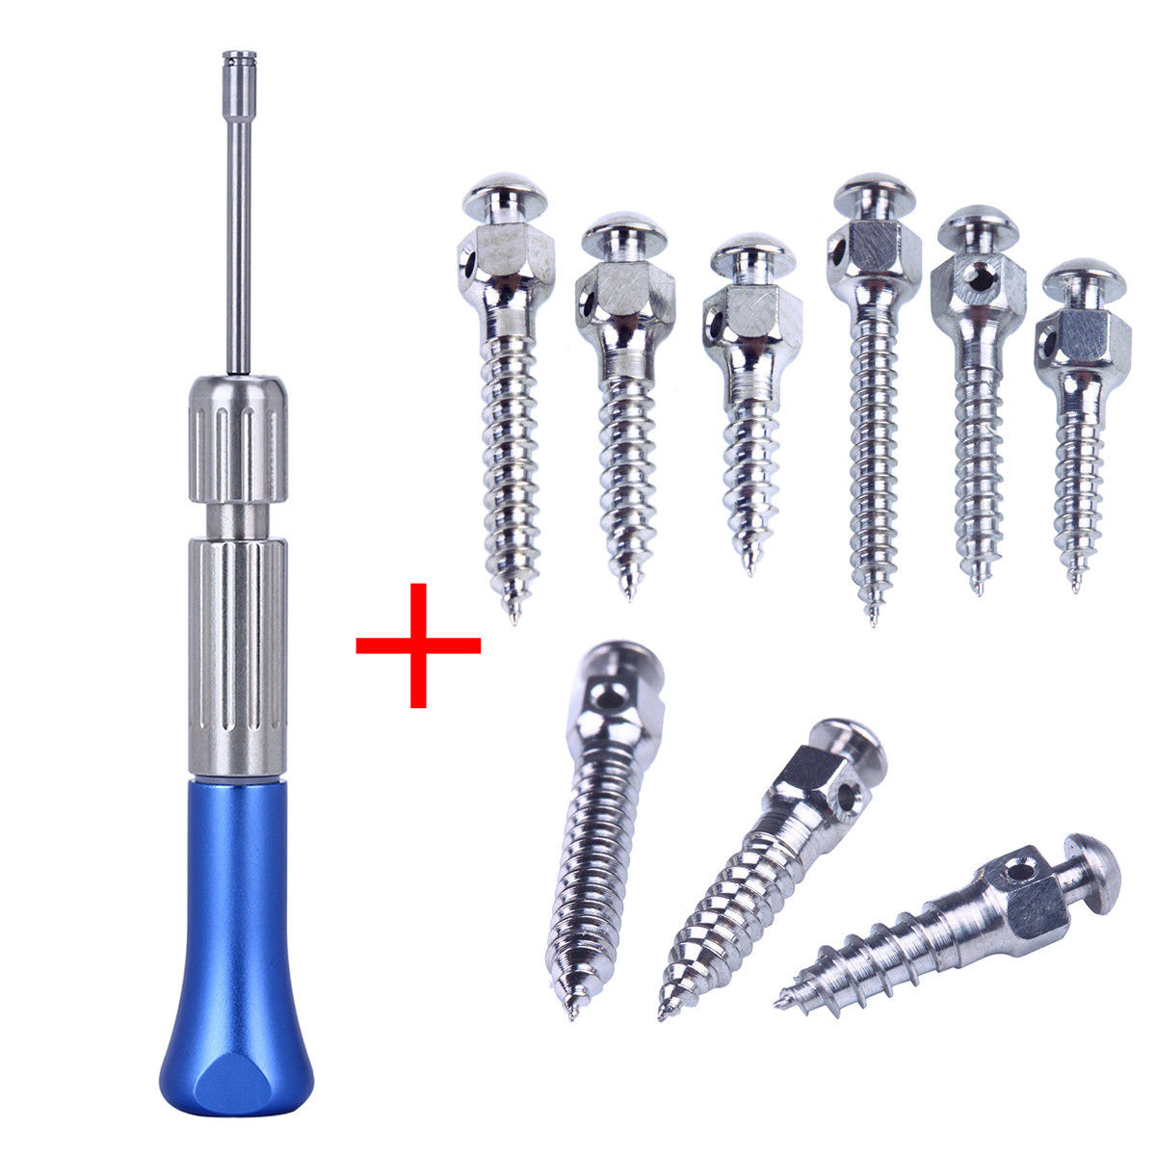
• The diameter of the screw
alveolar process
be narrow enough
Notes:
• The diameter of the screw. A screw that is to be placed into the
alveolar process must be narrow enough to fit between the
teeth. Bone screw TADs currently on the market can be as
narrow as 1.3 mm and as wide as 2 mm. The success rate drops
when the screw is narrower than 1.3 mm. Within the 1.3- to
2.0-mm diameter range, stability and survival are much more
strongly related to the amount of cortical bone contact rather
than the screw diameter, but a larger diameter screw does show
better primary stability when heavy force is applied. At this
point, the data suggest that root proximity is not a major factor
in long-term stability of the screw30 and that, at least in dogs,
penetration of the periodontal ligament does not lead to
ankylosis.31 If an alveolar bone screw is less than 0.5 mm from

Slide 56
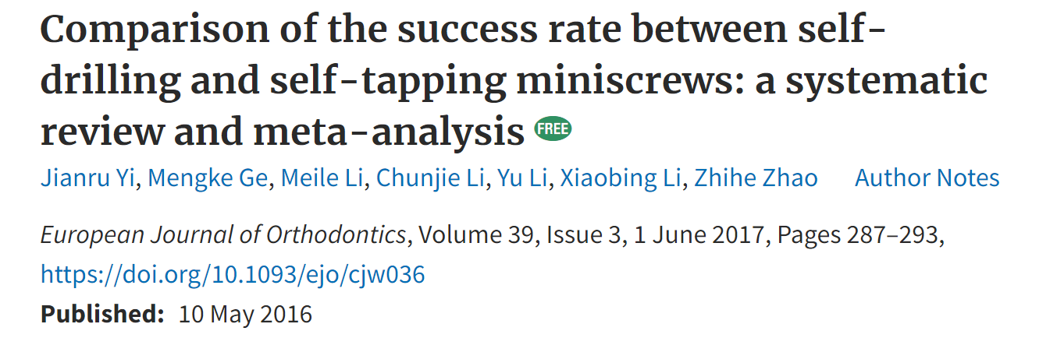
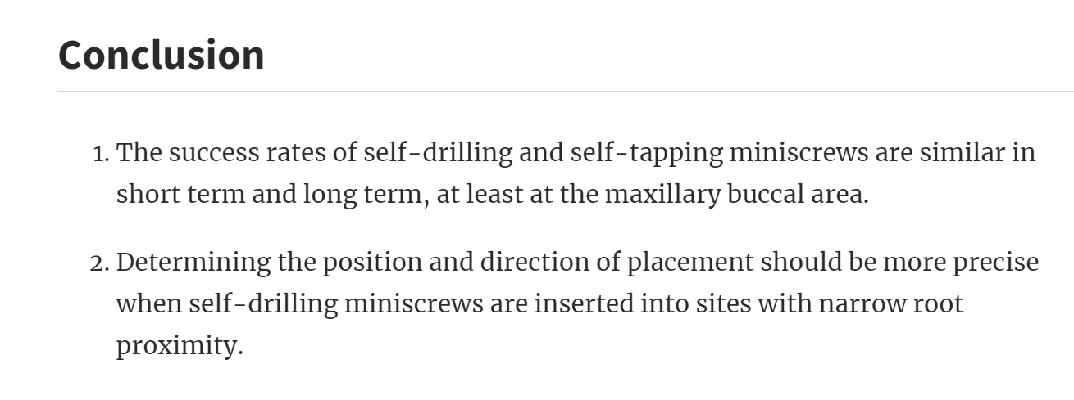
Notes:
the periodontal ligament, however, the success rate drops significantly.
32 In humans, the possibility of ankylosis as the screw
socket heals cannot be ruled out, so avoiding contact with tooth
roots probably is important for adolescent patients.
• The form of the tip. All orthodontic miniscrews are self-tapping
(i.e., they create their own thread as they advance). There are
two self-tapping designs: thread-forming and thread-cutting.
The difference is the presence of a cutting flute on the tip
of the thread-cutting screw. A thread-forming screw compresses
the bone around the thread as the screw advances, obtains
better bone-to-screw contact, and is better adapted for use with
alveolar bone. The flutes on a thread-cutting screw improve
penetration into denser bone. It appears that thread-cuttingscrews perform better in the mandibular ramus, mandibular
buccal shelf, zygomatic buttress, and palate.33
For a more detailed review of the factors that influence clinical
stability and success rates in major tooth movement, see Lee et al.

Slide 57
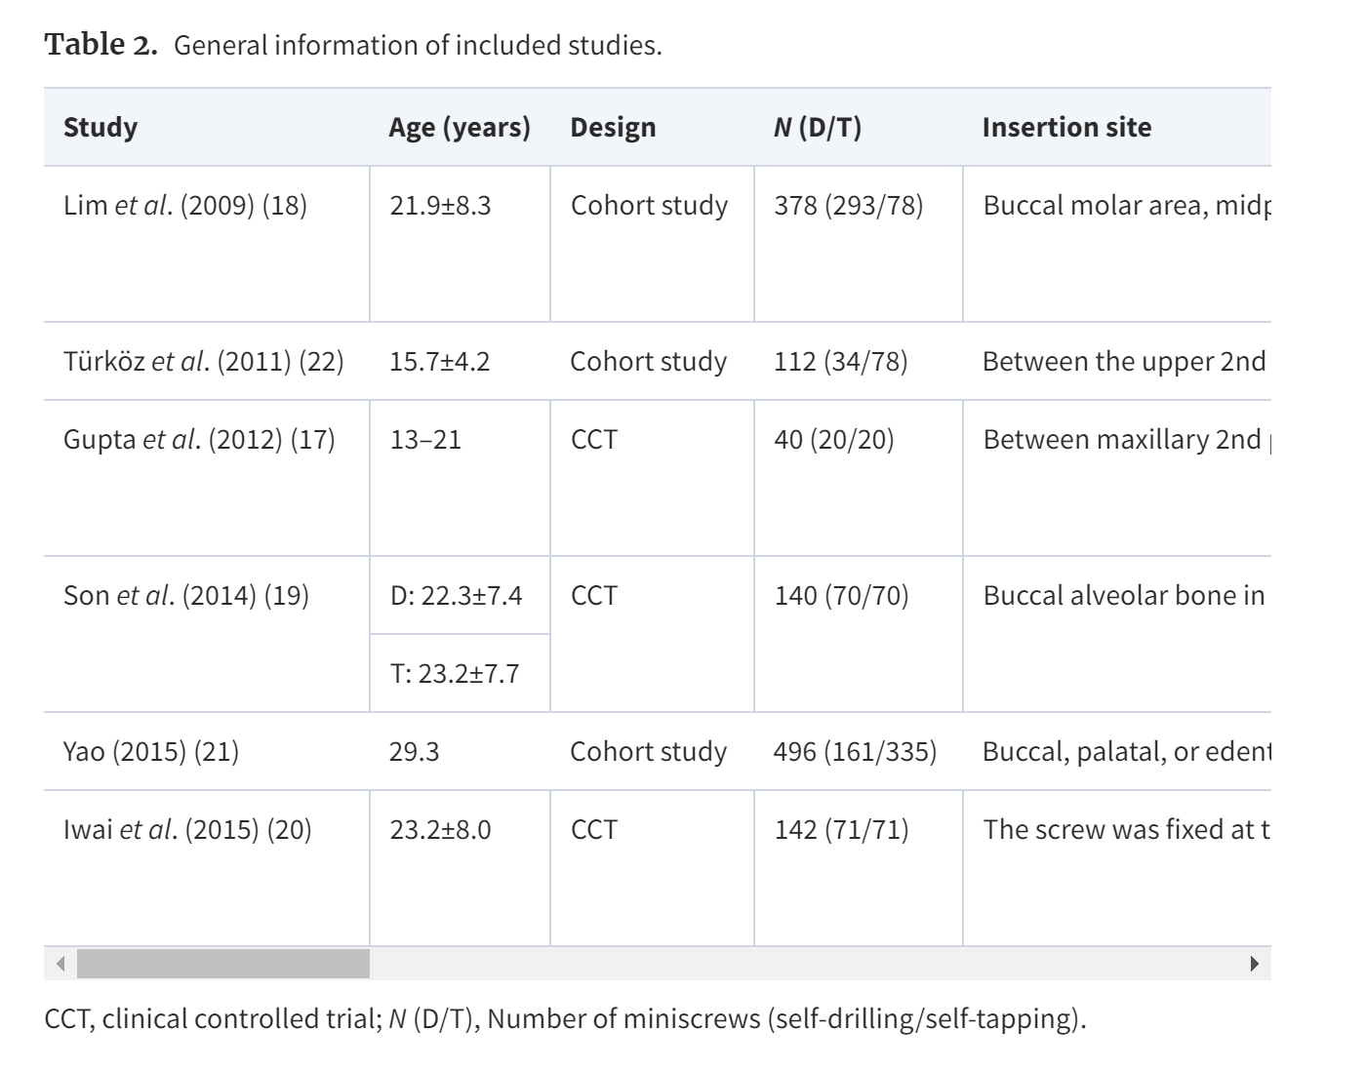
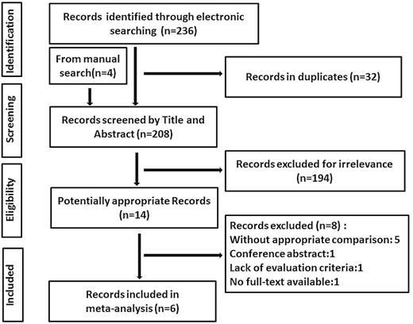
General information of included studies.
Flow diagram of the study inclusion of the systematic review and meta-analysis.

Slide 58
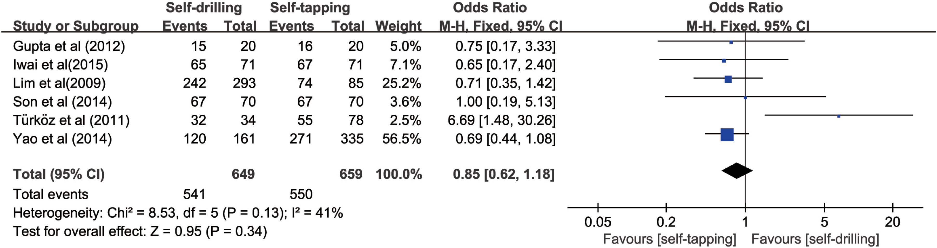
Six studies reported the success rates of self-drilling and self-tapping miniscrews as temporary anchorage auxiliaries for orthodontic treatment. The feasible data were pooled to investigate the overall success rates of two miniscrew system. The meta-analysis showed that the success rates did not differ between the two types of miniscrews (odds ratio (OR) 0.90, 95% confidence interval (CI) 0.52–1.53;)

Slide 59
Ease of Use.
For bone screws, ease of use has two components:
how easy or difficult it is to place the screw and how
easy it is to use the exposed screw head as an attachment for springs
or wires.
Profit,2017

Slide 60
(A) An alveolar bone screw used for direct anchorage usually serves as the attachment
point for a superelastic nickel–titanium (NiTi) spring, as in this use to retract protruding maxillary incisors.
(B) Alveolar bone screws also work well for indirect anchorage, when a rigid attachment from the screw
is used to prevent movement of anchor teeth, as in this patient in whom the maxillary posterior teeth are
being moved forward via a spring to the stabilized canine.
Profit,2017
Notes:
Factors in ease of screw placement include:
• Whether a pilot hole is needed. Self-drilling screws do not need
a pilot hole beyond the cortical plate and can penetrate the
cortical plate if it is thin.35 Screws of this type now have largely
replaced screws that require a pilot hole because they can be
used either way, with the decision being made at the time of
insertion. If the cortical plate is difficult to penetrate, a pilot hole
can decrease insertion torque and potential for screw fracture.
• Whether a tissue punch is needed. A tissue punch through the
gingiva is rarely needed unless a pilot hole is to be drilled but
frequently is needed in unattached tissue to keep gingival tissue
from wrapping around the screw thread.
• The ease or difficulty of turning the screw as it is inserted, while
keeping pressure on it. Once the screw threads engage, pressure
on it is no longer needed, but strong resistance to turning the
screw at that point reflects high insertion torque. This increases
primary stability, but it can lead to fracture of the screw, increased
microdamage to the bone, and decreased secondary stability.
Moderate insertion torque provides enough primary stability
without causing excessive bone compression and subsequent
remodeling. A driver made to fit around the head of the specific
screw type is needed for insertion, and some systems offer a
torque-controlled instrument for placement of their bone screws.
• The design of the area of the head to which a wire, spring, or
elastomeric will be attached. It is desirable to have an attachment
that locks this force delivery device in place. A slot in the head
that would allow insertion of a heavy wire would make it possible
to change the direction of force, but the resulting moment is
likely to twist or otherwise loosen the screw.
In summary, bone screws can be used readily as either direct
or indirect anchorage (Fig. 10.49). The desirable characteristics of
a bone screw TAD are listed in Box 10.2. This serves as a guide
in selecting the screw for a specific area and use, and suggests that
efficient practice requires having more than one type of bone screw
available.
Linked Screws in Palatal Anchorage. As we have noted previously,
the dense bone of the palate is an excellent place for bone
screws, with the greatest bone density found anteriorly and lateral
to the midline.36 Screws in the palate almost always are used in
pairs and often are linked together to stabilize a small plate that
has attachments to reach the dentition (Fig. 10.50). This linkage
of screws offers the same advantage of greater resistance to force
as two or more screws holding a miniplate. Linking palatal screws
differs from the miniplates discussed hereafter in that the linked
attachment usually does not offer the ability to change the direction
of force by adding an extension. With palatal anchorage, direct
anchorage usually is employed for intrusion of posterior teeth. For
repositioning teeth along the line of the arch (as in the maximum
retraction space closure shown here), indirect anchorage is the
usual choice.

Slide 61
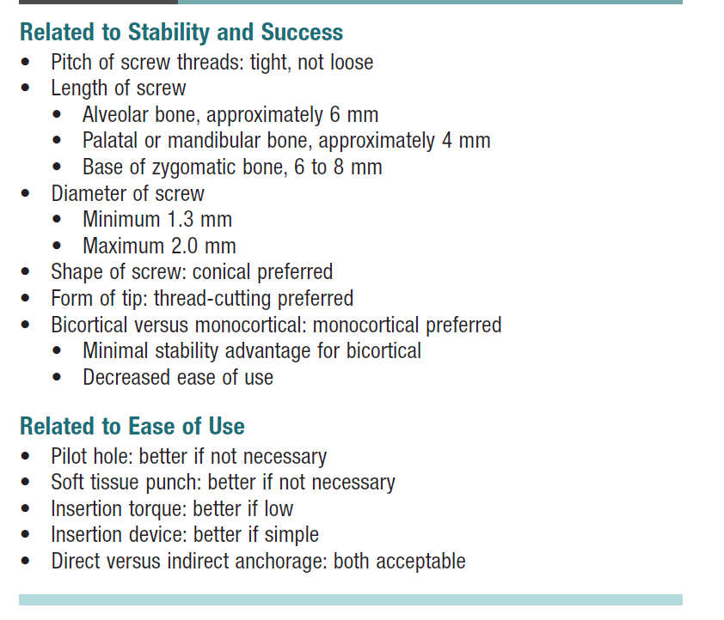
Design Factors for Bone Screws
Profit,2017

Slide 62
Linked Screws in Palatal Anchorage
Profit,2017
Screws in the palate usually are in pairs that are linked by
a plate or heavy wire, as shown here. The advantage over using a single
screw on each side is that neither screw can rotate when they are tied
together, but single screws can rotate, and this greatly increases the
chance that the screw will loosen and be lost
Notes:
Linked Screws in Palatal Anchorage. As we have noted previously,
the dense bone of the palate is an excellent place for bone
screws, with the greatest bone density found anteriorly and lateral
to the midline.36 Screws in the palate almost always are used in
pairs and often are linked together to stabilize a small plate that
has attachments to reach the dentition (Fig. 10.50). This linkage
of screws offers the same advantage of greater resistance to force
as two or more screws holding a miniplate. Linking palatal screws
differs from the miniplates discussed hereafter in that the linked
attachment usually does not offer the ability to change the direction
of force by adding an extension. With palatal anchorage, direct
anchorage usually is employed for intrusion of posterior teeth. For
repositioning teeth along the line of the arch (as in the maximum
retraction space closure shown here), indirect anchorage is the
usual choice.

Slide 63
Miniplates and bone secrew
(A) A miniplate placed at the base of the zygomatic arch requires creating a flap to expose
the bone and must be contoured so it fits closely to the bone surface. In this location it is above the roots
of the teeth and is ideally positioned as an anchor for mesiodistal movement of the maxillary teeth. (B) A
miniplate on the mandible to serve as an attachment for Class III elastics. Note that a segment of wire
has been used on one side to move the attachment point so that the elastic will not impinge on the
gingiva. Being able to move the attachment point is a major advantage of using miniplates rather than
single screws. (Courtesy Dr. H. DeClerck.)
Profit,2017
Notes:
Miniplates
Miniplates have two major components: the plate itself, which is
contoured to fit on the surface of the bone where it attached, and
a connector that penetrates into the mouth. Ideally, this is at the
junction of the fixed gingival tissue and alveolar mucosa, but the
location of the connector is not a critical variable. The connector
is designed so that superelastic NiTi springs (or less desirable
elastomerics) can be attached to it for direct anchorage, or wires
can be attached for indirect anchorage.
The most frequent location for miniplates as anchorage for
repositioning maxillary teeth vertically or sagittally is at the base
of the zygomatic arch (but the linked screws in the palate are used
even more often for the same purpose). Anchors in this area
combined with anchors on the anterior surface of the mandible
below the incisors (Fig. 10.51) also are used for Class III growth
modification (as discussed in Chapter 13).
For repositioning multiple mandibular teeth, either bone screws
or miniplates are most often placed on the buccal shelf of bone
below the lower molars (Fig. 10.52), although the anterior surface

Slide 64
A bone screw into the buccal shelf of bone below the mandibular molars provides excellent
anchorage for moving or stabilizing mandibular posterior teeth and is easier to use than the anterior
surface of the ramus.
Notes:
of the ramus is an alternate possibility. Miniplates designed for
this area are notched so that the vertical component of force
direction can be varied.
As with single bone screws, the key characteristics for miniplates
are stability and ease of use. The major determinants of
stability are:
• The number of screws with which the plate is attached, which
really is determined by the bone thickness and density in that
area. The success rate for plates of four designs placed by the
same clinician at the base of the zygomatic arch is shown in
Fig. 10.53. With these designs and with a straight-line plate
for that area, it appears that three screws provide more stability
than two, but nothing additional is gained with four screws.
For the palate, two linked screws usually are adequate.
• The age of the patient. As Table 10.5 shows, the number of
failures with miniplates at the base of the zygomatic arch or
on the anterior mandible in both North Carolina and Belgium
was much greater in young patients who had not yet entered
puberty. This determines when to use Class III elastics to
maxillary and mandibular miniplates (see Chapter 13): bone
maturity does not reach the level for good retention of the
screws before approximately age 11 (obviously, maturational
rather than chronologic age). The denser bone of the mandible
and palate is available at somewhat younger ages, but age still
is a limitation.
Because it is necessary to reflect a flap to place miniplates and
then suture the soft tissue incision, their surgical placement is
significantly more difficult than placement of screws. It is important
to contour the miniplates to fit closely against the bone of the
base of the zygoma and maintain bone contact at the point of
emergence to prevent excessive moments against the proximal
screw. As a general rule, orthodontists can place bone screws
into alveolar bone quite satisfactorily, but miniplates are better
done by those with more extensive surgical training. From the
surgeon’s perspective, this is a relatively short surgical procedure
that can be performed under local anesthesia without significant
complications.37
University of
North Carolina
(UNC)
Université de
Catholique de
Louvain (UCL)
Number of miniplates 59 141
Number of failures 4 (7%) 11 (8%)
Due to mobility 2 5
Soft tissue ulceration 0 4
Anchor breakage 1 2
Poor location 1 0
In growing patients 3 (75%) 8 (73%)
In adults 1 (25%) 3 (27%)
In mandible NA 6 (56%)
Adapted from Cornelis MA, Scheffler NR, Nyssen-Behets C, et al. Am J Orthod Dentofac
Orthop. 2008;133:8–14.
Miniplate Failure Rate TABLE
10.5

Slide 65
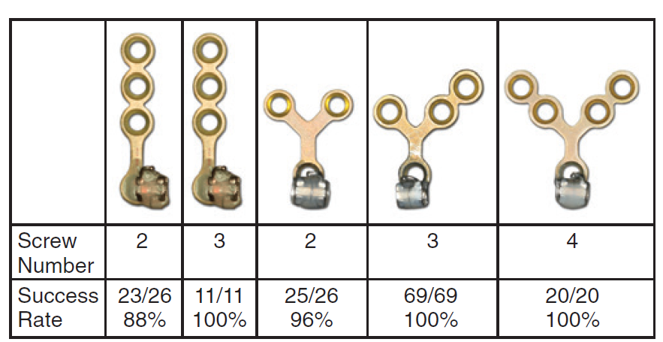
Success rates for plates of different designs and number of
screws placed at the base of the zygomatic arch by the same clinician.
Note that success rates were quite high in all these applications, but
failures were more likely with three screws than with two, and no better
with four screws than with three—so three screws are preferred.
Notes:
Once the plates are in place, however, they are well accepted
by patients and providers and are a safe and effective adjunct for
complex orthodontic treatment.38 They are as easy for the orthodontist
to use as alveolar TADs. Compared with individual alveolar
screws, miniplates have three major advantages:
• The amount of force that the miniplate can tolerate is significantly
larger because the plate is held by multiple screws and usually
is placed in an area with thicker cortical bone.
• If the miniplate connector has a locking mechanism (as it
should), the direction of pull can be changed readily and the
source of the force can be moved a considerable distance by
extending wire hooks from end of the connector (Fig. 10.54;
also see Fig. 10.51). With the vertical posts that are part of
the mandibular buccal shelf plate, the angle of force can be
changed just by using a higher or lower notch to tie the spring.
This also can be done with individual screws that have a slot
for a wire extension, but as we noted earlier, putting a force
on the extension introduces a moment that can overtighten
or loosen the screw, greatly increasing the chance of screw
failure. With multiple screws holding the miniplate, this is not
a problem.
• The miniplates can be placed well above the roots of the maxillary
teeth, so an interdental screw does not become a barrier to
moving all the teeth mesially or distally.
In comparing alveolar bone screws with miniplates (Table 10.6),
a reasonable conclusion is that individual screws are less invasive
and are indicated wherever they can provide adequate anchorage.
This is the case when a few teeth need to be repositioned. A long
screw at the base of the alveolar arch can be used if intrusion of
maxillary posterior teeth (which requires light force) is desired (see
Chapter 19), and shorter screws in the palate also can be used for
maxillary posterior intrusion. For more complex and extensive
movement of multiple teeth, with distalization of an entire dental
arch being the best example, miniplates offer better control and
are less likely to loosen or need to be replaced.

Slide 66
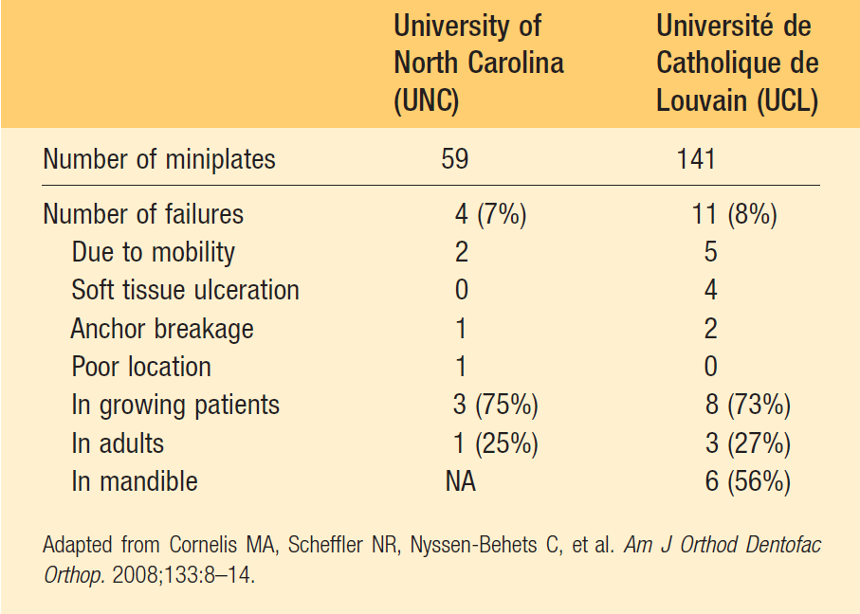
Miniplate Failure Rate
Profit,2017

Slide 67
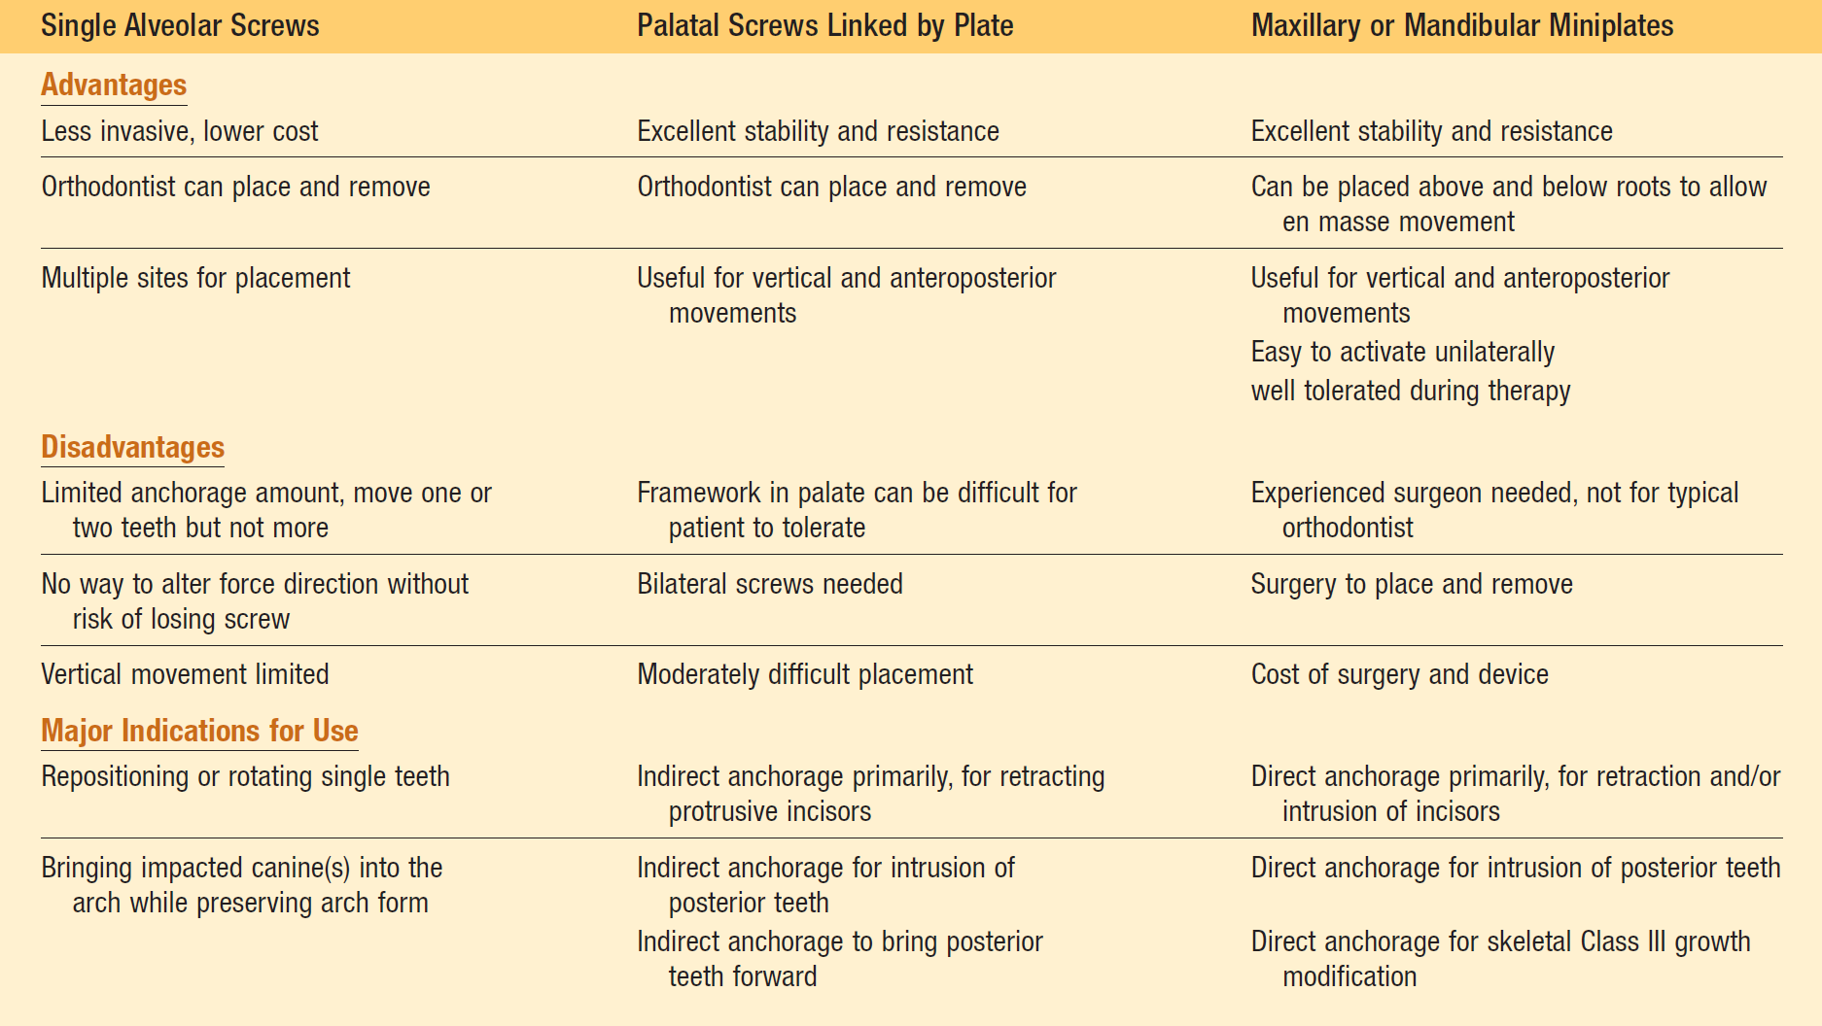
Bone Screws Versus Miniplates

Slide 68
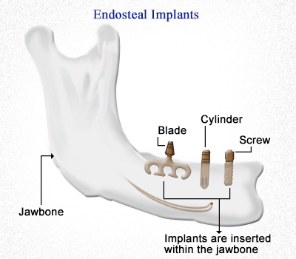
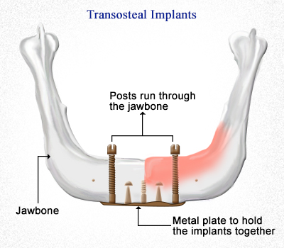
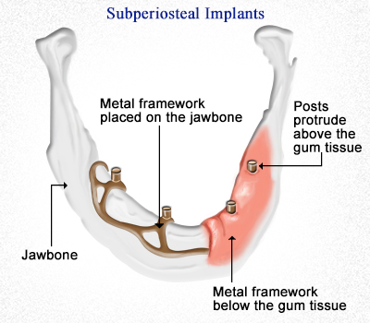
TADS
They can be located transosteally, subperiosteally, or endosteally
they can be fixed to bone either mechanically (cortically stabilized) or biochemically (osseointegrated).

Slide 69
Diameter and length
The diameter of the miniscrew will depend on the site and space available. In the maxilla, a narrower implant can be selected if it is to be placed between the roots. If stability depends on insertion into trabecular bone, a longer screw is needed, but if cortical bone will provide enough stability, a shorter screw can be chosen. The length of the transmucosal part of the neck should be selected after assessing the mucosal thickness of the implant site
(Dalstra etal,2004)

Slide 70
Possible insertion sites include
in the maxilla: the area below the nasal spine, the palate, the alveolar process, the infrazygomatic crest, and the retromolar area;
in the mandible: the alveolar process, the retromolar area, and the symphysis.
An intraoral radiograph is required to determine the correct location.
A small, ellipsoid template made of rectangular orthodontic wire can he attached to the teeth in the region with light-cured composite to facili-tate this evaluation.

Slide 71
position
Whenever possible, the mini-implant should be inserted through attached gingiva. If this is impossible, the screw can be buried be-neath the mucosa so that only a wire, a coil spring, or a ligature passes through the mucosa. In the maxilla, the insertion should be at an ob-lique angle, in an apical direction; in the mandi-ble, the screw should be inserted as parallel to the roots as possible if teeth are present. A transcortical screw can be used for added stabili-ty in edentulous areas, where trabecular bone is usually scarce. We do not use surgical guides “or special stents” for screw placement.
(Ailing etal,2003)

Slide 72
Implant Criteria
Implant materials
nontoxic and biocompatible, possess excellent mechanical properties, and provide resistance to stress, strain, and corrosion. Commonly used materials can be divided into three categories: biotolerant (stainless steel, chromium–cobalt alloy), bioinert (titanium, carbon), and bioactive (hydroxyapatite, ceramic oxidized aluminum). Because of titanium's characteristics (no allergic and immunologic reactions and no neoplasm formation), it is considered an ideal material and is widely used.
Bone grows along the titanium oxide surface, which is formed after contact with air or tissue fluid. However, pure titanium has less fatigue strength than titanium alloys. A titanium alloy—titanium-6 aluminum-4 vanadium—is used to overcome this disadvantage.

Slide 73
Implant sizes
Implant fixtures must achieve primary stability and withstand mechanical forces. The maximum load is proportional to the total bone–implant contact surface. Factors that determine the contact area are length, diameter, shape, and surface design (rough vs. smooth surface, thread configuration). The ideal fixture size for orthodontic anchorage remains to be determined. Various sizes of implants, from “mini implants” (6 mm long, 1.2 mm in diameter) to standard dental implants (6–15 mm long, 3–5 mm in diameter), have proved to effectively improve anchorage. Therefore, the dimension of implants should be congruent with the bone available at the surgical site and the treatment plan.

Slide 74
Mini-implant problems
Screw-related problems
A screw can fracture if it is too narrow or the neck area is not strong enough to withstand the stress of removal. The solution is to choose a conical screw with a solid neck and a diameter appropriate to the quality of bone.
Infection can develop around the screw if the transmucosal portion is not entirely smooth. If a screw system with variable neck lengths is used, the clinician can select one that suits the particu-lar implant site.

Slide 75

Operator-related problems
Application of excessive pressure during inser-tion of a self-drilling screw can fracture the tip of the screw.
Overtightening a screw can cause it to loosen. It is crucial to stop turning the screw as soon as the smooth part of the neck has reached the periosteum.
With a bracket-like screw head, the ligature should be placed on top of the screw in the slot perpendicular to the wire. Turning the ligature around the screw will make it impossible for the patient to keep the area free of inflamma-tion.
It is important not to wiggle the screwdriver when removing it from the screw head. The screwdriver will not stick if the long extension is removed before the part surrounding the screw.

Slide 76
Patient-related problems
The prognosis for primary stability of a mini-implant is poor in cases where the cortex is thin-ner than 0.5 mm and the density of the trabecular bone is low.
In patients with thick mucosa, the distance between the point of force application and the center of resistance of the screw will be greater than usual, thus generating a large moment when a force is applied.
Loosening can occur, even after primary sta-bility has been achieved, if a screw is inserted in an area with considerable hone remodeling because of either the resorption of a deciduous tooth or post-extraction healing.
Mini-implants arc contraindicated in patients with systemic alterations fit the bone metabolism due to disease, medication, or heavy smoking.

Slide 77
Implant maintenance
After surgery, the surrounding soft tissues must be maintained to ensure longevity of the implant. Plaque accumulation near the gingival margin can cause perimucositis. Prolonged inflammation leads to breakdown of bone around implants and peri-implantitis; this, without proper management, can lead to implant failure. Therefore, patients must be instructed to follow daily plaque control at home and have periodic professional care, similar to regular periodontal maintenance.

Slide 78
What factors should be considered when selecting a mini implant system in orthodontics?
The screw must be machined, not casted, to prevent breakage during insertion,
Made of untreated titanium alloy. Regular treated mini implants should be avoided as they osseo-integrate with the bone.
Self drilling head to eliminate the need of a pilot hole.
Tapered mini implants are preferred over cylindrical shape as they have better primary stability (REF).
Double thread screw system where the implant body will meet the cortical bone for maximum engagement. This is very important for better initial stability.
A temporary lock mechanism in the implant handle to hold the implant securely in place during application.
Available in different sizes to accommodate different clinical needs.
At least 1.2 mm in width (REF)

Slide 79
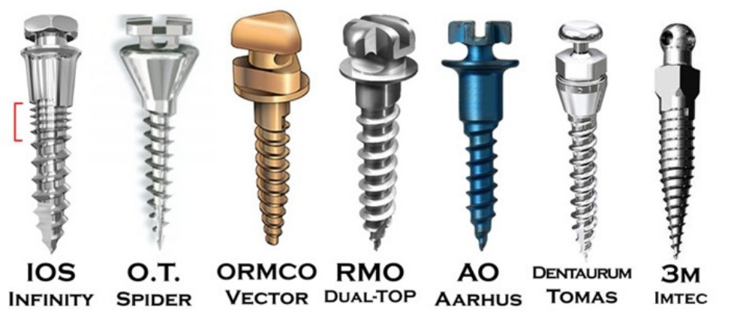
IOS sells the Infinity mini implant is 3 different sizes:
1.5 mm width with 8.5 mm length (IOS 20-100), best used for the maxilla in the buccal
1.3 mm width with 7.5 mm length (IOS 20-101), best used for the mandible and tight spaces
1.5 mm width with 11 mm length (IOS 20-131), for the palatal and ramus area

Slide 80
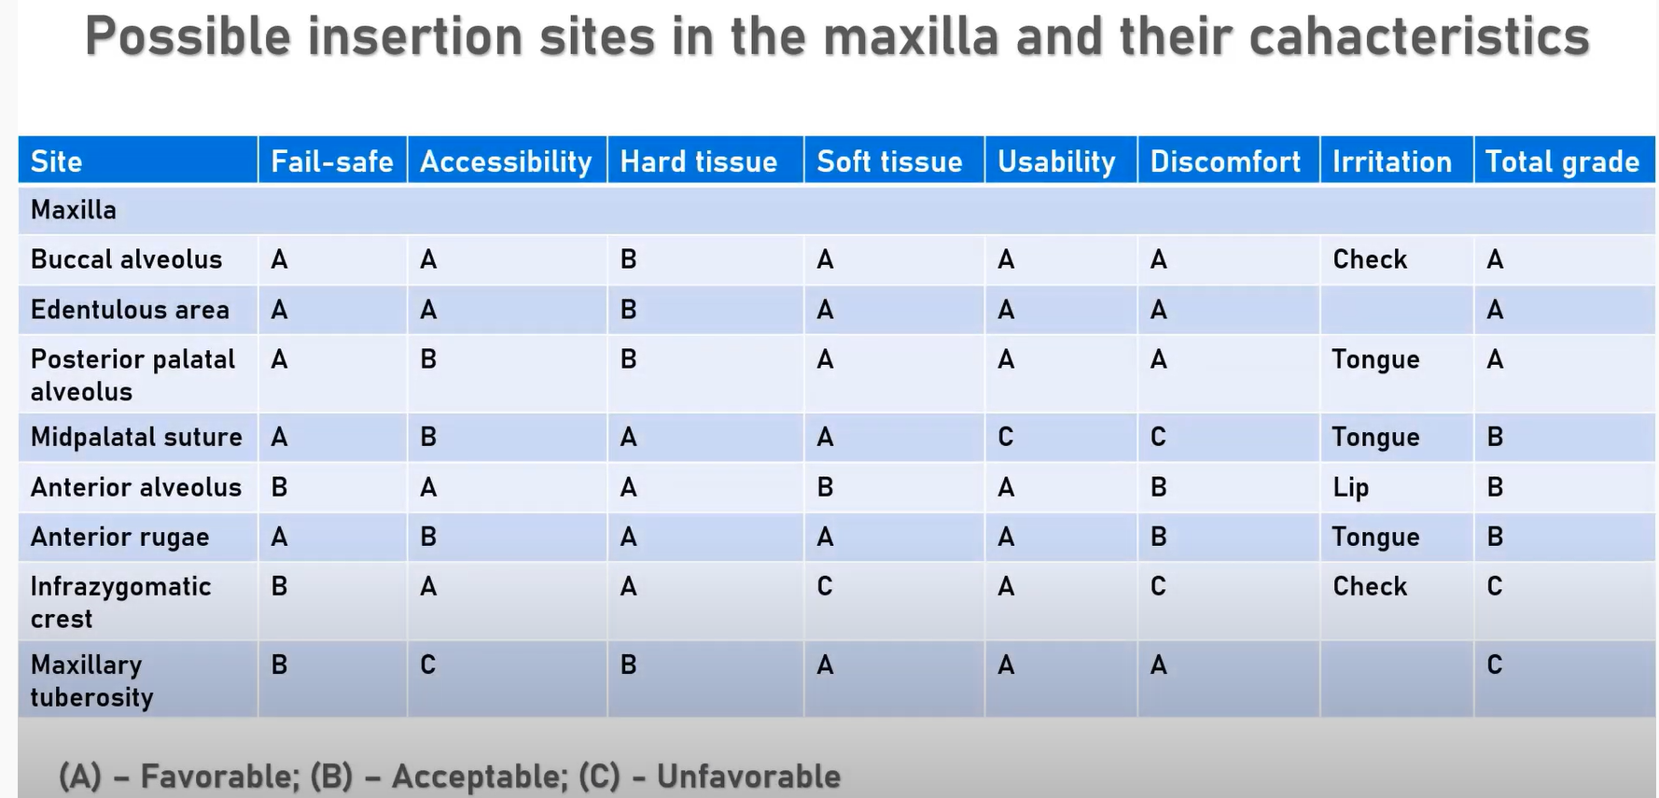
Ahmed etal.2020

Slide 81
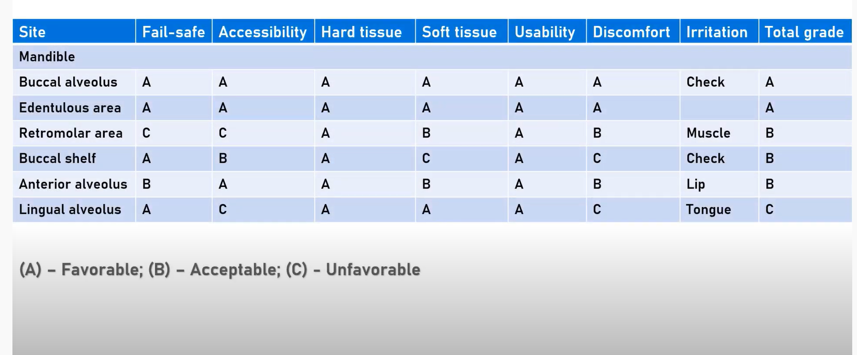
Ahmed etal ,2020

Slide 82
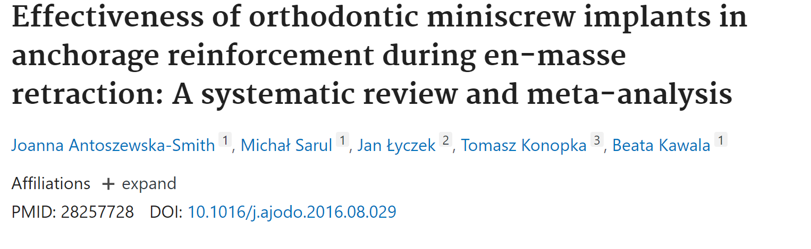
Conclusions: The results of the meta-analysis showed that TISADs are more effective than conventional methods of anchorage reinforcement. The average difference of 2 mm seems not only statistically but also clinically significant. However, the results should be interpreted with caution because of the moderate quality of the included studies. More high-quality studies on this issue are necessary to enable drawing more reliable conclusions.

Slide 83
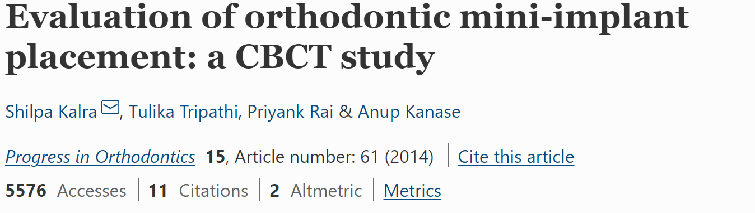
Conclusions
Although CBCT provides an accurate three-dimensional visualization of the interradicular space, the two-dimensional intraoral radiograph of the interradicular area provides sufficient information for mini-implant placement. Considering the amount of radiation exposure and cost with the two techniques, it is recommended to use two-dimensional radiographs with a surgical guide for a routine mini-implant placement.

Slide 84
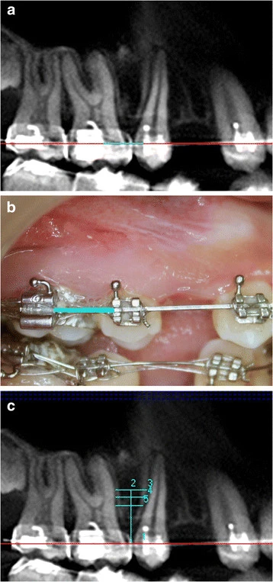
Orthodontic arch wire in second premolar and first molar region taken as standard reference for measurements. (a) Panorex View of CBCT image, (b) correlated clinically, and (c) various heights from the arch wire within the limits of mucogingival junction selected for bone measurements.
Kalra,2014

Slide 85
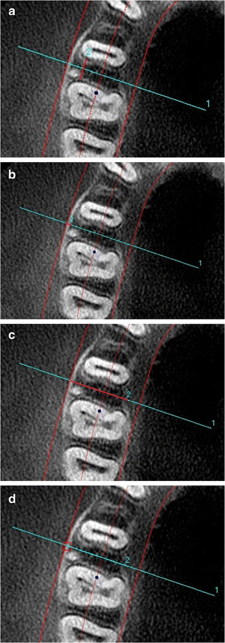
Bone measurements. (a) Mesiodistal distance, (b) buccal cortical bone thickness, (c) buccolingual thickness, and (d) bone density.
Kalra,2014

Slide 86
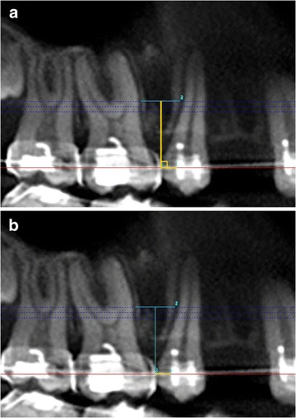
Determination of the point of entry of mini-implant by using CBCT data. (a) A perpendicular is dropped from ideal point of insertion of mini-implant to the arch wire. (b) Distance of point of intersection of perpendicular on the arch wire to distal end of second premolar bracket.
Kalra,2014

Slide 87
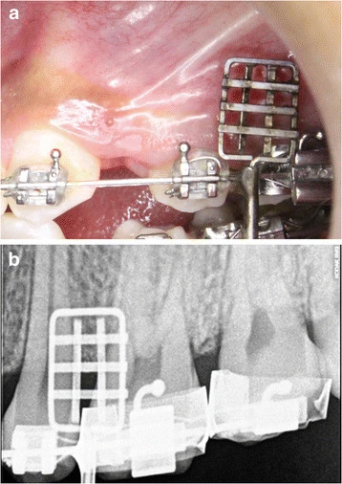
Custom made guide in second premolar and the first molar region. As seen (a) clinically and (b) radiographically.
Kalra,2014

Slide 88
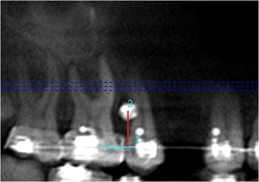
Kalra,2014
Height of mini-implant from arch wire.

Slide 89
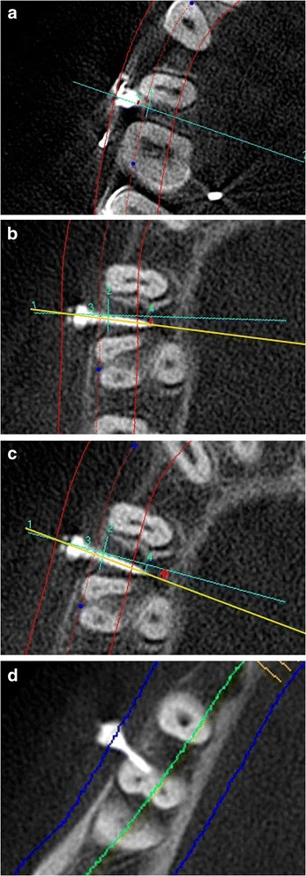
The post insertion measurements. (a) Deviation of the point of entry of the mini-implant (DMEP). (b) Deviation of the tip of mini-implant (DMT). (c) Angular deviation of path of mini-implant (DMA). (d) Root proximity to the mini-implant.
Kalra,2014

Slide 90
Conclusions
The following can be concluded from this study.
Although CBCT provides accurate three-dimensional visualization of the interradicular space, two-dimensional intraoral radiographs seem to provide sufficient information for mini-implant placement.
It is recommended for clinicians to use two-dimensional radiographs with surgical guide for routine mini-implant placement.
Considering the high cost and higher radiation dose as compared to two-dimensional radiographs, the routine use of CBCT is not recommended for orthodontic mini-implant placement. However, if mini-implant placement is difficult because of complex anatomy such as an expanded sinus or alveolar bone loss, the use of CBCT data for planning may be considered.
Kalra,2014

Slide 91
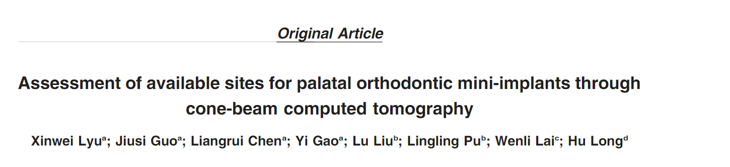
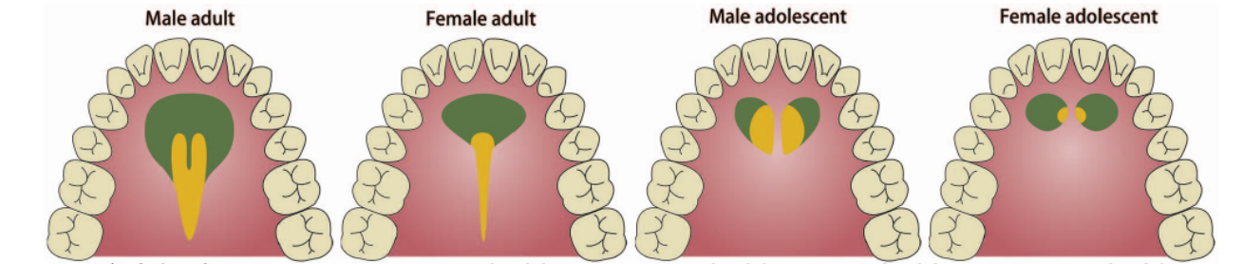
Angle Orthodontist, Vol 90, No 4, 2020
The green regions are recommended for the placement of palatal mini-implants where the thickness of palatal hard tissue was greaterthan 4.5 mm. The yellow regions are the optimal sites for palatal mini-implants, where the thickness of palatal hard tissue was greater than 4.5 mmand the thickness of soft tissue was less than 2 mm. For adolescents, midpalatal areas should be avoided for the insertion of mini-implants.

Slide 92
CONCLUSIONS
In conclusion, palatal thickness decreased from anterior to posterior and from median to lateral in aV-pattern. Palatal thickness was influenced by sex, age, and their interaction. A mapping of recommend-ed and optimal regions for palatal mini-implants is suggested for clinicians

Slide 93


Slide 94
Indications
1. Correction of deep bite
2. Extraction space closure
3. Canted occlusal planes and dental midline correction
4. Impacted canines alignment
5. Up-righting and extrusion of impacted molars
6. Intrusion of molars
7. Maxillary molar distalization and distalization of
mandibular teeth
8. Molar mesialization
9. En masse retraction of anterior teeth
10. Correction of vertical skeletal discrepancies
Ahmed etal,2007

Slide 95
failure
●● Primary failure occurs when a mini‐implant is clinically
mobile at the time of insertion. This is due to inadequate
cortical bone support in terms of its thickness and density,
or close mini‐implant proximity to an adjacent tooth
root or incorrect insertion technique. These factors will
be fully discussed in the relevant sections.
●● Secondary failure refers to a situation where the miniimplant
is initially stable but then exhibits mobility, usually
after 1–2 months. This delayed instability is due to
bone necrosis around the mini‐implant threads, which
may result from thermal bone damage (during pilot drilling),
excessive insertion torque, excessively close proximity
to a tooth root, traction overload, or a combination of these.
Most mini‐implant failures become clinically evident
within the first few months of insertion, enabling
early replacement.
Cousley,2019

Slide 96
Perforationof Nasaland Maxillary Sinus Floors
Motoyoshi et al,2020
Notes:
Concerns have been raised in the literature that mini‐implant
perforation of the nasomaxillary cavities (Figure 1.3) may
result in either infection or the creation of a fistula.
However, the consensus based on dental implant research
is that a soft tissue lining rapidly forms over the end of a
perforating fixture, and that mini‐implant sites heal by
bone infill because of the narrow width of the explantation
hole.

Slide 97
fracture
Cousley,2019
Intraoral radiographs taken after (a) insertion of a cylindrically shaped mini-implant mesial to the maxillary first molar,
and (b) its fracture near the coronal end of the body. The initial fracture line is visible in the intact mini-implant. (c) Sectional
orthpantomograph (OPG) showing the (asymptomatic) retained mini-implant body over five years later.
Notes:
If a miniimplant
fractures on removal, flush with the bone surface,
and the retained part is unlikely to impede any remaining
tooth movements, then it may be left in situ because of the
biocompatibility of titanium alloy (Figure 1.4c). In the rare
event that removal of a fractured part is indicated then this
involves creating access by raising a small mucoperiosteal
flap, trephination of a narrow collar of bone around the
mini‐implant end, and then derotation of the fractured
fragment using a Weingarts or mosquitos‐like instrument

Slide 98
(a) Hyperplasia of the palatal mucosa covering an overinserted mini-implant in the palatal alveolar site between the left
molars. (b) Normal tissue appearance after simple excision of the hyperplastic tissue and replacement of this mini-implant. Minor
peri-implant hyperplasia is seen on the right side.
Cousley,2019

Slide 99
The Infinitas design has a unique, multipurpose
head which combines cross‐slots with both external
and internal undercuts, all on one vertical level
Infinitas
Diagram of the Infinitas mini-implant head showing
its four bracket-like wings, divided by perpendicular cross-slots,
and the external and internal undercuts. A rectangular wire is
illustrated within the transverse cross-slot.
Notes:
The
Infinitas™ Mini-implant System
It may be a bewildering task for orthodontists to select
a mini‐implant kit since a great variety of systems are
now available worldwide. These differ from one another
in terms of their:
●● physical design features
●● technique steps (e.g. self‐tapping or self‐drilling)
●● ease of insertion and use (e.g. how traction auxiliaries or
wires are attached)
●● guidance stent feasibility
●● versatility
●● size and complexity of the kit
●● recommended clinical applications (e.g. direct or indirect
anchorage)
●● clinical instruction material.
It is unlikely that one system provides dramatically better
mini‐implant stability rates than all of the others and key
principles are widely applicable. However, since the treatments
and illustrations in this book mainly involve use of
the Infinitas mini‐implant system (DB Orthodontics Ltd,
UK, www.infinitas‐miniimplant.com), it is worth describing
both its generic and distinctive features for clarity and
reference purposes. The Infinitas mini‐implant is unique in
several aspects, especially in its head design and customised
three‐dimensional (3D) guidance stent facility [33]. This
chapter describes the key design and clinical features of the
Infinitas system’s dual clinical and guidance kits.

Slide 100
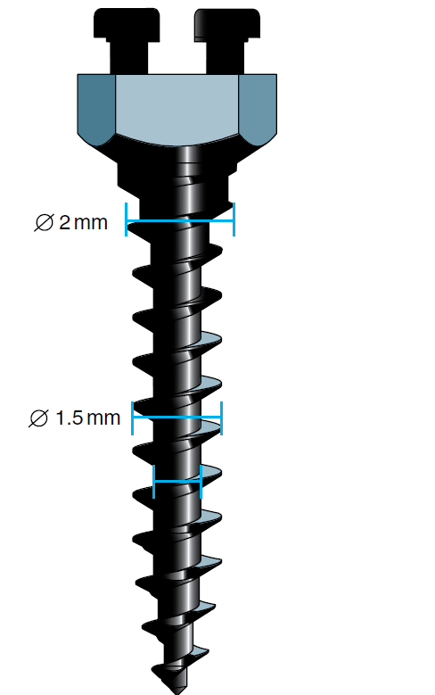
Diagram showing how the body’s coronal section
tapers out from a 1.5 to 2.0 mm thread diameter
This tapered body design provides a 2 mm diameter
superficially where it is most beneficial for strength
and stability, but avoids root proximity problems.

Slide 101
Diagram of the Infinitas cortical bone punch
traversing the mucosa and inserting into a thick cortical layer.
This tapered

Slide 102
Diagram of a (green) computer-generated
guidance stent, with twin midpalatal cylinders, superimposed on
a (red) digital model of the maxillary arch.
Notes:
Digital
Stent Fabrication Processes
The manual stent process, described above, has worked
well in the last 10 years, but it does involve the process of
mentally merging the topographical (model surface) and
2D radiographic information. In the coming years, this
process will be superseded by the introduction of digital
model technology. For example, it is now possible to produce
stents for palatal and alveolar insertion sites using
digital CAD‐CAM software (Figures 3.11 and 3.12). This
enables orthodontists already using virtual orthodontic
models to produce a physical stent, using a 3D printed
model and the (manual) Infinitas guidance kit. However,
whilst digital models provide accurate (tooth and soft
tissue)
topographical information, they can only offer
hints of the underlying root positions. They cannot give us
a direct view of what lies below the surface – the skeletal
(e.g. cortex and cancellous bone depth and distance to
adjacent structures) and dental anatomy in the sites where
the mini‐implant body will be positioned. These require
the additional input of CBCT data for comprehensive 3D
planning.
It is becoming feasible to accurately plan mini‐implant
positions in 3D by merging digital models and CBCT data
together [51]. This will unite their topographical and bone/
root

Slide 103
‘Appliance Designer’ software (www.3shape.com/
en/software/ortho-system). The baseplate, shown in light blue,
was sculpted on the digital model of the maxillary dentition.
The guidance cylinder (dark blue) was added and orientated in
3D prior to 3D printing a plastic stent in a biocompatible
material. The resultant mini-implant position is shown in
(c) immediately after insertion using the stent.

Slide 104
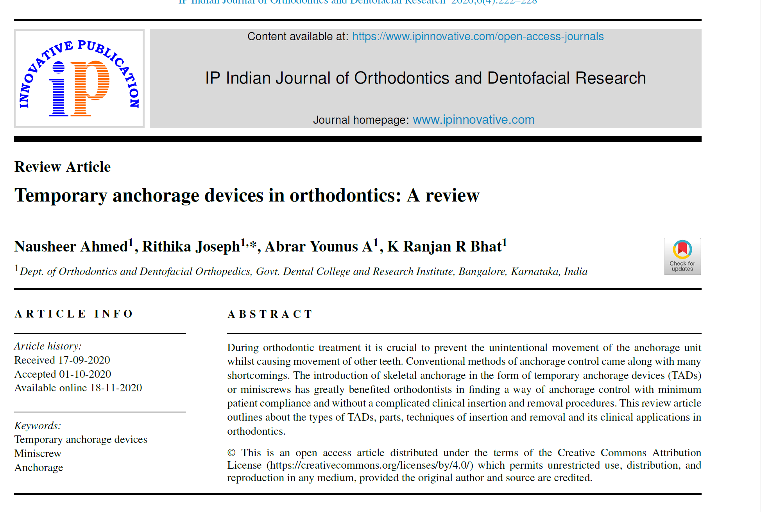

Slide 105
Conclusion
Temporary Anchorage Device is a strong aid for the
orthodontist in resolving many challenges faced during
tooth movement. Despite the limitations like root injuries,
peri-implantitis and implant failure, the advantages of easier
insertion and removal technique, immediate loading and
absolute anchorage gives TADs a very important place
in orthodontics. A thorough knowledge about the factors
affecting the success of mini implants will benefit in
achieving desired treatment results with minimal patient
chair-side time.

Slide 106

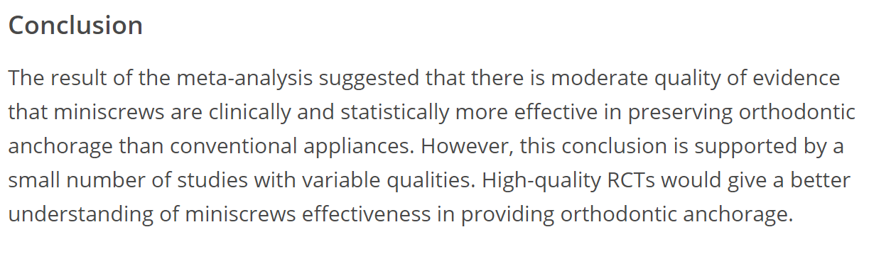

Slide 107


Slide 108

Bone density in maxilla and mandible according to Misch. D1 is primarily found in the anterior mandible, buccal shelf and midpalatal region, D2 primarily in the anterior maxilla, the midpalatal region and the posterior mandible, D3 in the posterior maxilla and mandible, and D4 is found primarily in the tuberosity region.

Slide 109
Regions of D1–D3 bone have been found to be adequate for temporary anchorage device (TAD) insertion. TADs placed in D1 and D2 bone exhibit lower stress at the screw-bone interface and may provide greater stationary anchorage during loading. Placement in D4 bone is not recommended owing to the high failure rate associated with it (35–50 percent)

Slide 110
Misch CE (1993) categorized
Based on clinical hardness of bone as perceived during drilling prior to implant placement Misch CE (1993) categorized the bone density into four groups.
Drilling and placing implants in D1 has the tactile analogue of oak بلوطor maple wood.
D2 bone is similar to the tactile sensation of drilling intoصنوبر spruce or white pine wood.
Drilling into D3 bone has the tactile analogue ofلبلسا اbalsa wood.
D4 bone is similar to drilling into styro foam.

Slide 111
Conclusion
1.
Knowledge of low density sites prior to implant placement allows clinician to use longer implant in these areas to improve retention.
2.
In areas of high bone density, use of pre-drilling method avoids the breakage of implant. Sufficient irrigation should be done to prevent overheating of bone in that area.
3.
Immediate loading of mini-implants is possible because of higher bone density in all the areas of cortical bone.
4.
In areas of low bone density, it is necessary to augment the anchorage as per requirement.

Slide 112


Slide 113


