Slide 1


Bracket positioning in different preadjusted systems
Training course
2nd part
Lect. Noor Falah Kadhim Al Khawaja

Slide 2
PREADJUSTED APPLIANCES
SWA
Larry Andrew straight wire appliance 1972
ROTH
Ronald Roth
DAMON
Dwight Damon
Mclaughlin, Bennett,and Trevisi1997
MBT

Slide 3
BRACKET SELECTION
ARCH WIRE SELECTION
FORCE LEVEL
Orthodontic treatment mechanics
BRACKET POSITIONING

Slide 4
Build Treatment into Bracket Placement
Rationale for the designs of specific bracketsو These brackets can be used to position the teeth in ideal locations in terms of both esthetics and stability, but only if they are placed
correctly on the teeth.
For proper bracket positioning
Height
Mesiodistal position
Angulation
When placing brackets it is important to view the teeth from the
correct aspect.

Slide 5
SWA
STRAIGHT WIRE APPLIANCE
The Andrews straight wire technique was introduced in the 1970s, consisting of one of the main innovations in orthodontics. This technique is based on the use of preadjusted brackets and treatment with minor need for bending the archwires. However, thorough bracket positioning is fundamental to transmit the prescribed angulation, inclination, rotation, and in–out for ideal teeth positioning.

Slide 6
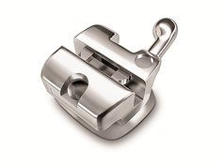
SWA
STRAIGHT WIRE APPLIANCE
Brackets are rectangular and the angulation prescribed for each tooth is built into the slot angulation. Therefore, these accessories have an angled slot in relation to their upper and lower edge base.
As for positioning, the author proposed that the long axis of the clinical crown (LACC) should be used as reference. The bracket must be positioned in the center of the clinical crown, the LACC midpoint,
axial adjustment, the mesial and distal bracket edges must be positioned parallel to the LACC.1 Following these references,

Slide 7
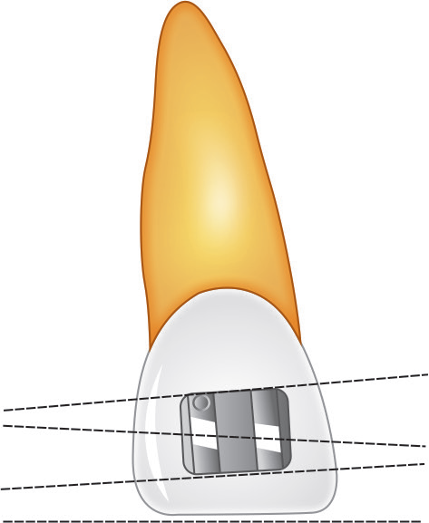
SWA
STRAIGHT WIRE APPLIANCE
several horizontal lines are projected to different directions, corresponding to slot, incisal edge (IE), and bracket upper and lower edges. The divergence between these lines may cause visual confusion, impairing accurate positioning of the accessories
Andrews brackets. Divergent horizontal lines

Slide 8
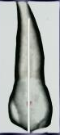
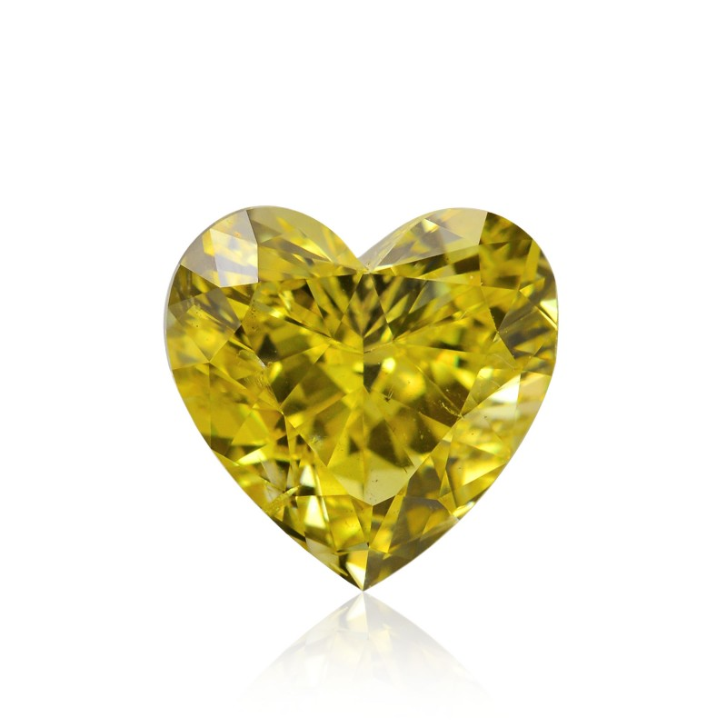
ROTH
The bracket placement vary slightly from the position advocated by Andrews, thus a flat, unbent, rectangular, full sized wire can be used as the finishing wire rather than one with reverse and compensating curve.
Reference point – Andrews FA point
The point on the facial axis that separates the gingival half of the clinical crown from the occlusal half.
The key in determining the bracket height is the canine and premolars (second premolars is an extraction case).
Ideally the center of the bracket should be placed at the maximum convexity of the crowns of the posterior teeth.
teeth with average height of gingival attachment, the maximum convexity of the teeth will be at the center of the clinical crown.

Slide 9
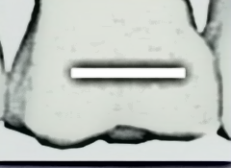
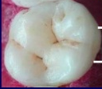
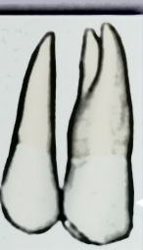
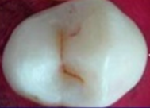
ROTH
Molars(upper/lower) MB Both the right and left bands should be checked to ensure that they are in the same relative position on the crowns
Premolars(upper/lower) Upper premolar bracket placement is the most variable because of tooth size. The most common error is not placing the bracket gingival enough, especially on smaller sized teeth.

Slide 10
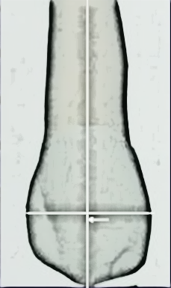
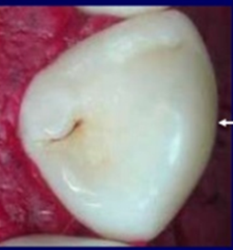
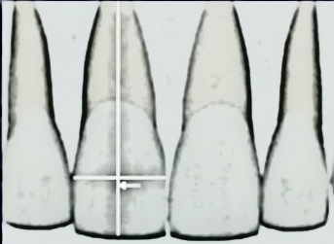
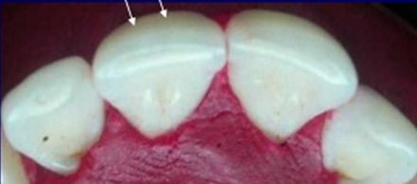
ROTH
Upper and lower Canine
Upper and lower incisors

Slide 11
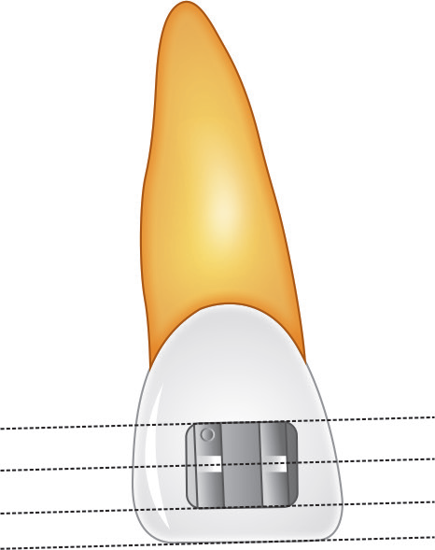
MBT
The MBT system proposes the use of rhomboidal or trapezoidal shaped brackets. In these brackets, the indicated angulation for each tooth is built in the angle formed between the lateral edges and the upper and lower edges. Thus, the slot is parallel to the upper and lower edges.
MBT brackets. Parallel horizontal lines

Slide 12
MBT
IE should be used as reference for bracket positioning in incisors. The bracket must be positioned in the centre of the LACC and the slot must be positioned parallel to the IE for axial adjustment.
Consequently, when brackets are placed in the vestibular faces of the incisors, the projected horizontal lines exhibit parallelism, which creates greater visual comfort for the operator, facilitating the bracket positioning stage
MBT brackets. Parallel horizontal lines

Slide 13
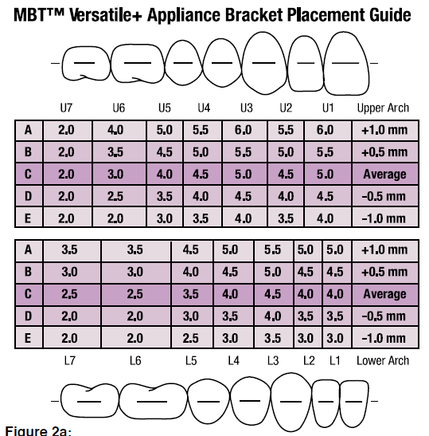
MBT
Using bracket positionig chart

Slide 14
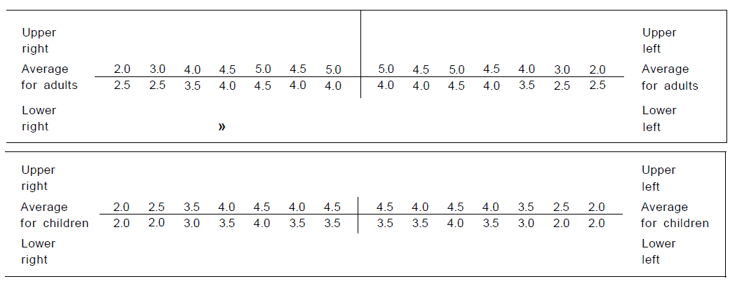
Individualized bracket-positioning chart - before completion. It is helpful to have an adult and a child version available.

Slide 15
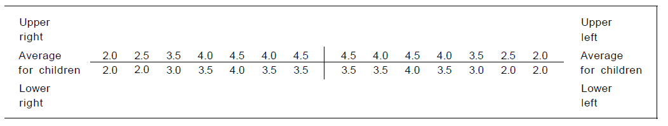
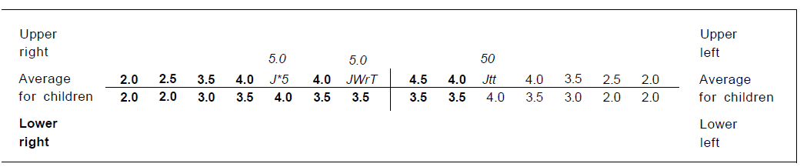
It is helpful in some cases to place upper canine and upper right CI brackets 0.5 mm more gingivally, especially in cases with pointed teeth

Slide 16
Chart individualization in deep-bite and open-bite cases
Can be helpful to place the incisor and canine brackets 5 mm more occlusally in deep-bite cases.
While In open-bite cases, they should be 0.5 mm more gingival.

Slide 17
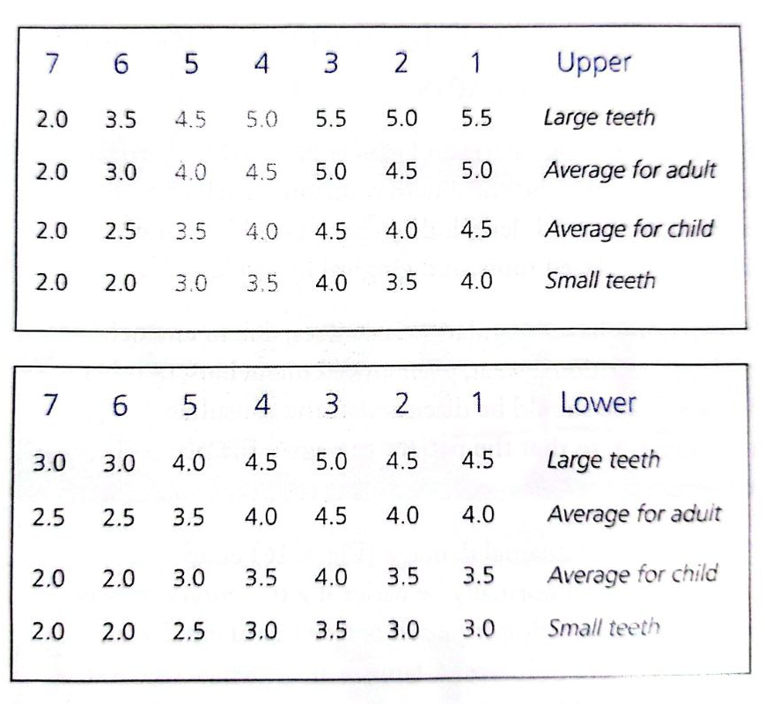
Chart for non- extraction cases

Slide 18
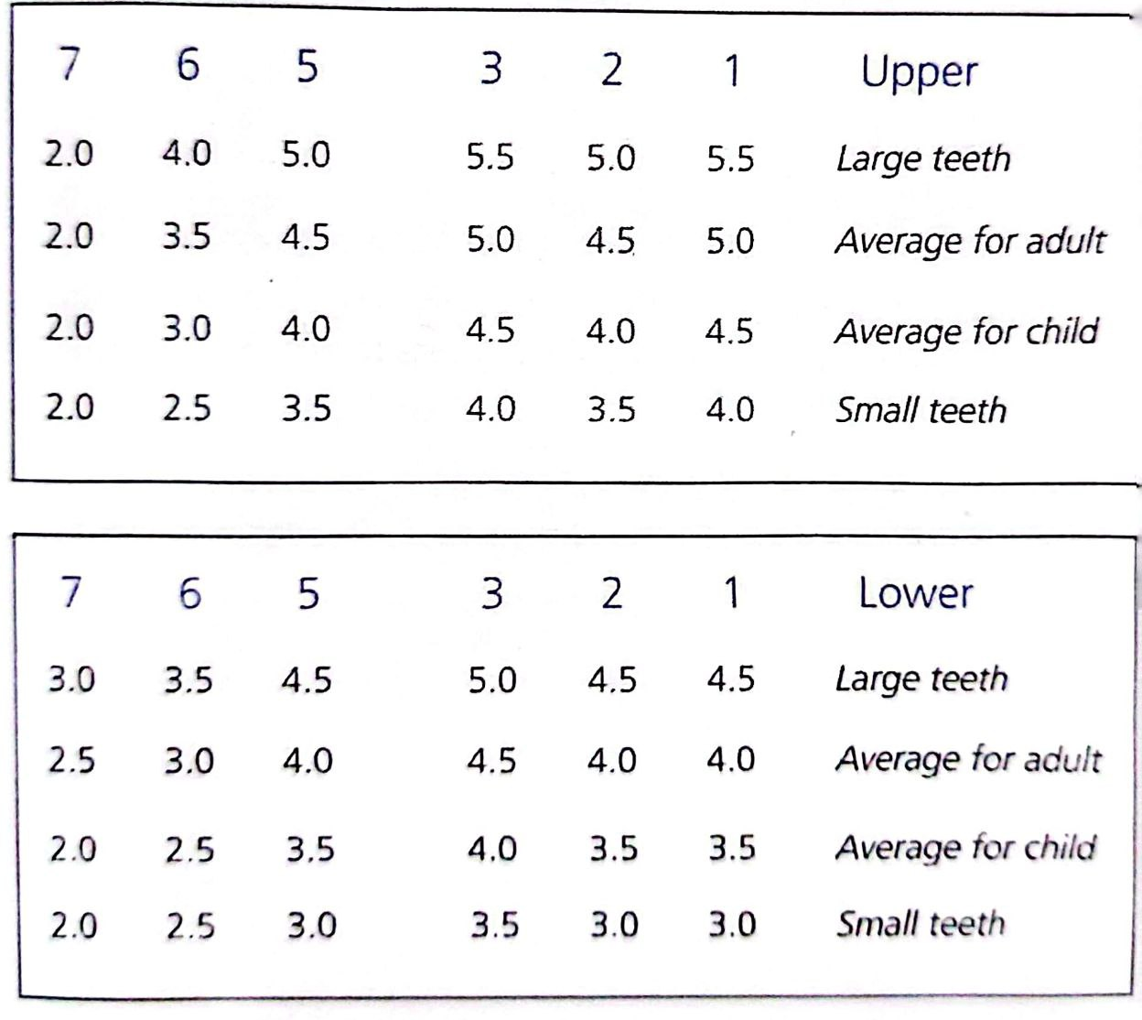
Chart for
1st PM extraction cases

Slide 19
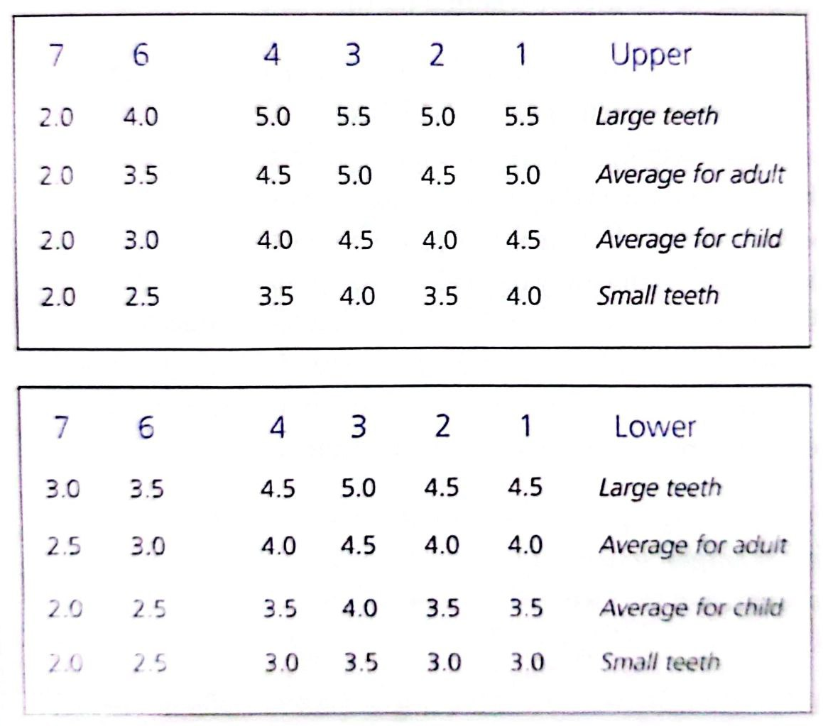
Chart for
2nd PM extraction cases

Slide 20
MBT
Using bracket positionig Gauges
Vertical accuracy can be greatly improved by the use of gauges and a bracket positioning chart .
This will deal with difficulties such as tooth length discrepancies, labially and lingually displaced roots, partly erupted teeth, and gingival hyperplasia.

Slide 21
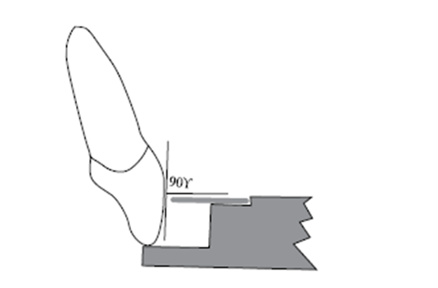
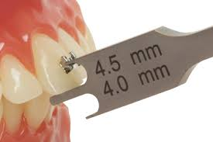
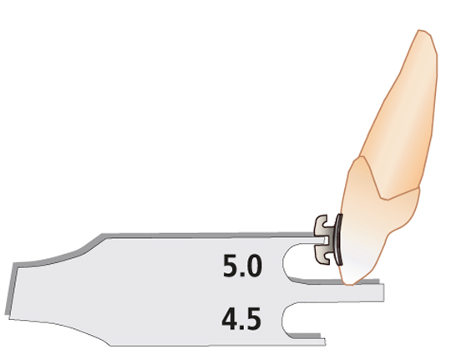
MBT
In the incisor region, the gauge is placed at 90° to the labial surface.

Slide 22
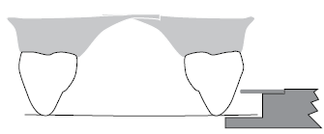
MBT
In the canine and premolar regions the gauge is placed parallel with the occlusal plane.

Slide 23
MBT
In the molar region the gauge is placed parallel with the occlusal surface of each individual molar.

Slide 24
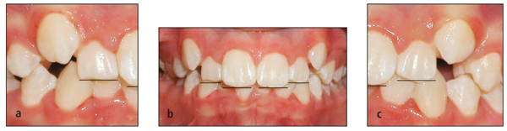
MBT
the incisal edges of the anterior teeth are examined for fractures, signs of excessive wear, and mamelon ridges. If the removal of these defects is part of the treatment plan, it is usually preferable to place the bracket more gingivally.

Slide 25
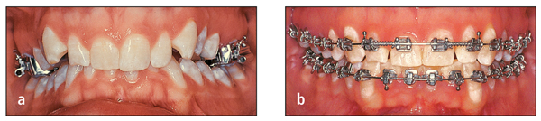
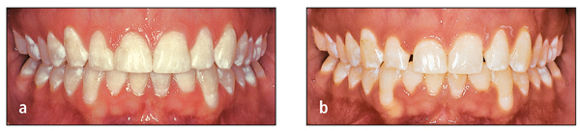
MBT
gingival crest is another important consideration. If one incisor is extruded significantly to obtain alignment of the incisal edges, the gingival contours may become imbalanced. The treatment plan should recommend restoration by a periodontist and/or restorative dentist

Slide 26
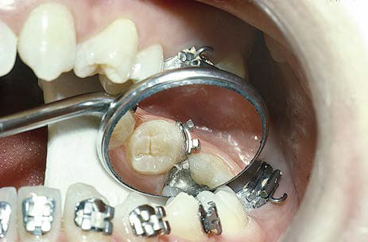
Bracket position on difficult teeth may be
checked with a mouth mirror

Slide 27
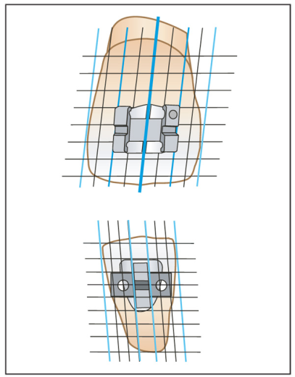
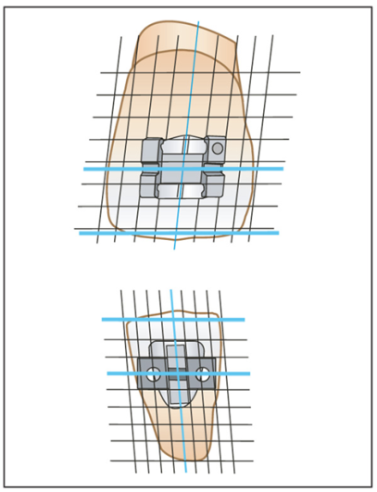

Bracket placement reference
Advantages versus disadvantages
Bracket Angulation
Proper angulation of the brackets on the teeth will bring the roots and crowns closer to their ideal positions at the end of treatment. To promote accuracy, the brackets are designed so that the horizontal aspects (ie, bracket slot and rotation wings) are aligned parallel to the incisal edge of the tooth. (However, mamelon ridges, attrition, and fractures result in irregular incisal edges that can interfere with this visual reference. For this reason, the long axis of the crown serves as a better and more consistent guide for parallel root alignment. If the vertical aspects of the bracket are aligned with the long axis of the crown, excellent root positioning can be achieved
vertical reference.
horizontal reference.

Slide 28
Bracket placement reference
Advantages versus disadvantages
when brackets are placed in the vestibular
faces of the incisors, the projected horizontal lines exhibit
parallelism, which creates greater visual comfort for the
operator, facilitating the bracket positioning stage
The divergence between these
lines may cause visual confusion, impairing accurate
positioning of the accessories
Andrews brackets. Divergent horizontal lines
MBT brackets. Parallel horizontal lines

Slide 29

Key of solution
In a study by Topolski F et al, 2016 this issue was solved, The use of the LACC as reference for bracket placement resulted in UCI crown angulation similar to the angulation in the bracket (5° for Andrews brackets and 4° for MBT brackets), regardless of shape. On the contrary, when the IE was used as reference, the natural angulation of the crown (mean of 1.2°) was reproduced, regardless of bracket shape.

Slide 30

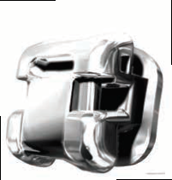
Damon
Horizontal and vertical auxiliary slots for greater versatility
Rhomboid shaped bracket and pad, and vertical scribe line guide precision bracket placement
Dwight Damon

Slide 31
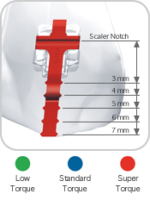
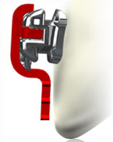
Damon
PRECISION BRACKET PLACEMENT
• Removable positioning gauge and rhomboid-shaped brackets and base guide bracket placement.
• Color-coded positioning gauges on brackets (3-3) denote torque values.
when placing the brackets, care must be given to place the mesial and distal outline of the pad in the long axis of the tooth rather than aligning the body of the bracket

Slide 32
Damon
Maxillary
U-l 4.75 mm
U-2 4.50 mm
U-3 5.00 mm
U-4 4.50 mm
U-5 4.25 mm
Mandibular
L-l 4.75 mm
L-2 4.50 mm
L-3 5.00 mm
L-4 4.50 mm
L-5 4.25 mm
bracket-positioning guide chart for
specific heights

Slide 33
Damon
Place appliance using the crown-long axis and bracket scribe line.
• Ensure that the internal slot and horizontal components of the bracket are parallel with the desired occlusal plane. This is especially important while placing the lower anteriors.
• Use a mouth mirror to aid placement.
What Damon says ???
Place the Damon appliance at the same height position as a traditional bracket system.

Slide 34
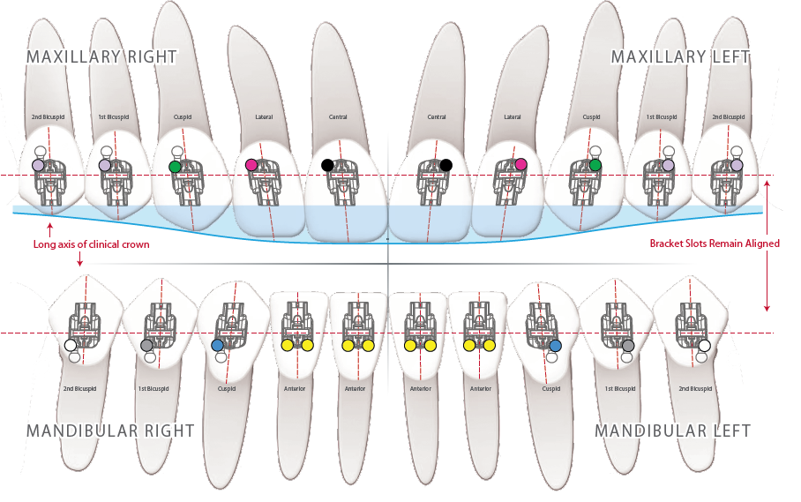

Drs. Tomás Castellanos and Thomas Pitts introduce placement of brackets based on the effect upon the smile arc
SMILE ARC PROTECTION
A a new table to guide vertical placement of brackets, based on the smile arc effect — therefore, the table is named Guide Position Smile-Arc (GPS-A)
The table facilitates the vertical placement of brackets in positions that result in adequate smile curves, as well as mutually protected occlusions.
For a functionally adequate occlusion and esthetic smile curvature, a divergence must be kept between the occluso-gingival position of the slot with occlusal cuspsor incisal edges, measured in mm, from the second molar tube all the way to the maxillary central incisor.
DR. PITTS

Slide 35


GPS-A
Smile curve flattened after orthodontic treatment. Brackets bonded with conventional heights.
Consonant Smile-Arc, results of
bonding brackets with GPS-A (Guide Position Smile-Arc)

Slide 36
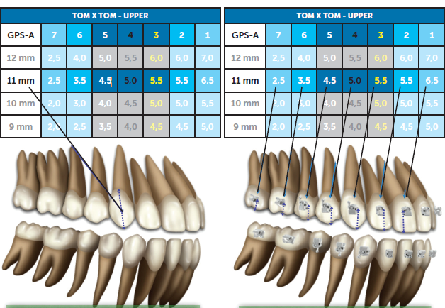
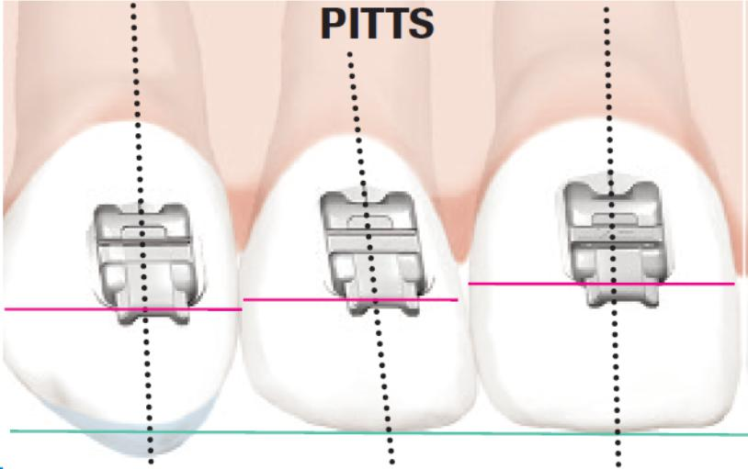
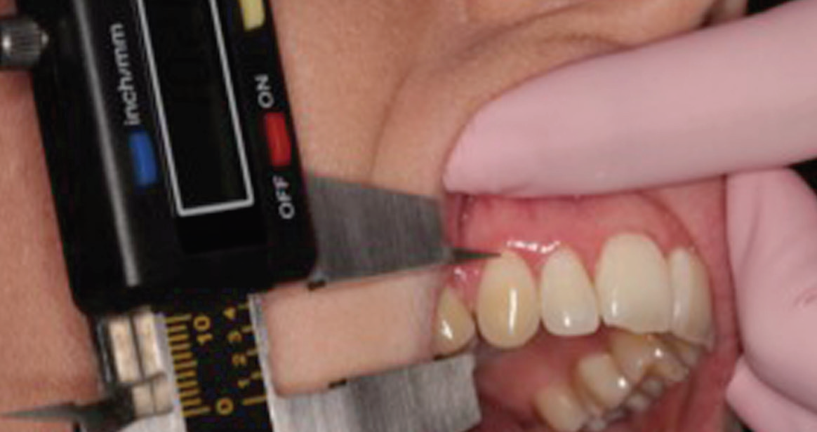
Step one : obtaining the ideal dental morphology.
Step two: Measure the length of the maxillary canine crown, from the cusp tip to the gingival margin (after reconstruction, recontouring, or gingivoplasty).
Step three: Find this measurement in the columns of the table GPS-A (Guide Position Smile-Arc upper), and choose the adjacent number in the row. The number in this file indicates the position for each bracket. Select in a similar way the height to bond brackets for mandibular teeth.
GPS-A

Slide 37
GPS-A
Versatile high-precision positioner for proper location of each bracket from
second molars to central incisors (GPS-A is a versatile high-precision positioner from Ortho Classic Inc.)

Slide 38
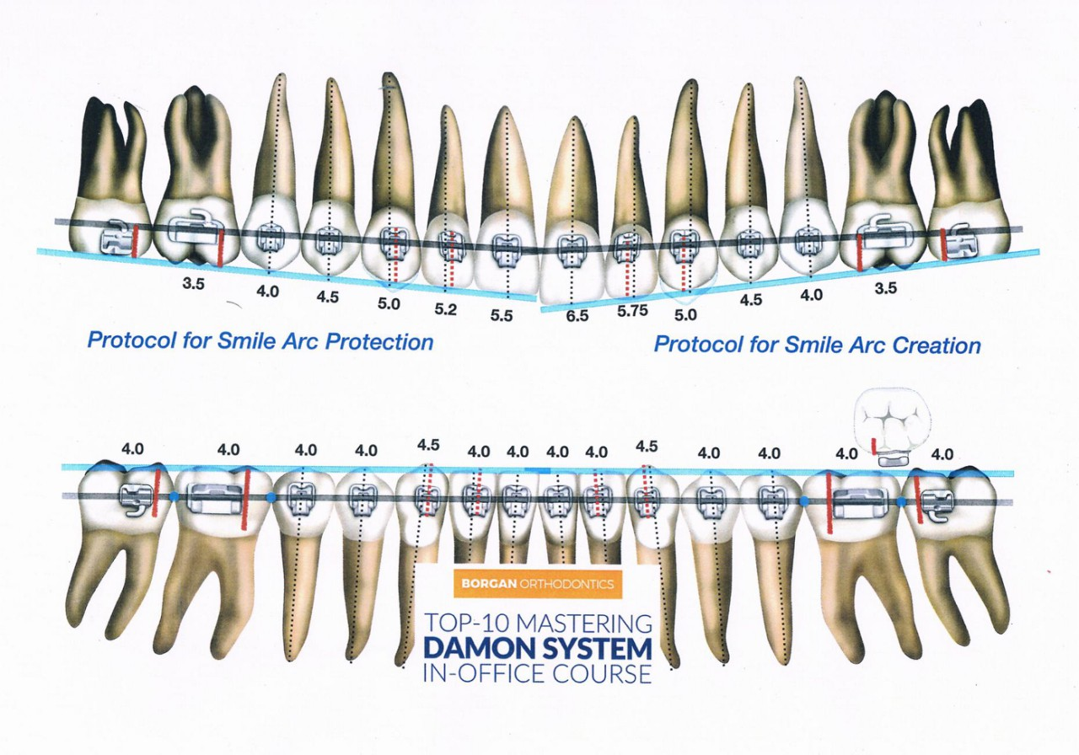
GPS-A

Slide 39
GPS-A
• A reduction of errors in positioning, which can be avoided, due to better precision,
• Reproducibility, and predictability of the bracket bonding.
• It allows a practical, standardized bonding procedure.
• Avoids bracket repositioning and/or the introduction of excessive corrective wire bends.
• Reduces chair time and unnecessary discomfort to the patient.
• Saving months of treatment, it becomes an effective tool to motivate patients.
• Allows better control of torque values.
ADVANTAGES

Slide 40
CLINICAL TIPS
Anterior open bite
Rotations
Right crown morphology

Slide 41
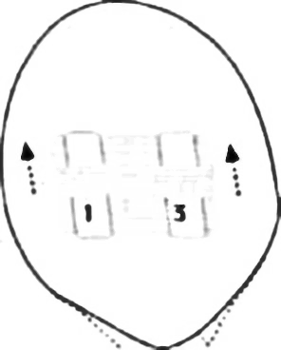
CLINICAL TIPS
Anterior open bite

Slide 42
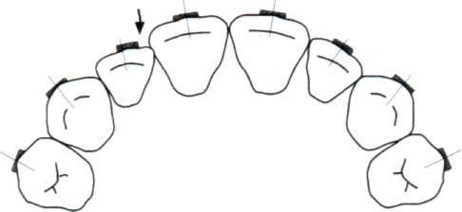
CLINICAL TIPS
Rotations

Slide 43
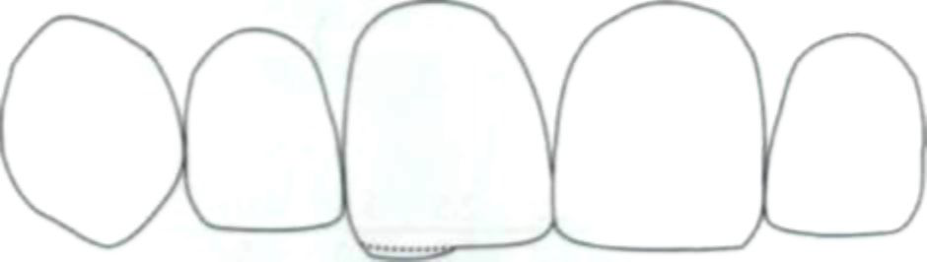
CLINICAL TIPS
Right crown morphology

Slide 44
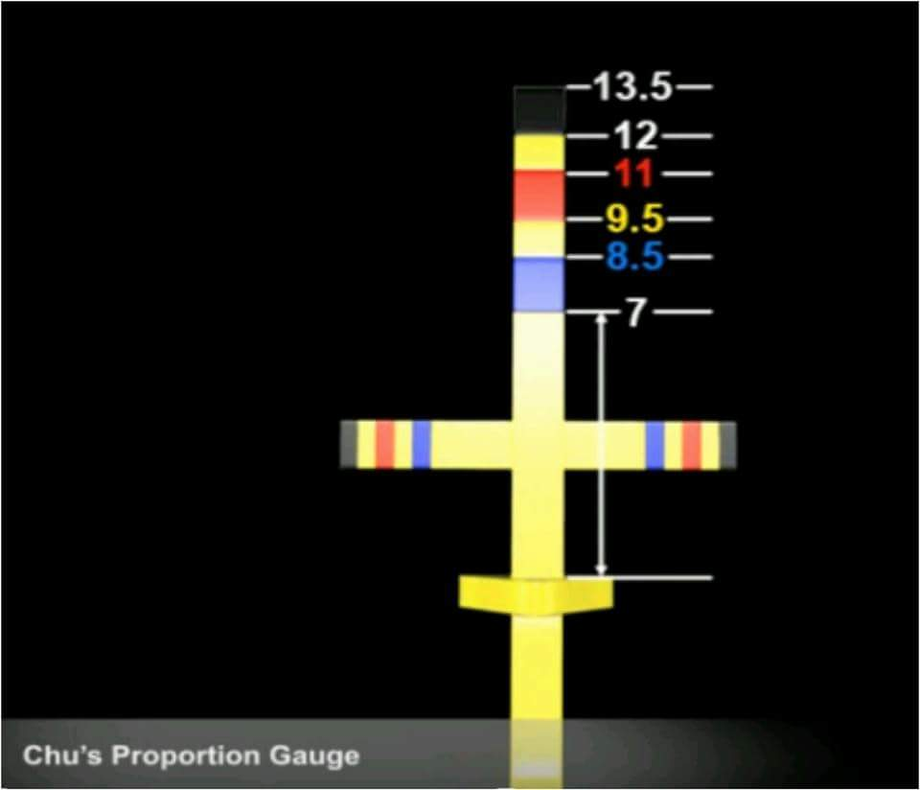
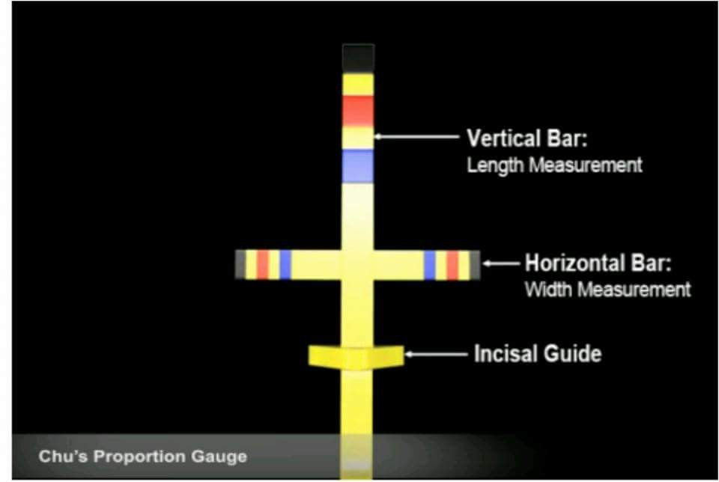
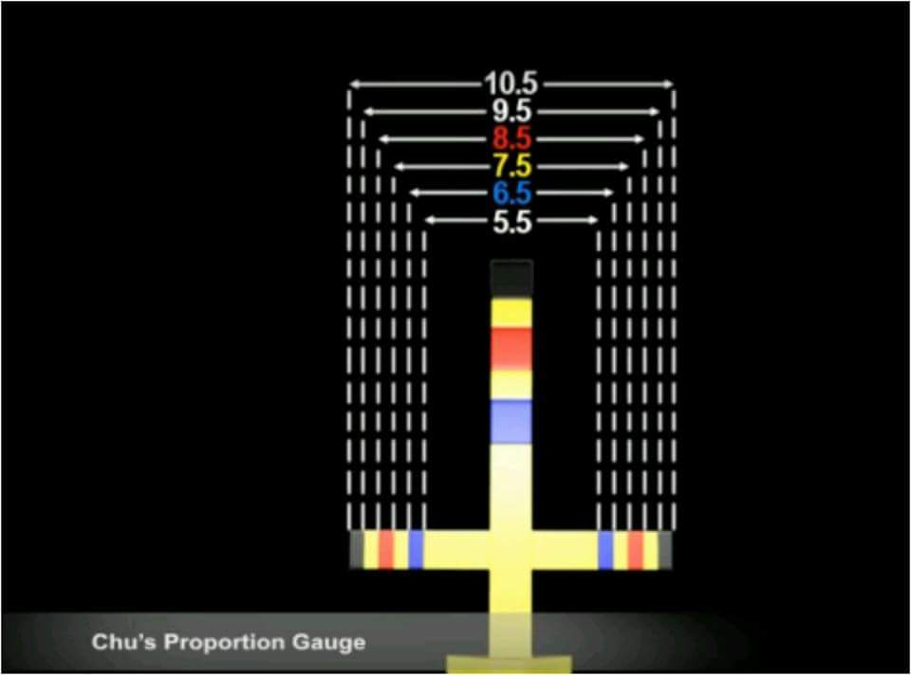
CLINICAL TIPS
Right crown morphology
CHU’S AESTHETIC GAUGES
Precise color-coded measurements
Provides quick, accurate diagnosis of tooth proportion
Provides accurate results and reduces chairside adjustment time
Easy to read

Slide 45
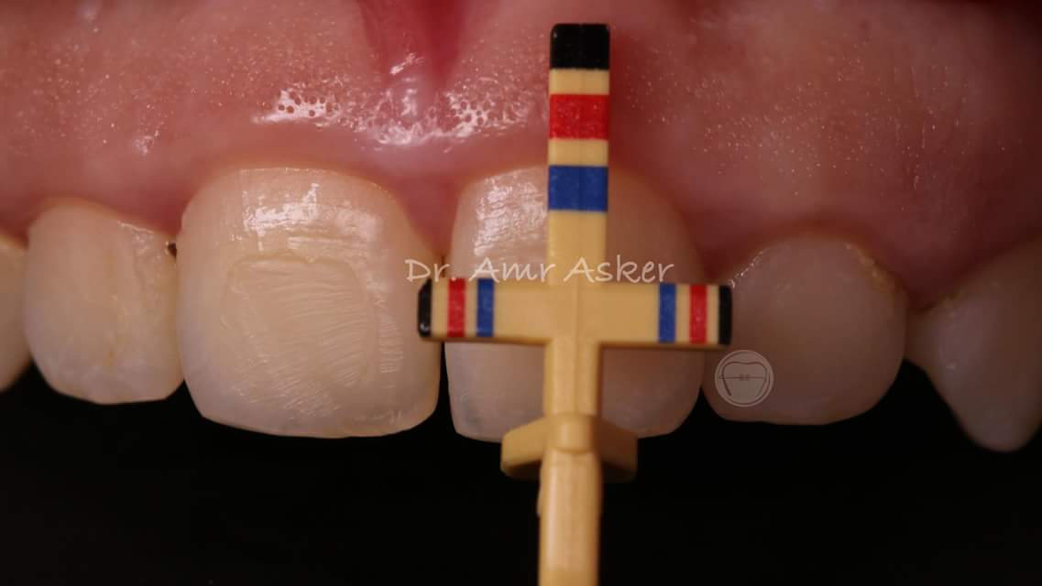
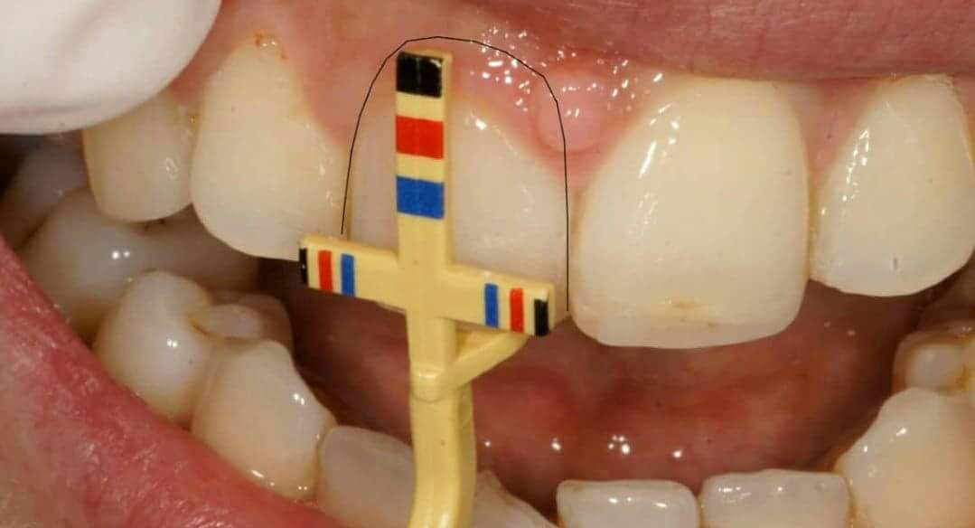
CLINICAL TIPS
Right crown morphology
CHU’S AESTHETIC GAUGES

Slide 46
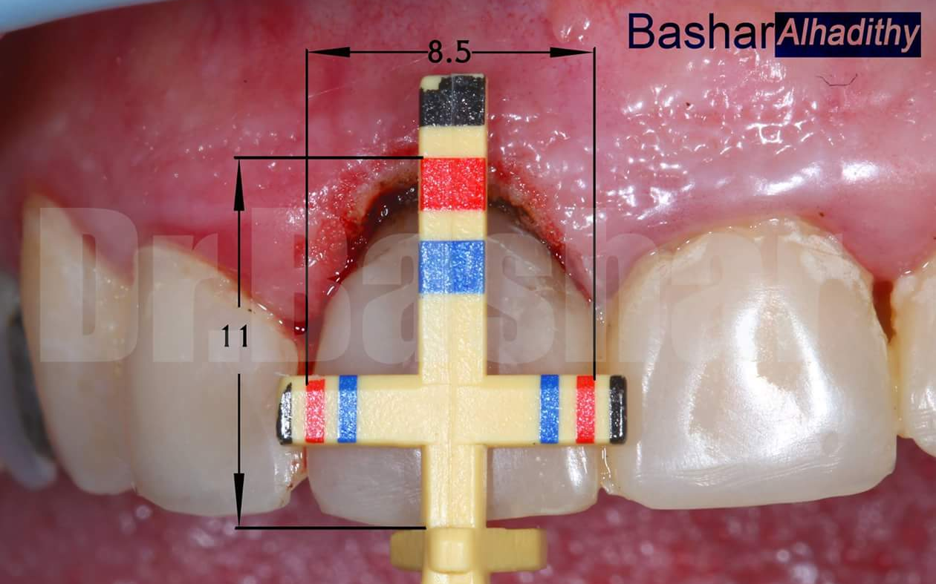
CLINICAL TIPS
Right crown morphology
Restorative &/or Gingivoplasties

Slide 47
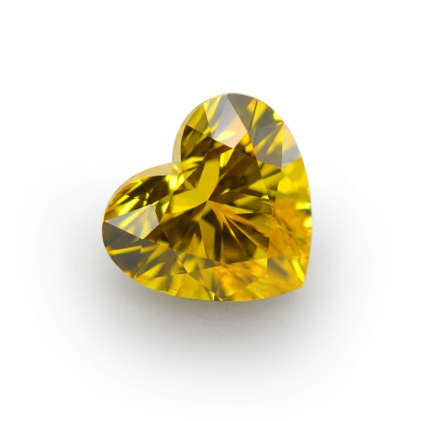
If you go on a long journey , you don’t walk all the way , you fly most of the way, then take a taxi and then walk the final 100 yards.
Larry Andrew

Slide 48
Thank you

