Slide 1
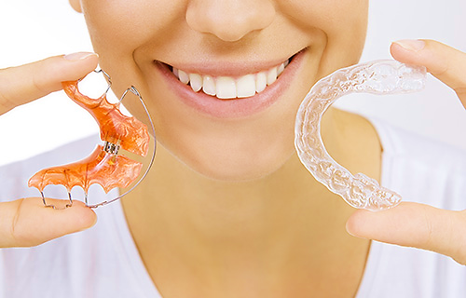
Retention Appliances

Slide 2
In orthodontics, although the patient may feel that treatment is complete when the appliances are removed, an important stage lies ahead.
Retention

Slide 3
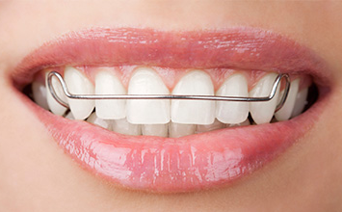
It is the phase of treatment intended to hold the teeth in their corrected positions after orthodontic tooth movements.

Slide 4
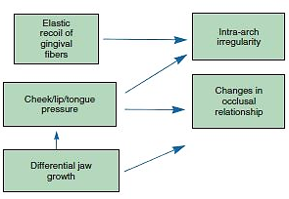
Why Retention Is Necessary?
Relapse
Reorganization.
• Soft tissue pressures.
• Growth.

Slide 5
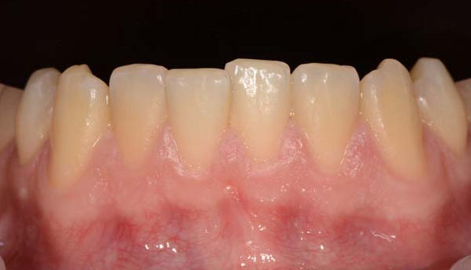
the reversal of tooth movements or occlusal changes which were achieved during treatment of the original malocclusion

Slide 6
HISTORY OF RETENTION
Different schools of thought have existed over time, and several historic concepts regarding retention:

Slide 7
Occlusal School
Kingsley stated, “The occlusion of the teeth is the most potent factor in determining the stability in a new position’.
Apical Base School
Axel Lundstrom suggested that the apical base was one of the most important factors in the correction of malocclusion and the maintenance of a corrected occlusion.
McCauley also suggested that intercanine width and intermolar widths should be maintained as originally presented to minimize retention problems.
Nance also noted that, “arch length may be permanently increased only to a limited extent’.
Mandibular Incisor School
Grieve and Tweed suggested that the mandibular incisors must be placed and kept upright over basal bone to maximize their stability.
Musculature School
Rogers introduced a consideration of the necessity of establishing proper muscular balance.

Slide 8
Care must exercised to establish a proper occlusion within the bounds of normal muscle balance and with careful regard given to the apical base, as well as to the relationship of the maxillary and mandibular bases to one another.

Slide 9
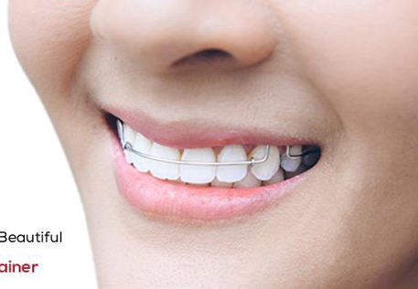
Timing of Retention
• Daily.
• Continued on a part-time basis.
• If significant growth remains, continued part-time until completion of growth.

Slide 10
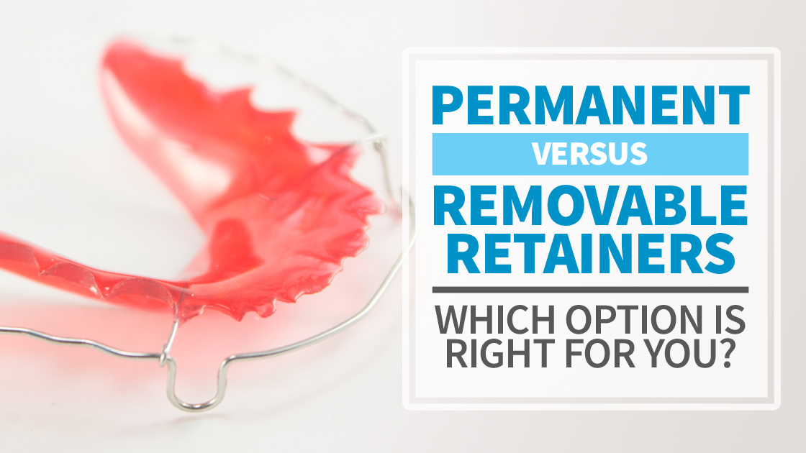
Types
of Retainers

Slide 11
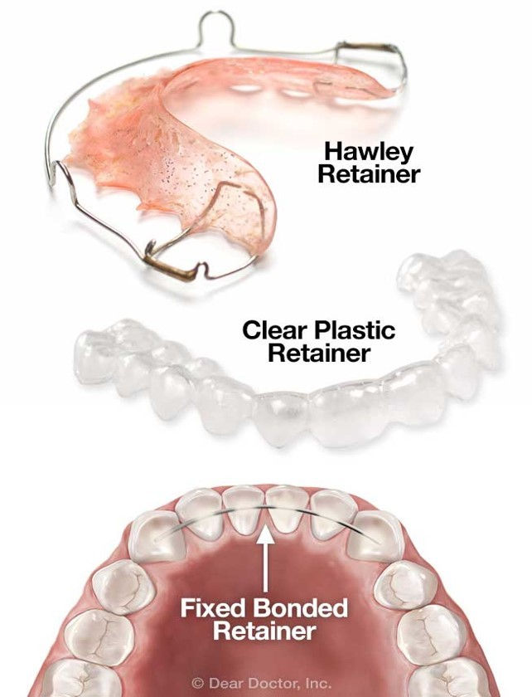
Removable retainers with a wire labial bow (Hawley retainers).
Removable vacuum formed retainers.
Fixed bonded retainers (smooth wire, flexible spiral/multi-strand wire)

Slide 12
Hawley Retainer

Slide 13
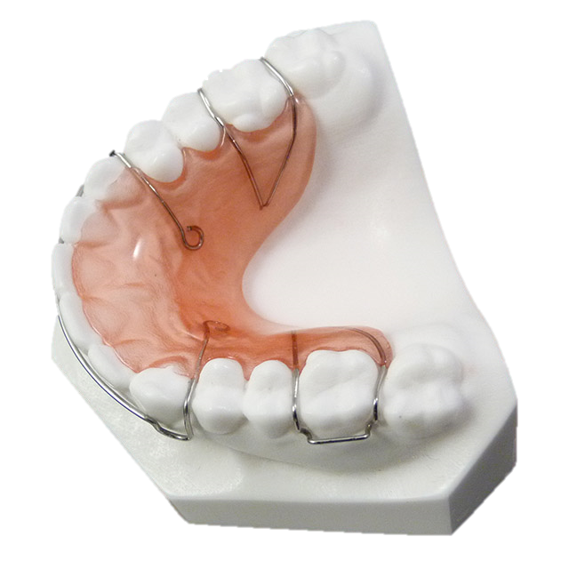
Conventional Hawley Retainer

Slide 14
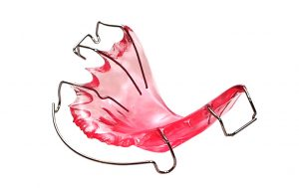
Hawley Retainers
it the most common removable retainer for the maxillary arch, designed in the 1920s.
It incorporates clasps on molar teeth, Hawley arch, and sometime bite plane is added to control overbite. The outer bow provides excellent control of the incisors.
The retainer allow the posterior teeth to settle into occlusion after appliance removal.
For any patient who once had an excessive overbite, light contact of the lower incisors against the baseplate (anterior bite plane) of the retainer is desired.

Slide 15
Hawley Retainers
Four-week appointment intervals are recommended.
At each appointment, appliance fit should be evaluated, and orthodontic correction monitored. Interproximal reduction, as well as appliance adjustment, may be necessary.
Patients should wear 22 hours a day and clean daily with toothpaste to prevent the buildup of plaque and odor.
Avoid Efferdent and other effervescent solutions, as it may erode components on the appliance

Slide 16
Modifications of Hawley Retainer

Slide 17
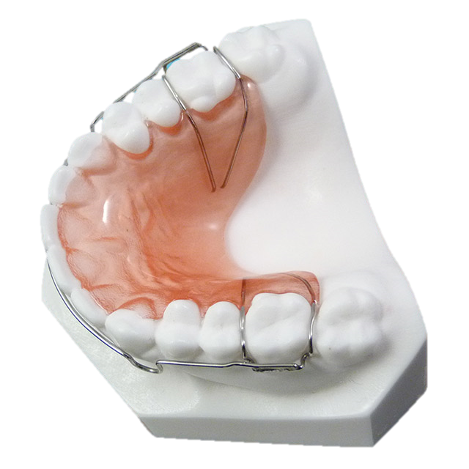
Labial Bow Soldered to Adams Clasps

Slide 18
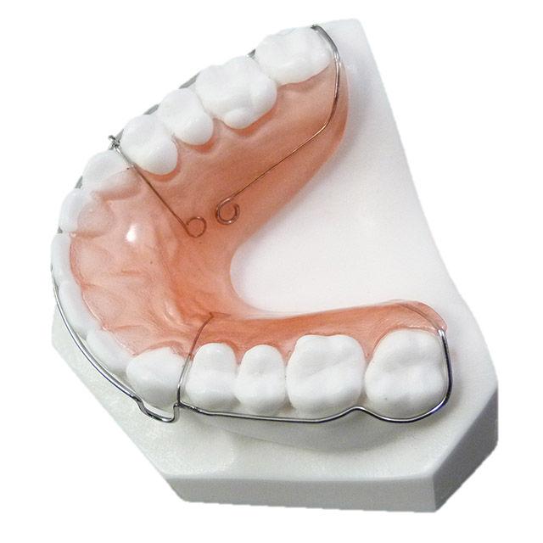
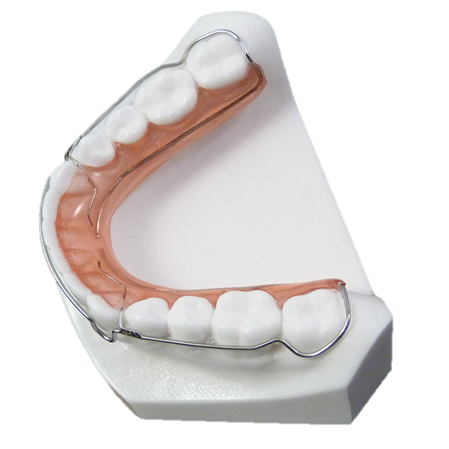
Wrap Around Hawley Retainer

Slide 19
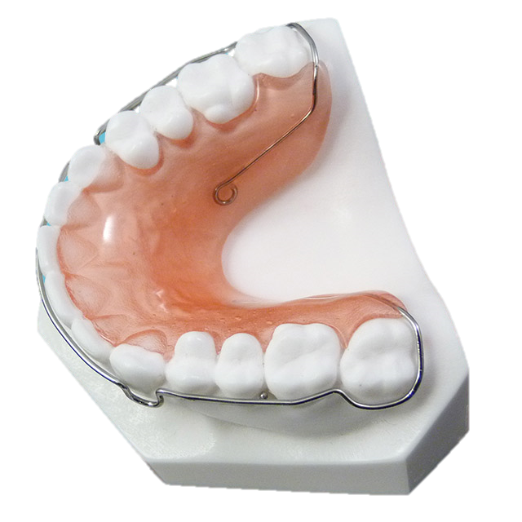
Wrap Around Hawley Retainer with Soldered Ball Clasps

Slide 20
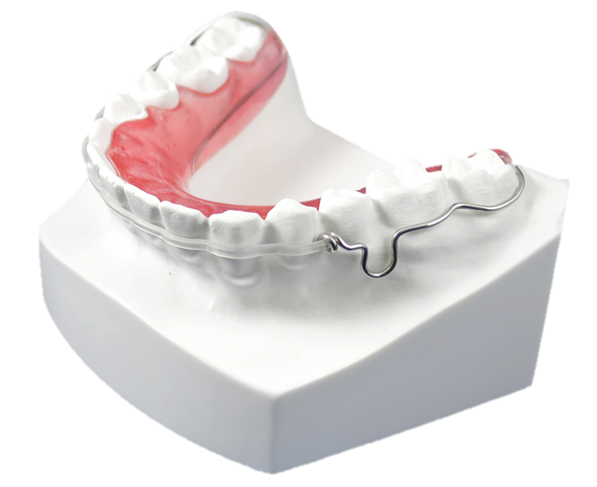
Clear Bow Wrap Around Hawley Retainer

Slide 21
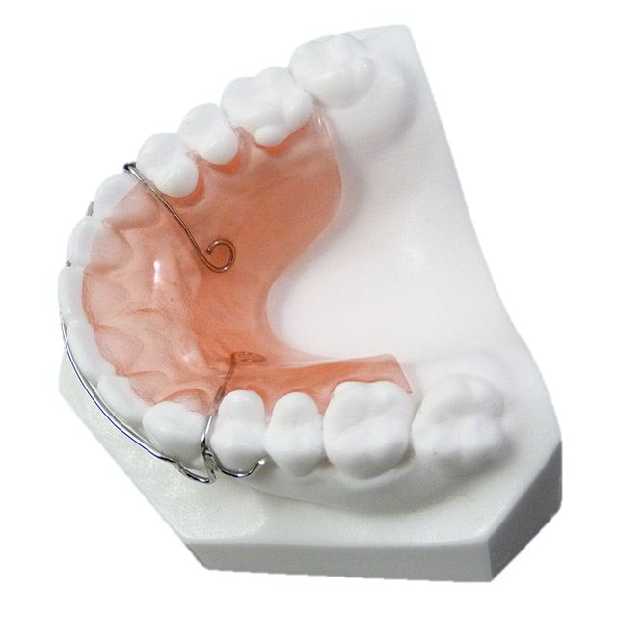
Retainer with Acrylic Extension

Slide 22
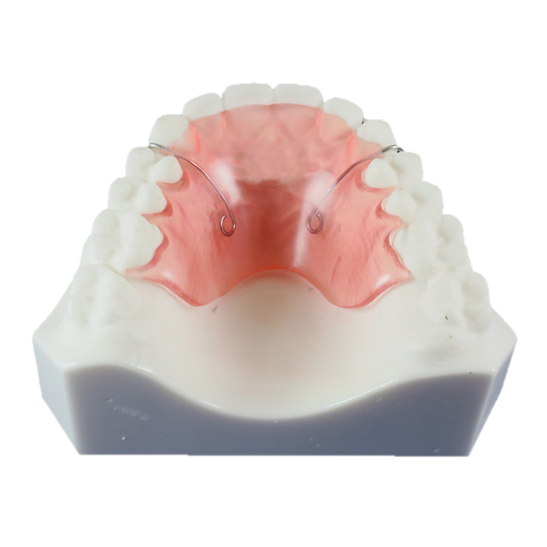
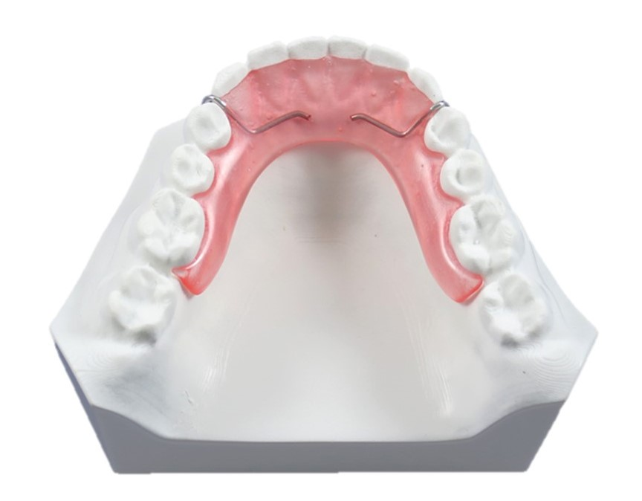
Retainer with Acrylic Extension with no clasps

Slide 23
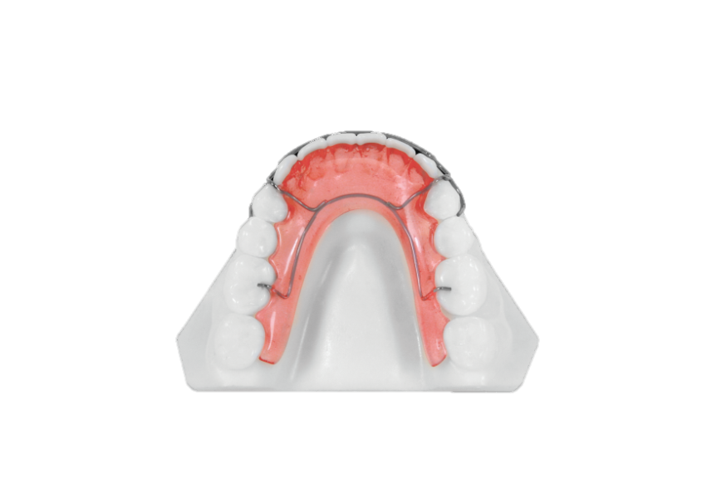
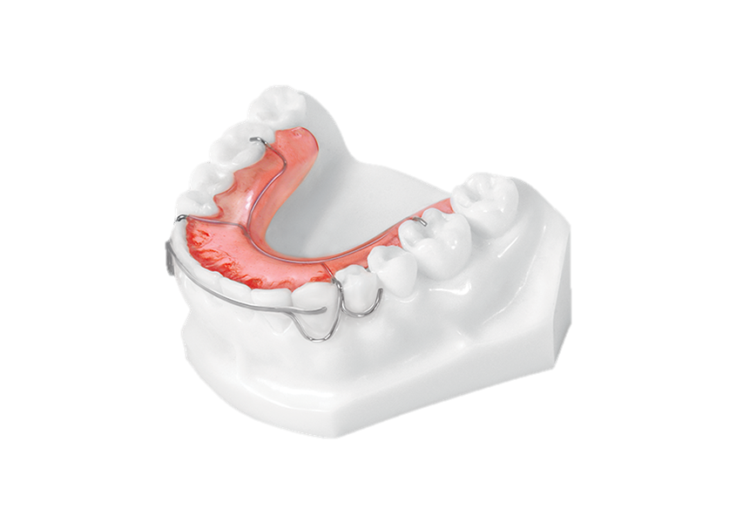
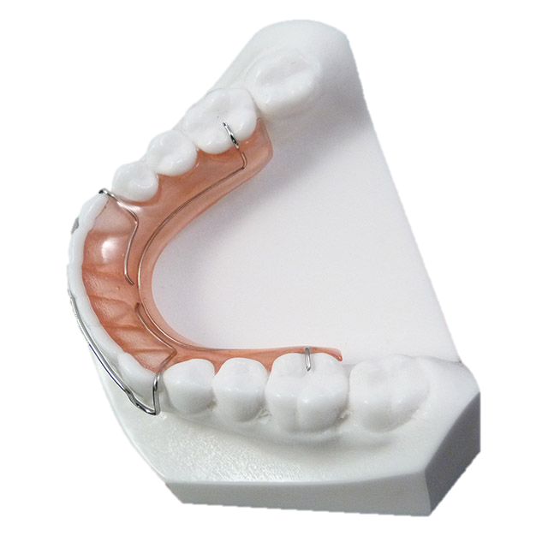
Hawley Retainer with Occlusal Rests

Slide 24
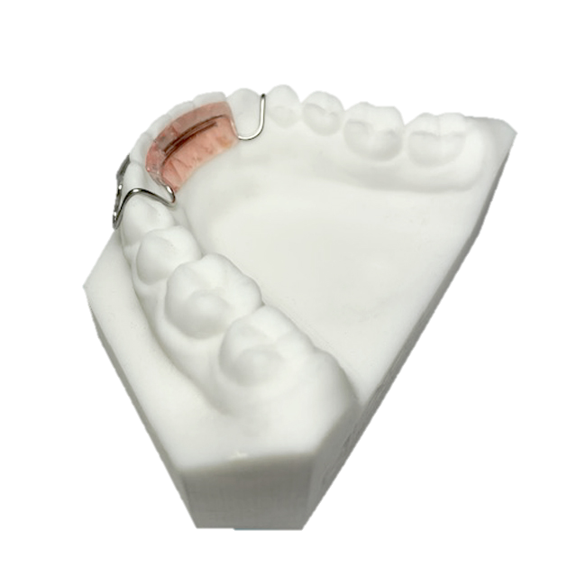
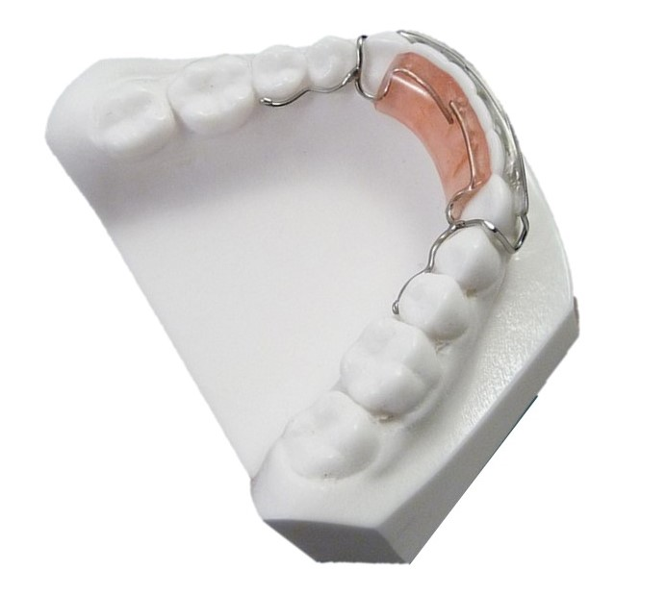
Clip Retainers

Slide 25
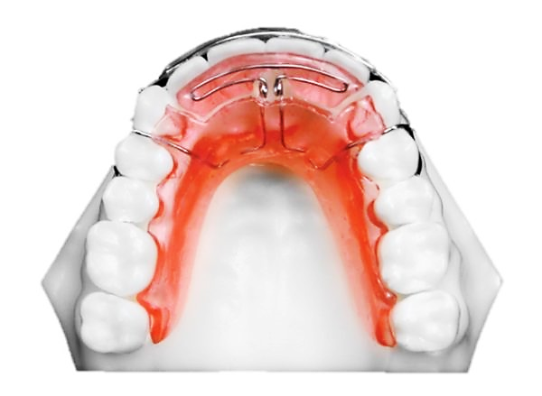
Spring Retainers

Slide 26
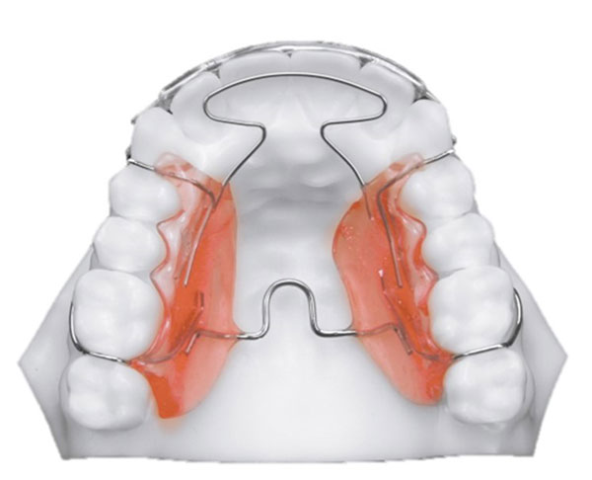
Open Spring Retainer

Slide 27
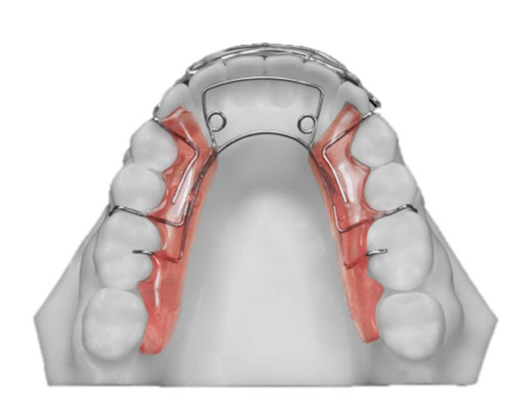
Premand Spring Retainer

Slide 28
Thank you

