Slide 1

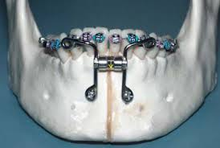
Distraction osteogenesis
Prepared by
Shahba AbdulGhafoor Mohammed
Ph.D. Student

Slide 2

Subjects
Distraction osteogenesis (DO)
Principles of distraction osteogenesis
Basic principles
Classification of distractor devices
Indications
Protocol
Clinical application
Alveolar DO
Mandibular DO
Maxillary DO
Transport DO
Craniofacial DO
Complications
Percentage of complications in craniomaxillofacial DO.
Research and advances
Automated continuous DO
Administration of growth factors to enhance bone healing
Development in distraction devices

Slide 3
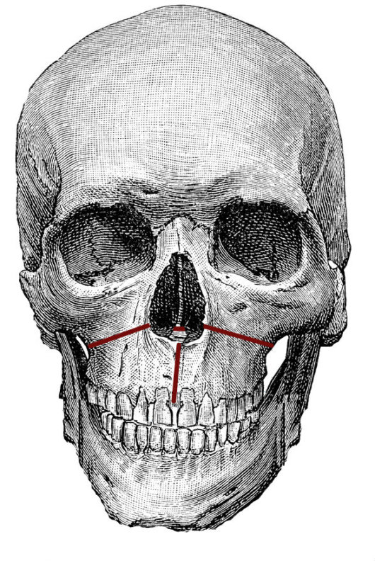
Distraction osteogenesis (DO)
Distraction osteogenesis (DO) is a surgical procedure for reconstructing skeletal deformities of the skeleton, jaws, and alveolar processes.
A corticotomy (osteotomy) divides the bone into
segments, or if there is an intervening suture or PDL, the bone
that is resisting movement is removed. A surgically assisted RPE
is the most common distraction procedure used in orthodontics.
Distraction of the PDL is a method for achieving rapid
tooth movement, but the method is too invasive for routine
clinical procedures.
Federico,2019
Notes:
A SARPE is usually carried out under local anesthesia and sedation. The first step is carried out by the orthodontist, who will previously place a rapid expansion device (RPE). During surgery, the maxillofacial surgeon performs a vertical osteotomy (cut in the bone) in the maxillary midline, as well as a Le Fort I osteotomy to facilitate expansion.
After five days of surgery, and following the specialist's instructions, the patient will begin to open the expander little by little, until reaching the necessary dimension to start the orthodontic treatment, then, a stabilization period of approximately three months begins, during this period the expansion stops but the expander is kept in place, causing the bones to fuse in their new position.
During this process, interdental spaces will be produced between the central incisors, or "central blades", this is completely normal and will be corrected later on with the orthodontic treatment. In some patients, a second orthognathic surgery is necessary to address the vertical and anterior-posterior changes.
Why get a SARPE?
This procedure avoids having to extract dental pieces to treat dental crowding, it also solves problems such as lateral crossbite, that can generate discomfort and dental wear, while achieving a harmonization of the facial features of the patient by achieving a balance of the width of the upper and lower arches.

Slide 4
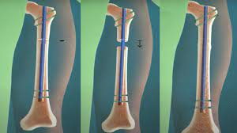
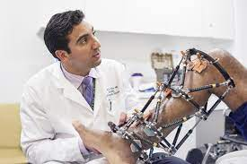
Distraction osteogenesis (DO) is used in orthopedic surgery, and oral and maxillofacial surgery to repair skeletal deformities and in reconstructive surgery. It was originally used to treat problems like unequal leg length, but since the 1980s is most commonly used to treat issues like hemifacial microsomia, micrognathism (chin so small it causes health problems), craniofrontonasal dysplasias, craniosynostosis, as well as airway obstruction in babies caused by glossoptosis (tongue recessed too far back in the mouth) or micrognathism.
Daniel,2018

Slide 5
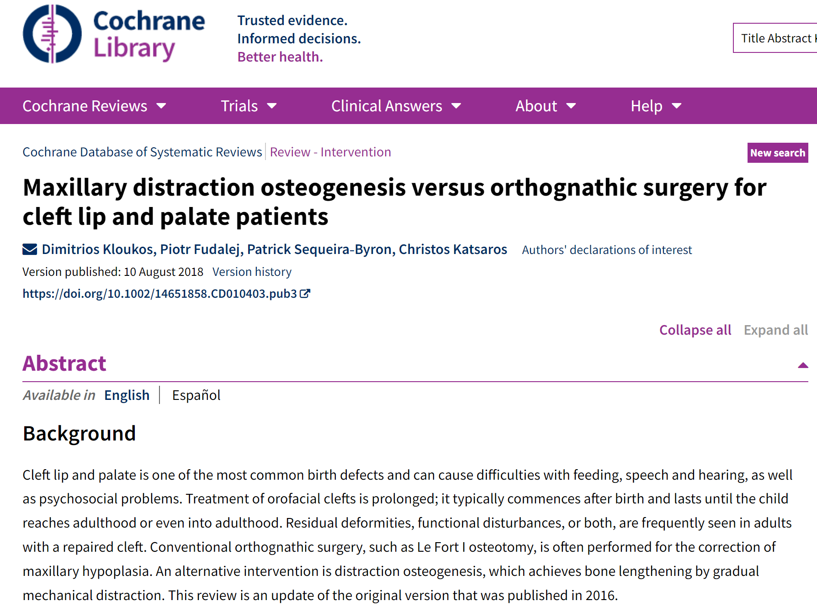

Slide 6
A 2018 Cochrane review of DO on the upper jawbone to treat cleft lip and cleft palate compared with orthognathic surgery found only one study, involving 47 participants and performed between 2002 and 2008 at the University of Hong Kong.
This was not sufficient evidence from which to generalize, but the authors noted that while both procedures produced notable hard and soft tissue improvements, the DO group had greater advancement of the maxillary and less horizontal relapse five years after surgery.
There was no difference in speech or nasal emissions outcomes nor in adverse effects; the DO group had lower satisfaction at three months after surgery but higher at two years.
(Kloukos, 2018).

Slide 7
Evolution in Orthodontics
Modern research and development in the field of DO has led to the implementation of numerous innovative and revolutionary distraction systems.
A wide variety of intraoral internal distractors now available are engineered to be small and compact with increased patient comfort and acceptance. This paved way طريق ممهد to further investigating the technique for applications in influencing the rate and vector of tooth movement.
Liou and Huang (1998) first applied this concept to orthodontic tooth movement and performed rapid canine retraction through distraction, which they aptly termed as ‘Dental Distraction’.
Later investigations validated that this rapid movement is a form of DO of the periodontal ligament which acts a ‘suture’ between alveolar bone and tooth with similar osteogenic potential (Liou, Figueroa & Polley, 2000).
In a more recent study, Sayin et al. (2004) investigated the clinical validation of this technique and substantiated that this procedure reduced the net orthodontic treatment time.
Soonafter this concept was introduced, İşeri etal. (2001) and Kişnişci et al. (2002) used a different technique called ‘Dentoalveolar
Notes:
Evolution in Orthodontics
Modern research and development in the
field of DO has led to the implementation of
numerous innovative and revolutionary
distraction systems. A wide variety of
intraoral internal distractors now available
are engineered to be small and compact
with increased patient comfort and
acceptance. This paved way to further
investigating the technique for applications
in influencing the rate and vector of tooth
movement.
Liou and Huang (1998) first applied this
concept to orthodontic tooth movement
and performed rapid canine retraction
through distraction, which they aptly
termed as ‘Dental Distraction’. Later
investigations validated that this rapid
movement is a form of DO of the
periodontal ligament which acts a ‘suture’
between alveolar bone and tooth with
similar osteogenic potential (Liou, Figueroa
& Polley, 2000). In a more recent study,
Sayin et al. (2004) investigated the clinical
validation of this technique and
substantiated that this procedure reduced
the net orthodontic treatment time. Soon
after this concept was introduced, İşeri et
al. (2001) and Kişnişci et al. (2002) used a
different technique called ‘Dentoalveolar
Distraction’ (DAD) for rapid canine
distalization by performing osteotomies
around the canines and achieved
accelerated movement. This surgical
technique does not rely on the stretching
and widening of the periodontal ligament,
thus prevents overloading and stress
accumulation in the periodontal tissues
(Gürgan, İşeri, & Kişnişçi, 2005). The
technique was later substantiated with
follow-up (Kurt, İşeri, & Kişnişci, 2010) anda large number of cases have since been
treated successfully (Kişnişçi & Iseri,
2011).
In the same year Isaacson et al. (2001)
successfully attempted to move an
ankylosed central incisor using
orthodontics, surgery and DO. Later, Kodof
et al. (2005) demonstrated the
effectiveness of treating ankylosed tooth
and the surrounding alveolar ridge defect
by a simple DO apparatus. More recent case
reports have emphasized the evolutionary
role of DO in attaining orthodontic
correction of ankylosed anterior teeth
(Dolanmaz, Karaman, Pampu & Topkara,
2010; Kim, Park, Son, Kim, Kim & Mah,
2010).

Slide 8
Principles of distraction osteogenesis Basic principles
In a normal fracture healing, soft callus formation (callotasis) allows the fracture site to heal. With this principle, DO involves the manipulation of this callus in the distraction chamber for structural lengthening before calcification occurs.
Corticotomy is a process where an osteotomy to the cortical layer of the bone is performed in order separate the segments while at the same time preserving the blood supply to the bone from the medulla and periosteum.
Distraction rate in DO describes the distance in millimeter (mm) in which the bone is moved per day and distraction rhythm describes the frequency of device activation per day.
Distraction osteogenesis comprises of three sequential phases; latency, distraction and consolidation phase which is distinct in every aspect.

Slide 9
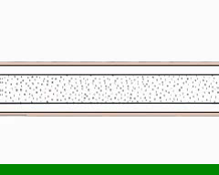

Slide 10
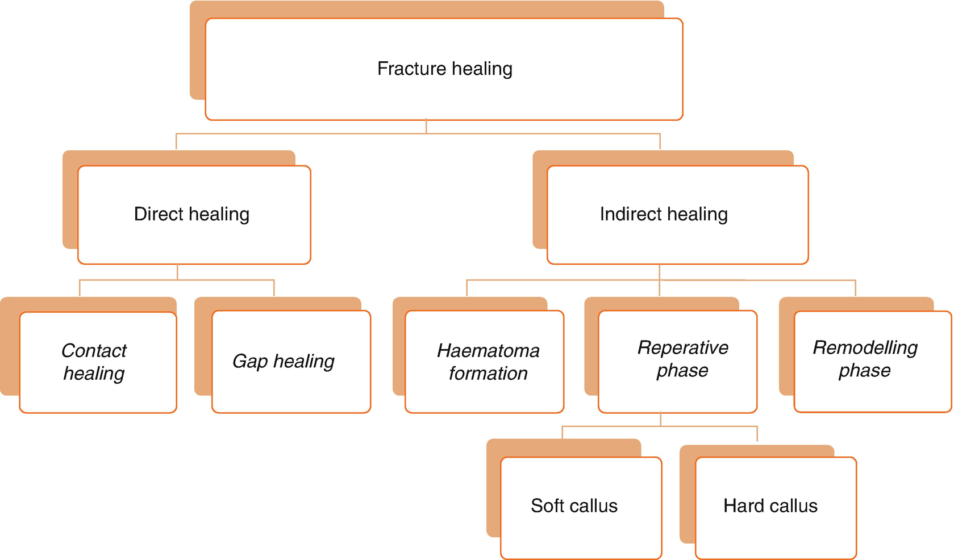
Notes:
1.
Direct (Primary) fracture healing: Direct cortical healing of the two fracture ends of a bone. Direct healing does not commonly occur by a natural process. This process occurs between rigidly opposed cortical fracture ends, which is mostly possible if there is open reduction or internal fixation surgery of the fracture fragments, resulting in a substantial decrease in interfragmentary strain (Marsell and Einhorn 2011).
2.
Indirect (Secondary) fracture healing: It is the most common type of fracture healing, which involves healing processes within the bone marrow, periosteum, and the soft tissues surrounding the bone. It does not require direct contact of fragments or rigidly stable conditions of the fracture fragments.
Direct Fracture Healing
Primary healing can occur through contact or gap healing.
Contact Healing: Cutting cones are formed at the end of the osteons closest to the fracture site if the fracture fragments are close to each other (less than 0.01 mm) and the strain is less than 2 %. The osteoclast and the osteoblastic activity occur, and this activity causes the generation of bony reunion and recondition of the Haversian system in the fracture site. The bridge formed by the osteons later mature into lamellar bone resulting in fracture healing.
Gap Healing: In situations where the interfragmentary gap of the fracture is more than 0.1 mm and less than 1 mm, and again the interfragmentary strain is less than 2 %, the bone formed originates from the marrow cells, and is called gap healing.
In this type of healing, the site is filled by intramembranous bone formation without the mediation of the cartilage phase (Griffon n.d.). Lamellar bone is formed perpendicular to the long axis.
Indirect Fracture Healing
This most commonly seen fracture healing form consists of both endochondral and intramembranous bone healing (Gerstenfeld et al. 2006; Marsell and Einhorn 2011). It occurs in four consecutive phases after the impact causing the fracture: (1) hematoma formation–inflammation, (2) soft callus, (3) hard callus, and (4) remodeling. It should be stressed that these phases overlap each other and there are no distinctive borders between.
The impact causing discontinuity in the bone architecture also causes disruption of the blood vessels, and consequently leads to the formation of a hematoma, which can be considered as the initiating phase of the regeneration process.
Hematoma Formation (Induction)
Damage to neighboring blood vessels may occur, resulting in fracture hematoma. Bleeding originates from the medullary cavity and periosteum as well as from the soft tissue and muscle injuries (Wraighte and Scammell 2007). As a result of bleeding, coagulation initiates, leading to fracture hematoma which activates the immune cells that are located within the evolving hematoma (Kolar et al. 2010).
This first phase promotes modulation and osteoinduction of local cells and is a source of signaling molecules (IL-1, IL-6, and TNF- α), which induce a cascade of cellular events that initiate healing. The expression of these signaling molecules peaks within 24 h and decline to nearly undetectable levels by day 3 (Cho et al. 2002). These cytokines are secreted by macrophages, inflammatory cells, and mesenchyme-originated cells, and have chemotactic effect on other inflammatory cells. They are active in the recruitment of fibrogenic cells to the injury site (Kon et al. 2001).
At the same time, thrombin and subendothelial collagen activate platelets, which results in release of platelet derived growth factor (PDGF) and transforming growth factor-β, which play a role in initiating fracture repair. These factors induce mesenchymal cell migration, activation and proliferation, angiogenesis, chemotaxis of acute inflammatory cells, and further aggregation of platelets. Simultaneously, BMPs not only are released from the bone matrix but also are expressed by recruited primary mesenchymal cells. During the subsequent days, MSCs proliferate and differentiate into a chondrogenic or osteogenic lineage. During this early phase of events, angiogenesis also takes place, and this is a prerequisite for further progression of the regeneration cascade. While callus are developing, vascular ingrowth is controlled by FGF, VEGF, and angiopoietin 1 and 2. During the initial periods of fracture healing, angiopoietin 1, and during endochondral and bone formation, VEGF, have been proposed to be induced (Dimitriou et al. 2005). Next phase is the reparative phase, which involves both soft and hard callus formation.
Proinflammatory Cytokines
Interleukins (IL-1, IL-6):IL–1: In the acute phase of inflammation, it is secreted by macrophages and stimulates production of IL-6 in osteoblasts, endorses production of the primary callus, and induces angiogenesis. IL–6: During acute phase, it induces angiogenesis, vascular endothelial growth factor production, and the differentiation of osteoblasts and osteoclasts.
Tumor Necrosis Factor-α (TNF- α): Secreted by macrophages, inflammatory cells, and mesenchymal origin cells present in the periosteum (Tsiridis et al. 2007). They endorse recruitment of MSCs. During endochondral ossification, they stimulate apoptosis of hypertrophic chondrocytes. They also stimulate osteoclastic function. In their absence, resorption of mineralized cartilage is delayed, which prohibits new bone formation.
Fibroblast growth factor (FGF): They are synthesized by monocytes, macrophages, mesenchymal cells, osteoblasts, and chondrocytes during bone healing.
FGFs endorse growth and differentiation of a variety of cells such as fibroblasts, myocytes, osteoblasts, and chondrocytes. During the early stages of fracture healing, they play a critical role in angiogenesis and mesenchymal cell mitogenesis. α-FGF mainly regulates chondrocyte proliferation and is probably important for chondrocyte maturation. β-FGF is represented by osteoblasts and is generally more potent than α-FGF. In a canine tibial osteotomy model, a single injection of FGF-2 was associated with an early increase in callus size (Tsiridis et al. 2007).
Insulin–like growth factor (IGF): Sources of IGF-I and II are the bone matrix, endothelial cells, osteoblasts, and chondrocytes. Serum concentration of IGF-I is controlled by growth hormone. IGF-I endorses bone matrix formation. IGF-II plays a role at a later stage of endochondral bone formation and stimulates type I collagen production (Tsiridis et al. 2007).
Platelet–derived growth factor (PDGF): It is secreted by platelets during the early phases of fracture healing, and it is an effective chemotactic stimulator for inflammatory cells and a proliferative and migrative stimulus for MSCs and osteoblasts.
Vascular endothelial growth factor (VEGF): They usually occur during endochondral ossification, and they are essential mediators of neoangiogenesis and endothelial cell-specific mitogens.
Growth and Differentiation Factors
Bone Morphogenic Proteins (BMPs): They are pleiotropic morphogens, which control growth, differentiation, and apoptosis of osteoblasts, chondroblasts, neural cells, and epithelial cells, produced by osteoprogenitor, mesenchymal cells, osteoblasts, and chondrocytes, within the extracellular matrix. They stimulate a sequential cascade of events for chondroosteogenesis (chemotaxis, mesenchymal and osteoprogenitor cell proliferation and differentiation, angiogenesis, and controlled synthesis of extracellular matrix). They can be assessed in for four subgroups:
Group 1: BMP-2 and 4
Group 2: BMP-5, 6, and 7
Group 3: GDF-5 (BMP-14), GDF-6 (BMP-13), GDF-7 (BMP-12)
Group 4: BMP-3 (osteogenin), GDF-10 (BMP-3b)
Transforming Growth Factor-β (TGF-β): It controls proliferation and cellular differentiation.
Growth differentiation factors (GDFs): GDFs 1, 5, 8, and 10 promote various stages of intramembranous and endochondral bone ossification during healing.
Reparative Phase
This phase becomes active within the first few days after fracture and persists for several months. Endothelial cells in the marrow transform to polymorphic cells and begin to express an osteoblastic phenotype and form bone. Osteoprogenitor cells (OPCs) are already present in the area under the periosteum, ready to begin intramembranous ossification. Primitive MSCs express BMPs on the first day. BMPs begin the differentiation of OPCs into osteocytes. It seems that BMPs 2, 6, and 9 are important in the differentiation of pluripotent MSCs into OPCs, and then BMPs 2, 4, 7, and 9 further differentiate them to become osteoblasts. Most of the BMPs are then able to differentiate osteoblasts into osteocytes, excluding BMPs 3 and 12. Bone repair starts at the peripheral region of the fracture site. Inner part of the periosteum (subperiosteal area) starts to generate intramembranous woven bone (hard callus) on the well-vascularized area of the cortex from day 2 to day 5. At this time, proliferation of OPC and undifferentiated MSC is increased. However, on the fracture site, damage to the blood supply causes hypoxic tissue generation, which induces cartilage formation by MSCs (Shapiro 2008).
Between the bone ends, in the soft callus, early cartilage formation begins. Undifferentiated MSCs begin to proliferate by day 3. Between days 4 and 7, osteonectin (adhesion molecule) starts to become more pronounced. On day 5, there is evidence of increased expression of mRNA for type II collagen from the cells that later acquire a chondrocytic phenotype.
From day 6 to day 10, osteocalcin is expressed in the hard callus. In both the soft and the hard callus, there is high cellular proliferation and vascular infiltration deeper into the callus starts on this phase. Osteopontin is present in both the osteocytes and the OPCs at the junction between the hard and soft callus. In the soft callus, chondrocytes begin to proliferate. Type II collagen mRNA expression peaks at around day 9. Other minor collagens appear. Adhesion and migration molecules, especially fibronectin, are found in the fibroblasts, chondrocytes, and ostoeblasts. In days 11–20, in the areas of hard callus formation, cellular proliferation ceases. The predominant collagen type is type II, but expression of mRNA for collagen type II is absent. Fibronectin levels decline by day 14. In the soft callus, the cartilage begins to calcify. There is “budding” of hypertrophic chondrocytes. The matrix vesicles release calcium and enzymes. The soft callus takes on the structure of a growth plate, with primary and secondary spongiosa. Since the callus with cartilaginous and fibrocartilaginous origin stabilizes the fracture site, it can be considered as an ideal environment for the bone formation to be established on the fracture area.
The soft callus is very weak in terms of resistance to movement and requires adequate protection in the first 4–6 weeks.
From days 21 to 25, there is no more cellular proliferation. In the hard callus area, the structure is now woven bone. In the soft callus, chondrocytes begin to undergo apoptosis, and there is some cellular necrosis. Solid union with woven bone is seen by around 35 days. Remodeling and formation of lamellar bone follow “Reprinted from Phillips AM (2005) Overview of the fracture healing cascade. Injury 36(Suppl 3):S5–S7) with permission from Elsevier”
Remodeling Phase
Following callus calcification, immobilization of the fracture is completed. From the examiner side, fracture can be considered as healed. After initial calcification, remodeling starts, which is the replacement of calcified cartilage and woven bone with lamellar bone. This phase continues for a long time period; however, adequate strength is typically reached in 3–6 months (Kalfas 2001).
Distraction Osteogenesis
Distraction osteogenesis procedure is based on the bone healing as well. It actually can be defined as a modification and deliberate direction of bone healing on patients’ favor. However, DO differs from normal bone healing in two basic aspects: (1) it has the advantage of having a controlled microtrauma; and (2) the ossification mechanism is membranous, not endochondral (Bouletreau et al. 2002).
As previously mentioned in the phases of bone healing, distraction osteogenesis procedure also consists of three sequential phases after the osteotomy and distraction appliance fixation: (1) latency phase, (2) distraction phase, and (3) consolidation phase

Slide 11
fracture healing
1.
Direct (Primary) fracture healing: Direct cortical healing of the two fracture ends of a bone. Direct healing does not commonly occur by a natural process. This process occurs between rigidly opposed cortical fracture ends, which is mostly possible if there is open reduction or internal fixation surgery of the fracture fragments, resulting in a substantial decrease in interfragmentary strain
2.
Indirect (Secondary) fracture healing: It is the most common type of fracture healing, which involves healing processes within the bone marrow, periosteum, and the soft tissues surrounding the bone. It does not require direct contact of fragments or rigidly stable conditions of the fracture fragments.
(Marsell and Einhorn 2011).
Notes:
Indirect (secondary) fracture healing is the most common form of fracture healing, and consists of both endochondral and intramembranous bone healing. ¹⁷. It does not require anatomical reduction or rigidly stable conditions. On the contrary, it is enhanced by micro-motion and weight-bearing.Apr 13, 2011

Slide 12
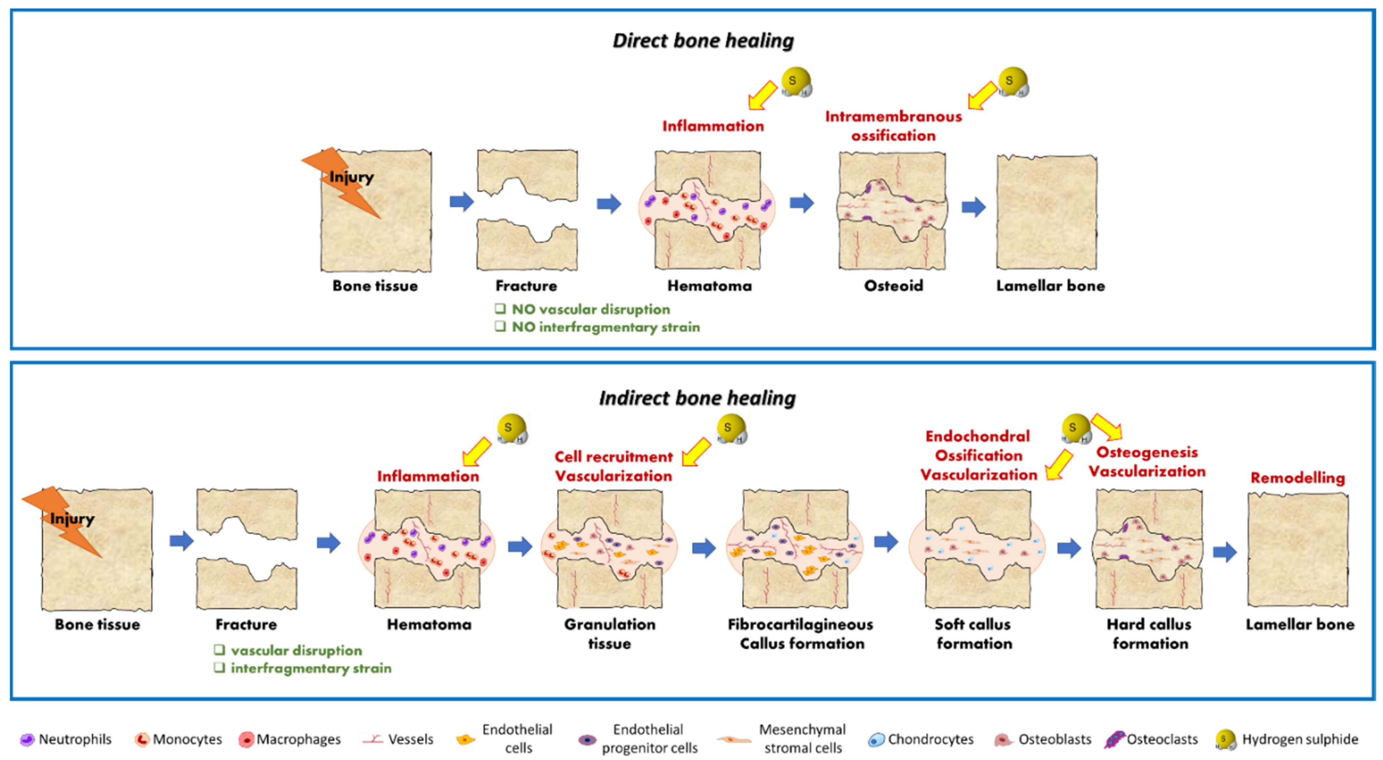
fracture healing
Notes:
Schematic representation of the process of bone fracture healing. Immediately after bone injury, the healing process is initiated by hematoma formation and inflammatory response accompanied by the release of pro-inflammatory cytokines. In direct bone healing (occurring at fractures that are perfectly aligned and with no vascular disruption) the inflammation activates a process of intramembranous ossification which directly produces a new lamellar bone structure without requiring any remodeling step. In indirect bone healing (occurring in fractures with large, hypoxic defects and interfragmentary strains), the intramembranous ossification response occurs subperiosteally directly adjacent to the ends of the fracture, generating a hard callus. Adjacent to the fracture line, endochondral ossification occurs: A cartilaginous callus form and several cells migrates and proliferate within it, building an intermediate cartilaginous template which subsequently undergoes calcification (primary bone formation); the cartilage and primary mineralized matrix are then resorbed and secondary bone formation occurs; ultimately bone remodeling by osteoclasts and osteoblasts take place and the callus is totally replaced by new bone indistinguishable from adjacent, uninjured tissue. The processes by which H₂S may modulate during bone fracture healing are highlighted by a yellow arrow.

Slide 13
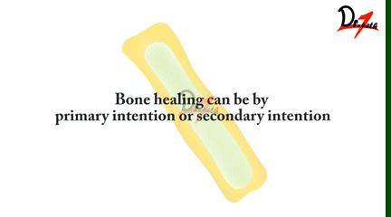
fracture healing

Slide 14

fracture healing
Proinflammatory Cytokines
Interleukins (IL-1, IL-6):IL–1
Tumor Necrosis Factor-α (TNF- α)
Fibroblast growth factor (FG
Insulin–like growth factor (IGF)
Platelet–derived growth factor (PDGF)
Vascular endothelial growth factor (VEGF)
Notes:
Proinflammatory Cytokines
Interleukins (IL-1, IL-6):IL–1: In the acute phase of inflammation, it is secreted by macrophages and stimulates production of IL-6 in osteoblasts, endorses production of the primary callus, and induces angiogenesis. IL–6: During acute phase, it induces angiogenesis, vascular endothelial growth factor production, and the differentiation of osteoblasts and osteoclasts.
Tumor Necrosis Factor-α (TNF- α): Secreted by macrophages, inflammatory cells, and mesenchymal origin cells present in the periosteum (Tsiridis et al. 2007). They endorse recruitment of MSCs. During endochondral ossification, they stimulate apoptosis of hypertrophic chondrocytes. They also stimulate osteoclastic function. In their absence, resorption of mineralized cartilage is delayed, which prohibits new bone formation.
Fibroblast growth factor (FGF): They are synthesized by monocytes, macrophages, mesenchymal cells, osteoblasts, and chondrocytes during bone healing.
FGFs endorse growth and differentiation of a variety of cells such as fibroblasts, myocytes, osteoblasts, and chondrocytes. During the early stages of fracture healing, they play a critical role in angiogenesis and mesenchymal cell mitogenesis. α-FGF mainly regulates chondrocyte proliferation and is probably important for chondrocyte maturation. β-FGF is represented by osteoblasts and is generally more potent than α-FGF. In a canine tibial osteotomy model, a single injection of FGF-2 was associated with an early increase in callus size (Tsiridis et al. 2007).
Insulin–like growth factor (IGF): Sources of IGF-I and II are the bone matrix, endothelial cells, osteoblasts, and chondrocytes. Serum concentration of IGF-I is controlled by growth hormone. IGF-I endorses bone matrix formation. IGF-II plays a role at a later stage of endochondral bone formation and stimulates type I collagen production (Tsiridis et al. 2007).
Platelet–derived growth factor (PDGF): It is secreted by platelets during the early phases of fracture healing, and it is an effective chemotactic stimulator for inflammatory cells and a proliferative and migrative stimulus for MSCs and osteoblasts.
Vascular endothelial growth factor (VEGF): They usually occur during endochondral ossification, and they are essential mediators of neoangiogenesis and endothelial cell-specific mitogens.

Slide 15
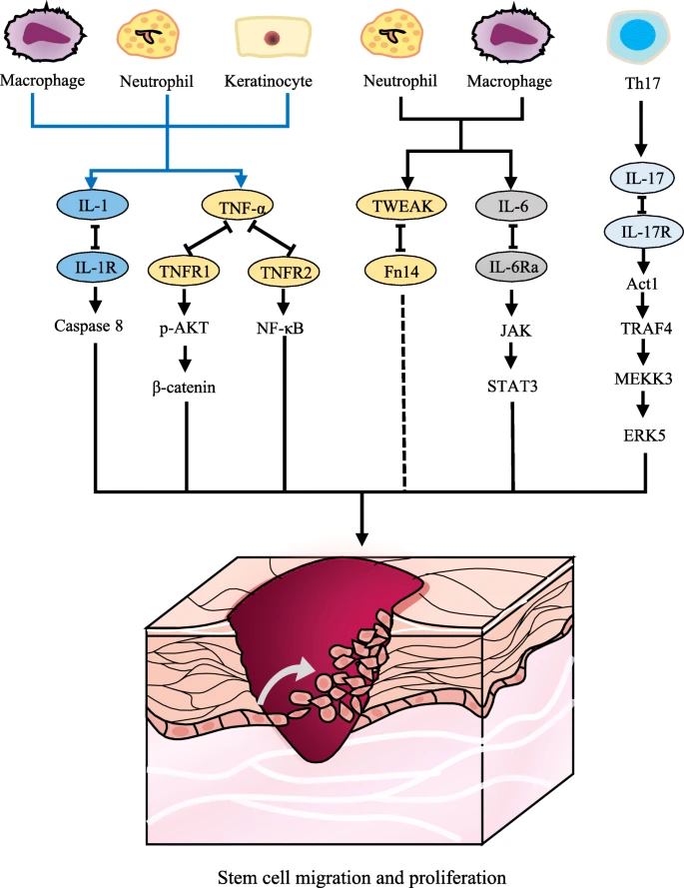
fracture healing
Schematic diagram of proinflammatory cytokines regulating keratinocytes or stem cells. Keratinocytes, neutrophils, and macrophages produce IL-1, which regulates stem cells through the caspase 8 signaling pathway. TNF-α binds to TNFR1 to induce AKT phosphorylation in iSCs or to TNFR2 to activate the NF-κB signaling pathway. Neutrophils and macrophages produce TWEAK, which binds to Fn14, and they have a potential effect on iSCs. IL-6 and IL-17 activate the STAT-JAK and Act1-TRAF4-MEKK3-ERK5 signaling pathways, respectively

Slide 16
fracture healing
Growth and Differentiation Factors
Bone Morphogenic Proteins (BMPs): They are pleiotropic morphogens, which control growth, differentiation, and apoptosis of osteoblasts, chondroblasts, neural cells, and epithelial cells, produced by osteoprogenitor, mesenchymal cells, osteoblasts, and chondrocytes, within the extracellular matrix. They stimulate a sequential cascade of events for chondroosteogenesis (chemotaxis, mesenchymal and osteoprogenitor cell proliferation and differentiation, angiogenesis, and controlled synthesis of extracellular matrix). They can be assessed in for four subgroups:
Group 1: BMP-2 and 4
Group 2: BMP-5, 6, and 7
Group 3: GDF-5 (BMP-14), GDF-6 (BMP-13), GDF-7 (BMP-12)
Group 4: BMP-3 (osteogenin), GDF-10 (BMP-3b)
Notes:
Proinflammatory cytokines initially play a beneficial role in acute wound healing by promoting the proliferation and antimicrobial peptide production of keratinocytes. However, overproduction of proinflammatory cytokines may lead to prolonged inflammation and wound healing. Therefore, blocking excessive proinflammatory cytokines exerts a therapeutic effect in chronic wound healing. Patients with chronic wounds have higher systemic and local levels of TNF-α. Topical application of anti-TNF-α neutralizing antibodies blunts leukocyte recruitment and NF-κB activation, alters the balance between M1 and M2 macrophages, enhances matrix synthesis, and finally accelerates wound healing in the secretory leukocyte protease inhibitor (SLPI) null mouse model, which has age-related delayed human wound healing [58]. Topical application of infliximab and adalimumab, monoclonal antibodies of anti-TNF, is effective for patients with chronic ulcers

Slide 17
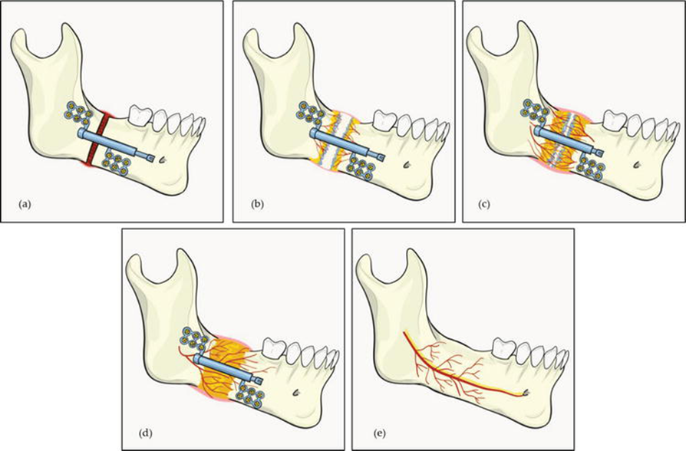
The phases of distraction osteogenesis
Hariri etal,2018
(a) Latency period in which hematoma formation occurs following osteotomy which is later replaced by granulation tissue. (b) During distraction period, bone gap is progressively increased with osteogenesis at the margin of distraction gap. (c) Osteogenesis extend to the Centre of the gap during consolidation phase. (d) Maturation of the ossification in the distraction chamber in late consolidation period. (e) Bone remodeling and continuity of alveolar canal after completion of distraction osteogenesis.

Slide 18
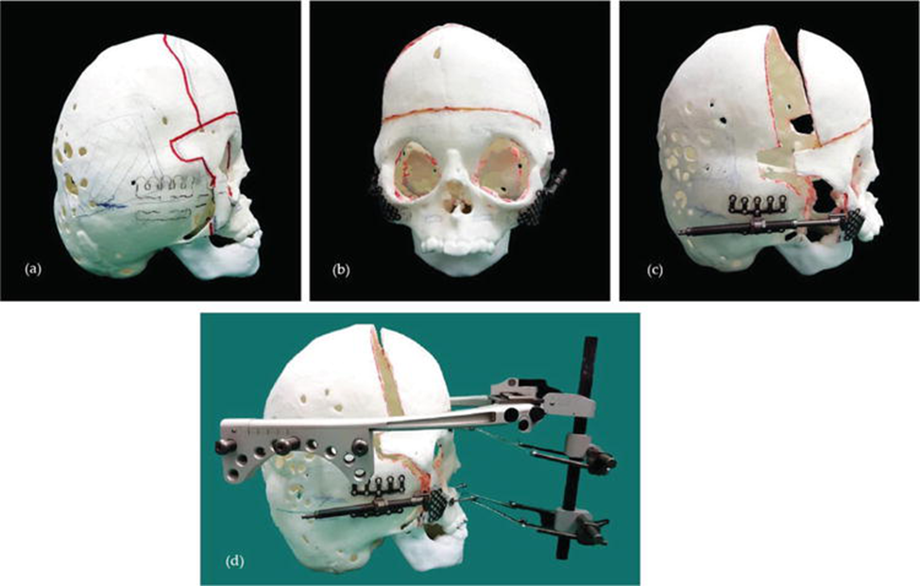
Surgical simulation for DO procedure using stereolithography (STL) model for craniofacial distraction in AP direction. (a) Red line markings indicate the planned osteotomy line. (b) Placement of internal devices at zygoma area bilaterally, parallel in the horizontal plane. (c) Distraction simulation on STL model to confirm correct direction and final position of distracted midfacial bone. (d) Placement of external device to distribute the distraction forces equally to supraorbital and maxillary region, therefore increasing the distraction stability.

Slide 19
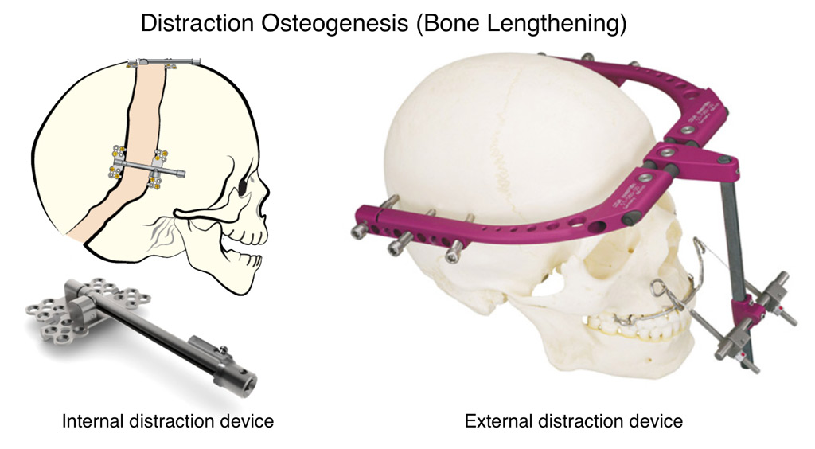
Distractor devices are generally classified as external or internal. External device is bone-borne, consisting of fixation clamps and distraction rods which are attached to the bone by percutaneous pins. Internal device can be placed subcutaneously or intraorally, and subdivided into bone-borne, tooth-borne or hybrid (a combination of bone-borne and tooth-borne).
Prajwalit etal,2021

Slide 20
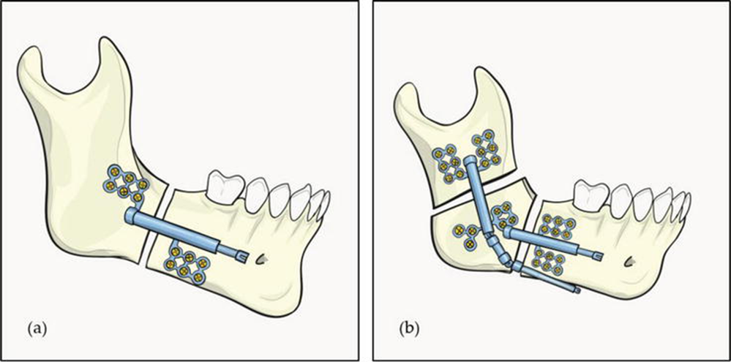
The devices are available in different vectors of distraction. Most commonly used is unidirectional or single vector distractor. There are also bidirectional, multidirectional and curvilinear distractors .

Slide 21
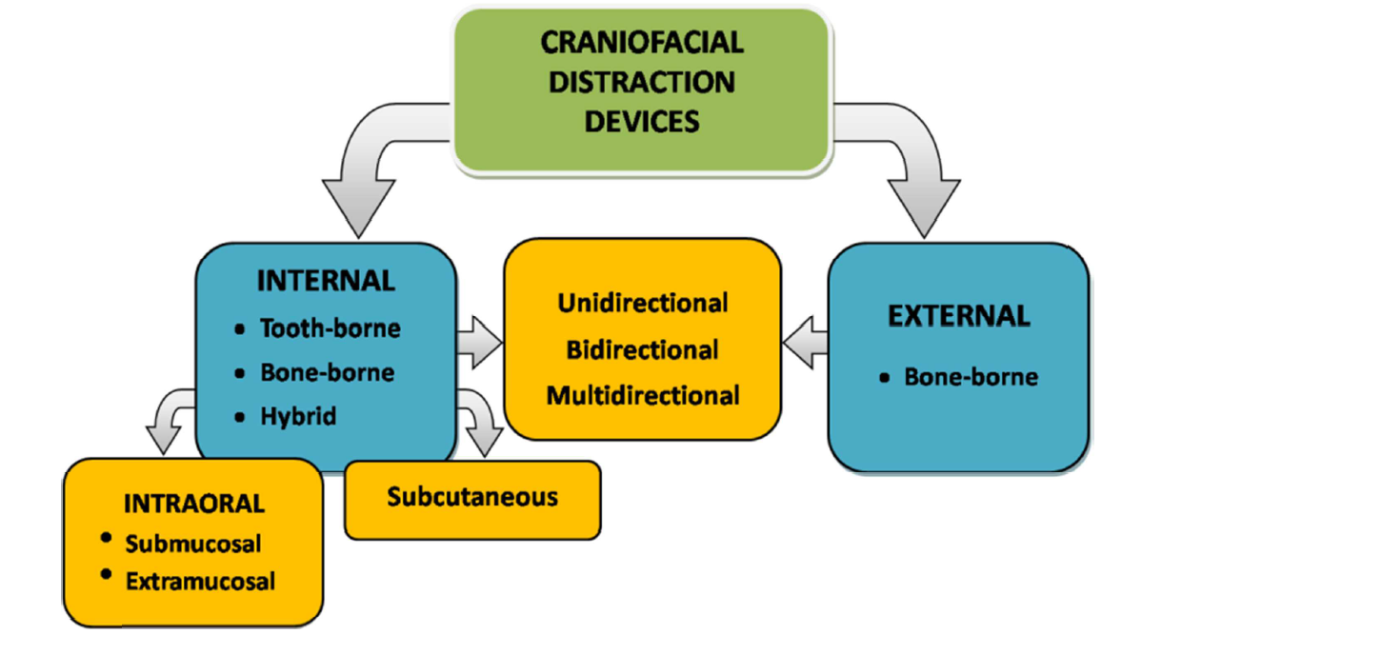
Classification of Craniofacial Distraction Devices

Slide 22
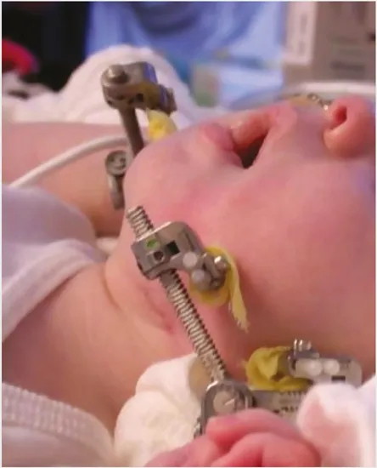
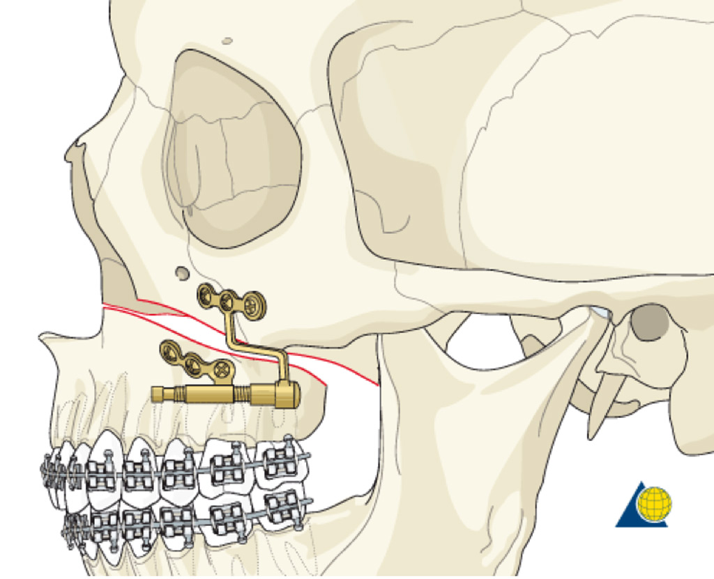
External device allows better vector control in multidirectional lengthening with adjustment possible during the distraction period. Internal devices carry less morbidity but both types of distractor device are associated with their own complications .
(Carls, 1998)

Slide 23

The choice of distractor depends on
the site of device application,
vector of distraction path,
magnitude of movement,
patient’s factors such as age, medical comorbidities, financial
as well as surgeon’s preference.

Slide 24
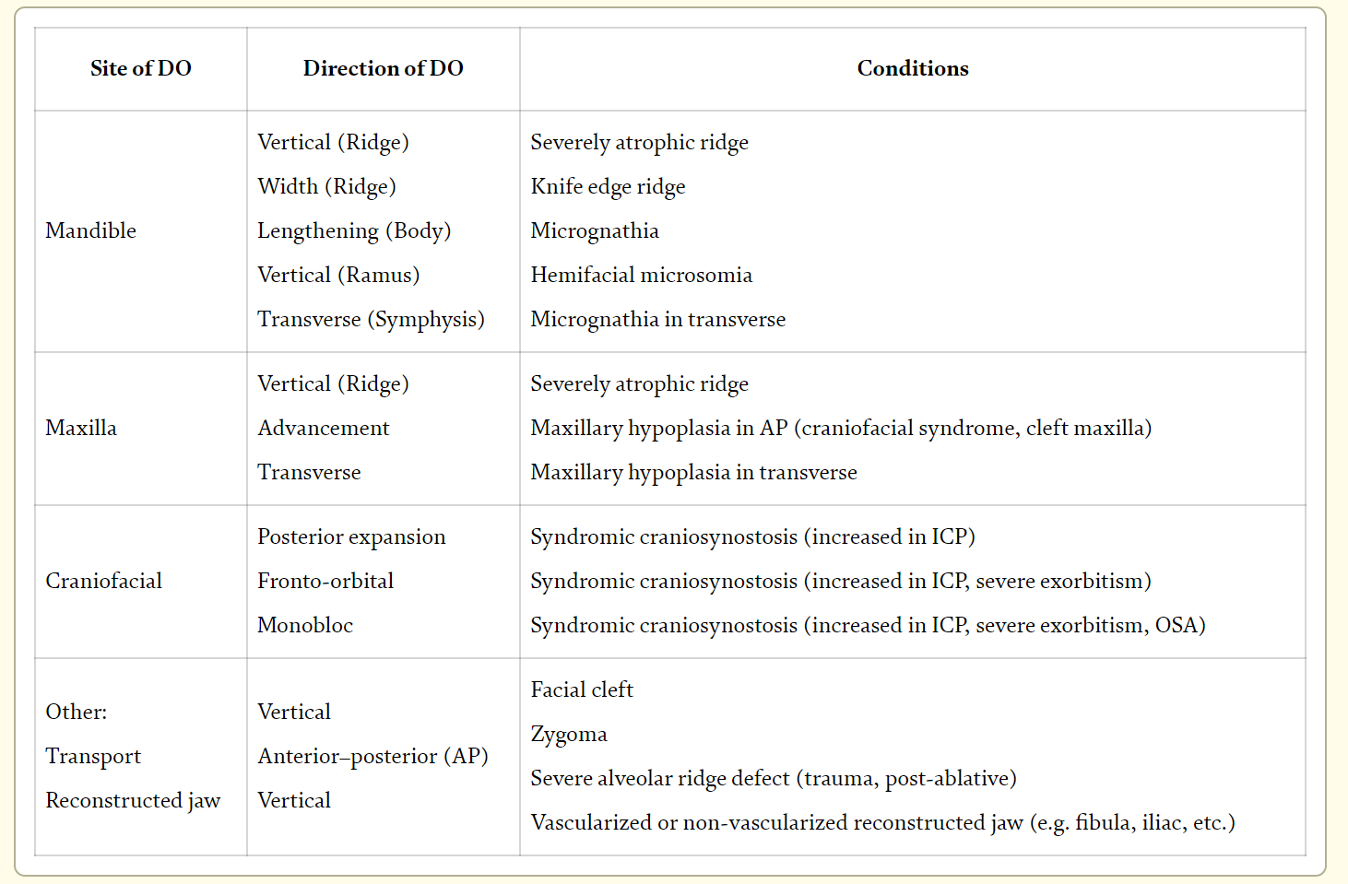

Indications for DO.

Slide 25

Protocol
There is a wide variation in the protocol of craniomaxillofacial distraction. Following osteotomy, latency period ranges from 3 to 7 days. Standard activation rate is 1 mm per day. Faster rate may cause incomplete osteogenesis or fibrous union while slower rate may result in premature ossification.
However, successful distraction in pediatric population has been reported with latency period as little as 24 hours, owing to significant vascularity and healing potential in young bone. In addition, distraction of 2 mm per day is proven safe and provide similar success rate as 1 mm per day in children younger than 12 months .
(Breik, 2016)

Slide 26
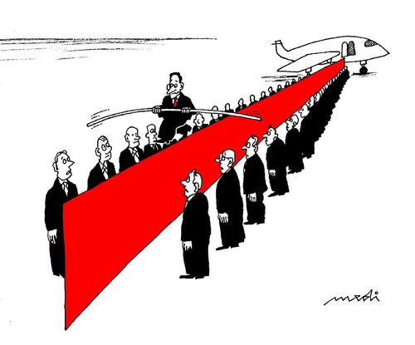
Protocol
Rhythm of activation can be adjusted based on manufacturer’s design of activation rod.
One full turn may represent 0.35, 0.5 or 1.0 mm.
Therefore, amount of desired daily bone lengthening can be divided throughout the day instead of single activation to produce higher bone quality in terms of volume and architecture.
Amid this, an experimental study by Djasim et al. concluded that an increase in rhythm from one to three activations daily does not create significantly more bone.
With the advent of automated device for continuous distraction, it allows bone fill at faster distraction rate compared to discontinuous distraction (Smith, 1999)

Slide 27
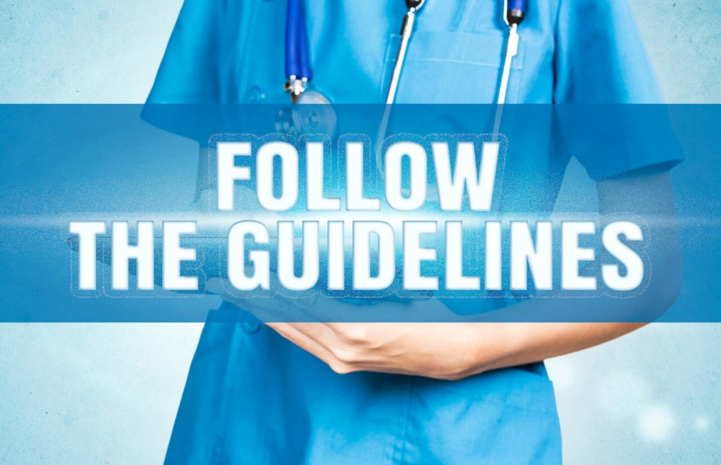
Period of consolidation
Is based upon the length of bony distraction. An experimental study on dog mandible by Smith et al. demonstrated that minimum time for bone regenerate to mineralize is 6–8 weeks, however they suggested that this period should be extended up to 10 or 12 weeks in human population.
The authors also discussed that the Ilizarov protocol which was based on long bone lengthening of allowing 2 days of consolidation for each millimeter of distraction does not apply in craniomaxillofacial bone. As craniomaxillofacial bone distraction is shorter in length as compared to lower limb distraction, it is less mineralized at the beginning of consolidation period therefore needing a longer consolidation period.

Slide 28
Period of consolidation
Whereas in long bones, due to more length of distraction, mineralization of regenerate would have started during distraction period itself resulting in less regenerate needed to be mineralized during consolidation period itself.
Most commonly practiced consolidation period for craniomaxillofacial region is 12 weeks.This duration may be lengthened based on surgeon’s clinical judgment such as in syndromic craniosynostosis cases. However, to accommodate patient’s and parents’ schedule, distraction devices are often removed well past the determined consolidation period.
(Alkan, 2017)

Slide 29
History of the Procedure
The history of DO begins with the old techniques of repositioning and stabilization of bone fractures used by Hippocrates, as noted in the book by Samchukov, Cherkashin, and Cope (1999).
In early 20th century Alessandro Codivilla (1905) introduced a crude method of DO for lengthening of the lower limbs.
Later, Abbott (1927) improved the Codivilla method by incorporating pins instead of casts; and Rosenthal (1930) first
performed this technique in the maxillofacial region; who was followed by Kazanjian (1941) and Crawford (1948).
Subsequently, Allan (1948) incorporated a screw device to control the rate of distraction.
However, DO did not gain immediate acceptance until the
breakthrough in 1951 when Gavril Ilizarov (1969), developed a technique for repairing complex fractures or nonunion of the long bones. Ilizarov’s procedure was based on the biology of bone and the ability of the surrounding soft-tissues to regenerate under tension.

Slide 30
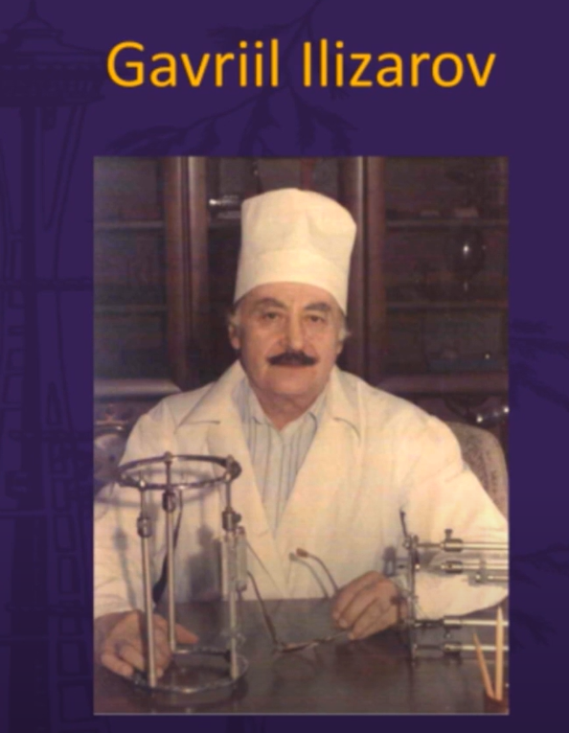
History of Ilizarov
Prof. Gavriil Abramovich Ilizarov started his career treating a number of patients in western Siberia, who had returned from World War II having sustained fractures. During the 1950s, Ilizarov began experimenting with external fixation designs; in 1954, he successfully treated his first patient, a factory worker with a tibial non-union. He experienced excellent results, significantly reducing healing time. During this time, he also, by chance, discovered distraction osteogenesis for bone lengthening when he observed callus formation in a patient who had mistakenly distracted his frame instead of compressing it.

Slide 31
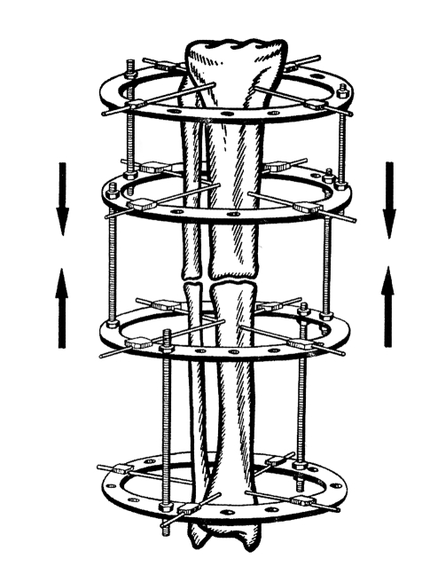
History of Ilizarov
Two ring blocks being compressed together. Note each block consists of two rings with two points of fixation per ring. Threaded rods are parallel to each bone segment, preserving alignment of the entire bone. Although this illustration only depicts two connecting rods, four are needed for adequate stability
Spiegelberg etal,2010
Notes:
History of Ilizarov
Prof. Gavriil Abramovich Ilizarov started his career treating a number of patients in western Siberia, who had returned from World War II having sustained fractures. During the 1950s, Ilizarov began experimenting with external fixation designs; in 1954, he successfully treated his first patient, a factory worker with a tibial non-union. He experienced excellent results, significantly reducing healing time. During this time, he also, by chance, discovered distraction osteogenesis for bone lengthening when he observed callus formation in a patient who had mistakenly distracted his frame instead of compressing it.
In 1968, Valery Brumel, an Olympic champion high jumper at the 1964 games, visited Ilizarov in Kurgan. He had suffered a compound fracture of his distal tibia in 1965 and, despite 20 operations over 3 years, had developed an infected non-union and a significant leg-length discrepancy. His resultant surgery was a widely publicised success and gained Ilizarov recognition within the Soviet Union.
In 1980, Carlo Mauri, a well-known Italian journalist and explorer, was treated in Kurgan. Mauri had suffered a distal tibial fracture 10 years previously during an Alpine accident. Whilst on an Atlantic exploration, his old leg wound re-opened and a Russian team physician advised him to consult Ilizarov in Kurgan. On his return to Italy, the surgeons were amazed by the healing that had occurred in this long-standing non-union and, the following year, arranged for Ilizarov to present his findings at the AO Conference in Bellagio. News of this advance was quick to travel and very soon was being adopted by surgeons both sides of the Atlantic.

Slide 32
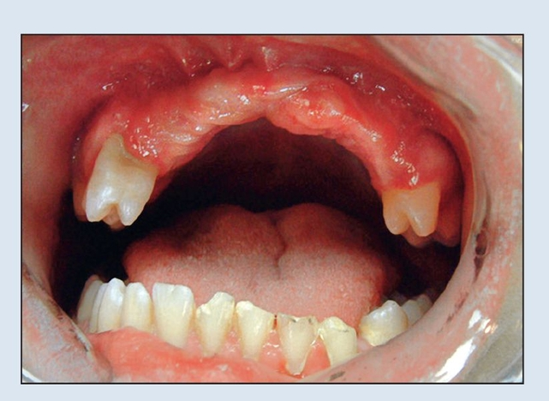
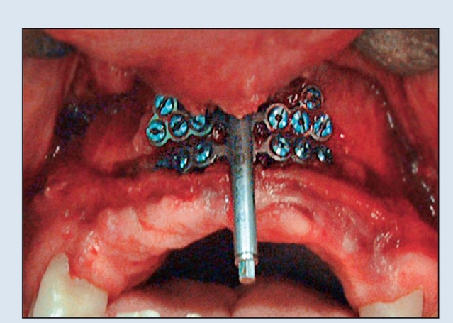
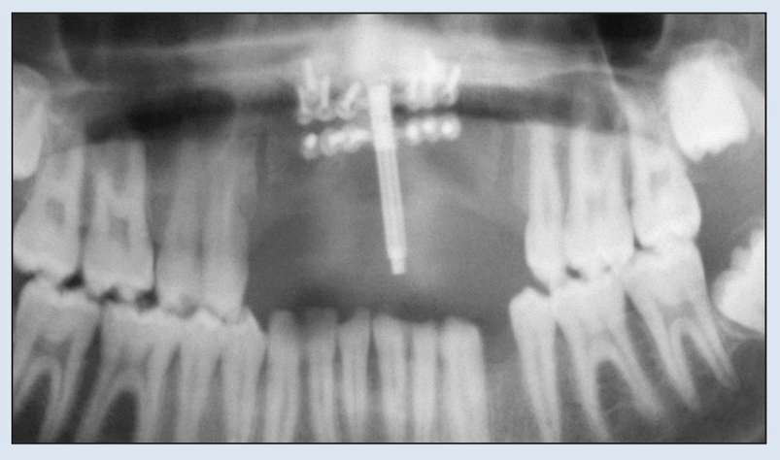
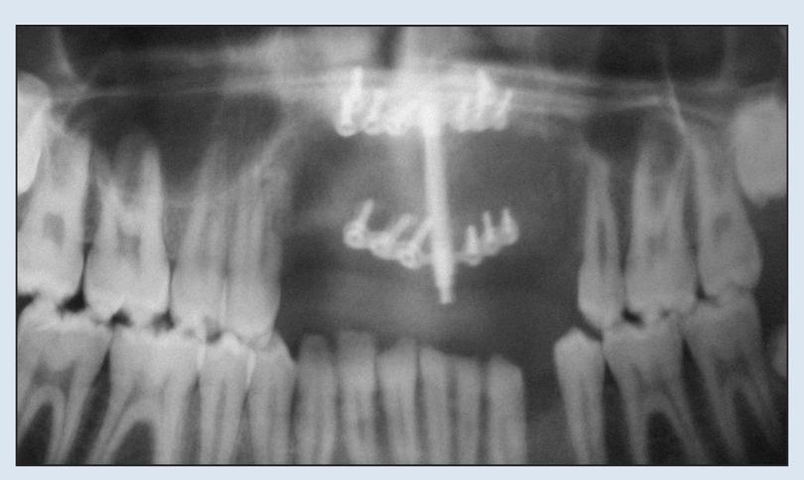
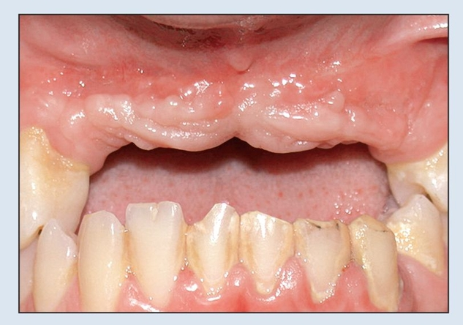
Clinical application
Alveolar DO
In deficient alveolar bone height for implant placement, DO could increase bone level up to 16 mm at the rate of 1 mm per day . However, comprehensive assessment is required in a severely resorbed ridge as minimal thickness for both basal and transport segment are necessary for the fixation of the distractor plates. It is also very important to ensure the lingual or palatal mucosa remains intact to the transport segment for vascularization.
Laster etal,2015

Slide 33
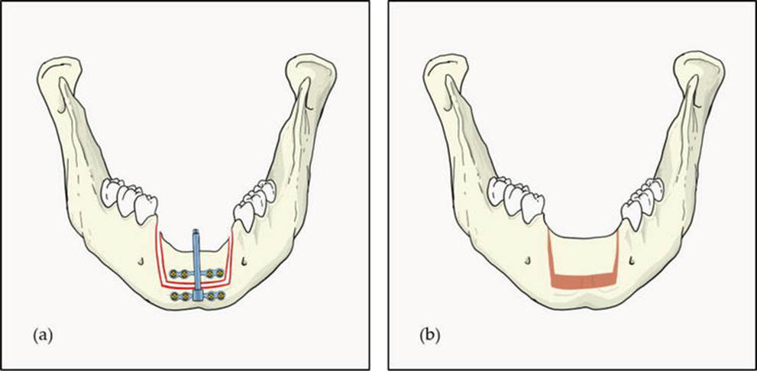

Slide 34
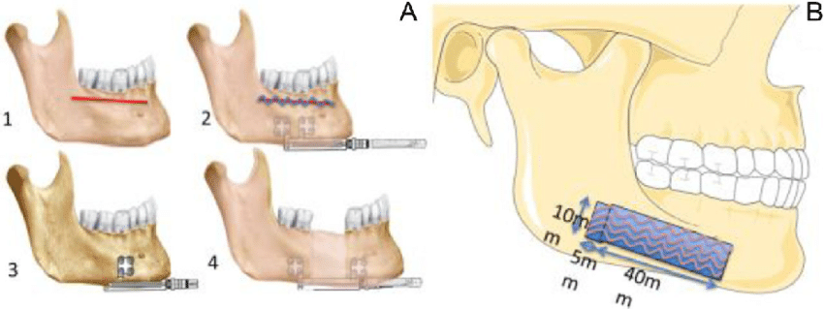
Mandibular DO
In micrognathia or mandibular hypoplasia in anterior–posterior (AP) direction, DO can be considered when superior mandibular body lengthening is needed . In comparison, a conventional bilateral sagittal split osteotomy may allow up to 10 mm of jaw lengthening while up to 30 mm advancement could be achieved with DO subjected to the size of device (Baur, 2021).
Dallard etal,2019

Slide 35
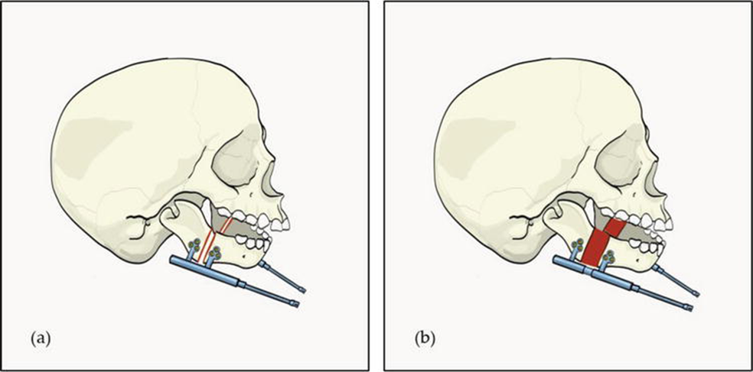
Mandibular DO
Example of mandibular DO for hypoplastic mandible. (a) Application of internal distractor device in parallelism for bilateral mandibular lengthening. (b) Distracted mandible in AP direction.

Slide 36
Mandibular DO
Mandibular DO is often indicated in cases of
OSA secondary to conditions such as Treacher Collins syndrome and non-syndromic micrognathia.
Improvement in apnea hypopnea index (AHI) score could be seen after 15 mm of DO and the distraction could continue up to 25 mm until an acceptable AHI of less than 5 is achieved.
However, the determination of distraction vector is paramount as deviated mandibular arch position at the end of distraction procedure may lead to severe malocclusion. Precaution is also needed intra-operatively as the osteotomy carries the risk of inferior dental nerve injury.

Slide 37
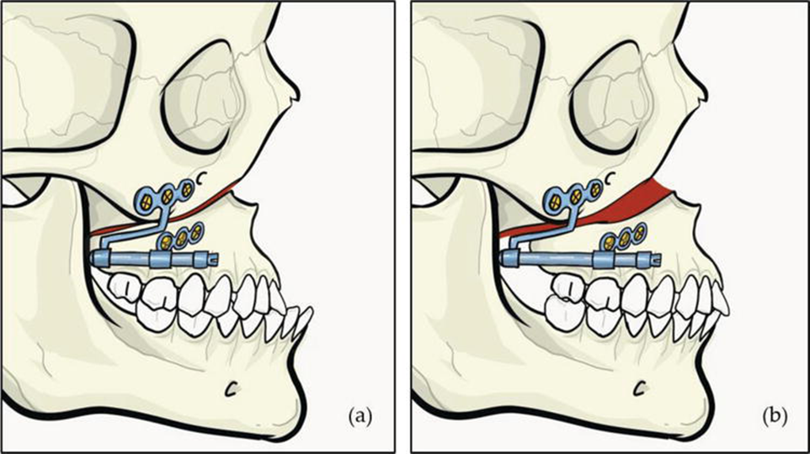
Maxillary DO
This technique can be applied for maxillary advancement in patients with OSA secondary to severe maxillary or midface hypoplasia (Figure 6). Other condition such as cleft maxillary hypoplasia may also need superior segmental advancement to correct the class III jaw discrepancy. Traditional Le Fort I osteotomy with superior advancement may carry the risk of significant relapse due to scar formation and soft tissue memory. (Shah, 2021) DO allows controlled soft tissue expansion and consolidation period thus reducing this problem.
Example of maxillary DO hypoplastic maxilla. (a) Application of internal distractor device following osteotomy. (b) Distracted maxilla in AP direction.

Slide 38
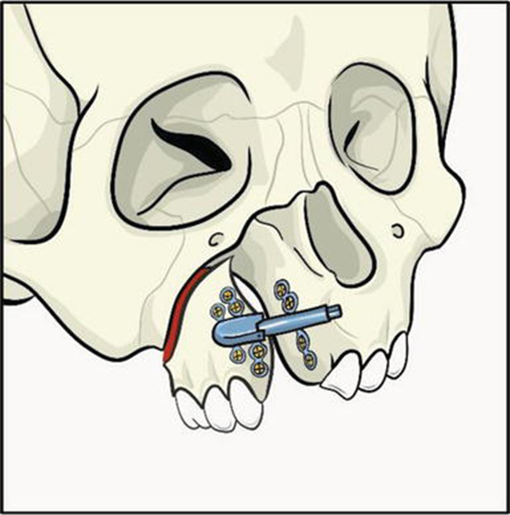
Transport DO
Transport DO can be indicated in a condition where significant defect is presence (Figure 7). Defect can be secondary to post-ablative procedure such as in maxillectomy, huge cyst enucleation or congenital condition such as in facial cleft. Comprehensive planning is important as the pre-determination of osteotomy design and vector is paramount in ensuring the right position for the transported segment is achieved at the targeted opposing bony region. The challenging aspect of transport DO is to ensure the vascularity and maintaining an intact distraction chamber as failure to do so may lead to transport segment resorption resulting to a more severe defect.
Application of transport DO to reconstruct a defect in the right maxillary bone.

Slide 39
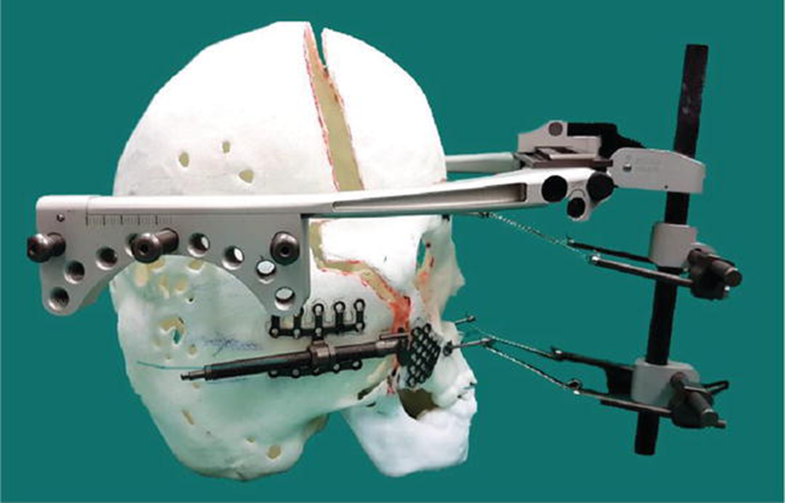
Craniofacial DO
Complex congenital craniofacial cases such as syndromic craniosynostosis may cause serious functional impairment (Figure 8). These conditions include Crouzon, Apert and Pfeiffer syndrome in which patients may suffer serious functional problems associated to increased ICP, severe exorbitism and OSA secondary to structural growth abnormality related to the early fusion of cranial sutures.
Craniofacial DO in a Pfeiffer syndrome patient incorporating external and internal devices. External device in which the head frame is fixed at parietal region using percutaneous cranial pins uses pulling mechanism by wires at supraorbital and maxillary regions to advance the bone. Internal device at zygoma area uses pushing mechanism to push the bone forward. Combination of these two mechanisms provide a stable distraction of the midfacial bone with equal distribution of forces.

Slide 40
Craniofacial DO
Despite its huge size, this external device is made of lightweight aluminum, titanium and carbon fiber components for patient comfort.
Patients with these problems often require massive segmental expansion of the skull and midface region to decompress the restricted intracranial space, achieving orbital protection and eyelid closure as well as opening up the nasopharyngeal space to treat the respective functional issues. Devices used for these cases may either be an external distractor device or internal devices or a combination of both (Hariri, 2017)

Slide 41
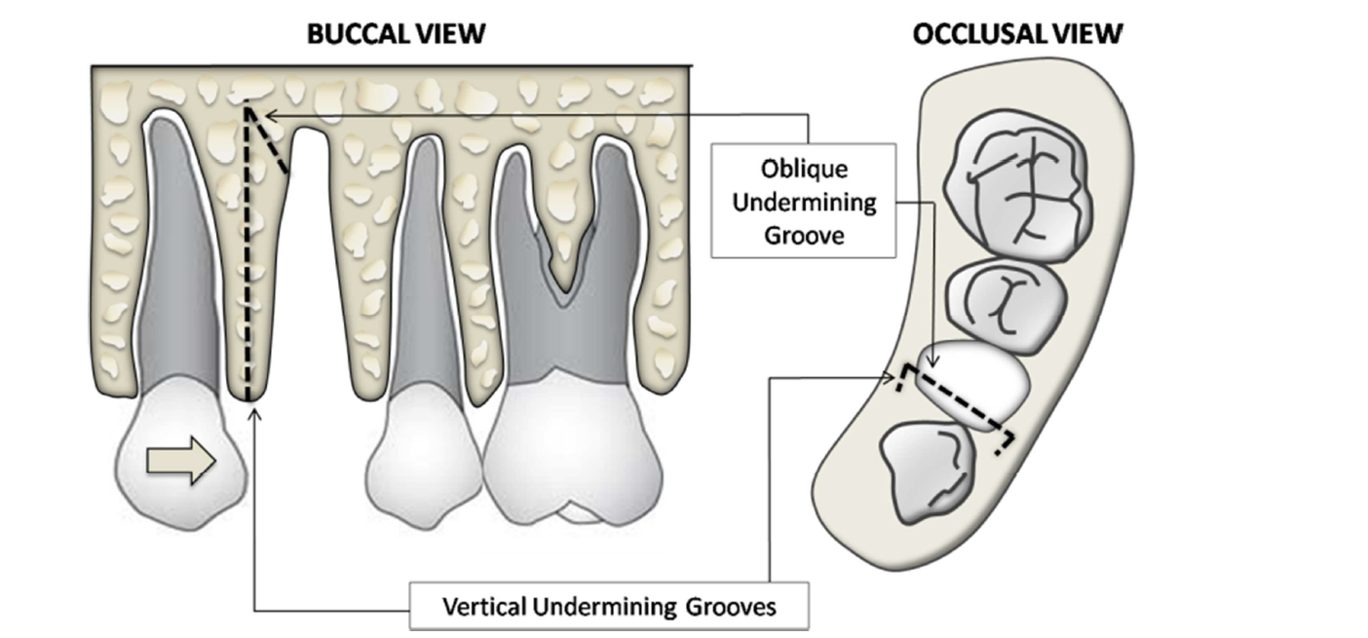
Periodontal Ligament (Dental) Distraction
Surgical Technique Involving Vertical and Oblique Undermining Grooves
(Osteotomies) to Eliminate Interseptal Bone Resistance Distal to Canine. No Cuts are
Performed on Buccal and Lingual Plates
George and Thomas,2014

Slide 42
Dentoalveolar Distraction
(DAD)
This more commonly used surgical
procedure involves peripheral osteotomies
in relation to the canine tooth and can be
done precisely with the aid of CT scan
(Figure 3). Periapical and panoramic
radiographs supplemented with CT scan
imaging are taken at the start and end of
the distraction and consolidation. The
osteotomy sites, root structures, individual
length of the canine teeth, proximity of the
maxillary sinus and the mental foramen
can be accurately determined.
George and Thomas,2014

Slide 43
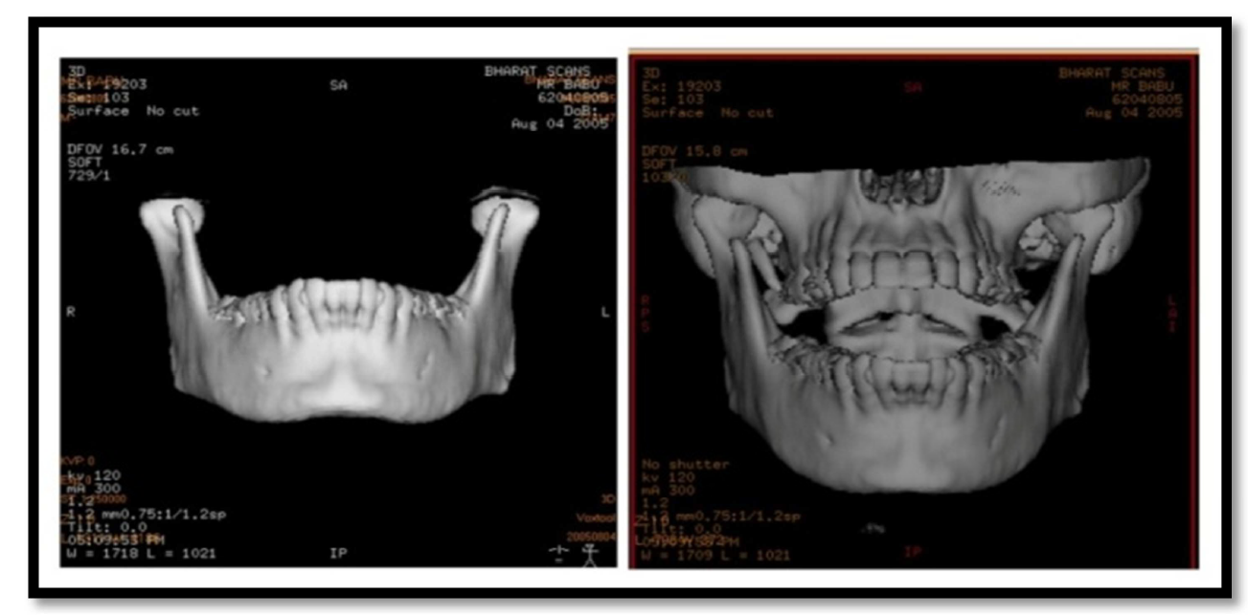
Dentoalveolar Distraction
(DAD)
Pre Operative CT Scan Assessment
George and Thomas,2014

Slide 44
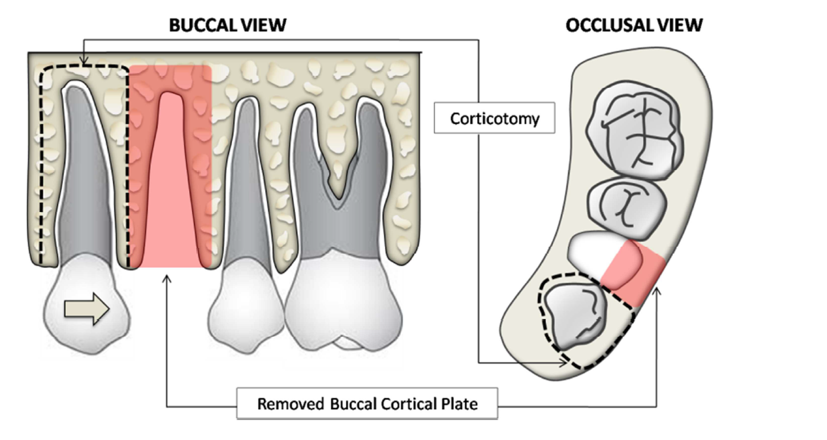
Dentoalveolar Distraction
(DAD)
Surgical Technique Involving Vertical and Horizontal Corticotomies. After
Removal of the Buccal Cortical Plate in Relation to the Extraction Socket the
Dentoalveolar Segment Will be Used as Transport Unit to Carry Canine Posteriorly
George and Thomas,2014

Slide 45
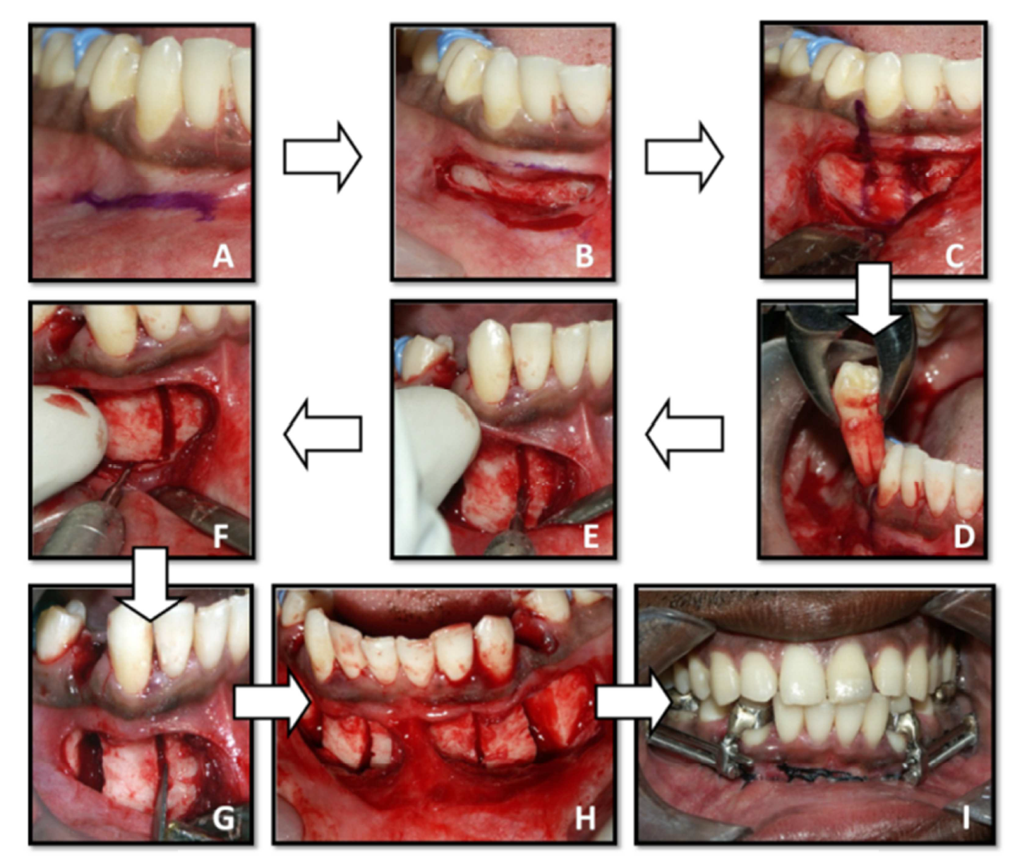
Dentoalveolar Distraction
(DAD)
Sequential Steps Involved in the Surgical Technique for Dentoalveolar
Distraction. (A) & (B) Horizontal Mucosal Incision; (C) Osteotomy Lines and Cortical
Holes Marked; (D) First Premolar Extracted; (E) & (F) Vertical and Horizontal
Osteotomies and Removed Cortical Plate; (G) Osteotomes Applied to Mobilize the
Alveolar Segment; (H) & (I) Post Surgery and Appliance Cementation
George and Thomas,2014

Slide 46
Majority of the individual canine
distractors currently used are custom
made,
1. An anterior segment: adapted onto the
canine.
2. A posterior segment: includes a
retention arm adapted onto the molar,
and a grooved screw slot.
3. A screw: of standardized diameter and a
pitch.
4. Sliding rod: acts as a guidance bar
through which the anterior segment
slides, and
5. Screw wrench or driver: to advance the
screw.
George and Thomas,2014

Slide 47
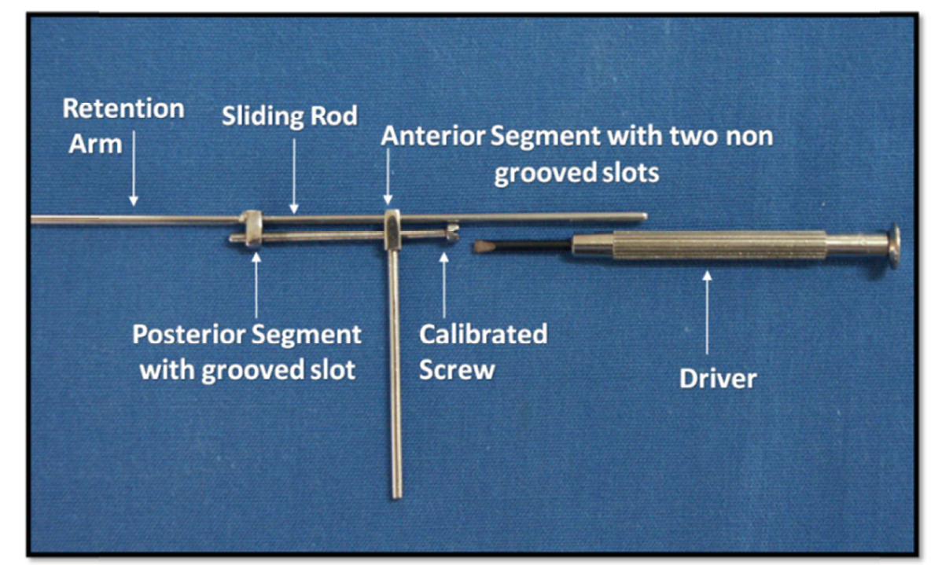
Custom Made Distractor Device
George and Thomas,2014

Slide 48
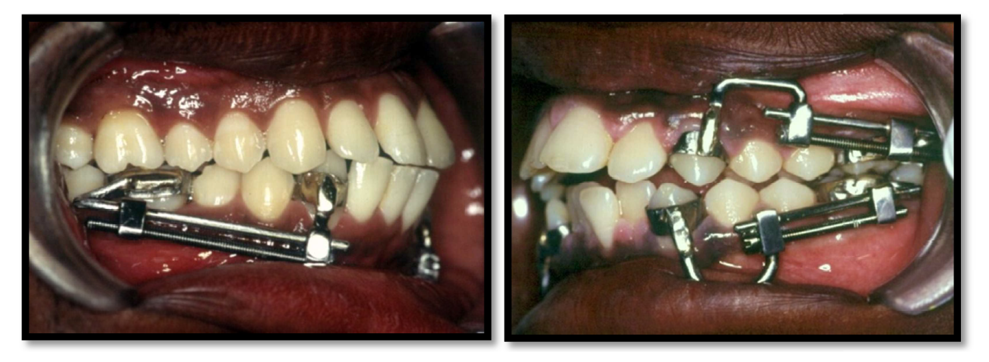
Dentoalveolar Distraction
(DAD)
Canine Distraction Appliances
George and Thomas,2014

Slide 49
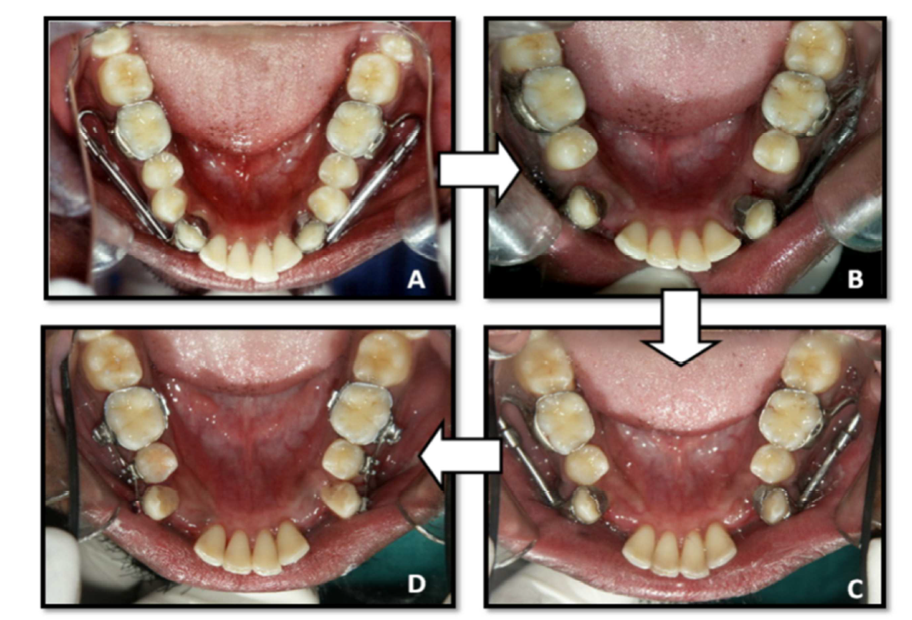
Dentoalveolar Distraction
(DAD)
George and Thomas,2014
(A) Pre Distraction; (B) during Distraction Phase (6days); (C) & (D) Post
Distraction (14 Days)

Slide 50
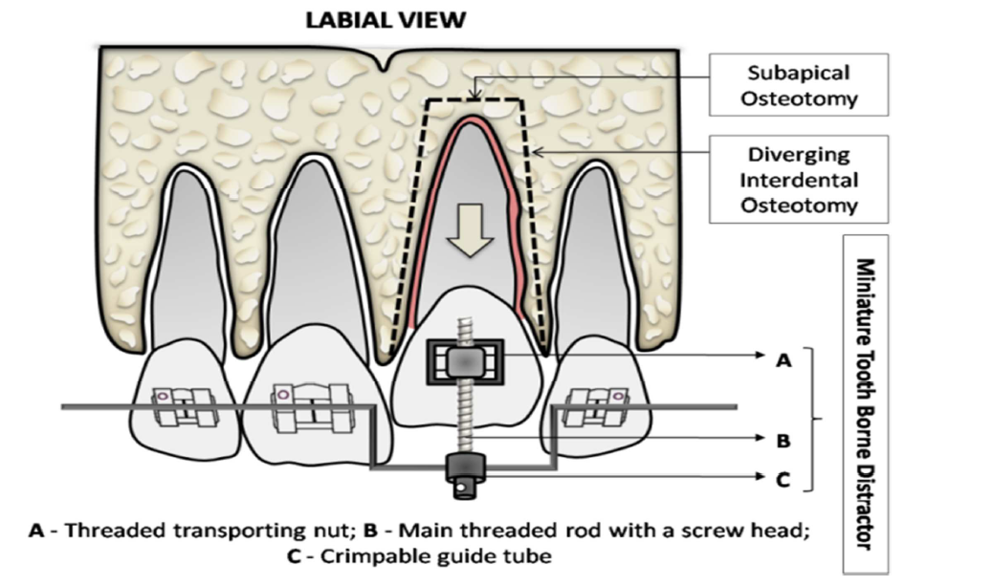
Management of Ankylosed Tooth
Surgical Technique Involving a Miniature Tooth Borne Distractor for Movement
of Ankylosed Tooth
George and Thomas,2014

Slide 51
Complication
(1) technical failure of the distraction process,
(2) injury to a vital structure,
(3) failure to guide the distraction process along the appropriate vector,
(4) infection and
(5) ‘other’. (Mofid, 2001).

Slide 52
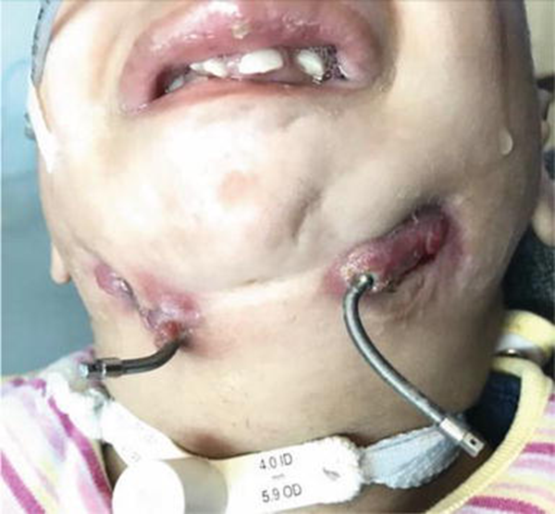
Complication
Common complication of a localized infection at the exit wound of mandibular distractor’s activation rods

Slide 53
Complication
In 2002, after reviewing 70 cases of bilateral mandibular distraction osteogenesis, van Strijen et al. has divided complications into three groups:
(1) intraoperative,
(2) intradistraction and
(3) post distraction.

Slide 54
Complication
In 2014, Mahdah et al. has adopted this classification and then further divided it into
device-related and non-device related.
Cheung et al. has described almost similar classification in which they divided the complications into stages namely: intraoperative, latency period, active distraction and consolidation.
Shetye et al. (Cheung, 2010). reported a stratification system for mandibular osteogenesis in which incidents related to hardware ادواتor hard and soft tissue were subdivided into minor, moderate, and major.

Slide 55
Complication
Agarwal (2013) used the same method as written by Cherkashin and Samchukov by separating the unfavorable result into error and complications.
An error is an inattentive action that results in a deviation of the course of treatment thereby leading to the development of a complication whereas a complication is an unexpected deviation from the treatment plan that without appropriate correction will lead to worsening of the existing, development of a new or recurrence of the initial pathologic process. Complications of distraction can be further categorized into two categories, technical complications and specific complications.

Slide 56
Complication
In a systemic review paper on complications of mandibular DO, an index was developed to standardized classification that is more detailed with regards to the relevant clinical situation and possible further treatment and is more widely applicable for use by clinicians
The severity and frequency of complications that may occur is correlated with the extent of the surgery. Overall, DO at craniomaxillofacial region is relatively safe. The rate of published complications in DO can vary from 27.7–40% . From literature review, average percentage of complications for alveolar DO was 36.3% , mandibular DO ranges from 20.5% to 35.6% and cumulative percentage at craniofacial region was found to be 35.6 percent . (Master, 2010).

Slide 57
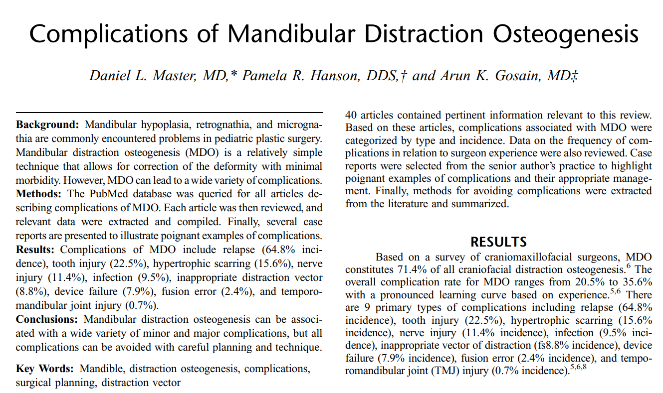
CONCLUSIONS Mandibular distraction osteogenesis can be associated with a wide variety of complications. However, all of these complications can be minimized or avoided in most cases with appropriate preoperative planning, meticulous intraoperative technique, and thorough postoperative management. REFERENC

Slide 58
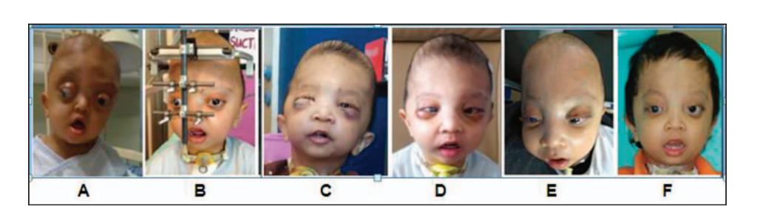
Complication
Percentage of complications in craniomaxillofacial DO.
There are few rare complications reported related to this field.
Hariri et al. (Hariri, 2015). has reported a case of eye exodeviation with limited abduction during monobloc Le Fort III DO.
With regards to mandibular DO, a case of severe temporal bone resorption after mandibular DO was reported and in 2017, two cases of temporomandibular joint ankylosis after early mandibular DO were noted.
Many of these complications can be avoided with meticulous technique and planning, but early recognition will optimize the outcomes for both patients and their family . (Winters, 2014).
. (Hariri, 2015).

Slide 59
Research and advances
Distraction osteogenesis offers many advantages in craniofacial surgical practice, such as the ability of correction of the deformity without the need for a bone graft . Because of the advances in surgical technique and technical equipment, the indications of the DO have significantly widened .
There has been an explosion of distractor designs available on the market in the last 20 years. Further development is limited by the intermittent mode of distraction activation and the mechanical age may soon be replaced by biological modulation of distraction for compromised tissues and hosts. Emerging results of distraction from some new research directions are further elaborated below . (Cheung, 2010)

Slide 60
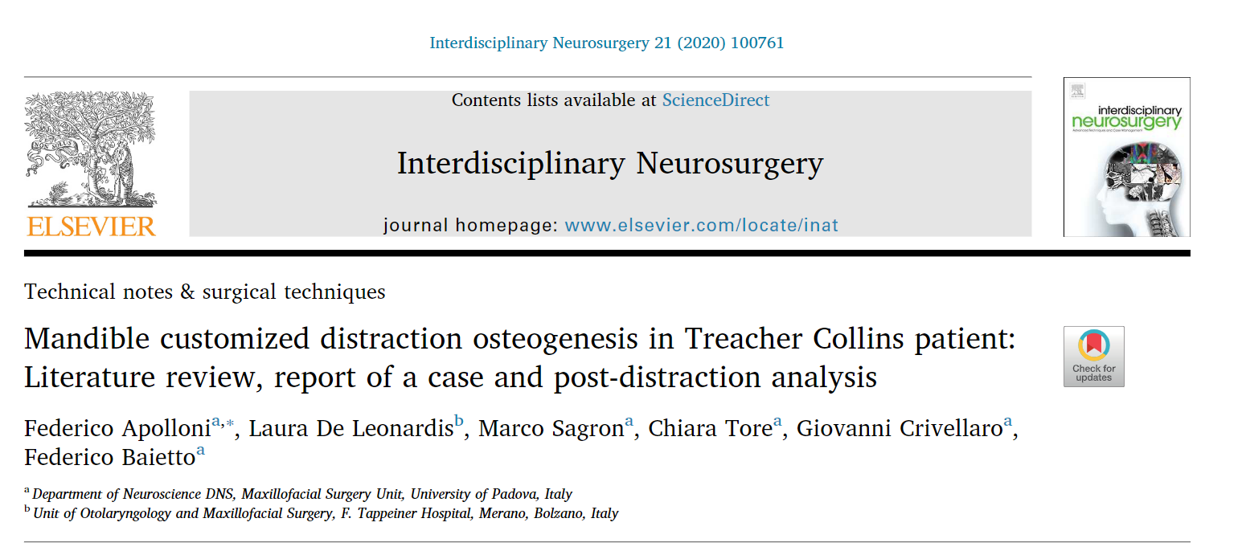

Slide 61
Automated continuous DO
Currently available distraction devices are patient and surgeon dependent. The patient must adjust the manual control two or more times daily, often over long periods. Because non-compliance and device failure are the leading causes of treatment failure, the patient requires numerous clinical visits to ensure proper distractor activation .
Considering these drawbacks, many research groups are working to design novel distraction devices that expand automatically and continuously.
An automated mechanism would eliminate the need for patient compliance and decrease the frequency of post-operative visits for patient supervision.

Slide 62
Automated continuous DO
At the moment, the types of these devices are classified into three categories based on the method of power:
hydraulic,
motor-driven and
spring-mediated .
It has also been reported that continuous distraction may be carried out at rates up to 2 mm per day with formation of bone in the gap. This would allow greater distraction distances in a shorter period, without sacrificing bone quality . (Kessler, 2005).

Slide 63
Administration of growth factors to enhance bone healing
Great efforts have been made by researchers and clinicians to promote bone formation via local and systematic administration of angiogenic and osteogenic growth factors or cytokines, including
bone morphogenic protein (BMP), transforming growth factor beta (TGF-β), platelet-derived growth factor (PDGF), vascular endothelial growth factor (VEGF), and fibroblast growth factor (FGF). Among all these growth factors and cytokines, BMPs play the most important role in bone healing and regeneration by inducing the osteogenic differentiation of mesenchymal stem cells and have a synergistic effect with the angiogenic growth factor, VEGF (Cheung, 2010). On a rabbit model of mandibular lengthening, recombinant human (rh) BMP-2 has been demonstrated to enhance bone ossification at both routine and rapid distraction rates. The addition of rhBMP-2 was able to compensate for the rapid distraction rate in DO [. Nevertheless, the effectiveness of delivery method, cost and biological safety still require further investigation .

Slide 65
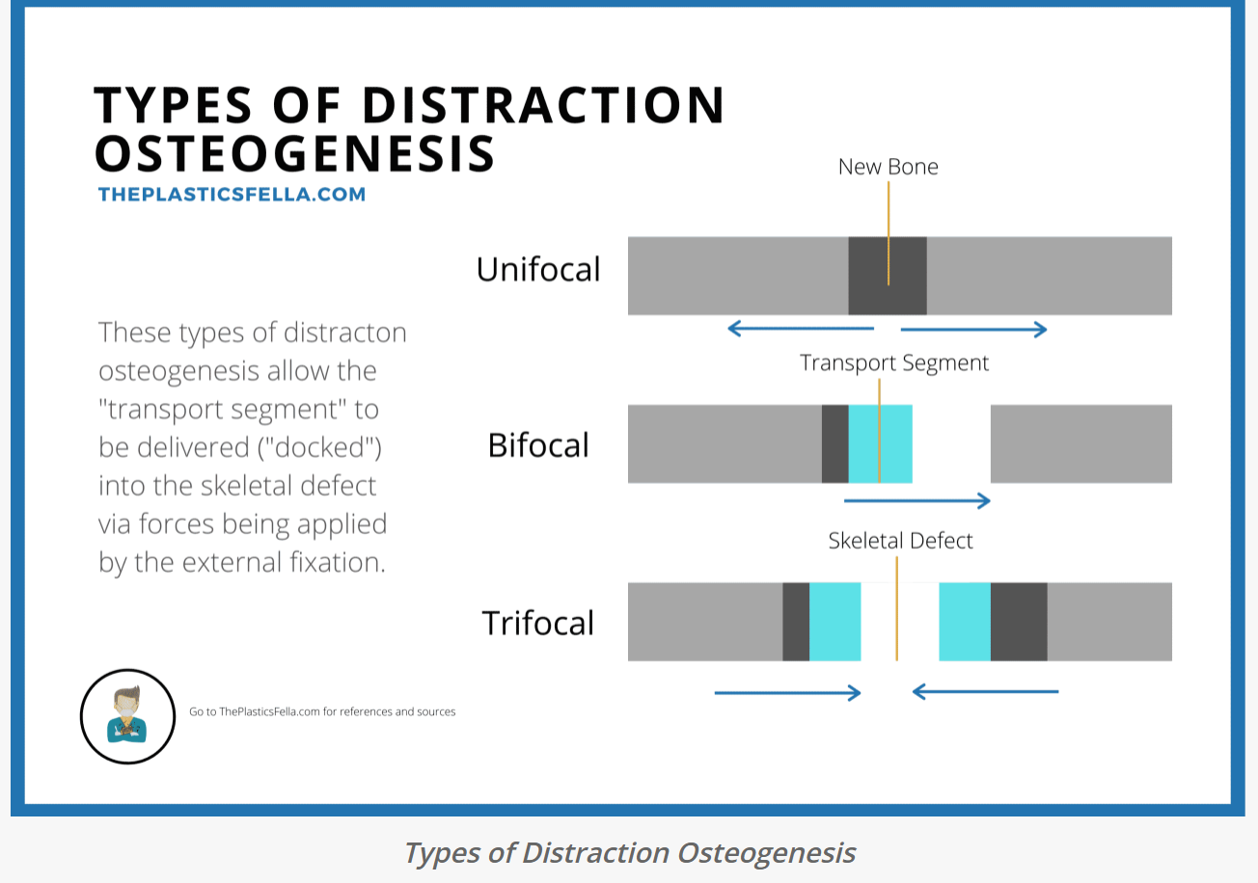

Slide 66
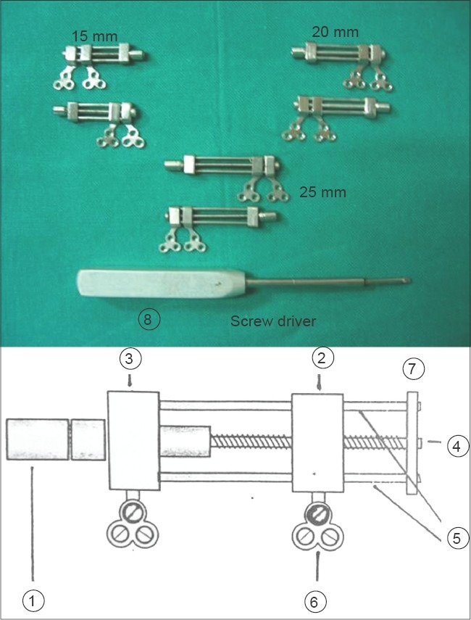
Notes:
Intraoral custom-made distraction osteogenesis device for mandible. Components: The various components of distraction assembly suggestive of functions they carry out (1) Sleeve for the distraction screw (2) Fixed block comprising of three-hole stainless steel triangular bone plate fixed to the medial fragment with the help of three 2mm monocortical screws (3) Movable block also comprising of three hole stainless steel triangular bone plate fixed to the distal fragment which moves along the threaded rod with the fragment at the time of distraction (4) Threaded central rod each thread of the rod has the pitch of 0.5mm, therefore one turn of 360degrees brings about distraction of 0.5mm. The appliance is designed in such a way that a maximum of 25mm distraction is achieved (5) Two guiding supporting rods one above and one below the central threaded rod in parallelism with the central threaded rod (6) Three hole stainless steel triangular bone-plate used for fixation of distraction appliance (7) Stabilizing plate holding the threaded rod and the two guiding plates together at the posterior end of the assembly (8) A special custom made screw driver is manufactured to fit in the slot of the distraction screw

Slide 67
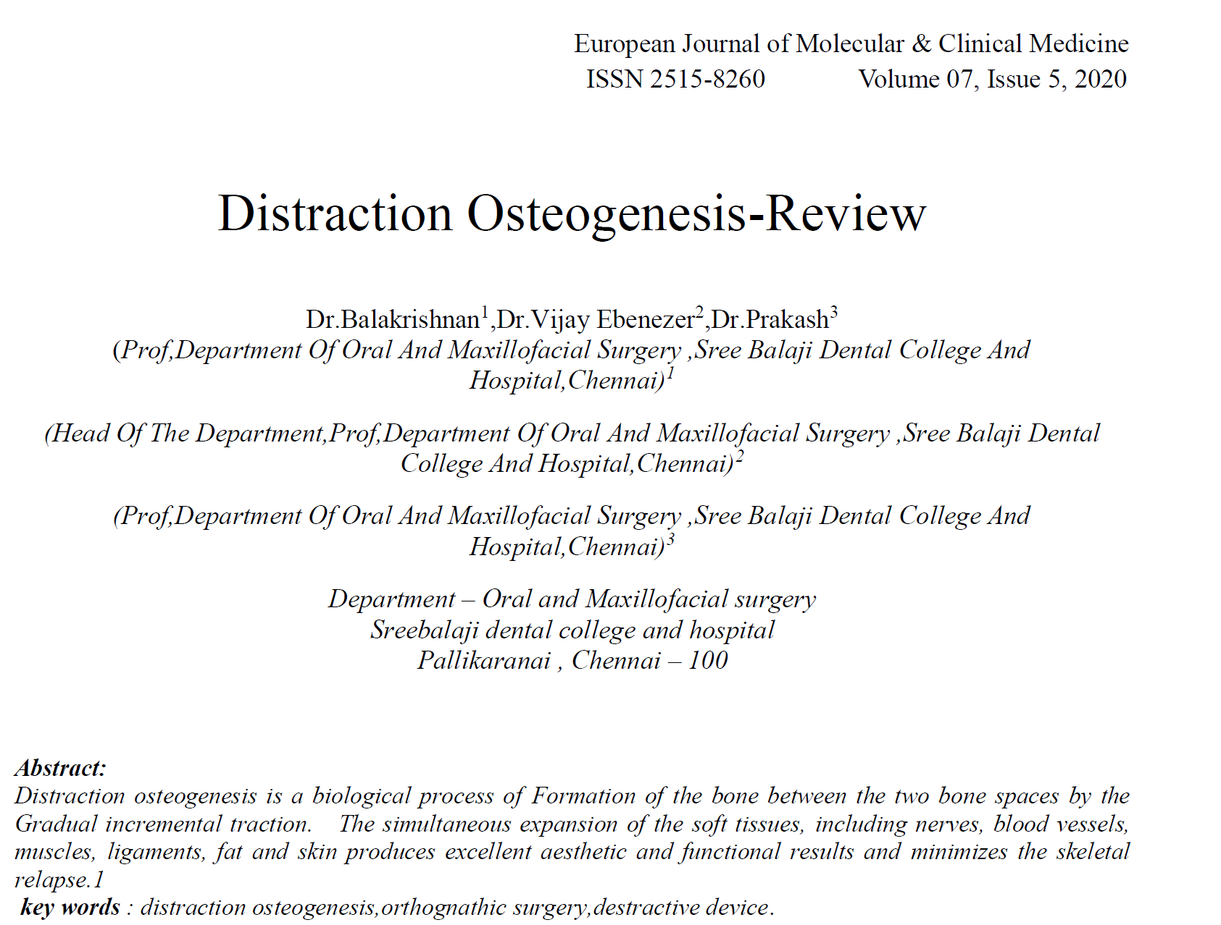
Conclusion: reconstruction of maxillofacial deformities and deficiencies is making headway progress. And
distraction osteogenesis is an integral part of the future trends in reconstruction. But, more detailed study and
research needs to be carried out to establish the critical parameters. In future, craniofacial distraction osteogenesis
may perhaps be the answer and the solution to bring out smiles in those affected by various craniofacial
deformities.

Slide 68
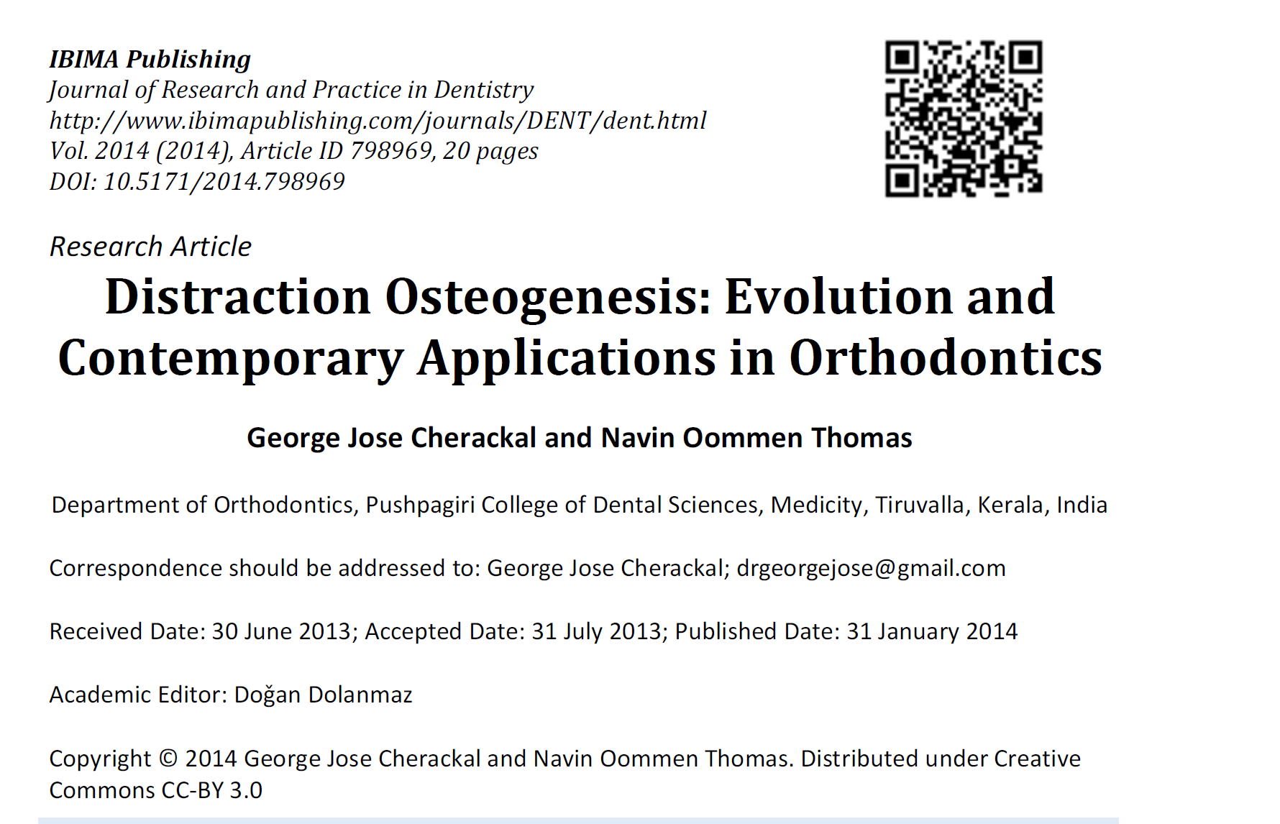

Slide 69
Conclusion
The human body possesses an enormous regenerative capacity. DO takes advantage of this potential to induce the regeneration of bone, nerve, blood vessels, and mucosa surrounding the tooth.
The current applications of DO in orthodontics makes it a promising technique since it helps to overcome many of the present limitations,
including reducing treatment duration not compromising the anchorage, and in the
management of complexities; without any unfavourable long-term effects on periodontal tissues and surrounding structures. Older adolescents and adults are good candidates for distraction, whilst bimaxillary dental protrusion and Class II patients with severe overjet best perceive accelerated orthodontics with DAD.
It is very important to consider surgical and dental concerns during treatment planning. These concerns include, osteotomy design and location, selection of the distraction device, distraction vector orientation, duration of the latency period, the rate and rhythm of distraction, duration of the consolidation period, postdistraction orthodontics and functional loading of the regenerate bone. With technologic advancements, distraction devices have become smaller and more sophisticated than previous versions.
Future may witness the use of the concepts of distraction to achieve better, faster & more efficient tooth movement with the refinement of distraction devices and protocols and modification of osteotomy
techniques.

Slide 70


