Slide 1
Root Treatment With Mucogingival Surgery

Slide 2
The goal of periodontal therapy is the regeneration and reconstruction of the lost supporting hard and soft tissues of the tooth to improve its ability in load transfer to the bone. One of the major factors inhibiting predictable periodontal tissue regeneration appears to be the nature of the diseased root surface

Slide 3
The root surface undergoes considerable alterations resulting in the destruction of the fiber attachment system. Root surface debridement of the teeth produces a smear layer that contains microorganisms and toxins which could interfere with periodontal healing .

Slide 4
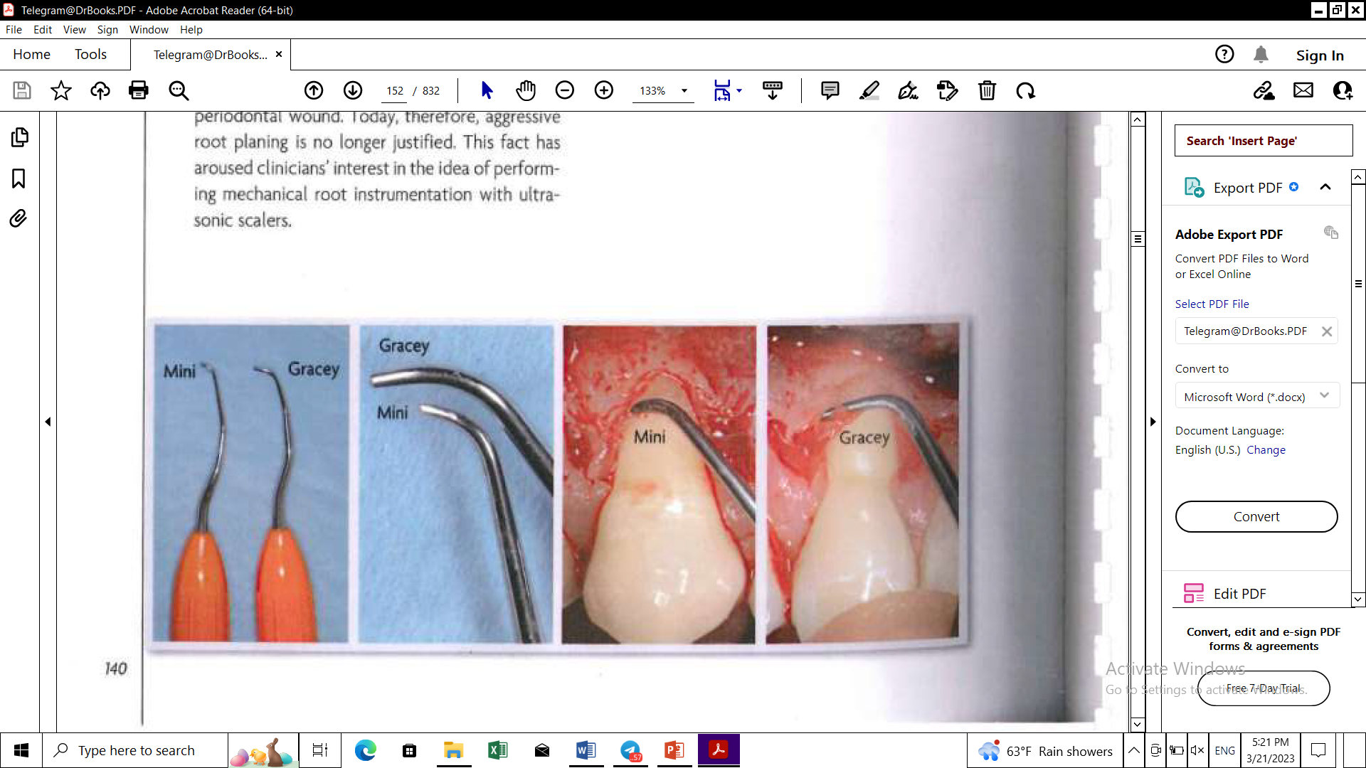
Mechanical instrumentation of root surfaces
Root planing is performed with curettes, the most indicated being Mini-Five Gracey curettes whose blade is shorter than that of the standard Gracey curette , reducing the risk of flattening the root

Slide 5
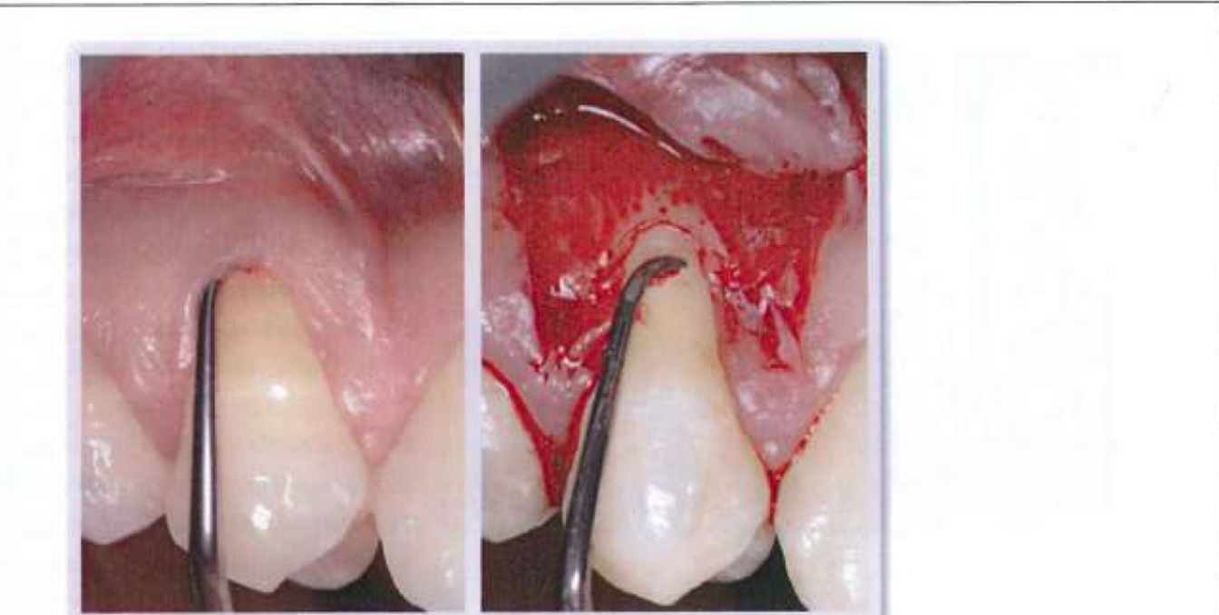
in the 1980s this was one of the main aims of mechanical Instrumentation, the rationale being to reduce root convexity and consequently the avascular surface to cover with soft tissue.
flattening the root reduces the number of dentin tubules available for clot attachment, which is the first healing event in a periodontal wound. Today, therefore, aggressive root planing is no longer justified
This fact has aroused clinician interest in the idea of performing mechanical root instrumentation with ultrasonic scalers.

Slide 6
Ultrasonic instruments not only are easier and faster to use in comparison with curettes but also cause less trauma to soft tissues when used subgingivally and cause less root hard tissue loss
Zucchelli et al (2009) showed no statistically significant differences in terms of root coverage or clinical attachment gain between recession defects treated with mechanical instrumentation (curettes) and ultrasonic devices in conjunction with a coronally advanced flap. The trial, however, excluded recession defects involving abrasion and root caries/demineralization

Slide 7
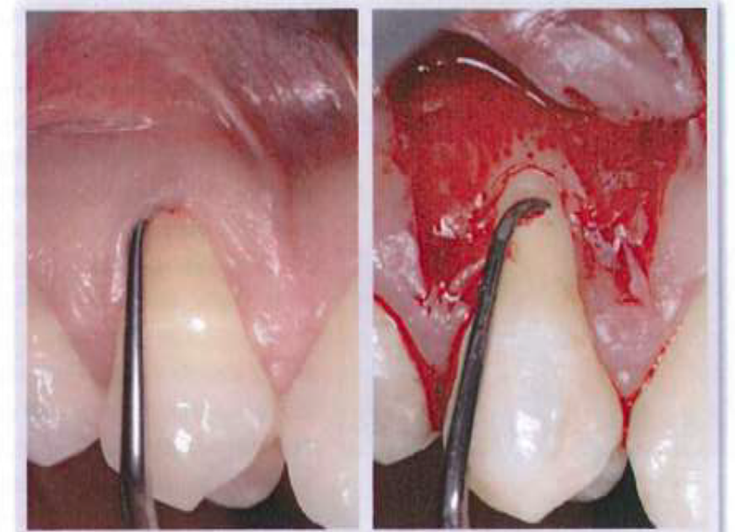
Root planing in association with mucogingival surgery may be performed
* presurgically
*or when the flap has been reflected (ie, open-flap scaling)
both of which have advantages and drawbacks

Slide 8
The benefits of presurgical planning
* preservation of radicular cementum integrity in the anatomical bone dehiscence area and operating in a blood-free environment.
Its disadvantages
* Soft tissue trauma (accidental curettage), especially with facial pockets in association with gingival recession.
*The risk of inadequate planing of the root surface in the facial pocket. This would leave an area of infected, softened root, which could jeopardize the root coverage surgery outcome or cause an increase in probing depth.

Slide 9
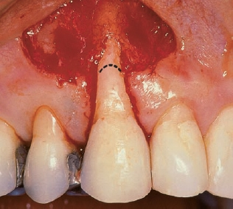
The advantages of open-flap scaling
* its ease of execution, since the soft tissues are out of harm's way.
* the possibility of thorough planing of the entire root surface where clinical attachment has been lost.
The potential drawback
*The risk of shaving off an area of healthy radicular cementum with attached fibers, especially connective tissue fibers in area of bone dehiscence.
In both cases root flattening must be avoided by careful curette handling. The sharp edge of the blade must be used to scale one (mesial or distal) half of the exposed root, and then the instrument should be reversed to scale the other half of the root.

Slide 10
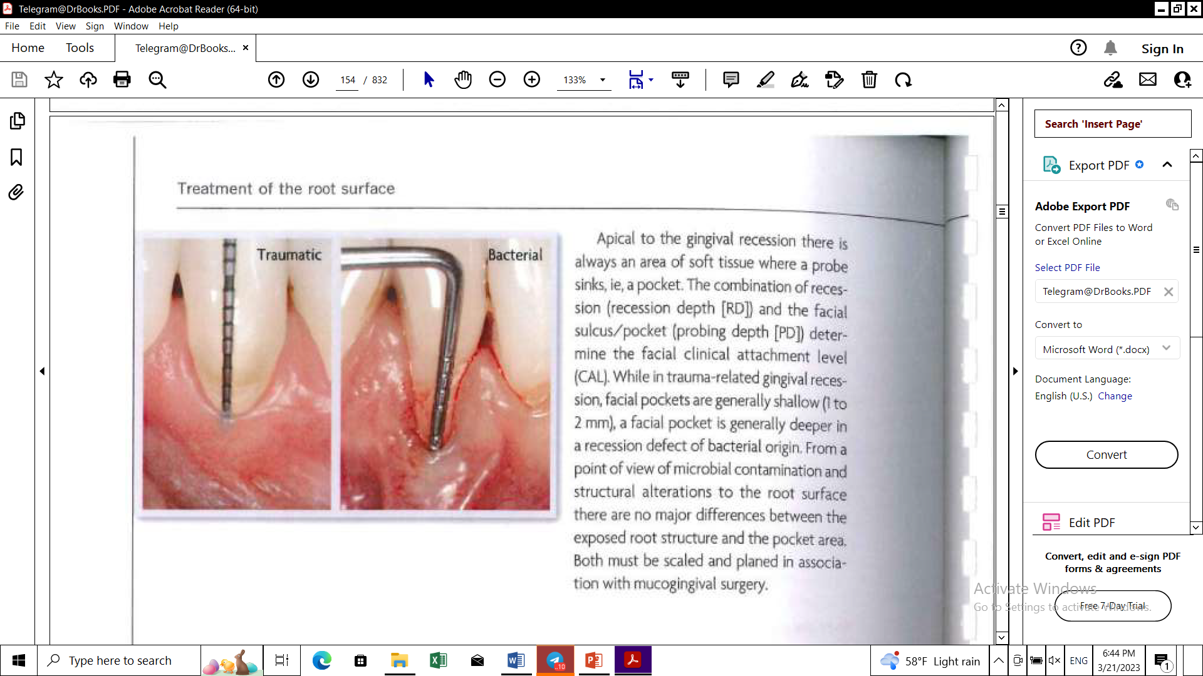
The combination of recession (recession depth [RD] and the facial sulcus/pocket (probing depth [PD]) determine the facial clinical attachment level (CAL). While in trauma-related gingival reces-sion, facial pockets are generally shallow (Ito 2 mm), a facial pocket is generally deeper in a recession defect of bacterial origin. From a point of view of microbial contamination and structural alterations to the root surface there are no major differences between the exposed root structure and the pocket area. Both must be scaled and planed in association with mucogingival surgery.

Slide 11
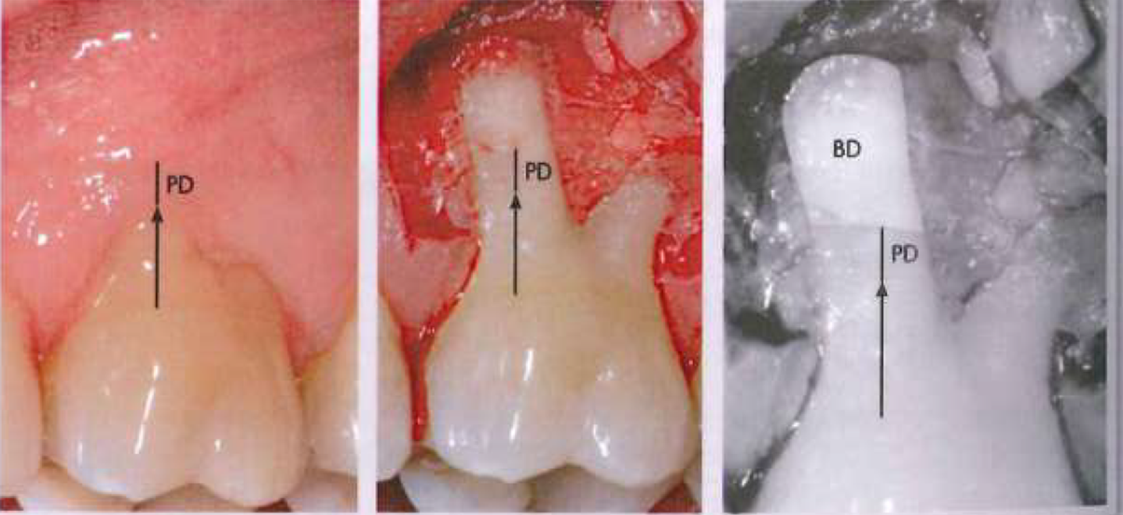
The anatomical substratum underlying the onset of recession is the presence of facial bone dehiscence (root exposure due to the lack of the facial bone wall). Very often the bone dehiscence is deeper than the CAL; in other words, there is an area of bone dehiscence not detectable by probing. This area is referred to as an anatomical bone dehiscence (BD) to distinguish it from a "pathologic" bone dehiscence in areas of gingival recession and pocket depth.

Slide 12
In the BD area the radicular cementum is intact, as is the epithelial/connective tissue periodontal attachment.
Anatomical bone dehiscence is often found accidentally during periodontal surgery and especially mucogingival surgery.
It is more frequent and deeper where the recession is of traumatic origin, particularly with teeth that have been displaced facially (eg, canines, mandibular incisors, and first molar mesial roots), are located in curved arch areas, and/or have undergone orthodontic treatment.

Slide 13
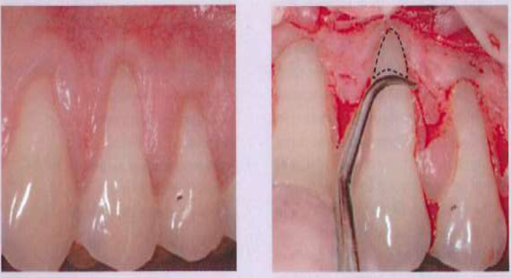
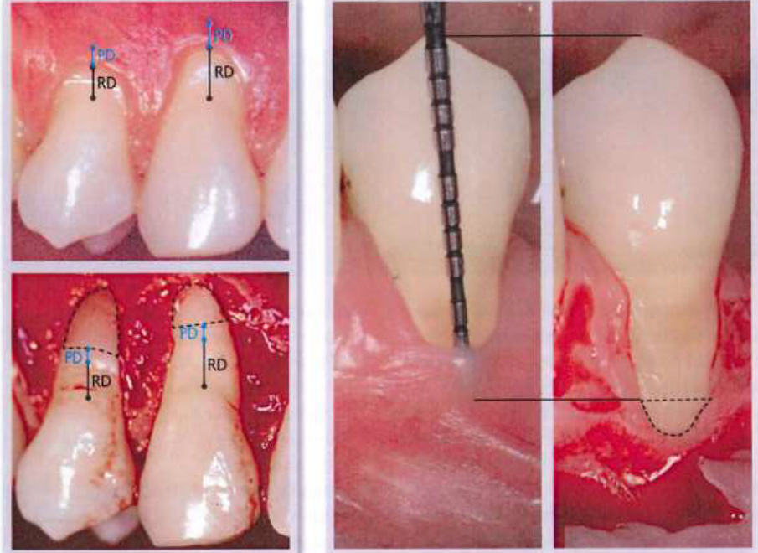
In the treatment of gingival recession it is necessary to distinguish between pathologic and anatomical bone dehiscence, by measuring CAL (RD + PD) before administering anesthesia. The CAL is then marked on the tooth after flap reflection, using the same fixed crown reference parameter, and the root
Instead, if the CAL is not measured prior to flap reflection, it is not possible to establish the apical limit for root instrumentation, and it is necessary to scale the entire bone dehiscence to avoid leaving an
surface area between the apical CAL limit and the buccal bone crest corresponds to the anatomical bone dehiscence (area surrounded by dotted line in figures below). This area must not be planed during mucogingival surgery.
undebrided, contaminated root area. The risk in this case is that of eliminating radicular cementum with functionally inserted connective fibers, thereby losing connective tissue attachment and buccal bone.

Slide 14
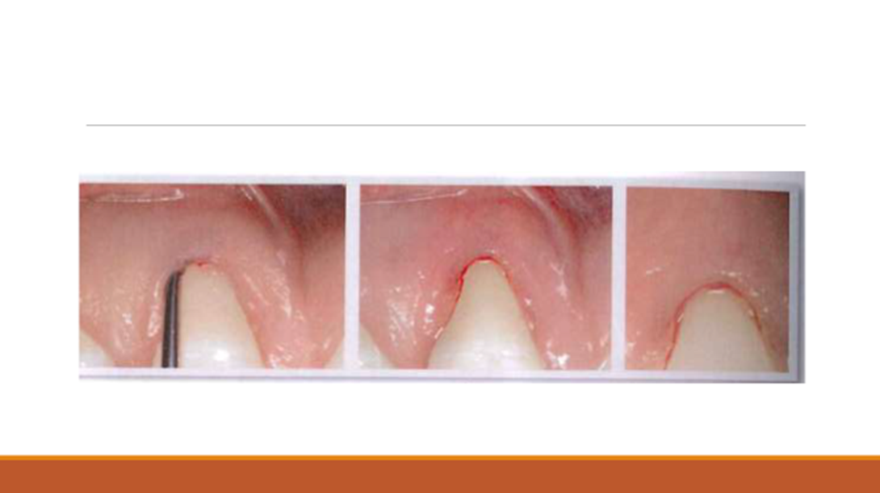
To prevent this risk many authors recommend root planing prior to commencing mucogingival surgery. Since all of the root surface up to the CAL must be debrided, subgingival closed-flap planing is required of the part of the root corresponding to the facial pocket. During subgingival planing, however,
The keratinized tissue remaining apical to recession defects of traumatic origin is often minimal and can be probed in its entirety. In this case accidental curettage may cause the keratinized tissue apical to root exposure to disappear completely.

Slide 15
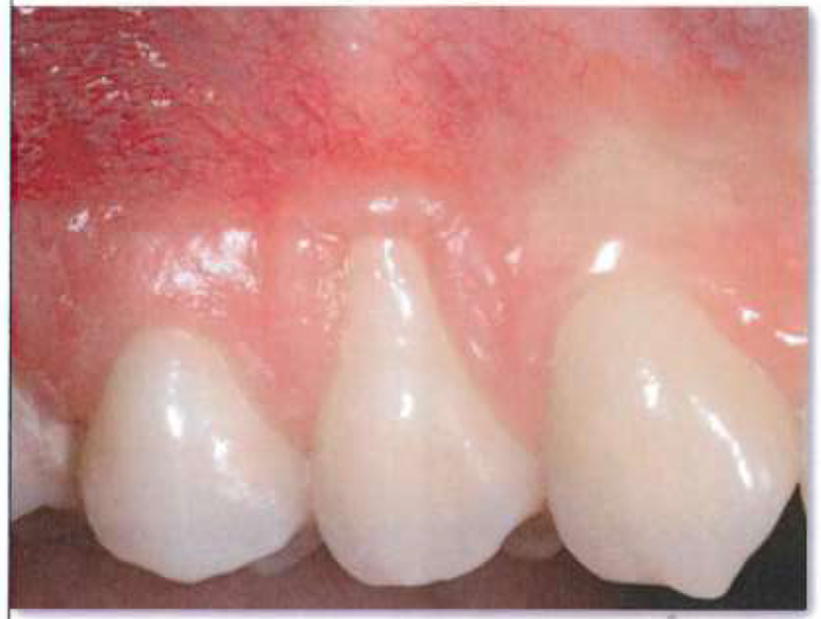
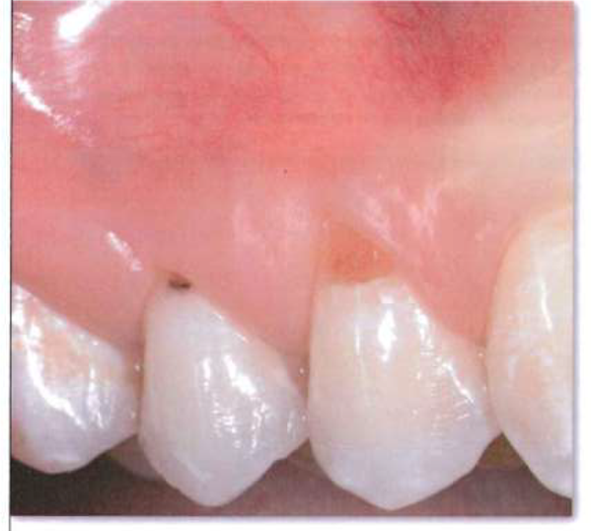
. Presurgical root planing is therefore not advisable when there is scarce remaining keratin-ized tissue apical to an area of recession. With bacteria-related recession the risk of unintentional curettage and consequently keratinized tissue loss is even higher because of greater pocket depth apical to root exposure
, where recession defects are compounded by demineralized and/or carious roots, closed-flap presurgical root planing is contraindicated due to the difficulty of ensuring thorough debridement of the diseased hard tissue without damaging the soft tissues of the facial sulcus/ pocket. In addition to the above limitations, presurgical root planing may also fail to ensure thorough planing of the subgingival root surface.
Failure to scale the root surface corresponding to presurgical probing depth could leave an infected, toxic, softened root area that may jeopardize the outcome of root coverage surgery or create pockets in the facial gingival tissue.

Slide 16
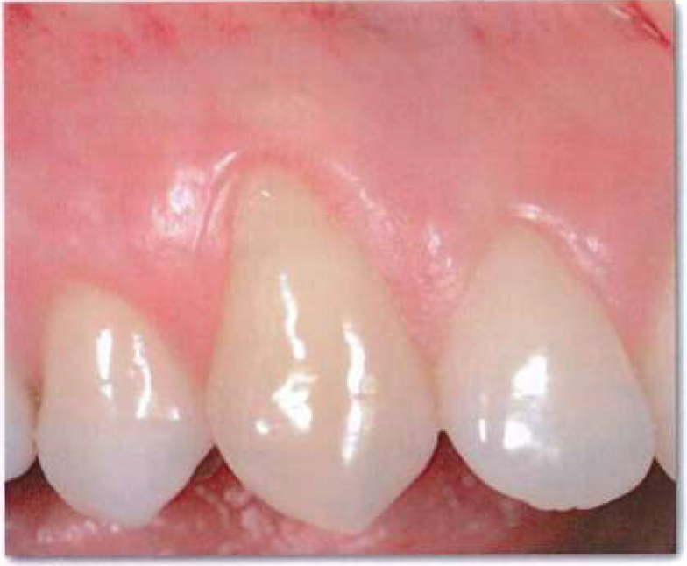
Presurgical root planing is indicated with shallow recession defects with a high (2 - 3 mm) band of kera-tinized tissue apical to the root exposure, shallow facial pockets 🙂 1 mm), and a thick gingival biotype.

Slide 17
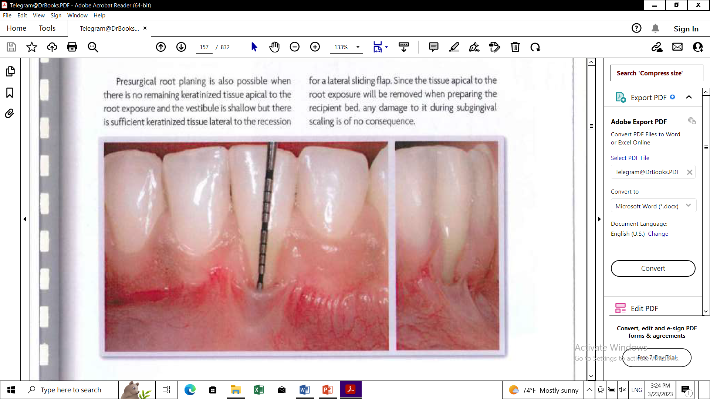
Presurgical root planing is also possible when there is no remaining keratinized tissue apical to the root exposure and the vestibule is shallow but there is sufficient keratinized tissue lateral to the recession.
for a lateral sliding flap. Since the tissue apical to the root exposure will be removed when preparing the recipient bed, any damage to it during subgingival scaling is of no consequence

Slide 18
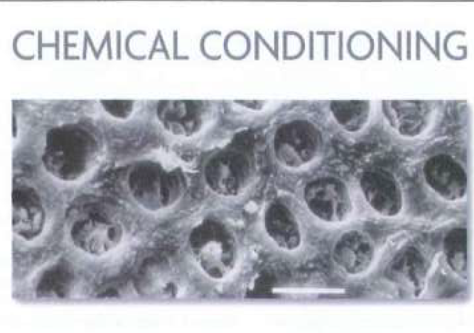

Slide 19
This ensures blood clot adhesion to the root surface, which is a first essential step toward periodontal wound healing
For many years acid substances (eg, citric acid and tetracycline) were used to condition root surfaces in mucogingival surgery. Their function was to expose the collagen component by widening the dentin tubule diameter, thus aiding fibrin clot adhesion.
Their acid nature, however, activated matrix metalloproteinase enzymes, which led to tubule collagen degradation, thereby removing the substrate for fibrin clot interaction with the root surface.
After scaling, the root is cleansed of debris and blood, and EDTA gel is applied and left for 2 minutes. The root is then rinsed with sterile saline solution for at least 1 minute. A visible clinical result of EDTA gel is wound cleansing and bleeding control.

Slide 20
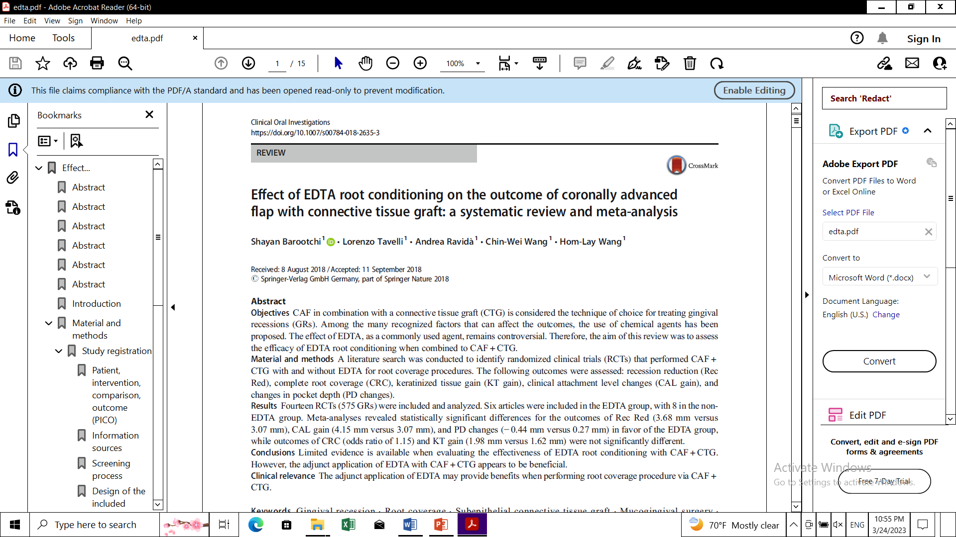

Slide 21


Slide 22
References
Giovanni Zucchelli , Mucogingival Esthetic Surgery
Shayan et. al., Effect of EDTA root conditioning on the outcome of coronally advanced
flap with connective tissue graft: a systematic review and meta-analysis. Clinical Oral Investigations, 2018

Slide 23
Root biomodification agents are often used to remove the smear layer and to expose collagen fibers making the root surfaces biologically acceptable which in turn is necessary for the success of regenerative procedures

