Slide 1
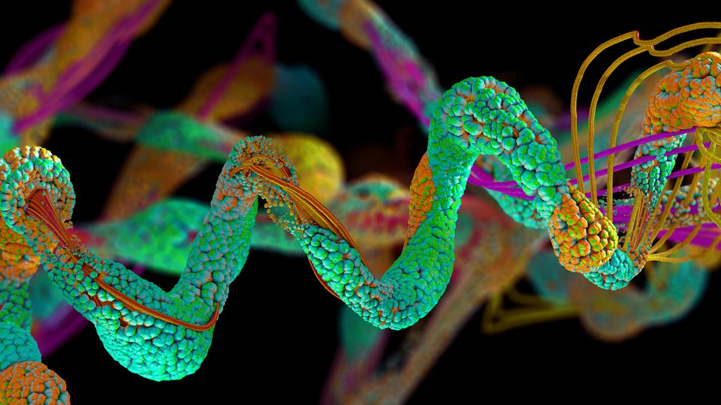
Proteomics Approach Towards Periodontal Disease Diagnosis
Assist. Prof. Nada K. Imran
B.D.S. , MS.c (Periodontics)

Slide 2
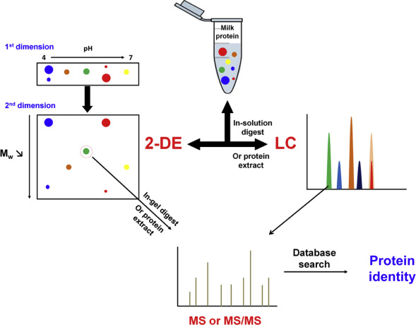
Proteomic analysis
Proteomic analysis (proteomics) refers to the systematic identification and quantification of the complete complement of proteins (the proteome) of a biological system (cell, tissue, organ, biological fluid, or organism) at a specific point in time.

Slide 3
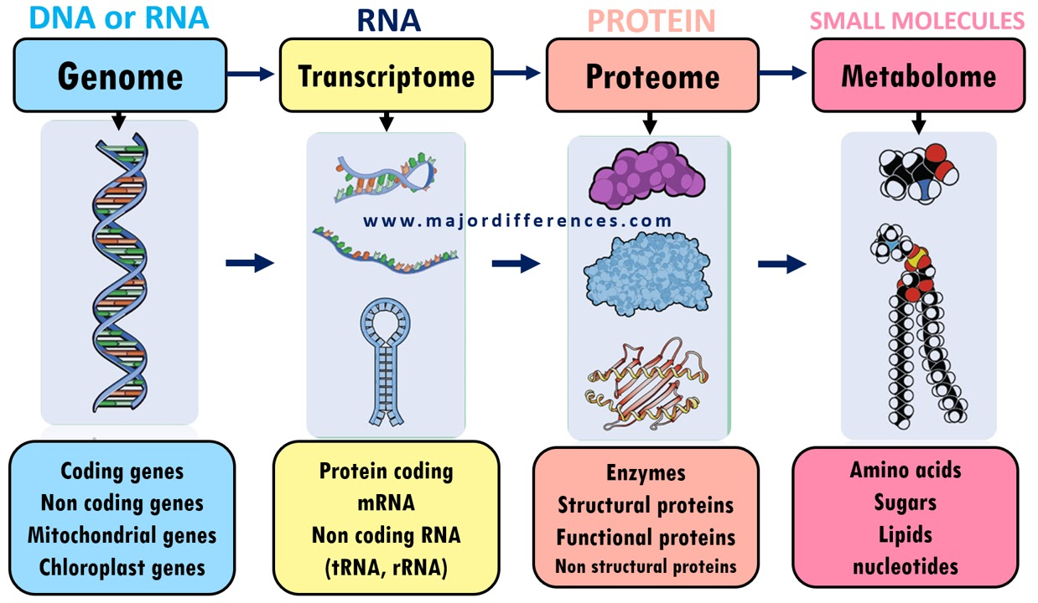
The proteome
Is the entire set of proteins produced or modified by an organism or system.

Slide 4
Proteomics: is the study of the proteome , it uses technologies ranging from genetic analysis to MS
Identification of ever-increasing numbers of proteins.
Proteomic technologies play an important role in drug discovery, diagnostics and molecular medicine
Involves the comparison of tissue samples from diseased and healthy people

Slide 5
Why Proteomics ??
Genomics
DNA tells what possibly
Transcriptomics
RNA tells what probably
Proteomics
Proteins tells what actually happen

Slide 6
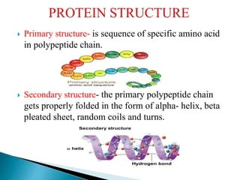
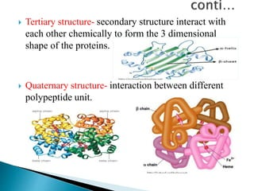
Types of proteins

Slide 7
Types of proteomics
Structural proteomics
To build a body of structural information that will help predict the structure& function for almost any protein from knowledge of it’s coding sequence
To analyze the characteristics of molecular protein-networks involved in a living cell , It concentrates on the following two issues:
(i) Elucidation of biological functions of unknown proteins
(ii) Cellular activity at molecular level.
Functional proteomics

Slide 8
Expression proteomics
It refers to the quantitative study of protein expression between samples differing by some variable
Depend on interactions between biological system components,
for example, identification of novel matrix metalloproteinase substrates that act to regulate inflammation
Cell map or interaction

Slide 9

Proteomics Objectives
1.
Protein / peptide separation
2.
Identification and characterization of resolved proteins by MS
3.
Data analysis and applications

Slide 10
Methods of protein detection
Label-based proteomics
Antibody-free protein detection
Mass Spectrometry
Label- free proteomics
Methods of protein detection
Immonoassays
ELISA Western Blot Immunofluorometric assay
Cytometric bead array Radioimmunoassay
Antibody-dependent protein detection
Immunostaining

Slide 11
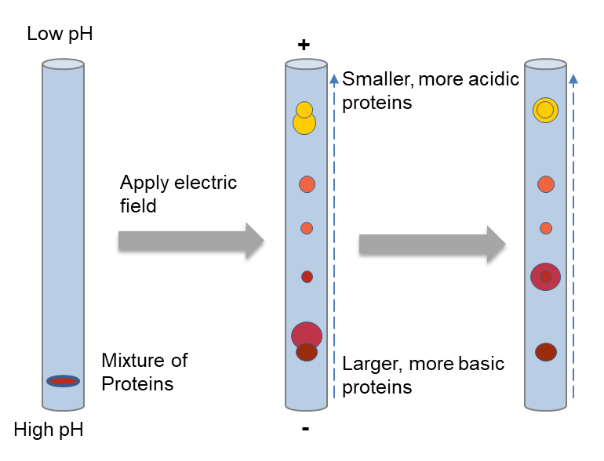
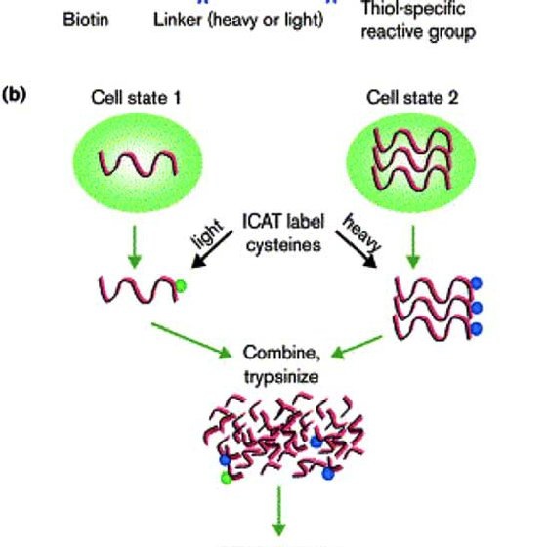
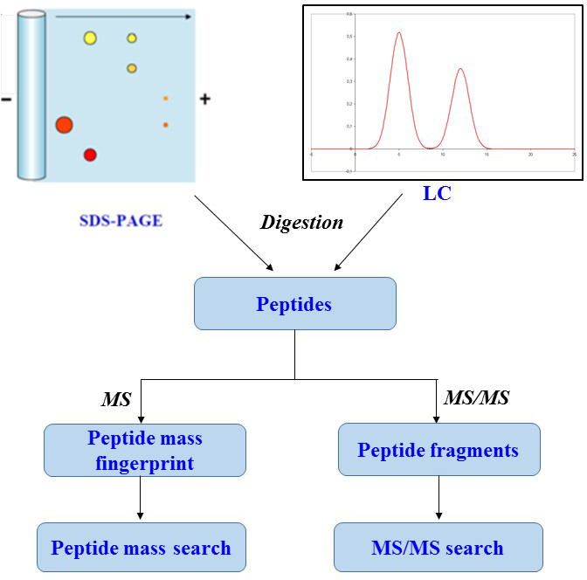
Techniques used in proteomics study
2-D gel electrophoresis ICAT( Isotope Coded Affinity Tag) PMF( Peptide Mass Fingerprinting)

Slide 12
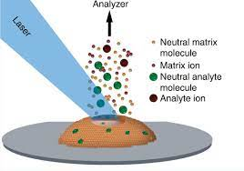
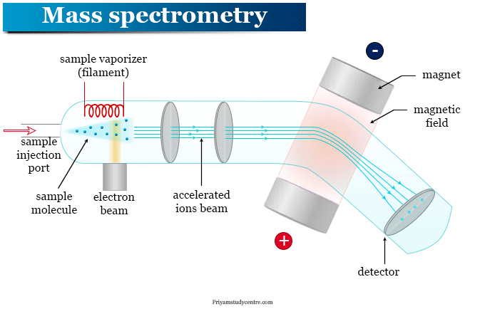
MALDI ( Matrix-Assisted Laser Desorption/ Ionization)
Mass spectroscopy

Slide 13

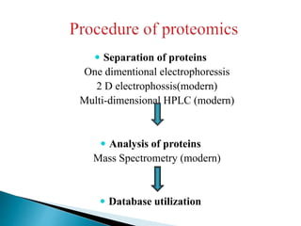
The major steps of proteomics
Seperation
Identification
Quantification
Analysis
Cell and tissue physiology, diagnosis, and drug development

Slide 14
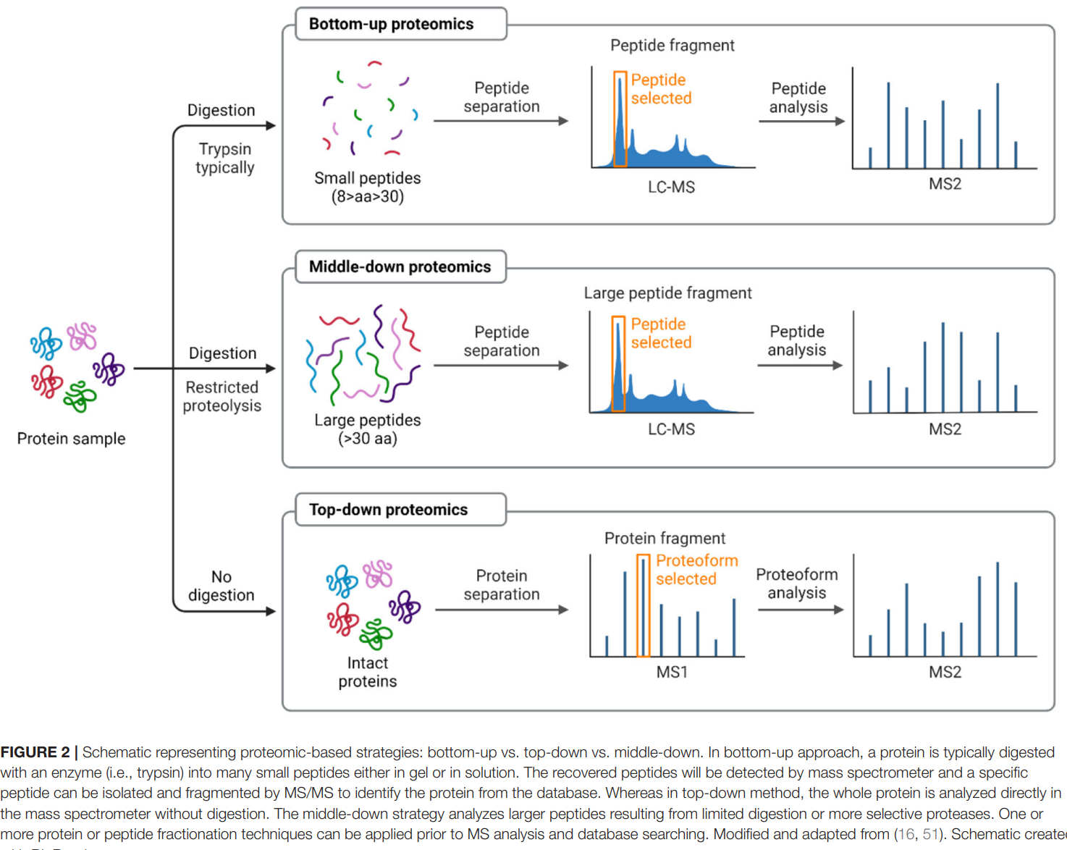

Slide 15

Proteomics and periodontal diseases diagnosis
Assessment of complete protein profiles in health compare to periodontitis has been the goal of the proteomics approach
Proteome analysis of bone and dental structure (enamel, periodontal ligament, and cementum) and oral fluid diagnostics (saliva and GCF) are the primary areas where dental proteomics has shown promising outcomes
Evidence suggests that proteomics facilitate the identification of GCF biochemical markers in patients with periodontal disease

Slide 16
A biomarker can be used instead of traditional diagnostic procedures when and where a periodontal professional is not available.
Proteomic technologies that have been previously introduced to discover and identify prospective GCF biomarkers for periodontal diseases

Slide 17
Most proteomic studies have been performed on different biological samples but not on periodontal pocket tissue that is the anatomo-pathological lesion signifying for the clinical diagnosis of the periodontal disease.
S100A9, HSPB1, LEG7 and 14-3-3 proteins resulted over-expressed in periodontal pocket tissue when compared with healthy patient analogous tissue.
The S100 proteins are family of calcium-binding cytosolic proteins

Slide 18
Some of its member, like S100A6, S100A7, S100A8, S100A9 and S100A11 were reported upregulated in periodontitis
In fact, Gao et al. found that Calprotectin (heterodimer of S100A8 and S100A9) exerts the expression of proinflammatory cytokines in human gingival fibroblasts through S100A9-TLR4 interactions

Slide 19
Albumin has the highest quantity, followed by immunoglobulin and keratin
Albumin is in accordance with other studies that found to be upregulated
in periodontitis and gingivitis in a large number.
In contrast to cytokines, several enzymes associated with polymorphonuclear cells (PMN), such as matrix metalloproteinase-8 (MMP-8), cathepsin G, and myeloperoxidase are found.

Slide 20
Upregulated level of actins and actin-related proteins were detected in GCF and saliva of periodontitis patients
High concentration of L-plastin in GCF is assumed to facilitate PMN in the inflammatory area, so PMN hypereaction occurs in periodontal disease
Among all upregulated proteins, there were also downregulated proteins that found in periodontitis. Cystatin has a protease inhibitory property

Slide 21
Conclusion
Proteomics is a composite study of a set of proteins
The detailed protein studies will shed light on the role of protein modification in protein function
The development of proteomics renders us with a powerful tool to examine biochemical processes at the molecular level and identify sets of proteins, that can be used for diagnosis of multiple diseases

Slide 22
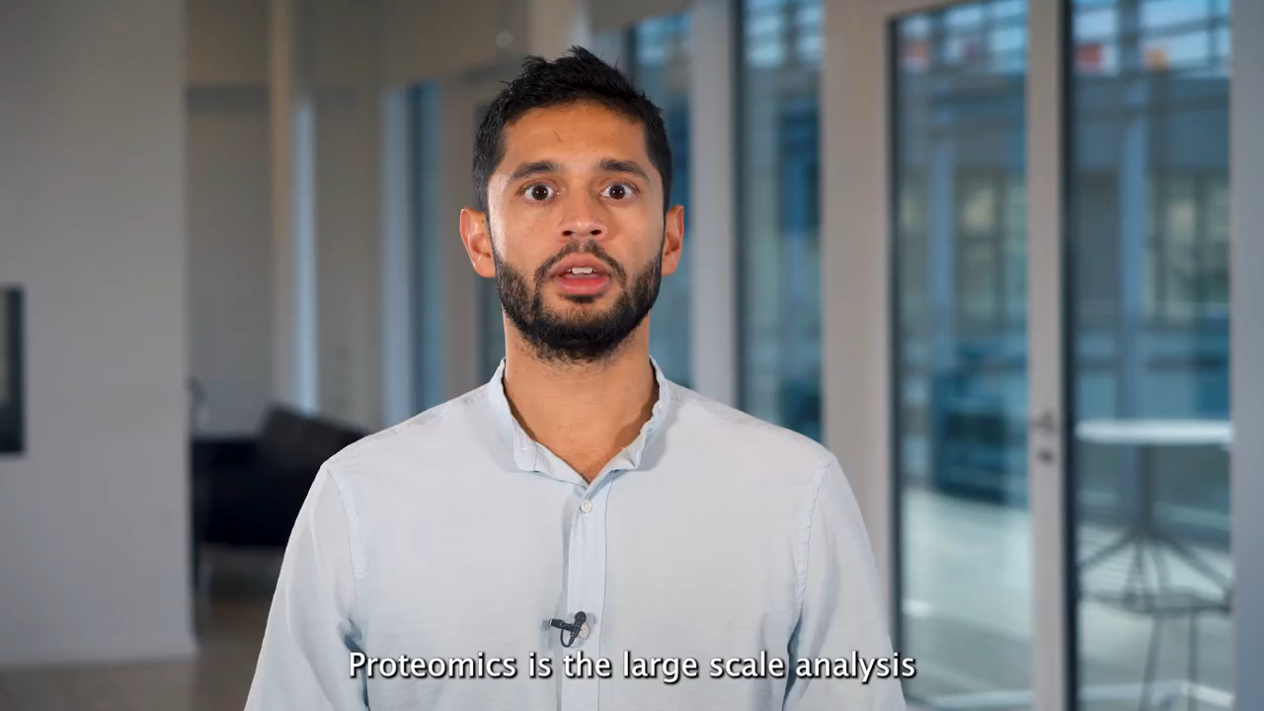

Slide 23


