Slide 1
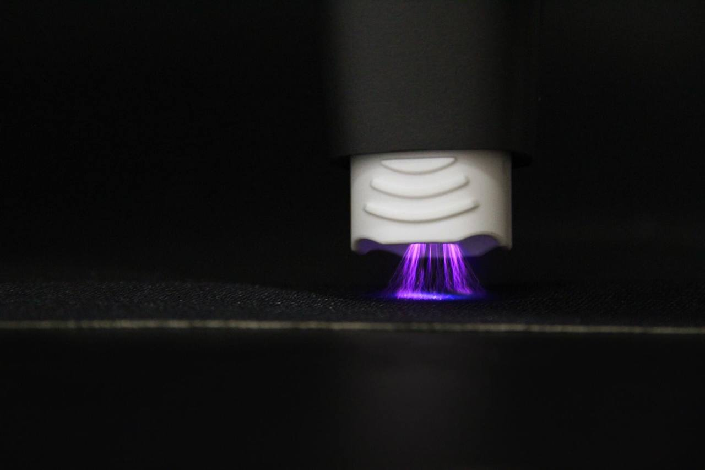
Clinical Applications of Non-thermal Plasma in Dentistry
By
Asst. Prof. Dr. Manhal Abdul-Rahman Majeed

Slide 2


Slide 3

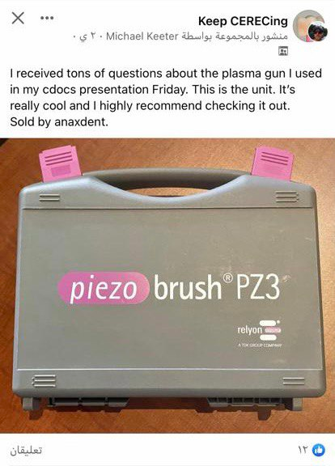

Slide 4
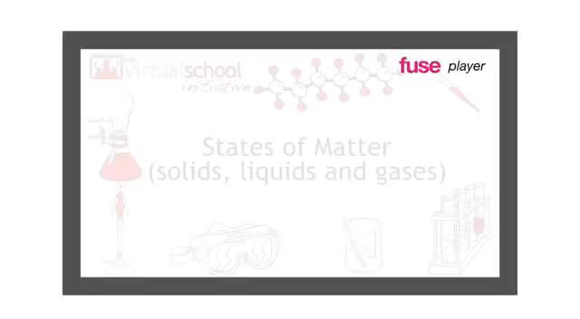
What is plasma?
Plasma is the fourth state of matter, discovered by the British physicist Sir William Crookes in the year 1879, but the name “plasma” was applied by Irving Langmuir, an American chemist, in 1929.

Slide 5
classification of Plasmas
Non-thermal
Thermal
Thermal plasmas have electrons and the heavy particles at the same temperature (they are in thermal equilibrium with each other).
Non-thermal plasmas have the ions and neutrals at a much lower temperature (sometimes room temperature), whereas electrons are much “hotter”. In recent years, cold (less than 40 °C at the point of application)

Slide 6
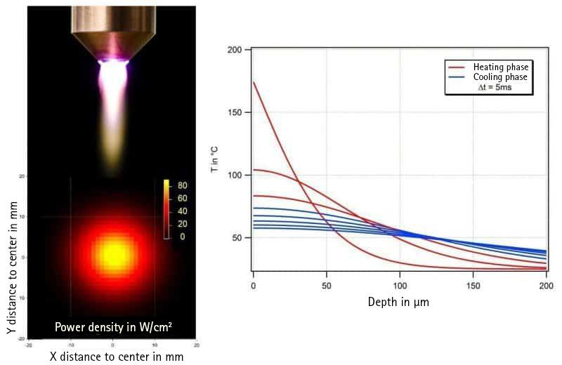
Particularly informative for the question of where the improved adhesive strength of bonds of crystalline thermoplastics after plasma treatment comes from is a consideration of the temperature development during application.
The temperature of the substrate surface and the layer near the surface is briefly increased during atmospheric plasma treatment. Of particular interest is the high dynamic with which the surface is heated up and then cools down again very quickly

Slide 7
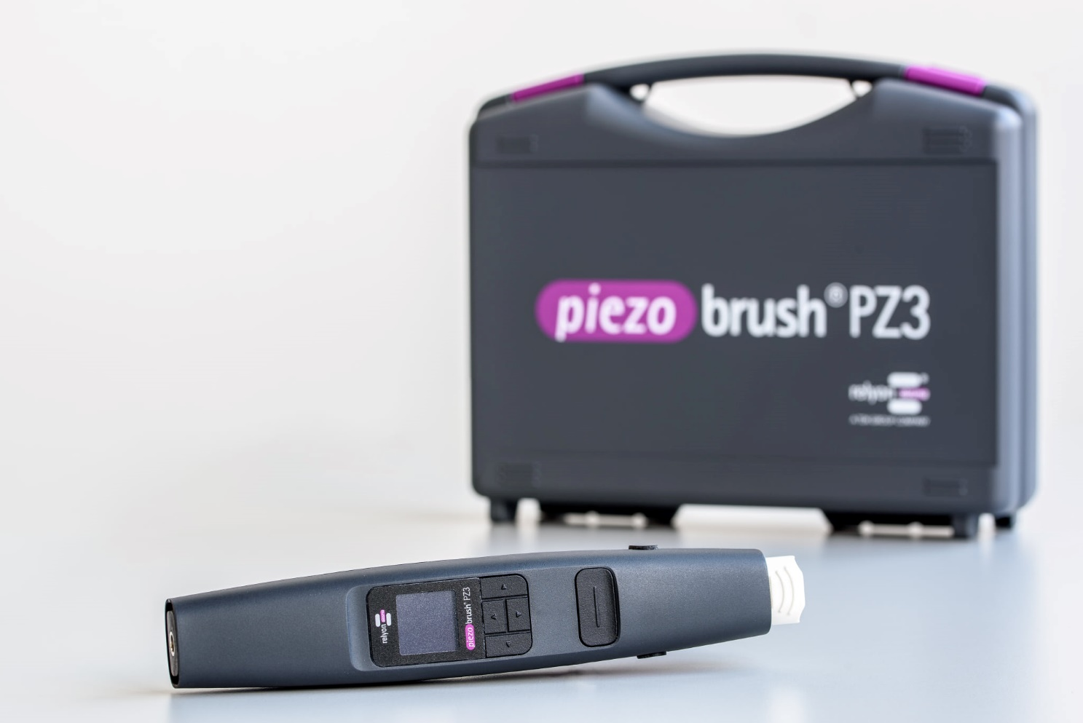
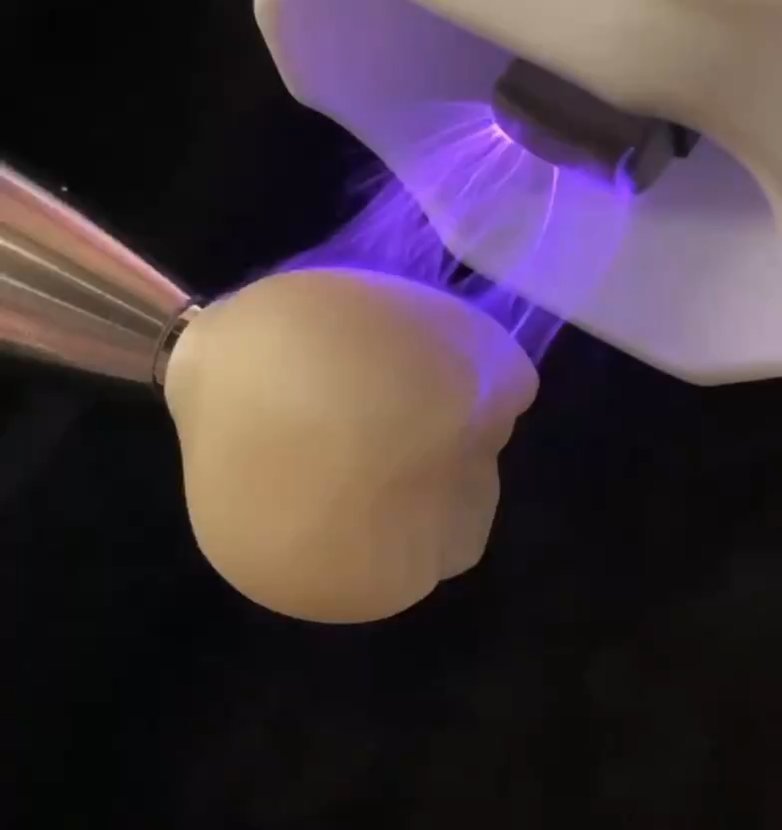
Non-thermal Atmospheric Pressure Plasma
The piezobrush PZ3
It is a hand-held cold-active plasma device with a temperature of less than 50℃ and maximum power consumption of 18 W. Plasma is generated by means of piezoelectric direct discharge (PDD).
5
Exchangeable
Modules
According to the required application

Slide 8
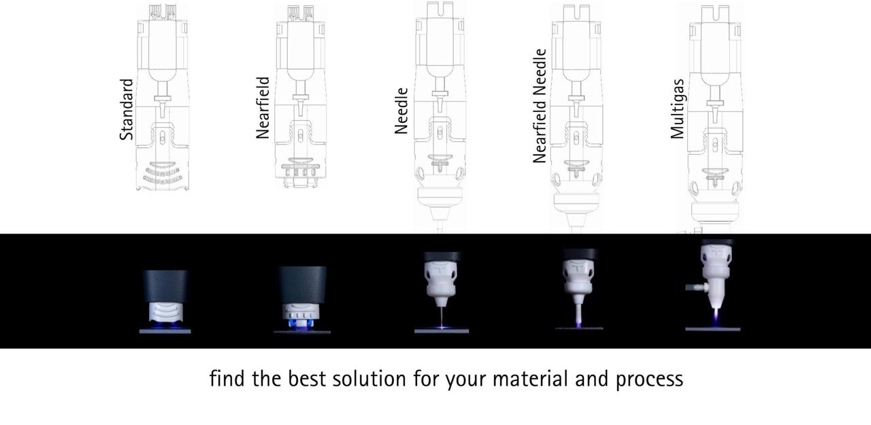

Slide 9

Standard Module
The Standard Module, which is designed for plasma pretreatment of electrically non-conductive materials. These include, for example, plastics, ceramics, glass, natural fibers, leather, and textiles. For effective treatment, the distance between the module and the substrate should be 2 to 10 millimeters.

Slide 10
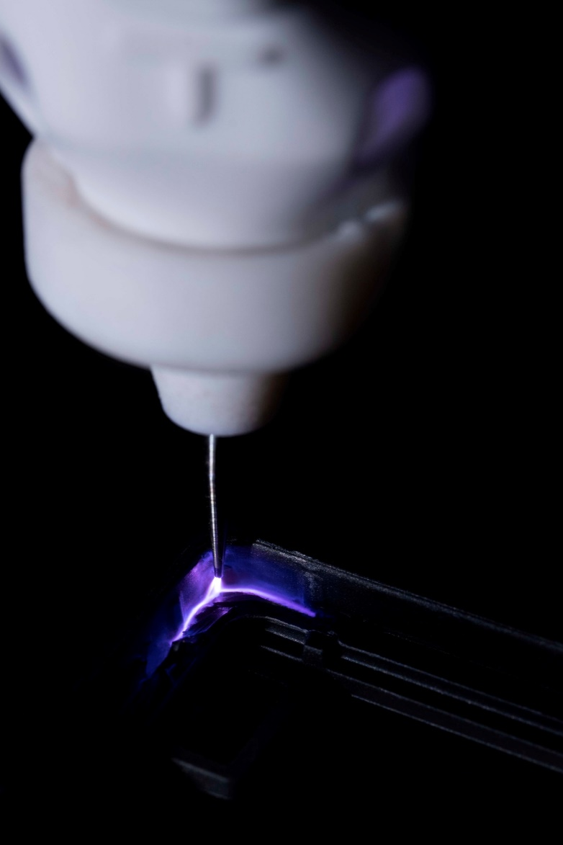
Needle Module
The Needle Module is particularly well suited for the treatment of small and hard-to-reach areas. The needle is used for very fine processing of the workpiece, which is why this exchangeable module for the piezobrush PZ3 and PZ3-I can be optimally used for narrow grooves, bores, or other cavities. It was developed for the treatment of non-conductive substrates.

Slide 11
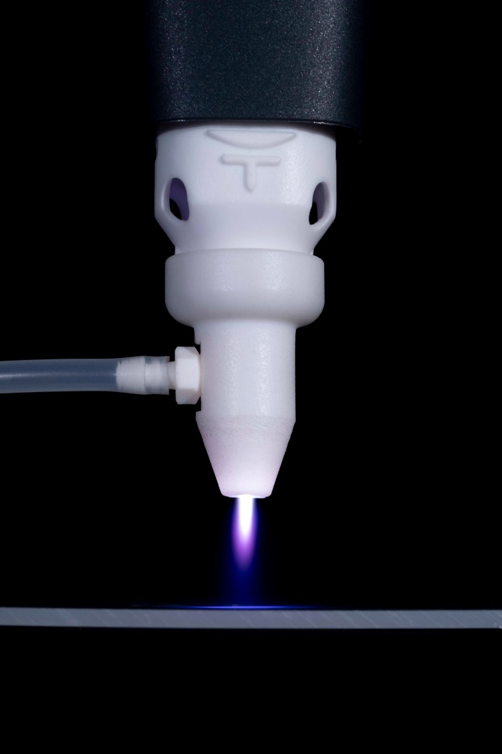
Multi gas Module
The Multi gas Module for the piezobrush PZ3 and PZ3-I can be operated with different inert gases. These include nitrogen, argon, and helium. It is used in combination with a silicone hose, which is plugged onto the gas connection. It is suitable for treating electrically non-conductive materials and, in combination with argon or helium, also for electrically conductive materials.

Slide 12
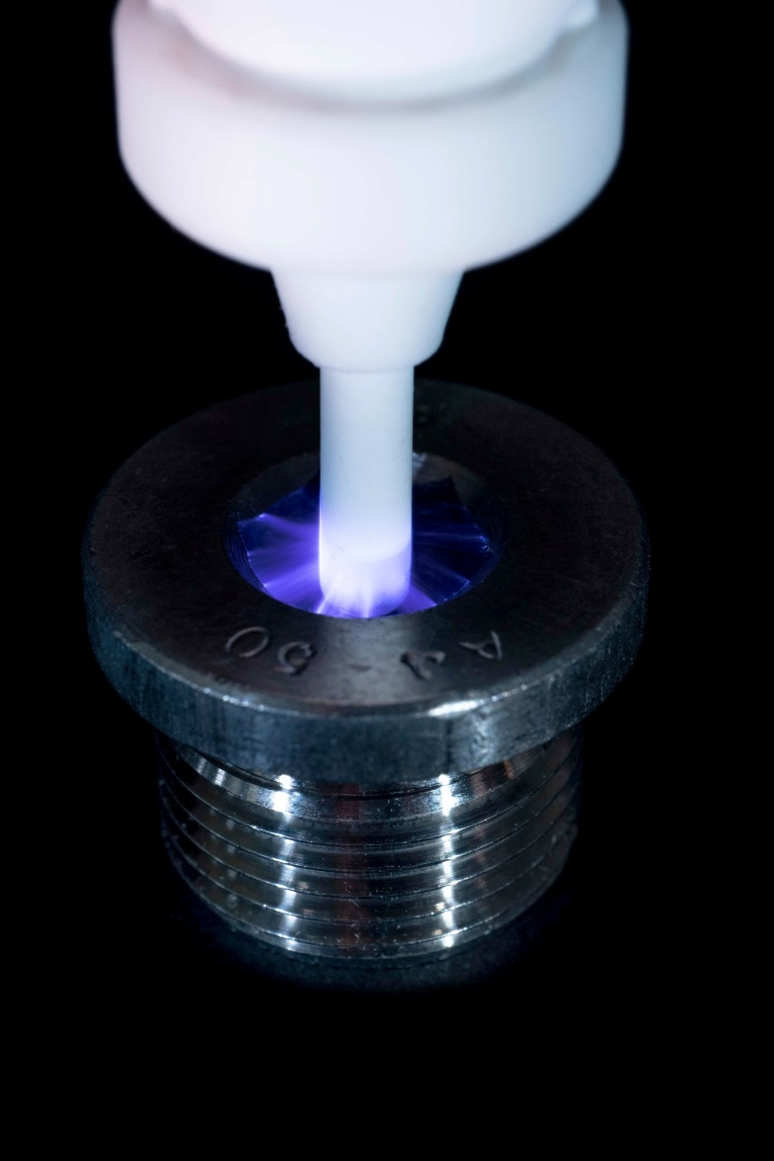
Nearfield Needle Module
The exchange Module Nearfield Needle for the piezobrush PZ3 and the piezobrush PZ3-I is used for the plasma treatment of very small or hard-to-reach areas suitable for electrically conductive substrates such as metals, CFRP, indium tin oxide (ITO) or conductive plastics.

Slide 13
EFFECTS OF PLASMA ON THE TARGET SURFACE

Slide 14
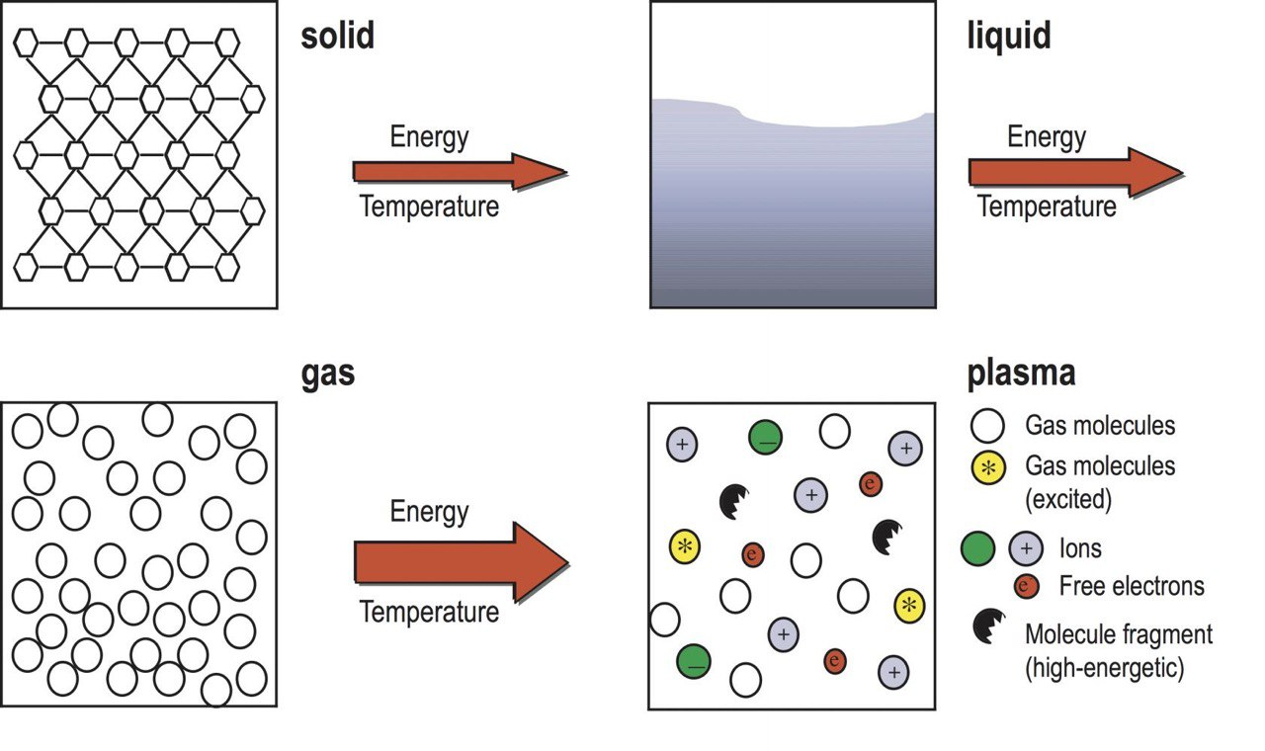

Slide 15
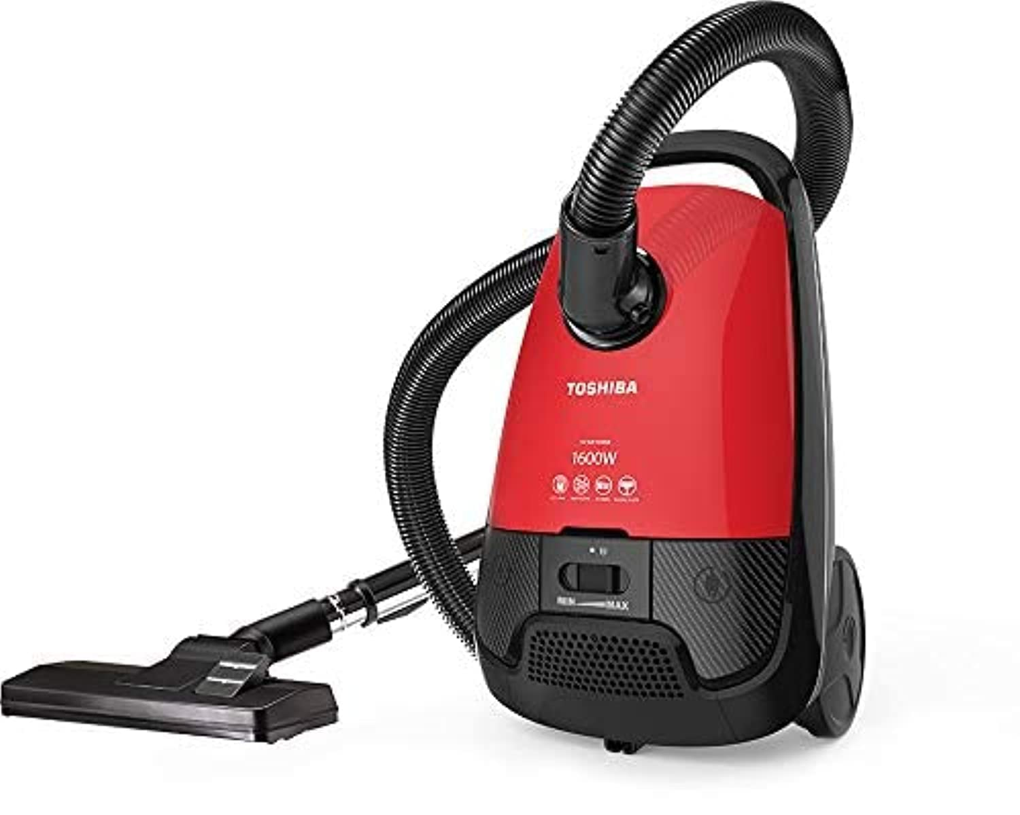
I. Cleaning Effect
EFFECTS OF PLASMA ON THE TARGET SURFACE
The plasma can effectively remove contaminants and impurities from the surface. The plasma's excited particles react with the surface layer of hydrocarbons and carbonate molecules, breaking the C-H and C-C bonds, thereby oxidizing them to form H₂O and CO₂, which are pumped away after being desorbed from the surface.

Slide 16
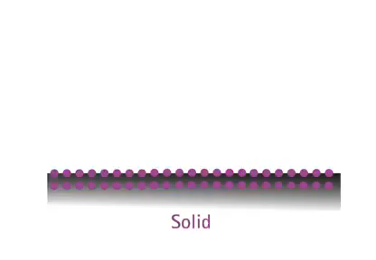
EFFECTS OF PLASMA ON THE TARGET SURFACE
II. Increasing the surface energy & wettability
Plasmas are ionized gases containing a mixture of electrons, ions, and free radicals that can induce chemical reactions resulting in significant changes on the functional groups of material surface. Such a surface treatment is capable of transforming non-reactive surfaces into reactive ones without affecting their mechanical properties. In this way, plasma application enhances surface energy (SE) and wettability of substrates improving the adhesion of the treated surface.

Slide 17
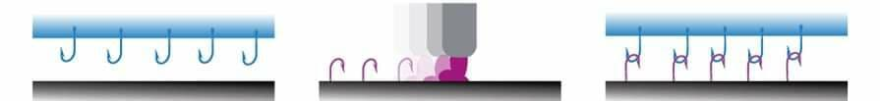
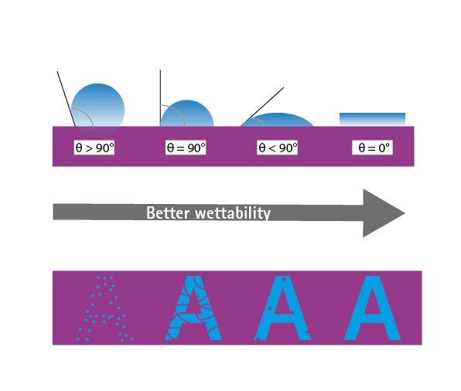
low surface energy Insufficient wettability Weak bond
Untreated surface
GENERATION OF ANCHOR GROUPS ACTIVATION OF THE SURFACE
Plasma treated surface
HIGH SURFACE ENERGY
INCREASE WETTABILITY STRONG BOND

Slide 18
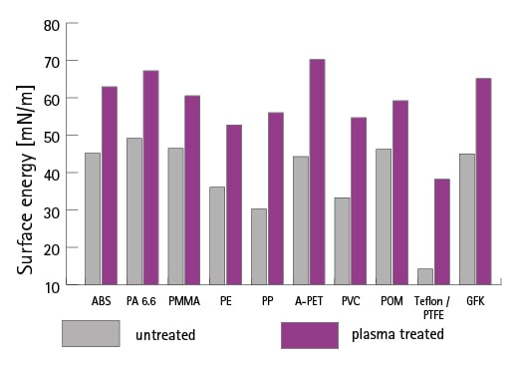
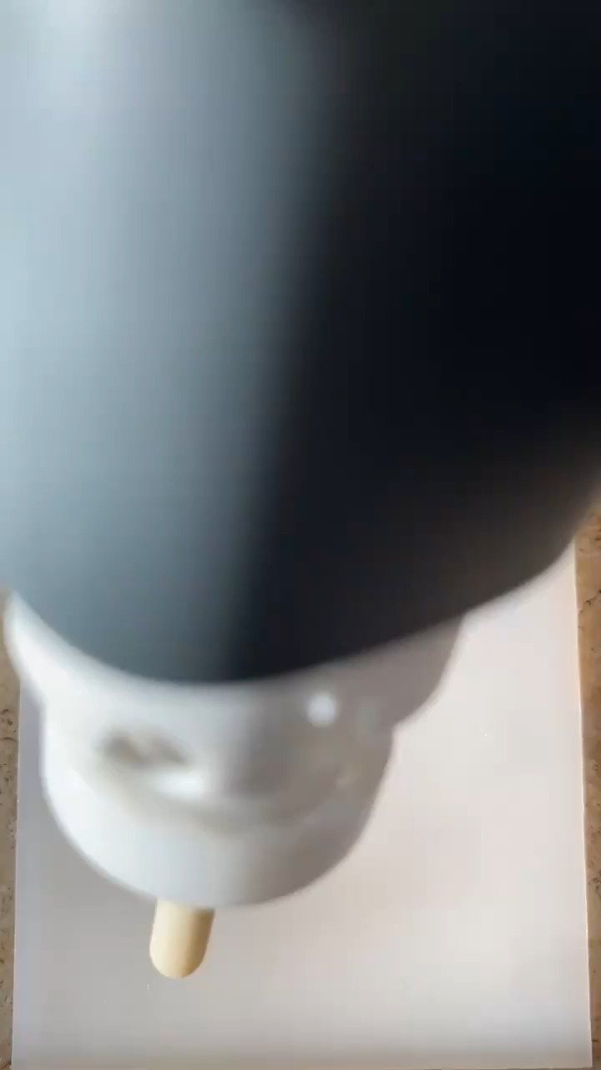
In many industrial processes it is important that the materials to be processed, e.g., plastics, have a certain surface tension or energy to achieve a certain quality level of the subsequent processes. For this reason, plasma treatment is often carried out upstream to remove the finest impurities and to compensate for differences between different batches of material. The graph clearly shows that plasma treatment can significantly increase the surface energy and thus the wettability of the various plastics.

Slide 19


Slide 20

DENTAL APPLICATIONS of PLASMA

Slide 21
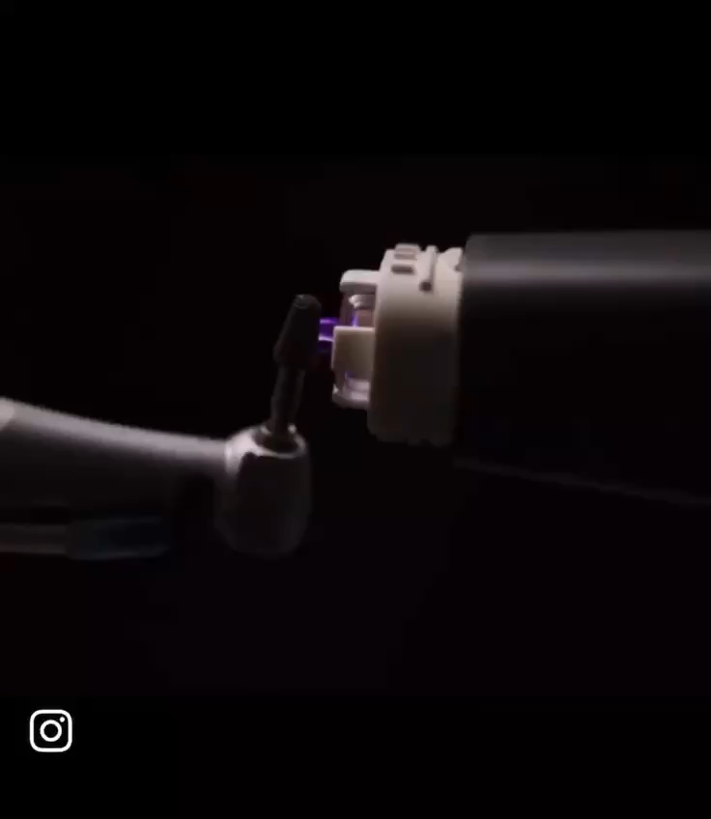
DENTAL IMPLANT SURFACE TREAMENT
The goal of the treatment is to make the implant super hydrophilic; means to achieve the best possible wettability. This property is the basis for biocompatibility and acceptance by the surrounding living tissue.
By increasing the surface energy the initial attachment of osteoblasts is improved, which subsequently leads to increased new bone formation after implantation. Thus, surface activation with plasma can improve bone regeneration, leading to increased and accelerated osseointegration.
This is particularly important in complex cases, immediate loading, or compromised patients.

Slide 22
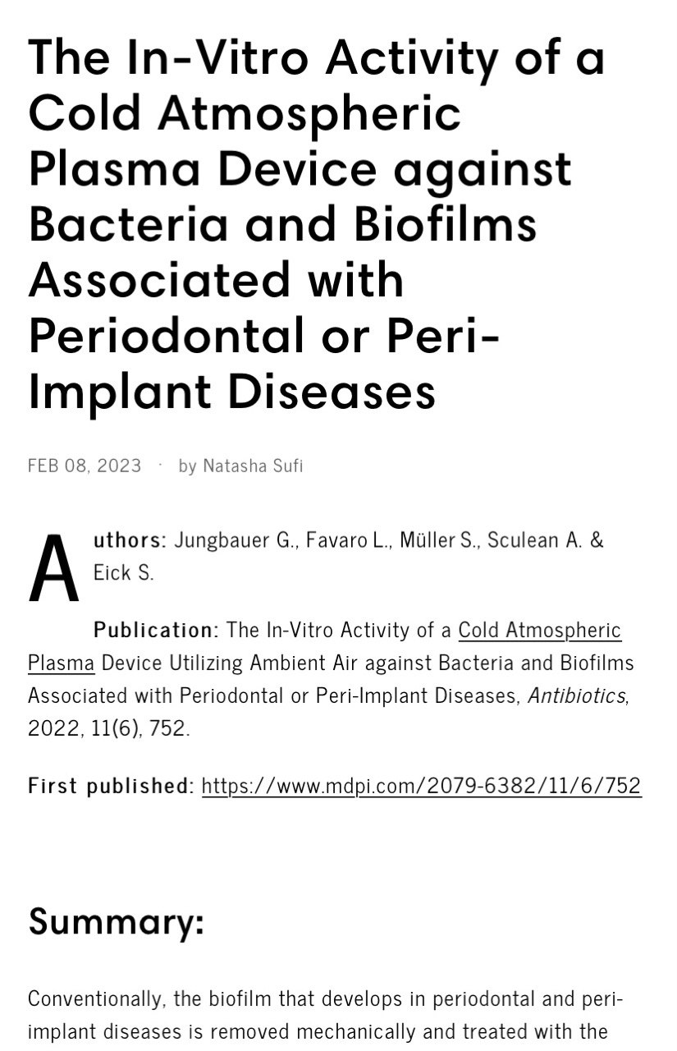
DENTAL IMPLANT SURFACE TREAMENT
In summary, CAP generated by the piezobrush® PZ3 can be used as an effective bactericide. CAP has a strong inhibitory effect on biofilms and can be used as a pretreatment of titanium implants to enable faster fusion with jawbone material.
In particular, the significant increase in fibroblast concentration promotes faster wound healing.
The possibilities of treating periodontal and peri-implant diseases with CAP have been demonstrated with the promising results of this study and form the foundation for further investigations.

Slide 23
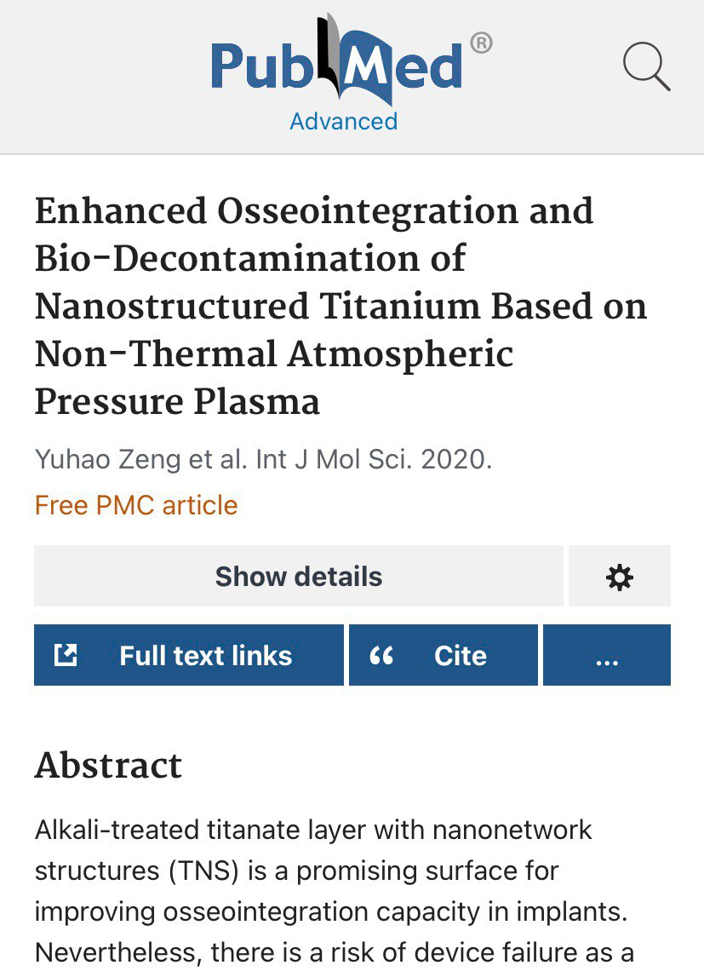
DENTAL IMPLANT SURFACE TREAMENT
Plasma treatment of titanium surfaces with nanonetwork effectively changed the chemical composition of the sample surface, which further improved implant hydrophilicity and facilitated cell attachment and extension; significantly accelerated new bone generation and improved osseointegration in the early stage of implantation.
Furthermore, the plasma treatment efficiently decontaminated the implant surface while preserving the nanoscale morphology of the TNS surface and generated a surface beneficial to osteogenesis at the same time, which could be used as a novel approach for immediate treatment before implantation or as the therapeutic method of peri-implantitis.
Moreover, the elucidation of the effect on cell adhesion, differentiation, and decontamination by plasma treatment has imparted meaningful advice for future research and the development of plasma-based therapeutic strategies.

Slide 24
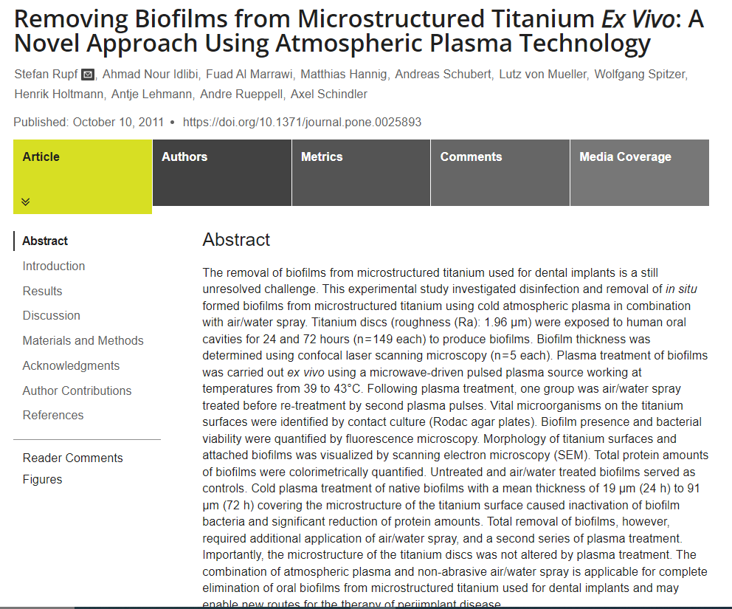
BIOFILM REMOVAL
Biofilms develop on tooth and oral mucosa, cause caries, periodontal diseases, and oral mucositis, which can also lead to inflammation around dental implants.
The combination treatment with plasma and a non-abrasive air/water spray is suitable for the elimination of oral biofilms from microstructured titanium used in dental implants.

Slide 25
BIOFILM REMOVAL
Upon the application of non-thermal plasma for disruption of biofilm on surface of teeth, the wall of the bacteria and extracellular matrix get distorted due to ionized non-thermal plasma eradicating the presence of biofilm on the surface of teeth.

Slide 26
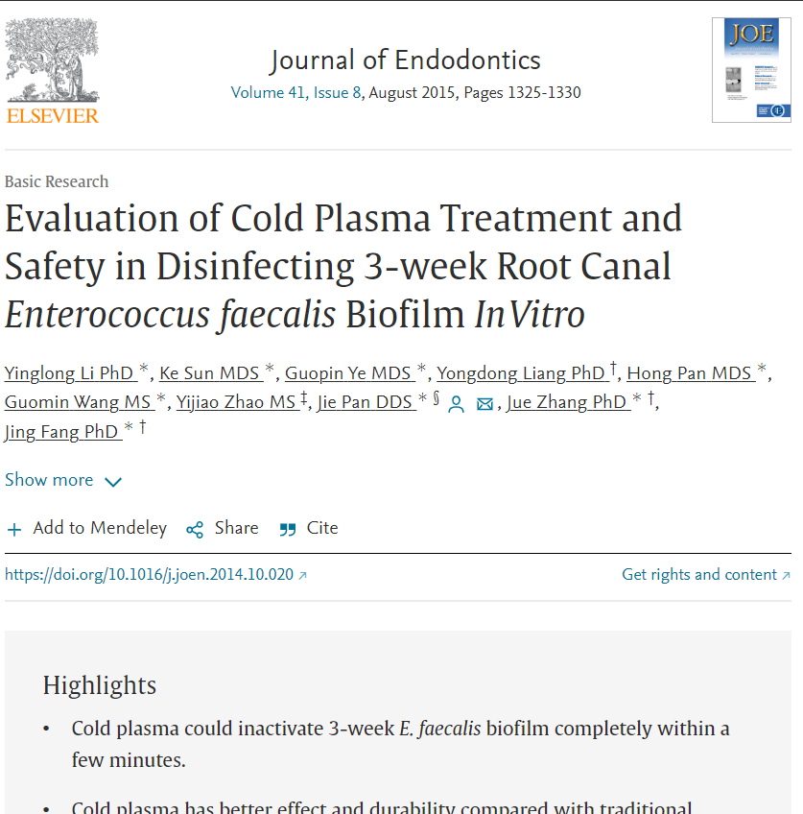
The biggest advantage of non-thermal plasma in treating root canal infections that can be depicted is its ability to reach small spaces that cannot be instrumented normally. However, clinical studies and proof are yet to come. These areas are the niche of the bacterial that cause reinfections, ultimately causing root canal treatment failures. Its gaseous nature gives it an enormous advantage over traditional instrumentation methods, apart from its highly efficient antibacterial properties.
ROOT CANAL DISINFECTION
Li et al. (2015) performed an in vitro study and found that 12 min of exposure to non-thermal plasma for three weeks completely killed Enterococcus faecalis, which is one of the main types of bacteria causing failure of root-canal treatment.
.

Slide 27
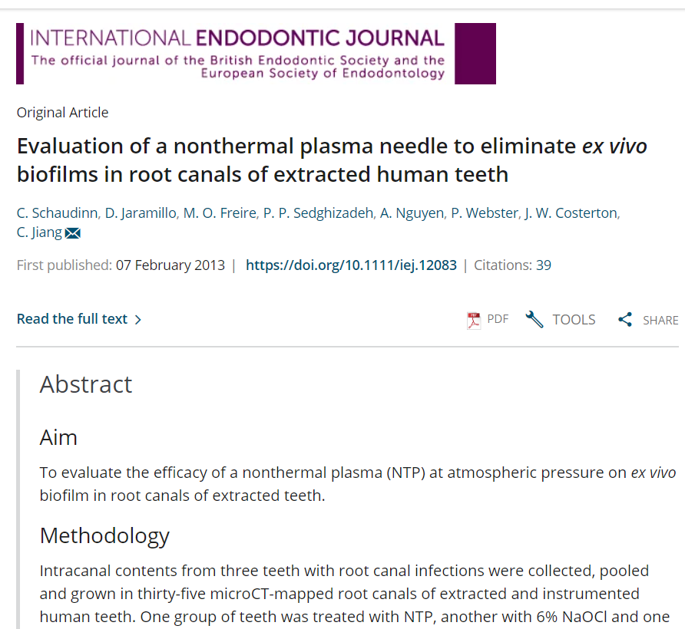
ROOT CANAL DISINFECTION
Plasma needle was used to eliminate ex vivo biofilms on root canals of extracted teeth. Teeth were divided into three groups: treatment with the plasma needle, treatment with 6% sodium hypochlorite (an antiseptic), and control. It was concluded that the plasma was effective at killing biofilms in extracted teeth, but using 6% sodium hypochlorite was more efficient.

Slide 28
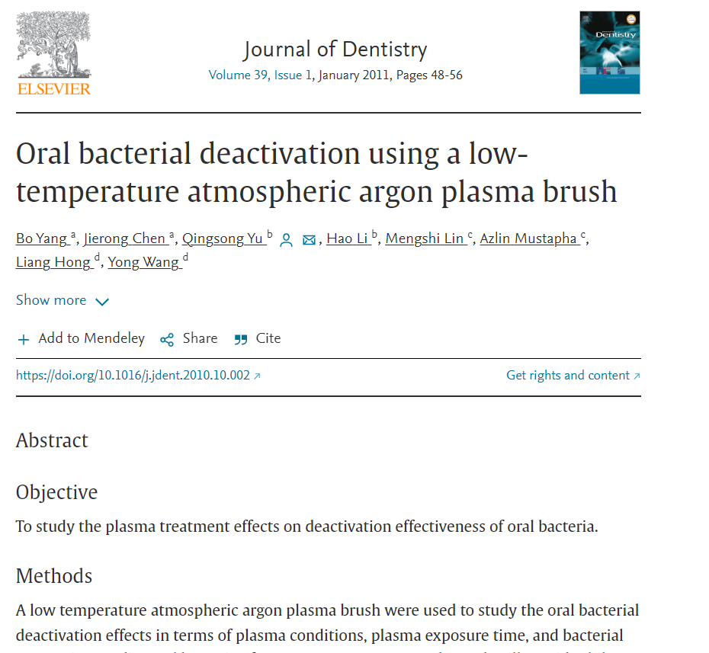
ROOT CANAL DISINFECTION
When low-temperature atmospheric argon plasma brush was used, about 100% bacterial elimination was achieved within 15 seconds for Streptococcus mutants and in 5 minutes for Lactobacillus acidophilus.
In comparison to lasers, plasmas can access small irregular cavities and fissure spaces.

Slide 29
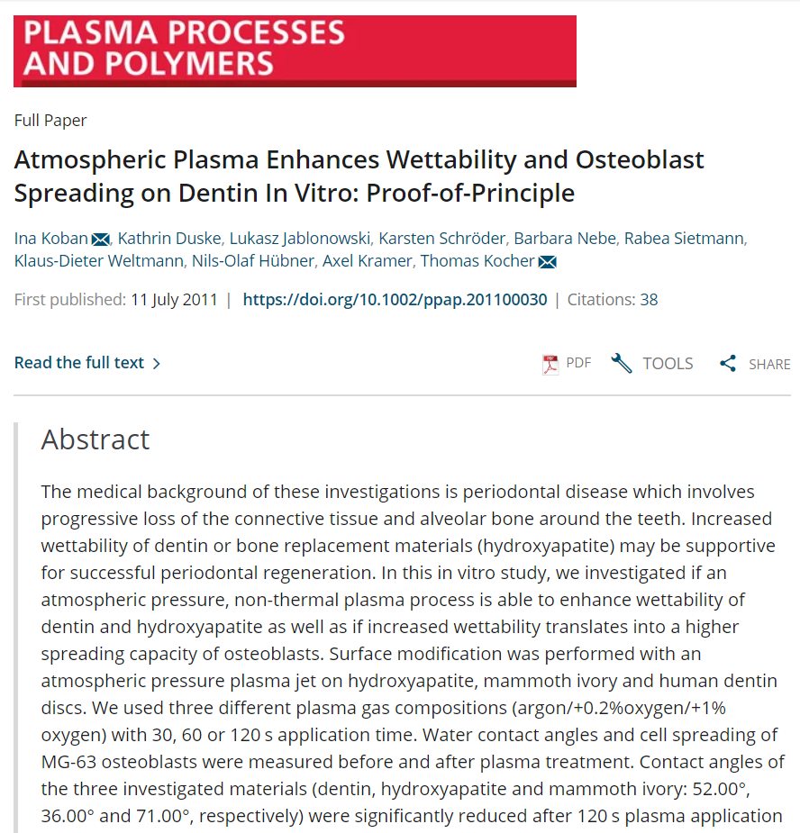
PERIODONTAL DISEASES
Cold plasma may be beneficial in the treatment of periodontal diseases like the elimination of pocket. It may also be used to treat and reduce the mobility of teeth and periodontitis due to its potential of inducing osteogenic differentiation in cells.

Slide 30
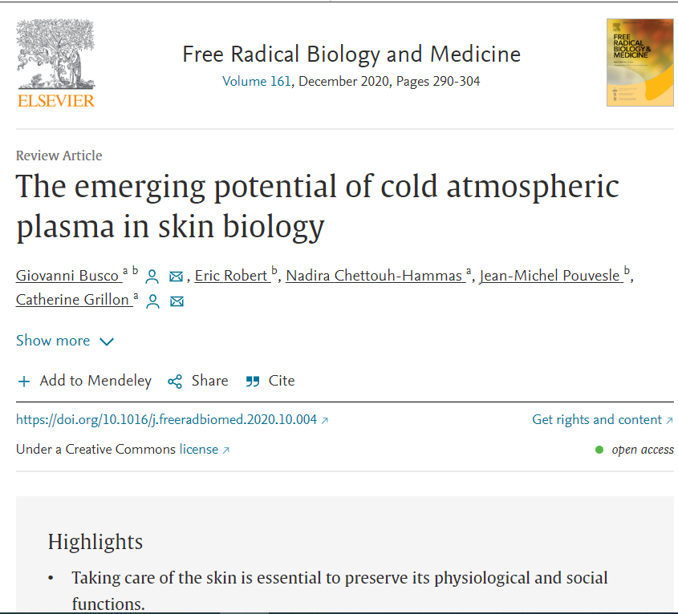
WOUND HEALING
Plasma generates free radicals well within the physiologic range of the body during natural tissue repair allowing for a higher cell turnover rate. So it has the potential to facilitate the wound healing procedure, reducing the incidence of complications like dry socket after extraction procedures or infected unhealed tissues after flap surgeries. However, a large number of studies need to be carried out, under varying conditions, to support this hypothesis.

Slide 31
WOUND HEALING
Plasma generates free radicals well within the physiologic range of the body during natural tissue repair allowing for a higher cell turnover rate. So it has the potential to facilitate the wound healing procedure, reducing the incidence of complications like dry socket after extraction procedures or infected unhealed tissues after flap surgeries. However, a large number of studies need to be carried out, under varying conditions, to support this hypothesis.

Slide 32
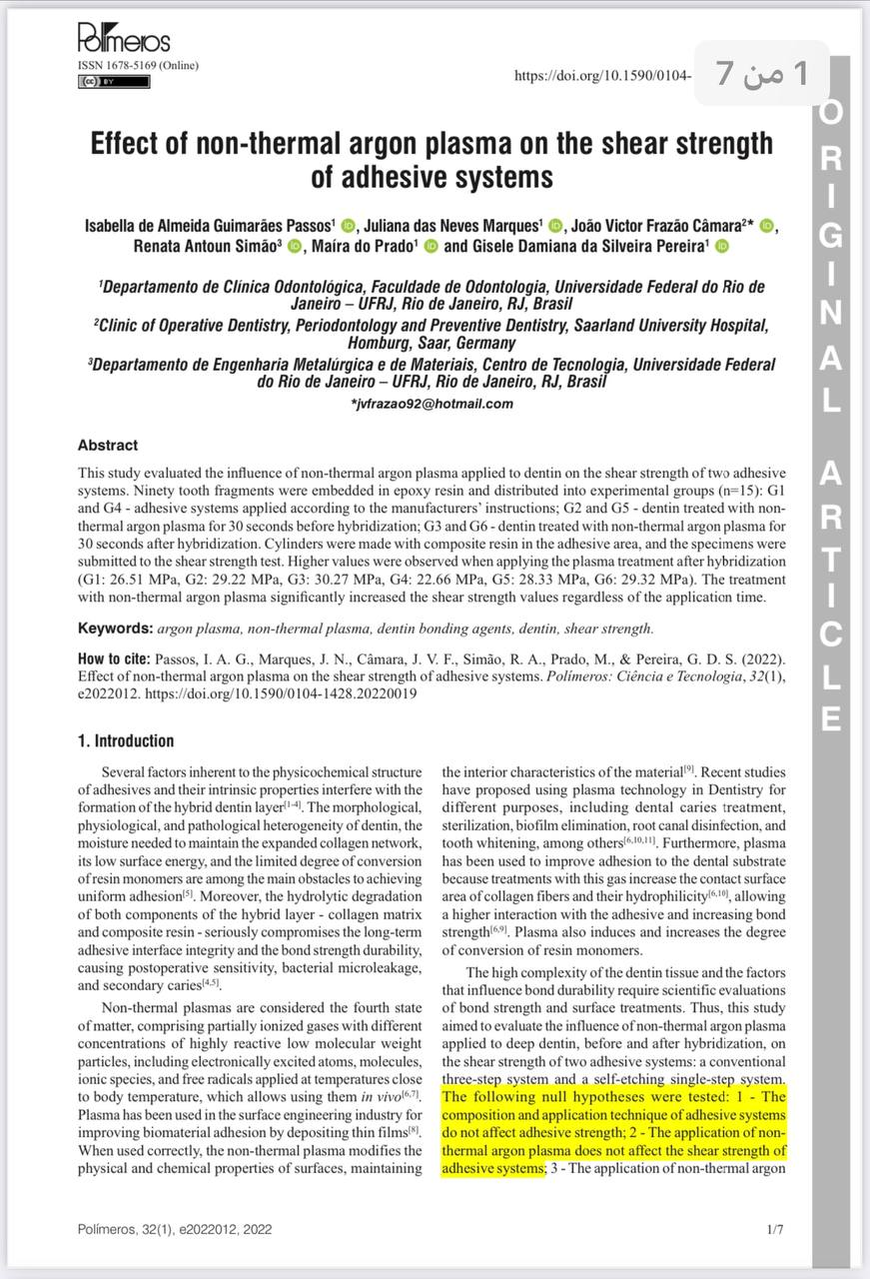
Study 1:
BOND STRENGTH OF ADHESIVE
-Applying non-thermal argon plasma for 30 seconds improved the bond strength to deep dentin.
-Non-thermal argon plasma applied to deep dentin before adhesive application significantly increased the bond strength of both adhesive systems, which ensured higher wettability and adhesion.

Slide 33
Study 1:
Non-thermal argon plasma applied to deep dentin for 30 seconds before adhesive application significantly increased the bond strength of both adhesive systems, which ensured higher wettability and adhesion.

Slide 34
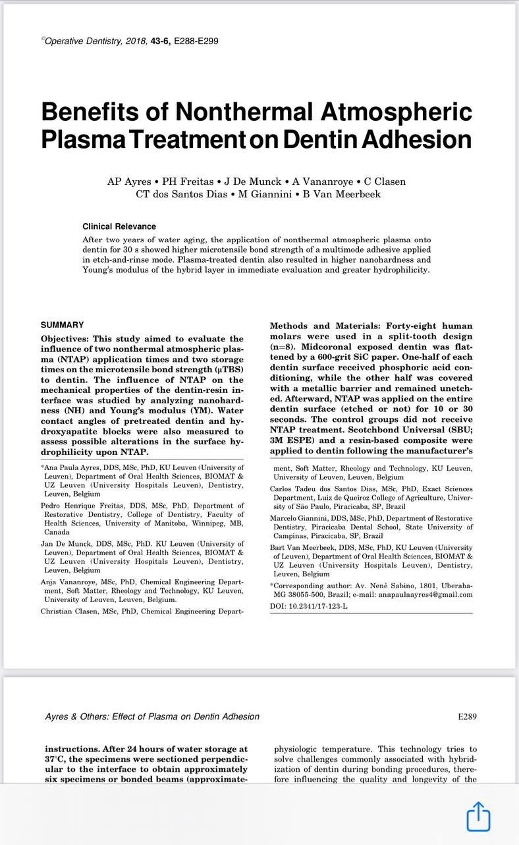
Study 2:
Dentin NTAP treatment for 30 seconds influences the µTBS of the multimode SBU adhesive in the ER approach after two years of water aging.
This positive result might be correlated with the increase in nanohardness and Young’s modulus of the hybrid layer and to the greater dentin hydrophilicity, two phenomena observed in short-time evaluation.

Slide 35
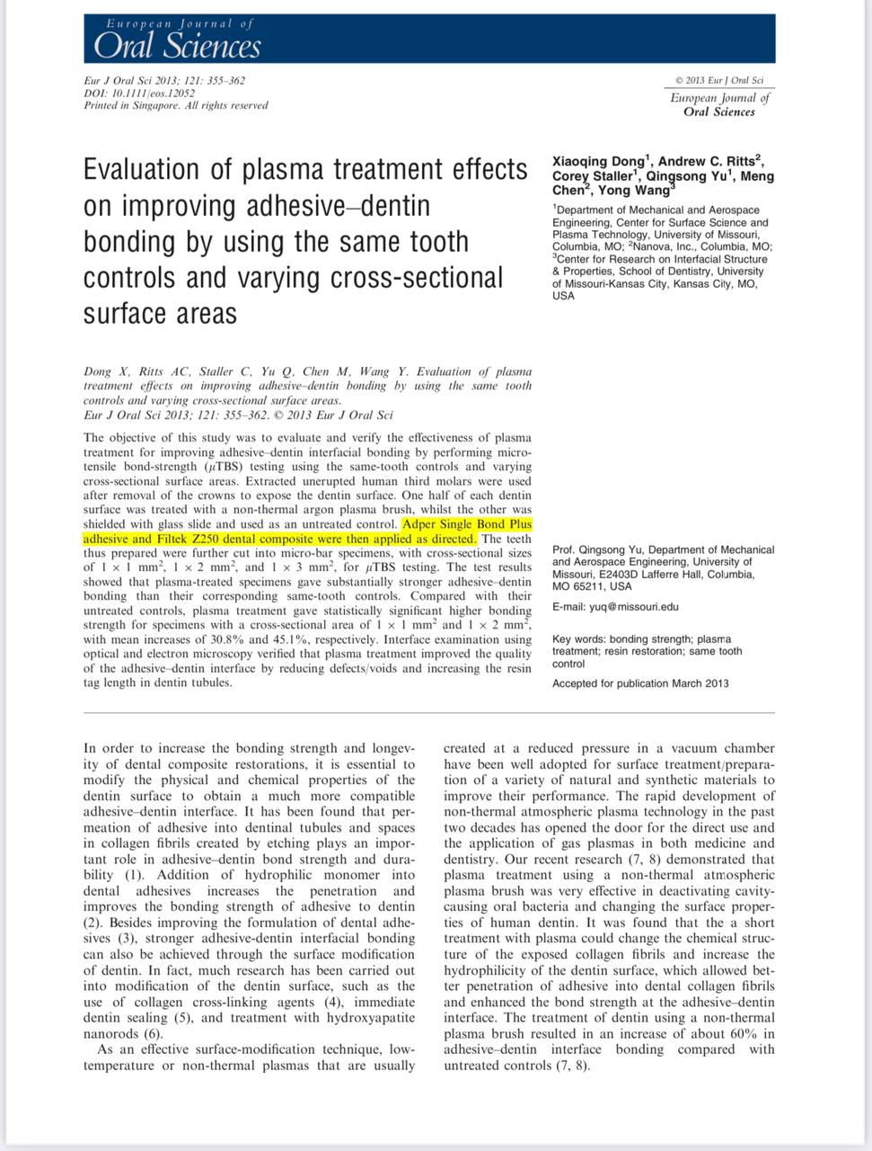
Study 3:
The results of this study showed that non-thermal argon plasma treatment is very effective in improving the bonding strength of the adhesive-dentin interface, which is crucial for increasing the longevity of dental composite restorations.

Slide 36
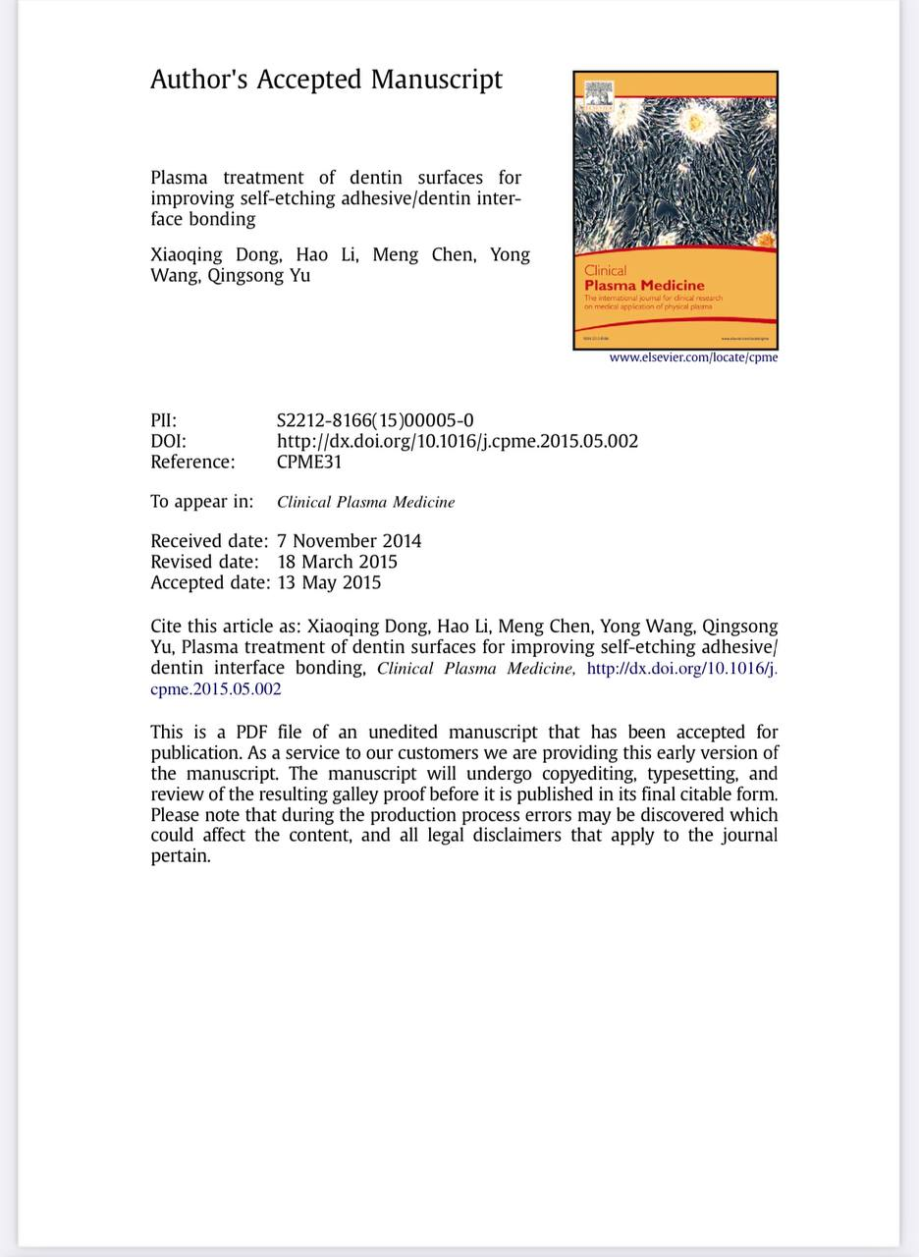
Study 4:
Non-thermal argon plasma treatment is very effective in improving adhesive/dentin interface bonding for durable composite restoration using mild self-etching systems. Such results can be attributed to that plasma treatment followed by rewetting process could partially open dentinal tubules, and thus enhance adhesive penetration to form thicker hybrid layer and longer resin tags and consequently improve the adhesive/dentin interface quality. The better interface quality leads to the long-term durability of adhesive-dentin bonding

Slide 37
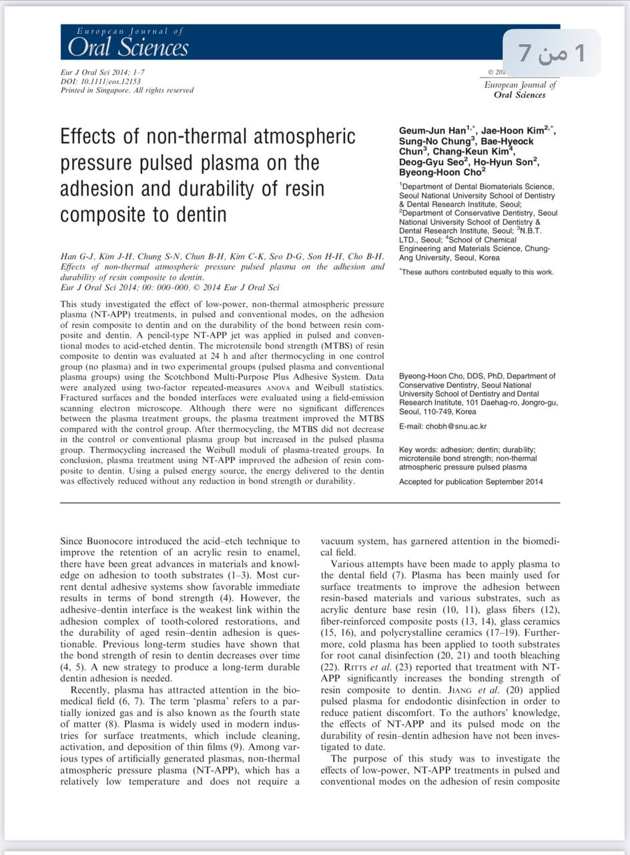
Study 5:
Plasma treatment using a low-power NT-APP improved the adhesion of resin composite to dentin. In this study, by adopting a pulsed energy source, the energy delivered to the dentin, a vital tissue in the oral cavity, was effectively reduced without compromising the bond strength or durability.

Slide 38
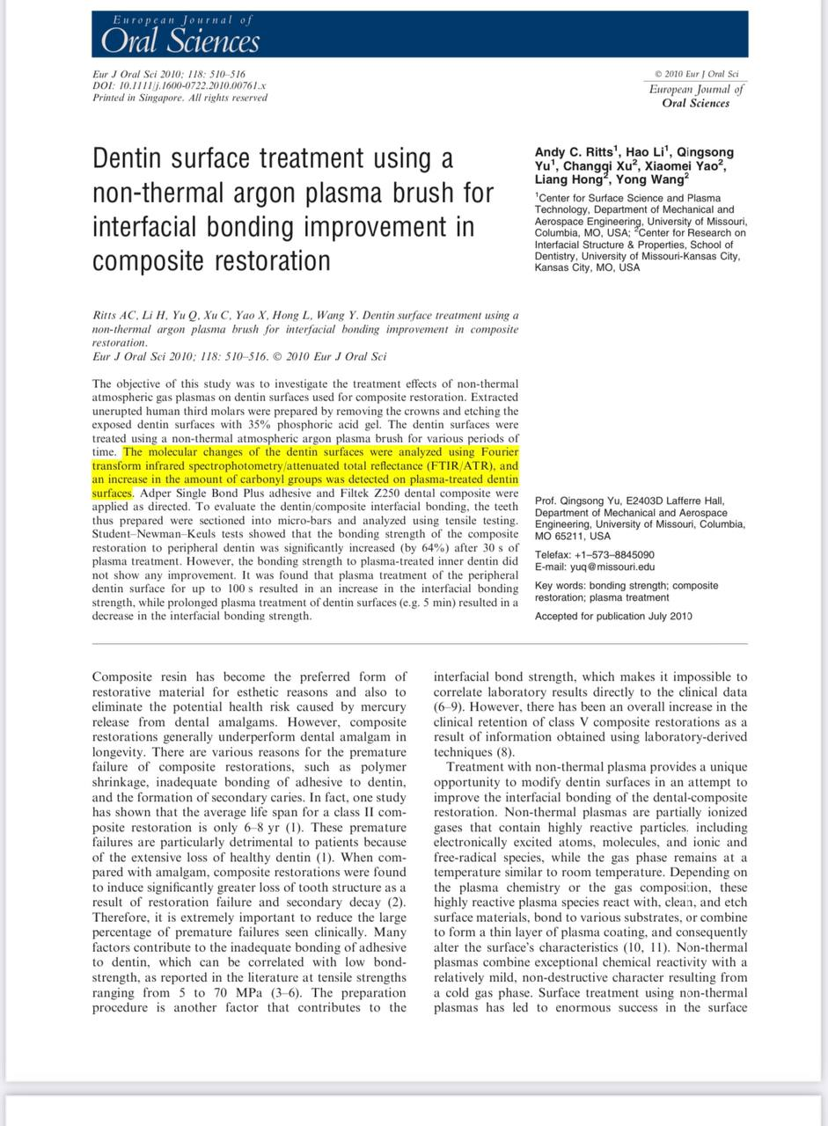
Study 6:
Short plasma treatment time is desirable in dental clinical applications because it will allow the rapid formation of a dental-composite restoration. However, prolonged treatment with plasma could cause collagen fiber degradation, and, as a result, lead to a weak interface, expressed as a lower ultimate tensile strength and elastic modulus.

Slide 39
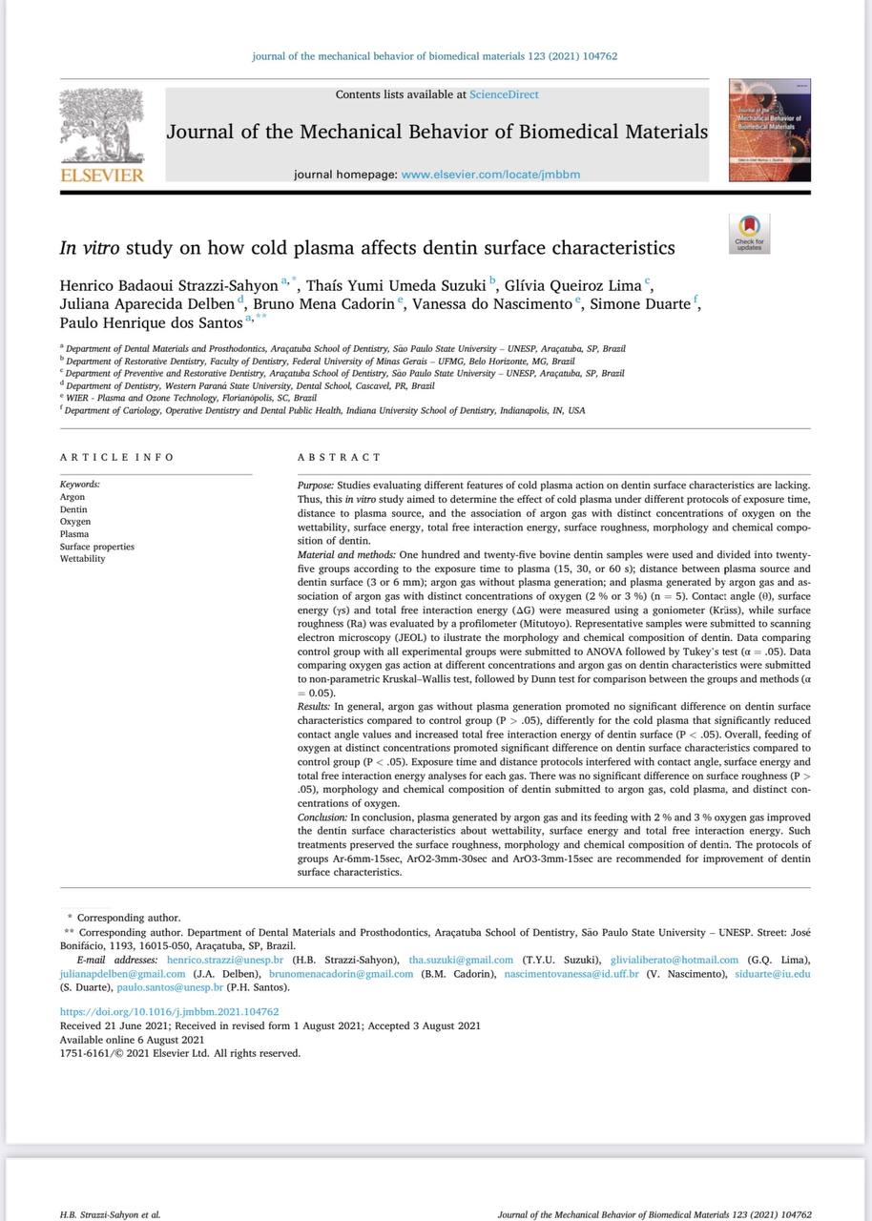
Study 7:
Plasma generated by argon gas and its feeding with 2 % and 3 % oxygen gas improved the dentin surface characteristics about wettability, surface energy and total free interaction energy. Such treatments preserved the surface roughness, morphology and chemical composition of dentin.

Slide 40
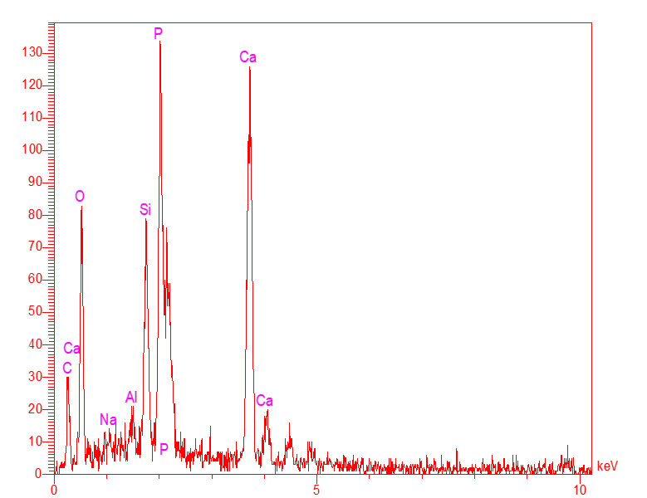
With out plasma
Elt | Line | Int | Error | K | Kr | W% | A% | ZAF | Formula | Ox% | Pk/Bg | Class | LConf | HConf | Cat#
C | Ka | 37.4 | 1.1581 | 0.0944 | 0.0456 | 19.84 | 31.25 | 0.2300 |  | 0.00 | 8.68 | A | 16.68 | 23.01 | 0.00
O | Ka | 124.3 | 1.1581 | 0.1800 | 0.0870 | 39.02 | 46.14 | 0.2231 |  | 0.00 | 27.55 | A | 35.60 | 42.44 | 0.00
Na | Ka | 5.7 | 3.3643 | 0.0039 | 0.0019 | 0.39 | 0.32 | 0.4842 |  | 0.00 | 2.31 | B | 0.23 | 0.55 | 0.00
Al | Ka | 8.7 | 3.3643 | 0.0057 | 0.0028 | 0.38 | 0.26 | 0.7339 |  | 0.00 | 2.47 | B | 0.25 | 0.50 | 0.00
Si | Ka | 129.4 | 3.3643 | 0.0903 | 0.0436 | 5.24 | 3.53 | 0.8337 |  | 0.00 | 7.40 | A | 4.79 | 5.68 | 0.00
P | Ka | 296.4 | 3.3643 | 0.2342 | 0.1132 | 13.82 | 8.44 | 0.8197 |  | 0.00 | 11.55 | A | 13.03 | 14.60 | 0.00
Ca | Ka | 286.5 | 0.6789 | 0.3914 | 0.1892 | 21.32 | 10.06 | 0.8877 |  | 0.00 | 18.94 | A | 20.09 | 22.55 | 0.00
 |  |  |  | 1.0000 | 0.4835 | 100.00 | 100.00 |  |  | 0.00 |  |  |  |  | 0.00
With plasma
Elt | Line | Int | Error | K | Kr | W% | A% | ZAF | Formula | Ox% | Pk/Bg | Class | LConf | HConf | Cat#
C | Ka | 44.9 | 1.5034 | 0.0510 | 0.0274 | 12.05 | 20.82 | 0.2274 |  | 0.00 | 5.18 | A | 10.26 | 13.85 | 0.00
O | Ka | 234.0 | 1.5034 | 0.1527 | 0.0821 | 39.21 | 50.84 | 0.2094 |  | 0.00 | 29.60 | A | 36.65 | 41.77 | 0.00
Na | Ka | 14.1 | 4.9615 | 0.0043 | 0.0023 | 0.49 | 0.45 | 0.4728 |  | 0.00 | 2.33 | B | 0.36 | 0.63 | 0.00
Al | Ka | 5.4 | 4.9615 | 0.0016 | 0.0009 | 0.12 | 0.09 | 0.7291 |  | 0.00 | 2.09 | B | 0.07 | 0.17 | 0.00
Si | Ka | 10.7 | 4.9615 | 0.0034 | 0.0018 | 0.22 | 0.16 | 0.8392 |  | 0.00 | 2.18 | B | 0.15 | 0.28 | 0.00
P | Ka | 835.6 | 4.9615 | 0.2975 | 0.1600 | 18.67 | 12.51 | 0.8568 |  | 0.00 | 16.16 | A | 18.03 | 19.32 | 0.00
Ca | Ka | 795.6 | 0.7319 | 0.4896 | 0.2633 | 29.23 | 15.13 | 0.9007 |  | 0.00 | 29.76 | A | 28.20 | 30.27 | 0.00
 |  |  |  | 1.0000 | 0.5378 | 100.00 | 100.00 |  |  | 0.00 |  |  |  |  | 0.00

Slide 41
APPLICATIONS of NON-THERMAL PLASMA in DENTAL LABORATORY

Slide 42
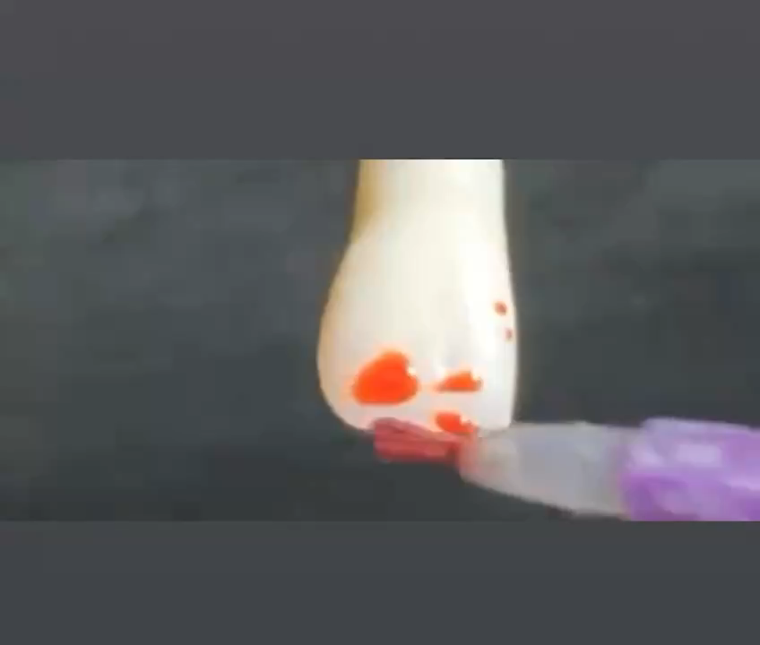
SURFACE PRE-TREATMENT OF CROWNS PRIOR TO STAINING & GLAZING

Slide 43
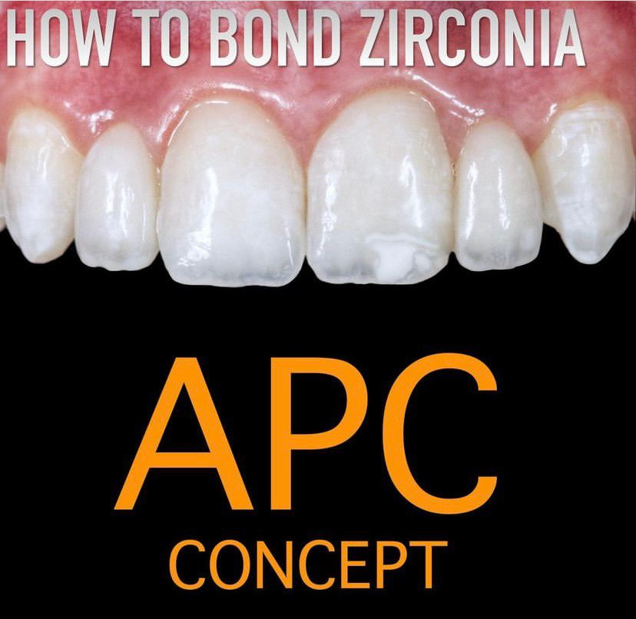
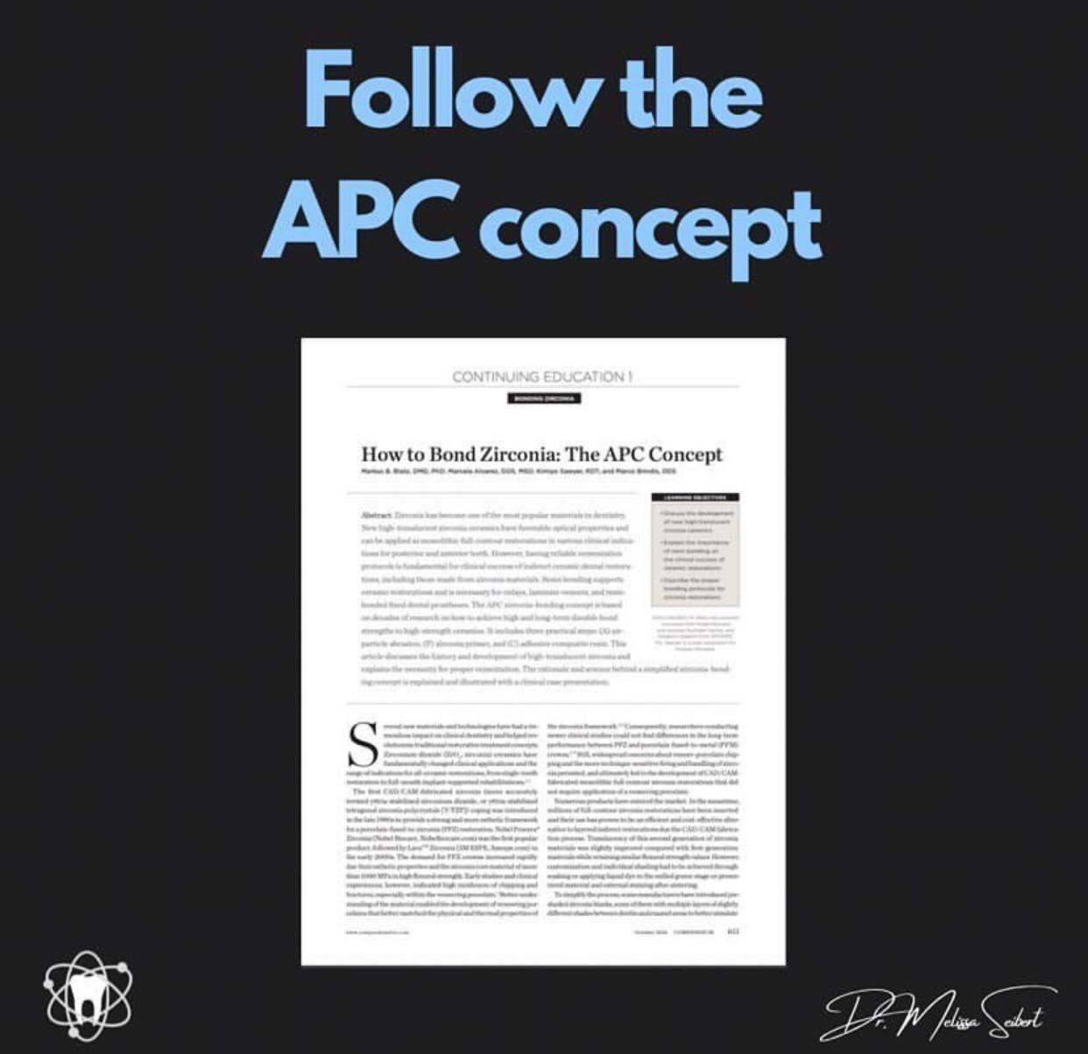

Slide 44
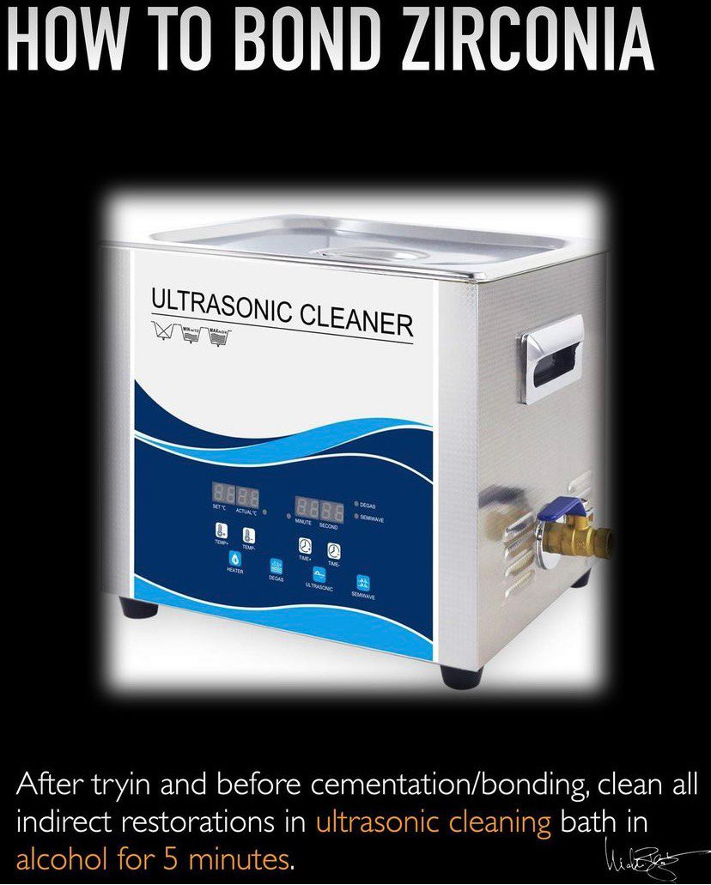

Slide 45
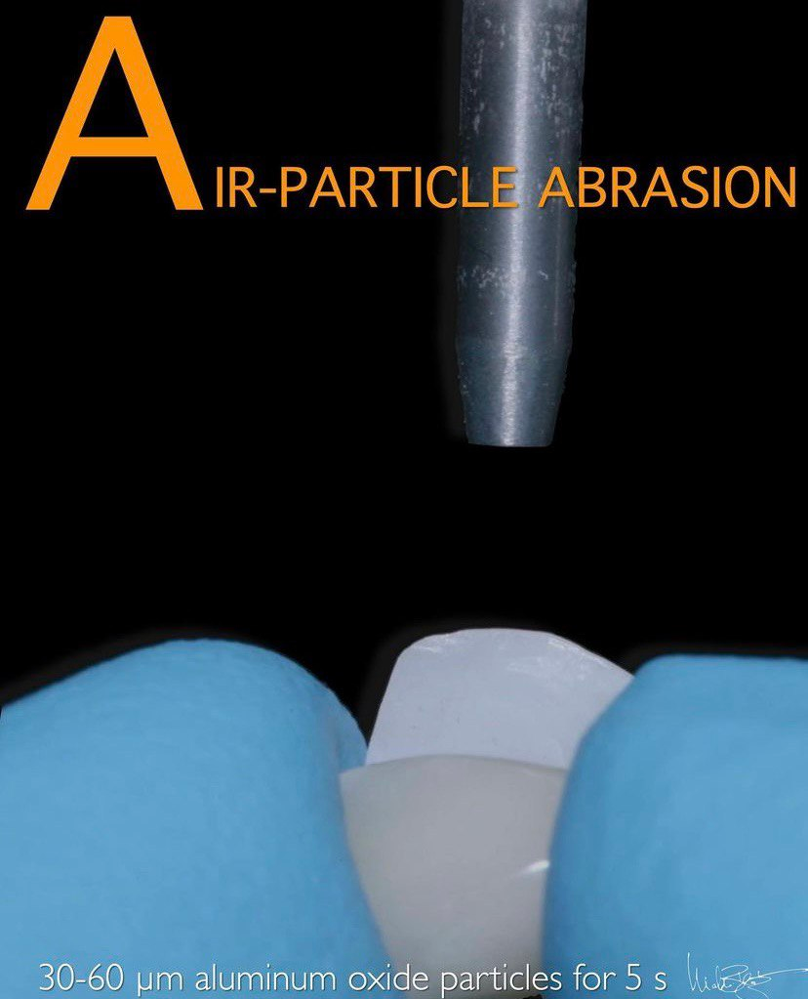

Slide 46
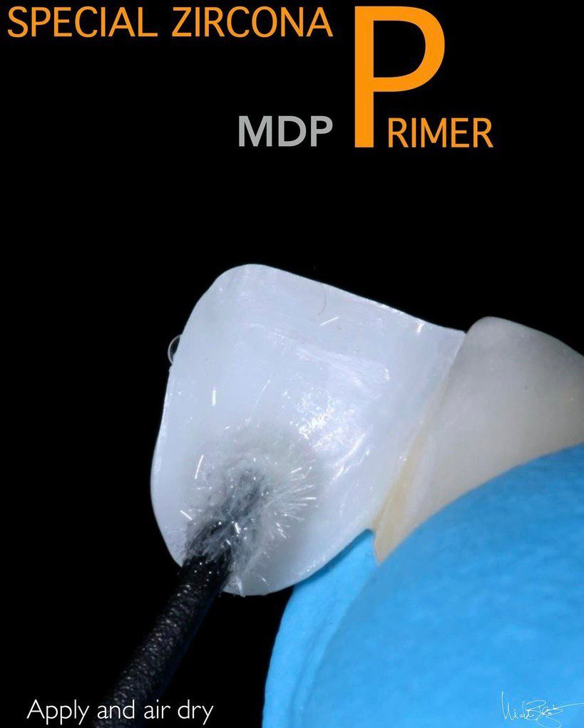

Slide 47
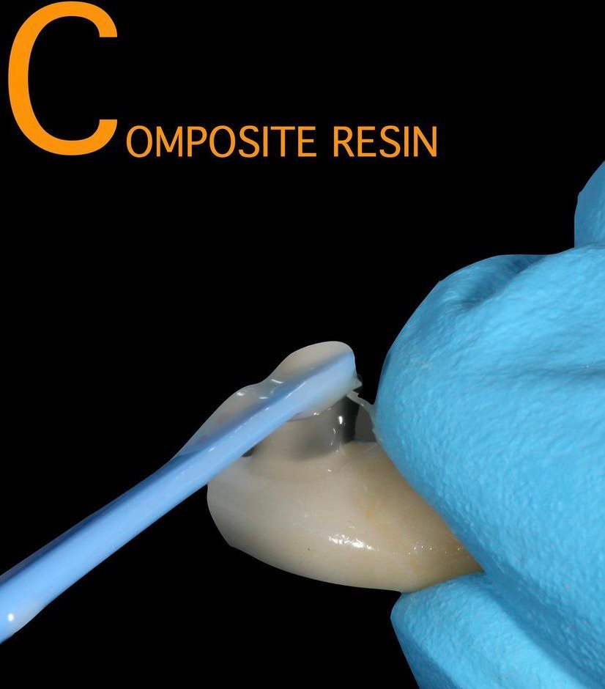

Slide 48
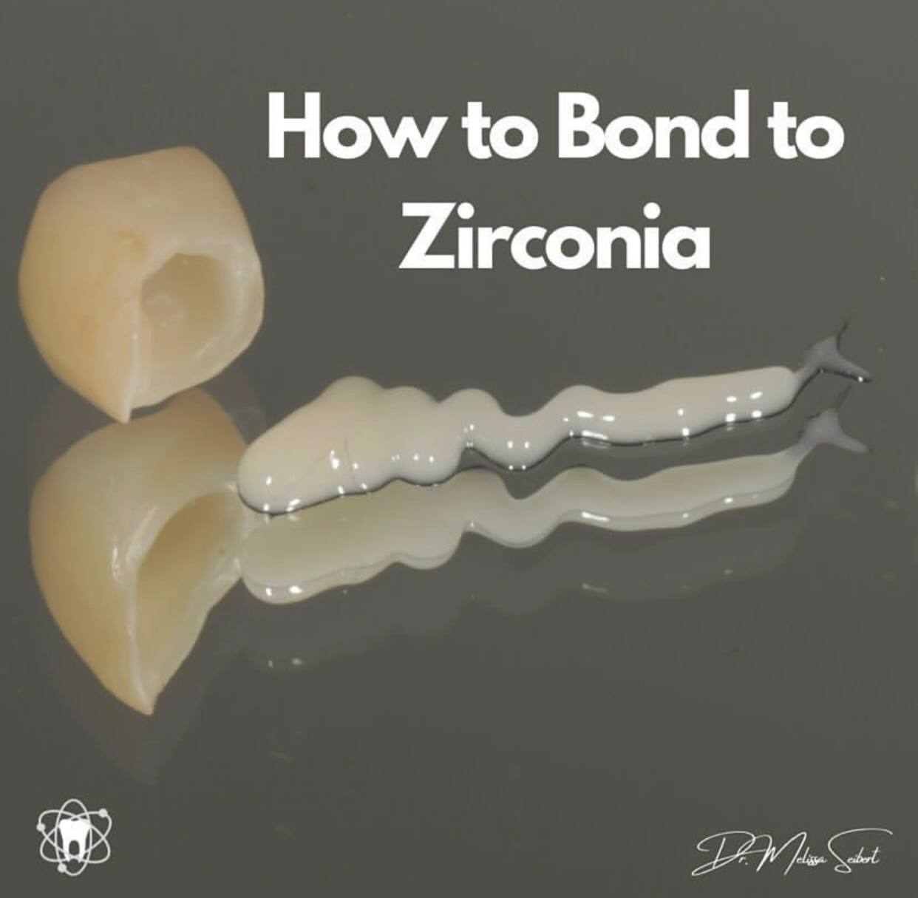

Slide 49
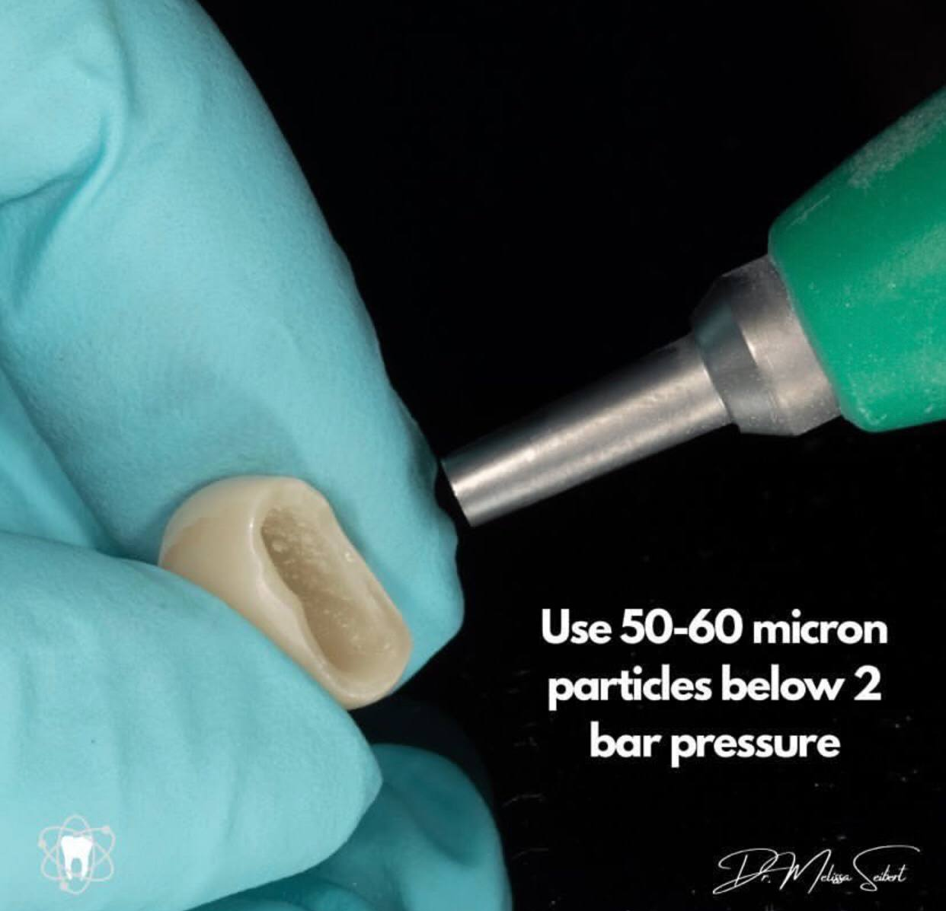
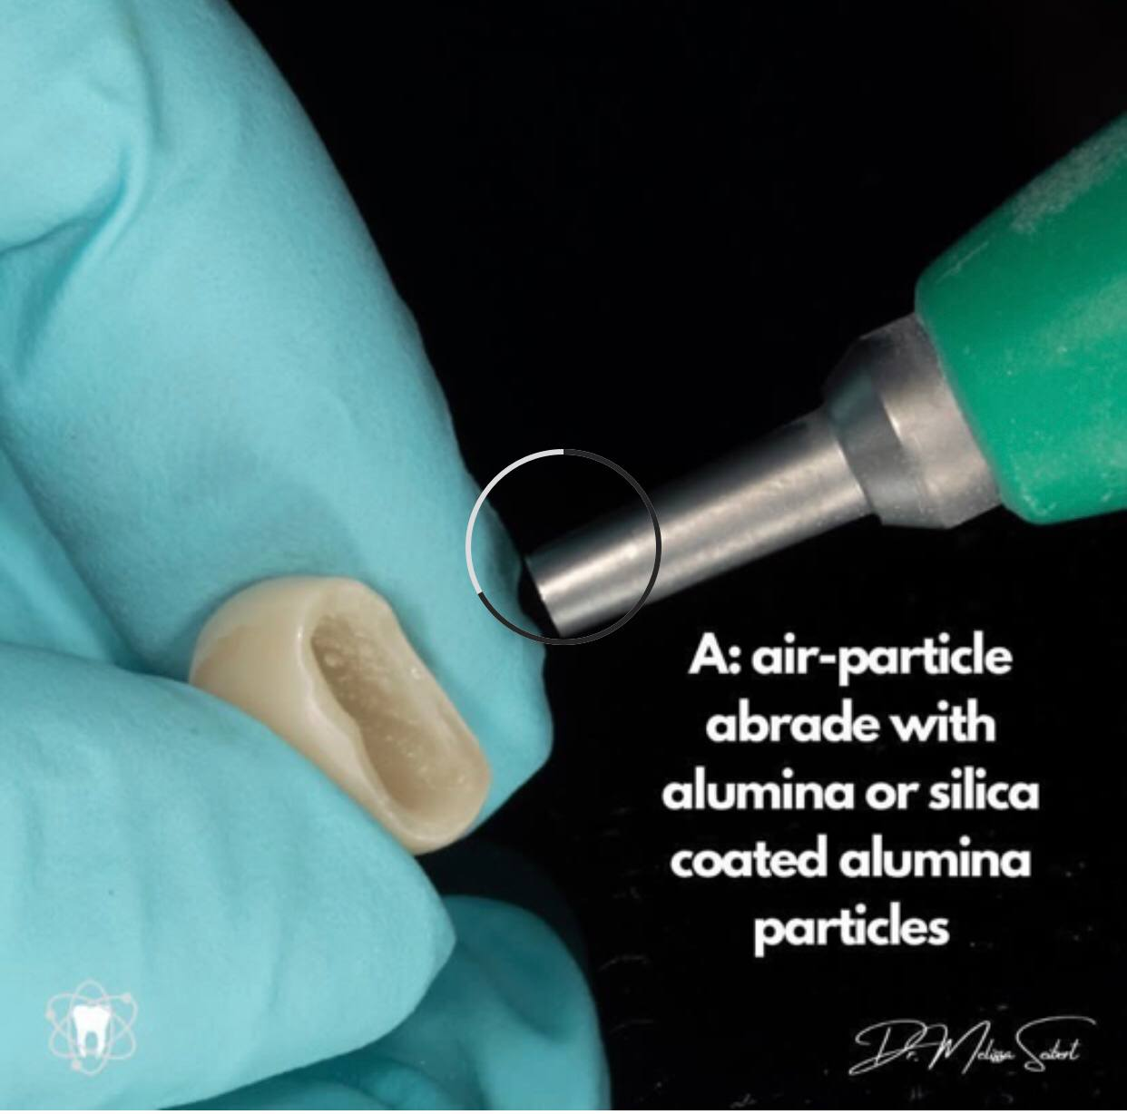

Slide 50
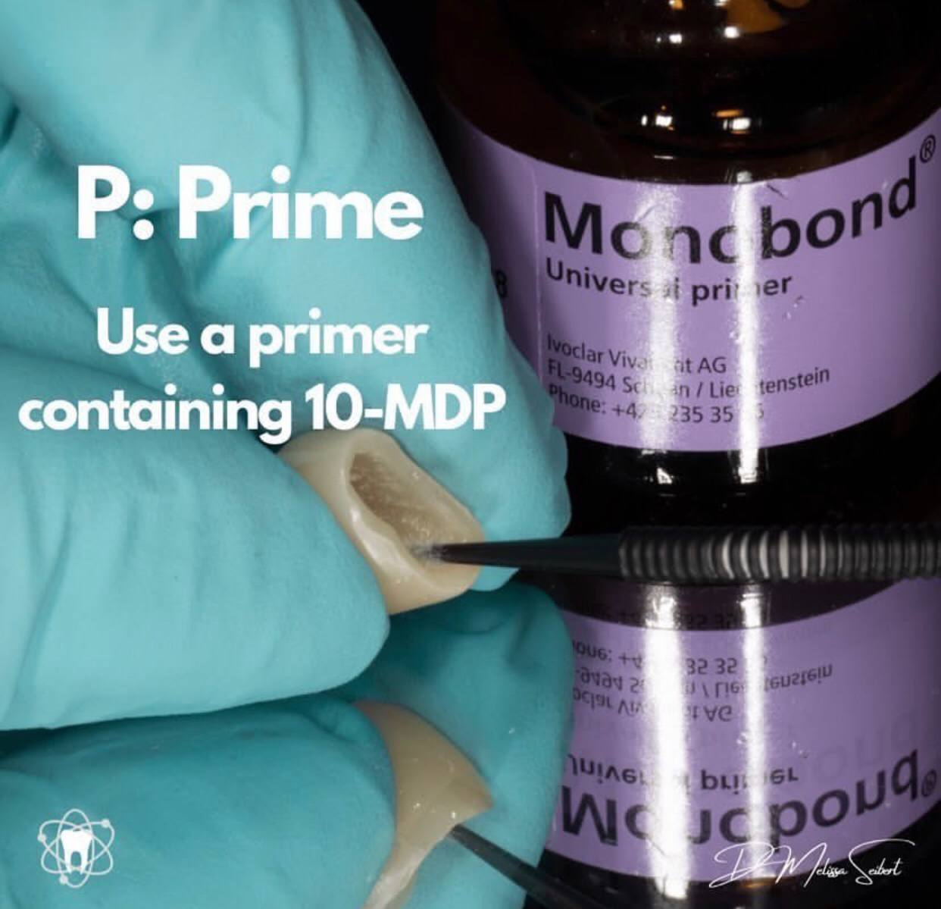
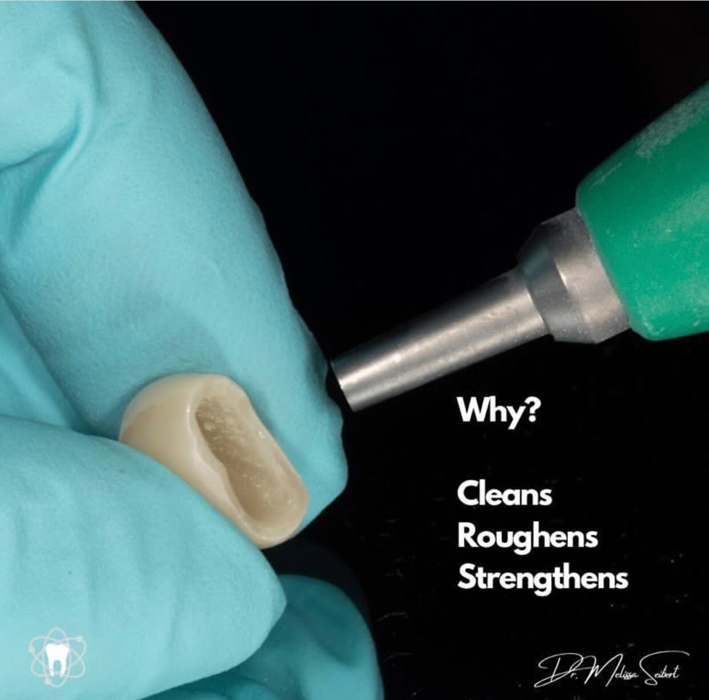

Slide 51
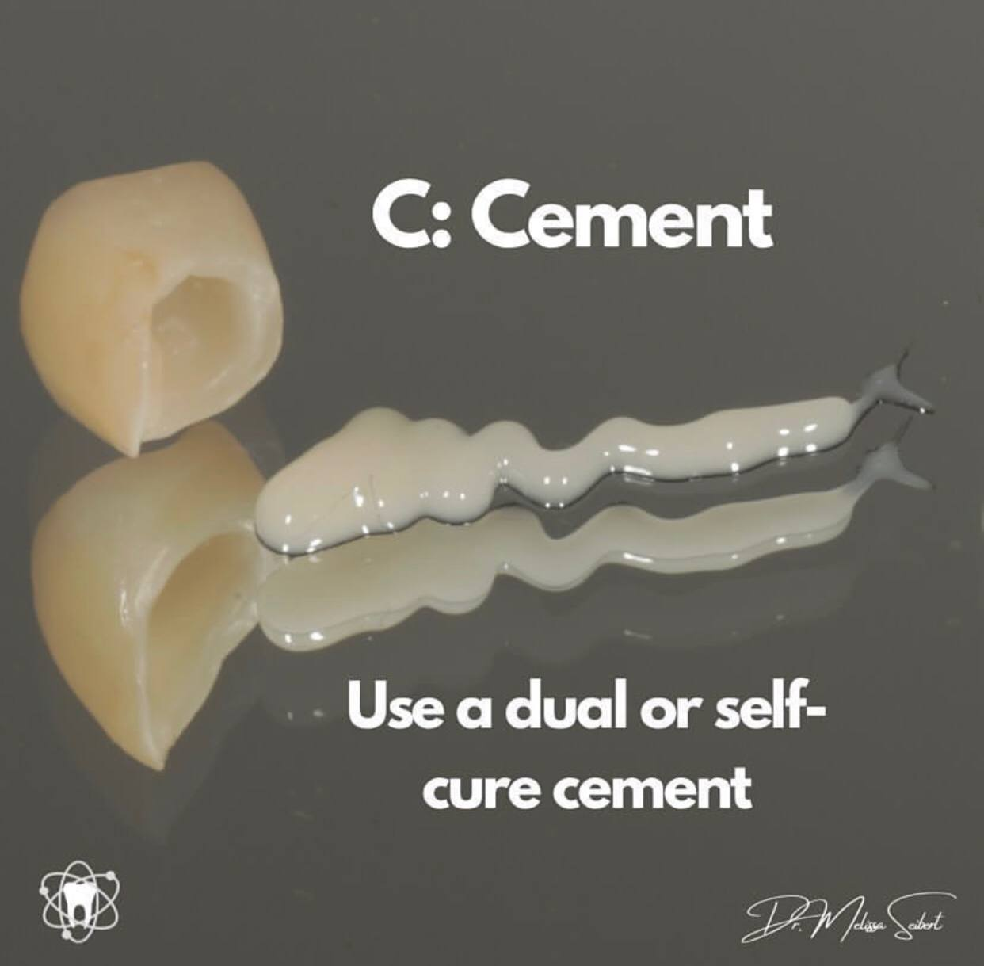
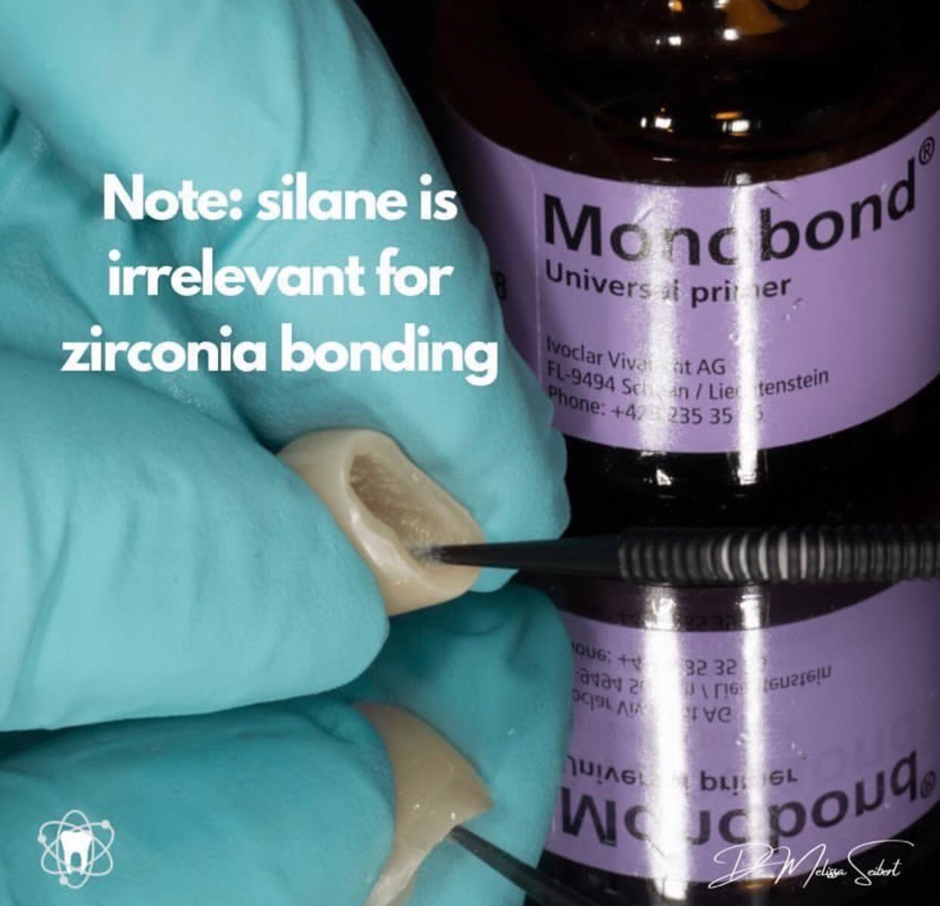

Slide 52
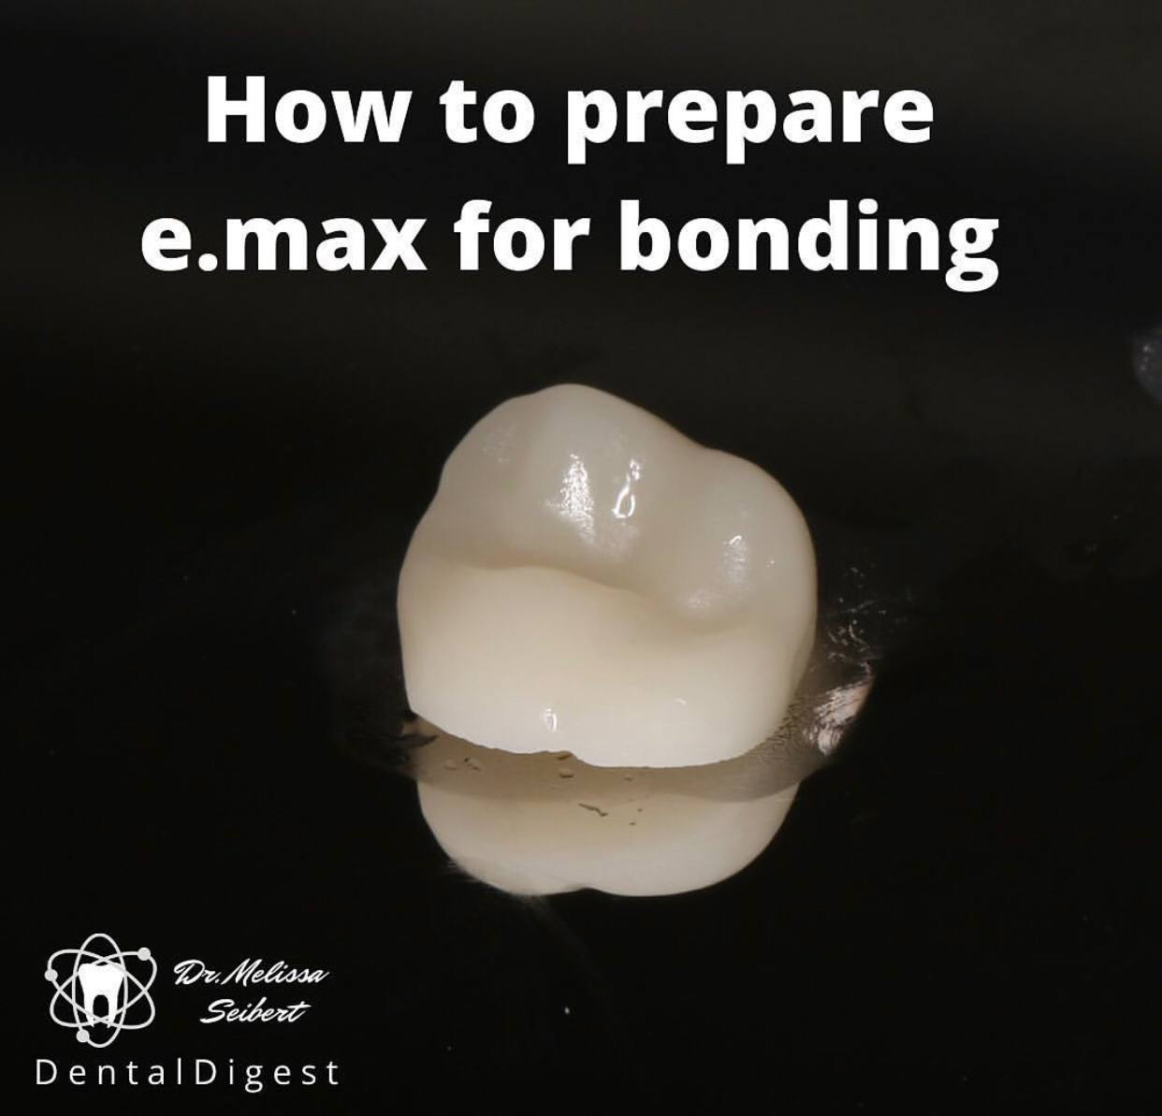

Slide 53
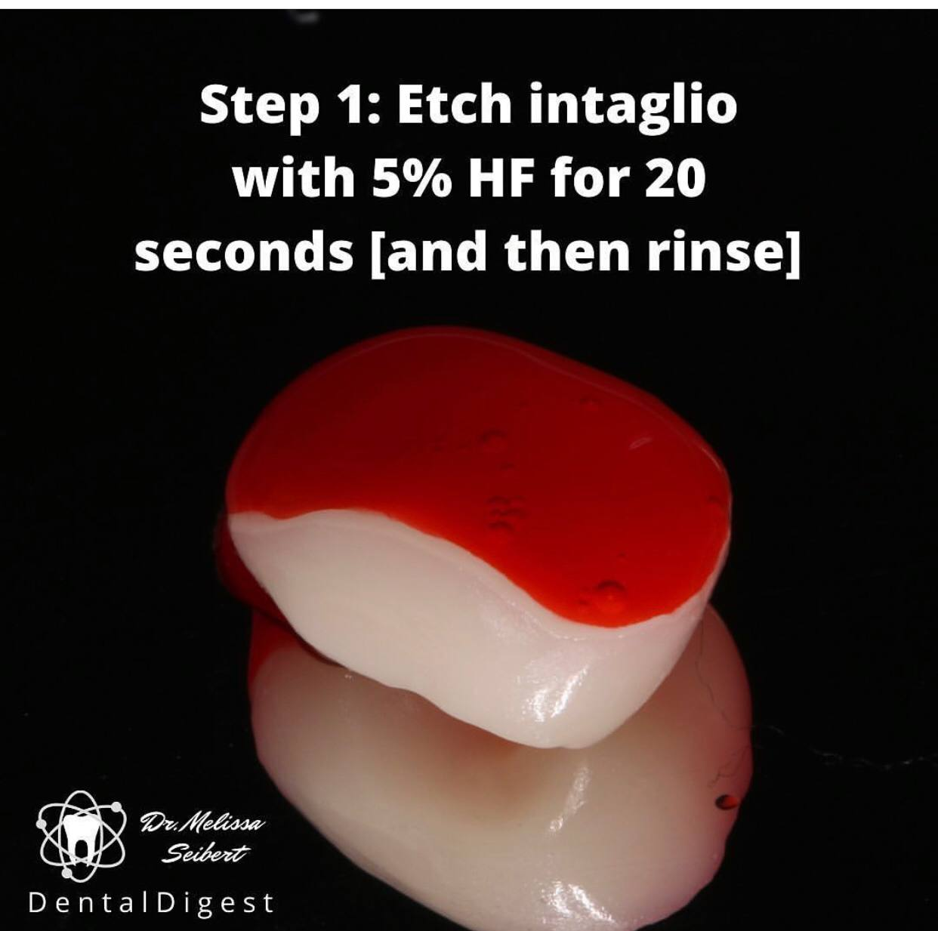


Slide 54


One great misconception clarified: adhesive on top of Silane does NOT help (to the contrary!) unless absolutely required per manufacturer’s instructions…

Slide 55


Porcelain is NOT CLEAN after HF etching. Ultrasonic bath cleaning in ethyl alcohol or distilled water can remove those whitish residues before you apply the silane.

Slide 56



SURFACE TREAMENT OF ZIRCONIA

Slide 57


EFFECT OF PLASMA SURFACE TREATMENT OF THREE DIFFERENT CAD/CAM MATERIALS ON THE MICRO SHEAR BOND STRENGTH WITH RESIN CEMENT
(A COMPARATIVE IN VITRO STUDY)
Jasim SJ & Majeed MA
(UNDER PUBLICATION)

Slide 58



Slide 59
Future Perspectives
Non-thermal plasma has a great potential to be used in dentistry in the near future, with applications in several dental specialties.

Slide 60
Acknowledgement
Dr. Muthana Kamal
Dr. Roaa Neamah
Dr. Shahad Jabbar

Slide 61

The way to get started is to quit talking and begin doing.
Thank You
Walt Disney

