Slide 1


Dental anomalies in children submitted to antineoplastic therapy
Ass.lecturer. Fatimah Jalil Ismail

Slide 2
Introduction
Malignant tumors are the second most common cause of death in children around the world
The most common types of pediatric cancers are leukemia, central nervous system tumors, and lymphomas.
Chemotherapy (CT) and/or radiotherapy (RT) are usually the treatment of choice in these diseases.
Most anti-cancer drugs used for cancer treatment block the growth of cancer cells owing to their cytostatic and cytotoxic effects and also enable these cells to be destroyed
The exact molecular mechanisms of antineoplastic therapy that result in dental anomalies remain unknown. The lack of specificity of both chemotherapeutic agents and radiation therapy in terms of differentiating neoplastic cells from metabolically active normal cells might result in dental and facial development abnormalities

Slide 3
Introduction
Previous animal studies have shown dental development disturbances induced by vincristine, vinblastine, doxorubicin, and cyclophosphamide .
RT can also cause disturbances in dental development in children; however, the minimal RT dose necessary to cause changes in dental development is unknown.
Therefore, the risk of dental anomalies (DAs) as a long-term side effect is quite high in children after cancer treatment

Slide 4
Factors affecting frequency and severity of dental anomalies
age at diagnosis : DAs are more common among children who have received cancer treatment at an earlier age, which is usually before the age of 5 years, On the other hand, the ages of 4-5 years are considered critical for tooth development . For this reason, it is emphasized that it is very important to investigate possible DAs in pediatric patients who have received cancer treatment before the age of 5 years
Type and dose of chemotherapeutic agent used
RT total and fraction dose : dose of 10 Gy RT will cause permanent changes in mature ameloblasts and a dose of 30 Gy is enough to stop dental development
Volume of oral cavity involved in the RT field

Slide 5
Types of dental anomalies
Antineoplastic therapies that affect the cells involved in odontogenesis may cause changes in tooth enamel and root development, premature apex closure, dental development delay or retained teeth
Dental anomalies of shape (microdontia, macrodontia and taurodontia)
number (hypodontia),
enamel defects (discolorations and hypoplasia) and
root formation disturbances (blunted root, tapered root and root development delay) have been described in many studies
Other anomalies, such as supernumerary teeth, have also been detected
Developmental defects of the enamel organ are well documented in the scientific literature. Enamel hypoplasias and discolorations are the most frequent dental defects from cytotoxic drugs

Slide 6
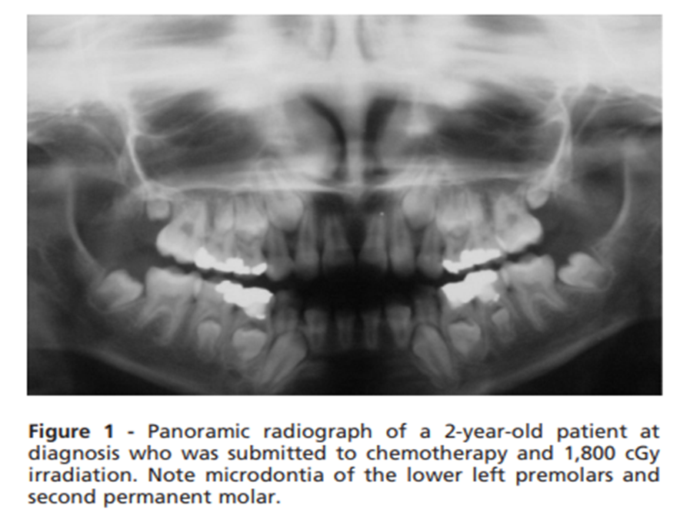
Types of dental anomalies
Children treated for ALL seem to be more severely affected and this result may be reflected in the longer duration of therapy, which leads to a greater risk of affecting the developing ameloblasts
These studies have also shown that radiation therapy induces both quantitative and qualitative changes in enamel and dentin during tooth formation, whereas chemotherapy induces mostly qualitative disturbances
. Microdontia is frequently detected in long-term childhood cancer survivors. Several studies have reported a prevalence of microdontia ranging from 22- 78% in this population
Clinically, hypodontia and microdontia have great importance because they can cause spacing and movement of teeth, resulting in poor dental alignment and malocclusion

Slide 7
Hypodontia
Intensive and repetitive chemotherapy during initial hard tissue formation can cause hypodontia.
which consists of the absence of one or more teeth.
It is caused by disturbances in the first periods of the tooth vital cycle because of the failure of the dental lamina and tooth bud development processes or because of impairment of the cellular multiplication that promotes the development of these buds (proliferation stage).
For antineoplastic therapy to result in dental agenesis, it must destroy the cells programmed to form a tooth or to affect the signaling systems between the tissues in a tooth bud and prevent calcification
. Some studies have reported a prevalence of hypodontia associated with anticancer therapy ranging from 6 to 44%

Slide 8
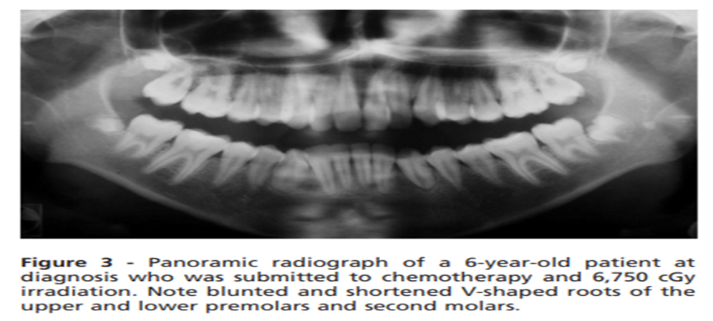
Root anomalies
The effects of cancer treatment in the later stages of tooth formation are characterized by disturbed root development
The first signs of root development in permanent teeth are observed on panoramic radiographs beginning approximately at age 3 years (central incisors and permanent first molars) to age 7.5 years (permanent second molars) and root formation is completed after the tooth has erupted into the oral cavity
Changes in odontoblast activity caused by abnormal secretory functioning of the dentin microtubules and complex changes in inter- and intracellular relationships can produce shortened, tapered and blunted roots (Figure 3).
Root development disturbances, such as arrested root development with short V-shaped roots, arrested root development with premature apical closure, blunted roots and anomalies in root number have been reported in patients treated with high-dose chemotherapy and radiotherapy.
Repeated high-dose chemotherapy can result in root agenesis

Slide 9
Taurodontia
which is characterized by an enlarged pulp chamber, apical displacement of the pulpal floor and no constriction at the level of the cementoenamel junction
, which is caused by the failure of Hertwig’s epithelial sheath diaphragm to invaginate at the proper horizontal level
. This abnormality usually affects permanent molar teeth, but it can also be observed in premolars and primary molar teeth and can become a challenge when endodontic treatment is needed, particularly because of its anatomy
. In literature, its prevalence in children treated for childhood cancer varies from 6% to 26%

Slide 10
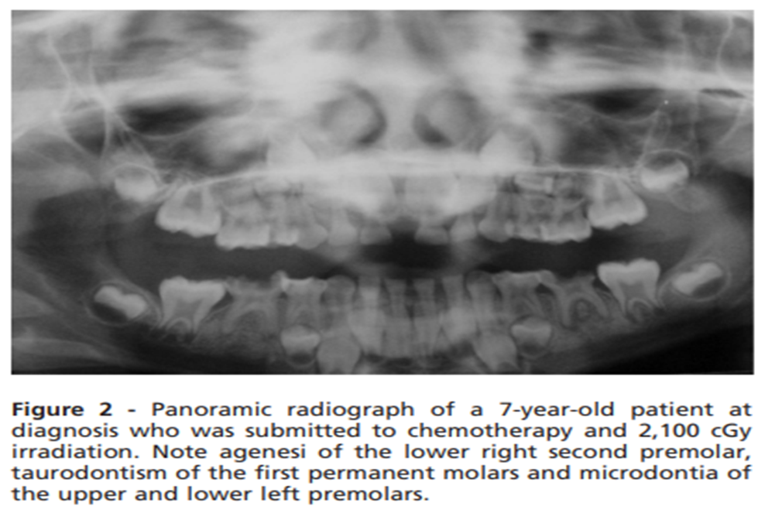

Slide 11
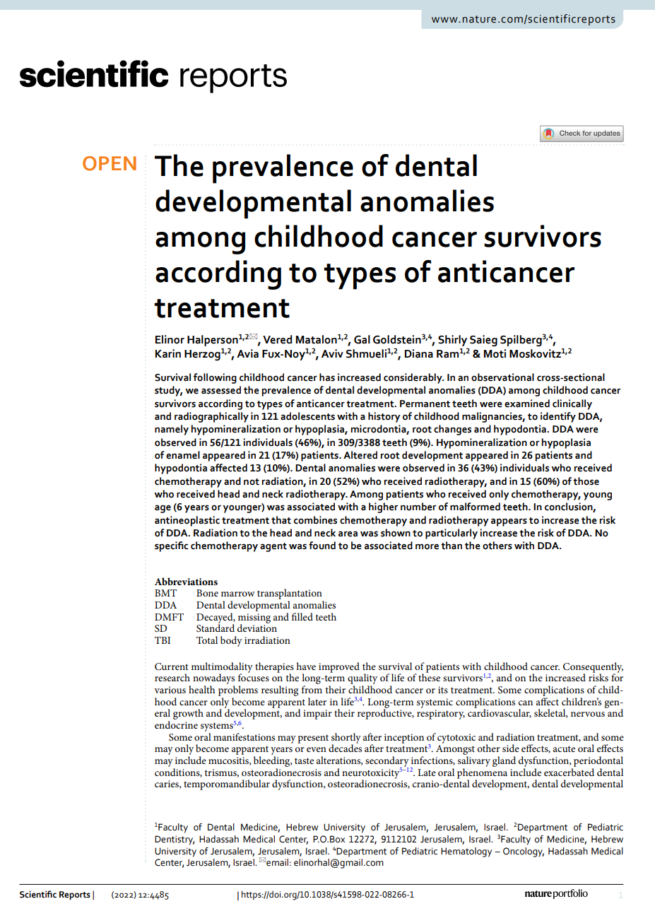
Most recent Study
The study population consisted of individuals who underwent annual general examinations at the survivorship care clinic of Hadassah Hebrew-University Medical Center, Jerusalem, Israel during 2017–2019, including full oro-dental examinations at the Department of Pediatric Dentistry. Eligibility criteria included anticancer treatment at age under 18 years at the Department of Pediatric Hematology–Oncology, Hadassah and at least 7 years old on the day of the dental examinations

Slide 12
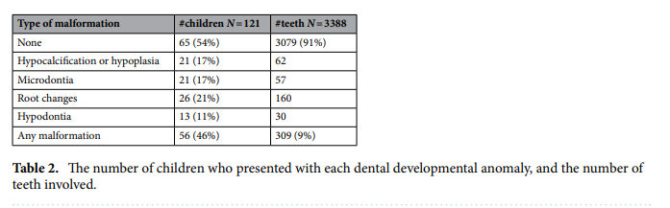
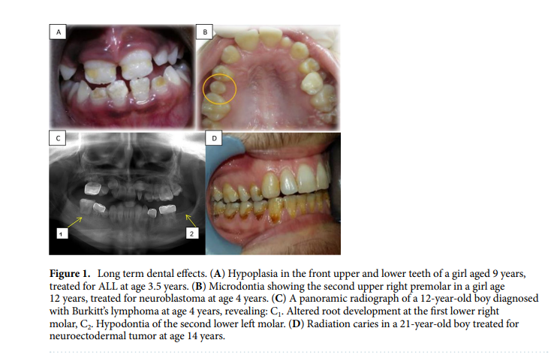
Most recent Study

Slide 13
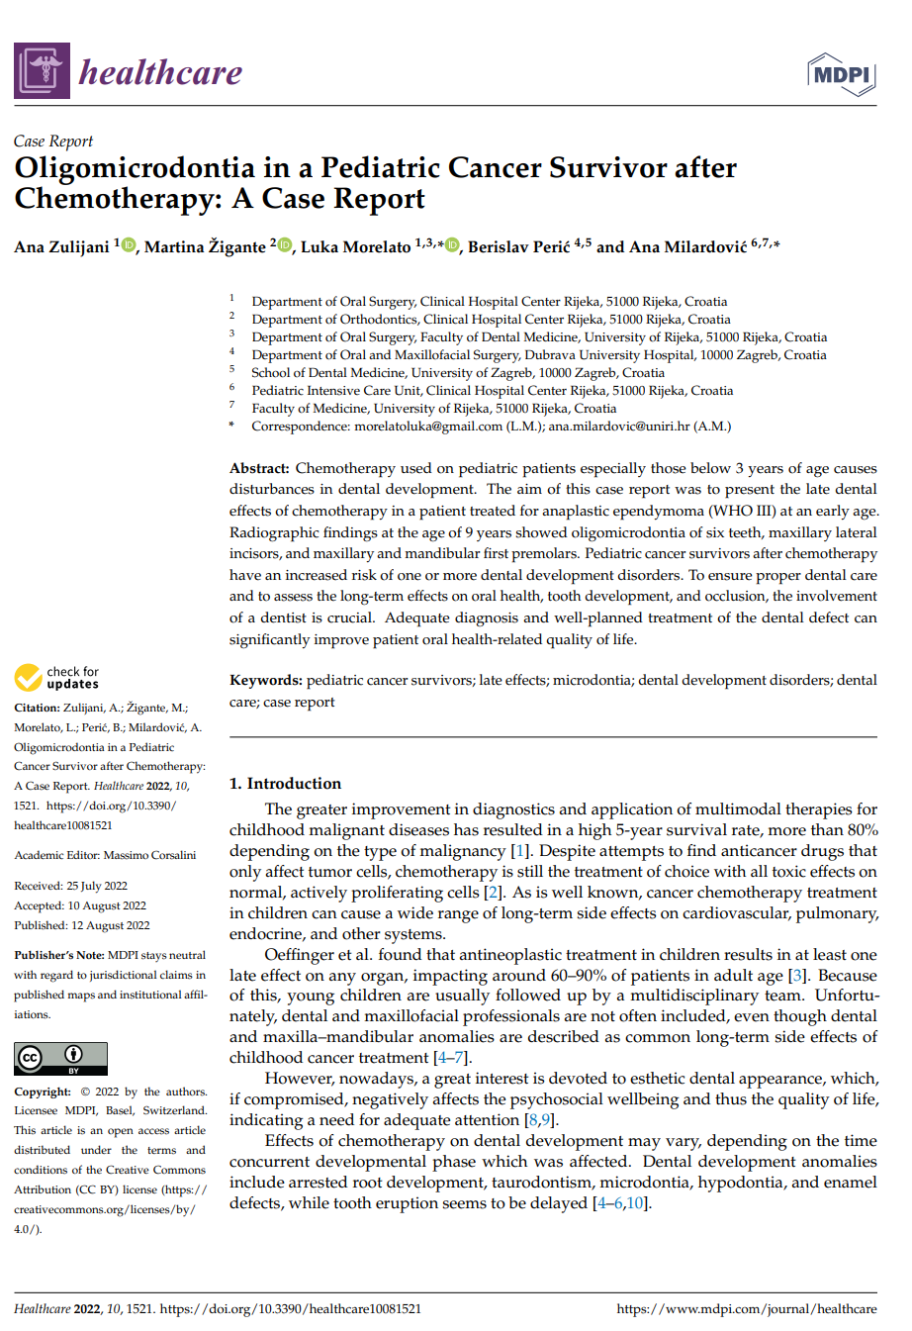
Most recent Case report
A 9-year-old girl was referred to the Department of Oral Surgery, Dental Clinic of Clinical Hospital Center Rijeka because of disturbances in the eruption of the permanent teeth after chemotherapeutic treatment for anaplastic ependymoma (WHO III) at an early age. Radiographic findings at the age of 9 years showed oligomicrodontia of six teeth, maxillary lateral incisors, and maxillary and mandibular first premolars

Slide 14
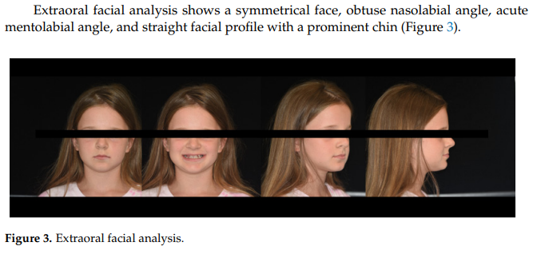
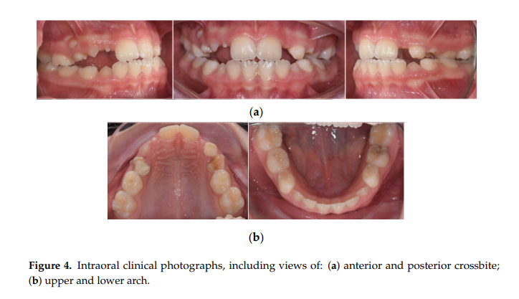

Slide 15
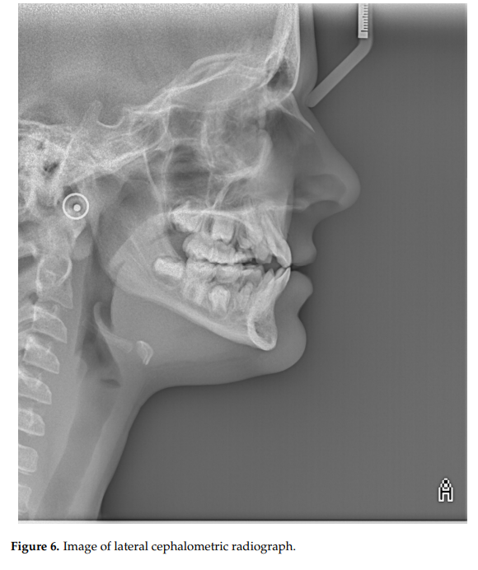
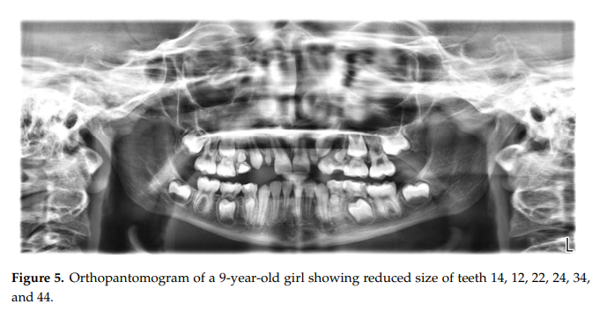
Cephalometric analysis revealed a tendency towards maxillary retrognathia, skeletal class III, a counterclockwise rotation of the maxilla, and proclination of lower incisors (Figure 6). Healthcare 2022, 10, x 5 of 9 Cephalometric analysis revealed a tendency towards maxillary retrognathia, skeletal class III, a counterclockwise rotation of the maxilla, and proclination of lower incisors

Slide 16

Thank you

