Slide 1
التطورات والاتجاهات الحديثة في
الهندسة الكيميائية الاحيائية
أ.د. علاء كريم محمد أ.د. علي حسين عبار
كلية الهندسة الخوارزمي
قسم الهندسة الكيميائية الاحيائية

Slide 2
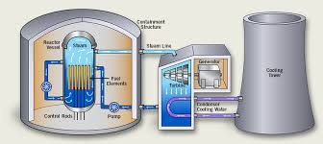
الهندسة الكيميائية الاحيائية وتطبيقاتها
Biochemical Engineering and Its Applications

Slide 3
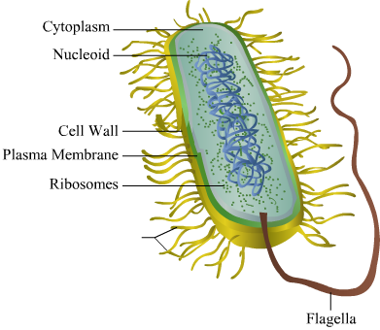
What is Biochemical Engineering?
Biochemical engineering is the use of biological materials (natural or organic), such as organisms, cells and biomaterials, to develop products and processes.
Products.
Such as
biofuel, Bioplastics
Biochemical Engineering
Processes
Such as
wastewater treatment
Removal of pollutants

Slide 4
ماهي الهندسة الكيميائية الاحيائية
الهندسة الكيميائية الحيوية هي استخدام المواد البيولوجية (طبيعية أو عضوية) ، مثل الكائنات الحية والخلايا والمواد الحيوية ، لتطوير المنتجات والعمليات.
Products.
Such as
biofuel, Bioplastics
Biochemical Engineering
Processes
Such as
wastewater treatment
Removal of pollutants

Slide 5
Industries that depend on biochemical engineering include:
Biofuels
Industries
Pharmaceuticals
water purification
Food

Slide 6
تشمل الصناعات التي تعتمد على الهندسة البيوكيميائية ما يلي:
الوقود الحيوي
الصناعات
العقاقير الطبية
معالجة وتنقية المياه
المنتجات الغذائية

Slide 7
microorganisms
Bioprocess
biological catalysts
animal and plant cells
Higher value product
Raw materials
microorganisms
enzymes
sub cellular
components

Slide 8
Biochemical engineers
Apply engineering principles to biological materials, processes, and systems
Design and construction of unit processes that
involve biological organisms or molecules
Bioprocess engineers
Manage production
processes
Biochemical engineers
Research
Translation of discoveries in Biochemistry and Medicine into commercial processes
Development

Slide 9
Fields combined and applied in Biochemical engineering
Chemical Engineering
Biochemistry
Biochemical Engineering
Biology
Genetics

Slide 10
Applications of Biochemical Engineering
1- Food Industry
There are several application of bioprocess in the field of food industry such as production of:
Vinegar
Cheese
Dairy
New trends of bioengineering focusing at many aspects such as:
packaging: ensuring the safety of the food.
Enzymes: are found in all food raw materials. When purified and used in food preparation, some of these enzymes offer benefits such as improved flavour, texture and digestibility.

Slide 11
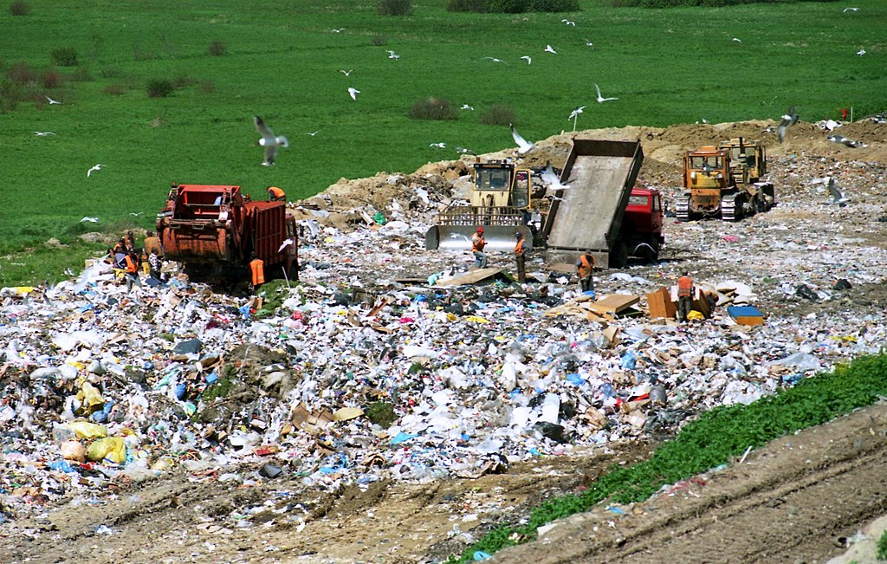
2- Landfills
Landfills are the primary method of waste disposal in many parts of the world, including United States and Canada.
Bioreactor landfills are expected to reduce the amount of and costs associated with management of leachate, to increase the rate of production of methane (natural gas) for commercial purposes and reduce the amount of land required for land-fills. Bioreactor landfills are monitored and manipulate oxygen and moisture levels to increase the rate of decomposition by microbial activity.

Slide 12
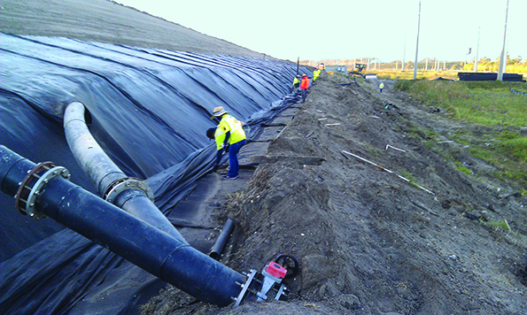
Bioreactor landfill

Slide 13
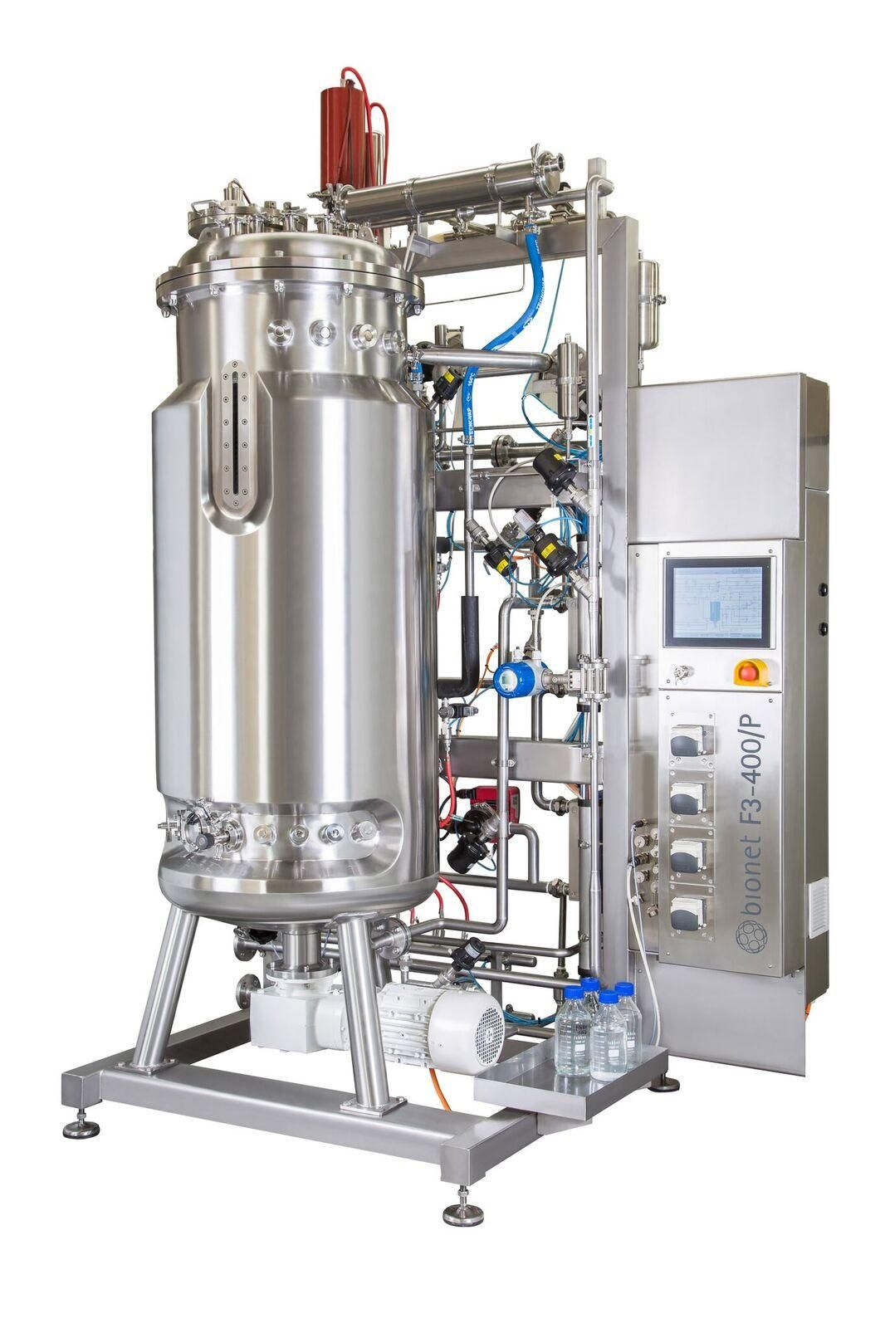
Bioreactor landfills are expected to reduce the amount of and costs associated with management of leachate, to increase the rate of production of methane (natural gas) for commercial purposes and reduce the amount of land required for land-fills Bioreactor landfills are monitored and manipulate oxygen and moisture levels to increase the rate of decomposition by microbial activity.

Slide 14
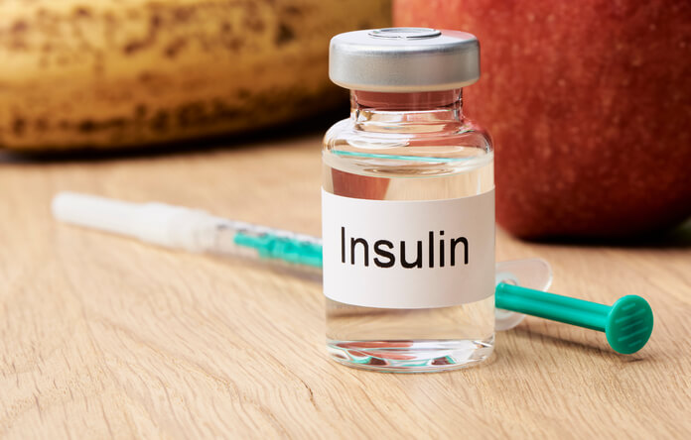
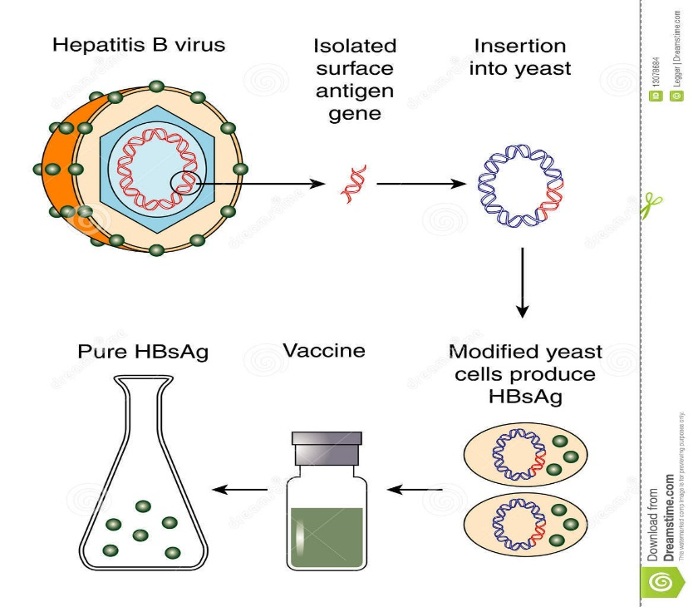
3- Medicine
Biotechnology has contributed to the discovery and manufacturing of traditional small molecule pharmaceutical drugs as well as drugs that are the product of biotechnology ( biopharmaceutics) such as:
Production of insulin for use by diabetics
Production of Hepatitis B vaccine

Slide 15
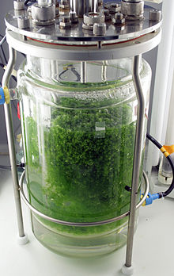
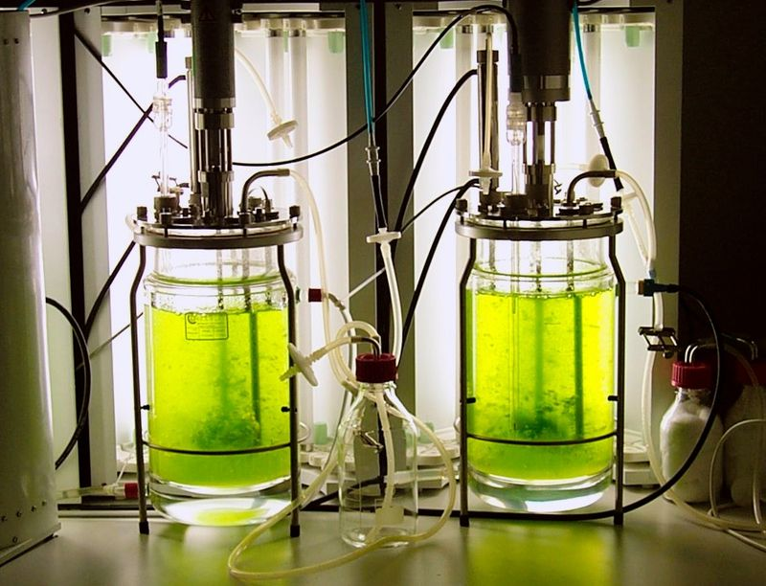
4- Moss Bioreactor
A moss bioreactor is a photobioreactor used for the cultivation and propagation of mosses.
The moss bioreactor is used to cultivate moss in a suspension culture in agitated, and aerated liquid medium. The culture is kept under lighting with temperature and pH value held constant. The culture medium contains all nutrients and minerals needed for growth of the moss
Production of protein factor H
Production of Enzyme
alpha-galactosidase

Slide 16
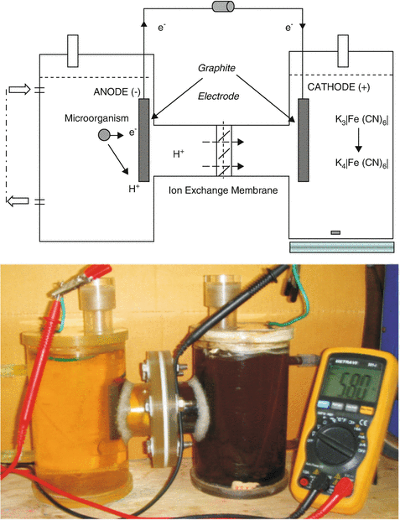
5- Bioelectrochemical reactor
Bioelectrochemical reactors are a type of bioreactor where bioelectrochemical
processes can take place. They are used in environmental remediation and electrochemical energy conversion.
Examples of bioelectrochemical reactors include
-Microbial electrolysis cells
- Microbial fuel cell
- Enzymatic biofuel cells
- Electrolysis cells
This bioreactor is divided in two parts: The anode, where the oxidation reaction takes place; And the cathode, where the reduction occurs.

Slide 17
6- Biofuel
Biofuel, any fuel that is derived from biomass—that is, plant or algae material or animal waste. Since such feedstock material can be replenished readily, biofuel is considered to be a source of renewable energy, unlike fossil fuels such as petroleum, coal, and natural gas. Biofuel is commonly advocated as a cost-effective and environmentally benign alternative to petroleum and other fossil fuels, particularly within the context of rising petroleum prices
There are several application of biochemical Engineering in the field of Bioenergy production such as:
Bioethanol
Biodiesel
Algal biofuel
Biogas

Slide 18
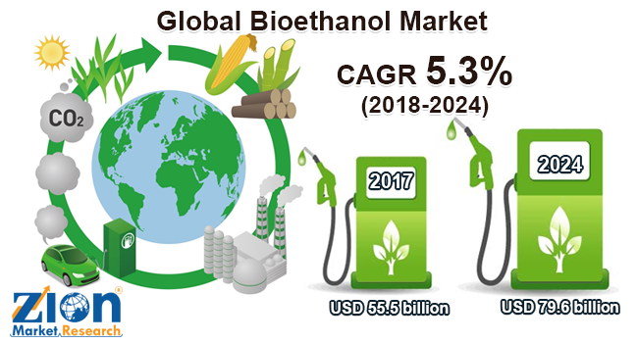
Bioethanol
Corn
Sugarcane
Bioethanol
Fermentation
of
Starch or Sugar

Slide 19
Ethanol from Celluloses materials (old method)
Celluloses
materials
H₂SO₄
0.5%
CO₂
H₂O
Ethanol
240ºC
Preliminary
treatment
Distillation
column
H₂SO₄
2%
Semi-Celluloses
materials
Fermentor
200ºC
Preliminary
treatment

Slide 20
Ethanol from Celluloses materials (New method)
CO₂
H₂O
Celluloses
materials
Ethanol
Cellulase Enzyme
Distillation
column
To produce 1 ton of Ethanol we need 4 ton of Celluloses material
Fermentor
- Converting cellulose into glucose is to use cellulase enzymes that are able to break down the cellulose.
- The enzymatic hydrolysis and sugar fermentation processes take place at the same time in the fermentor.
An advantage of this process is that sugars produced during hydrolysis are immediately fermented into ethanol, which avoids problems such as sugar accumulation and enzyme inhibition

Slide 21
Biodiesel
Oily plants
Soybean
Oil palm
Waste cooking oil
Biodiesel
Esterification

Slide 22
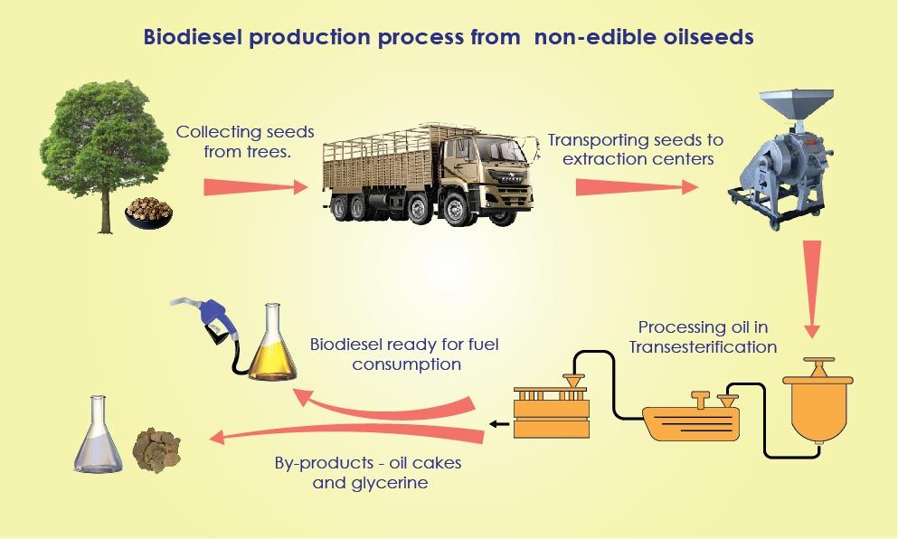

Slide 23
Production of Biodiesel
NaOH
Acid
Hexane
Separation
Unit
Reactor
50-66ºC
1.4 bar
Separation
Biodiesel
98%
purity
Oily seeds
Extraction
Methanol
Water
Glycerin
Treatment
Glycerin
For each 1 ton of (biodiesel) we need:
2.5 tons of oilyseeds
0.77 hectares land area.
Salts
Large , branched molecule structures of the oils (triglycerides) are transformed to smaller straight chain molecules

Slide 24
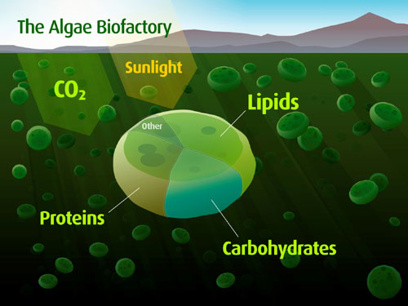
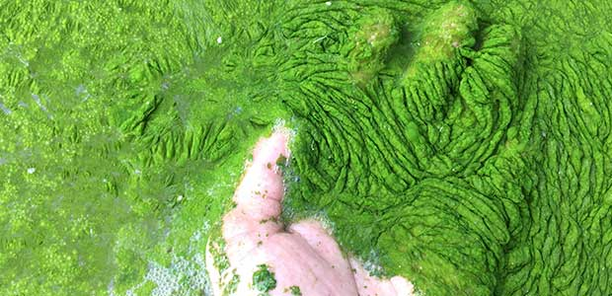
Biodiesel from Algae (Algal Biodiesel)
Algal biomass contains three main components:
Carbohydrates
Protein
Natural Oils

Slide 25
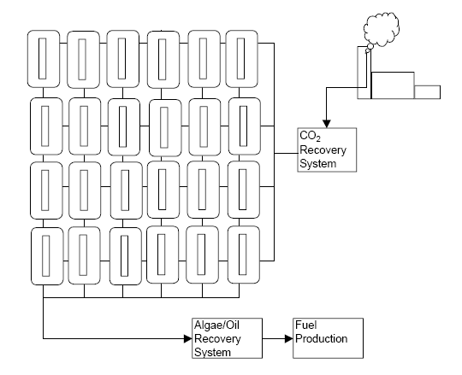
Algae farm

Slide 26
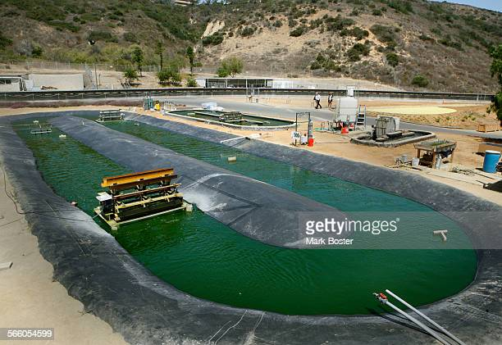
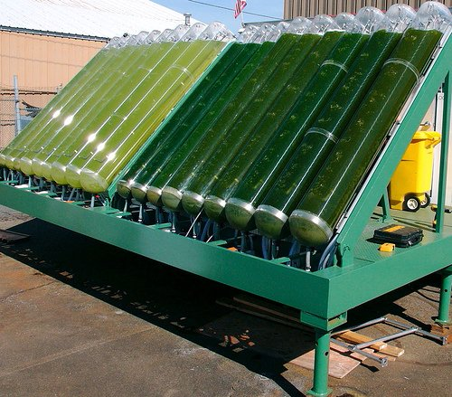
Algae Farm
Tubular bioreactors

Slide 27
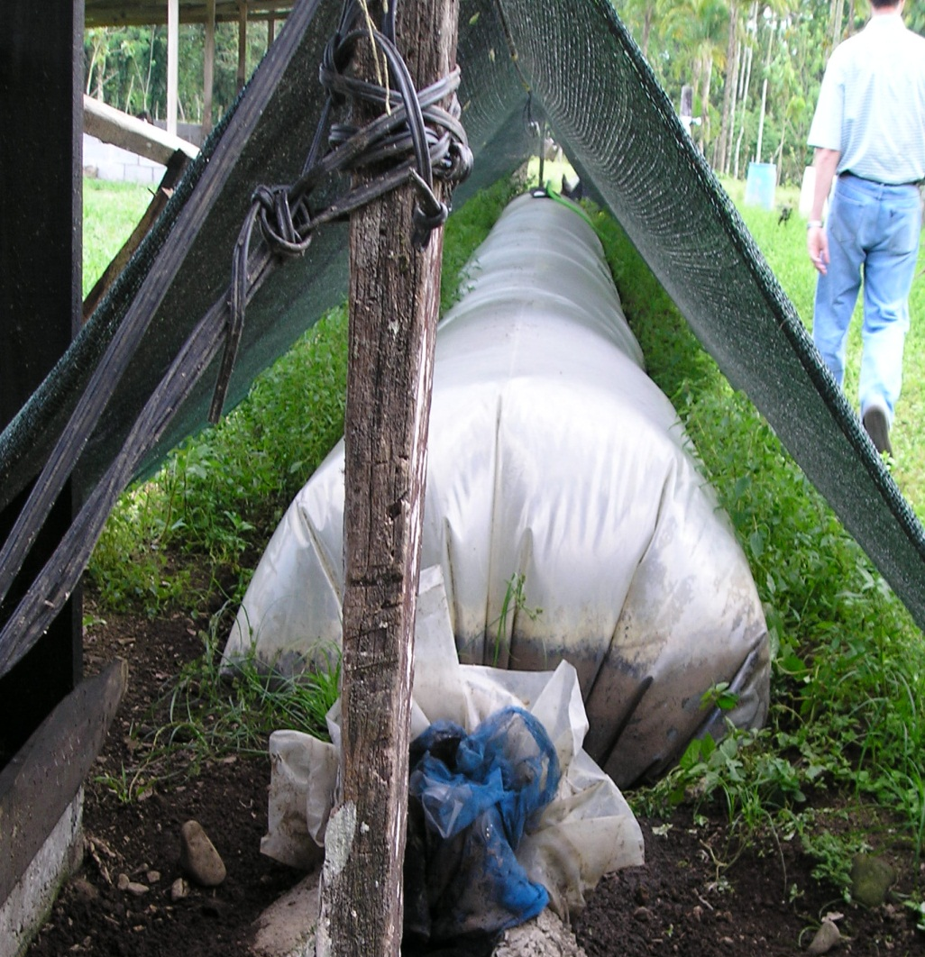
Biogas
Mainly methane
Clean, efficient source of renewable energy
Made from organic waste
Anaerobic digestion
Replaces non-renewable energy
Notes:
27
Biogas is an efficient way to produce clean, renewable energy out of different types of organic waste.
The organic waste, such as manure, fuels the process, causing anaerobic digestion to take place and break down the waste, creating methane.

Slide 28
Engineering Principles
Constituent | Measured | Typical
Methane | 66.60% | 60-70%
CO₂ | 33.32% | 30-40%
H₂S | 0.15% | <1%
Helium | 0.01% | -----
Nitrogen | 0.01% | -----
Hydrogen | Trace | -----
Biogas Treatment
Table shows the composition of biogas after it exits the digester
Biogas leaves the digester and is saturated with water
A condenser is facilitated to dry biogas and knock out all the impurities which dissolves in water
Hydrogen Sulfide needs to be removed by iron salt
Notes:
28
28

Slide 29
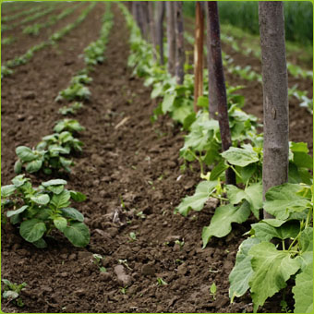
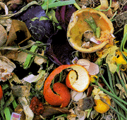
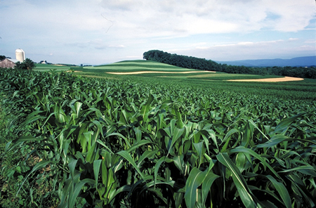
Biogas
Methane
+
ENERGY
O2
H2S
Ammonia
CO2
Organic Fertilizer
Organic Material, Biodegradable Waste
Anaerobic Environment
Hydrolysis, Fermentation, Acetogenesis, Dehydrogenization, Methanogenesis
Notes:
29

Slide 30
Some examples of biogas plants
Notes:
30

Slide 31
Biochemical process of anaerobic fermentation/digestion
Step 1:
Hydrolysis + Acidogenesis
Step 2:
Acetogenesis
Step 3: Methanogenesis
Bacterial
mass
Bacterial
mass
H₂ , CO₂,
acetic acid
Organic waste
Carbohydrates
Fats
Protein
Water
Methan
+ CO₂
Bacterial
mass
Propionic acid
Butyric acid
Alcohols,
Other components
H₂ , CO₂
acetic acid
Fermentative
bacteria
Acetogenic
bacteria
Methanogenic
bacteria
Notes:
31

Slide 32
Small scale plant
Plant details
Small Scale units
Suitable for household use
Can be erected anywhere.
Requires between 500gm - 1Kg of waste/day only!!!
Plant designed to use Kitchen waste!!!
Notes:
32
32

Slide 33
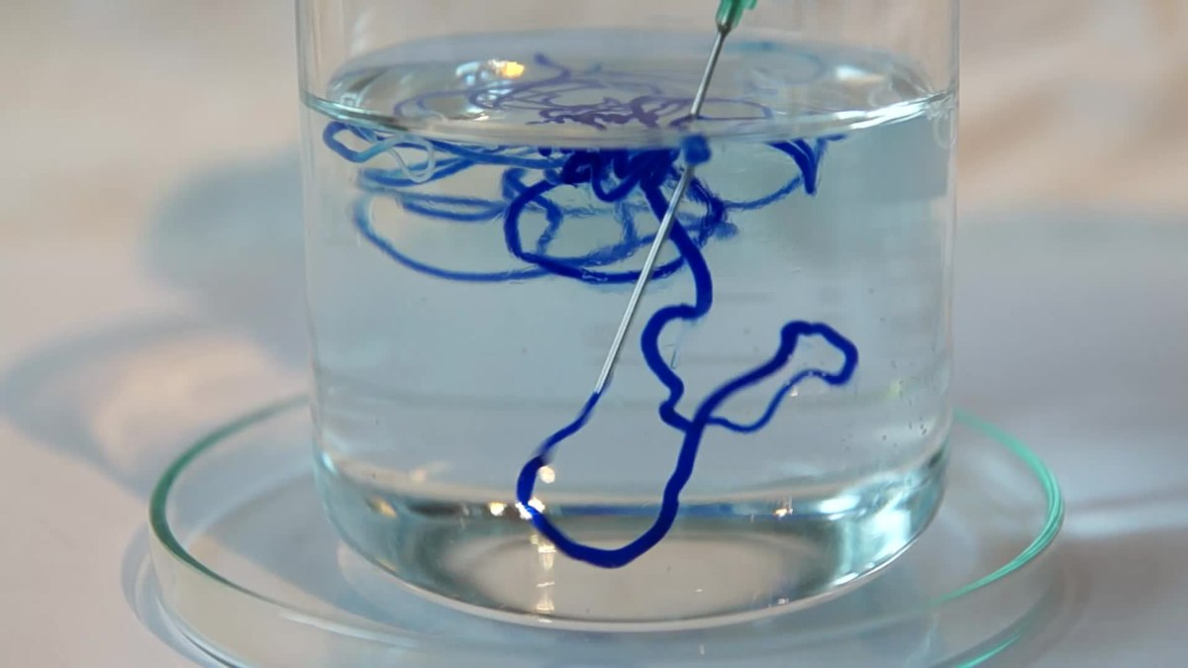
Activities of Biochemical Engineering Department Al-Khwarizmi Engineering College
Several studies concerning Biochemical Engineering have been carried out in biochemical Engineering department /Al-Khwarizmi Engineering College. Some of these studies are:
Production of Rayon from date palm fronds

Slide 34
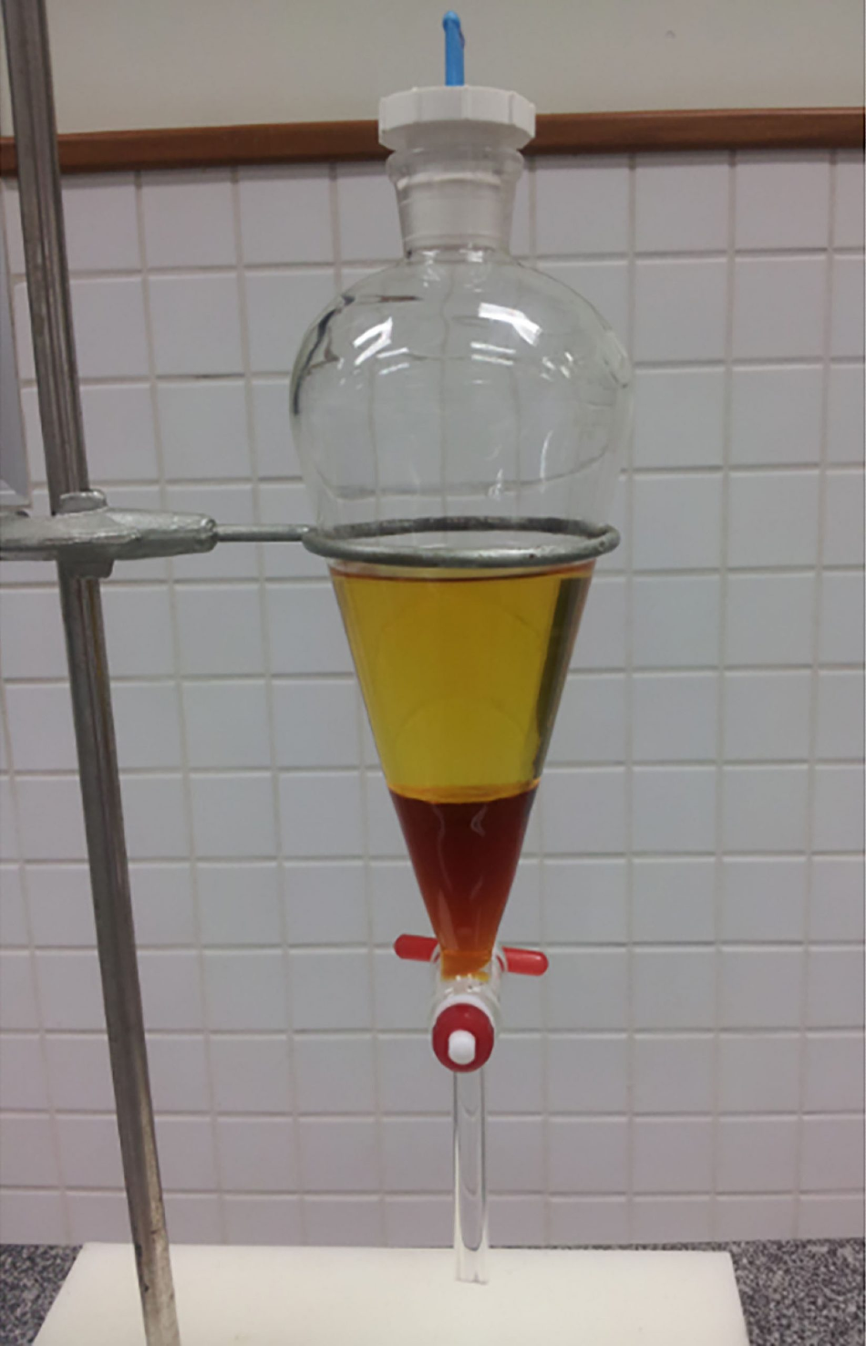
Production of Biodiesel from waste cooking oil using eggshells as catalyst.
Production of Biodiesel from waste cooking oil using snail shell as catalyst.

Slide 35
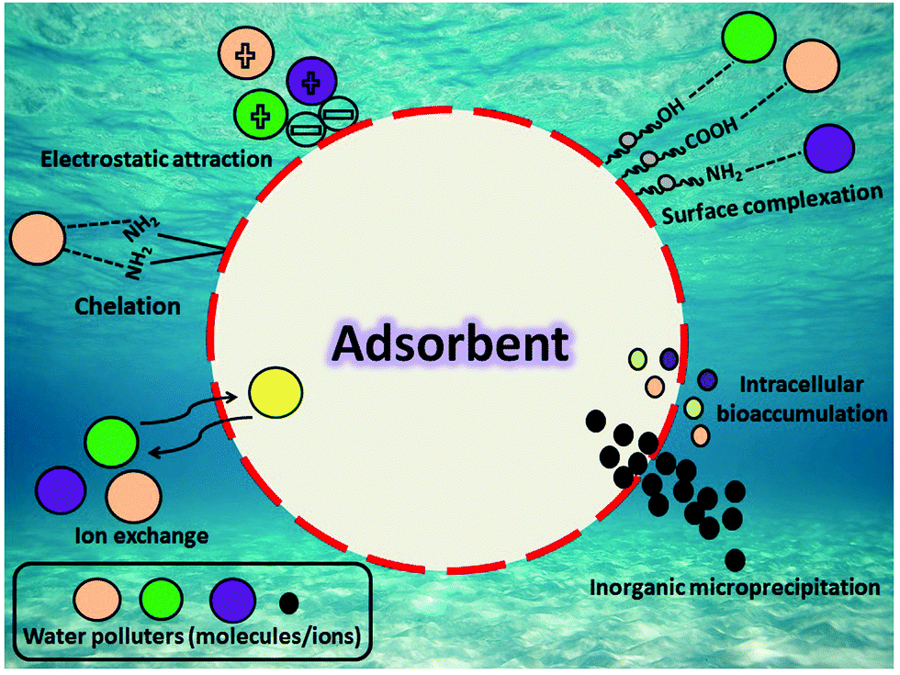
Removal of heavy metals from polluted water using different media such as
Bentonite
Activated Carbone
nanomaterials

Slide 36
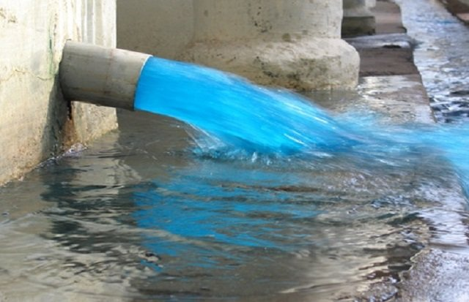
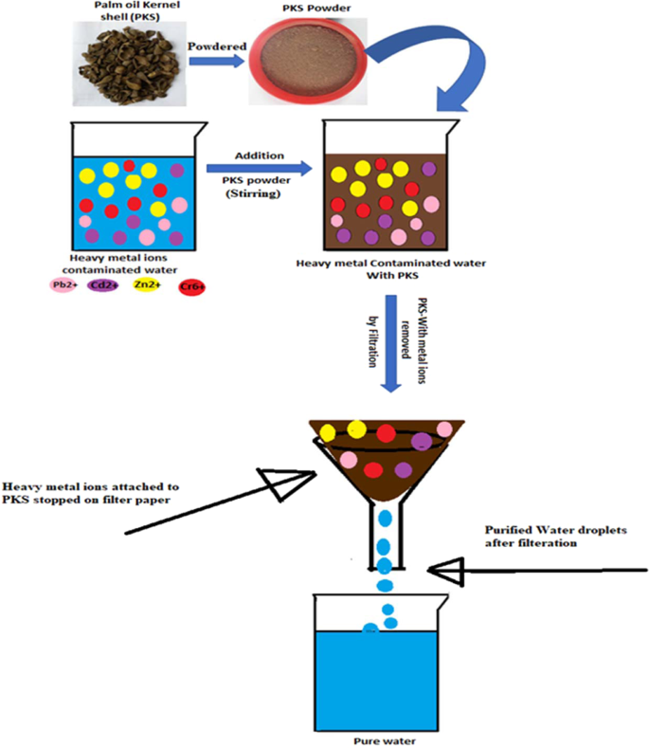
Removal of dyes from polluted water using different media such as
Bentonite
Activated Carbone
nanomaterials

Slide 37
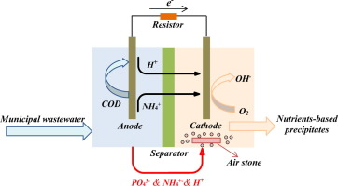
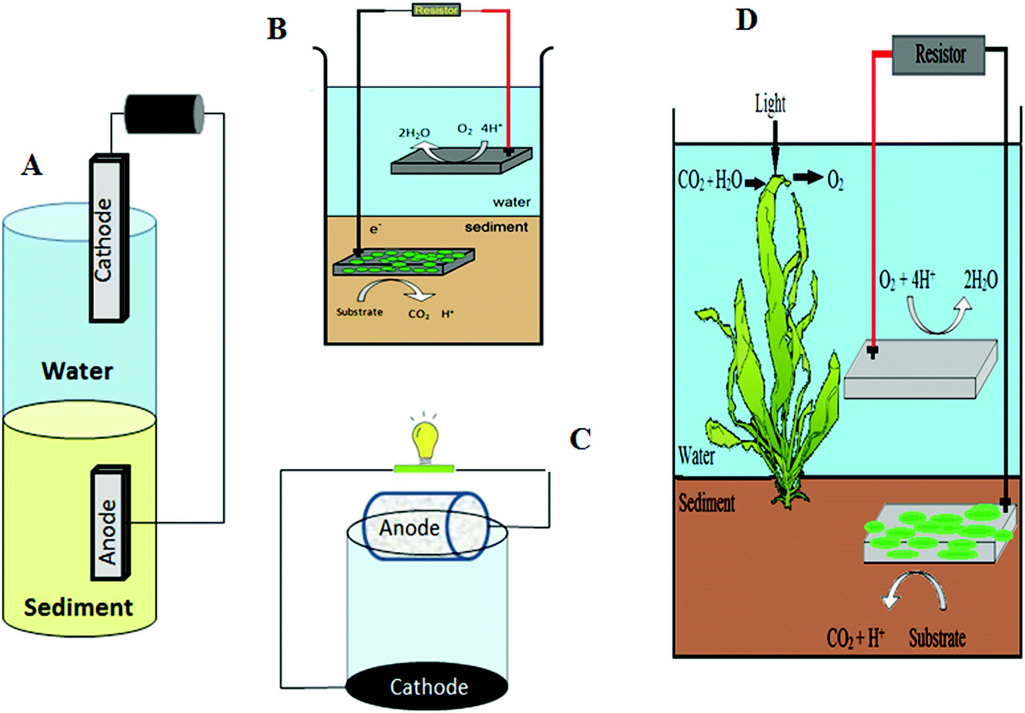
Using Microbial fuel cell for polluted water treatment

Slide 38
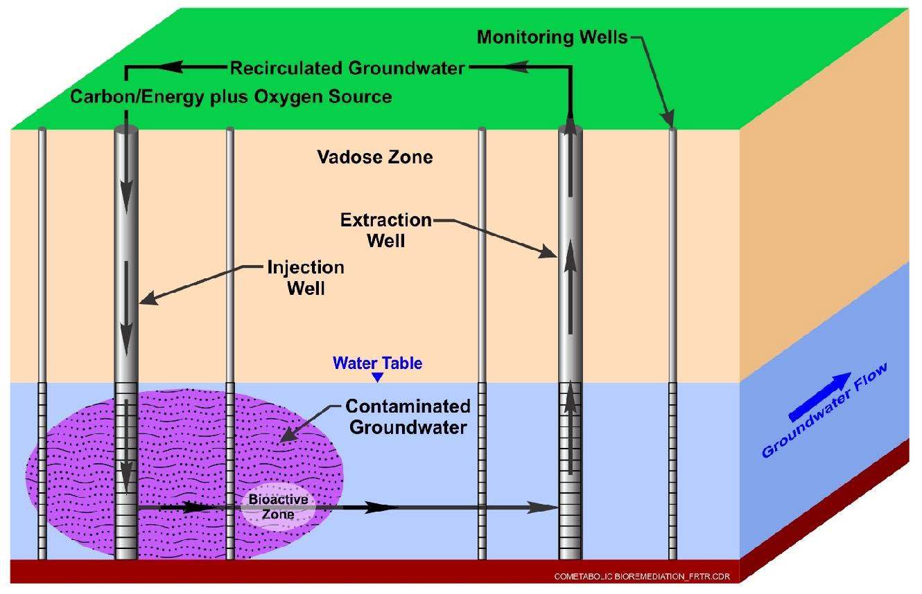
Using bioremediation to treat polluted soil

Slide 39
Thank you
For
Your listening

