Slide 1
A green approach for the synthesis of nanoparticles for water remediation | اسم النشاط
20/03/2023 | موعد بدء وانتهاء النشاط
ندوة | نوع النشاط
النهج الأخضر لتحضير الدقائق النانوية واستخداماتها في معالجة المياه الملوثة وهي من الطرق الحديثة في مجال تصنيع العوامل المساعدة النانوية ضمن مجال التنمية المستدامة والنظيفة | وصف النشاط
الاستاذ الدكتور محمد عبد عطية و الدكتور احمد خضير حسان و المهندس عماد لعيبي mohatiya1965@gmail.com | حساب مسؤول النشاط ووسائل الاتصال

Slide 2

FACULTY OF BIOCHEMICAL ENGINEERING
الهندسة الخوارزمي
A green approach for the synthesis of nanoparticles for water remediation
التصنيع الاخضر للمواد النانوية ( عوامل مساعدة ) لازالة المواد الملوثة من الماء
أ.د. محمد السراج (جامعة بغداد / كلية الهندسة الخوارزمي )
د. احمد خضير حسان (وزارة العلوم والتكنلوجيا )
السيد عماد ماجد لعيبي (وزارة الداخلية )
قاعة امانة مجلس الكلية عام 2023

Slide 3
Continuous Mode Photoreactor
Continuous reactors are preferred for large-scale wastewater operating units. Also, it has been established primarily in lab-scale studies. Fixed-bed, fluidized-bed, and continuous stirred tank (CSTR) reactors are examples of continuous systems. For heterogeneous reactions, fixed-bed and fluidized-bed are employed, whereas CSTR is used for homogeneous and heterogeneous reactions, where the catalyst is suspended in

Slide 4
a solution with continuous mixing. Fixed-bed and fluidized-bed reactors are more commonly utilized in Fenton-like and photo-Fenton-like processes .Each kind has limitations and advantages. For example, a fluidized-bed column has a large surface area and a high contaminant degradation rate. However, catalyst recovery is sometimes impossible, and the potential of catalyst agglomeration limits its usage in large-scale processes. Furthermore, the fluidized-bed reactor's limitation might be overcome by utilizing a fixed-bed reactor, where the catalyst can be easily separated from the liquid and regenerated, providing excellent industrial development opportunities

Slide 5
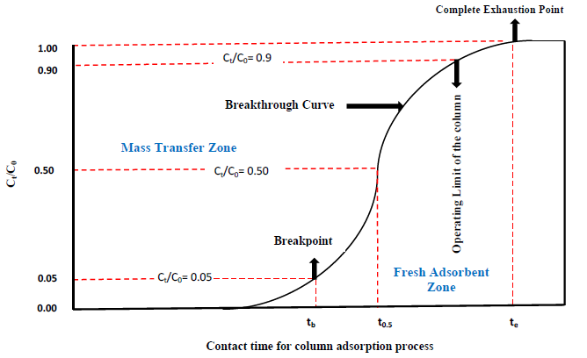
Furthermore, in terms of mass transfer, it is assumed that only convective mass transfer occurs, where all contaminated molecules flow in parallel streamlines at the same velocity. Furthermore, Fixed-bed reactors have been used for different contaminant treatments like petroleum refinery, dyes contaminated pharmaceuticals, heavy metals, and phenol contaminated wastewater. The breakthrough curve is an important concept that can evaluate the efficiency of the column system. This curve represents the graph between the ratio of the outlet concentration and the initial dye concentration (inlet) versus time.

Slide 6
Fixed-Bed Reactor
In this type, the catalyst is packed along a specific length of the column, and generally, two packed configurations could be performed, single and multi-packed. However, single packed is more frequently used for lab-scale study and the contaminate is fed up-flow. The fixed-bed is simple to construct; its perfect plug flow pattern ensures greater catalyst-to-reactant contact and reduced maintenance costs .It can also be upgraded from laboratory and pilot scales to industrial ones. Once the process initiates, the oxidation reaction start and the contaminates are treaties as they pass over the catalyst. In this system, temperature vary in axial and radial directions.

Slide 14

شكراً لحضوركم وحسن الاستماع

