Slide 1
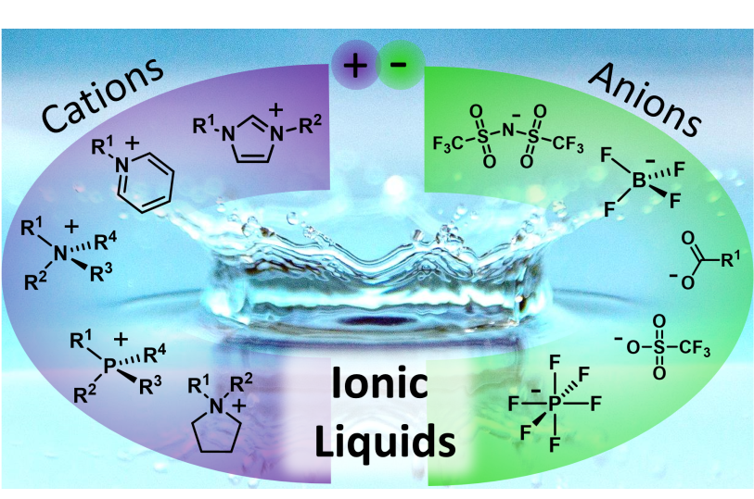
Ionic liquids as a novel field in chemical and biochemical science and engineering ( Introduction, importance, and applications )
University of Baghdad Al-khwarizmi College of Engineering
Safaa Rasheed Yasin

Slide 2
Ionic Liquids
Definition
Ionic liquids (ILs) are normally defined as compounds completely composed of ions with melting point below 100 °C. The first IL (ethyl-ammonium nitrate) was reported by Paul Walden in 1914, who at that time never realized that ILs would become a major scientific area after almost one century.
Actually, ILs as innovative fluids have received wide attention only during the past two decades. The number of SCI papers published on ILs has exponentially increased from a few in 1996 to >5000 in 2016, exceeding the annual growth rates of other popular scientific areas. This indicates that more and more researchers are engaged in studying this exciting area, with the outcomes being plentiful.

Slide 3
Ionic Liquids
A multidisciplinary study on ILs is emerging, including:
Chemistry
Physics
Electrochemistry
Materials science
Biology, medicine
Chemical engineering
Environmental science
More specifically, some important fundamental viewpoints are now different from the original concepts, as insights into the nature of ILs become deeper. For example, the physicochemical properties of ILs are now recognized as ranging broadly from the oft quoted “nonvolatile, non-flammable, and air and water stable” to those that are distinctly volatile, flammable, and unstable.

Slide 4
Ionic Liquids
This is attributed to numerous combinations of cations and nions that meet the definition of ILs, leading to a diverse suite of behaviors. Regardless, ILs remain more desirable than conventional volatile solvents and/or catalysts in many physical and chemical processes, often exhibiting “green” and “designer” properties to a useful degree.
As their chemical variety has grown, ILs have been further divided into many types, e.g.,
Room-temperature ILs (RTILs)
Task-specific ILs (TSILs)
Polyionic liquids (PILs), and
Supported IL membranes (SILMs) that include composites of ILs supported on metal−organic frameworks (MOFs).

Slide 5
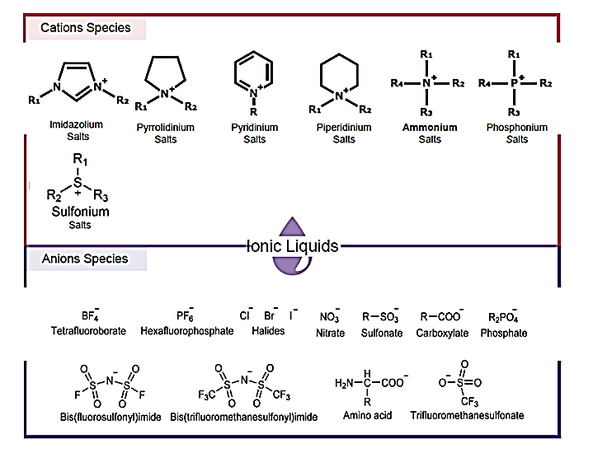
Ionic Liquids

Slide 6
The hybrid organic−ionic nature of ILs and the resulting intermolecular interactions give rise to a complex set of phenomena, creating an area of study that is both fascinating and challenging. Scientists and engineers are often required to screen for suitable ILs quickly for a specific process. For this purpose, the identification of structure−performance relationships disclosing the interplay among ILs, solutes, supports, and the components in mixtures becomes vital, requiring a close integration of experimental, theoretical, and computational methods. Thus, it is necessary to collect our recent findings in this area and summarize the governing rules behind these complex phenomena.

Slide 7
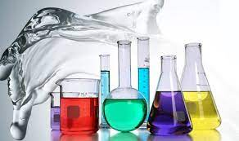
Ionic Liquids
Specifications
Low vapor pressure
High thermal stability
Electrical conductivity
Low flammability
Dissolve ability

Slide 8
Ionic Liquids
Applications
Batteries Fuel Cells
Nanomaterials (e.g. Biomedicine)
Solar energy Conversion
Industrial Solvents
Lubricants Heat Transfer
Enzymatic Catalysis
Nuclear Fuel Radioactive Waste

Slide 9
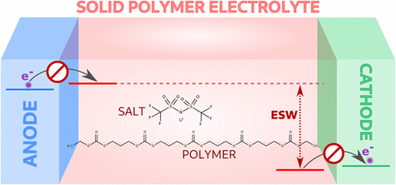
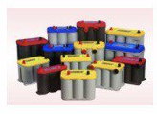
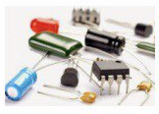
Ionic Liquids
Electrochemical
Its electrochemically stable potential window is much larger than other aqueous electrolyte solutions, the research of ionic liquid in electrochemical is undergoing.
The electrochemical window (EW) of a substance is the electrode electric potential range between which the substance is neither oxidized nor reduced.
Electrochemical Stability Window of Polymer Electrolytes in Solid-State Batteries from Atomic-Scale Modeling: The Role of Li-Ion Salts
Electrically conductive
Non-volatile
Non-combustible

Slide 10
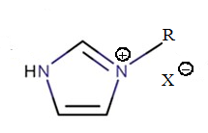
Ionic Liquids
Coal processing
Pretreatment with ionic liquid causes change of the coal structure allowing better gasification

Slide 11
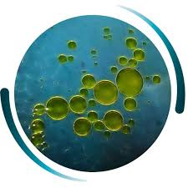
Separation
Ionic Liquids
Separation and purification: Due to their unique physicochemical properties, ionic liquids are well suited as solvents for separation and purification (e.g. Extraction of butanol from the fermentation broth by using ionic liquids.

Slide 12
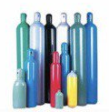
Gas handling
Ionic Liquids
Ionic liquids can be used instead of pressurized cylinders as a transport medium for reactive gases such as trifluoroborane, phosphine and arsine.
Thermal stability
Low vapor pressure
solvation

Slide 13
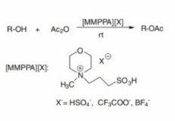
Chemical synthesis
Ionic Liquids
Ionic liquid have been used as solvents for many types of reactions. The advantage of using an ionic liquid instead of a common solvent in the reaction is that the reaction rate is several times faster than that of a conventional organic solvent, and the mixture of the ionic liquid and the catalyst used can be reused. Studies have shown that ionic liquids act as both solvents and catalysts during the reaction process.
Ac2O : Acetic anhydride

Slide 14
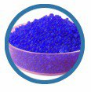
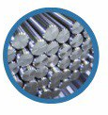
West recycling
Ionic Liquids
They offer the specificity required to separate similar compounds from each other, such as separating polymers in plastic waste streams. This has been achieved using lower temperature extraction processes than current approaches and could help avoid incinerating plastics or dumping them in landfill

Slide 15
Biomedicine
Ionic Liquids

Slide 16
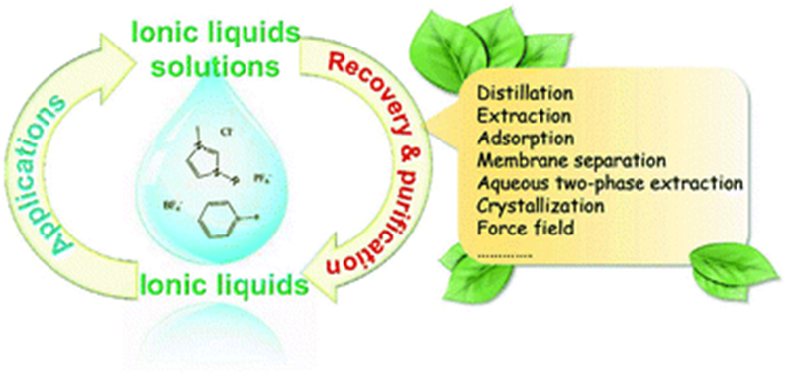
Recovery and purification of ionic liquids from solutions
Ionic Liquids

Slide 17
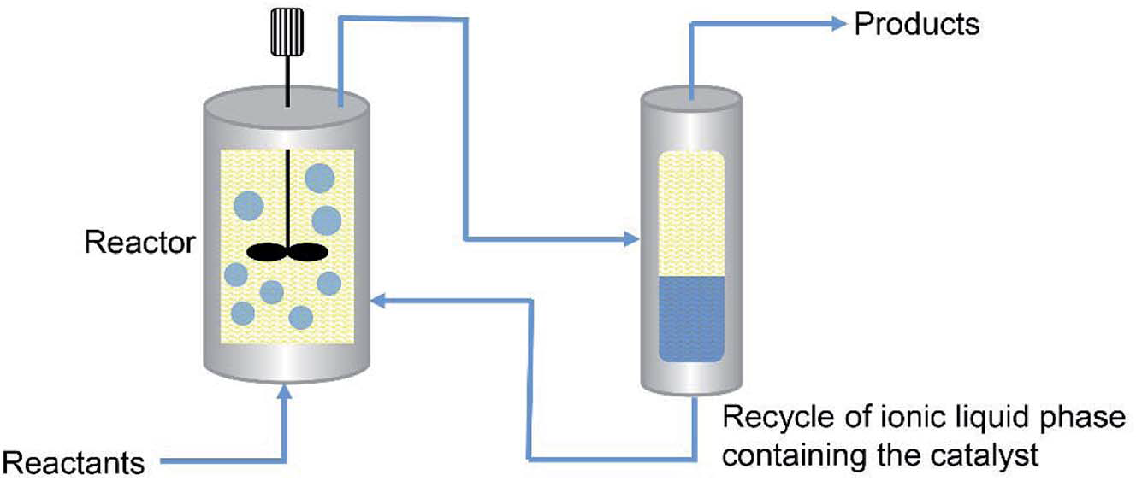
Ionic Liquids
Case studies: dimerization reactions
The IFP (France) has developed a biphasic process named Difasol, where the chloroaluminate(III) ionic liquid is used as solvent for the nickel-catalysed dimerization reactions.
dimerization is a process where two molecules of similar chemical composition come together to form a single polymer known as a dimer.

Slide 18
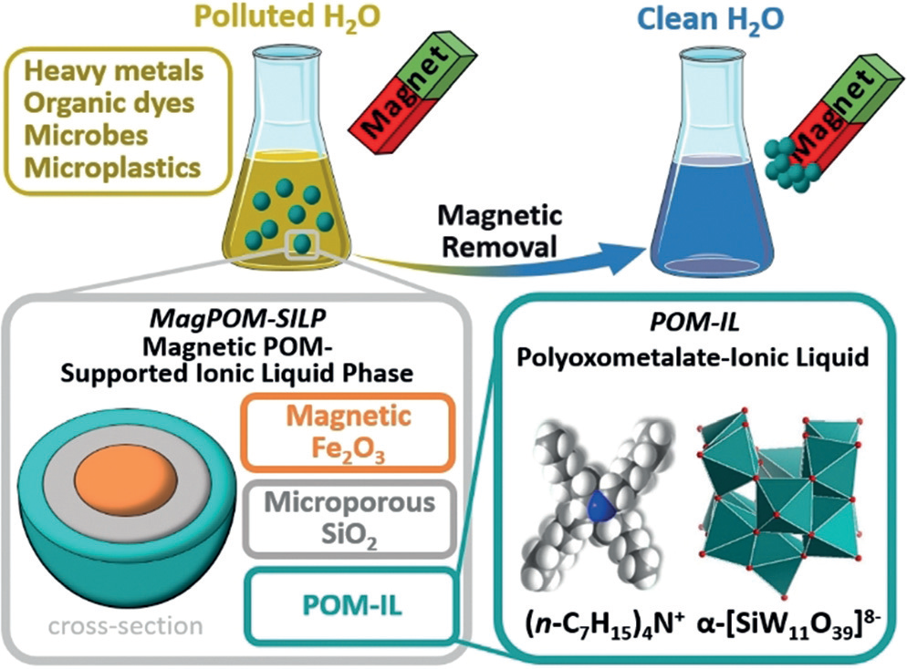
Ionic Liquids
Case studies: water purification
Concept of the removal of multiple pollutants from water using magnetic polyoxometalate supported ionic liquid phases (magPOM-SILPs). Color scheme (bottom right): teal polyhedra [WO6], gray C, red O, blue N, white H.

Slide 19
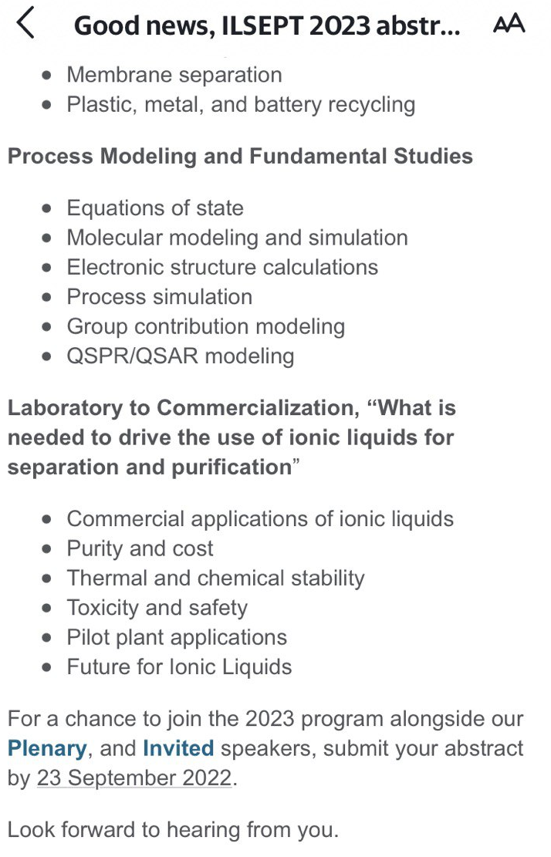
Novel researches in conference needs

Slide 20
Al-khwarizmi college of engineering

