Slide 1
Detection of Most Important Cephalometric Landmarks in Orthodontics Dx
دورة تدريبية
محاضرة علمية + webceph م. نور فلاح كاظم
Manual tracing ا. م نور محمد حسن
Autocad tracing م. هبة محمد حسين

Slide 2
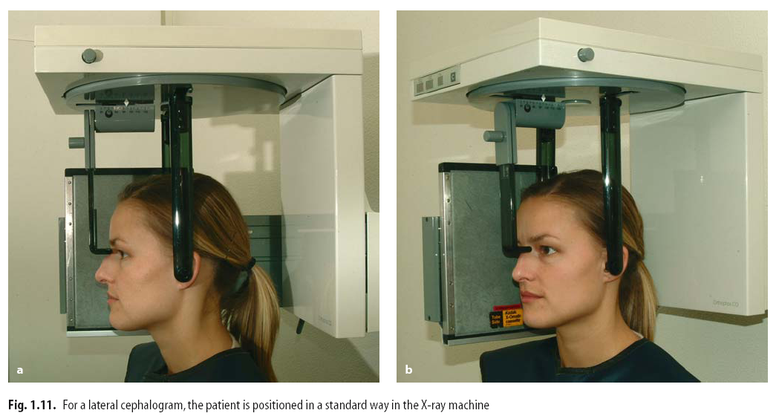
Components of the Cephalostat:
Ear Rods
Nasal Pointer
Orbital Pointer
A Metal Millimeter Scale

Slide 3
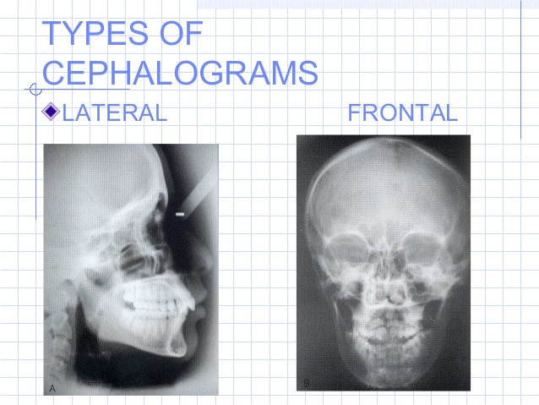
Two views can be used with this type of radiographic method:

Slide 4
Uses of Cephalometrics
  The LCR is used primarily in orthodontic diagnosis and treatment planning, particularly when considering orthognathic surgery.
  It is a useful record prior to treatment and can be used during treatment to assess progress. It is used to assess the aetiology of malocclusion; to determine whether the malocclusion is due to skeletal relationship, dental relationship or both.
  These radiographs can also be used for research purposes, although the radiographs must be clinically justified.

Slide 5
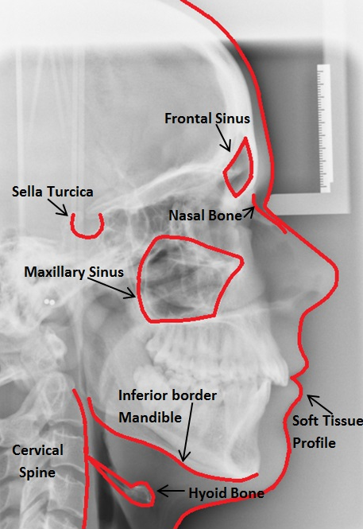
Anatomy
It is very important that prior to tracing the radiograph, it is examined for any pathology. Some of the basic anatomy seen on an LCR is detailed below.

Slide 6
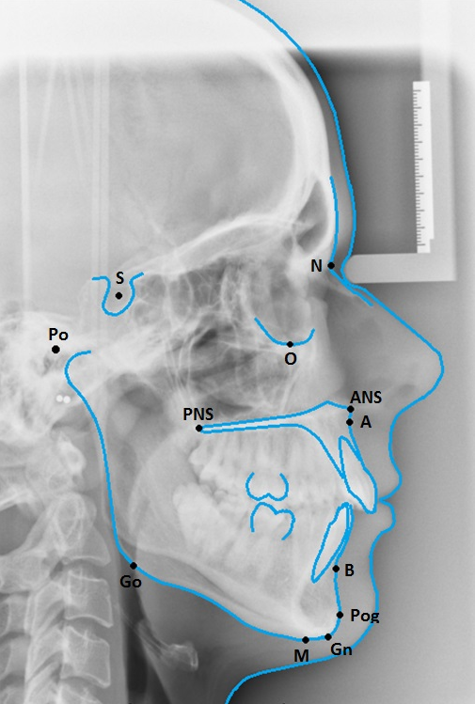
Cephalometric Points
A point (A)
B point (B)
Sella (S)
Nasion (N)
Orbitale (Or)
Porion (Po)
Anterior Nasal Spine (ANS)
Posterior Nasal Spine (PNS)
Gonion (Go)
Gnathion (Gn)
Menton (Me)
Pogonion (Pog)

Slide 7
Soft Tissue
Upper Lip Point (UL) –
Lower Lip Point (LL) –
Soft Tissue Pogonion (Pog’)
tip of the nose

Slide 8
There are 3 planes which are usually assessed;
Anteroposterior, Vertical Using the LCR
Transverse relationships by posteroanterior views of the skull, although this is rarely done in practice.

Slide 9
SN line
Frankfort Plane
Mandibular Plane (MnPl)
Maxillary Plane (MxPl)
“Esthetic Plane”“E” plane

Slide 10
a. Anteroposterior Relationship
SN line The plane demonstrated by a line through the nasion and sella
Frankfort Plane The plane demonstrated by a line through the orbitale and porion
Mandibular Plane (MnPl) The plane demonstrated by a line through the gonion and menton. The definition varies slightly, but the plane is used to show the plane of the lower border of the mandible
Maxillary Plane (MxPl) The plane demonstrated by a line through the anterior and posterior nasal spines
“Esthetic Plane”“E” plane is simply a line drawn from the tip of the nose to the tip of the chin. His key assessment was to look at how the upper and lower lip related to that line.

Slide 11
SNA This angle represents the relative anterioposterior position of the maxilla to the cranial base
normal value = 81˚ ± 3˚

Slide 12
SNB This angle represents the relative anterioposterior position of the mandible to the cranial base
normal value = 78˚ ± 3˚

Slide 13
ANB This angle represents the relative anterioposterior position of the maxilla to the mandible and can be used to determine skeletal class.
normal value = 3˚ ± 2˚

Slide 14
Maxillary Incisal Inclination (UInc to MxPl) The angle between the maxillary plane and the axis of the maxillary incisors (UInc)
normal value = 109˚ ± 6˚

Slide 15
Mandibular Incisal Inclination (LInc to MnPl) The angle between the mandibular plane and the axis of the mandibular incisors (LInc)
normal value = 93˚ ± 6˚

Slide 16
Inter-Incisal Angle The angle between the long axis of the maxillary incisors and the long axis of the
mandibular incisors
normal value = 135˚ ± 10˚

Slide 17
Maxillary-mandibular plane angle (MMPA) The angle formed between the Maxillary Plane and Mandibular Plane
normal value = 27˚ ± 5˚

Slide 18
Soft Tissue Relationship:
Naso‐labial Angle
normal value= 100˚ ± 8˚

Slide 19
Upper Lip‐EL
normal value = -4mm

Slide 20
Lower Lip‐EL
normal value = -2mm

Slide 21
b. Vertical Relationship
SN‐Mxpl:
normal value= 8˚ ± 3˚

Slide 22
Facial Proportion (FP)
Lower facial height mean 65mm
Upper facial height mean 54mm

Slide 23
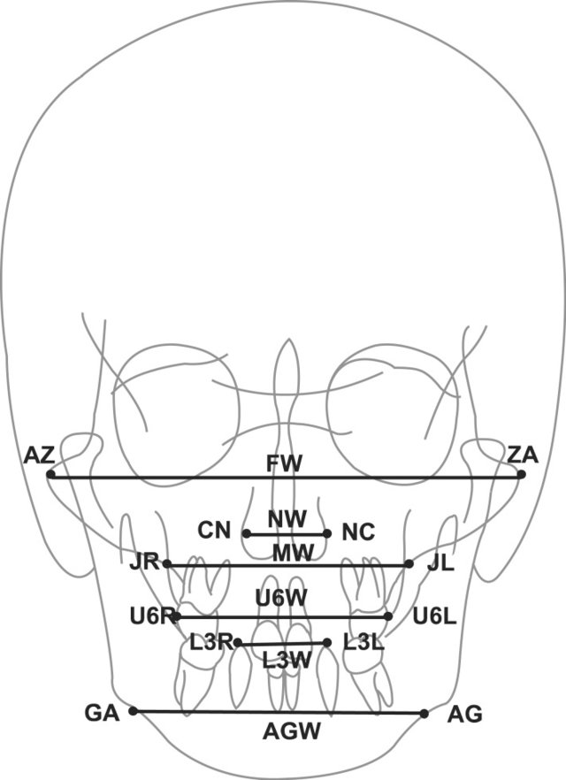
c. Horizontal Relationship
ZA and AZ, the centers of the left and the right zygomatic arches (facial width)
NC and CN, the left and the right outermost points of the widest range of the nasal cavity (Nasal width).
JL and JR, the deepest left and the right points on the jugular process (maxillary width)
U6L and U6R, The outermost points of the buccal surfaces of the left and right first molars (upper intermolar width)
L3L and L3R, the tips of the left and the right lower canines (lower intercanine width)
AG and GA, the deepest left and the right points of antegonial notch (antegonial width).

Slide 24
References
Mitchell L, Littlewood SJ, Nelson-Moon ZL, Dyer F. Introduction to Orthodontics (4th Ed). Oxford University Press; 2013
Whaites E, Drage N. Essentials of Dental Radiography and Radiology. Churchill Livingstone; 2013
Heasman P. Master Dentistry Volume 2. Churchhill Livingstone; 2009
British Standards Institute. Glossary of Dental Terms (BS 4492), BSI, London; 1983
Profitt, WR, Fields, HW and Sarver, DM. Contemporary Orthodontics. Fourth edition, Mosby, Inc., St. Louis, 2006.
Thilander, B and Ronning, O. Introduction to Orthodontics. Fifth edition, Minab/Gotab, Stockholm, 1985.
Walther, DP and Houston, WJ. Orthodontic Notes. Fifth edition, Butterworth‐Heinemann Ltd., Oxford 1994.
Wisth, P. Introduction to the Edgewise Technique: A Technical Manual. University of Bergen, Norway, 1985.
American Board of Orthodontics. Specific Instructions for Candidates. American Board of Orthodontics, St. Louis, 1990.

Slide 25
THANK YOU
For You Listening
Now My Colleague dr. Noor mohammed Will Show You Manual Tracing Of Cephalometric and dr. hiba mohammed tracing show you autocad and I dr. Noor falah will teach you how to use webceph application

Slide 26
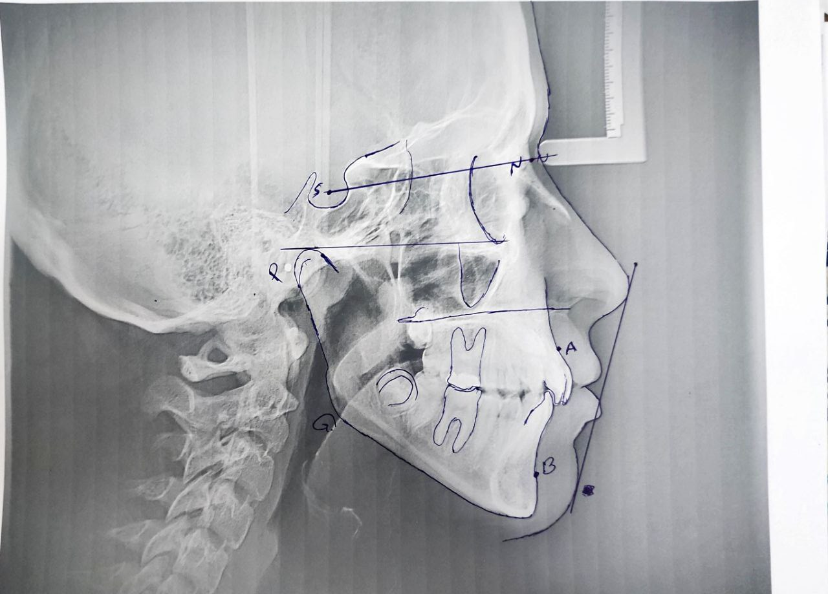
workshop of Manual tracing

Slide 27
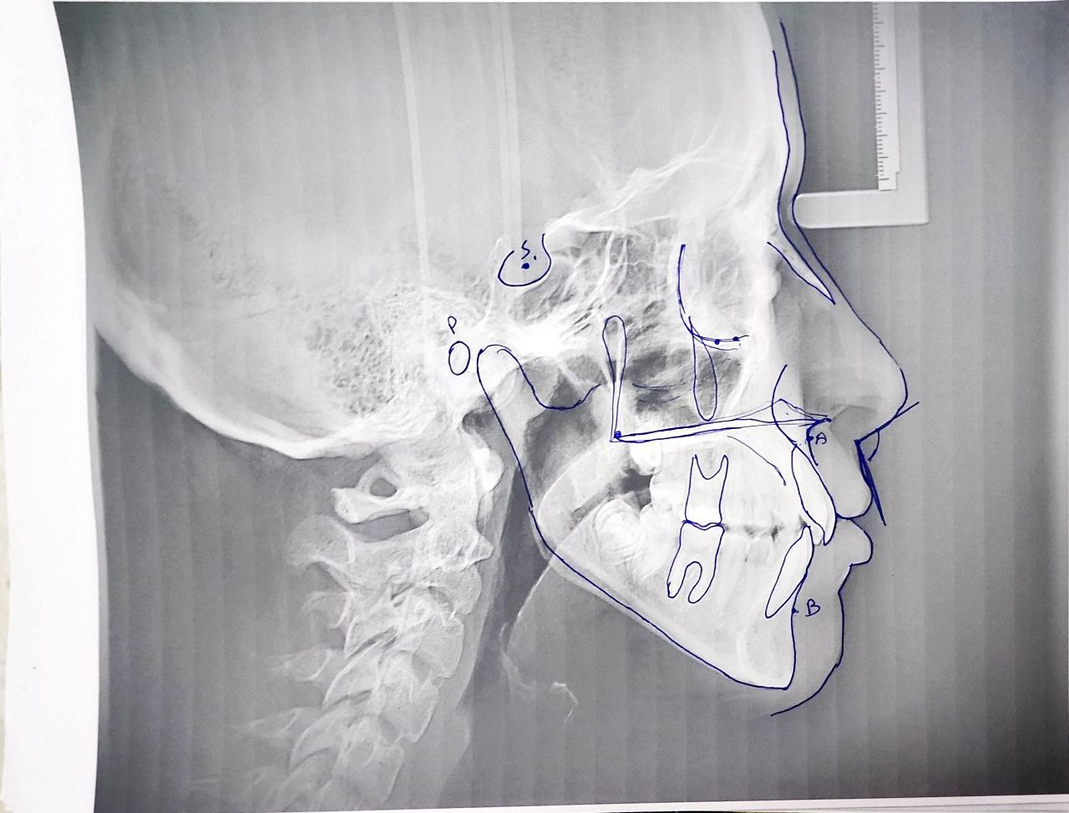

Slide 28
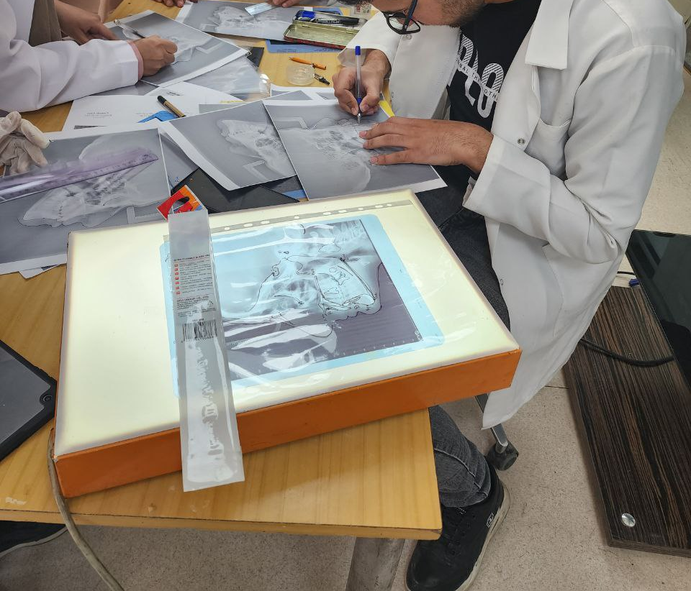
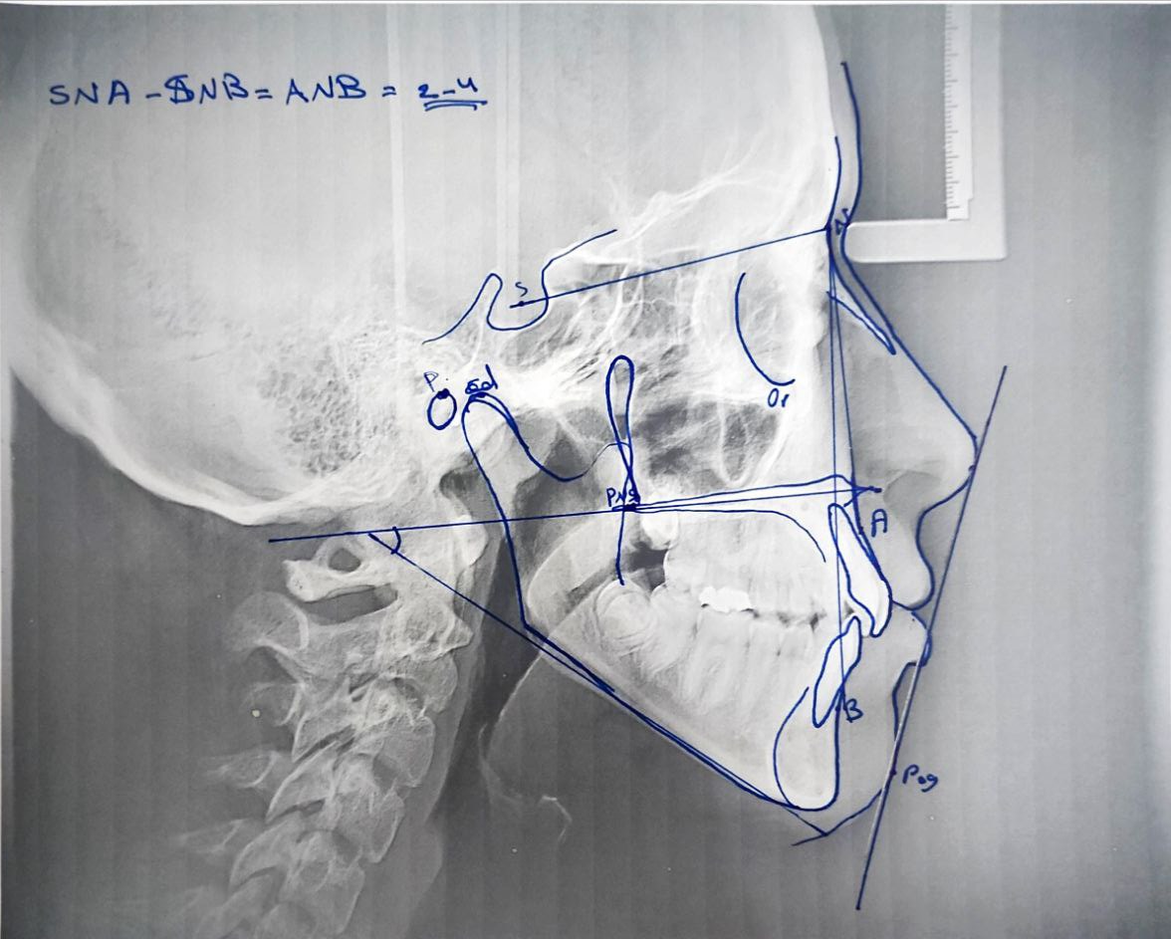

Slide 29
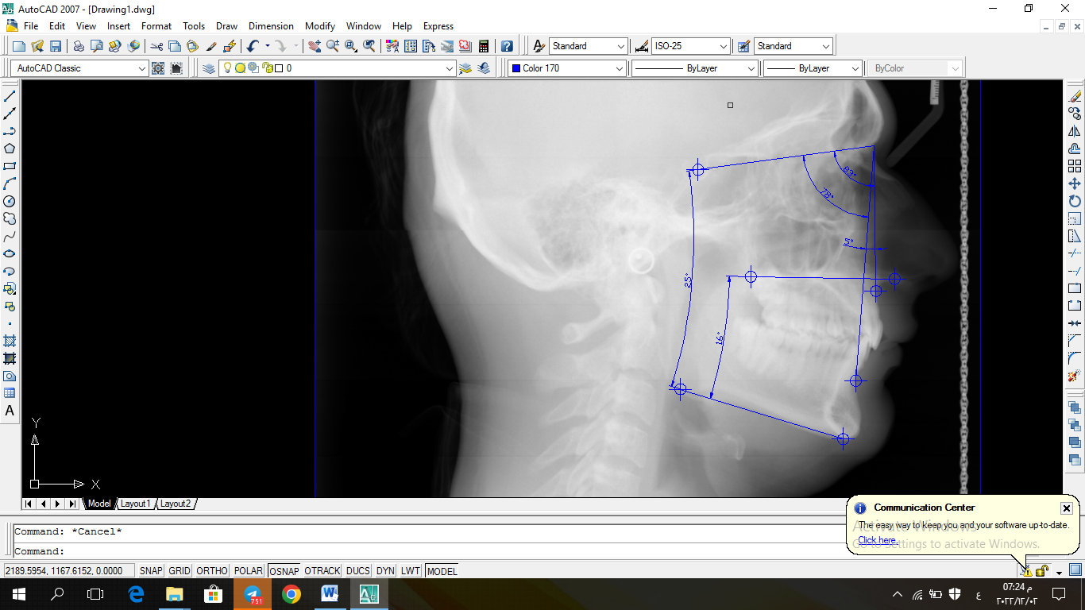
Workshop on Auto cad

Slide 30
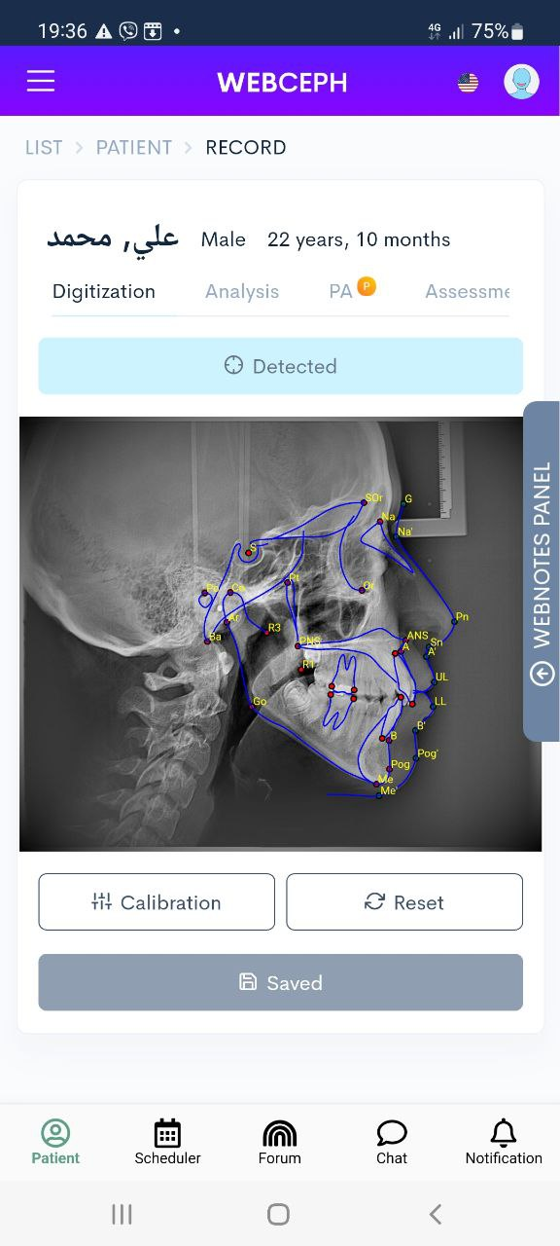
Workshop of Webceph application

Slide 31
