Slide 1

Immunohistochemistry staining techniques
Assistant lecturer.
Fatimah jalil Ismael

Slide 2
Definitions
Histochemistry is a science that combines the techniques of
biochemistry and histology in the study of the chemical
constitution of tissues and cells.
IHC is a technique for identifying cellular or tissue constituents (antigens) by means of antigen_antibody interactions, the site of antibody being identified either by direct labeling of the antibody, or by use of secondary labeling method.

Slide 3
Essential applications
* Study of cytological and histological differentation
and function
* Study of pathogenic mechanisms
* Identification and classification of micro-organisms
* Identification and classification of neoplasms
** Histogenetics and subtype classification

Slide 4
Immunohistochemical staining methods
* fluorophore-labeled immunofluorescence
* enzyme-labeled (immunoperoxidase) antibodies to identify proteins and other molecules in cells.
*In diagnostic surgical pathology, immunoperoxidase methods (usually single antigen- antibody and less commonly double antibody- antigen combinations

Slide 5
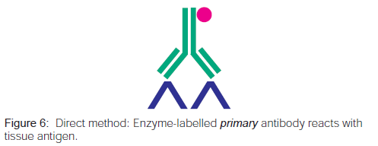
DIRECT METHOD

Slide 6
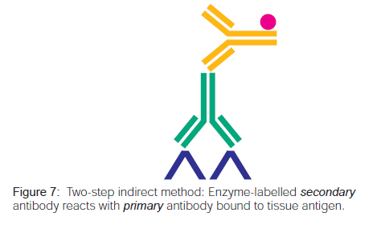
TWO-STEP INDIRECT METHOD

Slide 7
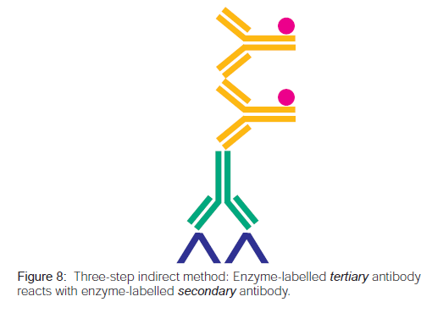
THREE-STEP INDIRECT METHOD

Slide 8
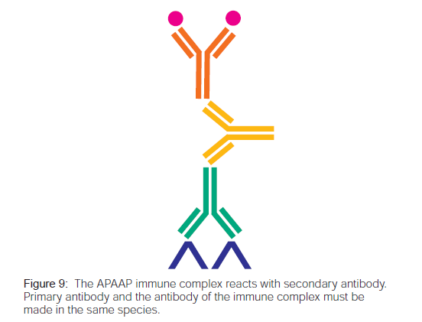
SOLUBLE ENZYME IMMUNE COMPLEX
TECHNIQUES

Slide 9
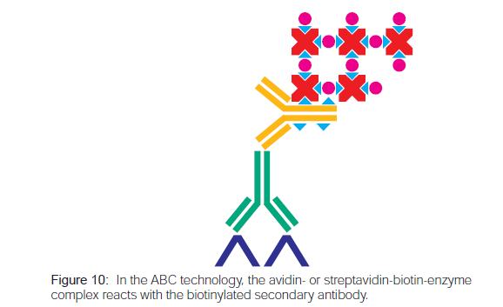
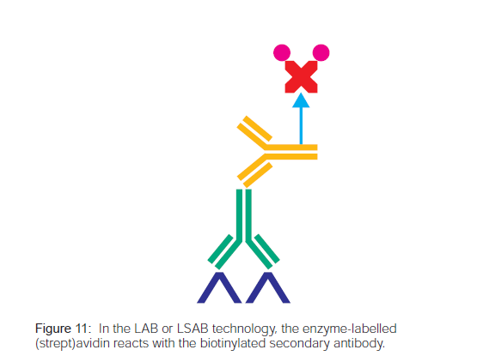
(STREPT)AVIDIN-BIOTIN TECHNOLOGIES

Slide 10
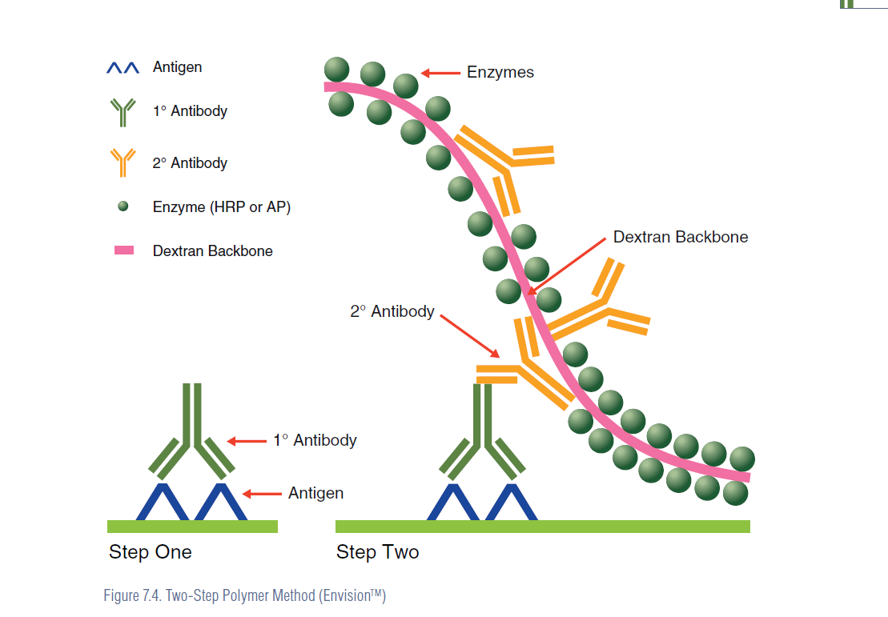
Polymer-Based Immunohistochemistry (EnVision™)

Slide 11
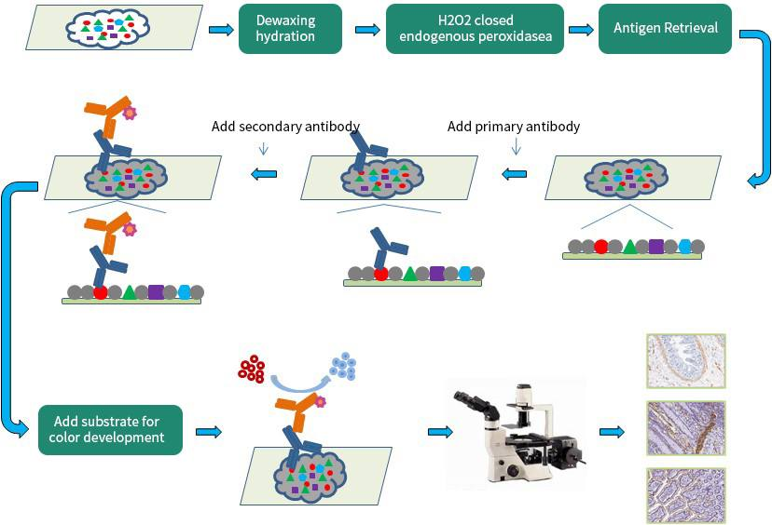
Steps
Fixation
Embedding and sectioning
Deparaffinization and hydration
Antigen (or epitope) retrieval
Blocking
Add primary antibody
Incubate
Wash
Add secondary antibody
Incubate
Wash
Add substrate
Wash
Counterstain

Slide 12
Tissue handling and fixation
Ischemia of the resected specimen before fixation results in degradation of protein, RNA, and DNA as well as activation of tissue enzymes and autolysis .
Therefore, variation in ischemic time can be a crucial factor affecting IHC results. Alteration in the results of (estrogen receptor, progesterone receptor, human epidermal growth factor 2, and Ki-67 )
Fixation is another important cause of variation in the reproducibility of IHC .Surgical specimens are fixed in 10% neutral buffered formalin (NBF) 24 hours in room temperature. This process prevents autolysis and preserves tissue and cellular morphology.
Fixation is also required in frozen sections in certain situations such as evaluating new antibodies. In those cases, acetone- or NBF-fixed frozen sections can be used.

Slide 13
Sectioning and storage
The recommended thickness of tissue section for IHC is mostly 4 μm, but it is optional depending on the purpose.
Thick tissue sections can produce higher background signals.
Slide storage conditions that are protected from oxidization by vacuum storage or paraffin coating are important as well as complete removal of water in the slide.
Storage time >>>Storing tissue sections for more than 2 months results in loss of p53

Slide 14
Antigen (or epitope) retrieval
Antibody binding epitopes can be masked in formaldehyde-based fixation due to cross-linkings of amino groups on adjacent molecules, in addition to the formation of methylene bridges.
For this reason, antigen retrieval, an additional step to unmask the epitope,
Techniques
The heat induced epitope retrieval (HIER) is the most widely used method for antigen retrieval. Various methods can be used for application of heat:
microwave ovens 120 °C full pressure and 750–800 W, respectively and typically for 10 minutes.
water baths
Citrate buffer 6 ph
heating plate 100°C for 30 minutes
pressure cookers
autoclaves

Slide 15
Techniques
enzymatic retrieval is used for limited antigens such as some cytokeratins and immunoglobulins. In such cases, tissue sections are incubated in either trypsin or proteinase for 10–20 minutes at 37°C. Then, terminate the reaction by adding phosphate buffered saline (PBS). However, this method is much more difficult to control.

Slide 16
Protein blocking
Protein blocking step is required to reduce unwanted background staining. A main cause for the background signal is the nonspecific binding of Fc portion of primary or secondary antibodies.
Ideal agent for the protein blocking is 5%–10% normal serum from the same species of secondary antibody.
Other agents include protein buffers such as 0.1%–0.5% bovine serum albumin, gelatin, or nonfat dry milk
Recently commercial mixes of synthetic peptides are also being widely used.
Incubation time for the blocking step can vary from 30 minutes to overnight. Incubation temperatures also vary from 4°C to room temperature.
Sufficient washing after the blocking step is critical to remove excess protein that may prevent detection of the target antigen.

Slide 17
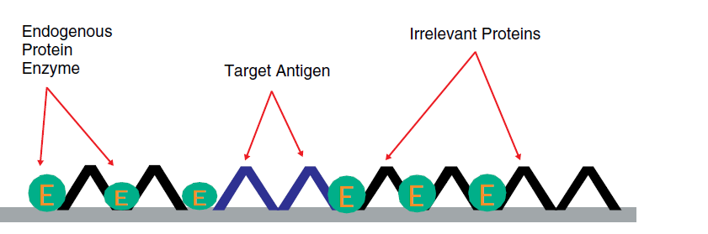
Protein blocking

Slide 18
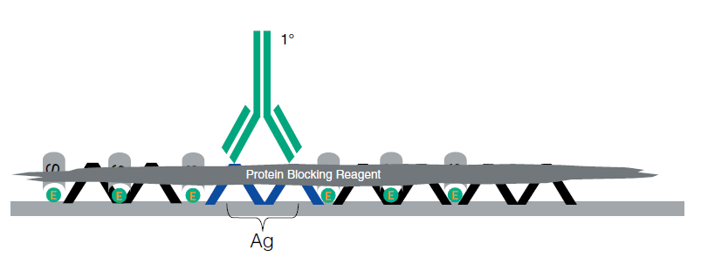
Protein blocking

Slide 19
Endogenous enzyme blocking
When using peroxidase antiperoxidase system in detection step, blocking of endogenous peroxidase activity is indispensable.
Diluted hydrogen peroxide as 3% is widely used for blocking endogenous peroxidase activity.
Tissues with high blood content (e.g., site of heavy hemorrhage), or with intense granulocytic inflammatory infiltrate, need a strong suppression of endogenous peroxidase activity.
Some antigen (such as CD4) can be destroyed by 3% H₂O₂. In this case, an H₂O₂concentration as low as 0.5% is recommended\
Endogenous alkaline phosphatase (AP), which is prevalent in frozen tissue, should be blocked with levamisol at a concentration of 10 mM.
Endogenous biotin in tissues is another issue. Although the level of endogenous biotin has been shown to be much lower in formalin fixation and paraffin embedding, residual activity can still be detected, especially in biotin-rich tissues such as liver and kidney. Endogenous biotin can be blocked by incubating tissue section in avidin solution (incubate sections in avidin solution for 15 minutes followed by brief rinse in PBS, and then incubate sections in biotin solution for 15 minutes, all at room temperature).

Slide 20
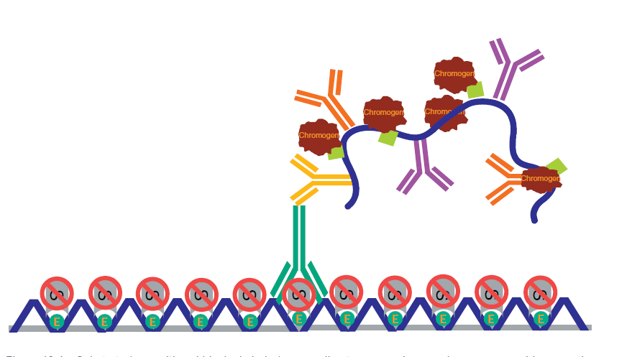
Endogenous peroxidase Blocking

Slide 21
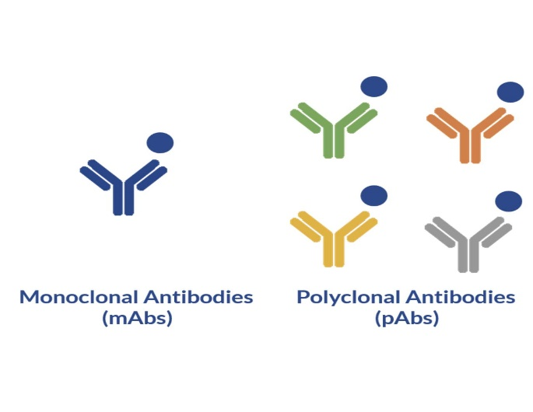
Antibody selection and validation
Polyclonal antibodies
are obtained from experimental animals through repetitive stimulation of antigen. These antibodies bind to multiple different epitopes in a single antigen.
react to a single epitope in an antigen. They are obtained from a single clone of hybridoma, which produces antibodies.Recently, monoclonal antibodies from rabbit or chicken have been introduced. These antibodies may give a better IHC results for antigens that are difficult to stain.
monoclonal antibodies

Slide 22
Monoclonal Vs polyclonal
Antibody | Advantages | Disadvantages
Monoclonal | Great epitope specificity and lower background | Less sensitivity or reactivity to masked epitope in a formalin fixed paraffin embedded sample
 | Better reproducibility
Polyclonal | Higher sensitivity (recognizing multiple epitopes) | Lesser reproducibility
 |  | Higher background due to natural antibodies

Slide 23
Detection system
Commonly used detection systems are as follows:
Avidin biotin complex method
Peroxidase based (PAP) method is preferred for tissues rich in endogenous peroxidase, such as bone marrow or lymphoid tissue.
Labeled streptavidin biotin method
phosphatase anti-phosphatase method (APAAP)
Polymer-based detection system
Biotin-free synthetic polymer system is recommended for tissues with high endogenous biotin such as liver and kidney.
Tyramine amplification system. In comparison to the standard IHC methods, polymeric and tyramine-based amplification methods have typically increased sensitivity by at least 50-fold or greater.

Slide 24
Detection system
Several different chromogens are available according to the type of tissue or counterstain. In general, diaminobenzidine (brown) or 3-amino-9-ethyl carbazole-red are routinely used for peroxidase. The choice depends on the type of tissue or counterstain.

Slide 25
Detection system

Slide 26
manual IHC versus automated IHC machines
Use automated IHC machine:-
improved reproducibility and reliability of IHC
Large number of samples are tested.
The samples are tested over a longer time.
does not allow subtle optimization or flexibility in the usage of reagent or retrieval methods.

Slide 27
Counter staining
contrast to the chromogens for better discrimination of the target signal.
allows researchers to identify the cell type and exact localization of the immunopositives.
Hematoxylin is the most commonly used counterstain
although various colors are now being used as techniques of multiplex IHC progress

Slide 28
Examples of counterstainings that are commonly used
 | Color | Location | Use
Hematoxylin (4 types: Harris’s, Mayer’s, Carazzi’s, and Gill’s) | Blue | Nucleus | The most popular one
Eosin | Red | Cationic group of protein | Eosin is bound by the majority of structures in any tissue
Methylene blue | Blue | Nucleus | Good to differentiate between DNA and RNA in tissues
Methylene green | Blue/green | Nucleus
Toluidine blue | Deep blue | Nucleus | It will also stain polysaccharides a pink/red color (metachromasia)

Slide 29
QUANTIFICATION OF THE DATA
To analyze the IHC data, including diagnostic value of certain molecular expression and prognostic relationship of the biomarkers, results of the IHC should be expressed in numerical values for statistical analysis, several quantification methods that are widely used are reviewed.
1-Assessment of the proportion of immunopositive cells
In evaluating IHC results, researchers commonly assess the relative percentage of immunopositive cells in relation to the total number of target cells. Each value is usually recorded as a numerical score in every 10% (0, 0%–9%; 1, 10%–19%; 2, 20%–29%; 3, 30%–39%; 4, 40%–49%; 5, 50%–59%; 6, 60%–69%; 7, 70%–79%; 8, 80%–89%; and 9, 90%–100%).
This method has a limitation that it does not show the intensity of the IHC staining, resulting in the lack of information regarding the subtle difference in protein expression level.
However, it can preclude the interpretational error resulting from inappropriate variation in staining intensity between cases due to differences in tissue status in a large-scale study and among applied batches especially in manual staining.

Slide 30
2-Combinative semiquantitative scoring
Combinative semiquantitative scoring is the most commonly used method in the current prognostic biomarker researches
yielding immunoscores that incorporate both quantitative and qualitative assessments. In addition to the quantitative data from the assessment of relative percentage of immunopositive cells as previously described,
intensity of the staining is also evaluated. The intensity is commonly scored from 0 to 3 (0, negative; 1+, weak positive; 2+, moderate positive; and 3+, strong positive). The final immunoscore is calculated by adding or multiplying each score.

Slide 31
3- Quantification using spectral image analysis
As multiplex IHC develops, analysis for multicolor stained specimen is essential.
Usual semiquantitative scoring is not appropriate in the analysis of multiplex IHC due to a massive amount of information in a single slide.
Thus, the use of spectral image analysis is increasing for the interpretation of multiplex IHC.
In spectral unmixing, the optical signal from each chromogen can be isolated and assessed separately and quantitatively

Slide 32
ANALYSIS OF THE DATA
After quantitative analysis of the IHC results, the continuous variables are usually changed into categorical forms, as it is much easier to analyze and make decisions.
The categorization of variables also enables clinicians to stratify patients according to the IHC results of the testing molecules.
Cut-off values for immunopositivity are commonly selected by the median and the quartiles of measurementsA z.
However, sometimes simply more than 5% or 10% criteria are used. There is no standardized method for setting the cut-off value for the categorization.
This lack of standardization sometimes causes inconsistent results between similar studies.

Slide 33


Slide 34
Working Classification of Antibodies Used In Immunohistochemistry

Slide 35
epithelial markers
Squamous epithelial
· Pancytokeratin.
· Carcino embryonic antigen.(CEA)
· Epithelial membrane antigen.(EMA)
cytoplasmic and apical
luminal membrane staining

Slide 36
Melanocytes
· S-100
Cytoplasmic
· Melan –A
Cytoplasmic
· Mart -1
· HMB - 45
· Tyrosinase
Cytoplasmic

Slide 37
Odontogenic epithelium
· Cytokeratin (ck) -5,13,14,19
Basal layer and intermediate layer - ck 5, 14, 19
Superficial cell layer - ck4,13
· Enamelin
· Ameloginin
· Laminin

Slide 38
Glandular epithelium
S-100
Actin
Calponin- myoepithelial cells
CK 7
Lysozyme
Estrogen receptors
Progesterone receptors
CK -14
EMA- ductal cells
P63- myoepithelial cells

Slide 39
Muscle Markers
Skeletal muscle marker
· Myogenin (myf- 4, myf- 5)
· Myo D1
Smooth muscle marker
· Desmin
· Smooth muscle actin (SMA)
· Calponin
· Caldesmon

Slide 40
Vascular Markers
· CD 31(Cluster of differentiation)
· CD 34
· CD105/ Endoglin
· VEGF
· Von willebrand factor (VIII)
· Ulex europaeus
Podoplanin
· Podocalynin

Slide 41
Neural Markers
S-100
Neuron specific enolase (NSE)
CD57
p75 NTR
CD99
CD56
Neuro filament protein (NFP)
Synaptophysin
Chromogranin
Claudin – 1
Glut – 1

Slide 42
Neuro Ectodermal Markers
· CD99
· CD56/ NCAM - neural cell adhesion molecule
· NB84

Slide 43
Histiocytic / Dendritic Cell Markers
· Lysozyme
· CD68
· CD21
· Clusterin,

Slide 44
Langerhans cell neoplasms express
· S100 protein
· CD1a.

Slide 45
Lymphoid Markers
T cell markers
· CD 2
· CD3
· CD30
· CD99
· CD43
· CD45 RO
· TDT

Slide 46
B cell markers
· CD 20
· CD75 a
· CD26
· Pax5

Slide 47
Bone Markers
· Receptor activator of nuclear factor-kappa B ligand
(RANKL)
· CD99
· Osteocalcin
· Osteonectin
· Alkaline phosphatase.
· Osteoclast trap.
· Osteoprotegrin

Slide 48
Proliferative Markers Which Shows Up And DownRegulation
Up regulation
· TGF – α (Transforming growth factor – alpha)
· PCNA (Proliferative cell nuclear antigen)
· Cyclin D1
· Ras
Down regulation
· p53
· TGF – β

Slide 49
Germ Cell Tumor Markers
o Alpha feto protein(AFP)
o Human chorionic gonadotropin.(HCG) – In pregnancy.
o Germ cell tumor.
o Choriocarcinoma
o Islet cell tumor.
o CA125(Cancer Antigen)

Slide 50
Metastatic Epithelial Tumor Markers to Jaw
· CK 7 and 20 – Low molecular weight cytokeratin
· Presence for metastatic lung and rectal adenocarcinoma.
· Villin - Actin binding protein.

Slide 51
Markers in spindle cell tumors
· Smooth muscle actin
· Desmin
· S100
· Cytokeratins
· CD34
· EMA

Slide 52
Markers in Pleomorphic cell tumors
CK
· CD30
· S100
· Actin
Desmin

Slide 53
Round cell tumors
· CK
· Desmin and/or myf-4
· CD99
· S100

Slide 54
Markers salivary gland lesions (Intercalated duct lesions)
· CK7
· CK14
· Lysozyme
· Calponin
· S-100
· Progesterone receptors.
• Estrogen receptors.

Slide 55
Other markers
· CD99
· CD117 (transmembranous tyrosine kinase receptor)
· MDM- 2
· CDK-4
· FLI-1
· WT-1

Slide 56
Tumor markers can be broadly classified as
1. Oncofetal antigens (e.g. alpha-fetoprotein (AFP), Carcinoembryonic antigen (CEA), Pancreatic oncofetal antigen, fetal sulfoglycoprotein.
2. Tumor associated antigens /Cancer Antigens e.g.CA125, CA19-9, CA15-3, CA72-4 CA50 etc.
3. Hormones e.g. Beta human chorionic gonadotropin, calcitonin, placental lactogen etc.
4. Hormone receptors (e.g. estrogen and progesterone receptors)
5. Enzymes and Isoenzymes (e.g. prostate specific antigen (PSA), prostatic acid phosphatase (PAP), neuron specific enolase (NSE), glycosyl transferases, placental alkaline phosphatase (PALP), terminal deoxy nucleotidyl transferase (TDT), lysozyme, alpha amylase
6. Serum and tissue proteins (beta-2 microglobulin, monoclonal immunoglobulin/para proteins, glial fibrillary acidic protein (GFAP), protein S-100, ferritin, fibrinogen degradation products)
7. Other biomolecules e.g. polyamines

Slide 57
Intermediate Filaments
The intermediate filaments comprise the major component of the cytoskeleton and consist of five major subgroups
vimentin,
cytokeratins,
desmin,
neurofilaments,
glial fibrillary acidic protein (GFAP)]
small number of minor subgroups (e.g. nestin, peripherin).
Ultastructurally, the intermediate filaments appear as wavy unbranched filaments that often occupy a perinuclear location in the cell.

Slide 58
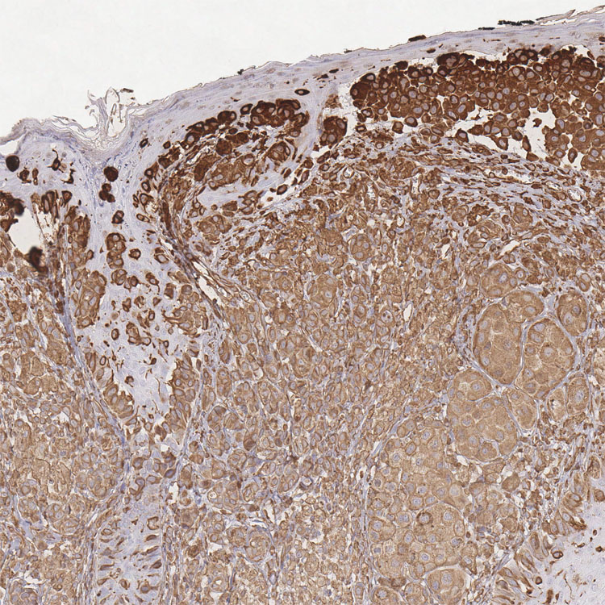
Vimentin
Cytoplasmic
Vimentin, a 57-kDa intermediate filament protein, has been expressed by all mesenchymal cells. Vimentin is universally expressed in all most all the cells during early embryogenesis
it is progressively been replaced in many cells by type specific intermediate filaments. Few mesenchymal tissues express vimentin with the type-specific intermediate filaments.
It is also commonly expressed by sarcomatoid carcinomas at any site, an unfortunate fact that greatly limits its utility in the immunohistochemical distinction of carcinomas from sarcomas.

Slide 59
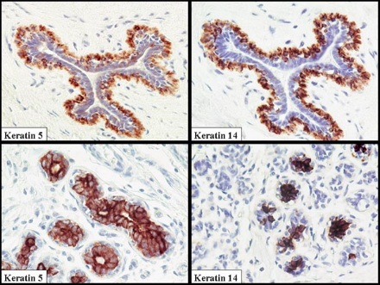
Cytokeratins
Cytoplasmic
Cytokeratin are the most complex members of the intermediate filament protein family. They are a group of more than 20 proteins.
The cytokeratins may be grouped by their molecular weights (40-67 kDa) and into acidic and basic subfamilies.
The cytokeratins are mostly grouped as low-molecular-weight cytokeratins (generally cytokeratins 8, 18, and 19) and high molecular weight cytokeratins (generally cytokeratins 1,5, 10, and 14).
Cytokeratins are highly sensitive markers for identifying carcinomas and are generally employed as markers distinguishing epithelial from non epithelial tumors (lymphomas, sarcomas, melanomas).
Cytokeratins is expressed in only a portion of cytoplasm, often yielding a “PERINUCLEAR” OR “DOT LIKE PATTERN” typically in merkel cell tumors

Slide 60
Figure 1 Showing subcategorization of acidic (A) and basic (B)cytokeratin subgroups within various tissues

Slide 61
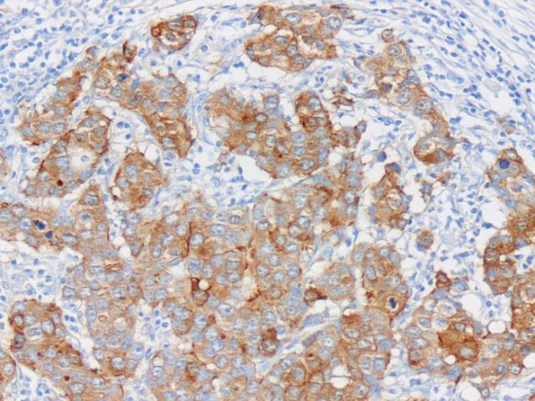
Epithelial membrane antigen (EMA)
Epithelial membrane antigen (EMA) belongs to a heterogeneous family of highly glycosylated transmembrane proteins known as human milk fat globule (HMFG) membrane proteins. This family of antigens is high molecular weight molecules found in secretory epithelial cells, to a lesser degree, in non-secretory epithelium (e.g., squamous epithelium) and rarely in non-epithelial cells.30
Among normal mesenchymal cells, EMA expression is limited to perineurial cells, meningeal cells.
Tumors which can be detected are Perineuromas, malignant peripheral nerve sheath tumors, synovial sarcoma, meningiomas, angiomatoid fibrous histiocytoma, dentigerous cyst, KCOT, osteosarcoma, Neurofibromas, pleomorphic adenoma, salivary duct carcinoma, polymorphous low grade carcinoma, basal cell carcinoma, adeno carcinoma, clear cell carcinoma

Slide 62
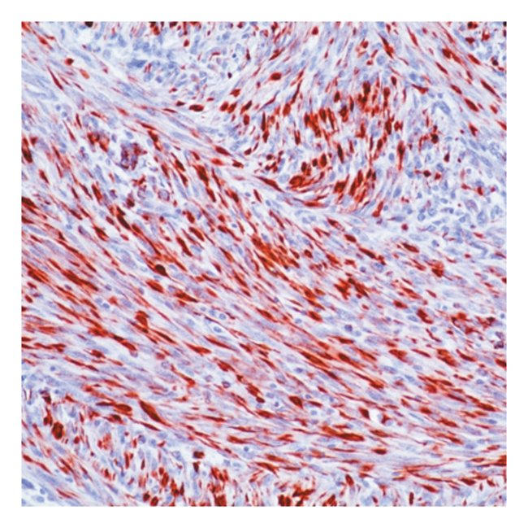
Desmin
Cytoplasmic, may show a fibrillary aspect
Desmin is the intermediate filament protein associated with both smooth and skeletal muscle differentiation;
it is rarely expressed by myofibroblasts and their corresponding tumors.
In skeletal muscle desmin is localized to the Z-zone between the myofibrils, where it presumably serves as binding material for the contractile apparatus.33
Desmin may also be expressed by non muscle cells, including the fibroblastic reticulum cell of the lymph node, submesothelial fibroblast, and endometrial stromal cells.
Tumors which can be detected are Benign & malignant smooth & skeletal muscle tumors, especially Rhabdomyosarcoma

Slide 63
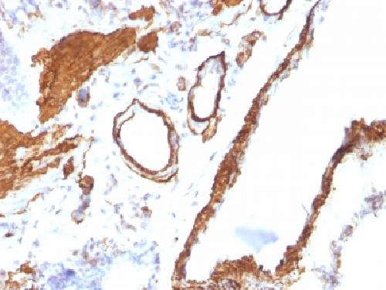
Actin
Cytoplasmic and membrane
Actin, also is expressed by both smooth and skeletal muscles.
Actin microfilaments transmit traction and contraction forces generated within a cell to the extracellular matrix during embryonic development, wound healing and cell motility, and to maintain tissue structure and tone.
The tumors which can be detected are
Leiomyoma & sarcoma,
rhabdomyoma & sarcoma,
mucoepidermoid sarcoma,
salivary duct carcinoma,
adenoid cystic carcinoma

Slide 64
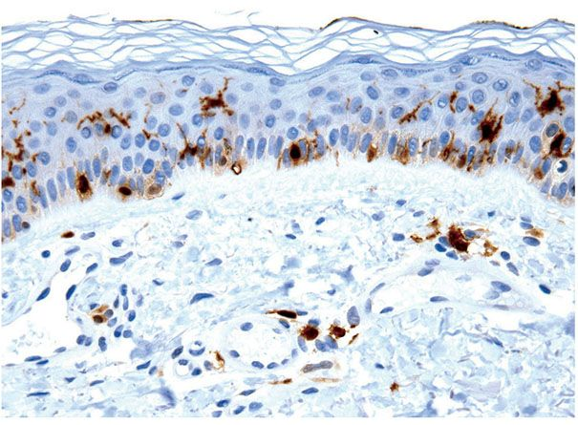
Markers of Nerve Sheath Differentiation
S-100 Protein
The S-100 protein is a 20-kDa acidic calcium-binding protein, so named for its solubility in 100% ammonium sulfate. The protein is composed of two subunits, α and β. S-100 protein can be demonstrated in a large number of normal tissues, including some neurons and glia, schwann cells, melanocytes, Langerhans cells, interdigitating reticulum cells of lymph nodes, chondrocytes, myoepithelial cells and ducts of sweat glands, salivary glands, and the breast, serous glands of the lung, fetal neuroblasts and sustentacular cells of the adrenal medulla and paraganglia.
The tumors which can be detected are Benign & malignant nerve sheath tumour,
melanoma, schwannoma, chondrosarcomas, langerhans cell tumour,
Neurofibromas, some muscle tumors, pleomorphic adenoma,
basal cell adenoma, mucoepidermoid carcionoma, adenoid cystic carcionoma, adeno carcionoma.

Slide 65
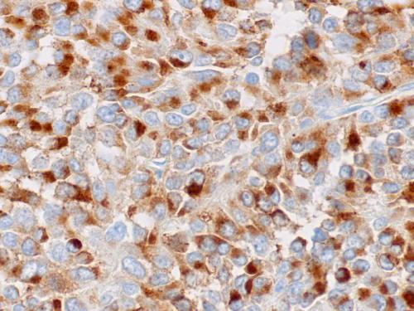
Markers of melanocytic differentiation HMB-45
Cytoplasmic.
HMB-45 is a monoclonal antibody and is used to detect an epitope specific for melanocyte, malignant melanoma and melanoma metastasis.
The reactive agent is present in the cutaneous melanocytes, melanoma cells and pigments in retina.

Slide 66
Vascular Markers

Slide 67
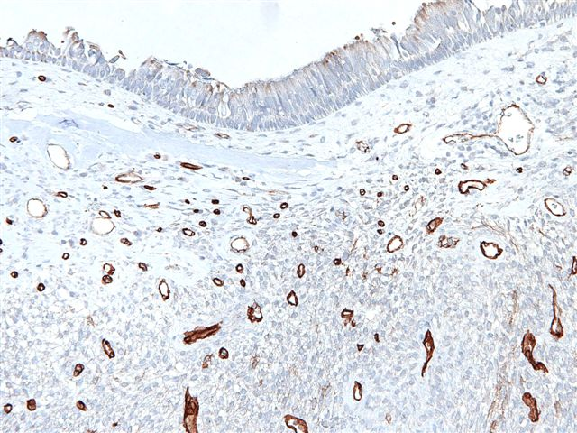
CD34 (Human Hematopoietic Progenitor Cell Antigen)
Predominantly confined to the cell surface
The function of CD34, a 110-kD a transmembrane glycoprotein, is unknown. It is expressed on hematopoietic stem cells, endothelium, the interstitial cells of Cajal, and a group. 'of interesting dendritic cells present in the dermis, around blood vessels, and in the nerve sheath.3
CD34 is expressed in more than 90% of vascular tumors and is the most sensitive marker of Kaposi's sarcoma
CD34 positive cells also found in prostate, urinary bladder, fallopian tubes, thyroid gland, pancreas, colon, uterine cervix and testis.

Slide 68
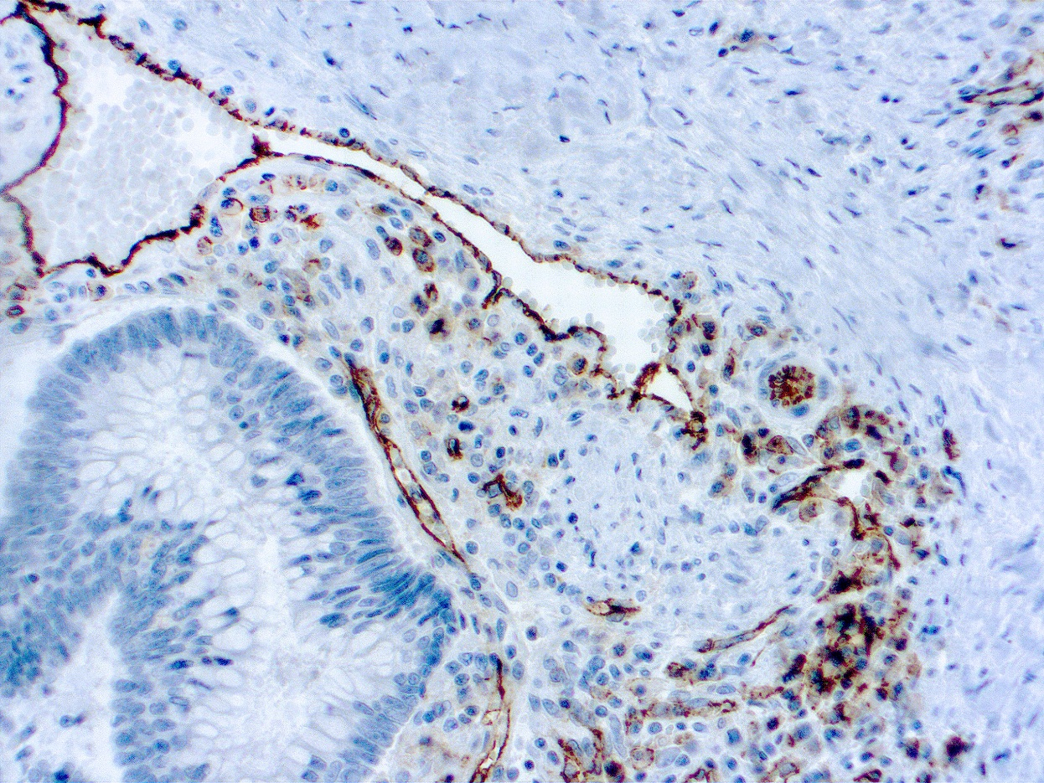
CD31 (Platelet Endothelial Cell Adhesion Molecule-1) Predominately cell membrane, with weaker cytoplasmic staining.
CD31 (PECAM-1; platelet/endothelial cell adhesion molecule-1) is a single chain type-1 transmembrane protein that plays a role in adhesive interactions between adjacent endothelial cells as well as between leukocytes and endothelial cells.
It is expressed in more than 90% of angiosarcomas,
hemangioendothelioma hemangiomas, and Kaposi's sarcoma

Slide 69
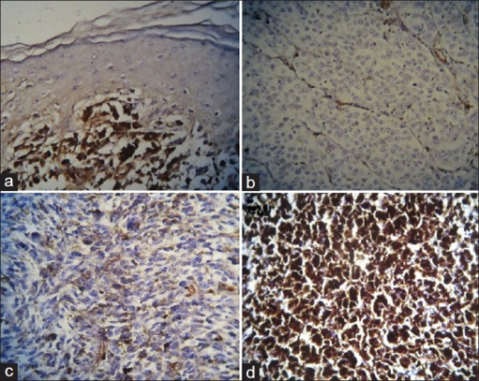
VEGF
VEGF is a type of glycoprotein which has both angiogenic, mitogenic as well as vascular permeability factor thus enhancing activity in endothelial cells.
It serves as an important marker in premalignant lesions (leukoplakia, lichen planus),
malignant (oral squamous cell carcinoma),
salivary gland tumors, odontogenic cysts and tumors,
kaposis’s sarcoma and lymphangioma

Slide 70
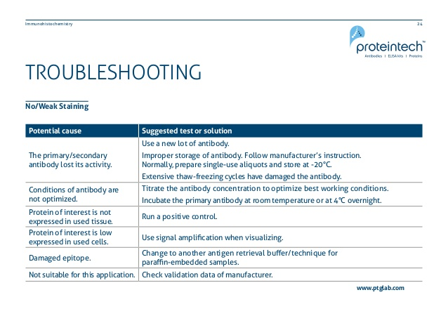

Slide 71
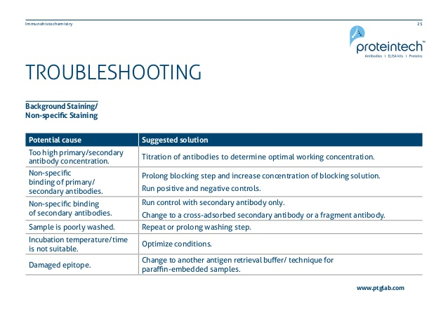

Slide 72
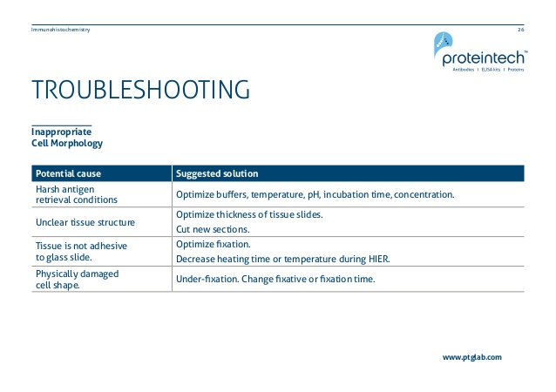

Slide 73
IMMUNOHISTOLOGY OF HEAD AND NECK LESIONS

Slide 74
Squamous Cell Carcinoma
KEY DIAGNOSTIC POINTS
• Squamous carcinomas are nearly always positive for CK.
• Common CK expression in squamous carcinomas includes AE1/AE3 and CKs 5, 5/6, 14, and 17.
• Nuclear p63 expression is common in squamous cell carcinomas but is not specific.
• Cytokeratin stains may help detect subtle metastatic foci, especially in posttreatment lymph nodes.
• Overexpression of p53 may be linked to response to radiation and/or chemotherapy.

Slide 75
Oropharyngeal Squamous
Cell Carcinoma
Basaloid Squamous Cell Carcinoma
• The major differential diagnosis for BSCC includes adenoid cystic carcinoma, sinonasal undifferentiated carcinoma,
nasopharyngeal carcinoma, and small cell neuroendocrine carcinoma.
• The best immunohistochemical markers include p63, p53, and neuroendocrine markers. BSCC will be positive for p63 and p53 but will be negative for most neuroendocrine markers.

Slide 76
Spindle Cell Squamous Cell Carcinoma
The diagnosis of SCSCC requires the identification of acomponent of squamous neoplasia or immunohistochemical epithelial differentiation of the spindle cells.
• Despite the use of multiple cytokeratin and epithelial markers, as many as 30% of SCSCCs will be nonreactive in the spindle cells.

Slide 77
Mucosal Melanoma
• MM shows a wide variety of patterns and cytomorphologic features, often with prominent nucleoli, intranuclear inclusions, and occasional pigmentation.
• MMs react with an array of melanocytic markers—S-100 protein, human melanoma black 45 (HMB-45), melan-A, and tyrosinase—whereas CD117 and CD56 are infrequently positive, and CAM5.2 is rarely positive.

Slide 78
Small Cell Neuroendocrine Carcinoma
• SCNEC shows sheets, ribbons, and nests of small cells with molding, high nuclear/cytoplasmic ratio, hyperchromatic nuclei, necrosis, and high numbers of mitoses.
• SCNEC is positive for AE1/AE3 and CAM5.2 (dotlike) and for a variety of neuroendocrine markers, including synaptophysin, CD56, CD57, chromogranin, and NSE.

Slide 79
Rhabdomyosarcoma
• A-RMS may arise in the sinonasal tract, showing an alveolar to nested arrangement with cells that have eccentric eosinophilic cytoplasm.
• A variety of myoid markers are positive (desmin, myogenin, MyoD1, myoglobin, actins), but it is important to remember that AE1/AE3, CAM5.2, and CD56, along with synaptophysin, may be focally positive in some cases.

Slide 80
Ewing Sarcoma/Primitive
Neuroectodermal Tumor
• ES/PNET is composed of uniform round cells with scant cytoplasm arranged in a lobular, nested, or diffuse configuration, often with necrosis and increased mitoses.
• Tumor cells are positive for CD99 and FLi-1, along with variable reactions with epithelial, neuroendocrine, and other mesenchymal markers

Slide 81
Sinonasal Intestinal-Type Adenocarcinoma
• Sinonasal ITACs very closely resemble intestinal adenocarcinomas; they are separated into four major histologic types: colonic, solid, papillary, and mucinous.
• Sinonasal ITACs are usually positive with AE1/AE3, CK7, CK20, CDX-2, villin, and CEA and also show neuroendocrine differentiation in some cases

Slide 82
Glomangiopericytoma
• Glomangiopericytomas are unique spindle-cell tumors arranged in short, cellular fascicles.
Cells show a syncytial architecture,
limited pleomorphism, peritheliomatous vascular hyalinization, extravasated red blood cells, and mast cells.
• Glomangiopericytomas show a perivascular myoid phenotype and are strongly positive for SMA, vimentin, and MSA but are negative with CD34, CD31, factor VIIIRAg, desmin, and AE1/AE3.

Slide 83
Nasopharyngeal Carcinoma
• Nonkeratinizing carcinoma is the classic type of NPC showing a syncytial architecture of cells with vesicular nuclei and an intimate relationship with lymphoid elements.
• The neoplastic cells are strongly and diffusely positive with EBER, AE1/AE3, CK5/6, and p63 but are nonreactive with CK7, desmin, and S-100 protein.

Slide 84
Nasopharyngeal Angiofibroma
NPAF is a unique fibrovascular neoplasm that develops in males only. An association with FAP has been established.
• The stromal cells are immunoreactive with nuclear β-catenin, vimentin, androgen receptors, and variably with SMA and CD117.

Slide 85
Granular Cell Tumor
• GCT develops in the oral cavity (tongue) and larynx with pseudoepitheliomatous hyperplasia and large, polygonal
cells with abundant granular cytoplasm that shows limited
pleomorphism.
• The neoplastic cells are immunoreactive with S-100 protein,
CD68, vimentin, NSE, and calretinin but are nonreactive
with keratins, muscle markers, HMB-45, and TFE3.

Slide 86
Myoepithelioma
• A benign tumor of myoepithelial cells exclusively, lacking ductal elements and usually identified in the parotid or palate.
• Solid, myxoid, reticular to cordlike proliferation of either spindled or plasmacytoid cells, possibly showing clear cells.
• Variable reactivity with a variety of myoepithelial markers that include AE1/AE3, CK5/6, 34βE12, S-100 protein, p63, calponin, SMA, and SMMHC.

Slide 87
Mucoepidermoid Carcinoma
• Three cell populations can generally be seen in MEC—
epidermoid cells, mucous cells, and intermediate cells—
variably set within a cystic background.
• CK5/6, Ki-67, and p63 nuclear expression may help with the differential diagnosis.

Slide 88
Polymorphous Low-Grade Adenocarcinoma
• A malignant tumor characterized by infiltrative growth of
cytologically uniform cells arranged in architecturally diverse patterns that develop exclusively in minor salivary glands.
• Reacts with EMA, S-100 protein, and Bcl-2, findings that can
help with the separation from PA and ACC.

Slide 89
Adenoid Cystic Carcinoma
• ACC has three prominent growth patterns: cribriform,
tubular, and solid, and it is composed of epithelial and
myoepithelial cells.
• Differential immunohistochemical stains highlight each cell compartment and may be used in separation from other tumors in the differential.
The small “tubules” seen in adenoid cystic carcinoma can be highlighted with an epithelial membrane antigen, whereas the remaining myoepithelial cells are not highlighted.
B, Cytokeratin 5/6 also highlights the inner luminal or epithelial cells.
C, A monoclonal carcinoembryonic antigen selectively highlights just the luminal aspect.
D, CD117 highlights the epithelial cells, shown here in a tubular pattern.

Slide 90
Hyalinizing Clear Cell Carcinoma
• Hyalinizing clear cell carcinoma is an infiltrative tumor
composed of monotonous clear cells with prominent cell
borders and abundant glycogen; they lack any myoepithelial differentiation.
• The neoplastic cells are positive with AE1/AE3, CAM5.2,
CK7, EMA, and p63; cells are negative with S-100 protein,
calponin, actins, and GFAP.
• The tumor must be separated from other tumors that have a clear cell component, including metastatic clear cell RCC.

Slide 91
Salivary Duct Carcinoma
• SDC resembles high-grade breast carcinoma.
• SDC is positive for EMA, GCDFP-15, BRST-2, androgen
receptor, and Her-2/neu.

Slide 92
Low-Grade Cribriform Cystadenocarcinoma
• Low-grade cribriform cystadenocarcinoma is a rare tumor
that grows in a variety of patterns.
• This tumor is positive for S-100 protein in a strong and diffuse manner, supported by a layer of myoepithelial cells at the periphery.

Slide 93
Mammary Analogue Secretory Carcinoma
• A lobular tumor with microcystic and glandular spaces filled with eosinophilic homogenous or bubbly secretions but lacking acinar granules.
• This tumor is positive with AE1/AE3, mammaglobin, MUC1,
MUC4, S-100 protein, STAT5a, GCDFP-15, and EMA.

Slide 94
Metastatic Tumors
• Metastatic tumors are most commonly attributed to head and neck primary tumors, but sites below the clavicle are also possible.
• An IHC staining panel can often help to identify the tumor type.
• Determining the source of a metastatic carcinoma in the head and neck can be difficult or impossible even with IHC stains; often it will require clinical and radiologic correlation.
Metastatic Renal Cell Carcinoma express a wide variety of markers that include AE1/AE3, vimentin, Pax-2, Pax-8, RCC marker, CD10, CA9, E-cadherin, claudin-7, CD117, TFE3, thrombomodulin, uroplakin III, p63, and CD57,
Metastatic Breast or Prostate Adenocarcinoma
The glandular or single-file infiltration can be quite characteristic, supported by positive ERs, PRs, and/or Her-2/neu

Slide 95


