Slide 1

PAP TEST
CLINICAL GLIMPSE
م.د. كواكب نجم الدين عبدالله
طبيبة اختصاص نسائية وتوليد (بورد عربي)
المركز الوطني الريادي لبحوث السرطان

Slide 2
MASS SCREENING PROGRAMME
It is a series of diagnostic and therapeutic services offered actively and free of charge to an apparently healthy population and promoted by a National Health Service with the aim of early diagnosis of the disease, before symptoms appear
PAP Test is one of the measures of Cervical Cancer Screening

Slide 3
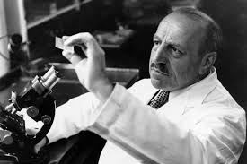
WHAT IS PAP TEST?
It is the screening test for pre-invasive and early invasive cervical cancer which is carried out on a sample of cells obtained from the cervix, It was developed by the prominent Greek doctor Georgios Papanikolaou

Slide 4
FREQUENCY OF PAP TEST
Cost-effective analysis suggest the Pap test should be routinely performed every 3 years; it is more important to screen all women within (25-64 age group) than to screen the same women at more frequent intervals.
ADVANTAGES OF PAP TEST
Simple
Offers rapid detection
Sensitive
Non invasive
Low cost method

Slide 5
REASONS FOR FAILURE TO DETECT CERVICAL NEOPLASIA
Incorrect sampling of cervical epithelium.
Failure of transfer of significant biological material from sampling devices to the slide.
Incorrect slide processing, administrative and clerical errors.
Incorrect interpretation of the smear at light microscope (reporting error).

Slide 6
CERVICAL SAMPLING TECHNIQUE - GENERAL INFORMATION
To obtain accuracy in Pap testing it is necessary first of all to obtain a representative cellular sample for examination.
The sample should contain cells from the ectocervix, endocervix and the transformation zone (ESPECIALLY).
It is not always possible to identify the TZ because the position changes during the course of a woman’s lifetime, according to her age and phase of her reproductive life.
Whenever the endocervix cannot be reached easily with the Ayre’s spatula, a cytobrush or cone-shaped endo-cervical brush must be employed.

Slide 7
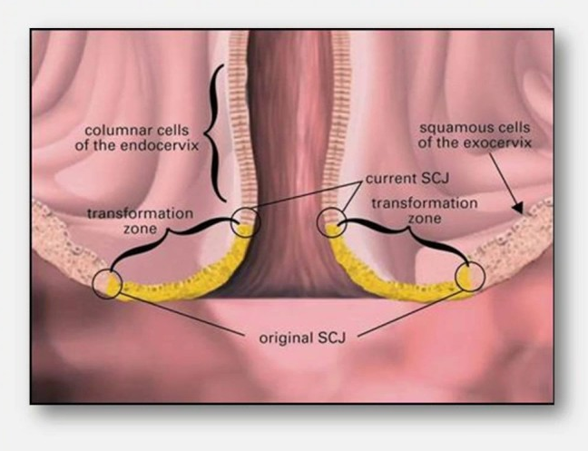
CERVICAL SAMPLING TECHNIQUE - GENERAL INFORMATION
CERVICAL ZONES

Slide 8
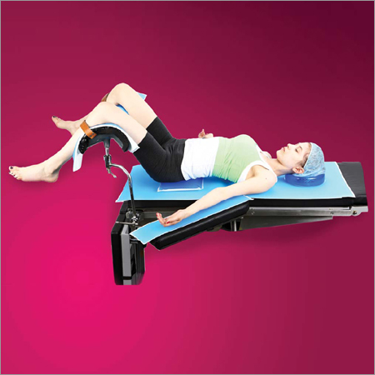
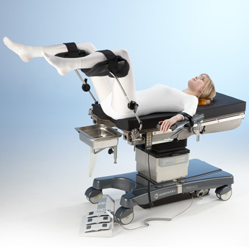
CERVICAL SAMPLING TECHNIQUE - GENERAL INFORMATION
PATIENT’S POSITION DURING THE PROCEDURE

Slide 9
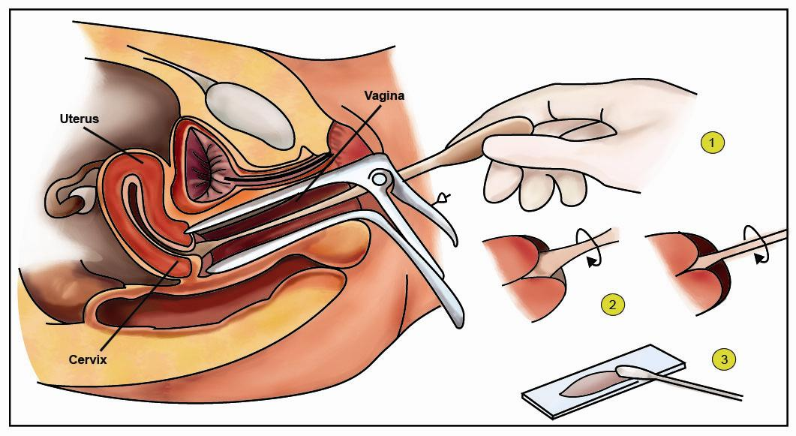
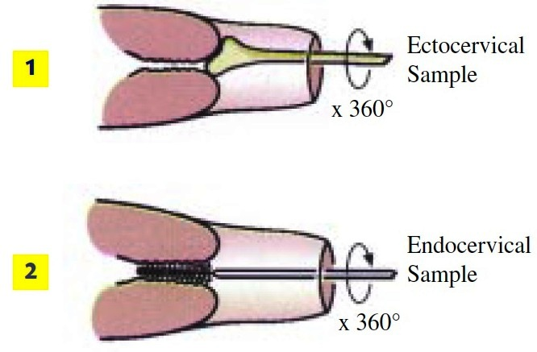
CERVICAL SAMPLING TECHNIQUE - GENERAL INFORMATION

Slide 10
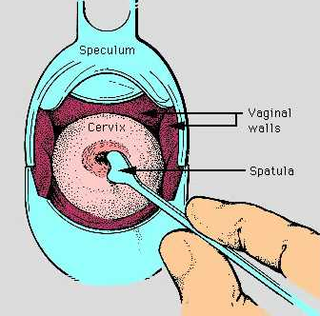
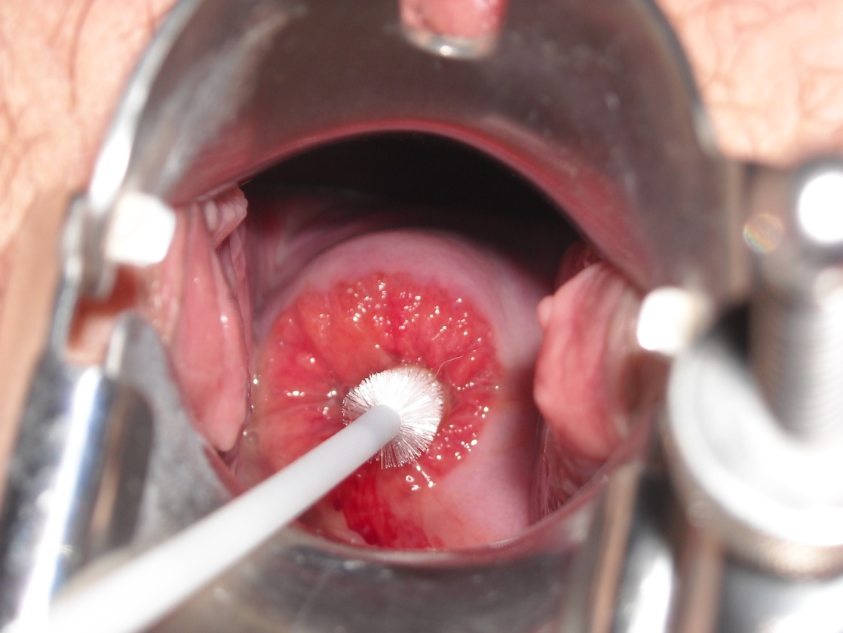
CERVICAL SAMPLING TECHNIQUE - GENERAL INFORMATION

Slide 11

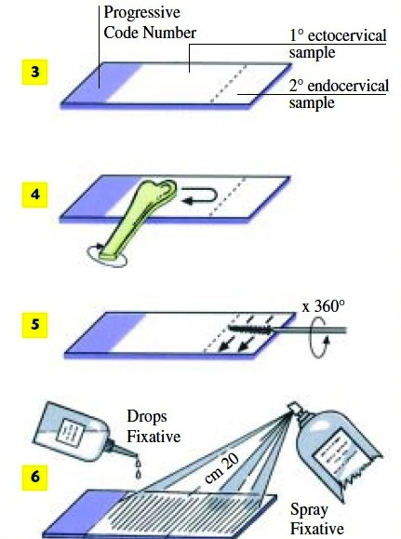
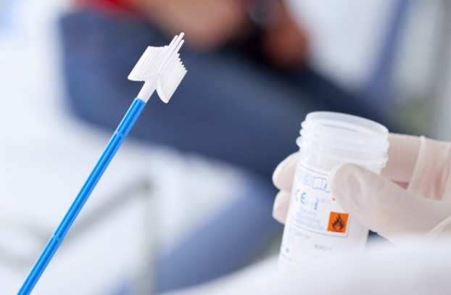
CERVICAL SAMPLING TECHNIQUE - GENERAL INFORMATION

