Slide 1
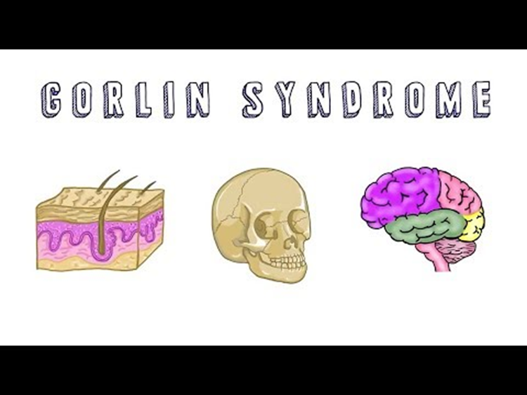
BY
Assistant lecturer
Rana Murtada

Slide 2
Gorlin syndrome, also known Nevoid basal cell carcinoma syndrome (NBCCS) is a hereditary condition characterized by a wide range of developmental abnormalities and a predisposition to neoplasms.
is a rare and autosomal dominant inherited disease, summarized by Gorlin and Goltz in 1960
This syndrome existed during Dynastic Egyptian times as shown by findings compatible with the syndrome in mummies dating back to 1,000 b.c.
The estimated prevalence varies from 1/57,000 to 1/256,000, with a male-to-female ratio of 1:1.

Slide 3
It has been found to be caused by a specific gene mutation.
Inheritance is autosomal dominant, with complete penetrance but variable expressivity, although approximately 40% of cases represent new mutations. The gene responsible for the disease has been mapped to the long arm of chromosome 9, and the normal product of this gene is thought to act as a tumor suppressor. However, when the tumor suppressor function is altered, malignancies occur. The variety of malformations found in this syndrome suggests that the gene also has an essential role in controlling development of normal tissues.

Slide 4
Clinical description
Many different signs and symptoms may be associated with this syndrome include
basal cell carcinomas (BCCs), which may appear very early
odontogenic keratocysts (OKCs) that generally develop in the first, second and third decades.
palmar and/or plantar pits.
ectopic calcifications of the falx cerebri.
Congenital skeletal abnormalities, macrocephaly with frontal bossing, cleft lip and/or palate, and eye anomalies.
Various low-frequency neoplasms, such as medulloblastomas, meningiomas, and ovarian and cardiac fibromas have been also reported.

Slide 5
Skin
Basal cell carcinomas may arise in various stages of the syndrome: most often they appear between puberty and 35 years of age but cases have been reported in 3 or 4 year-old patients in general.
The incidence varies widely among ethnic groups: only about 40% of black patients affected by gorlin syndrome manifest BCCs, while in whites they are reported in up to 90% of cases.
BCCs may vary in number (from a few to literally thousands) and range in size from 1 to 10 mm in diameter. Clinically, they may vary from flesh-colored papules to ulcerating plaques and may be mistaken for skin tags, nevi, or hemangiomas.
There appears to be a relationship with increased sun exposure. and therefore BCCs are most likely to appear on the sun exposed parts of the body, but non-exposed areas may also be involved. The most common locations are the face, the back, and the chest; the waist and extremities are rarely involved

Slide 6
Oral cavity
Recurrent jaw cysts are the main oral sign, being present in 90% of patients.
These cysts are known as keratocysts as they are characterized by a thin external fibrous capsule and an internal lining of keratinized stratified squamous epithelium. Keratocysts appear in the tooth bearing areas of the jaws, and are believed to arise from the dental lamina .
Cysts may appear in both jaws. In several cases, the first symptom of the syndrome may be an odontogenic keratocyst
Odontogenic keratocysts (OKCs) are the most consistent and representative signs of gorlin syndrome in the first and the second decades of life. OKCs are detected in patients under 10 years of age, lesions may start to develop as early as at 7 or 8 years of age and underline the fact that keratocysts in patients affected by gorlin syndrome arise earlier than those in healthy subjects.
there is continued development of new and recurring cysts until about age 30, when the rate of development tends to decrease.

Slide 7
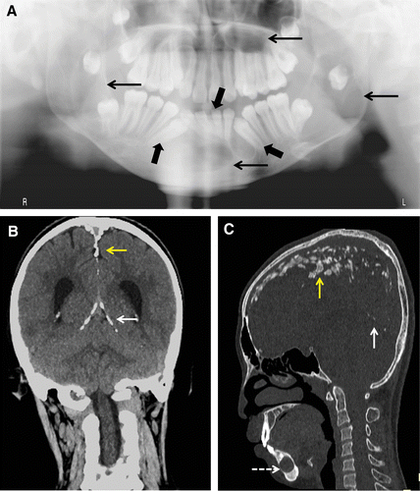

Slide 8
Most non-gorlin keratocysts are isolated lesions, but in this syndrome the keratocysts are commonly multiple, from 1 to 30, and the average number is 5
The most common site in the mandible is the molar-ramus region (44%), followed by the incisor-canine region (18%).
In contrast, the majority of maxillary cysts occur in the incisor-canine (15%) and molar-tuberosity (13%) regions. Only a few cysts have been reported in the premolar region.
There may be few symptoms until cysts reach a large size, especially when the ascending ramus is involved. Presentations include swelling and/or displaced, impacted teeth.
About one-half of patients present with swelling, a quarter with mild pain, and 15% with an unusual taste following rupture of a cyst. Despite these manifestations, jaw fractures almost never occur.

Slide 9
There have been a few reports of ameloblastoma arising in odontogenic keratocysts or, rarely, of squamous cell carcinoma.
Other defects may be malocclusion, impacted teeth, mandibular prognathism, dental ectopy or heterotopy, and dental agenesis. Cleft palate and lip are rare (5%) .
Recently, a new sign has been described: bilateral hyperplasia of the mandibular coronoid processes.

Slide 10
Skeletal system
The height (these patients can be much taller than expected for their family)
the shape of the ribs, the shape of the bones in the vertebral column, and the shape of the skull are principally affected
An abnormal skull configuration (characterized by frontal, biparetial or temporal bossing)
Relative macrocephaly.
As a result of the abnormal growth of the skull ,about 70% of patients affected by gorlin have eyes which appear wider apart than usual

Slide 11
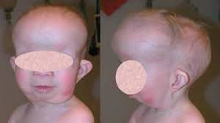

Slide 12
Diagnostic methods
Diagnosis of Gorlin syndrome can be made in the presence of two major criteria or one major and two minor criteria
Major criteria
Two or more basal cell carcinomas in persons younger than 20 years
Odontogenic keratocysts of the jaw
Three or more palmar or plantar pits
Bilamellar calcification of the falx cerebri
Bifid, fused ribs
First-degree relative with Gorlin Syndrome

Slide 13
Minor criteria
Macrocephaly
Congenital malformations (e.g. cleft lip or palate, frontal bossing, hypertelorism)
Other skeletal abnormalities (e.g.marked pectus deformity, syndactyly of digits)
Radiological abnormalities (e.g. bridging of the sella turcica, vertebral anomalies such as hemivertebrae, fusion/elongation of the vertebral bodies, modelling defects of the hands and feet)
Ovarian fibroma
Medulloblastoma

Slide 14
Diagnosis
Genetic counseling, the syndrome is a hereditary condition, thus referral to a geneticist for counseling is mandatory.
diagnosis can often be achieved by radiographic means (calcification of falx, rib anomalies,calcification of ovarian fibromas). Depending on the situation, imaging studies may include magnetic resonance imaging (MRI) of the brain, echocardiography, abdominal ultrasonography, dental radiography, and skeletal survey.
Antenatal diagnosis may be useful to prevent complications. Ultrasound scans during pregnancy may be helpful in detecting serious developmental malformations, even if they are rare.
Prenatal diagnosis for pregnancies at increased risk is possible by analysis of DNA extracted from fetal cells obtained by amniocentesis (usually performed at about 15–18 weeks of gestation)

Slide 15
Management
Patients affected by Gorlin syndrome must be treated by several specialists.
Keratocysts can be treated by surgical removal completely.
One of the most problematic aspects is the 60% rate of recurrence following surgery. In part, this may be due to incomplete removal, i.e., from retention of epithelial islands and/or satellite microcysts.
This is intended to ablate any daughter cysts; only in extreme cases it is necessary to remove an entire section of the affected jawbone.

Slide 16
As regards BCC, only a small fraction of these tumors become invasive and very rare cases of death result from spread to the brain or lung.
the risks of BCCs show a strong positive correlation with exposure to UV radiation. Thus, these patients need to avoid excess sun exposure.
Surgical excision is the typical approach for a patient with BCC if the number of lesions is limited.
Other treatments that may be effective and more efficient than surgical excision in patients with multiple lesions include laser ablation, photodynamic therapy, and topical chemotherapy.
Vitamin A analogs, such as retinoids, may play an important role in preventing or slowing the development of new BCCs

Slide 17
Prognosis
The most common lesions accounting for gorlin syndrome are usually not life-threatening.
Medulloblastoma may be a potential cause of early death.
Problems can derive from some techniques used for the therapy of specific lesions: i.e. radiation therapy for medulloblastoma that may cause multiple BCCs.
careful follow-up is essential, and co-operation from members of various specialities will ensure optimal treatment and follow-up.
Since most symptoms of Gorline syndrome begin to appear during childhood and adolescence, the dentist would most likely be the first one to suspect the syndrome since an odontogenic cyst of the jaw might be the first sign.

