Slide 1
Immunohistochemistry of Soft Tissue Sarcomas
Prof. Bashar H. Abdullah
Lecturer. Omar Shebli

Slide 2
Soft tissue sarcoma
A heterogeneous and relatively uncommon group of neoplasms
Frequently share similar morphologic features
IHC is particularly useful in the classification of these soft tissue tumors
Nevertheless, IHC should still be considered as an ancillary technique and does not replace routine light microscopic examination.

Slide 3
Spindle cell soft tissue sarcoma
The diagnosis of leiomyosarcoma can be established using a panel of antibodies that include desmin, smooth muscle actin, pan muscle actin, and h-caldesmon.
We use all of the abovementioned antibodies to establish a differential diagnosis with other spindle cell tumors, such as the myofibroblastic family of soft tissue tumors
leiomyosarcoma VS myofibrosarcoma.

Slide 4
Spindle cell soft tissue sarcoma
Inflammatory myofibroblastic tumor constitutes a tumor entity characterized by the proliferation of myofibroblasts together with numerous inflammatory cells, predominantly plasma cells, and lymphocytes.
Immunohistochemically, the tumor cells display positivity for vimentin, smooth muscle actin, and muscle specific actin, and some cells are desmin positive.

Slide 5
Spindle cell soft tissue sarcoma
Malignant peripheral nerve sheath tumor (MPNST)
Epithelial membrane antigen (EMA) and CD34
Rhabdomyoblastic differentiation express markers such as actin, desmin, and myogenin.

Slide 6
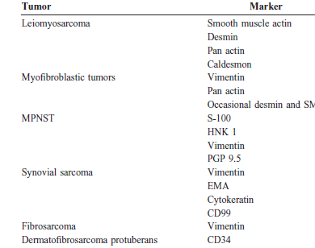

Slide 7
Pleomorphic soft tissue sarcoma
Malignant Fibrous Histiocytoma
IHC is also a useful tool for distinguishing
pleomorphic sarcomas from anaplastic carcinomas (which express EMA or cytokeratin), lymphomas (CD45, ALK, B/T cell markers), and melanomas (S-100, melan A, HMB 45)

Slide 8
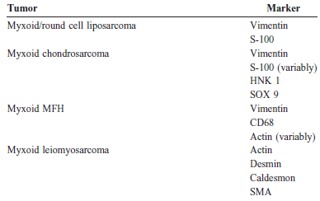
Myxoid soft tissue sarcoma

Slide 9
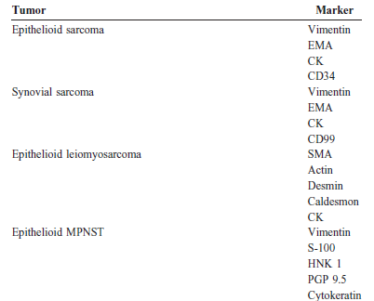
Epithelioid soft tissue sarcoma

Slide 10
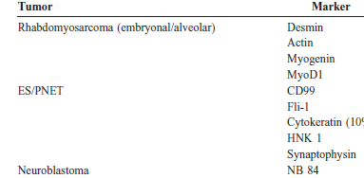
Small round cell tumor

