Slide 1
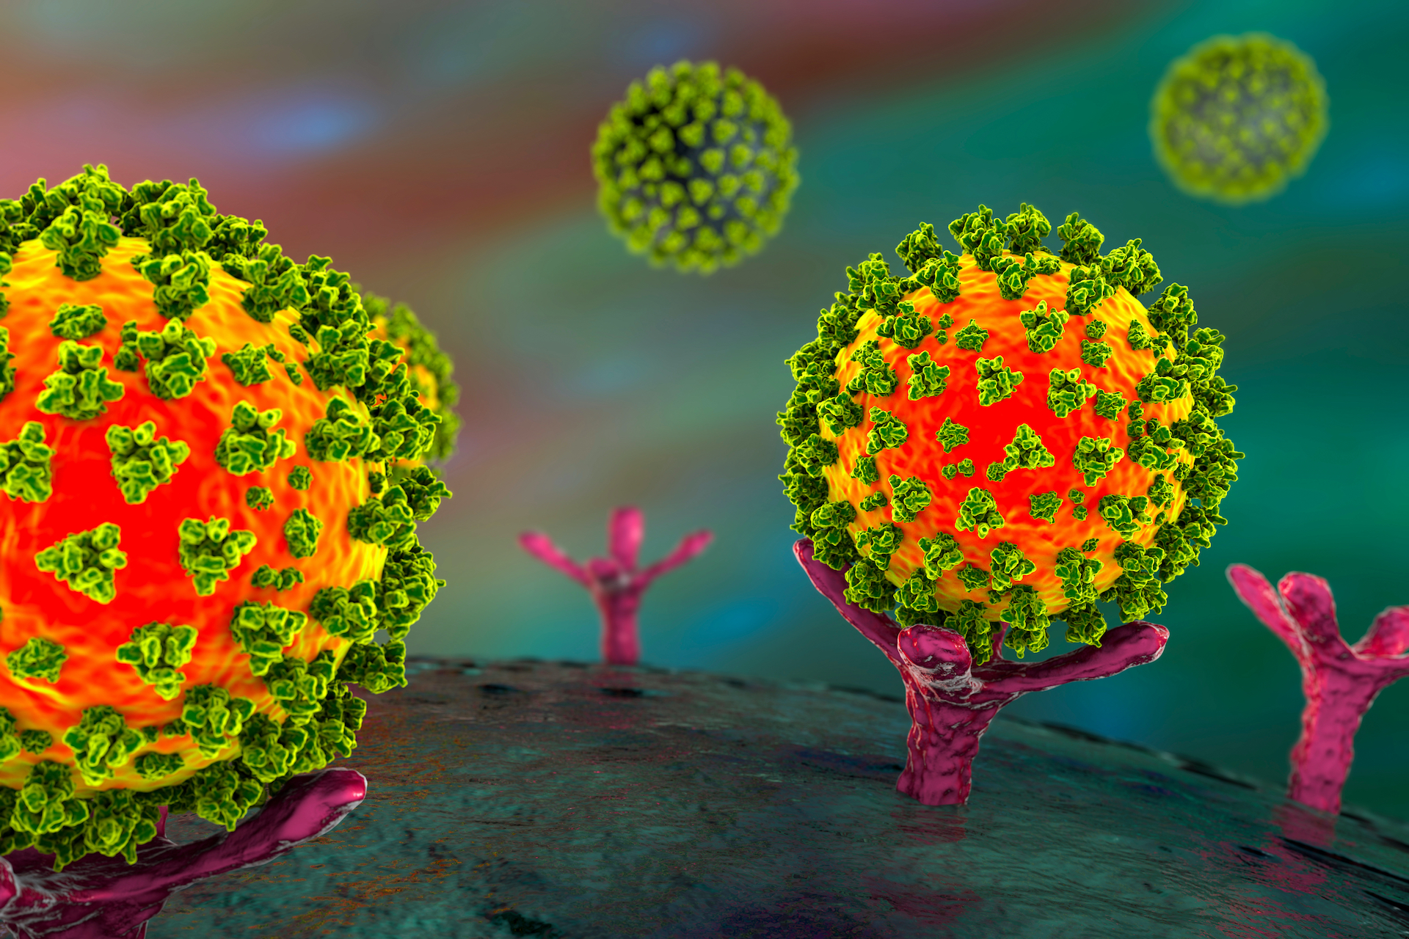
NEW OMICRON SUBVARIANTS
BY
DR.FERIAL MAHMOOD ABDUL RIDA

Slide 2
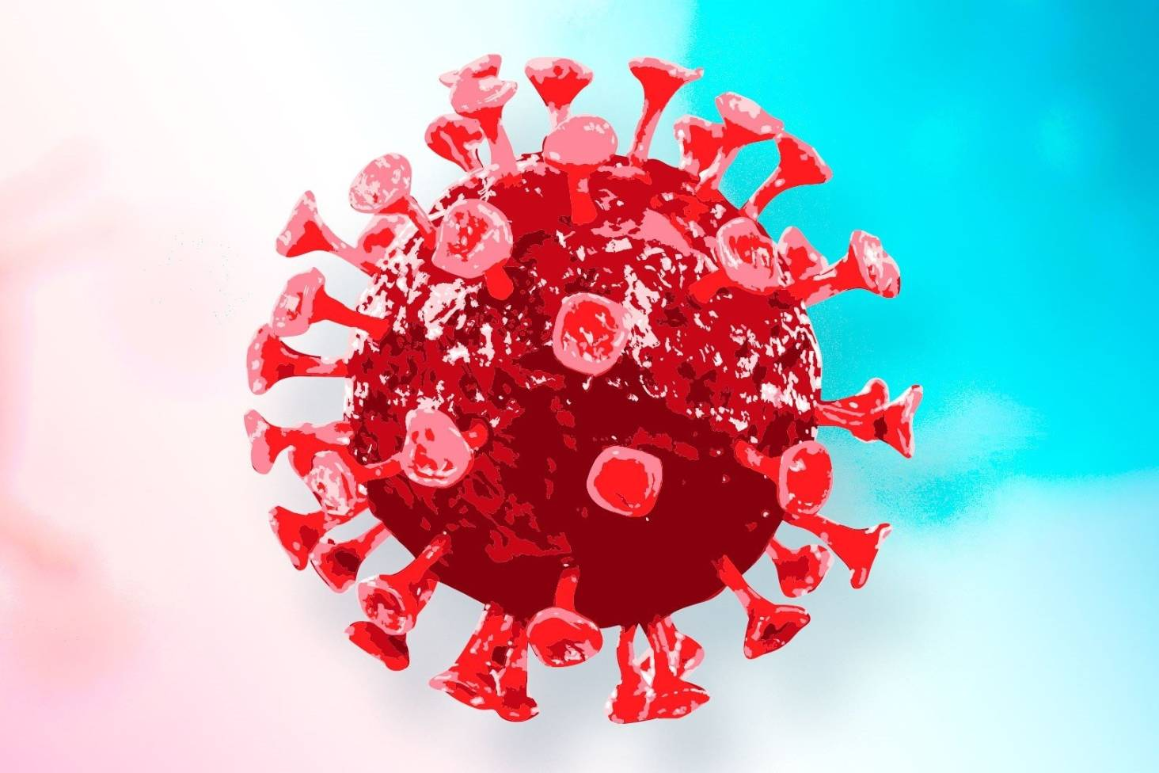
WHO on November 24, 2021, from South Africa and Botswana and classified as VOC which carries mutations found in other VOCs
More than 50 mutations have been identified in the recent Omicron variant of which 50% is within the RBD site of the S protein
26–32 substitution, deletion and insertion mutations only on the S protein
Omicron variant has the deletion at spike position 69–70, which is similar to the Alpha variant; there are three key mutations conferring immune escape which have been also noticed in the Beta and Gamma variants

Slide 3
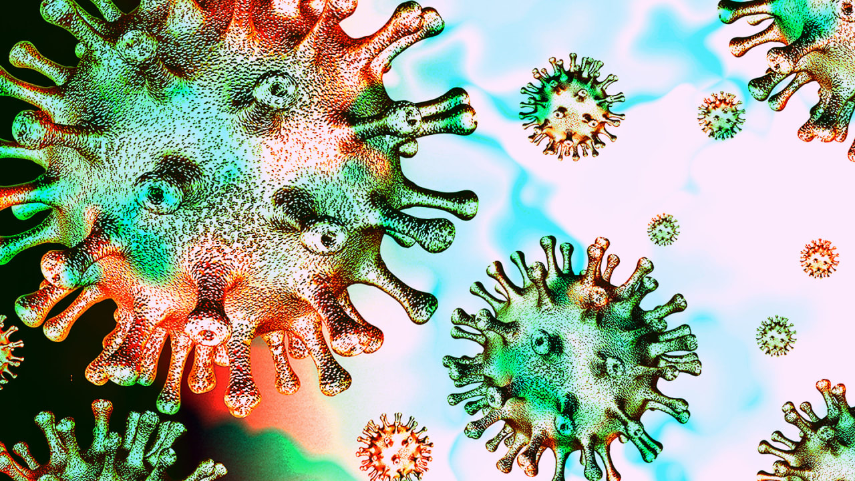
Phylogenetic analysis, based on the prevalence of high numbers of mutations, revealed that the Omicron variant is closely related to the Gamma (P.1) variant and may possess similar characteristics at the molecular level

Slide 4
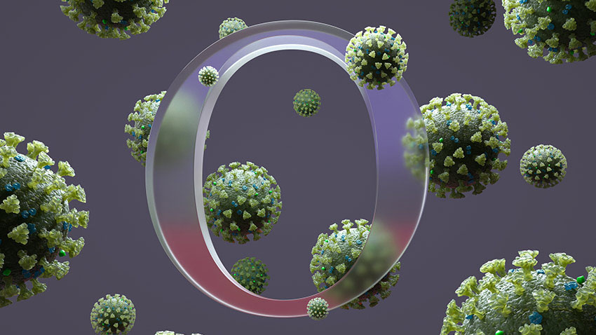
at least 15 critical mutations in the S protein as identified by the Center for Disease Control (CDC) possibly imparted the viral infectivity advantages especially over the fatal Delta variant (B.1.617.2)

Slide 7
terminology
Viruses constantly change through mutation, and new variants of a virus are expected to occur," Sometimes new variants emerge and disappear. Other times, new variants persist.
Variants are categorized into three categories: (1) "variants of interest," (2) "variants of concern" and (3) "variants of high consequence.“
Variants of interest just mean we've seen a number of the same genetic mutations emerge and scientists around the world are on the lookout for it every single time. A virus anywhere in the world gets this genetic sequence, it gets updated into a database that's shared internationally, so we can really see what's emerging. When a variant of interest emerges

Slide 8
A variant of concern is one in which "there is evidence of an increase in transmissibility, more severe disease (e.g., increased hospitalizations or deaths), significant reduction in neutralization by antibodies generated during previous infection or vaccination, reduced effectiveness of treatments or vaccines, or diagnostic detection failures," according to the CDC.
variant of high consequence "has clear evidence that prevention measures or medical countermeasures have significantly reduced effectiveness relative to previously circulating variants. the vaccine was not working very well

Slide 10
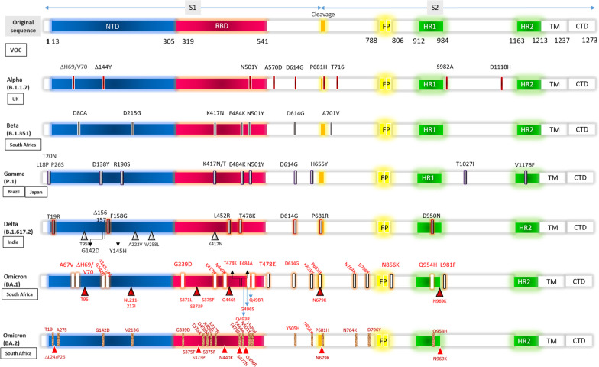

Slide 11
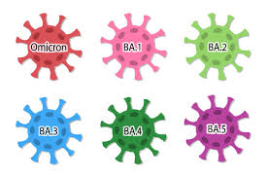

Slide 12
WHO, this novel variant enhances immune or diagnostic evasion, causes less severe disease, and shows enhanced transmissibility.
it poses a detrimental impact on epidemiology and shows increased variability in clinical presentation. The four most common symptoms of an Omicron infection, according to the US Centers for Disease Control and Prevention, are cough, fatigue, congestion, and a runny nose
the Omicron RBD binds more strongly to the human ACE2 protein than does the original Wuhan strain. However, the SARS-CoV-2 Omicron RBD shows weaker binding affinity than the Delta variant

Slide 14
Most COVID-19 strains contain at least one change from the original Wuhan sequence, D614G, altering the virus’s ability to escape the immune response.
The N501Y mutation is present in all VOCs, except the Delta variant.
The increase in binding affinity to the ACE2 receptor by N501Y could aid in an increase in transmission.
combination of N501Y + Q498R may increase the binding affinity to ACE2, while other substitutions may lead to a decrease in the binding affinity to the ACE2 in the Omicron spike proteins .
The N501Y mutation-containing lineages might become more infectious since several kinases are elevated in patients.

Slide 15
Omicron’s spike protein mutations, such as D614G, N501Y, and K417N, are found in some other VOCs, thus making the virus more infectious .
K417N, which is known to reduce the ACE2 binding affinity to the spike protein. These strong interactions at the ACE2 interface may contribute to the rapid spread of the Omicron variant.
H655Y, N679K, and P681H mutations in the Omicron spike protein, also found in the Alpha and Delta variants, could increase the transmission of the virus

Slide 16
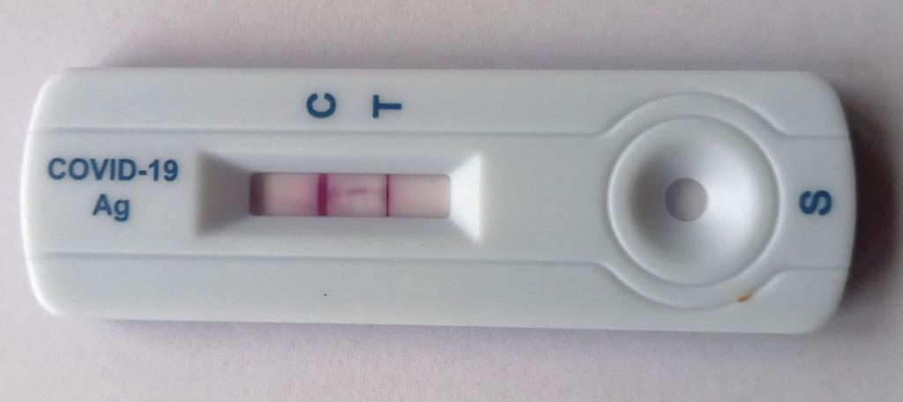
The deletion at spike protein (∆69–70), position 69–70, similar to the Alpha and Eta variants, that leads to the S-gene dropout or S-gene target failure.
This phenomenon may provide a useful alternative to measure the prevalence of the Omicron variant.
This phenomenon does not apply to the BA.2 sub-lineage of the Omicron variant, as it does not contain the deletion at S: 69–70 and is S-gene target positive (SGTP) on PCR diagnostic assays.
E484K could escape neutralization by convalescent sera, while S477N was resistant to neutralization

Slide 17
spike protein mutations of the Omicron sub-lineages, BA.1, BA.2

Slide 18
spike cleavage site
cluster of mutations (such as H655Y, N679K, P681H) present at the S1–S2 furin cleavage site in the Omicron variant may increase spike cleavage and could aid in transmission. The N679K present at the furin cleavage site adds to the polybasic nature and is associated with an increase in transmission
The P681H mutation (also found in Alpha) enhances spike cleavage, and could also aid in transmission. At this position, an alternate mutation (P681R) is found in Delta mutation at the P681 position with an R (P681R) similar to the Delta variant (B.167.2) of about 9.71% instead of the H (P681H) mutation. This variant is of considerable public concern, as it is increasing at a high rate in many countries, including the U.S., due to its increased transmissibility and immune evasion.

Slide 19
nucleocapsid (N) protein region
In the nucleocapsid (N) protein region, the Omicron variant also possesses two additional mutations such as R203K and G204R (found in ancestral mutation) that enhance sub-genomic RNA expression and viral RNA binding with key host proteins, thus increasing the viral load

Slide 20
The BA.4 variant was first detected from a specimen collected on 10 January 2022 in Limpopo, South Africa. BA.5 was also first detected in South Africa, this time from a sample collected on 25 February 2022 in KwaZulu-Natal. Antibodies produced by vaccine against COVID-19 more effective than recovered infection. growing in prevalence: number of countries reporting the detection of these variants and the number of cases are rising. 1% in January 2022 -35% on 29 April 2022

Slide 21
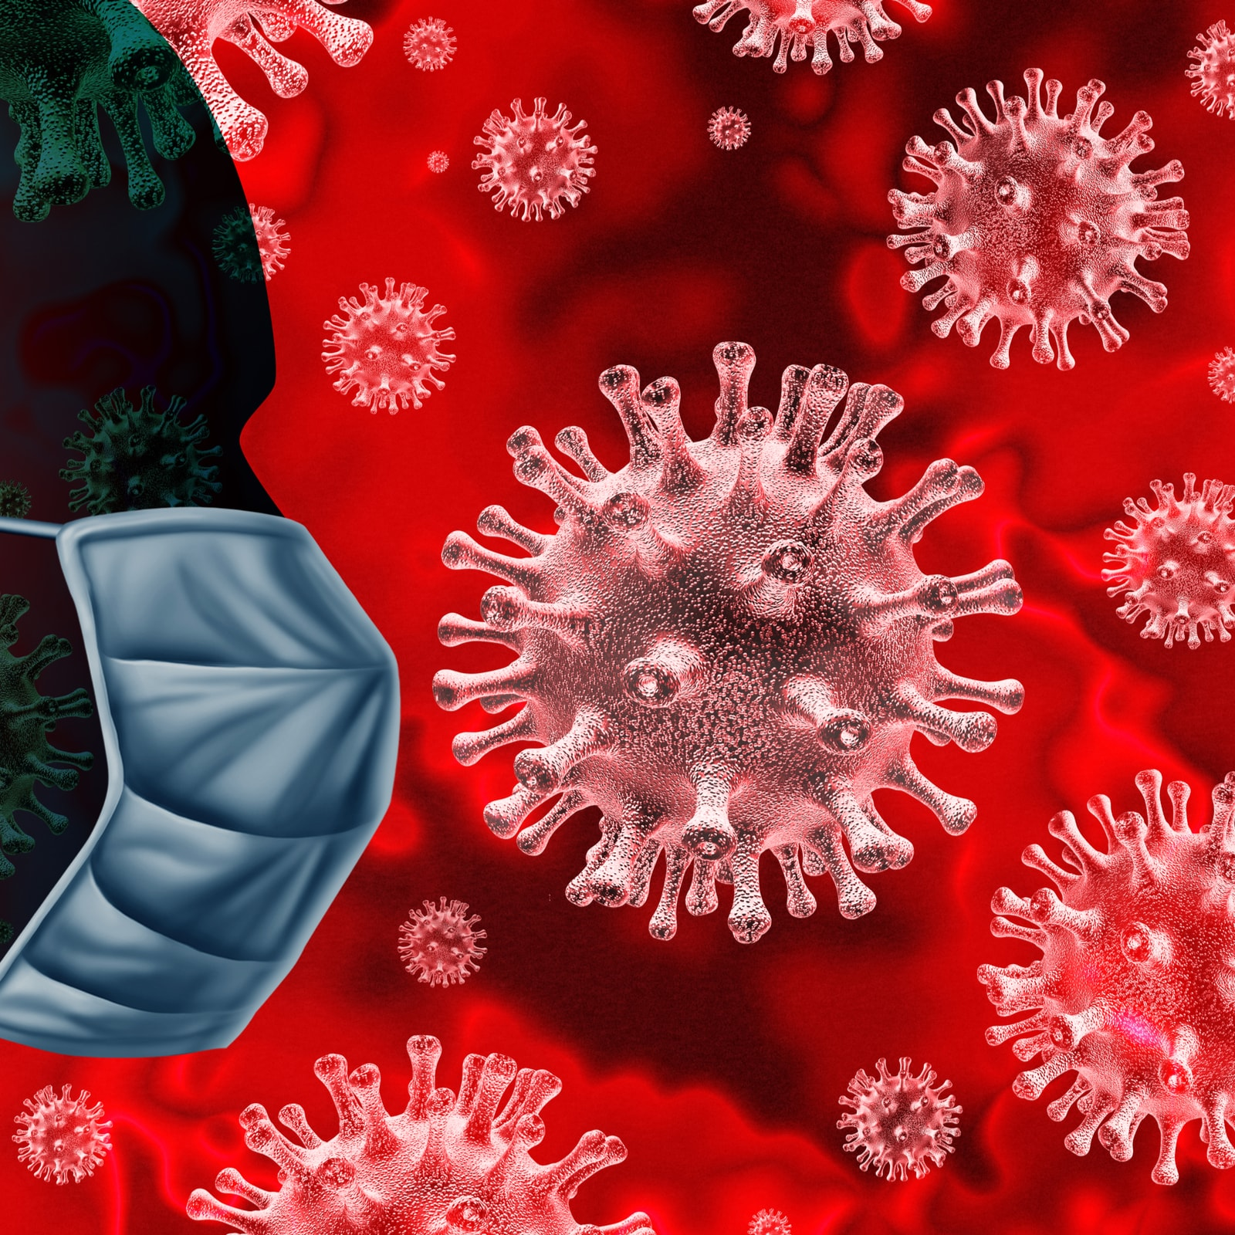
variants are more transmissible than the existing Omicron variant, or it could the result of waning immunity from past infection or vaccination .
two sub-variants are often discussed together because the mutations in their spike protein gene are identical, even though they differ in mutations found elsewhere.
The spike protein is important, because this is what the virus uses to infect human cells, and therefore determines how easily the virus is transmitted. It is also the part of the virus used in most COVID-19 vaccines.

Slide 22
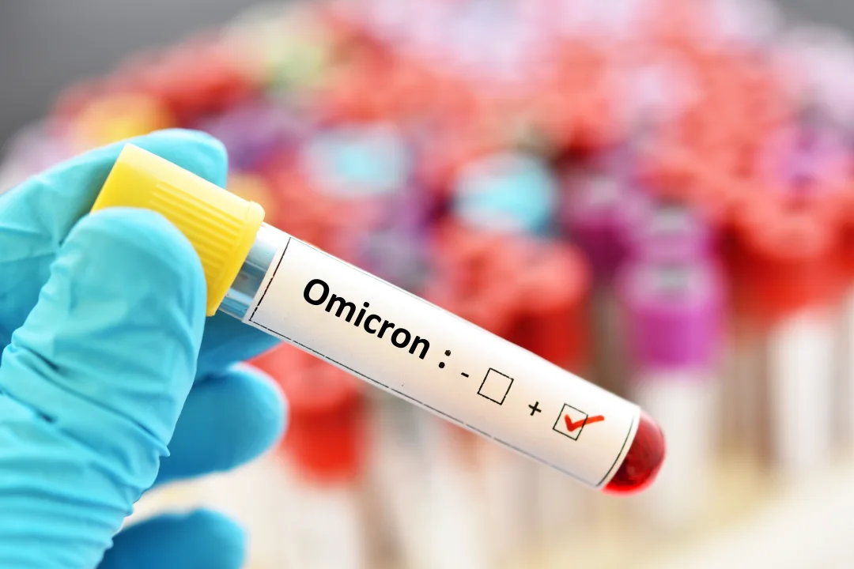
L452R mutation, which was also previously detected in the Delta variant, and is thought to make the virus more contagious by enhancing the virus’s ability to attach to human cells; it may also help it to partially evade destruction by immune cells.
F486V mutation, near where their spike protein binds to human cells. This may also help them partially evade our immune response.
Unlike the BA.2 variant, most BA.4 and BA.5 sequences also contain a genetic change that affects the readout of certain routine PCR tests, leading to a phenomenon called S-gene dropout This provides a quick means of tracking these sub-variants in countries where BA.2 is dominant.
recovered from the original Omicron variant could prevent cells from being infected with the BA.4 and BA.5 variants.

Slide 23
THANK YOU FOR ATTENTION

