Slide 1
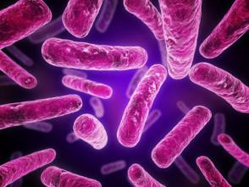
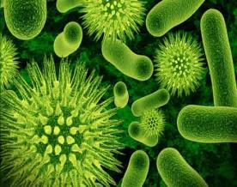
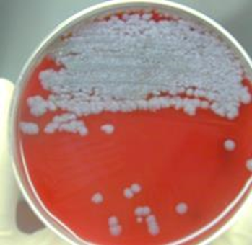
Introduction
Infectious Disease

Slide 2
Agenda
Introduction
Most Common Infectious Diseases to Cause Death
Agent-Host-Environment Factors
That Lead to Disease
Transmission Basics
Infectious Diseases Throughout History
Some Types of Microbes
Diagnosis
Prevention
Control

Slide 3
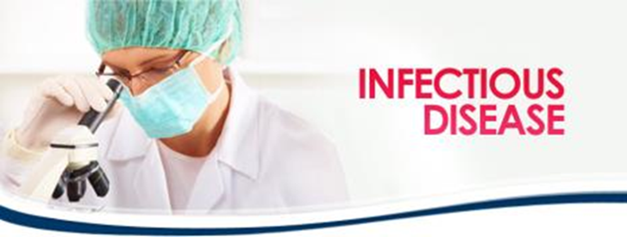
Introduction
Infectious diseases can be caused by several different classes of pathogenic organisms (commonly called germs). These are viruses, bacteria, protozoa, and fungi. Almost all of these organisms are microscopic in size and are often referred to as microbes or microorganisms.
Infectious diseases also include emerging infectious diseases; diseases that have newly appeared (e.g., Middle East Respiratory Syndrome) or have existed but are rapidly increasing in incidence or geographic range (e.g., drug-resistant tuberculosis (XDR TB) and COVID-19
Most often, illness is directly caused by the infectious agent or its toxic product, which arises through transmission from an infected person, an infected animal, or a contaminated inanimate object to a susceptible host.
Infectious disease control and prevention relies on a thorough understanding of the factors determining transmission
Notes:
Although microbes can be agents of infection, most microbes do not cause disease in humans. In fact, humans are inhabited by a collection of microbes, known as the microbiome, that plays important and beneficial roles in our bodies.
The majority of agents that cause disease in humans are viruses or bacteria, although the parasite that causes malaria is a notable example of a protozoan.
Examples of diseases caused by viruses are COVID-19, influenza, HIV/AIDS, Ebola, diarrheal diseases, hepatitis, and West Nile. Diseases caused by bacteria include anthrax, tuberculosis, salmonella, and respiratory and diarrheal diseases.

Slide 4
Shifting Trends in Cause of Death in the United States
Notes:
The newly emerged infectious disease, COVID-19, caused by the virus SARS-CoV-2, became a top #3 cause of death in the US 2020 (# 1- Heart Disease; #2- Cancer).

Slide 5
Shifting Trends in Cause of Death in the World in 2020
Notes:
Infectious diseases are responsible for immense global burden of disease that impacts public health systems and economies worldwide (especially vulnerable populations).
In 2020, two infectious diseases - lower respiratory infections and diarrheal diseases - were ranked in the top ten causes of death worldwide by the World Health Organization (WHO). Both of these diseases can be caused by a variety of infectious agents.
Deaths from the infectious diseases HIV/AIDS and tuberculosis have fallen significantly in recent years, and they no longer appear on the list of top ten causes of death globally. However, these diseases are still a leading cause of death in low-income countries. Malaria is another infectious disease that is a top cause of death in low-income countries. These three diseases are due to single infectious agents.
A newly emerged infectious disease, COVID-19, caused by the virus SARS-CoV-2, became a top cause of death in 2020. According to data analyzed by the Centers for Disease Control and Prevention (CDC), COVID-19 was listed as the third leading cause of death during 2020 in the United States, behind heart disease and cancer.
This Top Ten List is only one organization’s idea. Other Top Ten Lists exist in other agencies.

Slide 6
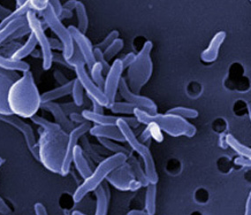
Transmission of Infectious Diseases
There are a number of different routes by which a person can become infected with an infectious agent. For some agents, humans must come in direct contact with a source of infection, such as contaminated food, water, fecal material, body fluids or animal products. With other agents, infection can be transmitted through the air.
The route of transmission of infectious agents is an important factor in how quickly an infectious agent can spread through a population.
An agent that can spread through the air has greater potential for infecting a larger number of individuals than an agent that is spread through direct contact.
Notes:
Another important factor in transmission is the survival time of the infectious agent in the environment. An agent that survives only a few seconds between hosts will not be able to infect as many people as an agent that can survive in the environment for hours, days, or even longer. These factors are important considerations when evaluating the risks of potential bioterrorism agents.

Slide 7
The Epidemiological Triad: Agent–Host–Environment
A classic model of infectious disease causation, the epidemiological triad, envisions that an infectious disease results from a combination of agent (pathogen), host, and environmental factors.
Infectious agents may be living parasites (helminths or protozoa), fungi, or bacteria, or nonliving viruses or prions.
Environmental factors determine if a host will become exposed to one of these agents, and subsequent interactions between the agent and host will determine the exposure outcome.
Notes:
The epidemiological triad model of infectious disease causation. The triad consists of an agent (pathogen), a susceptible host, and an environment (physical, social, behavioral, cultural, political, and
economic factors) that brings the agent and host together, causing infection and disease to occur in the host.
Following exposure, the first step is often colonization, the adherence and initial multiplication of a disease agent at a portal of entry such as the skin or the mucous membranes of the respiratory, digestive, or urogenital tract.
Environmental factors promoting vulnerability can also lead to an increase in susceptibility to infection by inducing physiological changes in an individual. For example, a child living in a resource-poor setting and vulnerable to malnutrition may be at increased risk of infection due to malnutrition induced immunosuppression.

Slide 11
Potential outcomes of host exposure to an infectious agent
Agent and host interactions occur in a cascade of stages that include infection, disease, and recovery or death.
Following exposure:
The first step is often colonization, the adherence initial multiplication of a disease agent at a portal of entry such as the skin or the mucous membranes of the respiratory, digestive, or urogenital tract.
Infection will always cause some disruption within a host, but it does not always result in disease.
Disease indicates a level of disruption and damage to a host that results in subjective symptoms and objective signs of illness.
Disease indicates a level of disruption and damage to a host that results in subjective symptoms and objective signs of illness and may result in either recovery or death.

Slide 12
Host Factors vs. Infectious Agent Factors
The outcome of exposure to an infectious agent depends upon multiple host and infectious agent factors that determine individual susceptibility to infection and disease
Susceptibility refers to the ability of an exposed individual to resist infection or
limit disease as a result of their biological makeup.
Factors: innate, genetic factors, acquired immunity, vaccine
Immunity is affected by extremes of age, stress, pregnancy, nutritional status, and underlying diseases
Barriers: healthy intact skin, the flushing action of tears, and the trapping action of mucus are the first host obstacles to infection.
Not susceptible
Infectivity
Susceptibility
Pathogenicity
Adverse immune response
Protective Immune response
Virulence
Adverse Response
Protective Immune response
Notes:
For example, wound infection and secondary sepsis are serious complications of severe burns which remove the skin barrier to microbial entry.
Lysozyme, secreted in saliva, tears, milk, sweat, and mucus, and gastric acid have bactericidal properties, and vaginal acid is microbicidal for many agents of sexually transmitted infections (STIs).
Microbiome-resident bacteria (a.k.a. commensal bacteria, normal flora) can also confer host protection by using available nutrients and space to prevent pathogenic bacteria from taking up residence
The innate and adaptive immune responses are critical components of the host response to infectious agents:

Slide 13
Environmental factors facilitating emergence and/or spread of specific infectious diseases
 | Environmental factor | Mechanism | Disease
Climate & weather | Above–normal rainfall | Incr. rodent reservoir | Hantavirus
Natural disaster | Tornado | Environmental disruption | Mucormycosis
Infrastructure | No Water treatment plant | Lack of microbial barriers | cryptosporidiosis
Change in land use | Deforestation | Creation of vector breeding sites | Malaria
Industry & technology | Medical technology | Inappropriate use of antibiotics driving genetic change | Antibiotic-resistant infections
Travel & commerce | Visiting friends and family | Import of virus | COVID-19
Politics | Government response | Denial of viral etiology epidemic | HIV/AIDS or COVID-19
economics | Low income | Lack of protection against vector | Dengue
War and conflict | Displaced persons camps | Inadequate WASH | Cholera
Social/behavioral | Sexual practices | High-risk sexual behavior | HIV-1 infection

Slide 14
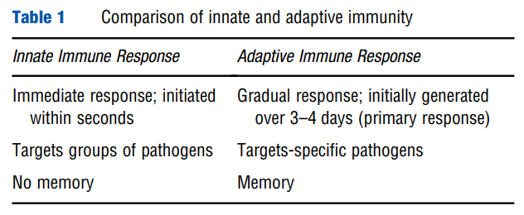
Host Factors vs. Infectious Agent Factors (continued)
Infectivity is the likelihood that an agent will infect a host, given that the host is exposed to the agent.
Pathogenicity refers to the ability of an agent to cause disease, given infection, and virulence is the likelihood of causing severe disease among those with disease.
Virulence reflects structural and/or biochemical properties of an infectious agent.
Immune Response:
Notes:
The innate and adaptive immune responses are critical components of the host response to infectious agents:
Each of these responses is carried out by cells of a distinct hematopoietic stem cell lineage: the myeloid lineage gives rise to innate immune cells (e.g., neutrophils, macrophages, dendritic cells)
and the lymphoid lineage gives rise to adaptive immune cells (e.g., T cells, B cells). The innate immune response is an immediate, nonspecific response to broad groups of pathogens.
By contrast, the adaptive immune response is initially generated over a period of 3–4 days, it recognizes specific pathogens, and it consists of two main branches: (1) T cell-mediated
immunity (a.k.a. cell-mediated immunity) and (2) B cell mediated immunity (a.k.a. humoral or antibody-mediated immunity).

Slide 15
Infection Transmission
Direct Contact
Agent transferred from reservoir or host
Person-to-Person
Direct spread of droplets
Animal to Person (e.g., bite)
Mother to Unborn Child
In utero, perinatal
Indirect Contact
Agent transferred indirectly from reservoir or infected host
Mechanical
Touching an infected inanimate object then yourself without thoroughly washing.
Biological
Biological Vector
Intermediate Vector (e.g., flea, tick)
Airborne (sneeze, cough)
Notes:
The importance of good hygiene and isolation can limit the transmission.
This is particularly important for pregnant women due to the unborn being a “captive” of whatever infects the mother-to-be.
How do infections spread?
Direct contact infections spread when disease-causing microorganisms pass from the infected person to the healthy person via direct physical contact with blood or body fluids. Examples of direct contact are touching, kissing, sexual contact, contact with oral secretions, or contact with body lesions.
Indirect contact infections spread when an infected person sneezes or coughs, sending infectious droplets into the air. If healthy people inhale the infectious droplets, or if the contaminated droplets land directly in their eyes, nose or mouth, they risk becoming ill. Droplets generally travel between three and six feet and land on surfaces or objects including tables, doorknobs and telephones. Healthy people touch the contaminated objects with their hands, and then touch their eyes, nose or mouth.

Slide 16
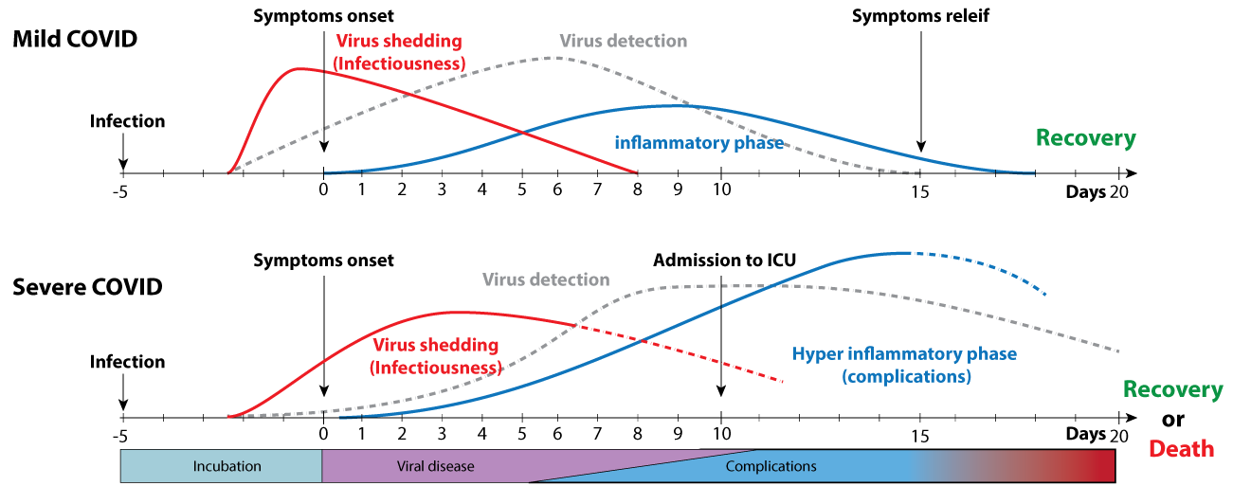
Transmission Basics
A unique characteristic of many infectious diseases is that exposure to certain infectious agents can have consequences for other individuals, because an infected person can act as a source of exposure.
Notes:
Source: https://viralzone.expasy.org/9116
COVID-19 disease is characterized by a several stages. The first stage corresponds to the viral infection with symptoms typical of respiratory virus infection and immune inhibition. The infection can lead to complications (stage II) with respiratory problems. At this stage the virus replication is already low. Complications can worsen to stage III with Acute Respiratory Distress Syndrome (ARDS), SIRS/shock and cardiac failure.
The figure below explains the time course of COVID-19. All numbers correspond to average days after/before symptom onset, these numbers can vary for each individual.
Virus shedding would happen on average between 2 days before symptoms, up to 8 days after symptoms. Residual virus material can be detected after, but not infectious virus.
Virus shedding is extended and peaks during the second week for patients with pneumonia or further complications and can last up to 21 days.
Most people will suffer mild to heavy symptoms during stage I (fever, dry cough, diarrhea, loss of sense of smell or taste), and no complications. Severe COVID is characterized by hyper-inflammatory response (shortness of breath, ARDS, SIRS/shock, Cardiac failure), with observed increase of IL6 and subsequent damages to lungs and cardiovascular system . Moreover, viral infection starts milder but last longer . Blood-clotting is not rare and may contribute to the severity of complications.

Slide 17
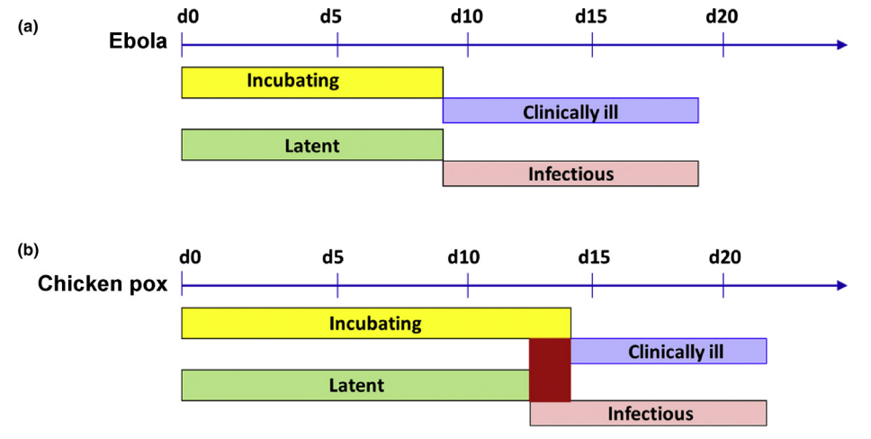
Transmission Basics
With respect to disease, the incubation period is defined as the time from exposure to an infectious agent until the time of first signs or symptoms of disease.
The efforts to control an outbreak through contact tracing and quarantine require knowledge of the latent, latent, and infectious period.
Most often, incubation period is followed by the period of clinical illness which is the duration between first and last disease signs or symptoms.
= No clinical illness
Notes:
http://dx.doi.org/10.1016/B978-0-12-803678-5.00516-6
Principles of Infectious Diseases: Transmission, Diagnosis, Prevention,
and Control; Jean Maguire van Seventer, 2016
With respect to transmission of an infectious agent, the latent (preinfectious) period is the duration of time between exposure to an agent and the onset of
infectiousness. In 3b, Incubatory carriers exist when the incubation period overlaps with the infectious period, as can occur in some cases of chicken pox
For example, efforts to control the recent Ebola West Africa outbreak through contact tracing and quarantine were based on knowledge that the infectious period for Ebola does not begin until the start of the period of clinical illness, which occurs up to 21 days following exposure. It is followed by the infectious period (a.k.a. period of communicability) which is the time period when an infected person can transmit an infectious agent to other individuals.
In parasitic infections, the latent and infectious periods are commonly referred to as the prepatent period and patent period, respectively.

Slide 18
Transmission Basics (continued)
Convalescent carriers
Healthy carriers
A carrier is, by definition, an infectious individual who is not
showing clinical evidence of disease and, thus, might unknowingly
facilitate the spread of an infectious agent through a population.
Notes:
c) Some patients with Vibrio cholerae infection remain infectious as convalescent carriers after recovery. Convalescent carriers occur when the period of infectiousness extends beyond the period of clinical illness (Figure 3(c)). Carriers of this type can be a significant issue in promoting the spread of certain enteric infections, such as those caused by the bacterium, V. cholerae.
d) Salmonella Typhi infection can result in an apparently healthy carrier that never shows signs or symptoms of disease. Healthy carriers, infected individuals that remain asymptomatic but are capable of transmitting an infectious agent, occur commonly with many infectious diseases (e.g., meningococcal meningitis and typhoid fever) and are also significant challenges to disease control

Slide 19
Dynamics of Infectious Diseases within Populations
Endemic: Constant presence of a disease or infectious agent within a given geographic area. The usually prevalence of a given disease within such an area (HIV, MERS, malaria).
Epidemic: Occurrence in a community or region of cases of an illness or outbreak clearly in excess of expectancy (Hep A, salmonella).
Pandemic: Occurring over a wide geographic area and affecting an exceptionally high proportion of the population (Covid-19).
Epidemics and pandemics have always had major social and economic impacts on affected populations, but in our current interconnected world, the impacts are truly global. This has been clearly demonstrated by the COVID-19 pandemic that began in 2020. Infections in one region can easily spread to another.
Notes:
Infectious diseases have plagued humans throughout history, and in fact have even shaped history on some occasions.
The plagues of biblical times, the Black Death of the Middle Ages, and the “Spanish flu” pandemic of 1918 are but a few examples.
The 1918 flu pandemic killed more than a half million people in the United States and up to 50 million people worldwide and is thought to have played a contributing role in ending World War I.

Slide 20
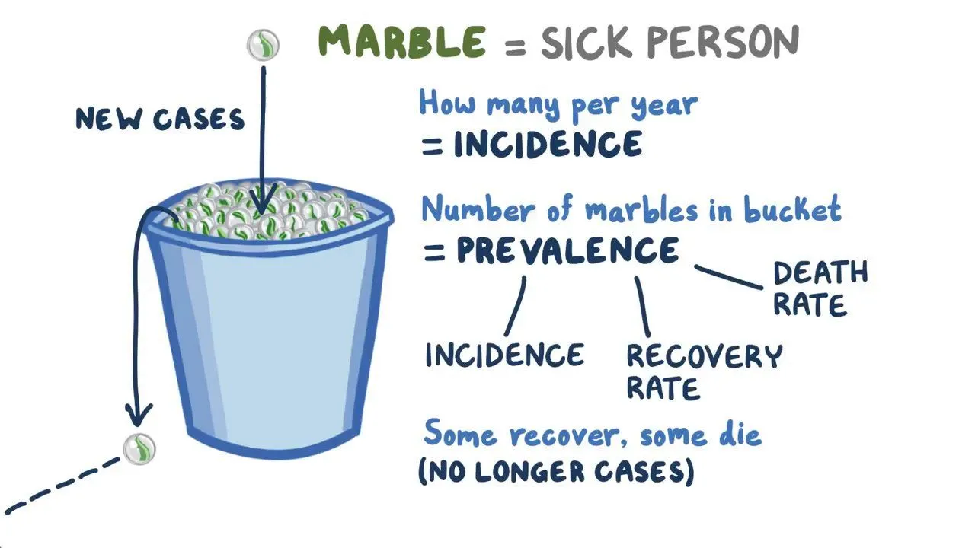
Dynamics of Infectious Diseases within Populations
Two fundamental measures of disease frequency are prevalence and incidence.
Notes:
Osmosis.org
Prevalence is an indicator of the number of existing cases in a population as it describes the proportion of individuals who have a particular disease, measured either
at a given point in time (point prevalence) or during a specified time period (period prevalence).
In contrast, incidence (a.k.a. incidence rate) is a measurement of the rate at which new cases of a disease occur (or are detected) in a population over a given time period.

Slide 21
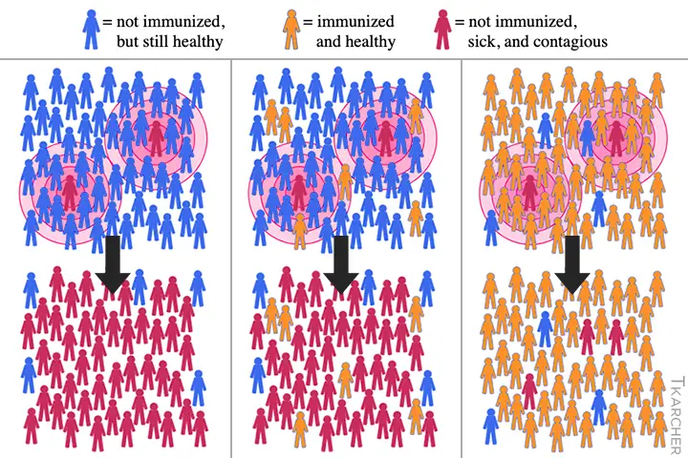
Herd immunity occurs when one is protected from infection by immunization occurring in the community.
Notes:
https://www.medpagetoday.com/infectiousdisease/covid19/88401
Herd immunity (a.k.a. community immunity) refers to population-level resistance to an infectious disease that occurs when there are enough immune individuals to block the chain of infection/transmission. As a result of herd immunity, susceptible individuals who are not immune themselves are indirectly protected from infection.
An important public health consequence of herd immunity is that immunization coverage does not need to be 100% for immunization programs to be successful.

Slide 22
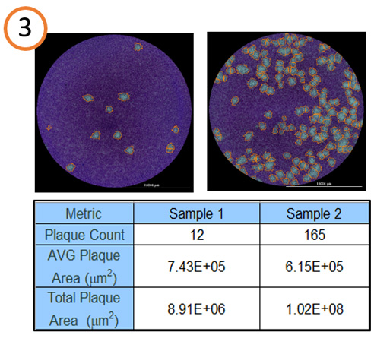
Infectivity
Infectivity is the likelihood that an agent will infect a host, given that the host is exposed to the agent.
Virulence is the likelihood of causing severe disease among those with disease. Virulence reflects structural and/or biochemical properties (e.g., receptor binding, toxins produced) of an infectious agent.
Infective doses are cited as required for the condition to affect a person.
Disease Infective Dose
Inhalation Anthrax 8,000 to 10,000 spores
Pneumonic Plague <100 organisms
Ebola 1-10 plague forming units
Smallpox Infective dose is assumed low
Plaque assays are a common type of infectivity assay, used to count discrete “infectious centers.”
Notes:
https://www.biotek.com/applications/virology-plaque-assay.html
An individual virion infects a cell.
The virus replicates, producing progeny virions.
Second generation virions infect and kill surrounding cells to generate a hole or plaque in the cell monolayer that is visible to the naked eye (or at low magnification).
Often the live cells are stained, providing a dark background for the clear plaques

Slide 23
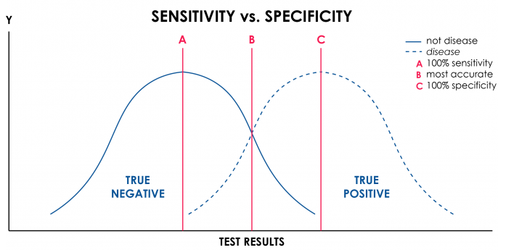
Infectious Disease Diagnosis
Proper diagnosis of infectious illnesses is essential for both appropriate treatment of patients and carrying out prevention and control surveillance activities.
Two important properties that should be considered for any diagnostic test utilized are sensitivity and specificity.
Sensitivity refers to the ability of the test to correctly identify individuals infected with an agent (‘positive in disease’).
Specificity is the ability of the test to correctly identify individuals not infected by a particular agent
Often, screening tests are highly sensitive (to capture any possible cases), and confirmatory tests are more specific (to rule out false-positive screening tests).
False Negative
False Positive
Notes:
A test that is very sensitive is more likely to pick up individuals with the disease (and possibly some without the disease); a very sensitive test will have few false negatives.
Specificity is the ability of the test to correctly identify individuals not infected by a particular agent (‘negative in health’); high specificity implies few false positives.

Slide 24
Infectious Disease Diagnosis
Direct Examination and Molecular Techniques: Direct examination of specimens reveals gross pathology. Microscopy may identify microorganisms in specimens or with specific probes to identify genus- or species-specific DNA or RNA sequences. PCR is the most widely used method for microbial nucleic acid detection
Culture: Isolation of infectious agents frequently requires specialized media. Nonselective (noninhibitory) media permit the growth of many microorganisms. Selective media contain inhibitory substances that permit the isolation of specific types of microorganisms to identify.
Microbial Identification: Colony and cellular morphology may permit preliminary identification. Growth characteristics under various conditions, utilization of carbohydrates and other substrates, enzymatic activity, immunoassays, and genetic probes are also used.
Serologic diagnosis: A high or rising titer of specific antibodies to an agent may suggest or confirm a diagnosis.
Antimicrobial Susceptibility: Microorganisms, particularly bacteria, are tested in culture media with antibiotics to determine whether they are susceptible to antimicrobial agents.
Notes:
Institute of Medicine (US) Committee on Emerging Microbial Threats to Health in the 21st Century; Smolinski MS, Hamburg MA, Lederberg J, editors. Microbial Threats to Health: Emergence, Detection, and Response. Washington (DC): National Academies Press (US); 2003. Appendix C, Pathogen Discovery, Detection, and Diagnostics.
The main categories of analyses used in pathogen identification can be classified as phenotypic, revealing properties of the intact agent, nucleic acid-based, determining agent nucleic acid (DNA or RNA) characteristics and composition, and immunologic, detecting microbial antigen or evidence of immune response to an agent.
Cultured material containing large quantities of agent can undergo analyses to determine characteristics, such as biochemical enzymatic activity (enzymatic profile) and antimicrobial sensitivity, and to perform phage typing, a technique which differentiates bacterial strains according to the infectivity of strain-specific bacterial viruses (a.k.a. bacteriophages).

Slide 25
The Infectious Agent and Its Reservoir
The Chain of Infection (or transmission)
One way to visualize the transmission of an infectious agent though a population is through the interconnectedness of six elements linked in a chain.
The chain starts with the infectious agent residing and multiplying in some natural reservoir; a human, animal, or part of the environment such as soil or water that supports the existence of the infectious agent in nature.
Public health control and prevention efforts focus on breaking one or more links of the chain in order to stop disease spread.
The classic example of a human reservoir is the cook Mary Mallon (Typhoid Mary); an asymptomatic chronic carrier of Salmonella enterica serovar Typhi who was linked to at least 53 cases of typhoid fever
Notes:
The chain starts with the infectious agent residing and multiplying in some natural reservoir; a human, animal, or part of the environment such as soil or water that supports the existence of the infectious agent in nature. A reservoir is often, but not always, the source from which the agent is transferred to a susceptible host. For example, bats are both the reservoir for Marburg virus and a source of infection for humans and bush animals including African gorillas. However, because morbidity and mortality due to Marburg infection is significant among these bush animals, they cannot act as a reservoir to sustain the virus in nature (they die too quickly), although they can act as a source to transmit Marburg to humans.
The infectious agent leaves the reservoir via a portal of exit and, using some mode of transmission, moves to reach a portal of entry into a susceptible host. Animals are a reservoir for many human infectious diseases. Zoonosis is the term used to describe any infectious disease that is naturally transmissible from animals to humans. These diseases make up approximately 60% of all infectious diseases, and an estimated 75% of recently emerging infectious diseases
A thorough understanding of the chain of infection is crucial for the prevention and control of any infectious disease, as breaking a link anywhere along the chain will stop transmission of the infectious agent. Often more than one intervention can be effective in controlling a disease, and the approach selected will depend on multiple factors such as economics and ease with which an intervention can be executed in a given setting.

Slide 26
Hierarchy of public health efforts targeting infectious diseases
Public health interventions targeting infectious diseases:
control, the reduction of disease incidence, prevalence, morbidity or mortality to a locally acceptable level; continued intervention measures are required to maintain the reduction (e.g. diarrheal diseases)
elimination of disease, reduction to zero of the incidence of a specified disease in a defined geographical area(e.g. neonatal tetanus)
elimination of infections, reduction to zero of the incidence of infection caused by a specific agent in a defined geographical area as a result of deliberate efforts; continued measures to prevent re-establishment of transmission are required (e.g. poliomyelitis)
eradication, permanent reduction to zero of the worldwide incidence of infection caused by a specific agent as a result of deliberate efforts; intervention measures are no longer needed (e.g. smallpox)
Notes:
Ref: The 1997 Dahlem Workshop on the Eradication of Infectious Diseases defined a continuum of outcomes due to public health interventions targeting infectious diseases:
Targeting Directly Transmitted Infectious Diseases
Case finding and contact tracing are public health prevention and control activities aimed at stopping the spread of infectious diseases transmitted by either direct contact or direct spread of droplets. Once identified, further activities to limit transmission to susceptible individuals can involve definitive diagnosis, treatment, and, possibly, isolation of active cases and carriers, and observation, possible quarantine, or prophylactic vaccination or treatment of contacts. Patient education is an important feature of any communicable infectious disease control effort. Environmental changes, such as decreasing overcrowded areas and increasing ventilation, can also contribute to limiting the spread of some infectious diseases, particularly respiratory diseases.

Slide 27
Infectious Diseases in History
1346, during a plague outbreak, Mongols catapulted victims into a city.
1520, Narvaez expedition to Aztec empire spread smallpox.
1763, during French and Indian War (Pontiac’s Rebellion), blankets and handkerchiefs were given to Native Americans.
Notes:
Some infectious diseases were used as biological warfare agents due to their infectivity.
Present use is considered by some due to their inability to be detected by human senses until clinical effects occur.
“Chapter 1, History of Biological Weapons: From Poisoned Darts to Intentional Epidemics,” found at http://www.hsdl.org/?view&did=19931”

Slide 28
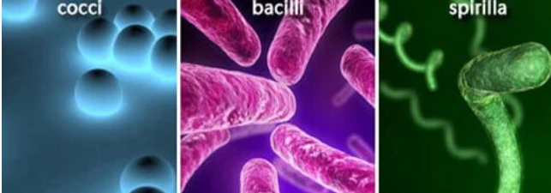
Bacterial Infections
A single-celled organism.
Under certain circumstances some can transform into spores.
Bacteria are larger than viruses and are capable of reproducing on their own.
Beneficial bacteria live in the human gastrointestinal (GI) tract and play an important role in digestion and immunity.
Bacteria can infect any area of the body. The disease-causing method can occur in one of two ways:
Invading host tissues, and
Producing poisons (toxins)
Pneumonia, dermatitis, meningitis, and food poisoning are few examples.
Certain gram-negative bacterium, like E. coli and Salmonella can be present in uncooked foods.
Bacterial skin infections are usually caused by gram-positive strains of Staphylococcus and Streptococcus or other organisms.
Many sexually transmitted diseases (STDs) are caused by harmful bacteria (Chlamydia, Gonorrhea, Syphilis, Bacterial vaginosis).
Notes:
Bacteria is a single-celled organism and under certain circumstances it can transform into spores.
Certain bacterium, like E. coli, can be present in uncooked foods.
Bacteria live in every climate and location on earth. Some are airborne while others live in water or soil. Bacteria live on and inside plants, animals, and people. The vast majority of bacteria are harmless to people and some strains are even beneficial. In the human gastrointestinal tract, good bacteria aid in digestion and produce vitamins. They also help with immunity, making the body less hospitable to bad bacteria and other harmful pathogens. When considering all the strains of bacteria that exist, relatively few are capable of making people sick.

Slide 29
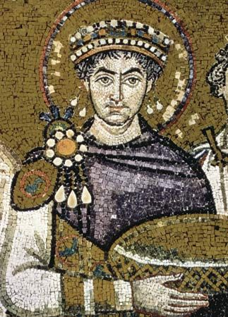
Bubonic Plague in History
Bubonic plague is a bacterial infection spread mostly to humans by infected fleas that travel on rodents. Called the Black Death, it killed millions of Europeans during the Middle Ages.
The first recorded bubonic plague epidemic ravaged the Byzantine Empire during the sixth century. It was named the Plague of Justinian after emperor Justinian I, who was infected but survived through extensive treatment.
It gets its name from the swollen lymph nodes (buboes) caused by the disease. The nodes in the armpit, groin and neck can become as large as eggs and can ooze pus.
Notes:
Bubonic Plague was spread by the bite of the black rat flea which upon feeding on a host, the y. pestis would clog the flea’s mid gut causing it to regurgitate the y. pestis onto the host.
Source: en.wikipedia.org/wiki/Bubonic plague

Slide 30
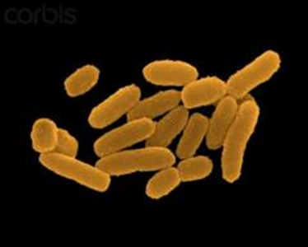
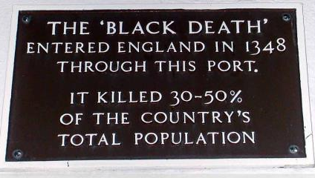
Bubonic Plague in History
Plague is an infectious disease caused by a specific type of bacterium called Yersinia pestis. Y. pestis can affect humans and animals and is spread mainly by fleas (black rat flea).
In the late Middle Ages (1340–1400) Europe experienced the most deadly disease outbreak in history when the Black Death, the infamous pandemic of bubonic plague, hit in 1348, killing a third of the human population.
Bubonic plague still occurs throughout the world and in the U.S., with cases in Africa, Asia, South America and the western areas of North America.
Notes:
London docks was the point of entry of the plague into England.
https://my.clevelandclinic.org/health/diseases/21590-bubonic-plague
Because most people who got the plague died, and many often had blackened tissue due to gangrene, bubonic plague was called the Black Death. A cure for bubonic plague wasn’t available.

Slide 31
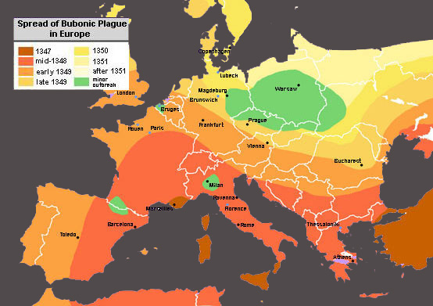
Movement of the Black Plague
Notes:
Take a close look at the gradients for the spread. These indicate not only an expansion over the land mass but also intrusion from maritime ports to landfall.
Source: en.wikipedia.org/wiki/Bubonic plague

Slide 32
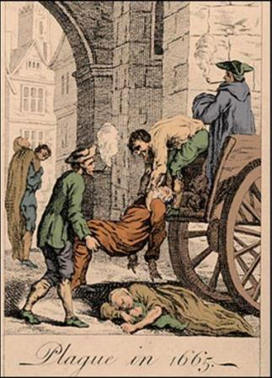
Bubonic Plague in History
In 1665-1666, the Plague hit London killing an estimated 100,000 people; 20% of London's population.
The bubonic plague can be treated and cured with antibiotics now. If you are diagnosed with bubonic plague, you’ll be hospitalized and given antibiotics. In some cases, you may be put into an isolation unit.
Notes:
In 1665-1666, the Plague hit London killing an estimated 100,000 people; 20% of London's population.
Source: en.wikipedia.org/wiki/Bubonic_plague and www.princeton.edu/~achaney/tmve/wiki100k/docs/Great_Plague_of_London

Slide 33
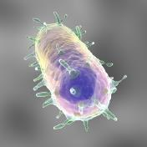
Plague
Bubonic: From rats by the bite of an infected fleas.
Septicemic: When plague bacteria multiplies in the blood stream.
Spreads rapidly until hemorrhagic pneumonia involves entire lung area.
Pneumonic: May result from septicemic form or from inhalation of the organism.
Pneumonic affects the lungs and is spread person to person by way of cough droplets.
Notes:
Human plague in the United States occurs as mostly scattered cases in rural areas effecting 10 to 20 persons each year. Globally, the World Health Organization (WHO) reports 1,000 to 3,000 cases every year.

Slide 34
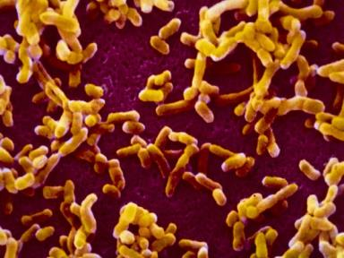
Plague
Type Infection of:
Bubonic: Lymph nodes
Septicemic: The blood
Pneumonic: Lungs
Notes:
Plague types designated according to area infected.

Slide 35
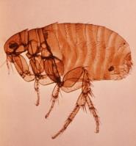
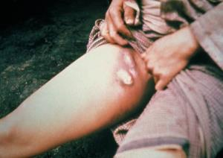
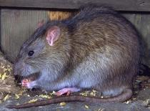
Bubonic Plague
From the bite of the black rat flea.
“Black Death” transmittable by bite of an infected flea or person to person by respiratory route.
This can include domesticated animals, i.e., cats to wild animals, i.e., rabbits, rats, squirrels.
Characterized by buboes which appear.
Notes:
Plague transmitted to persons by fleas from infected animals.
This can include domesticated animals, i.e. cats to include wild animals, i.e. rabbits, rats, squirrels.
Plague can enter through broken skin or flea bites.
Characterized by buboes which appear as shown in the right slide.
Symptoms can appear suddenly-usually within 2 to 5 days of exposure.
“Disease only lasts for 1 to 2 days before death occurs (if untreated).” Jane’s Chem-Bio Handbook, page 132.
Source: http://www.visualdx.com/view/diagnosis/plague_septicemic

Slide 36
Septicemic Plague
This form of the disease occurs when the bacteria multiply in the blood, causing bacteremia and severe sepsis.
Primary septicemic plague results from direct inoculation of the bacteria into the bloodstream, typically via the bite of an infected animal or flea or direct contact with infected tissues.
Secondary septicemic plague occurs when there is progression of disease and dissemination of bacteria following bubonic presentation.
Notes:
Septicemic Plague.
This form of the disease occurs when the bacteria multiply in the blood, causing bacteremia and severe sepsis.
Primary septicemic plague results from direct inoculation of the bacteria into the bloodstream, typically via the bite of an infected animal or flea or direct contact with infected tissues.
Secondary septicemic plague occurs when there is progression of disease and dissemination of bacteria following bubonic presentation.
http://www.visualdx.com/view/diagnosis/plague_septicemic

Slide 37
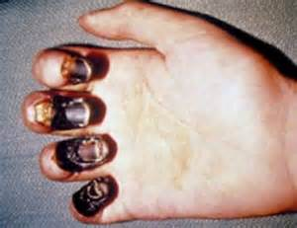
Septicemic Plague
Septicemic plague is rarely transmissible human to human but may become transmissible if the disease reaches the pneumonic stage.
Septicemic plague, either primary or secondary, has approximately 40% mortality when treated, and in untreated cases, the mortality is 100%.
Notes:
Septicemic plague is rarely transmissible human to human but may become transmissible if the disease reaches the pneumonic stage.
Septicemic plague, either primary or secondary, has approximately 40% mortality when treated, and in untreated cases, the mortality is 100%.
http://www.visualdx.com/view/diagnosis/plague_septicemic

Slide 38
Pneumonic Plague Symptoms
Spread person to person by way of cough droplets.
Cough with bloody sputum
Difficulty breathing
High fever
Nausea/vomiting
Weakness
Progresses quickly leading to respiratory failure and shock in 2 days of infection.
Initiate antibiotics within a day of signs and symptoms or it is likely to be fatal. May result from septicemic form or from inhalation of organism.
Notes:
Pneumonic Plague Symptoms
Spread person to person by way of cough droplets.
Cough with bloody sputum
Difficulty breathing
High fever
Nausea/vomiting
Weakness
Progresses quickly leading to respiratory failure and shock in 2 days of infection.
Initiate antibiotics within a day of signs and symptoms or it is likely to be fatal. May result from septicemic form or from inhalation of organism

Slide 39
Plague Symptoms
Symptoms: High fever, headache, general aches, extreme weakness, glandular swelling, pneumonia, hemorrhages in skin and mucous membranes possible, extreme lymph node pain.
Incubates: Bubonic, 2-6 days; unvaccinated: few days longer if vaccinated. Pneumonic: 1 to 6 days.
Fatal: Bubonic if untreated; Pneumonic if untreated.
Treatment: Tetracycline with streptomycin.
Notes:
Symptoms: High fever, headache, general aches, extreme weakness, glandular swelling, pneumonia, hemorrhages in skin and mucous membranes possible, extreme lymph node pain.
Incubates: Bubonic, 2-6 days; unvaccinated: few days longer if vaccinated. Pneumonic: 1 to 6 days; septicemic incubates 1-6 days.
Fatal: Bubonic if untreated; Pneumonic if untreated.
Treatment: Tetracycline with streptomycin.
1. Good BW agent due to being extremely infective, especially in pneumonic form.
2. Disseminating plague in aerosolized liquid droplets from 1 to 5 microns in diameter could be extremely lethal against unprotected, unwarned populace.

Slide 40
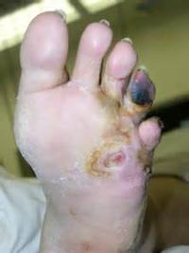
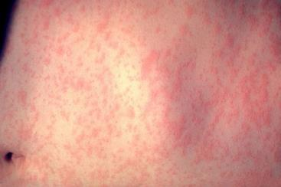
Plague Complications
Death
Gangrene
Meningitis
Notes:
Plague complications can include:
Death
Gangrene or
Meningitis

Slide 41
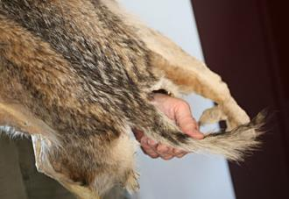
Plague Risk Factors
Where you’re located
Your occupation
Hobbies
Notes:
Risk Factors:
Where you’re located.
Are you located where you could contact animals?
Rural areas but also
Urban areas which are overcrowded, have poor sanitation and a high rat population.
Your occupation.
Do you do anything involving animals; domesticated or wild? Veterinarians? Game Commission picking up “road-kill?” Farming?
Do your hobbies take you into environments possessing the risk factors?
Plague is reportedly found in SW United States: Colorado, New Mexico, Arizona and California
“Greatest number of human plague infections occurs in Africa.” Mayo Clinic Staff.

Slide 42
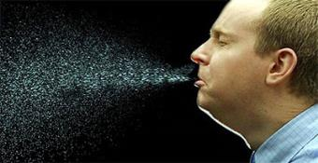
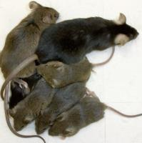
Pneumonic Plague Prevention
Affects lungs, least common form but most deadly.
Spread person to person through cough droplets (aerosolized).
Rodent-proof your home
Use insect repellent to kill fleas
Notes:
Pneumonic plague prevention:
Cover your mouth when you cough or sneeze.
Rid your home of rodents whose fleas may carry the plague.
Use insect repellent to kill fleas.

Slide 43
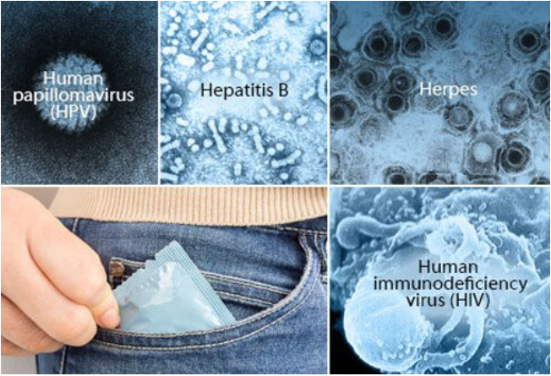
Viruses
Smaller than bacteria, a virus is able to cause diseases ranging from the common cold, HIV/AIDS, Influenza, chickenpox, cold sores, COVID-19.
Usually consist of a protein coat with genetic material (either RNA or DNA).
These are intracellular parasites and lack a system for their own metabolism; they are dependent on the synthetic machinery of their host cells.
Every virus requires its own special type of host cell for multiplication.
Viruses can affect many areas in the body, including the reproductive, respiratory, and gastrointestinal systems. They can also affect the liver, brain, and skin.
Can cause cancer as well (HPV- cervical, throat, and penile cancer)
Notes:
Smaller than bacteria, a virus is able to cause diseases ranging from the common cold to AIDS.
Usually consist of a protein coat with genetic material (either RNA or DNA).
Every virus requires its own special type of host cell for multiplication.
USAMRIID, Medical Management of Biological Casualties Handbook, 4th edition, February, 2001, page 78

Slide 44
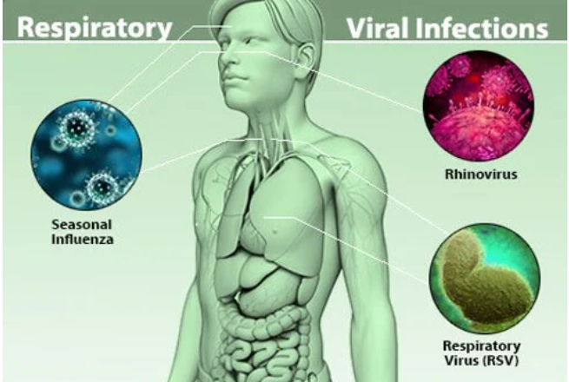
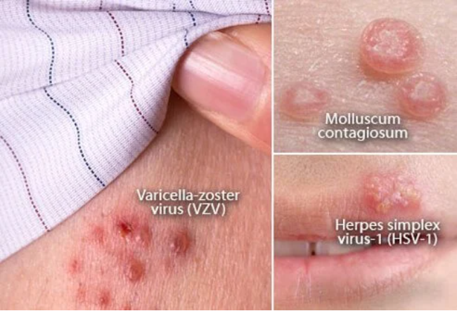
Viruses
A viral infection is a proliferation of a harmful virus inside your body.
Viruses cannot reproduce without the assistance of a host. Viruses infect a host by introducing their genetic material into the cells and hijacking the cell's internal machinery to make more virus particles.
With an active viral infection, a virus makes copies of itself and bursts the host cell (killing it) to set the newly-formed virus particles free.
In other cases, virus particles "bud" off the host cell over a period of time before killing the host cell.
Certain viruses -- like the ones that cause chickenpox and cold sores -- may be inactive or “latent” after the initial infection.
Notes:
https://www.onhealth.com/content/1/viral_infections
Human papillomavirus (HPV) is the most common sexually-transmitted infection in the US. There are many different types of HPV. Some cause genital warts while others increase the risk of cervical cancer. Vaccination can protect against cancer-causing strains of HPV.
Hepatitis B is a virus that causes inflammation in the liver. It's transmitted through contaminated blood and bodily fluids. Some people with the virus don't have any symptoms while others feel like they have the flu. The hepatitis B vaccine is more than 90% effective at preventing infection.
Genital herpes is a common sexually-transmitted infection caused by herpes simplex virus-2 (HSV-2). Herpes simplex virus-1 (HSV-1), the virus responsible for cold sores, can also sometimes cause genital herpes. There's no cure for genital herpes. Painful sores often recur during outbreaks. Antiviral medications can decrease both the number and length of outbreaks.
Human immunodeficiency virus (HIV) is a virus that affects certain types of T cells of the immune system. Progression of the infection decreases the body's ability to fight disease and infection, leading to acquired immune deficiency syndrome (AIDS). HIV is transmitted by contacting blood or bodily fluids of an infected person.

Slide 45
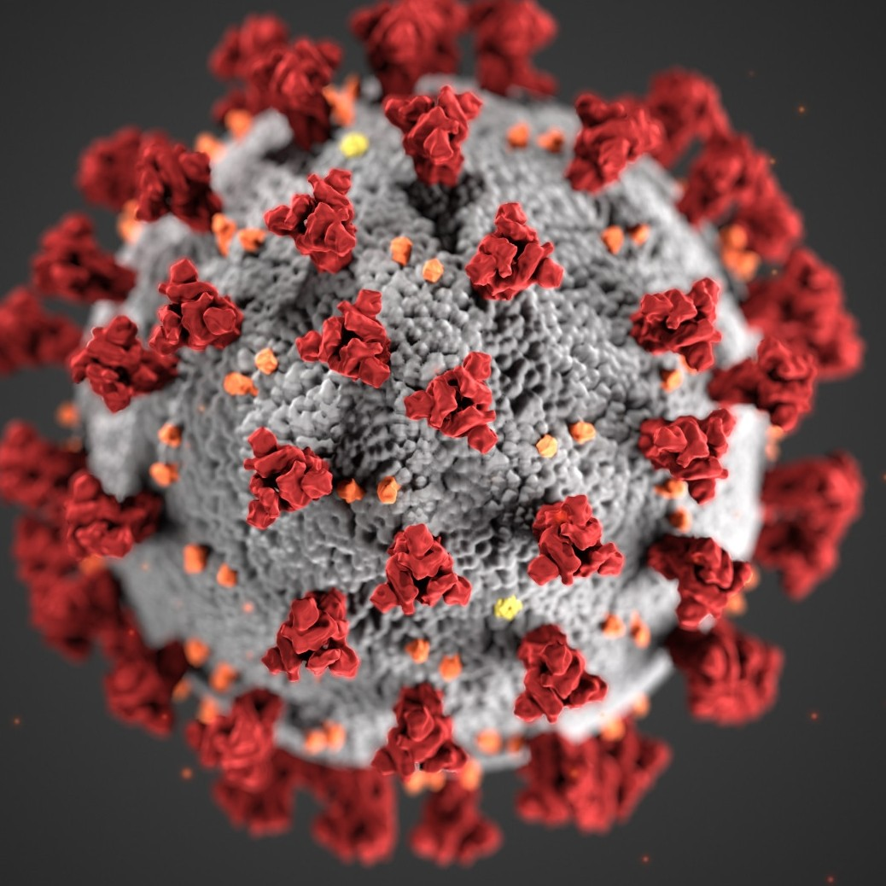
Infectious Diseases in History: Coronaviruses
The SARS outbreak of early 2003. This epidemic demonstrated that new infectious diseases are just a plane trip away. The virus, SARS-CoV, which caused a severe, and sometimes fatal, respiratory illness emerged in China. More than 8,000 people were infected by July 2003, and 774 died. Air travelers rapidly spread the disease to Canada, the United States, and Europe. Even though the SARS outbreak was relatively short-lived and geographically contained, the economic loss to Asian countries was estimated at $18 billion as fear inspired by the epidemic led to travel restrictions and the closing of schools, stores, factories, and airports.
In 2013, a new SARS-like virus emerged in Saudi Arabia. Named MERS-CoV, the virus causes Middle East respiratory syndrome, or MERS, a severe and often fatal respiratory disease. Infection occurs through direct contact with an infected animal (camel) or person. Even though MERS did not spread easily from person to person, the virus spread to 27 countries in the Middle East, Europe, Asia, and North America, including the United States.
The most recent coronavirus to emerge is named SARS-CoV-2. It causes the disease known as COVID-19. The effects of COVID-19 pandemic have been felt around the worldwide, with schools and businesses closing, travel restricted, and in some cases even limitations on people leaving their homes. The pandemic has caused major economic hardships, stressed healthcare systems, and impacted mental health.
Notes:
Scientists first identified a human coronavirus in 1965. It caused a common cold. Later that decade, researchers found a group of similar human and animal viruses and named them after their crown-like appearance
Experts say SARS-CoV-2 originated in bats. That’s also how the coronaviruses behind Middle East respiratory syndrome (MERS) and severe acute respiratory syndrome (SARS) got started.
SARS-CoV-2 made the jump to humans at one of Wuhan’s open-air “wet markets.” They’re where customers buy fresh meat and fish, including animals that are killed on the spot.
Some wet markets sell wild or banned species like cobras, wild boars, and raccoon dogs. Crowded conditions can let viruses from different animals swap genes. Sometimes the virus changes so much it can start to infect and spread among people.

Slide 46
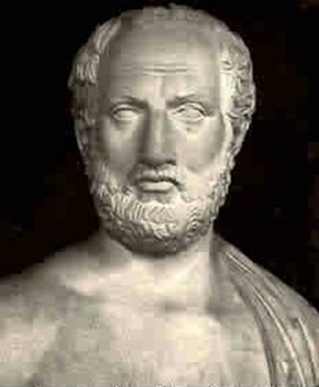
Smallpox in History
Over the course of millennia, these tiny infectious particles traveled the globe along trade and exploration routes, afflicting victims with high fevers and numerous raised lesions on their skin. One of history’s deadliest diseases, smallpox is estimated to have killed more than 300 million people since 1900 alone.
The mummified body of the Egyptian pharaoh Ramses V (died c. 1156 BC) bears evidence of pustules characteristic of smallpox.
It is possible that smallpox was behind the great plague of Athens in 430 BC, recorded by the Greek historian Thucydides, and a devastating plague carried to Italy by a Roman army returning from Mesopotamia around AD 165.
Thucydides
Notes:
Some scholars feel that smallpox originated among settled agricultural populations in Mesopotamia as early as the 5th millennium BC and in the Nile River valley in the 3rd millennium BC.
A huge pandemic reached from Europe to the Middle East in 1614, and epidemics arose regularly in Europe throughout the 17th and 18th centuries.
Source: http://www.britannica.com/EBchecked/topic/549405/smallpox, 12/4/2014.

Slide 47
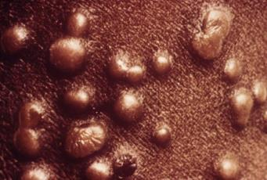
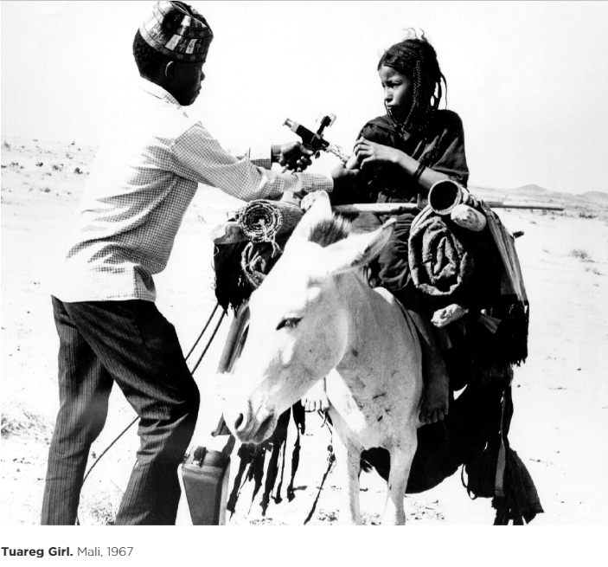
Smallpox in History
The virus that causes smallpox comes in two forms—the relatively mild Variola minor and its deadlier cousin, Variola major.
Death followed in one-third of Variola major cases. Even when victims survived, smallpox often left the survivors scarred for life. Although the first smallpox vaccine appeared in 1796, outbreaks continued well into the 1900s.
1949: Large-scale vaccination finally eliminated smallpox from the United States.
1967: World Health Organization (WHO) began a global vaccination program.
1980: the disease was officially declared eradicated.
Notes:
The virus that causes smallpox comes in two forms—the relatively mild Variola minor and its deadlier cousin, Variola major. Over the course of millennia, these tiny infectious particles traveled the globe along trade and exploration routes, afflicting victims with high fevers and numerous raised lesions on their skin. Death followed in one-third of Variola major cases. Smallpox was one of the first diseases to be controlled by a vaccine, due to the experiments of English physician Edward Jenner in 1796. Even when victims survived, smallpox often left the survivors scarred for life.
Source: http://www.britannica.com/EBchecked/topic/549405/smallpox, 12/4/2014

Slide 48
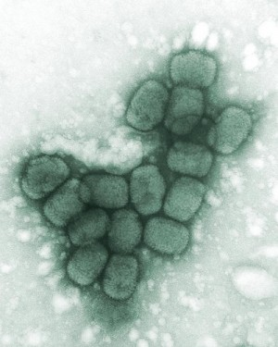
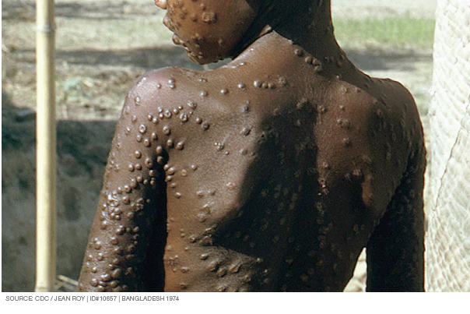
Virus: SMALLPOX
Caused by variola virus.
Highly contagious, disfiguring and often deadly. Most people survive.
No cure or treatment exists to this day.
Naturally occurring smallpox was wiped out worldwide by 1980 — the result of an unprecedented global immunization campaign.
A vaccine can prevent smallpox, but the risk of the vaccine's side effects is too high to justify routine vaccination for people at low risk of exposure to the smallpox virus.
Notes:
Viral: SMALLPOX
Caused by Variola virus.
Highly contagious, disfiguring and often deadly.
No cure or treatment exists. A vaccine exists as a preventative.
Side effects are high for the vaccine which did not warrant vaccinations on a large scale.
If you were vaccinated as a child, it may provide partial immunity.
Clandestine stockpiles are not known.

Slide 49
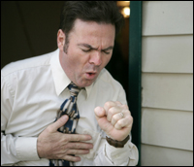
Smallpox Contracted via:
Direct contact person to person
Indirectly via an airborne virus
Contaminated items
As a terrorist weapon (potentially)
Notes:
Smallpox is contracted by way of:
Direct contact person to person
Indirectly via an airborne virus
Contaminated items
As a terrorist weapon

Slide 50
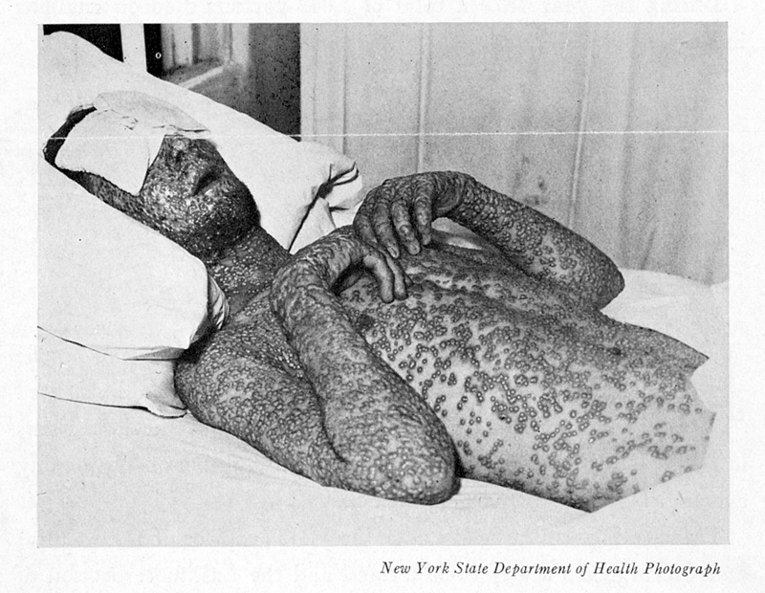
Smallpox Symptoms
Incubation period: 7 to 17 days during which time you can not infect others.
Following incubation:
Fever
Overall discomfort
Headache
Severe back pain and fatigue
Vomiting is possible
Notes:
Smallpox Symptoms
Incubation period: 7 to 17 days during which you can’t infect others.
Following incubation:
Fever
Overall discomfort
Headache
Severe back pain and fatigue
Vomiting is possible

Slide 51
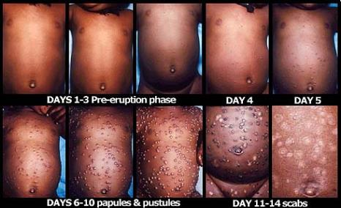
Smallpox Symptoms
A few days later, flat, red spots on your face, hands and forearms which then appear on your trunk.
Lesions may then turn into small blisters with clear fluid
8-9 days later scabs fall off leaving deep, pitted scars.
Notes:
https://www.mayoclinic.org/diseases-conditions/smallpox/symptoms-causes/syc-20353027
Smallpox Symptoms
A few days later, flat, red spots on your face, hands and forearms which then appear on your trunk.
Lesions may then turn into small blisters with clear fluid
8-9 days later scabs which fall off leaving deep, pitted scars.

Slide 52
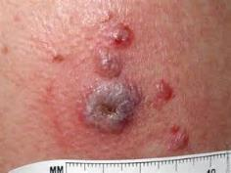
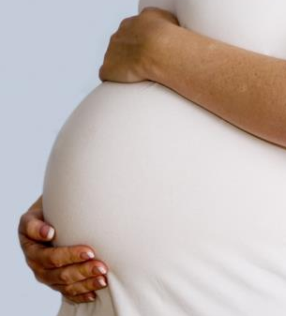
Smallpox Symptoms
Lesions may also form on mucus membranes of nose and mouth.
Most who contract smallpox survive. Blindness may occur in some.
More lethal smallpox affects pregnant women and those with compromised immune systems.
Lethality: High to moderate.
Notes:
Smallpox Symptoms
Lesions may also form on mucus membranes of nose and mouth.
Most who contract smallpox survive. Blindness may occur in some.
More lethal smallpox affects pregnant women and those with compromised immune systems.
Lethality: High to moderate lethality.

Slide 53
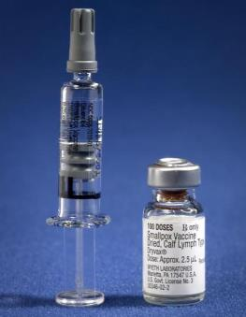
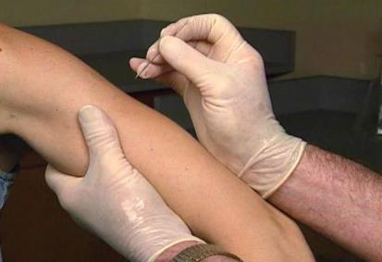
Smallpox Prevention
Vaccine may lessen infection if given within 4 days of exposure.
Childhood vaccination may provide partial immunity
Notes:
Smallpox prevention includes,
Vaccine may lessen infection if given within 4 days of exposure.
Childhood vaccination may provide partial immunity.

Slide 54
Smallpox Treatment
No cure - treat symptoms.
Rehydrate.
Antibiotics may be used for those who have a bacterial skin or lung infection.
Treatment
Vaccine exists which is a preventative-not cure.
No specific therapy, supportive care must include prevention of secondary infections.
Notes:
Smallpox Treatment.
No cure - treat symptoms.
Rehydrate.
Antibiotics may be used for those who have a bacterial skin or lung infection.
Treatment
Vaccine exists which is a preventative-not cure.
No specific therapy, supportive care must include prevention of secondary infections.
http://www.nlm.nih.gov/medlineplus/ency/article/000596.htm

Slide 55
Questions

