Slide 1
Visibility of the mandibular canal on CBCT cross-sectional images
م.رشا جميل

Slide 2
The identification of the mandibular canal (MC) is of fundamental importance for preoperative planning of surgical procedures involving the posterior mandible.
Finding the MC on imaging examinations is a requirement for endosseous implants surgeries, since the available height of the edentulous site is determined by the distance between the alveolar ridge and the MC.

Slide 3
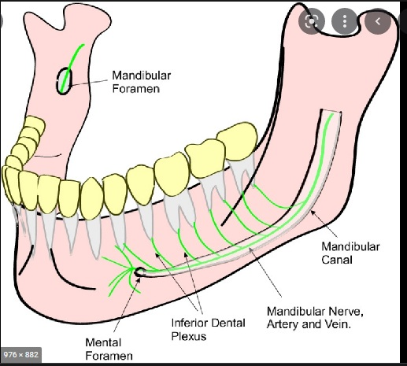

Slide 4
Several imaging modalities have been used to assess the course of the MC, including panoramic radiography, conventional tomography, computed tomography (CT), and the most recently introduced cone-beam computed tomography (CBCT)

Slide 5
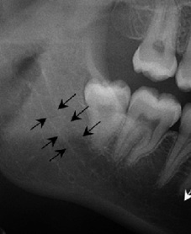

Slide 6
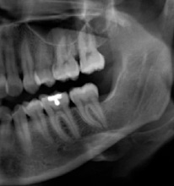

Slide 7
Compared to conventional two-dimensional techniques, CBCT imaging presents as main advantages the elimination of superimposition of neighboring structures, and absence of image magnification. Furthermore, CBCT presents short scanning time, and radiation dose up to 15 times lower than multislice CT (MSCT). The technology is becoming increasingly more available in dental and radiological practices

Slide 8
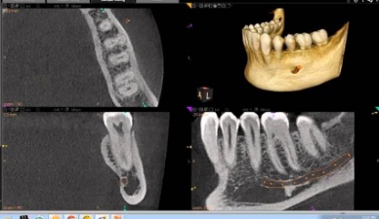

Slide 9
The identification of the MC is a delicate task. The radiographic appearance usually involves a radiolucent zone lined by superior and inferior borders.
The cortication of the canal is variable, which may explain why in some cases the MC is not well-visualized even with CBCT .

Slide 10
Depending on :
Bone density
Patient age
Pathological changes
Some time it differ in visualization in different areas of the jaws according to dental condition

Slide 11
200 CBCT images
selected and examined by specialized maxillofacial radiologists.
digital CBCT system
under standard exposure factors (parameters).
400 hemi-mandible examined by cross sectioned views of CBCT

Slide 12
selective criteria:
Good image quality.
No pathological lesion, fracture, implant and missing teeth in posterior part of mandible except third molar.
each sample were achieved at different mandible regions; second premolar area (A), first molar area (B), second molar area (C) and distal to second molar area (D)

Slide 13
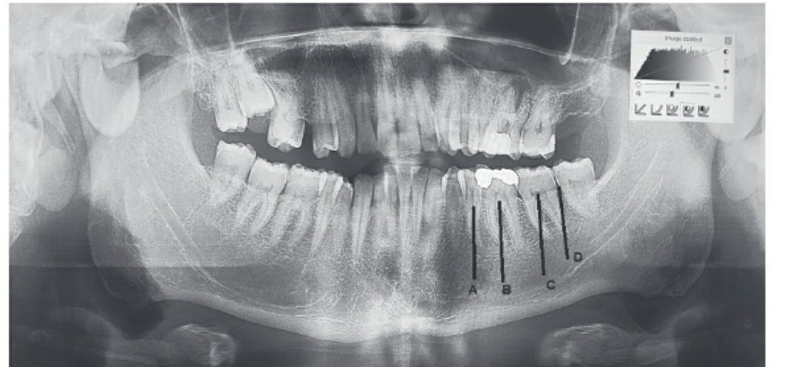

Slide 14
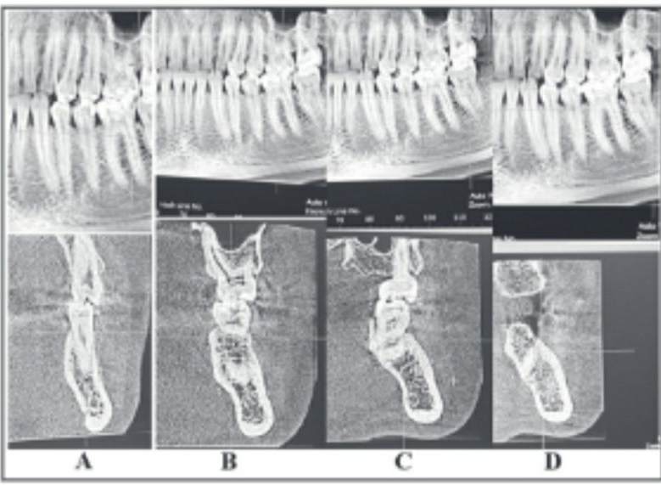

Slide 15
RESULTS
the visibility of the canal from its surroundings became less clear towards the posterior region of the mandible.
The results showed a significant difference between the area under examination

Slide 16
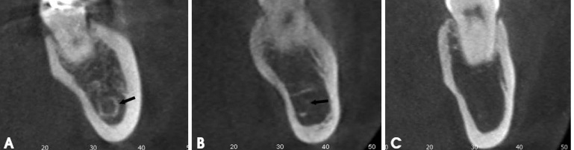
A-Clearly visible
B. Probably visible
C. In visible

Slide 17
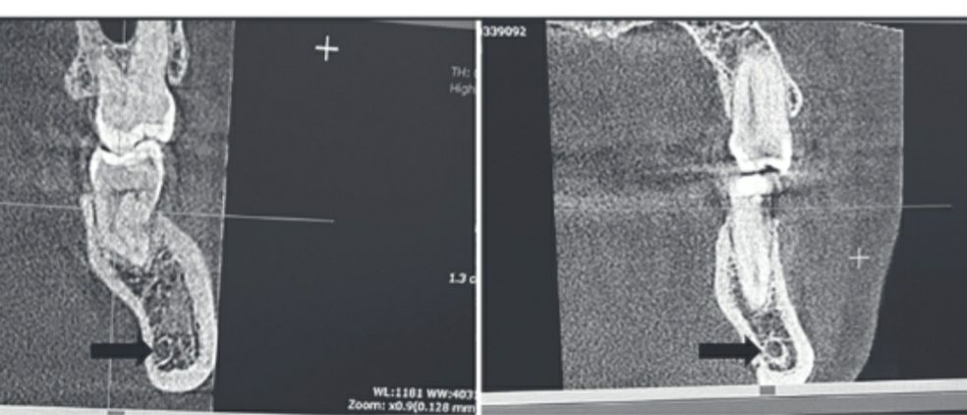
Cross-sectional image show clear MC at 2nd premolar and probably un clear at 1st molar area in the same patient

Slide 18
Differences in the visibility of the mandibular on CBCT cross-sectional images between male and female patients were statistically non- significant.

Slide 19
