Slide 1
LASER Application in medicine &Biology
المدرس فرح عبد الجليل

Slide 2
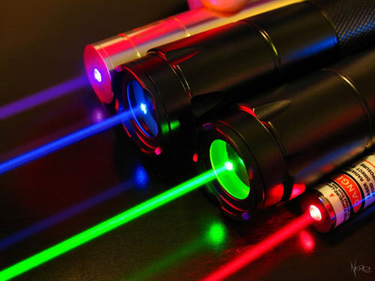
L A S E R

Slide 3
LASER
Light.
Radiation
amplification
Emission
stimulated

Slide 4
Basic Element of LASER
Active medium
Optical cavity
Pumping sours

Slide 5
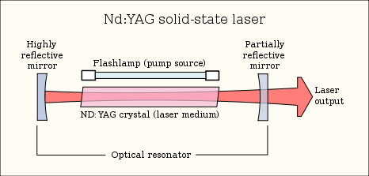

Slide 6
Types of Laser
He-Ne
GAS LASER
diode
Semiconductor LASER
Nd-YAG
Solid stat
Rho-dye
Liquid-dye

Slide 7
LASER Properties

Slide 8
Coherence

Slide 9
Monochromaticity

Slide 10
Directionality

Slide 11
Brightness

Slide 12
Laser application in
Engineering
Medicine
biology
Military

Slide 13
Types laser interaction mechanisms
λ
depended interaction mechanisms

Slide 14
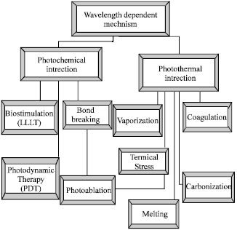

Slide 15
λ
independed interaction mechanisms
Ultra short pulses

Slide 16
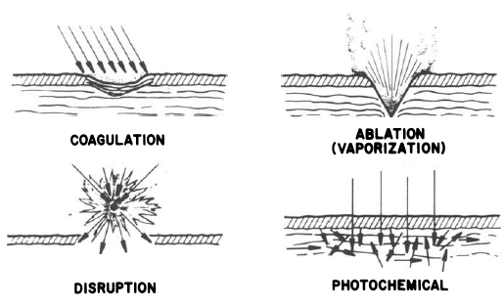

Slide 19
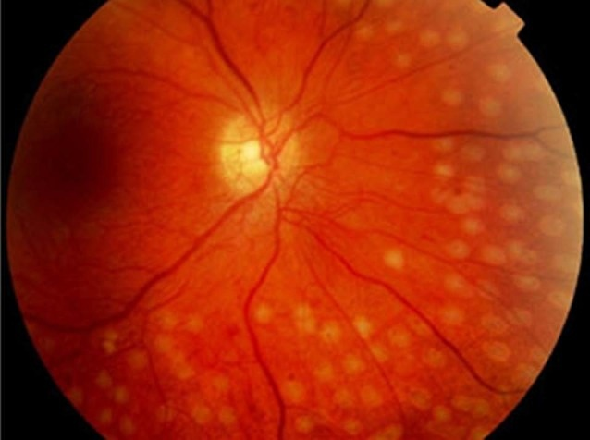

Slide 21
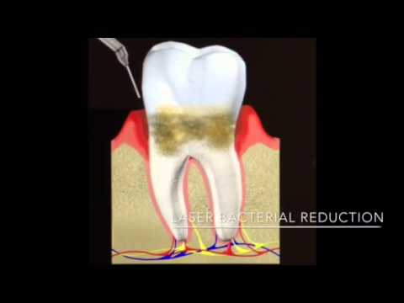

Slide 22
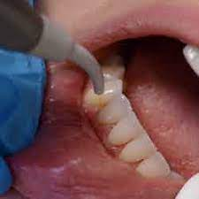

Slide 23
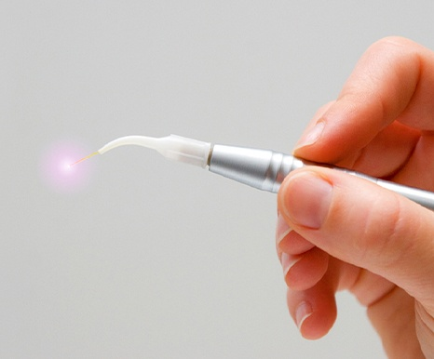

Slide 24
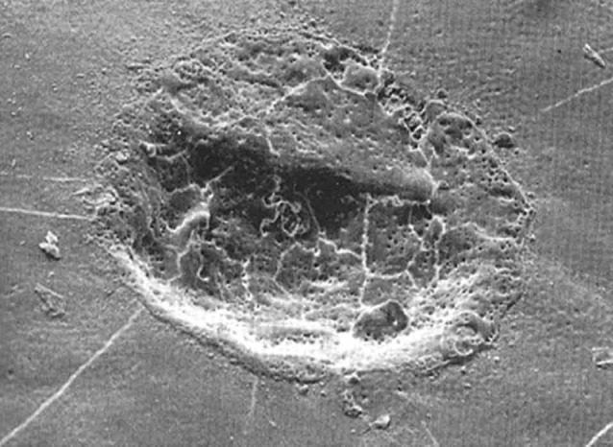

Slide 25
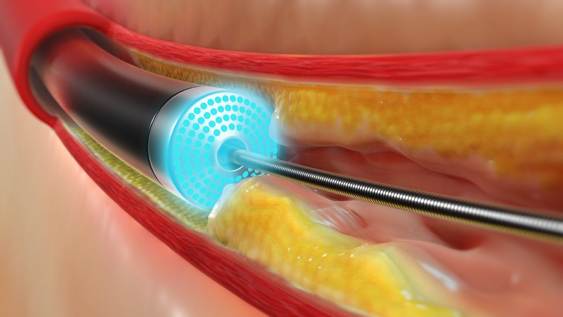

Slide 26
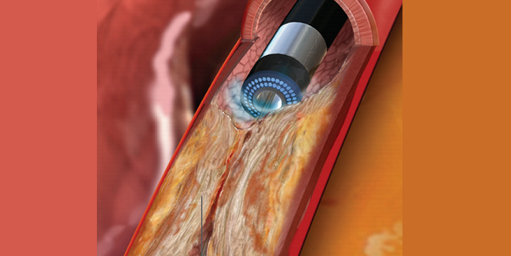

Slide 27
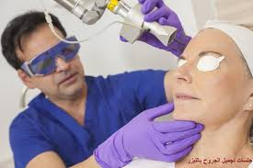

Slide 28
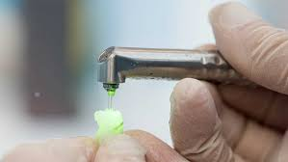

Slide 29
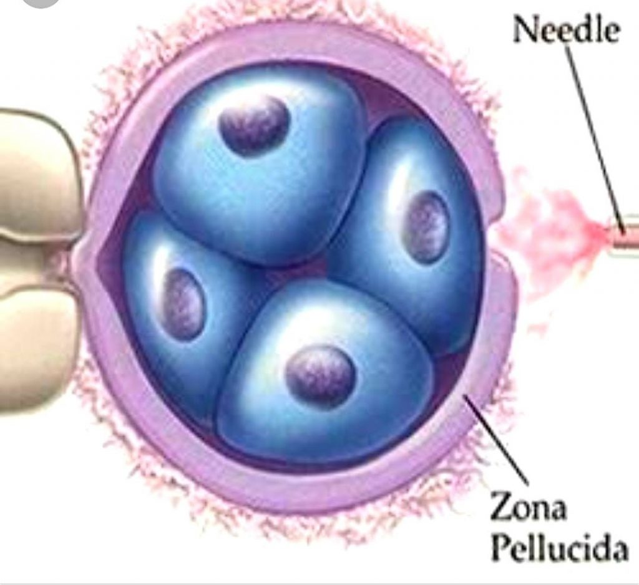

Slide 30
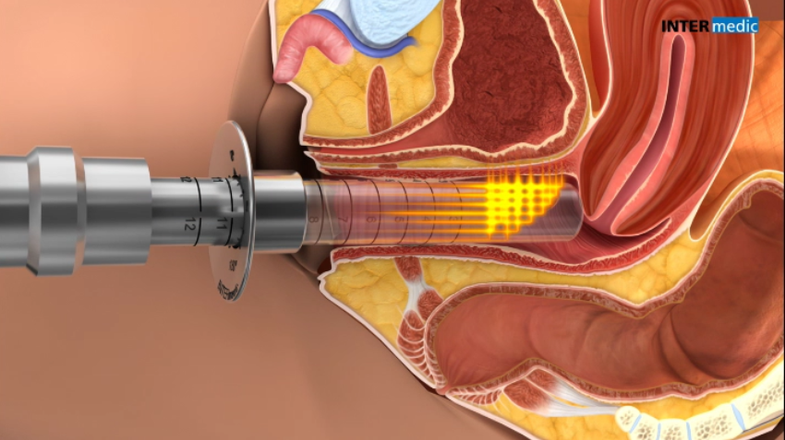

Slide 31
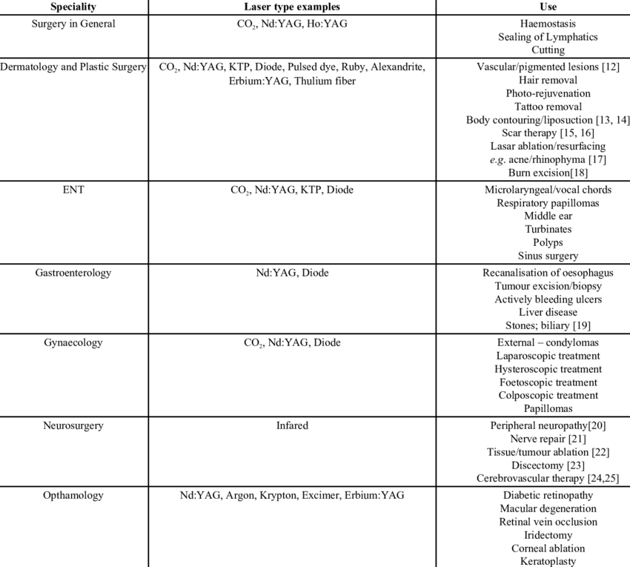

Slide 32
Thank you

