Slide 1
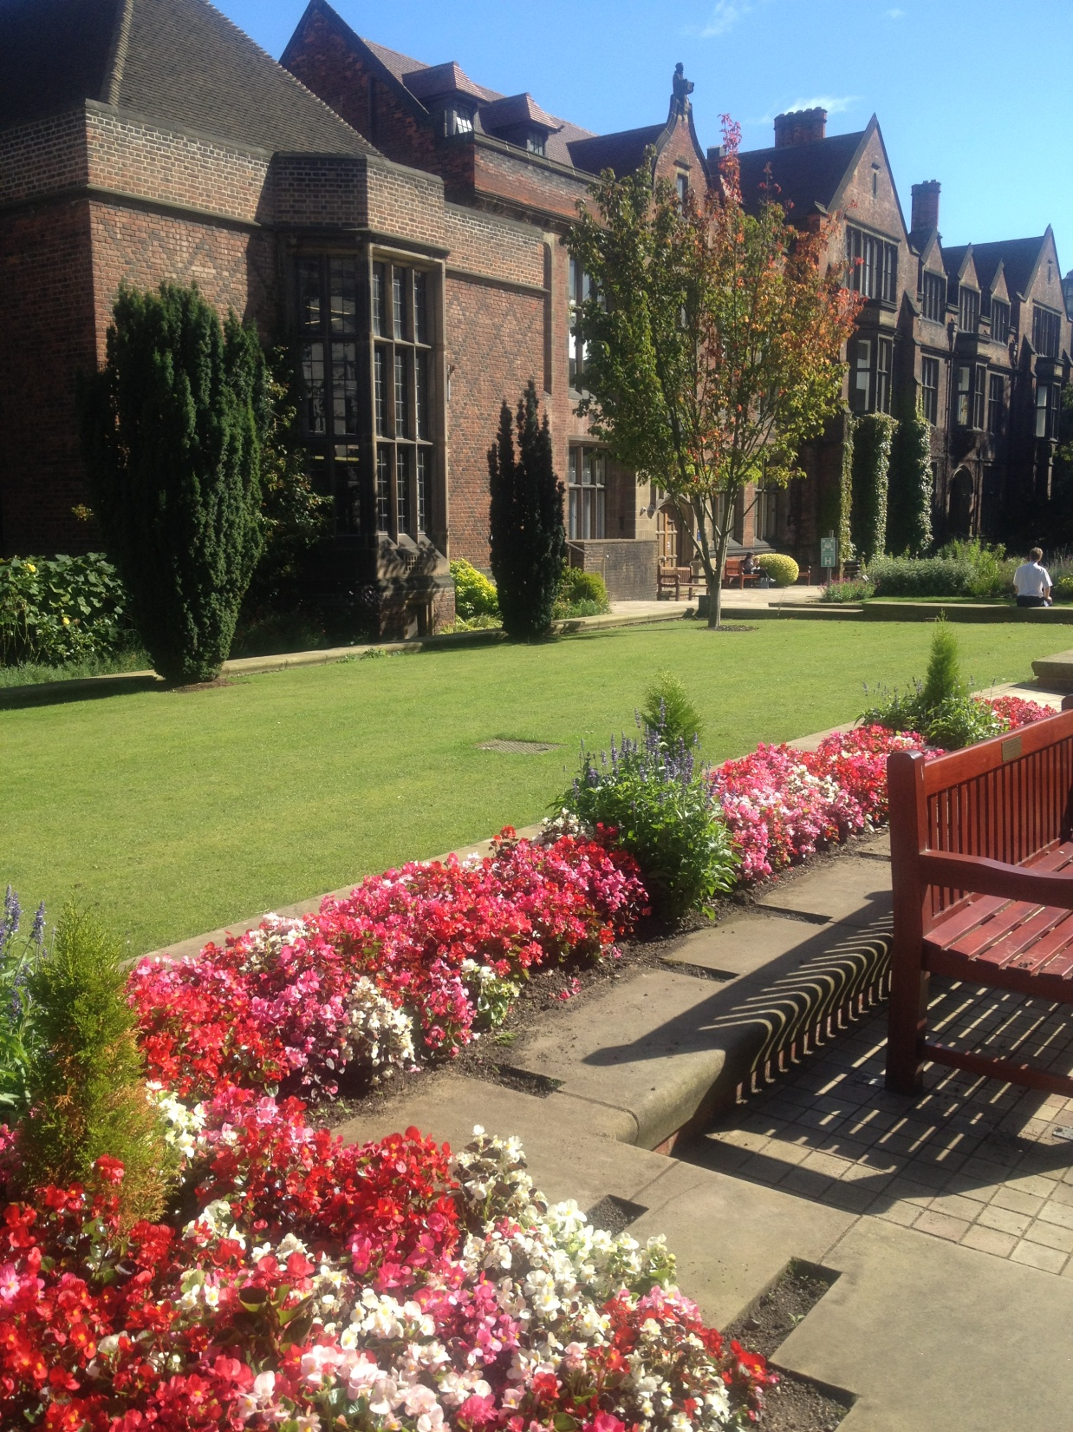
Raman Spectroscopy
in Diagnosis of
Oral Epithelial Dysplasia
Ass Prof Dr Ameena Ryhan Diajil

Slide 2

Contents
Introduction
Aim and objective
Materials and methods
Results and discussion
Conclusion

Slide 3
Introduction:
Presently, the current diagnosis of cancer and potentially malignant disorders (PMD) is through histopathological assessment which includes removal of a tissue biopsy from a suspicious area, subjecting it to many steps of tissue processing (fixation, sectioning and staining) followed by pathologist examination. This is largely based on the measurement of structural and morphological changes to detect cancer cells, BUT unable to provide biochemical information on cellular tissue structure, suffering from both inter- and intra-observer variability associated with cost and delay of both diagnosis and treatment accordingly.

Slide 4
Thus, there is real clinical need for a diagnostic technique that can detect early changes, and to fully understand the biological process associated with carcinogenesis.
Recently, Optical spectroscopy techniques have shown a considerable promise as complementary and possible alternatives to the current diagnostic technique; providing detailed information about biochemical tissue components.

Slide 5
Raman Spectroscopy (RS)
Raman spectroscopy is an optical technique based on the interaction of light with matter.
When electromagnetic energy interacts with a material, it can either be reflected, absorbed, transmitted, or scattered.
One type of scattering is Raman scattering and is the basis for Raman spectroscopy.
Raman spectroscopy is a technique to study the vibrational characteristics of molecules.

Slide 6
It is a LASER BASED SYSTEM has been widely used in the biomedical sciences applied over a wide range of samples from single cells to tissues.
It requires a monochromatic high intensity laser light for the excitation of the tissue specimen to probe the cellular biochemical changes.
Light of a single wavelength is focused onto a sample. The photons from the laser interact with the molecules of the sample and are scattered inelastically.
The scattered photons are collected and a spectrum is generated from the scattered photons.
It can explore many specific chemical bonds present within tissue, providing detailed biochemical information with molecular specificity, providing a highly specific Spectral Fingerprint.

Slide 8
How dose Raman spectroscopy work?
Tissue undergoing transformation towards dysplasia and subsequently toward malignancies undergoes structural and metabolic changes which change their light interaction properties due to substantial changes in the cellular biochemistry.
Qualitative and quantitative analysis of these changes may provide important information about specific diagnosis and/or the grade of disease process.

Slide 9
Aim and Objective
The aim was to investigate the suitability of RS for distinguishing dysplastic lesions from morphologically normal tissue and whether RS is able to identify dysplastic changes at early stages; to develop a spectroscopic tissue diagnosis based on overall spectral differences.
The objective was by using archived tissue specimens to assess whether RS is an objective diagnostic tool by trying to detect changes in biochemical tissue structure of diseased tissues and comparing these changes with normal tissue, with the objective of trying to find biochemical tissue markers for early diagnosis of oral Potentially Malignant Disorders (PMDs).

Slide 10
Materials and methods
Preparation of Oral Tissue Samples
Formalin Fixed Paraffin Embedded tissue blocks of patients diagnosed with dysplastic lesions in their floor of mouth (FOM) were used.
For every case, two adjacent sections of 10 µm thick specimens were cut.
1st section was for the Raman analysis, mounted onto a 20 mm x 20 mm x 0.5 mm barium fluoride (BaF₂) window which was then dried overnight.

Slide 11
The 2nd section was mounted onto a glass slide and stained with H and E.
Two oral pathologists independently assessed the tissue to grade the epithelial dysplasia using the WHO classification systems (mild, moderate, severe dysplasia and CIS)
If disparity was found between the two pathologists, a consensus grade agreed by both after reviewing the sections together again.
Once this grade had been decided for all sections, the areas on the H and E slides relating to epithelial dysplasia and morphologically normal epithelium were marked by one of the pathologists, so that the areas for Raman analysis could be identified on the parallel BaF₂-mounted section.

Slide 12
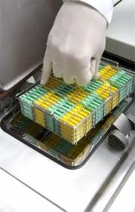
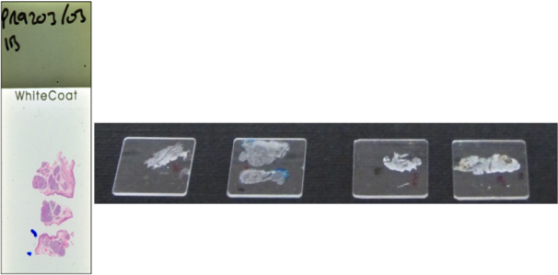
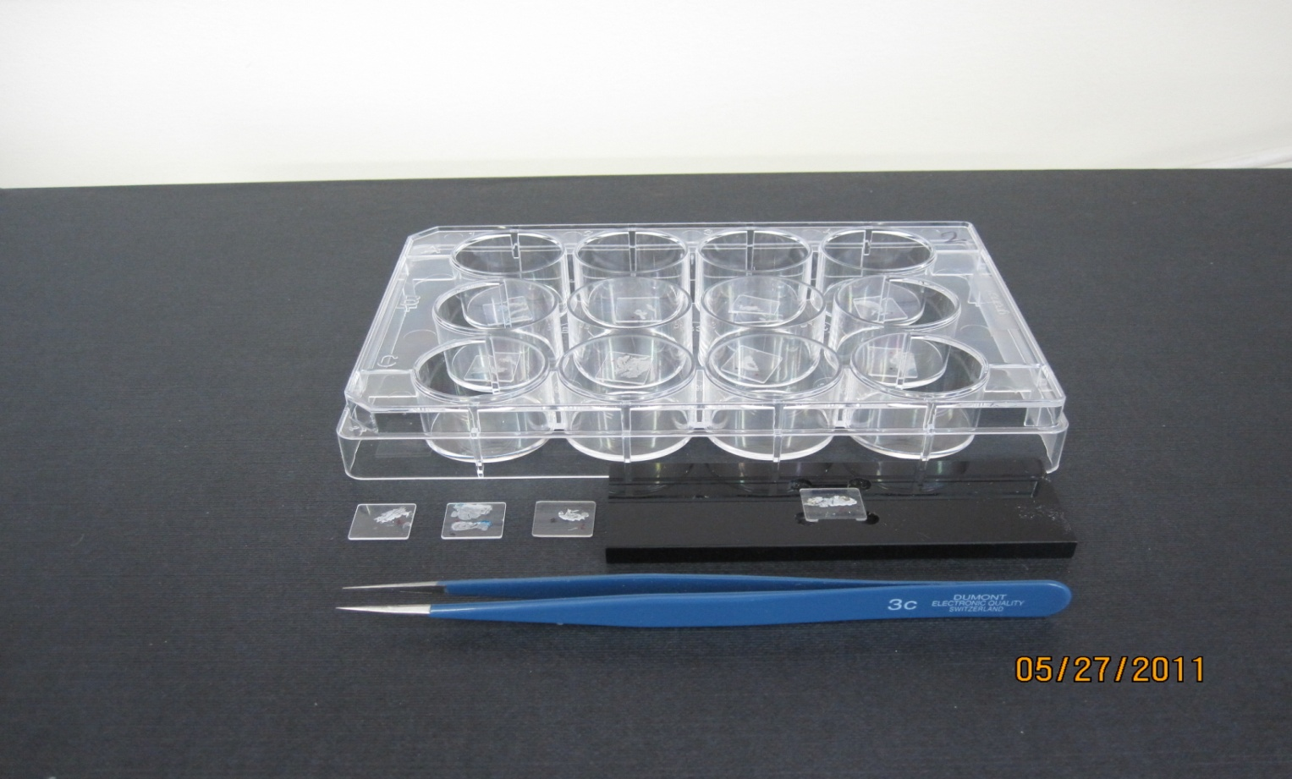

Slide 13
Morphologically normal tissue from an unaffected area at the resection margins from the same patient was used as control to minimise the individual source of variation that might relate to patient demography, risk factors, medical history and medications used, which may cause other source of variations not related to the disease itself.
All samples used in this spectroscopic study were taking from patients affected with PMDs in one oral subsite, the FOM, eliminating the effect of anatomical site variation.

Slide 14
Before Raman analysis, all tissue sections on the BaF₂ substrate were de-waxed using the following protocol:
  Immersed in a sealed glass bath containing 60 ml of n-hexane (3 pg/ml impurities) for 5 minutes.
  Immersed in a sealed glass bath containing 60 ml ethanol (99.8%) for 5 minutes.
  Placed overnight in an oven (25 °C) to allow to fully dry.
  Stored in a sealed desiccator containing silica gel beads until analysis.

Slide 15
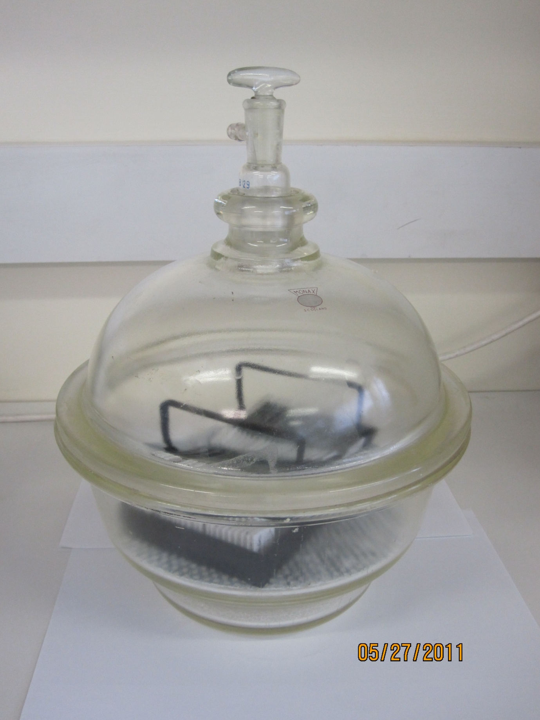
Desiccator

Slide 16
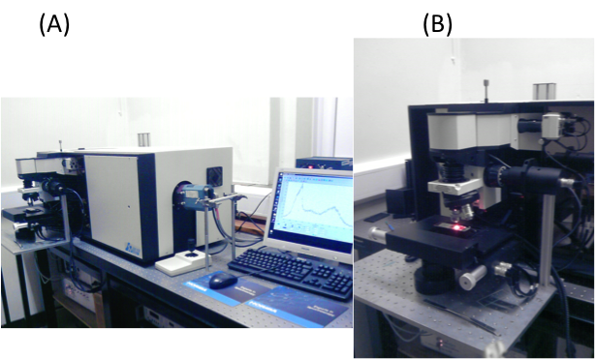
Raman analyses were conducted using a LabRam HR Raman spectrometer (HORIBA Scientific, France) connected to confocal microscopy and controlled by Lab Spec 5 software. The objective of the microscope focuses the incident laser light onto only a small point of the specimen depending on the objective lens used.
2. Raman Instrumentation

Slide 17
3. Collection of Raman Spectra
H and E stained specimen placed in one light microscope to identify the correct experimental.
BaF₂-mounted specimen was mounted in a specifically manufactured holder and positioned in the confocal Raman microscopy, using a 10x lens so that the area of interest was in the centre of the visual field.
The lens was swapped for a 50x lens to focus the laser light onto the specimen.
(NOTE: spot size approximately 1.5 mm in diameter, with an approximate laser power at the sample surface of 2.5 mW).

Slide 18
A series of locations on the basal epithelium were selected (10-12 points per location) with spectral acquisition was started automatically using the attached software.

Slide 19
All spectra were measured over the spectral range of 800 to 1800 cm⁻¹, which is well known to encode the most important information of biochemical tissue changes “fingerprint”.
At each point two co-added spectra were measured, each collected over 30 seconds.
Mean spectra were calculated for each group of tissue to allow the identification of the important Raman peaks for each tissue type.
Peak position and peak relative intensity for each group of dysplasia and morphologically normal tissue specimens were measured.

Slide 20
Histopathology group WHO classification system | N | Number of spectra collected |  | Total
 |  | Dysplastic | Morphologically normal
Mild | 12 | 134 | 110 | 244
Moderate | 10 | 79 | 93 | 172
Severe | 6 | 83 | 107 | 190
CIS | 4 | 90 | 82 | 172
Total | 32 | 386 | 392 | 778

Slide 21


Results
and
Discussion

Slide 22
Mean relative intensity of the identified Raman peaks in dysplastic groups
Spectral Range (cm⁻¹) | Mean Relative Intensity (a.u)
 | Md | Modd | Sd | CIS
829-835 | 0.047 | 0.082 | 0.048 | 0.069
859 | 0.18 | 0.181 | 0.124 | 0.173
1007-1009 | 0.642 | 0.552 | 0.594 | 0.654
1035-1039 | 0.417 | 0.326 | 0.376 | 0.345
1065-1068 | 0.472 | 0.158 | 0.526 | 0.425
1084-1091 | 0.31 | 0.252 | 0.28 | 0.267
1135-1137 | 0.381 | 0.378 | 0.348 | 0.358
1174-1177 | 0.263 | 0.223 | 0.255 | 0.186
1213-1214 | 0.364 | 0.283 | 0.342 | 0.293
1235-1243 | 0.443 | 0.393 | 0.384 | 0.375
1299-1301 | 0.267 | 0.364 | 0.293 | 0.31
1315-1322 | 0.243 | 0.22 | 0.195 | 0.208
1344-1347 | 0.399 | 0.336 | 0.333 | 0.337
1375-1377 | 0.375 | 0.282 | 0.312 | 0.216
1403 | 0.443 | 0.314 | 0.318 | 0.25
1421-1424 | 0.552 | 0.499 | 0.499 | 0.475
1446-1454 | 1.22 | 1.244 | 1.26 | 1.238
1589-1591 | 0.883 | 0.656 | 0.617 | 0.549
1609 | 0.766 | 0.628 | 0.636 | 0.602
1658-1661 | 1.08 | 0.977 | 0.925 | 1.059

Slide 23
Mild epithelial dysplasia
The mean spectrum of Md showed a predominant protein pattern with contributions from nucleic acids, amino acids with a significantly higher relative intensity of phenylalanine protein at 1009 cm⁻¹. This reflects increased protein content associated with dysplastic changes compared to Mn and reflects the ability of the Raman system to detect early biochemical tissue changes at early stages of dysplasia.

Slide 24
Moderate Dysplasia
In Modd, higher relative intensity at 896 cm⁻¹, 929–931 cm⁻¹ ,971 cm⁻¹, 1137 cm⁻¹,1322 cm⁻¹,1345 cm⁻¹ and amide I of proteins (1658 cm⁻¹). This suggests the progressive increase in proteins, amino acids and nucleic acid components reflecting the progress of the disease from normal towards dysplasia.
In morphologically normal tissue, the differences were statistically significant at 1087 cm⁻¹, which can be attributed to lipids (0.289 vs. 0.252) (p=0.001; Mann-Whitney U test) which dominated the spectra of normal epithelium.

Slide 25
Severe Dysplasia
Showed a significantly higher concentration of proteins and nucleic acids reflected by higher relative intensity at 1344 cm⁻¹, compared to Sn (0.333 vs.0.236) (p=0.011).
The Sn exhibited a significantly higher relative intensity of amide III of protein at 1243 cm⁻¹.

Slide 26
Carcinoma in situ (CIS)
CIS showed a significantly higher concentration of both phenylalanine protein at 1007 cm⁻¹, (0.654 vs. 0.627) (p=0.021) and at 1091 cm⁻¹ (proteins and nucleic acids), compared to CISn (0.267 vs. 0.250) (p=0.043). All layers of stratified epithelium are proliferating and are more likely to express many surface proteins from signalling agents, antigens, antibodies and enzymes. This may explain the higher proteins and nucleic acid content in this type of tissue, which is in complete agreement with histopathology.

Slide 27
Spectral Intensity and Dysplasia Severity
A decreased intensity with increased dysplasia severity from the mild through moderate and severe dysplasia to the CIS was seen:
At 1589-1591 cm⁻¹ (olefinic/lipids) this strongly supports the concept of protein-dominated spectra in dysplastic tissue.
Since the number of proliferating cells increases progressively with higher grades of dysplasia and with more energy consumption for their biological transformation process, resulting in lower lipid and more protein content with progression of the disease.

Slide 29
Conclusion
Spectroscopic tissue analysis confirmed the ability of RS to identify early biochemical tissue changes associated with tissue progression from normal to dysplastic.
This study support the lipid-dominated spectra of normal tissue and protein-dominated spectra in dysplastic tissue supported by the histopathological base of knowledge.
The higher concentration of nucleic acids and proteins and formation of new proteins from the proliferating cells in dysplastic tissue, were supported by the histopathological criteria used for biopsy diagnosis.

Slide 30
The current study supported the ability of RS to provide a single peak for diagnostic purposes:
Olefinic stretch of lipids at 1589-1591 cm⁻¹ was consistently decreased with increased dysplasia severity supporting the lower lipids content in dysplastic tissues.
This Raman peak may be used to differentiate between different grades of dysplasia; however, further studies are required to confirm and validate this finding.

Slide 31
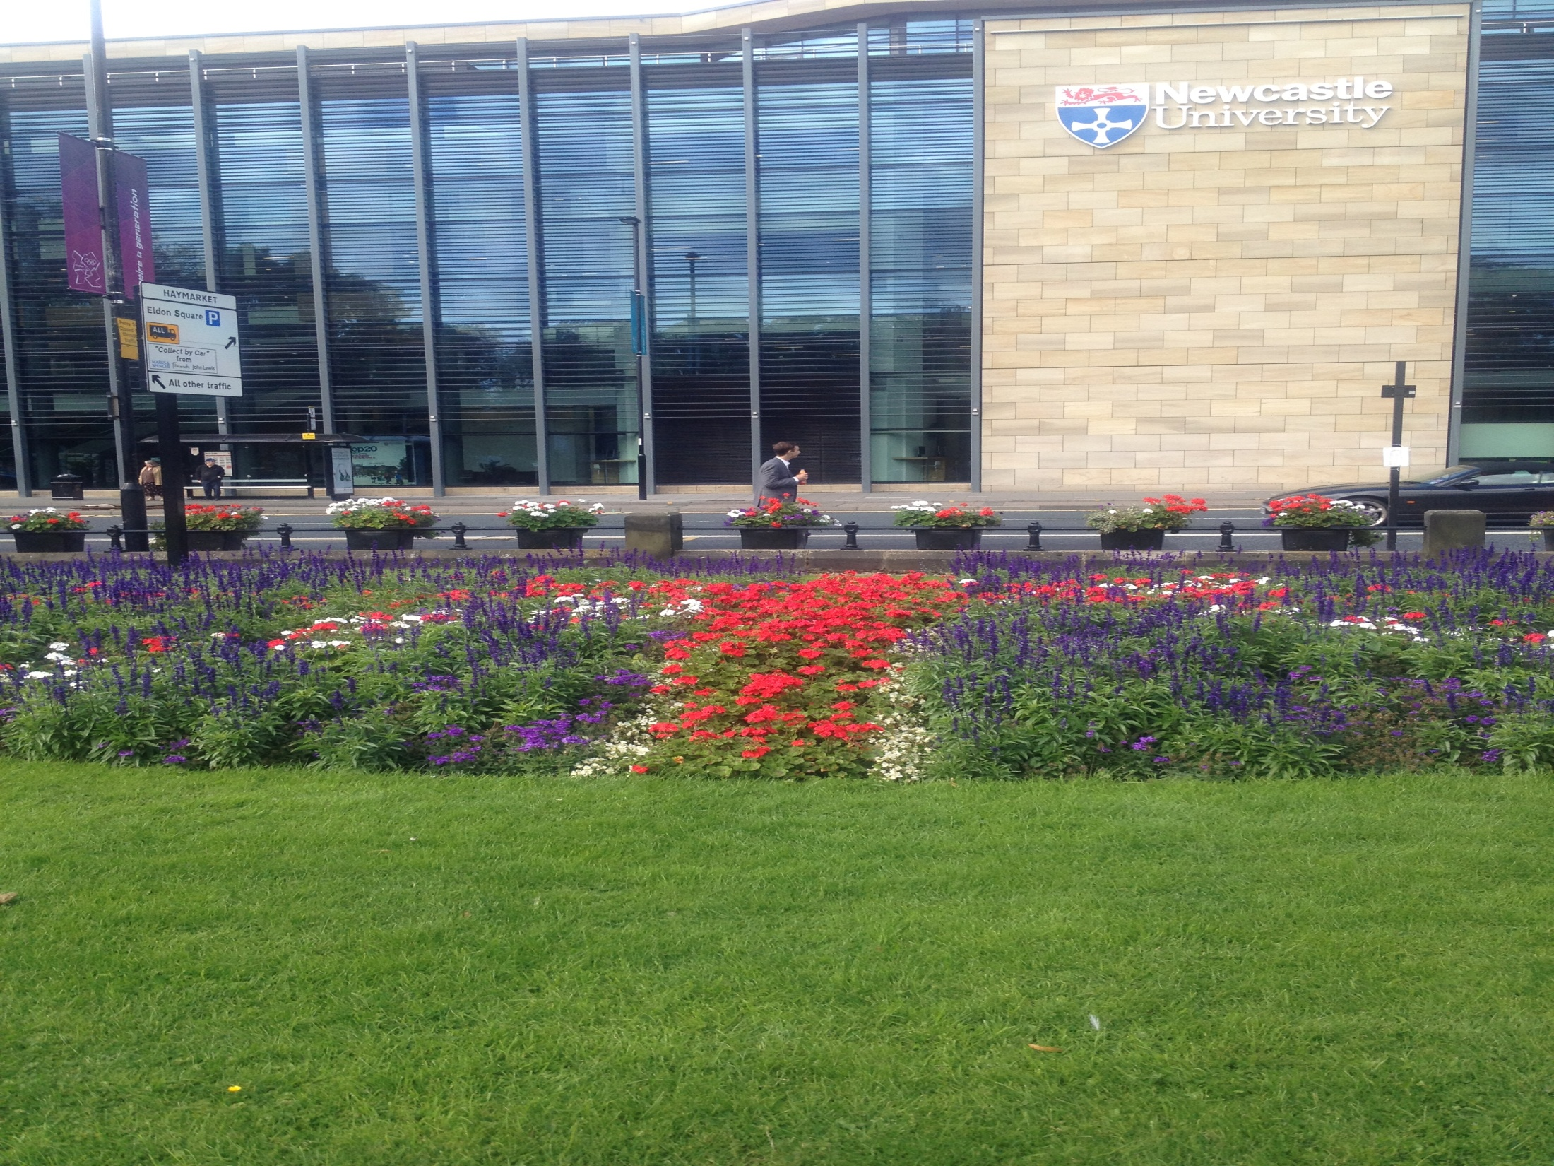
Thank you

