Slide 1
Mendeley software
presented by Dr. Nadiya

Slide 2
This tutorial will help you to use Mendeley to cite and reference the papers while
writing scientific papers.
And I am going to look at how
Mendeley Desktop can be used to organize your own research library and share it to other researchers. It is commonly used as academic software for indexing and organizing PDF documents and research papers.
Mendeley (www.mendeley.com) is a combination of a website and a desktop application which helps manage, share and discover both content and contacts in research.
The Web Library allows you to access your Mendeley library from your browser at any time.
You need to download mendeley desktop for windows
Import papers, web pages and other documents directly into your reference library from search engines and academic databases. Mendeley Web Importer is available for all major web browsers.

Slide 3
Objectives:
1-What are the features of Mendeley software?
2- How to get starting with Mendeley?
3-The application of Mendeley Desktop manager with word Microsoft and Mendeley web importer .
4-How to manage and import researches?

Slide 4
Mendeley Desktop
It can be used to organize your own research library and share it to other researchers. It is commonly used as academic software for indexing and organizing PDF documents and research papers.
Import papers, web pages and other documents directly into your reference library from search engines and academic databases. Mendeley Web Importer is available for all major web browsers.

Slide 5
What are features of Mendeley?

Slide 6
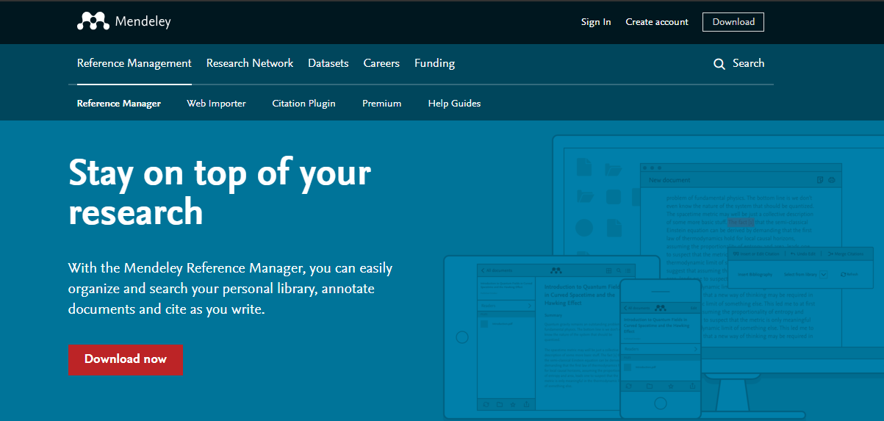
Get starting with Mendeley Desktop
1-http://www.mendeley.com
2-Free Reference Manager & Citation Generator - Mendeley

Slide 7
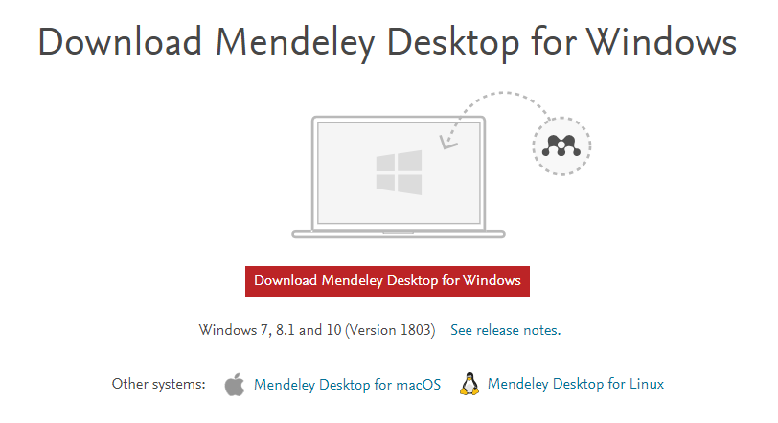
Get starting with Mendeley Desktop

Slide 8
3-Install the Mendeley Web Importer -- Install the Web Importer into your favorite web browser to import references and documents from a wide range of academic databases.
4. Install the Mendeley MS Word Plugin-- Installing the Microsoft Word plugin will allow you to insert citations and bibliographies into your Microsoft Word document.

Slide 9
The application of Mendeley Desktop manager with word Microsoft and Mendeley web importer
How to manage and import researches?

Slide 11
Thank you

