Slide 1
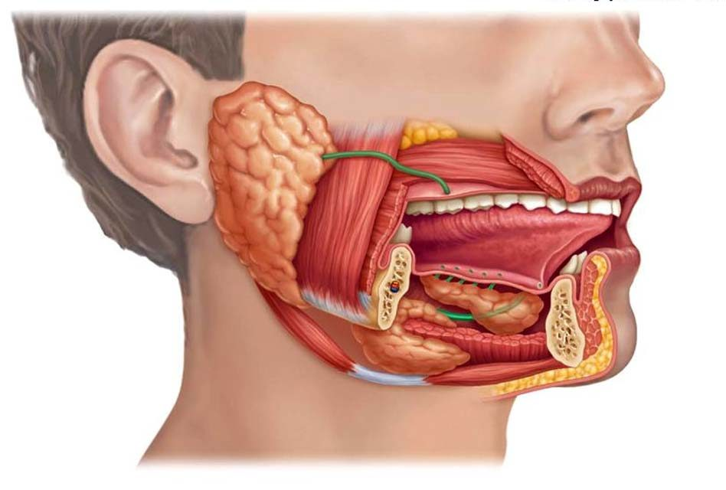
SALIVAry DIAGNOSTIC for diseases
By
Lect. Heba N. Yassin
2022

Slide 2
Introduction
Common oral diseases like dental caries, periodontal diseases and oral cancer have major impact on quality of life. For prevention, treatment and prognosis, it is essential to measure the disease objectively and accurately in a quantitative manner.
Salivary diagnostics has several researchers and has been verified as an important tool in the diagnosis of many systemic conditions and prognosis of the disease.

Slide 3
Why saliva is used for diagnosis?
Saliva is the exudate of serum; hence saliva contains all the biological compounds like hormones, growth factors, antibodies, enzymes, microbes and their products.
Salivary diagnostics has become popular because collecting saliva is non-invasive, inexpensive, less technique sensitive and easy to perform as compared to serum.

Slide 4
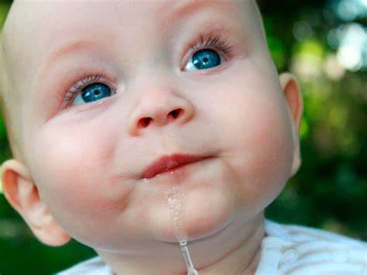
Definition
A clear, tasteless, odourless, slightly acidic (pH 6.8) viscous fluid, consisting of the secretion from the parotid, sublingual, submandibular salivary glands and the mucous glands of the oral cavity.

Slide 5
General properties
Volume: it is approximately about 1 ml/ minute
Contribution by each major salivary gland is:
i. Parotid glands: 25%
ii. Submandibular glands: 70%
iii. Sublingual glands: 5%.
Reaction: Mixed saliva from all the glands is slightly acidic with pH of 6.35 to 6.85.
Specific gravity: It ranges between 1.002 and 1.012
Tonicity: Saliva is hypotonic.

Slide 6
Salivary flow
• The average person produces approximately 0.5 L– 1.5 Lper day
Unstimulated Flow (resting salivary flow―no external stimulus) Typically 0.2 mL – 0.3 mL per minute
Stimulated Flow (response to a stimulus, usually taste, chewing, or medication [eg, at mealtime]) • Typically 1.5 mL – 2 mL per minute
Notes:
is not a syndrome, it’s a sequence. While it is a collection of features, one happens because of the one that came before
There are two proposed theories:
-The first is that the tongue simply gets in the way of the palate from fusing
-The second is that the tongue prevents the newly fused palate from staying fused (this is currently the more popular theory)
PRS is associated with cleft palate (50%of children with the sequence have cleft palate).

Slide 7
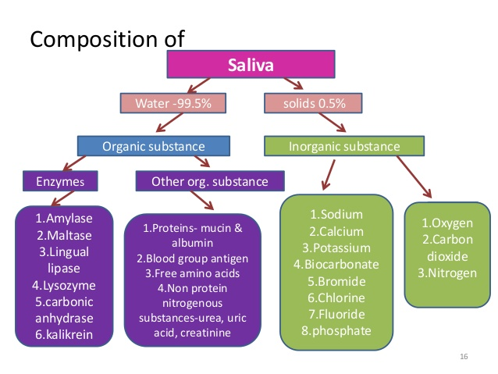
COMPOSITION

Slide 8
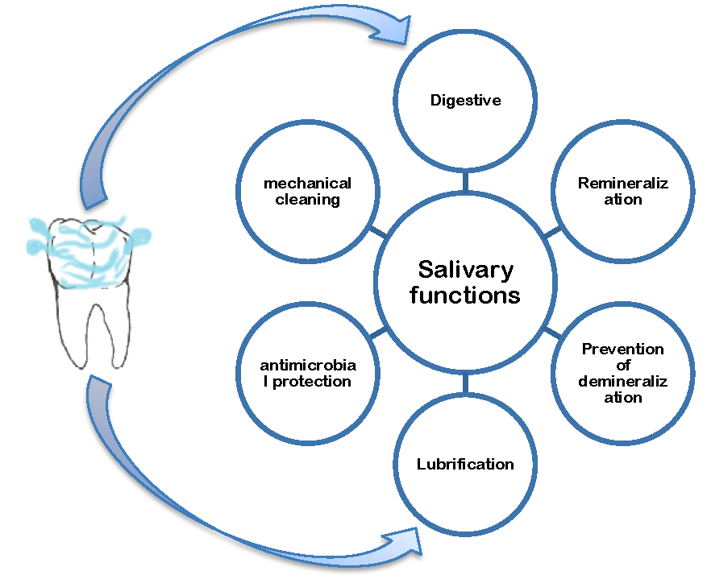
FUNCTIONS OF SALIVA
1. PROTECTION
2. BUFFERING
3. PELLICLE FORMATION
4. MAINTENANCE OF TOOTH INTEGRITY
5. ANTIMICROBIAL ACTION
6. TISSUE REPAIR
7. DIGESTION
8. TASTE

Slide 9
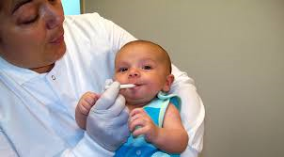
How to Collect Saliva: Collection Methods and Devices
:

Slide 10
Usage of stimulated or un-stimulated saliva for collection
Unstimulated saliva is considered as an ideal sample because it has no effect on flow rate and salivary composition of salivary glands. But some researches shows that stimulated saliva also can provide equally or more precise detection of cancer biomarkers .
Notes:
younger maternal age group Also low level of education was found in majority of iraq babies with CL(P)

Slide 12
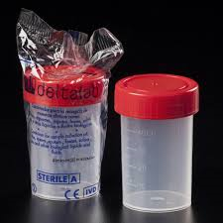
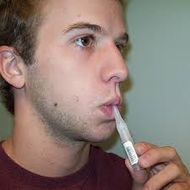
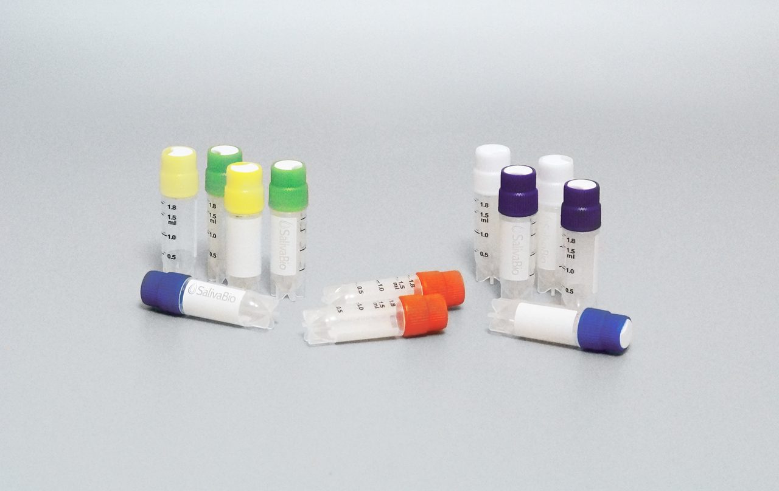
Passive drool
The participant allows saliva to collect on the floor of the mouth, then leans forward and dribbles into a tube is considered the gold standard of collection methods across different analytes. However, it requires compliance from patients and might even be difficult for some adult
Cryovial 2mL
60 ml polypropylene containers

Slide 13
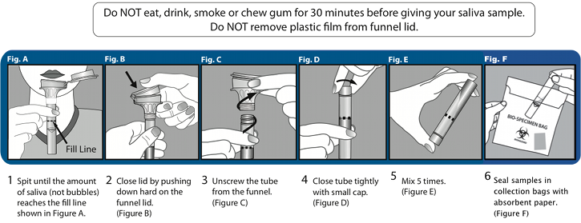
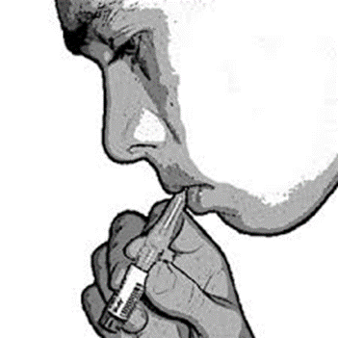
Instructions for Collecting Saliva:
Remove cap from cryovial
Remove Saliva Collection Aid from packaging and place securely into cryovial.
Instruct participants to allow saliva to pool in the mouth.
With head tilted forward, participants should drool to collect saliva in the cryovial.
Repeat until sufficient sample is collected. Reserve air space in the vial to accommodate the expansion of saliva during freezing. Collection of samples to be analyzed for multiple analytes may require additional cryovials.
Replace cap onto cryovial.

Slide 14
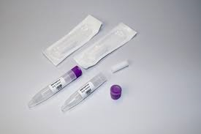
The Salimetrics Oral Swab (SOS)
If participants are not willing or able to drool saliva into a vial.
If the saliva samples are to be analyzed for cortisol, testosterone, α-amylase, chromogranin A, C-reactive protein, or SIgA, the Salimetrics Oral Swab (SOS) is an excellent alternative to passive drool because of its ease of use.
The SOS also helps filter mucus and other matter from the sample, which may help improve immunoassay results.

Slide 15
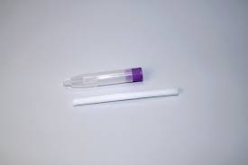
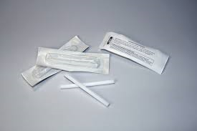
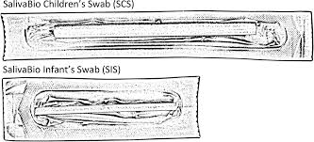
Collection Methods and Devices
Infants and Small Children
The Children’s Swab and Infant’s Swab We recommend the SalivaBio Children’s Swab (SCS) for children under the age of 6, and the SalivaBio Infant’s Swab (SIS) for infants under 6 months of age.
The extra-length SalivaBio Children’s Swab (SCS) may also be used for saliva collection from infirmed adult patients to avoid any danger of choking.
Notes:
-Vitamin A deficiency had been proven to cause cleft palate, because it had been suggested that vitamin A provides the developing palatal processes with plasticity and mobility in addition,
hypervitaminosis A prevent palatal processes fusion because it may cause cell shrinkage with fluid accumulation in the intercellular spaces and reduction in the cell proliferation and mitotic rate.
. DiabetesIt is one of the most common metabolic diseases affecting the normal embryonic growth of the fetus this may be due to the use of insulin in such patients which (insulin) considered as one of the teratogenic drugs

Slide 16
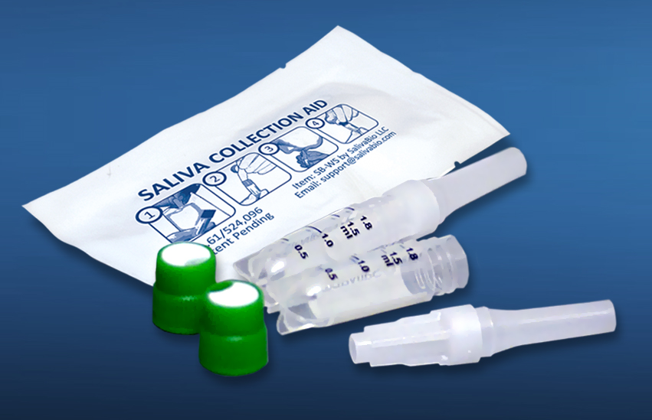
• Passive drool is highly recommended because it is both cost effective and approved for use with almost all analytes.
• If participants are not willing or able to drool saliva into a vial, the SalivaBio Oral Swab may be used as an alternative collection method, but only for certain analytes
• To avoid problems with analyte retention or the introduction of contaminants, use only high quality polypropylene vials for collection, such as 2 ml cryovials.
• The vials used must seal tightly, must be able to withstand temperatures down to -80oC.

Slide 17
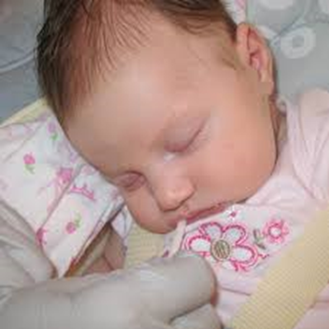
Advantages
Noninvasive diagnosis of disease and monitoring of general health.
Painless, patient suffers no discomfort and little anxiety in the collection process.
Simple in collection with a modest trained assistant and applicable in remote areas.
Relatively cheap technology as compared to other tests.
Cost effective applicability for screening large population.

Slide 18
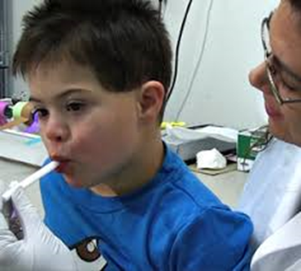
Can be used to study special population where blood sampling is a problem e.g children, anxious /handicap/ elderly patients.
Convenient for multisampling.
Safer for health professionals than blood tests.
Compared to blood and urine, saliva is also cheaper to store and ship.
In addition saliva does not clot and can be manipulated more easily than blood

Slide 19
Limitations
Levels of certain markers in saliva are not always a reliable reflection of the levels of these markers in serum.
Salivary composition can be influenced by the method of collection and degree of stimulation of salivary flow.
Changes in salivary flow rate may affect the concentration of salivary markers and also their availability due to changes in salivary pH.
Variability in salivary flow rate is expected between individuals and in the same individual under different conditions
Furthermore, certain systemic disorders, numerous medications and radiation may affect salivary gland function and consequently the quantity and composition of saliva.
Whole saliva also contains proteolytic enzymes derived from the host and from oral microorganisms. These enzymes can affect the stability of certain diagnostic markers. Some molecules are also degraded during intracellular diffusion into saliva.

Slide 20
Storage and transportation of saliva
Saliva is very sensitive sample, which is influenced by systemic, physiological, microbial, environmental (food products) and biochemical changes in oral cavity. It also fluctuates with time of collection, Ph of the surrounding environment, temperature type of saliva collection method, and storage methods.
Some study reported that storage at −80°C provides less biochemical and microbial changes in saliva hence gives better results as compared to −20°C. To avoid altered results, there should be least time gap between sample collection and analysis
Notes:
Hypo- and hyper tention: these pathologic conditions modified the passage of blood flow through the placenta thus affeced the normal maternal-foetal
interchange of fluids
c. Rubella (German measles):
It is one of the most potent infections and can lead to various congenital malformations. Clinical studies showed that an attack of Rubella during the first trimester result in birth defect

Slide 22
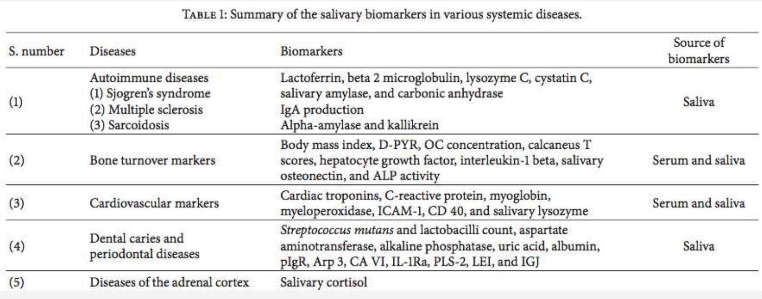

Slide 23
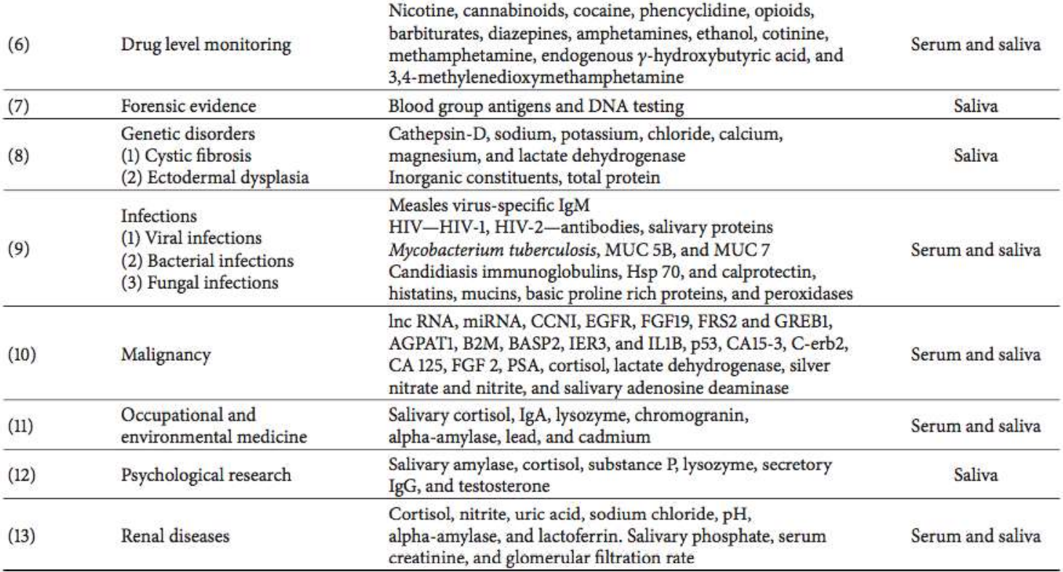

Slide 24
Conclusion
Blood is still the gold standard for diagnostics of diseases and drugs, Saliva offers an alternative to serum as a biologic fluid for diagnostic purposes
However, unlike blood and other body fluids, salivary diagnostics offers an easy, inexpensive, painless, and stress free approach to disease detection.

Slide 25
