Slide 1
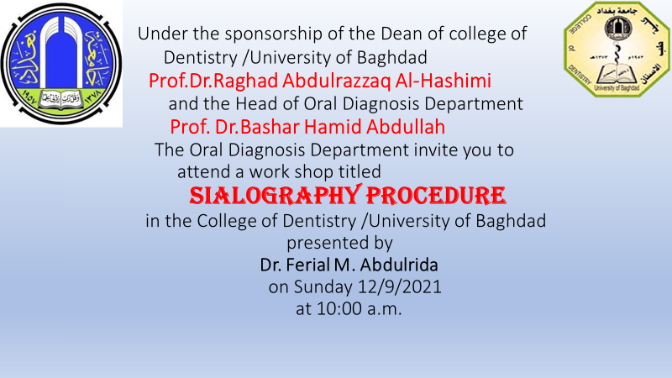

Slide 2
Sialography
Sialography (also termed radio sialography) is the radiographic examination of the salivary glands. It usually involves the injection of a small amount of contrast medium into the salivary duct of a single gland, followed by routine X-ray projections.

Slide 3
History of sialography
was first described by Barsony . in 1925, about a year following the advent of cholecystography

Slide 4
There are three types:
since
1. conventional/fluoroscopic sialography (with or without digital subtraction)
2. CT sialography (ultrafast technique)
3. MR sialography
In most cases, ultrasound (with sialography, if required) is an appropriate imaging modality for the investigation of ductal pathology. In cases of sialolithiasis, ultrasound of the parotid glands is a useful, readily available, noninvasive, and inexpensive option.
Andrew Murphy◉ and Dr Ian Bickle◉ et al.
December 02, 2020

Slide 5
Indications
suspected sialolithiasis or salivary duct obstruction
suspected sialadenitis: to identify ductal strictures
suspected sialectasis in chronic inflammatory disorders and autoimmune diseases

Slide 6
History of contrast media
Radiographic contrast has been used for over a century to enhance the contrast of radiographic images.
In 1896, in the year after X-rays were discovered, inspired air became the first recognized contrast agent in radiographic examinations of the chest.

Slide 10
