Slide 1
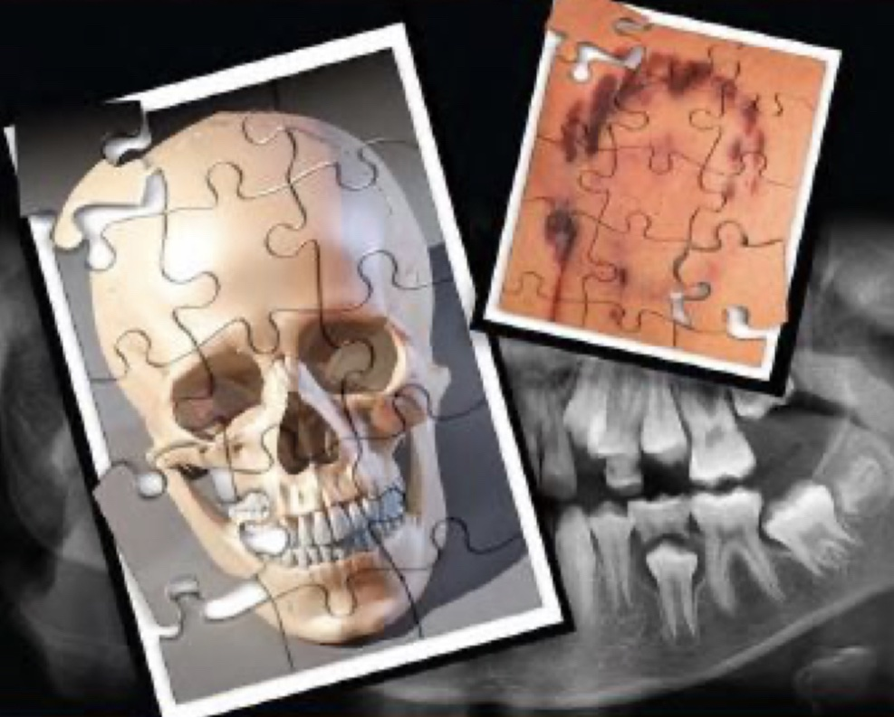
FORENSIC DENTISTRY

Slide 2
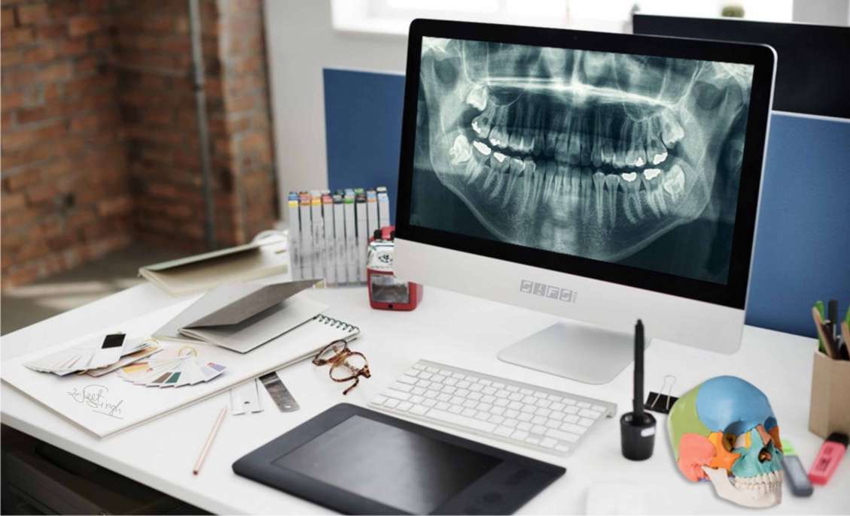
College Of Dentistry
University Of Baghdad
Department of Oral Diagnosis
Oral and Maxillofacial Radiology
Lec. ZAINAB ALBAHRANI

Slide 4
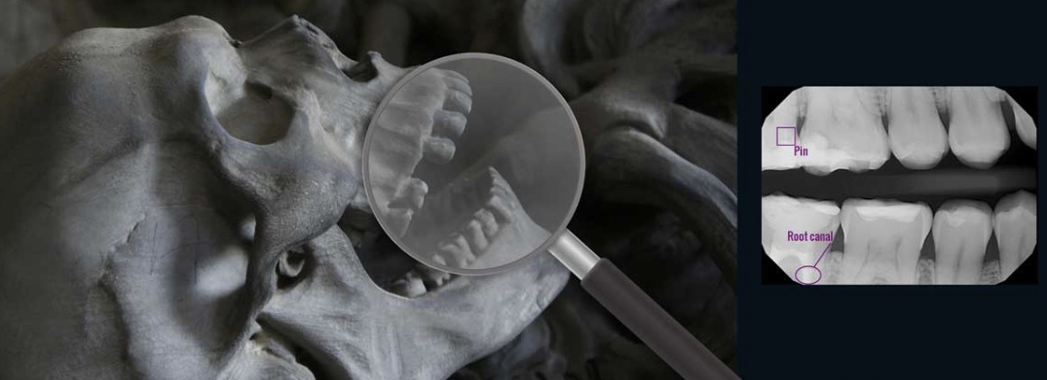

Slide 5
in dentistry.

Slide 7
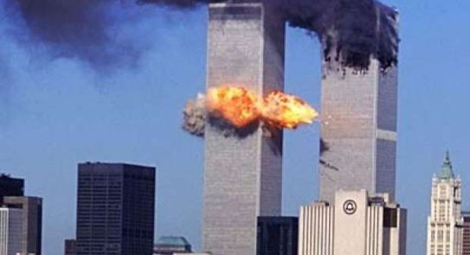

Slide 8
Indications of forensic dentistry

Slide 18
Comparing between pre and post death records

Slide 20
Natural
Accidental
criminal

Slide 24
Dental DNA

Slide 25
1- CYTOGENIC GRINDING METHOD

Slide 26
2- LESS DESTRUCTIVE METHOD

Slide 29
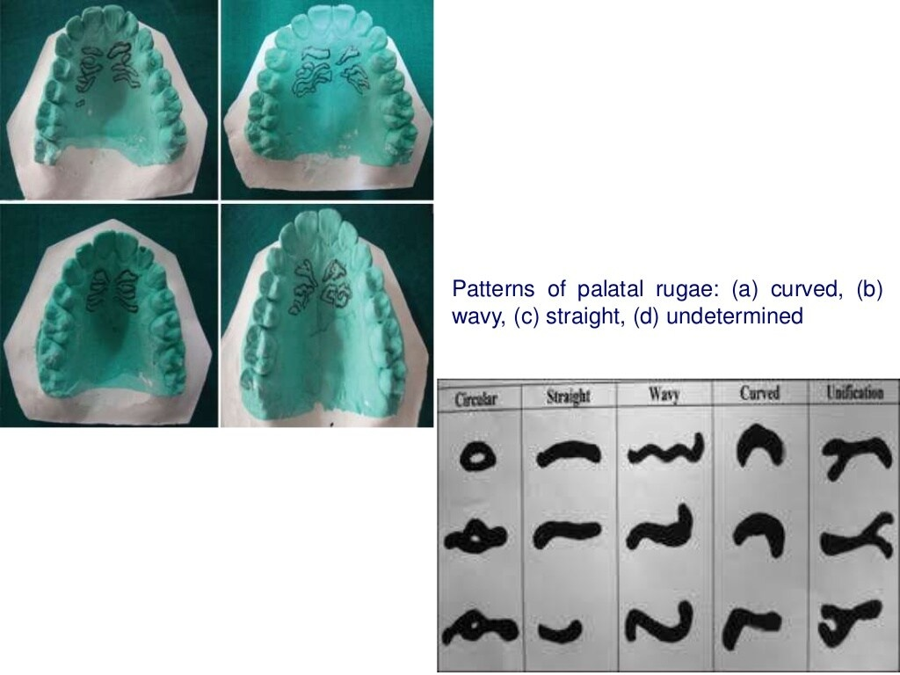

Slide 31
Regarding the morphology

Slide 33
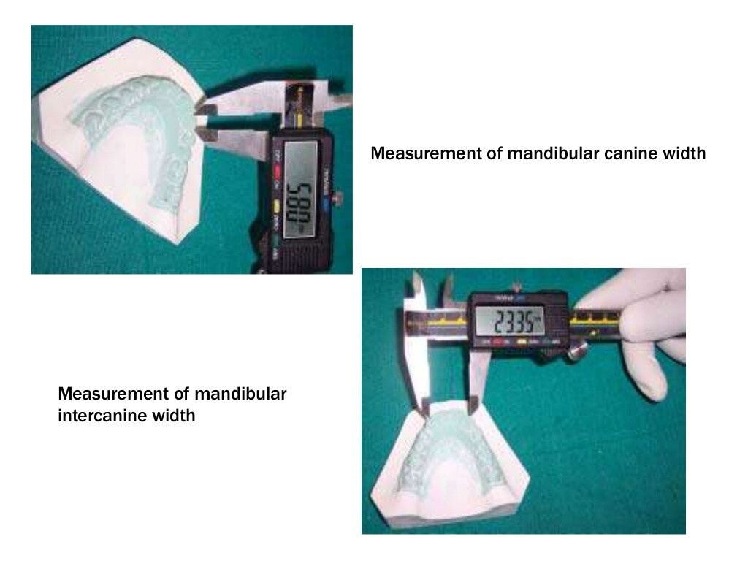

Slide 40
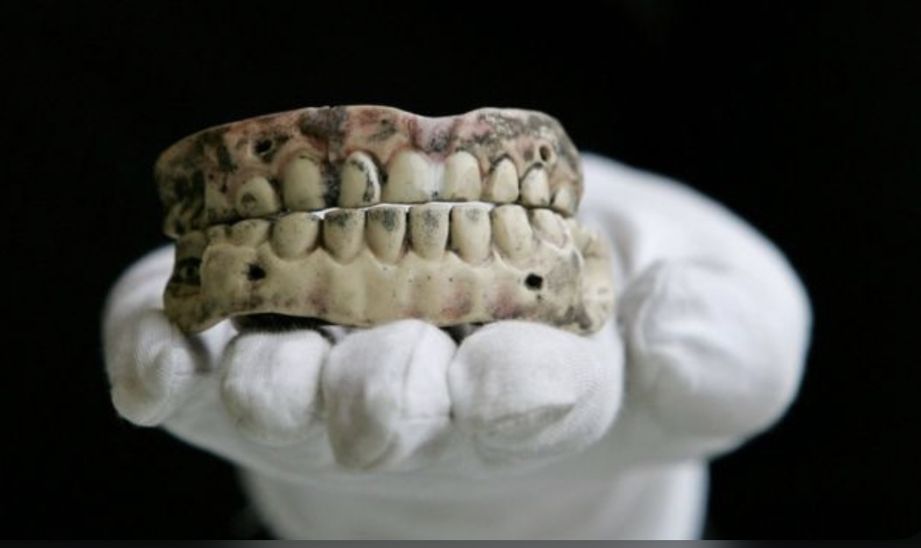
BITE MARKS

Slide 50
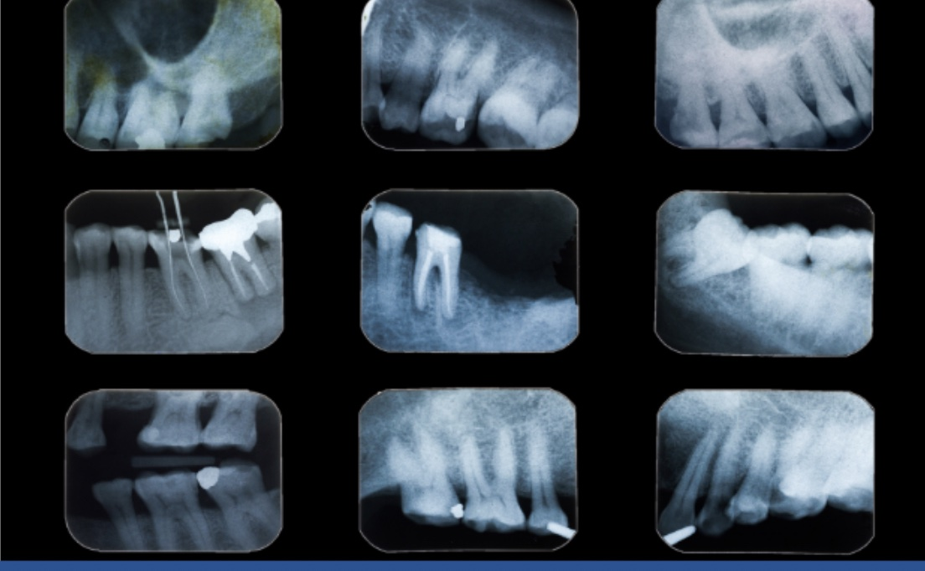

Slide 51
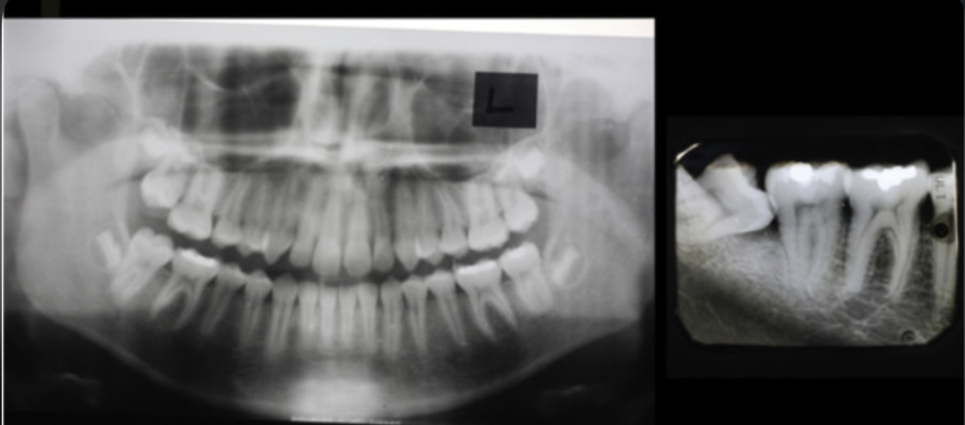

Slide 53
Either conventional radiographs or digital images may be used in single-person
Using larger image films (e.g., occlusal), a complete radiographic survey can be accomplished in six radiographs
The conventional films or specimens can readily be wrapped in polyethylene stock bags to prevent contamination
Most forensic dentists use digital systems. The advantages of digital systems include the ability make retakes to modify the imaging angle to replicate the antemortem images

Slide 54
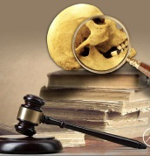
CONCLUSION

