Slide 1
Oral lichen planus and its recent management
م.م. نور سعد محمد علي Oral diagnosis department/Oral medicine

Slide 2
Introduction
OLP is a chronic inflammatory cell‐mediated immune disease of unknown etiology. Skin and mucous membranes are most commonly involved. In addition to oral mucosa, other mucous membranes (e.g., genitals in women, esophagus, rectal area) as well as scalp and nails can be affected. Several sites may be involved, consecutively or simultaneously. Typically, OLP is bilateral (symmetric) and can appear both white and red, depending on disease activity. It is striking because of its versatile presentation between individual patients. Some have long periods of remission, while others have frequent exacerbations and are not very responsive to treatment.

Slide 3
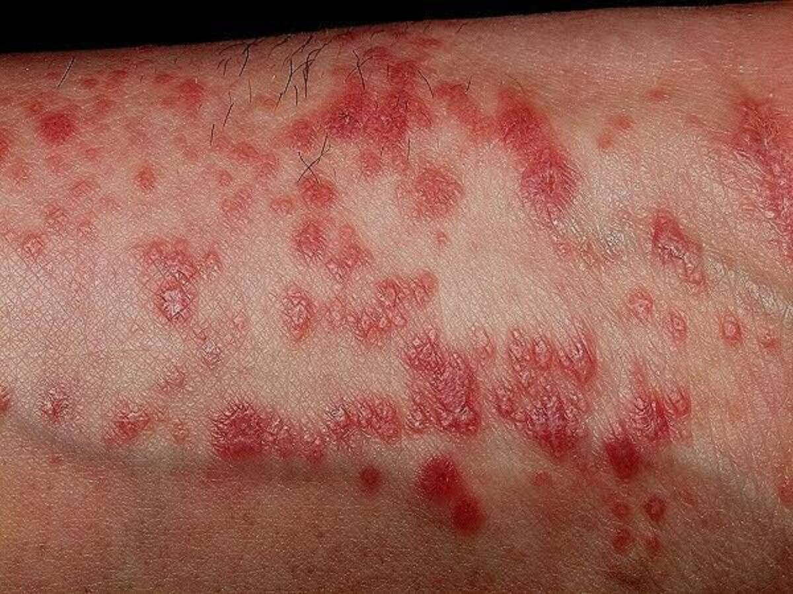
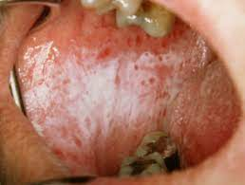
Lichen planus

Slide 4
Epidemiology
The prevalence rate of OLP is reported as 0.5–2.2% with a malignant transformation rate of 1.09% .
Oral lesions occur in about 50% of patients with cutaneous lichen planus; Conversely, cutaneous lesions occur in 10–15% of persons with OLP. The proportion of women is higher than that of men, with a ratio of 3:2.
The condition usually occurs in people older than 40 years, the mean age of onset being 53 years. It is very rarely encountered in children, and does not seem to have a hereditary predisposition.
oral lichen planus may occur before ,at the same time or after skin lesions.
The highly risk for oral lichen planus was 13.7% among people who smoked or chewed tobacco.

Slide 5
Etiology
The specific etiology of oral planus lichen is uncertain. But some potential initial triggering factors which determine keratinocytes destruction are considered to be the following:
1-Genetic background :Genetic polymorphism of cytokines, IFN-gamma, increase in frequency of 308A TNF-alpha allele (SKIN).
2-Psychosocial factors: Stress and anxiety
3-Trauma:Koebner phenomenon.
4-Medical conditions such as auto immune disease, diabetes, chronic liver disease, intestinal diseases, increases cholesterol level, hypertension, Thyroid dysfunction, GVHD and infections hepatitis C virus (HCV) can also cause onset of oral lichen planus.
5- Systemic medicines can also contribute to the production of oral lichenoid reactions (OLR) and lichen planus, such as nonsteroidal anti-inflammatory drugs, antihypertensive, and oral hypoglycemic .
6-Amalgam, copper , and nickel from dental restorative content can also be related to the localization of OLR in some patients.

Slide 6
Pathophysiology
OLP is considered a T cell-mediated autoimmune disorder in which apoptosis of basal epithelial cells is caused by clusters of differentiation (CD8)+ T cells which responsible for apoptosis of the keratinocytes in the basal cell layer. These lymphocytes are a major component of the sub epithelial inflammatory infiltrate in the mucosal lamina propria. The tissue destruction originates from the lymphocytic infiltrate and production of cytokines, characteristic of T‐helper type 1 immune cellular response (IL‐12, TNFα, interferons)

Slide 7
They activate keratinocytes for increased expression of(Intracellular adhesion molecule) (ICAM1 )and the class II major histocompatibility complex (MHC) antigens. Other cells participating are CD4 cells, dendritic cells, natural killer (NK) cells, and mast cells, Autoantibodies do not appear to be involved in the pathogenic process. The antigen that would trigger the onset of OLP is still unknown.

Slide 8
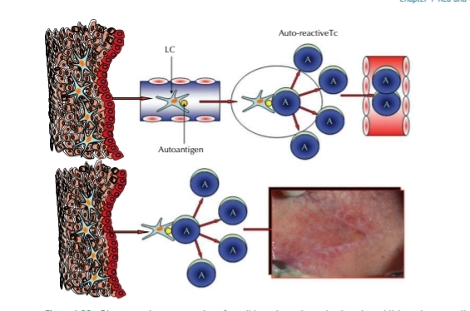
Diagrammatic representation of possible pathogenic mechanisms in oral lichen planus, a cell‐mediated autoimmune disease where cytotoxic CD8+ T lymphocytes are responsible for apoptosis of the keratinocytes in the basal cell layer. Autologous antigen peptides from basal cells or elsewhere are presented by Langerhans cells (Lc) to auto reactive T cells (Tc), which clonally expand and induce apoptosis in the basal cell layer and lead to the clinical lesions of oral lichen planus.

Slide 9
Clinical findings
OLP may contain both red and white elements and these, together with the different textures, provide the basis for the clinical classification of this disorder. Oral lesions are typically multifocal, bilaterally distributed, most commonly symmetrically on the buccal mucosa, on lateral sites of the tongue, and on gingiva. However, they may appear anywhere in the mouth, including the lip vermilion. Palatal lesions are less common. The white and red components of the lesion can be a part of several clinical phenotypes:

Slide 10
● Reticular (and papular as its close clinical variant).
● Erythematous (also referred to as atrophic).
● Ulcerative (also referred to as erosive).
● Plaque‐like.
● Bullous—very uncommon and usually associated with one of the other phenotypes.

Slide 11
1-The reticular form of OLP is characterized by fine white lines or striae .
in all regions of the oral mucosa
More common in buccal mucosa
rarely on the mucosal side of the lips.
can sometimes be observed at the vermilion border.
2-The papular type of OLP is usually present in the initial phase of the disease. Small and densely distributed hyperkeratotic papules are present. These papules may coalesce and form a more reticular type,

Slide 12
3-Plaque-type OLP shows a homogeneous well-demarcated white plaque
clinically be very similar to homogeneous oral leukoplakia. The difference between these two mucosal disorders is the simultaneous presence of reticular or papular structures in the case of plaque-like OLP
Typically, the reticular, papular, and plaque-like forms of
OLP are asymptomatic, although the patient may experience feeling of roughness

Slide 13
4-Erythematous (atrophic) OLP is characterized by a homogeneous red area.
When OLP is present in the buccal mucosa or in the palate, striae are frequently seen in the periphery. Some patients may display erythematous OLP exclusively affecting attached gingiva.
This form of lesion may occur without any papules or striae and presents as desquamative gingivitis.
5- Ulcerative lesions (erosive)
Clinically, grayish/yellowish fibrin pseudomembranes coated ulcers are surrounded by an erythematous zone frequently displaying radiating white striae. The affected patient complains of chronic sensitivity, increased in conjunction with food intake.

Slide 14
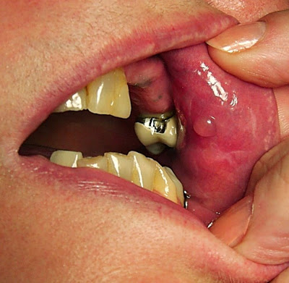
  6-Bullous form
    Intraoral bullae on buccal mucosa and lateral surface of tongue
    Rupture soon after appearance resulting in classic appearance of erosive lesions

Slide 15
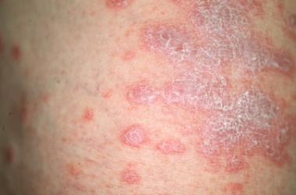
skin lesions.
erythematous purple, polygonal, pruritic papulesThe predilection sites are the trunk and flexor surfaces of arms and legs , The papules may be discrete or coalesce to form plaques. intense scratching of the lesions, but trauma may aggravate the disease, which is referred to as a Koebner phenomenon.
genital involvement …….. Symptoms including burning, pain, vaginal discharge, and dyspareunia.
Esophageal OLP ……. the main complaint being dysphagia.

Slide 16
1.1% of OLP lesions advance to OSCC, with a higher occurrence of cigarettes, alcohol users and hepatitis C virus infected individuals.
Erosive OLP tends to be the form with the highest frequency to advance to OSCC. Malignant transformation happens most often in lesions that are found on the tongue.

Slide 17
Diagnostic tests
Clinical exam: for reticular LP with characteristic appearance of Wickham’s striae or annular pattern on erythematous background
Histological and Direct Immunofluorescent examinations: for plaque and erosive LP because they can resemble other mucosal lesions including malignancy

Slide 18
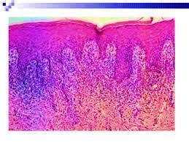
Histological exam
characterized by a dense “band‐like,” predominantly T‐lymphocytic subepithelial infiltrate in the lamina propria .
T lymphocytes from the lamina propria penetrate epithelium and cause apoptosis of epithelial basal cells, which is sometimes described as vacuolar (hydropic) degeneration and lysis of basal cells, seen under a microscope as scattered cytoid (hyaline, colloid) Civatte bodies along the epithelial interface.

Slide 19
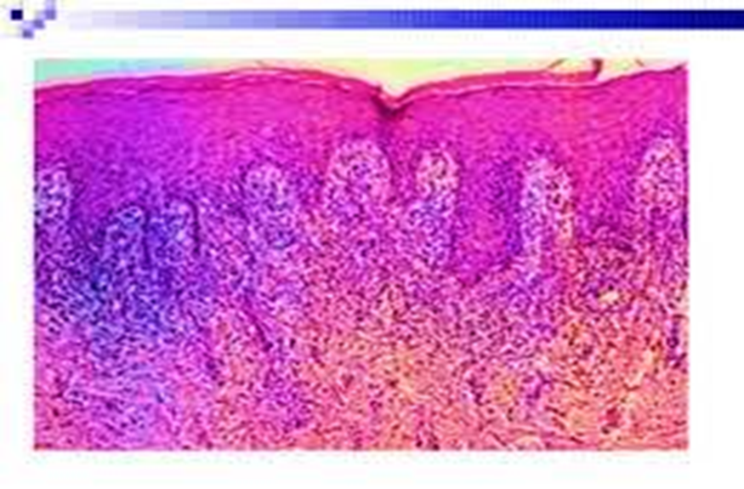
Eosinophils and fibrin may be seen just beneath the basement epithelial layer covering the lamina propria. The basal epithelium may display “sawtooth” rete pegs, but this feature, although typical for cutaneous lichen planus, is not so frequently present in OLP. The epithelium shows hyperorthokeratosis and hyperparakeratosis (stratum corneum), often with a thickening of the granular cell layer and acanthosis (thickening of stratum spinosum).

Slide 20
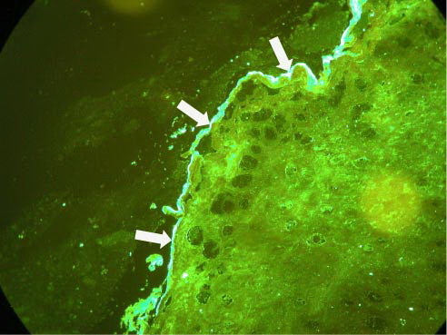
Direct Immunofluorescent examination
  Requires biopsy
  Differentiates between other autoimmune conditions
  Detects shaggy deposition of fibrinogen along the basement membrane

Slide 21
Epicutaneous patch testing.
Hematological investigations .
Photographic records of lesions.

Slide 22
The differential diagnosis can include
frictional keratosis
lichenoid reactions
leukoplakia
lupus erythematosus
pemphigus, mucus membrane pemphigoid,
erythematous candidiasis
chronic ulcerative stomatitis.

Slide 23
Lichenoid drug reactions are usually unilateral in distribution, accompanied by a history of new drug intake. The most reliable method to diagnose lichenoid drug reactions is to note if the reaction resolves after the offending drug is withdrawn, and returns if the patient is challenged again.
Dental restorative material induced lichenoid reactions can be identified when OLP like lesions are confined to areas of the oral mucosa in close contact or proximity to restorative materials, usually amalgam.
A positive patch test, a strong clinical correlation of proximity of a restoration
biopsy suggestive of diffuse lymphocytic infiltrate rather than a subepithelial band favor a diagnosis of oral lichenoid reactions.

Slide 24
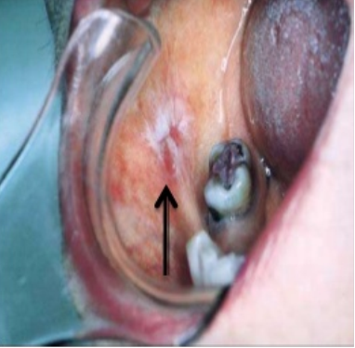
Lichenoid reactions

Slide 25
lesions of lupus erythematosus (LE) most often resemble erosive lichen planus but tend to be less symmetrically distributed. The keratotic striae of LE are much more delicate and subtle than Wickham's striae and show a characteristic radiation from the central focus. Biopsy of LE shows a characteristic perivascular infiltrate.

Slide 26
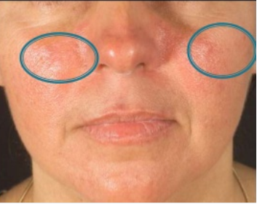
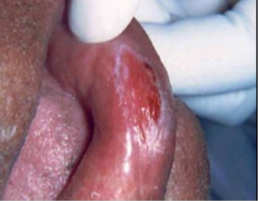
LUPUS ERYHTEMATOSUS

Slide 27
PEMPHIGUS VULGARIS
    Nikolsky's sign positive in pemphigus vulgaris
    Patient gives the recurrence history of bullae and vesicle formation

Slide 28
BENIGN MUCOUS MEMBRANE PEMPHIGOID
  Eye involvement
  Mucosal blistering, ulceration, subsequent scaring
  Desquamative gingivitis is the most common manifestation and may be the only manifestation of the disease appearing bright red.

Slide 29
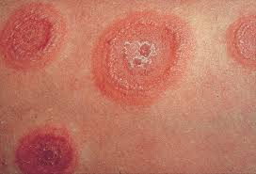
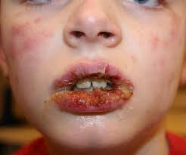
ERYTHEMA MULTIFORMAE
  Bullae and vesicle formation
  Appear as a target or iris lesion
  More severe form of erythema multiformae is STEVEN JOHNSON SYNDROME
  Course of lesion is acute and generally involves the labial mucosa.

Slide 30
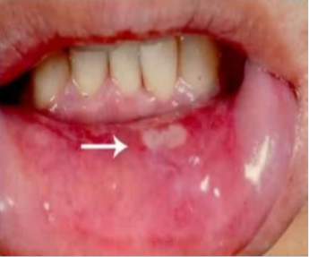
Chronic ulcerative stomatitis (CUS) is an immune-mediated disorder affecting the oral mucosa which clinically and histopathologically resembles lichen planus. Diagnosis of CUS is based on direct immunofluorescence studies where autoantibodies are directed against p63 in the basal and parabasal layers of the epithelium. These lesions have to be differentiated from lichen planus because CUS does not respond to corticosteroid therapy and has to be treated using antimalarial drugs.

Slide 31
MANAGEMENT AND TREATMENT
Management of OLP should be done in a systematic manner.
The first step is to develop a history-based diagnosis,
clinical evaluation and
complex histo-pathology testing, direct immunofluorescence (DIF), indirect immunofluorescence (IIF),
skin patch testing

Slide 32
The second stage is to advise the patient of the following: OLP is a persistent condition with predicted flare-up times and symptom-free periods; each patient will have variations in disease activity.

Slide 33
The targets of therapy are to relieve unpleasant signs, eradicate ulcerative lesions, decrease the risk of oral cancer, prolong symptom-free times and promote proper oral and dental hygiene.
Owing to its recalcitrant disposition and also its idiopathic etiology, multiple drugs will need to be tried.

Slide 34
topical and systemic immuno- suppressants are typically administered to relieve clinical symptoms, but most of the cases of OLP tend to be more persistent and more resistant to treatment despite of many treatment modalities like topical and systemic steroids, anti-inflammatory coating gels, topical calcineurin inhibitors, retinoids and immunosuppressants.

Slide 35
Side effects
side effects such as dysgeusia, tachyphylaxis, oral mucosa thinning, adrenal suppression ,systemic absorption and secondary candidiasis up on long term management.

Slide 36
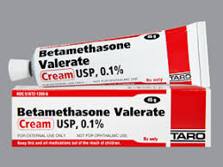
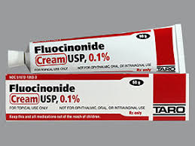
  Topical steroids are considered as the first line of treatment as well as the gold standard in OLP treatment for decades.
  Betamethasone cream (0.1%) 60 g; apply after meals and at bedtime
  Fluocinonide gel/cream 0.05% 60 g; apply after meals and at bedtime .

Slide 37
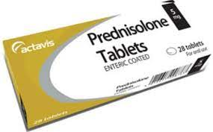
In mild cases of OLP, topical steroids can be used but systemic corticosteroids must be given in cases where topical corticosteroid doesn't work, such as in recalcitrant, erosive and erythematous OLP.
Here, 40-80 mg of prednisolone is prescribed for 5-7 days.

Slide 38
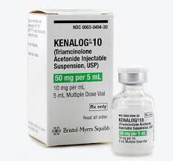
Intralesional therapy: triamcinolone acetonide 5–10 mg/mL; inject 1–3 mL per session with sessions at 3–4 week intervals

Slide 39
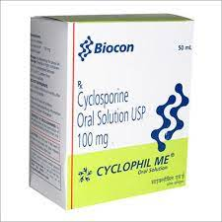
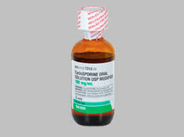
Some immunosuppressants and immunomodulatory agents are indicated in cases of contraindications for systemic steroids (breast-feeding, herpetic diseases, glaucoma, HIV, asthma, diabetes mellitus, or hypertension): calcineurin inhibitors (cyclosporine, tacrolimus, pimecrolimus), mycophenolate mofetil, efalizumab.
Cyclosporine can be used as a mouth rinse. However due to its high cost, it should be reserved for recalcitrant cases.

Slide 40
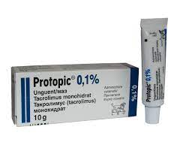
Tacrolimus is a more powerful inhibitor of calcineurin that can be used in the treatment of recalcitrant and erosive OLP safely and efficiently.
It has an immunosuppressive effect similar to cyclosporine and can readily penetrate into the mucosa. It is highly advised to use it two times/day (ointment of Protopic 0.1%) . for a limited period of time because of its ability to facilitate malignant transformation in long term use .

Slide 41
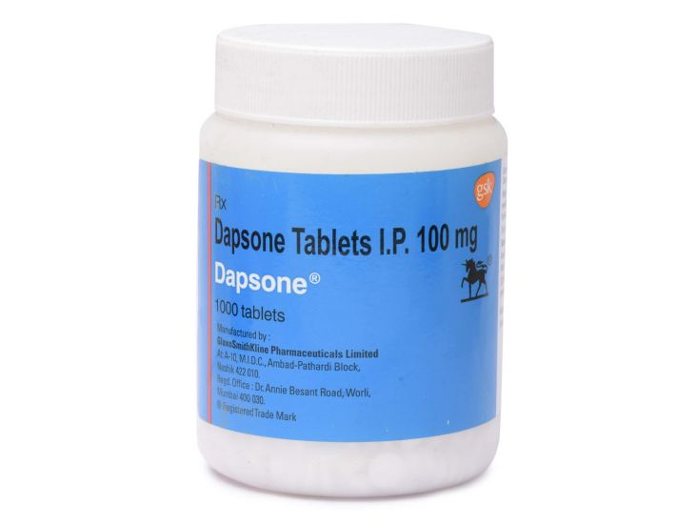
When steroids are contraindicated, Dapsone an antibacterial agent, dapsone inhibits bacterial synthesis of dihydrofolic acid and hence is used in the treatment of leprosy. When used for the treatment of skin diseases, it probably acts as an anti-inflammatory agent by inhibiting the release of chemotactic factors for mast cell.
(usual adult dose of 100 mg a day for 3 months), is an important medicine in erosive OLP.

Slide 42
Mycophenolates
Originally used to treat psoriasis, mycophenolic acid (now reformulated as mycophenolate mofetil) has been reintroduced in dermatological medicine. Being a very well-tolerated immunosuppressive drug used in organ transplant, it has been successfully used to treat severe cases of OLP. Mycophenolates are quite expensive and effective with long-term usage.
Low-dose, low molecular weight heparin (enoxaparin)
Low-dose heparin devoid of anticoagulant properties inhibits T lymphocyte heparanase activity which is crucial in T-cell migration to target tissues. This promises to be a simple, effective and safe treatment for OLP when injected subcutaneously as it has no side effects.

Slide 43
In case of isolated plaques and non healing erosive OLP, surgical excision is recommended In clustered erosive and symptomatic OLP, free gingival grafts were used, indicating a complete eradication of the disease.
Micronutrients, like antioxidants, modify the role of the immune system and are perceived appealing substitutes of negligible side effects while handling OLP.

Slide 44
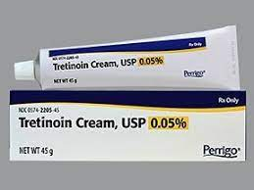
Vitamin A
Topical retinoids like tretinoin, isotretinoine or fenretinide have been reported to induce transient reversal of white striae in OLP. although effects may only be temporary. Systemic retinoids have been used in cases of severe lichen planus with variable degree of success. relative to topical corticosteroids, topical retinoids are usually less effective since they are associated with side effects such as cheilitis and elevated serum triglyceride and liver enzyme levels.

Slide 45
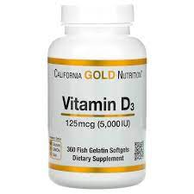
Vitamin D
One study showed that subjects who took vitamin D supplements in addition to the routine treatment improved the clinical appearance of the lesion in the 1st week and completely disappeared on a period of 4 weeks.

Slide 46
In another study of OLP treatment,3 groups of patients were put on psychiatric counseling and vitamin D along with topical corticosteroid. The result of this study showed that patients receiving vitamin D supplements with or without the psychiatric counseling, improved their symptoms.

Slide 47
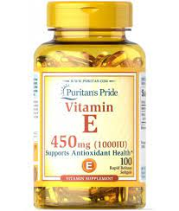
Vitamin E
In another clinical trial, adjunctive systemic use of vitamin E with topical triamcinolone acetonide adhesive paste has demonstrated positive results without any side effects.

Slide 48
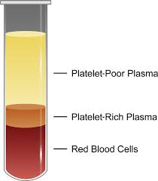
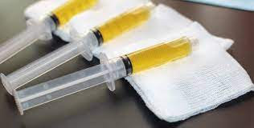
NON-PHARMACOLOGICAL MODALITIEs platelet rich plasma
platelet rich plasma (PRP) patients own plasma is used for the treatment. PRP showed to be effective in decreasing the symptoms and improvement in clinical signs of OLP, which was resistant to conventional therapy .

Slide 49
A case report of erosive OLP which showed resistance to conventional therapy was efficiently treated by PRP. There was significant reduction in patient's symptoms and the clinical presentation of the lesion after 1st week and the lesion was completely regressed in terms of size and inflammation by the 4th week.
On the follow up visit after 6 months, no recurrence of the lesion was observe . They concluded that PRP could be used in the erosive form, which proved to be successful once a week when implemented

Slide 50
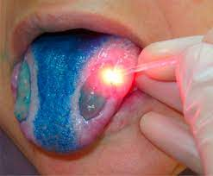
Photodynamic therapy

Slide 51
Photodynamic therapy
Photodynamic therapy (PDT) is a technique that uses a photosensitizing compound like methylene blue, activated at a specific wavelength of laser light, to destroy the targeted cell via strong oxidizers, which cause cellular damage, membrane lysis, and protein inactivation. PDT has been used with relative success in the field of oncology, notably in head and neck tumors. PDT is found to have immunomodulatory effects and may induce apoptosis in the hyper proliferating inflammatory cells which are present in psoriasis and lichen planus.

Slide 52
Laser
patients who are suffering from painful erosive OLP and are unresponsive to even topical super potent corticosteroids, surgical management using cryosurgery and different types of laser have also been tried.
A 980-nm Diode laser, CO₂ laser evaporation, biostimulation with a pulsed diode laser using 904-nm pulsed infrared rays and low-dose excimer 308-nm laser with UV rays have been tried.
All types of laser destroy the superficial epithelium containing the target keratinocytes by protein denaturation. A deeper penetrating beam like the diode laser destroys the underlying connective tissue with the inflammatory component along the epithelium. The few studies documented show a lot of promise, but their effectiveness is yet to be proven.

Slide 53
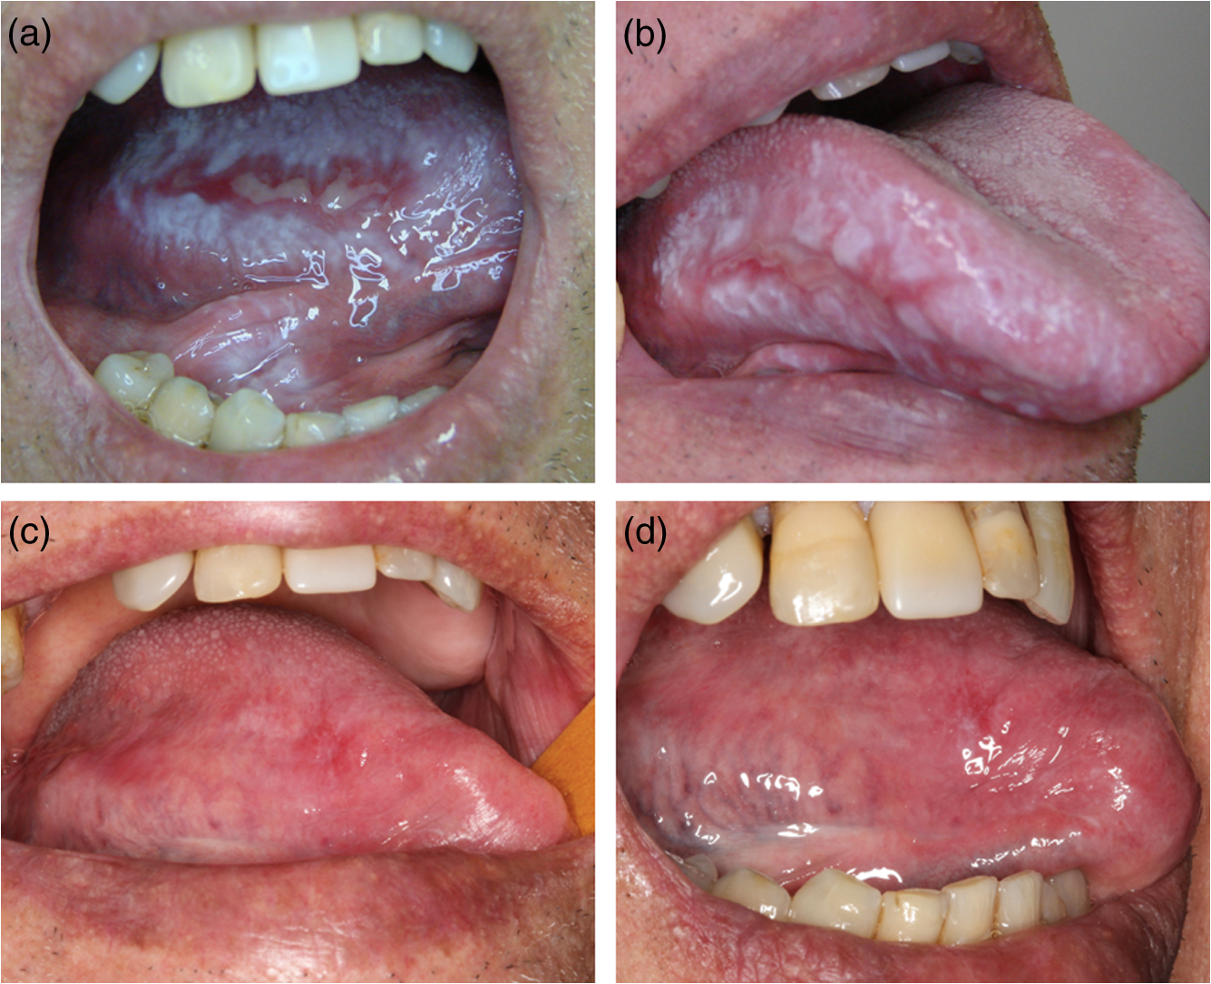

Slide 54
PUVA therapy
This non-pharmacologic approach uses photochemotherapy with 8-methoxypsoralen and long wave ultraviolet light (PUVA). Psoralens are compounds found in many plants, which make the skin temporarily sensitive to UV radiation. Methoxypsoralen is given orally, followed by administration of 2 hours of UV radiation intraorally in the affected sites. It has been successfully used in the treatment of severe cases of OLP.
Two major disadvantages of PUVA therapy include the adverse effects of nausea and dizziness secondary to psoralen and 24-hour photosensitivity when this medicine is taken orally. Also, dosimetry can be difficult within the complicated geometry of the mouth, because PUVA is usually administered on skin over large, open surfaces.

Slide 55
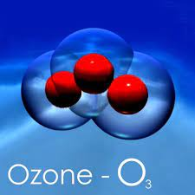
Ozone (O3)
Ozone (O3) has also gained a lot of interest in treating OLP. O3 is a very strong antioxidant that is being used as a disinfectant and a germicidal agent used in medical purposes.
It also increases blood circulation and has healing effect.

Slide 56
A case-controlled study showed that Compared to the group treated with corticosteroids alone, lesion size, Thongprasom score and discomfort dramatically reduced in the group treated with ozone and topical corticosteroids.
This was supported by another two studies carried out by Mostafa et al.2018. and Bayer et al .2017,Ozonized water seems to be effective as an adjunct therapy, in combination with topical corticosteroids, for the treatment of eOLP.

Slide 57
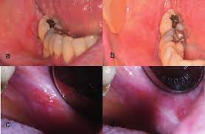
Ozone (O3)

Slide 58

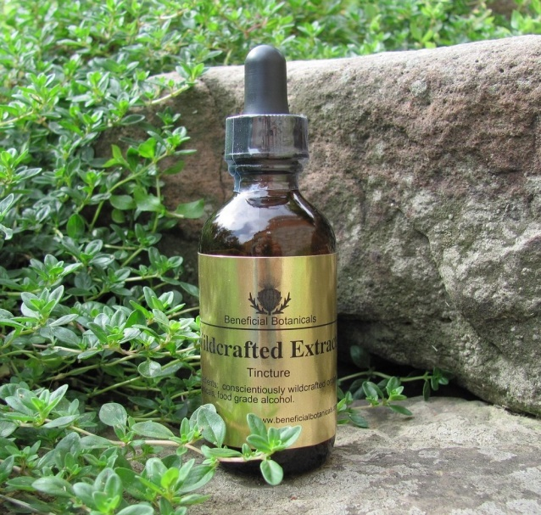
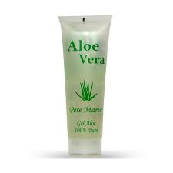
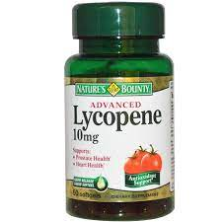
natural agents
like, lycopene, curcumin, purslane,chamomile and aloe vera have also been assessed for management of OLP with varying outcomes.

Slide 59
CONCLUSION
Oral lichen planus is a chronic inflammatory condition of uncertain etiology. Patients who have a history of chewing tobacco, areca nut chewing, smoking and alcohol consumption should be monitored constantly as there is a higher chance of the lesion to undergo malignancy specially in case of atrophic and erosive type. Depending on the form and severity of the lesion and doctor’s own preference, the treatment could be non-surgical or surgical. However, more intensive studies must be carried out to find the best treatments which are cost effective in the long run.

Slide 60


