Slide 1

INLE Advanced Training
Eelaf Ayyed

Slide 2

Agenda
How to get Activity completion report.
How to get Quiz report.
Override users.
H5P.

Slide 3


Activity Completion
Activity that allows you to select one or more course activities or resources and change their default settings (usually 'manual') to a setting of your choice.

Slide 4
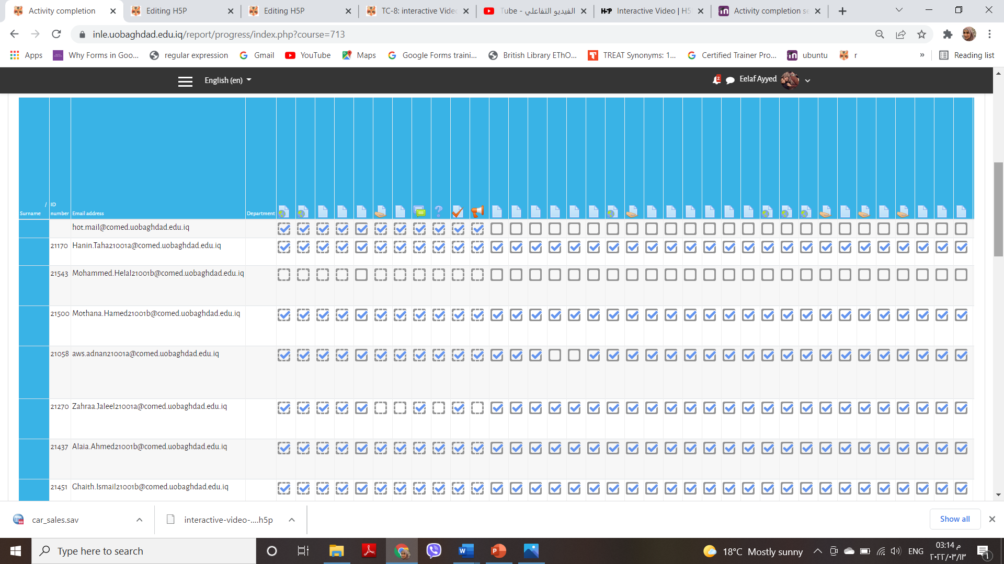
Activity Completion

Slide 5

Report of Exam

Slide 6
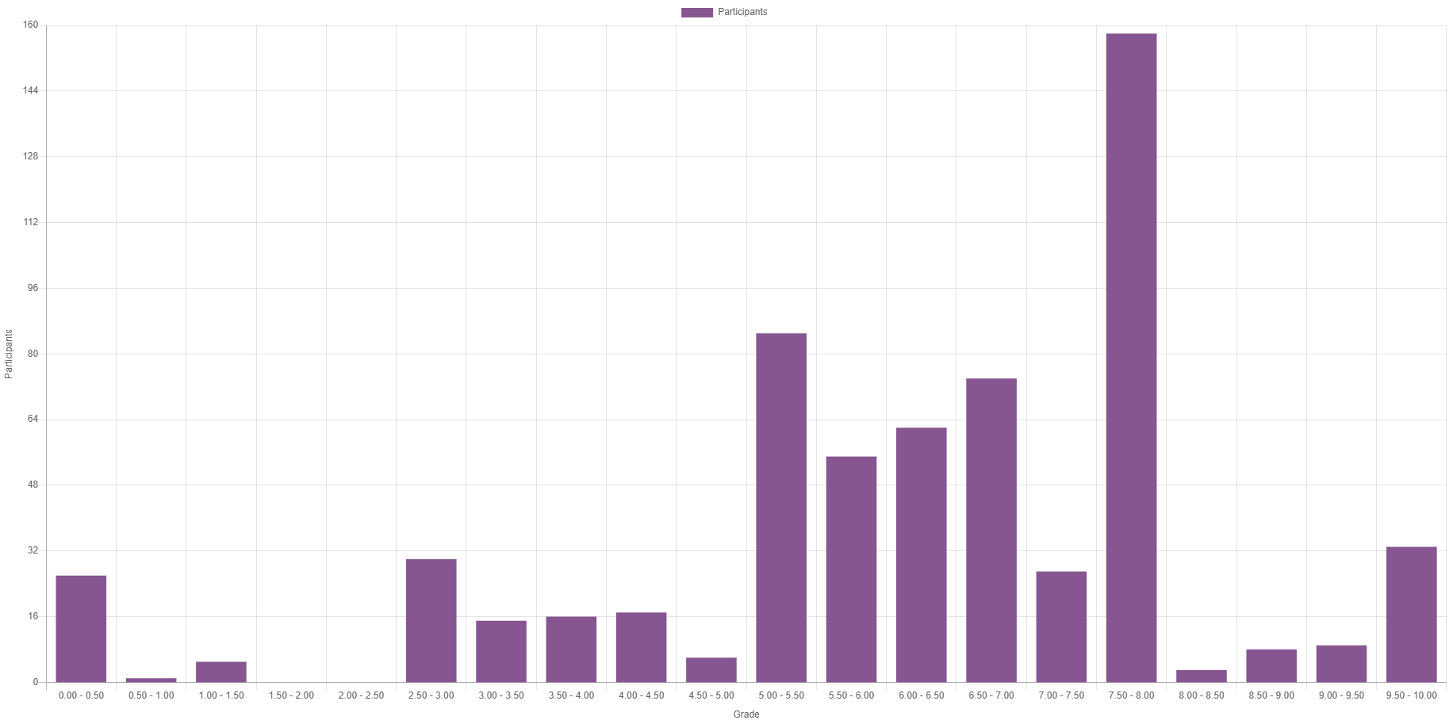
Results

Slide 7
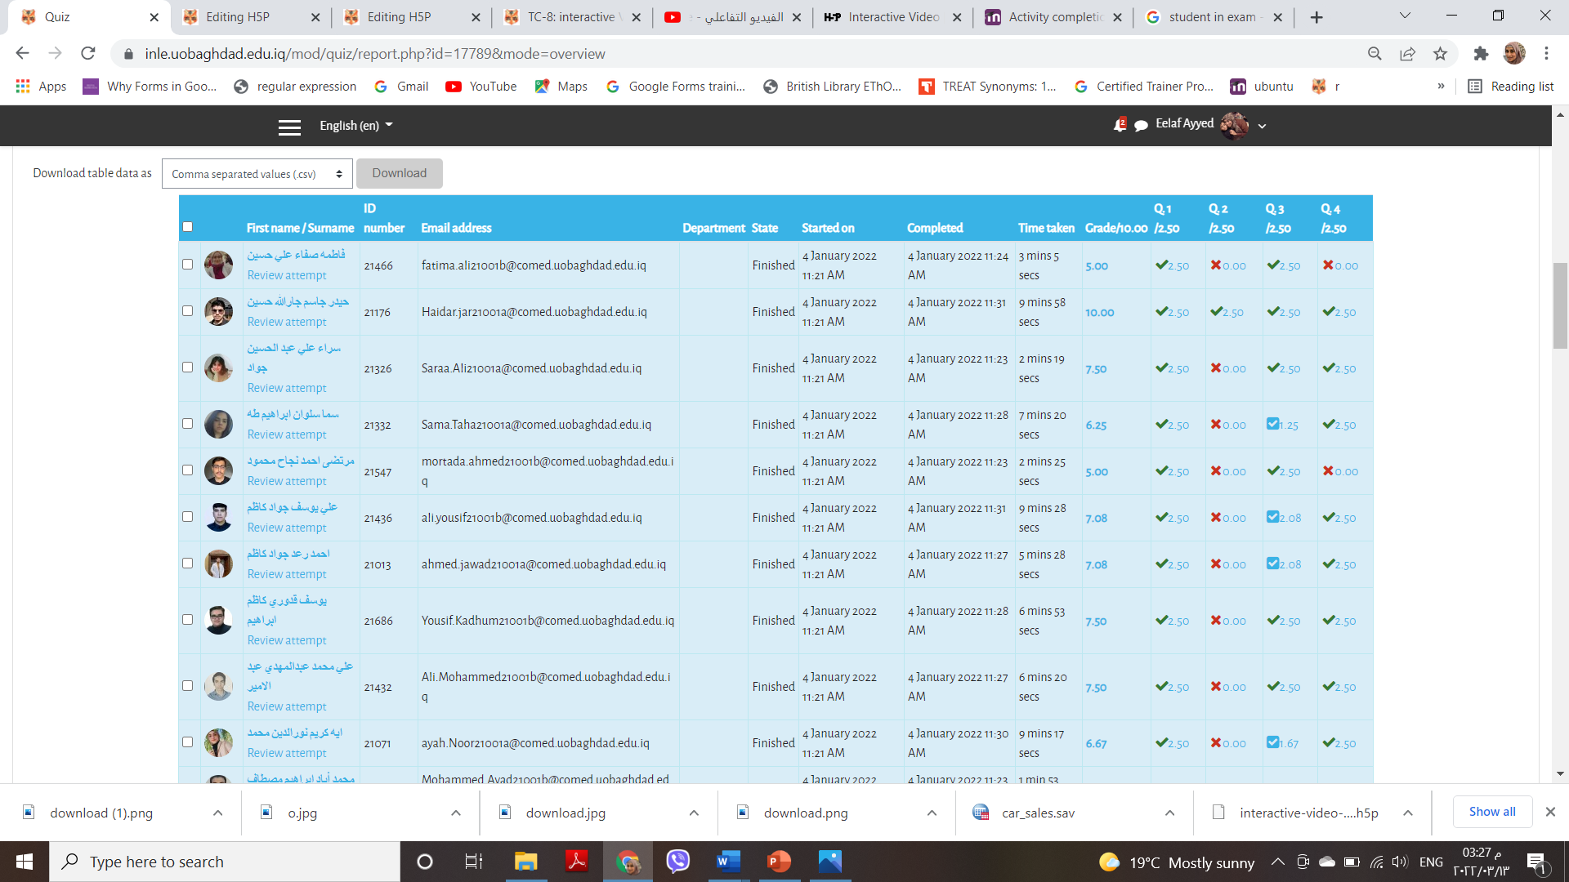
Results

Slide 8

Override Users

Slide 9


Slide 10

Thank you
Eelaf Ayyed
elaff@comed.uobaghdad.edu.iq

